Slide 1
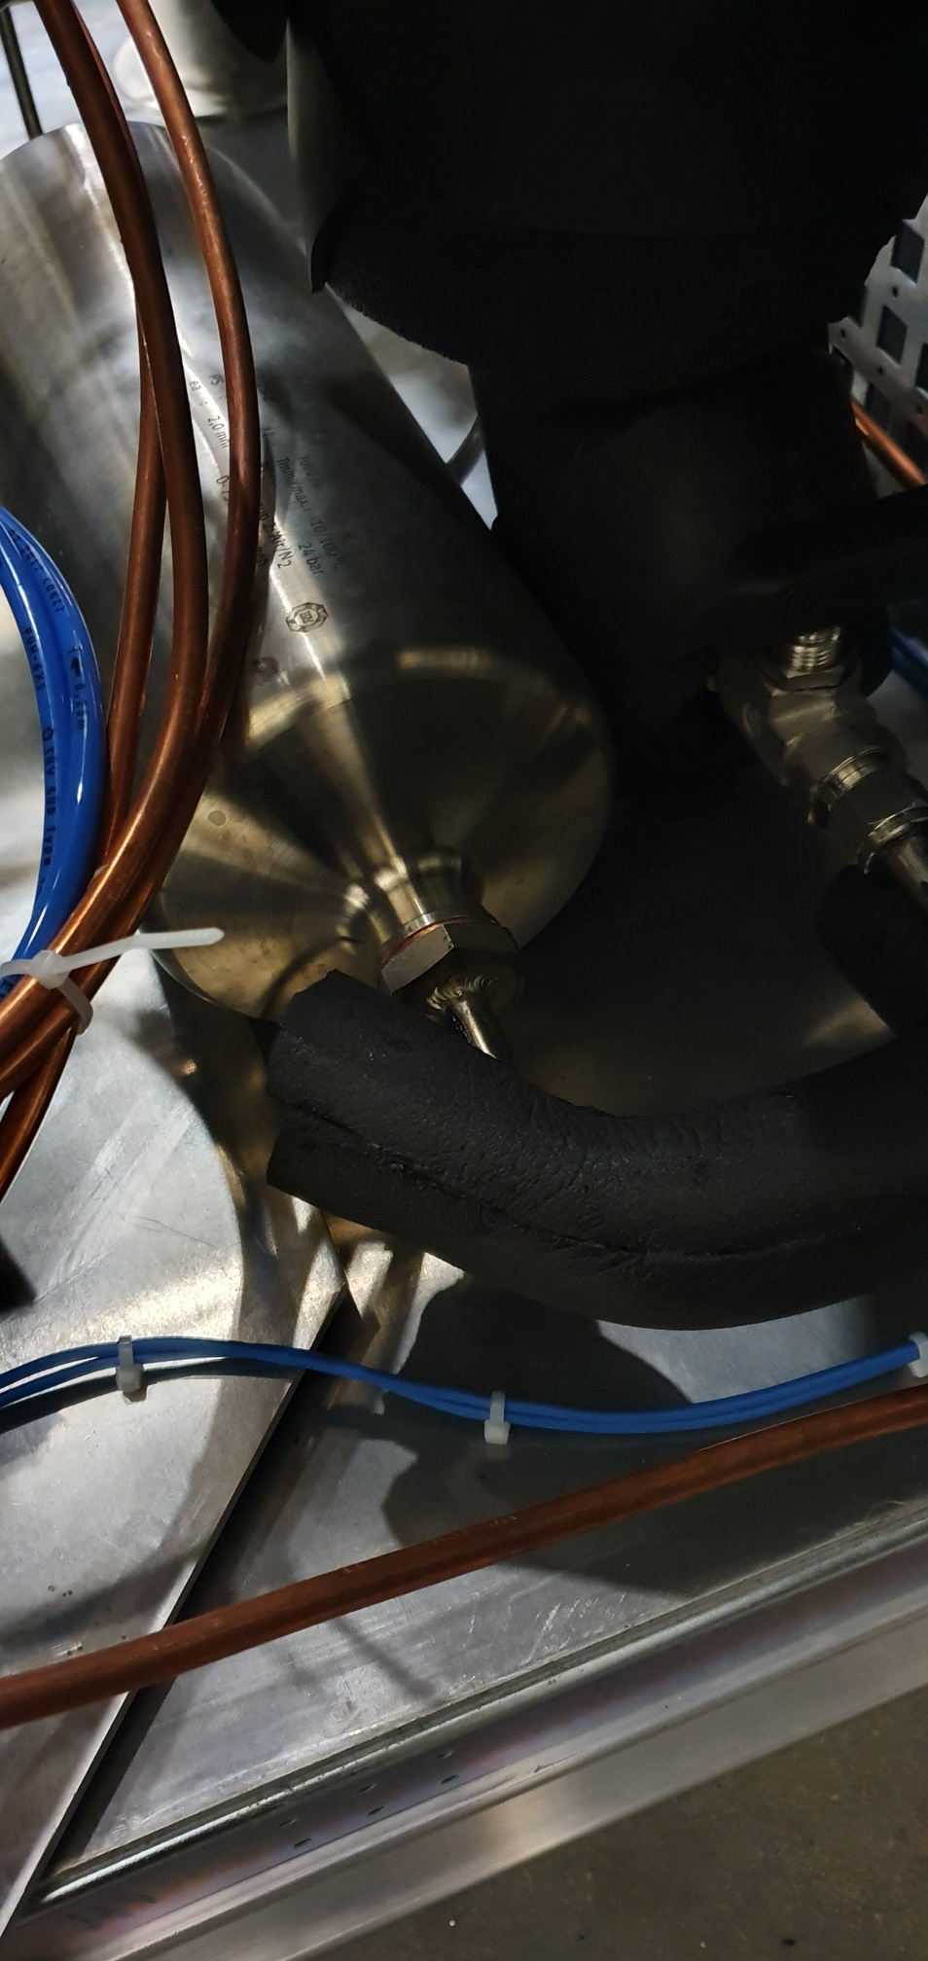
Weld if possible
@155

Slide 2
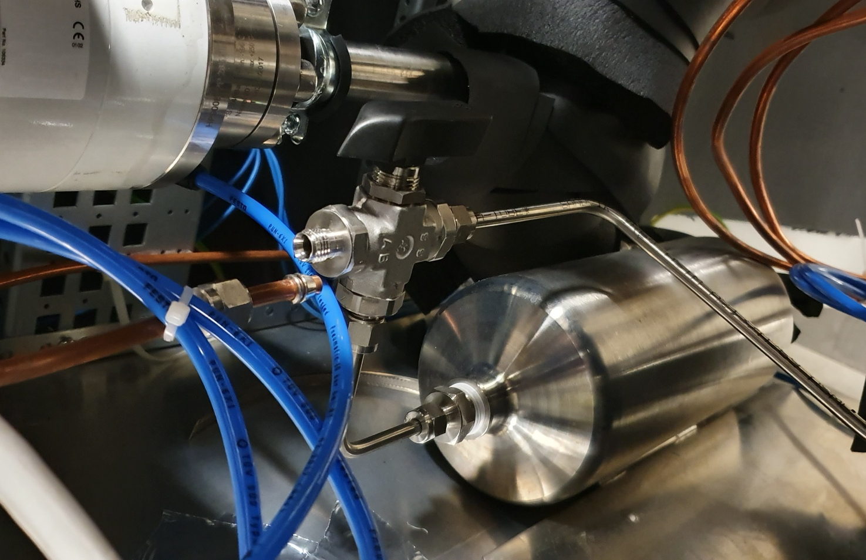
Replace with valve OD10
Reduction OD10→ OD6
Weld for OD10
@155
OD10 to buffer 20 liters

Slide 3
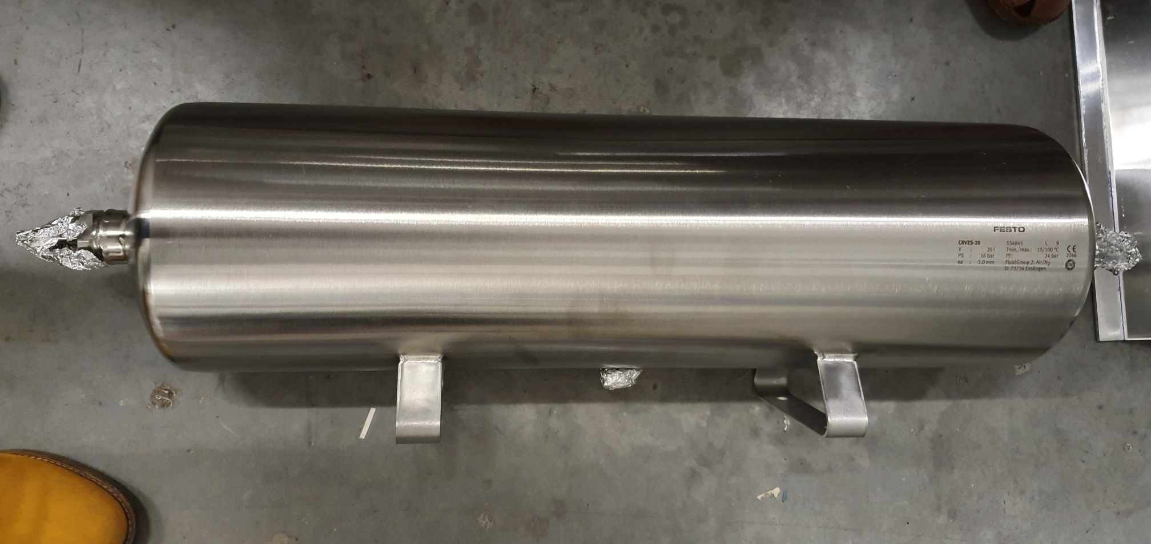
Weld one end of flexible OD10-OD10
Weld 150 cm pipe OD10
Weld pipe for pressure sensor connection
Pressure sensor 0-5 barg
@155

Slide 4
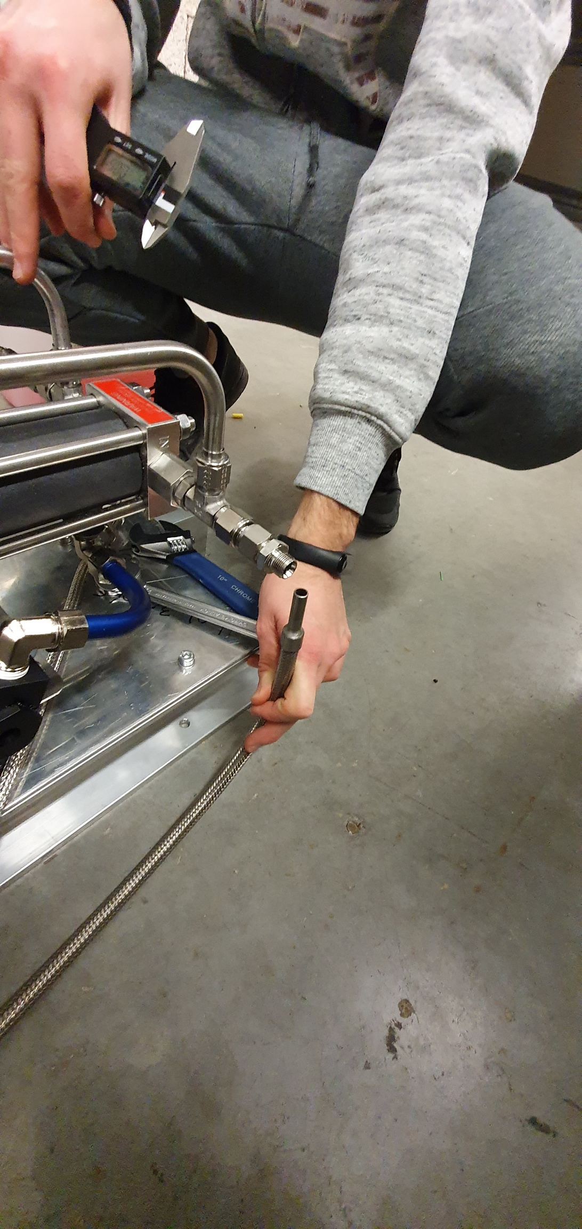
Weld small piece of pipe OD 10 L-shape
Long enough to allow to use connector
@155

Slide 5
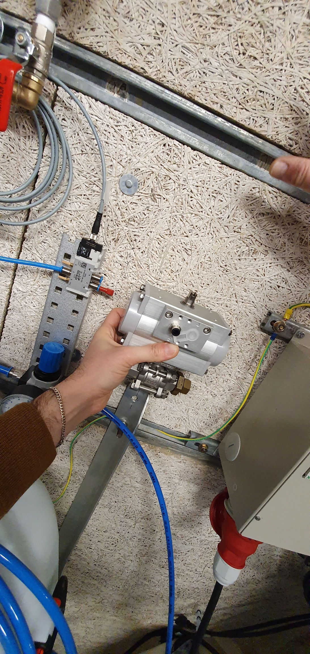
Fix pneumatic valve to rail on the wall
@CMS

Slide 6
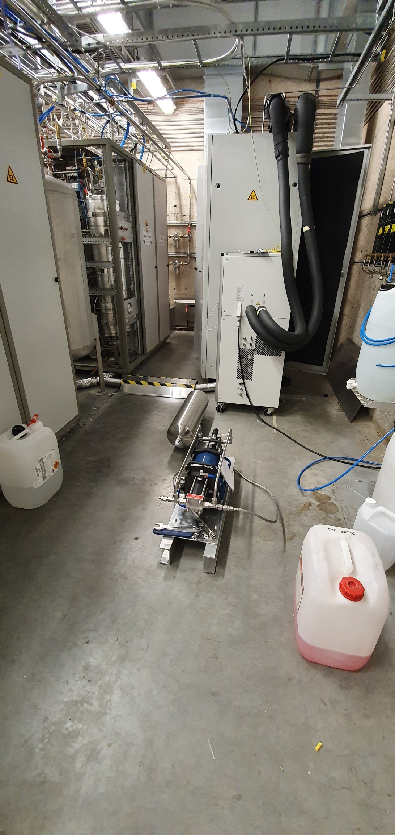
Global view
Bring drill to fix
Compressor
Protection for exctraction pipe
Protection for pipe from compressor to wall to drum and pneumatic
@CMS

Slide 7
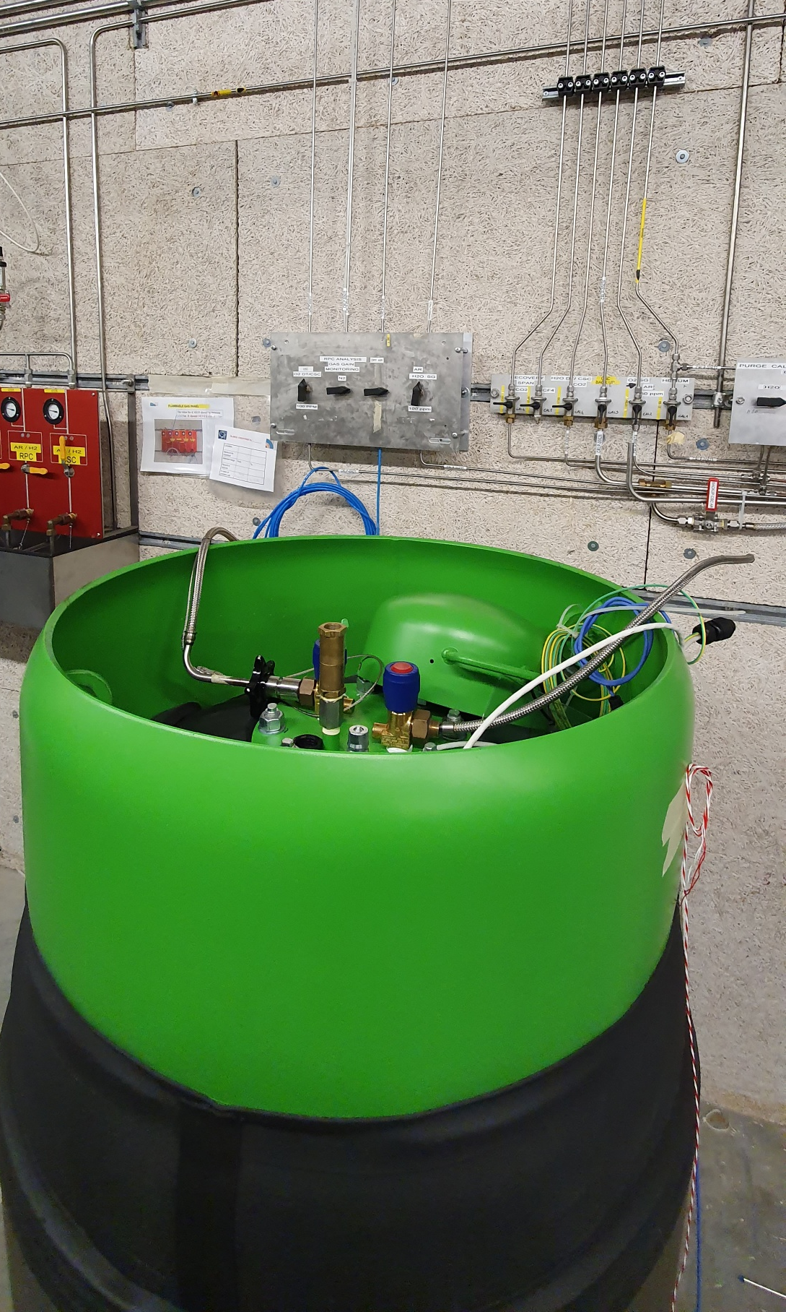
From compressor
Add pressure reducer (Andrea). Then flexible (from drum to filter)
Output drum should be OD12
Pipe OD10 from compressor
It can be on the floor (in the corner)
filter
@CMS
@CMS

Slide 8
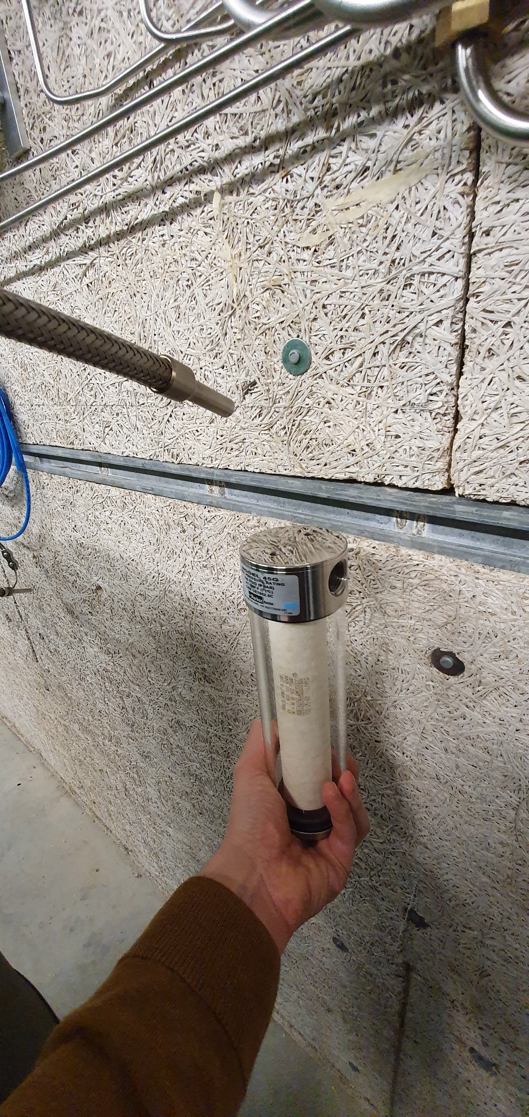
Connection on filter on the contrary of what is written on the filter:
1 is drum side
2 is mixer side
Filter better in vertical

Slide 9
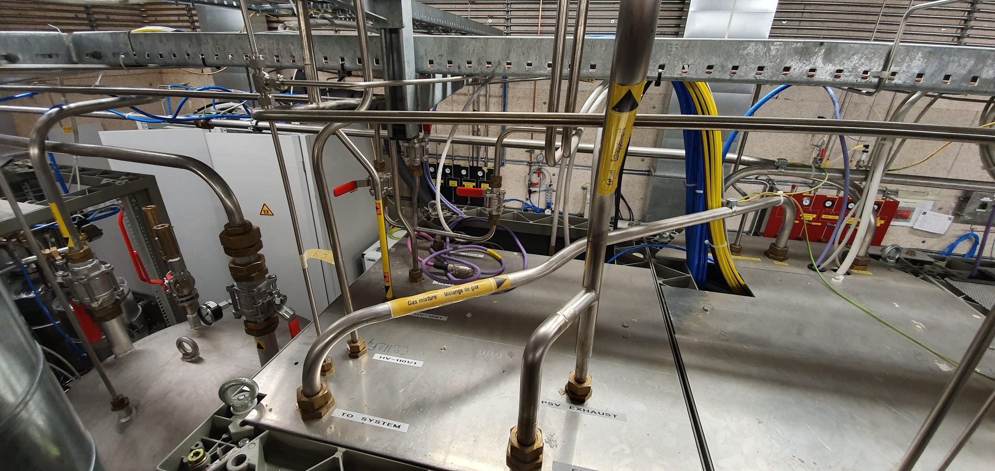
Pipe from drum
@CMS

Slide 10
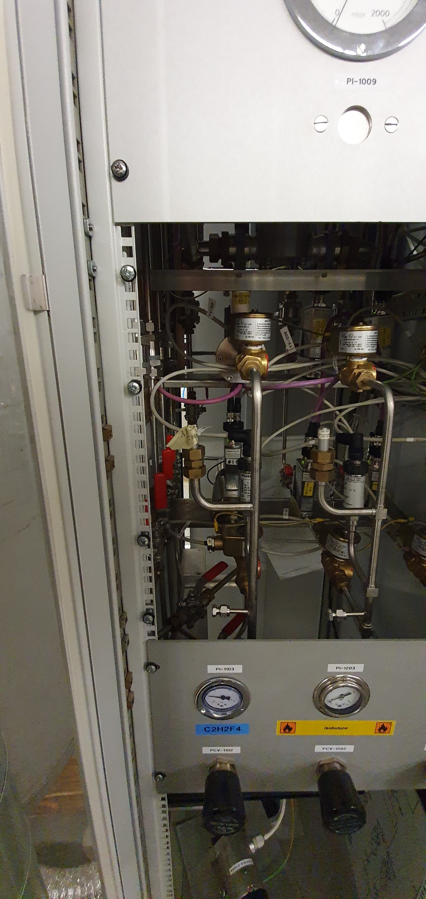
Input of recuperated R134a in mixer
@CMS

