Slide 1
Pipe or hose ?
The gas connections inside RPCs
Ian
1 July 2024

Slide 2
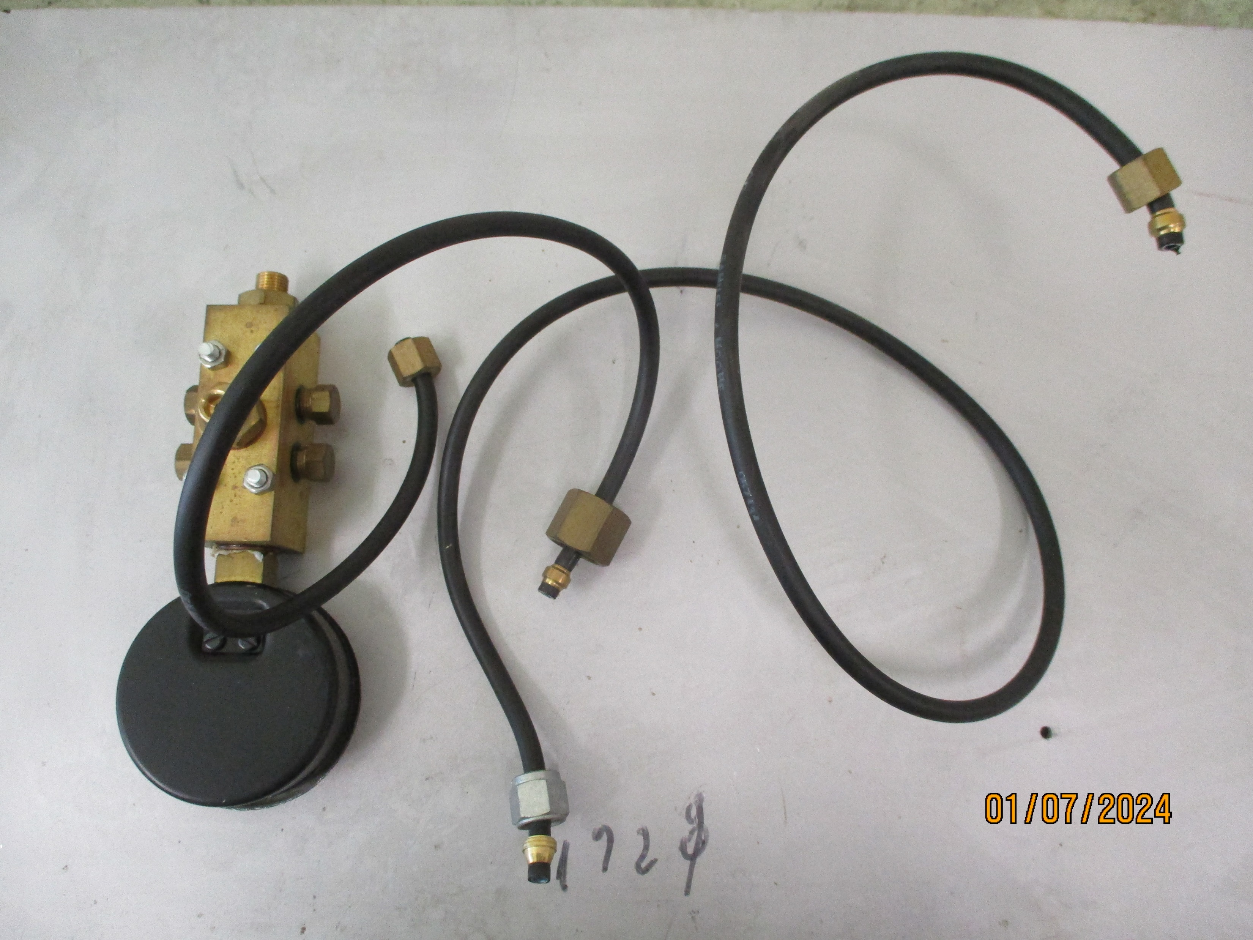
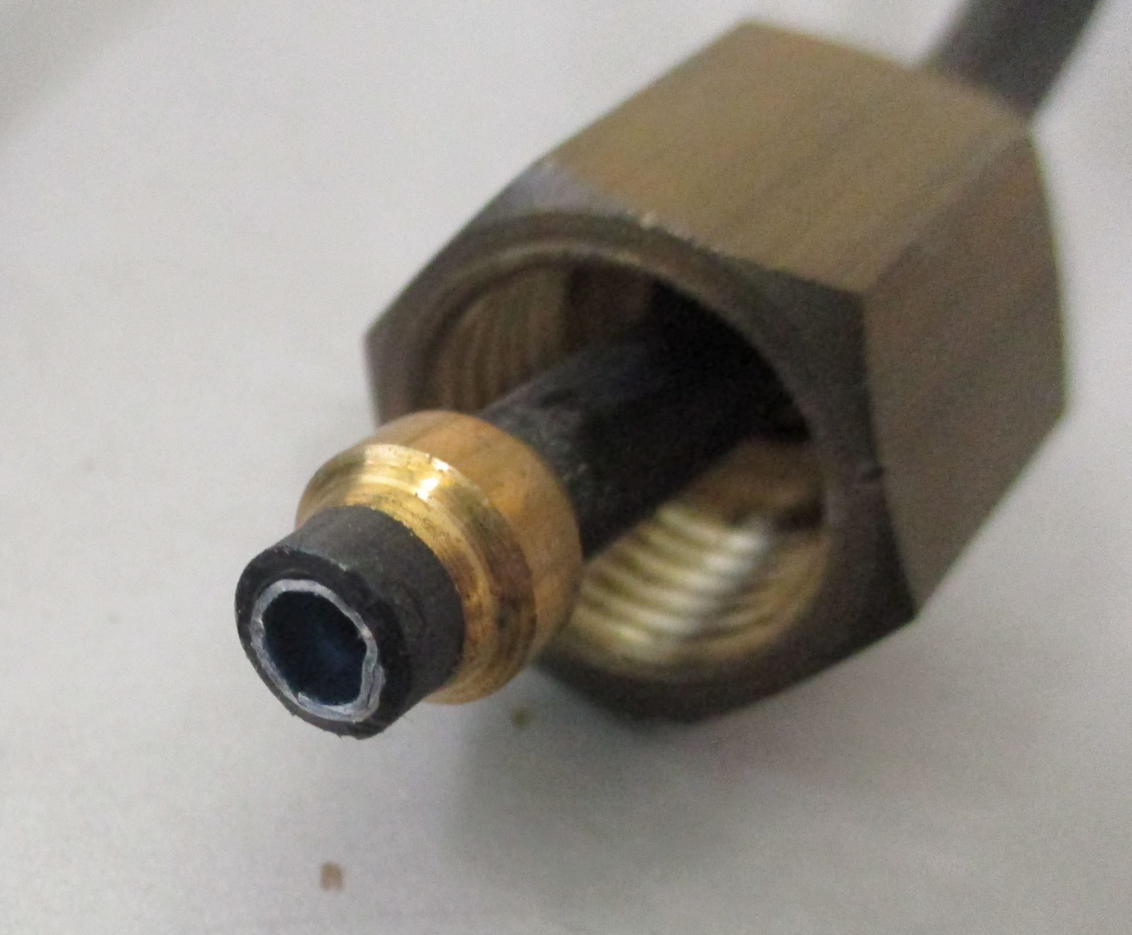
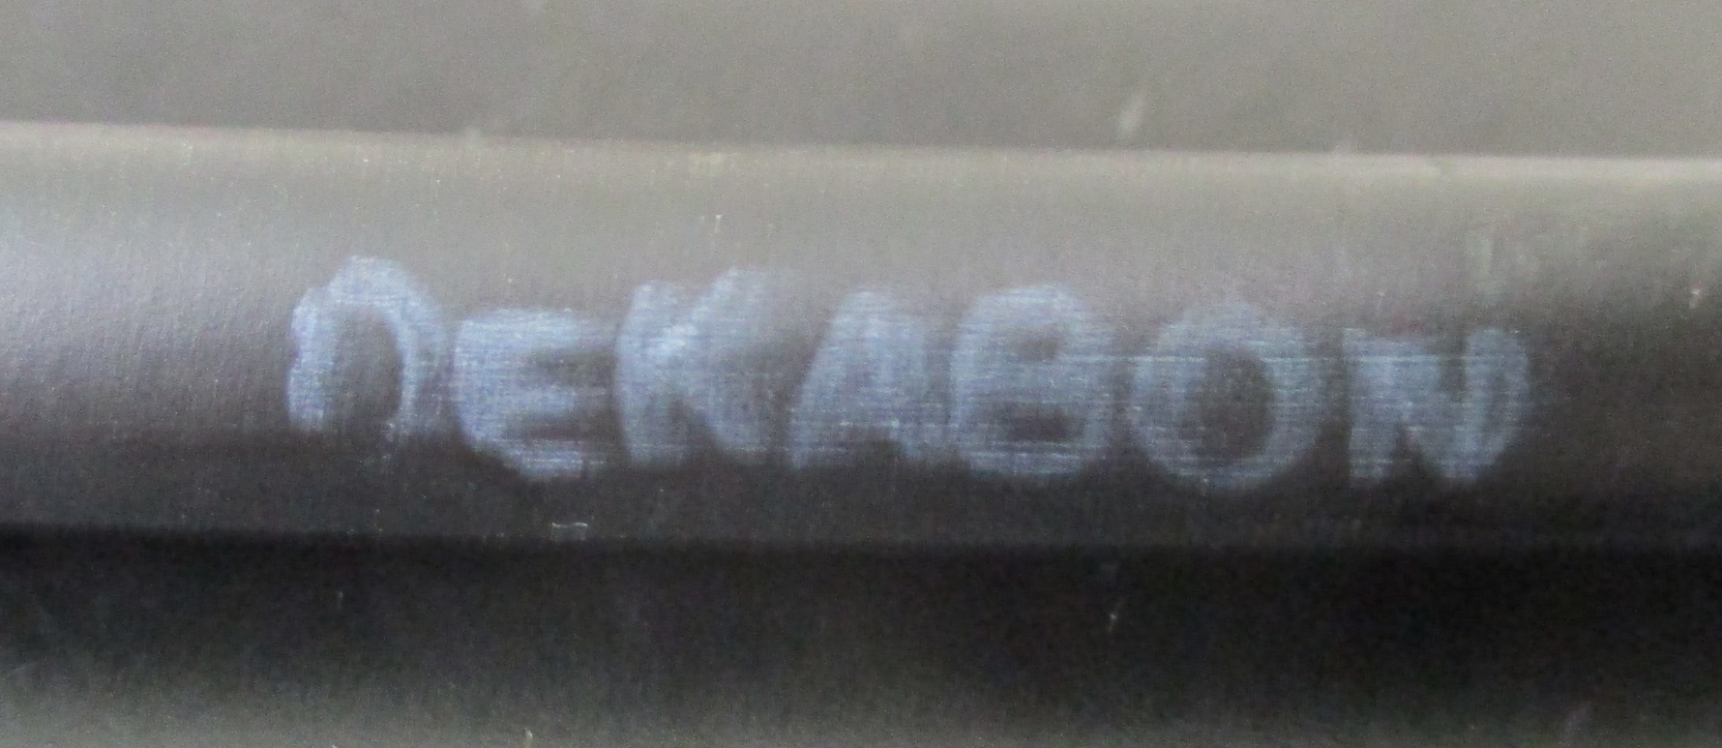
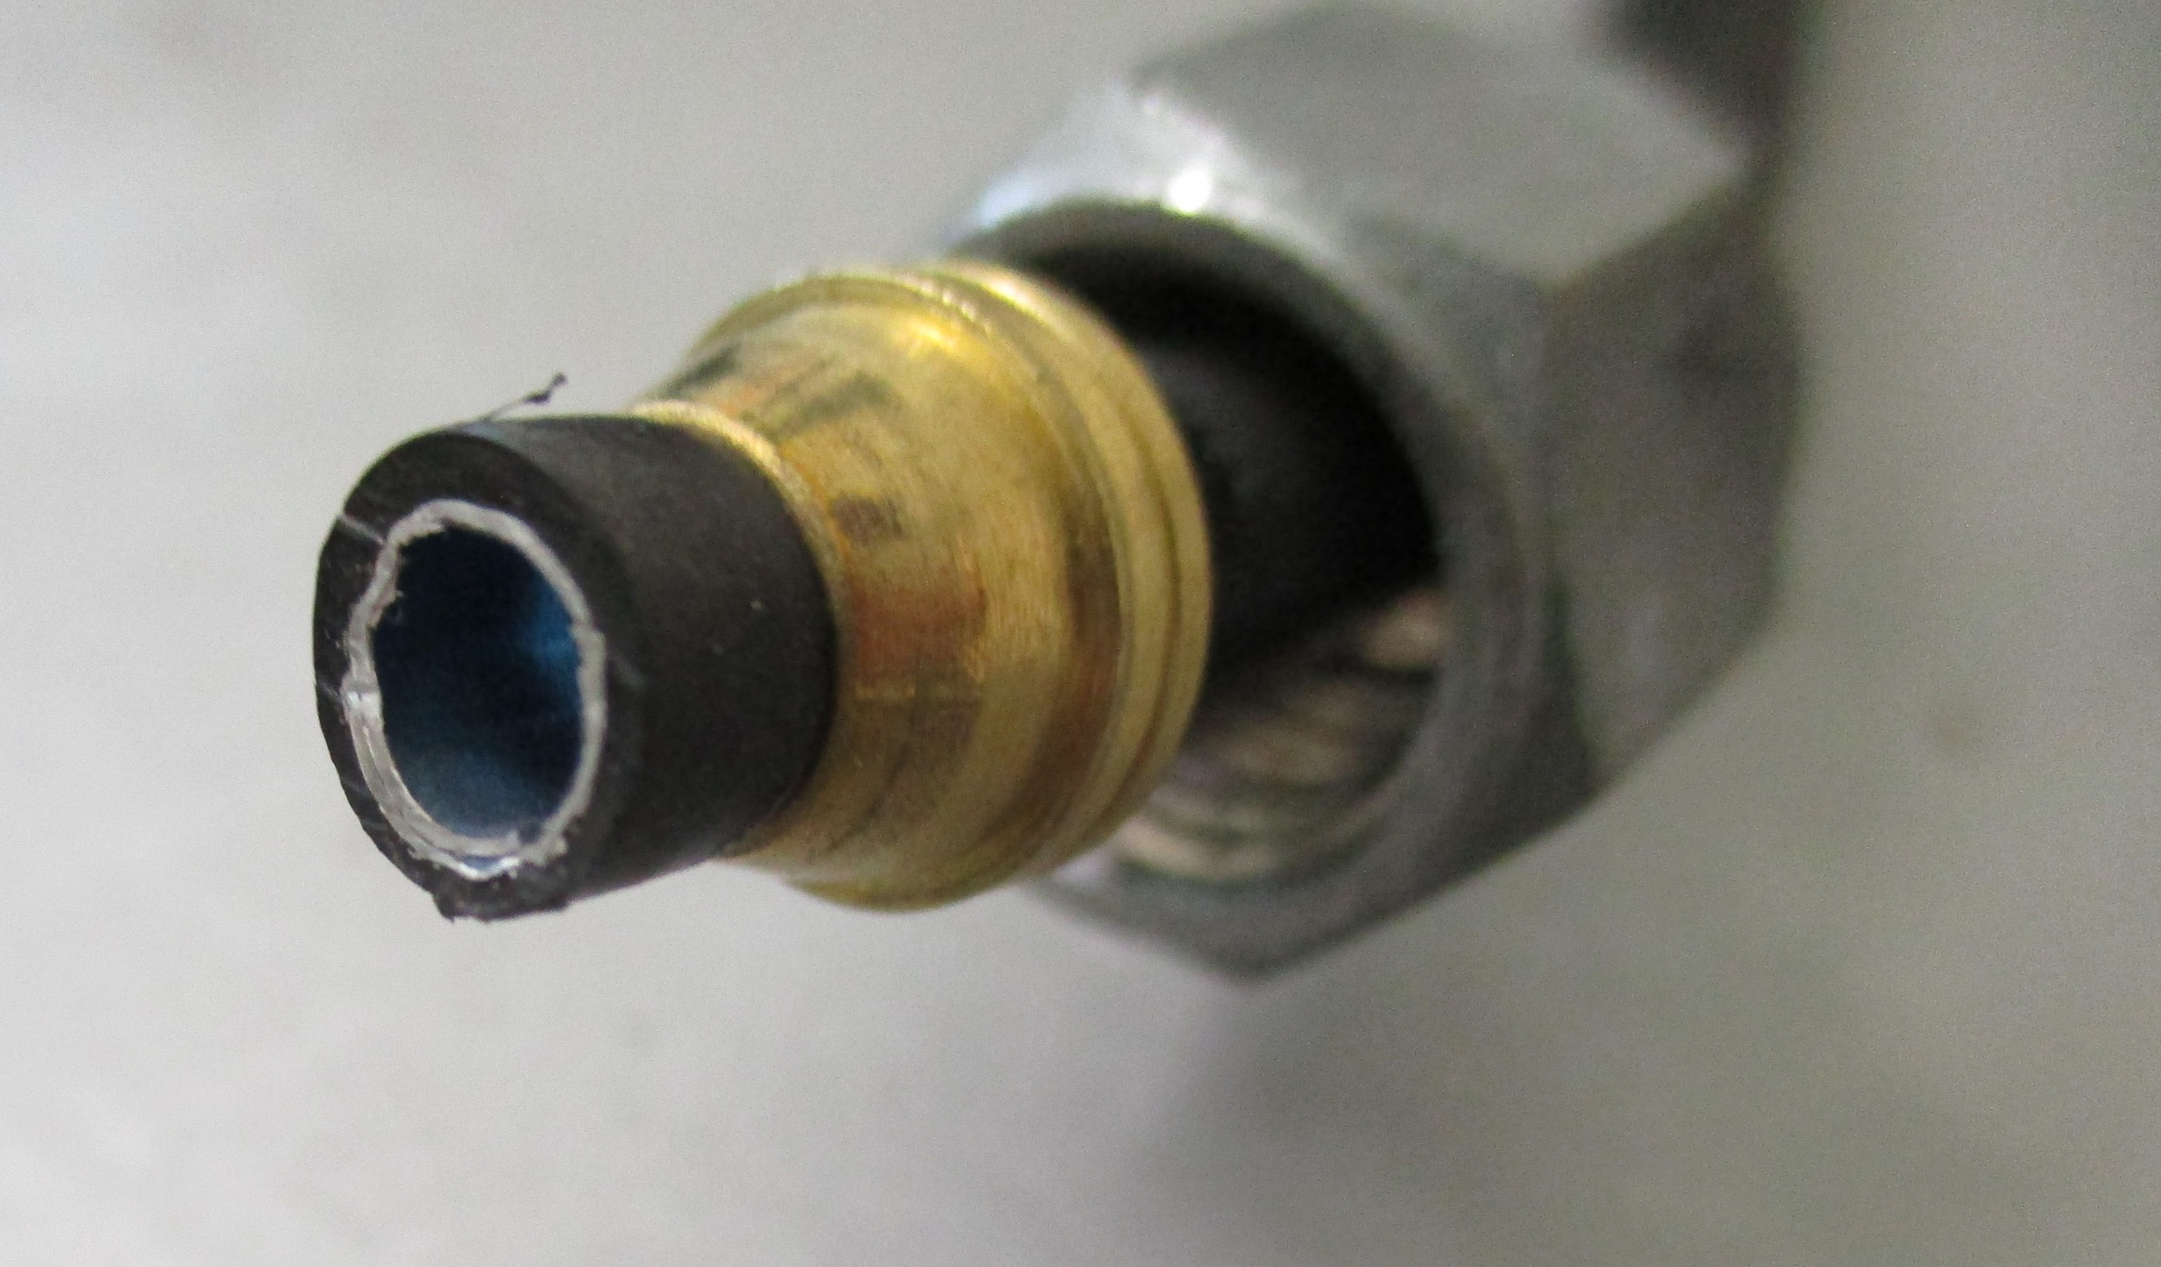
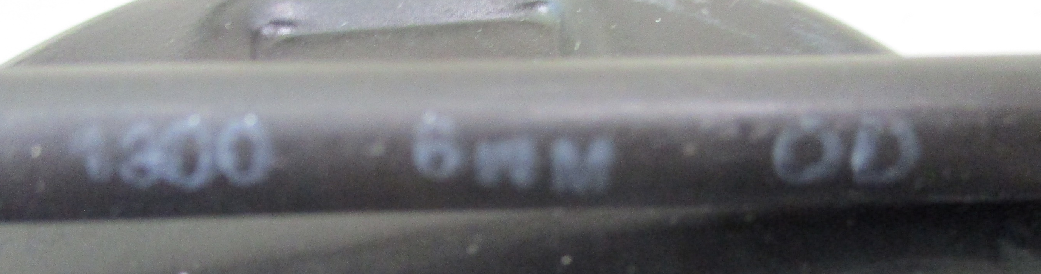
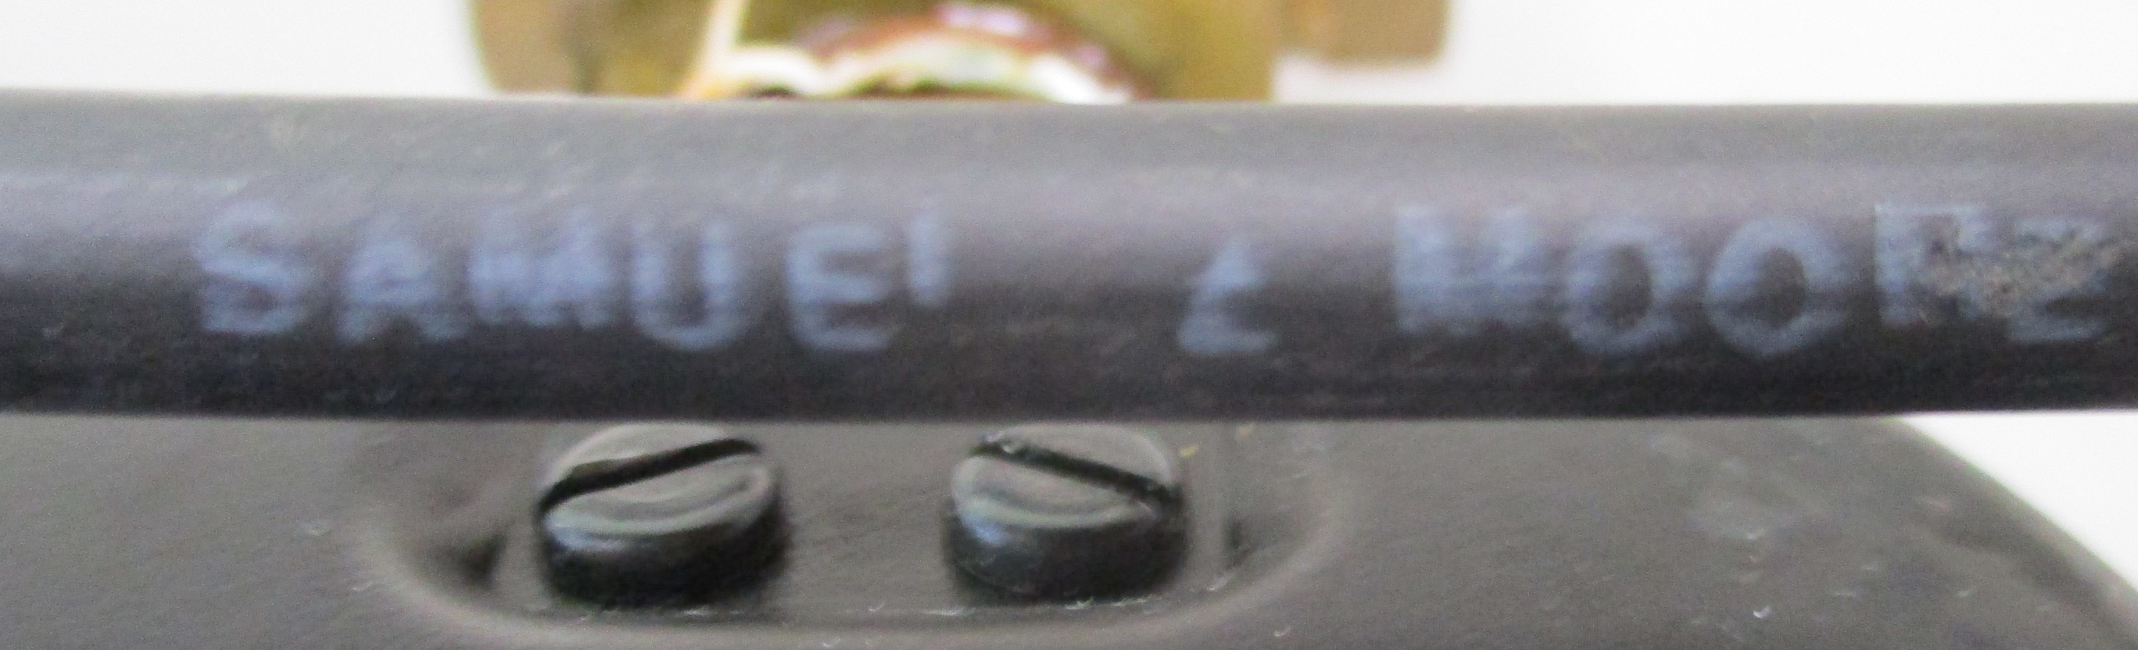
Composite pipe (or is it a hose) Aluminium with PE inside (same as that used inside the chambers) and out. It is so soft !
Very soft even after 10-20 years like rubber. Stays where you put it. No tools required, perfect for delicate fingers
Seen here with Legris and double ferrule unions.
Introduced at CERN by the Mr. Bosteels who invented the underpressure cooling still used in LHC experiments

Slide 3
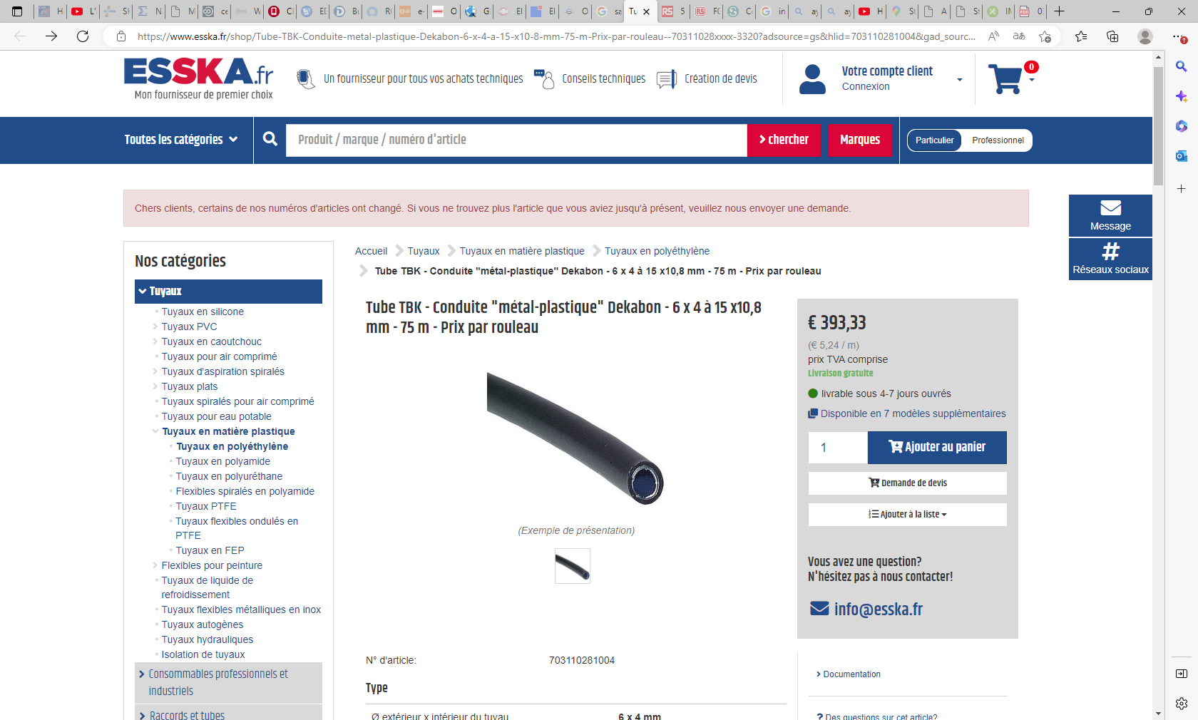
Tube TBK - Conduite "métal-plastique" Dekabon - 6 x 4 à 15 x10,8 mm - 75 m - Prix par rouleau (esska.fr)
Cheaper than copper at CERN stores

Slide 4
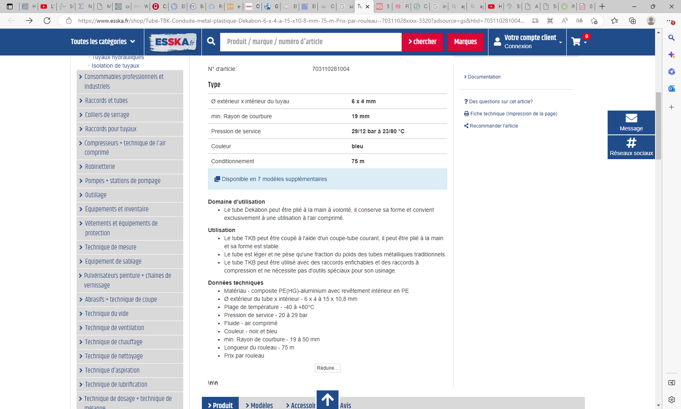

Slide 5
Translated by google
Area of ​​use
The Dekabon tube can be bent by hand as desired, it retains its shape and is suitable exclusively for use with compressed air.
Use
The TKB tube can be cut using a common tube cutter, it can be bent by hand and its shape is stable.
The tube is lightweight and weighs only a fraction of the weight of traditional metal tubes.
TKB tube can be used with push-in fittings and compression fittings and does not require special tools for machining.
Technical data
Material - PE(HG)-aluminum composite with PE liner
Outer tube x inner Ø - 6 x 4 to 15 x 10.8 mm
Temperature range - -40 to +80°C
Operating pressure - 20 to 29 bar
Fluid - compressed air
Color - black and blue
min. Radius of curvature - 19 to 50 mm
Roll length - 75 m
Price per roll

Slide 6
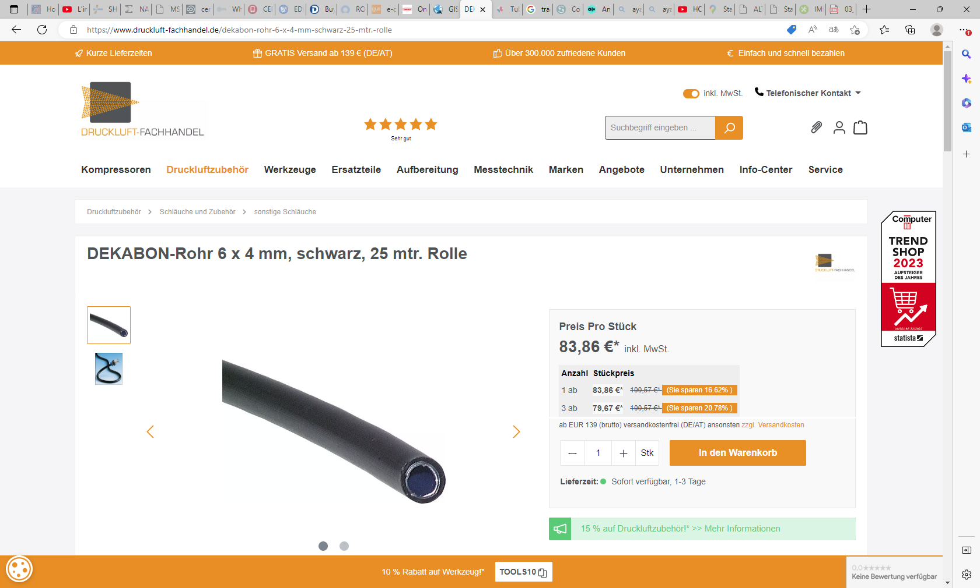
https://www.druckluft-fachhandel.de/dekabon-rohr-6-x-4-mm-schwarz-25-mtr.-rolle

Slide 7
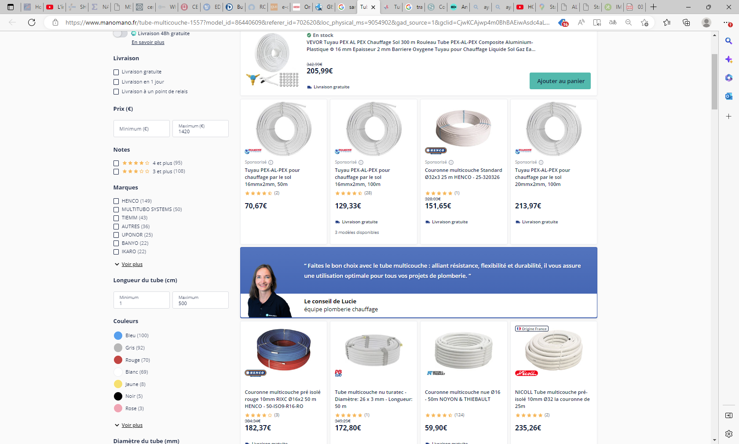
It has found its market in the 16-22mm range for doing all plumbing in domestic and industrial applications replacing copper so we can use it for all those electric cars………….

Slide 8
