Slide 1
Incremented gas control
Ian
24 Nov 2025

Slide 2
Argument to go from continuous flow control to incremental flow.
Mehadi showed be aYoutube a of a guy mixibnbg gases or his laser using one of those pads used to lift furniture. Iwaas not really impressed as it looked rather crude given the precision we are looking for 0.5% of 10 [litres/hr] = 0.05 [l/h]
However I thought a bit and asked the question can we make it on a far smaller scale AND use the principle of a “positive discplacement pump (PDP) meaning incremental floow
Then I asked the question what is a the type of pump that uses PDP, gear pumps etc but does not contaminate the gases.
There why not try a periisaltic pump, as used for blood. A quick search reveals that we are not the foiruist to use this for ghases And that 10 times btrer than what we need is commercial available
Namely 0.007 [l/h]

Slide 3
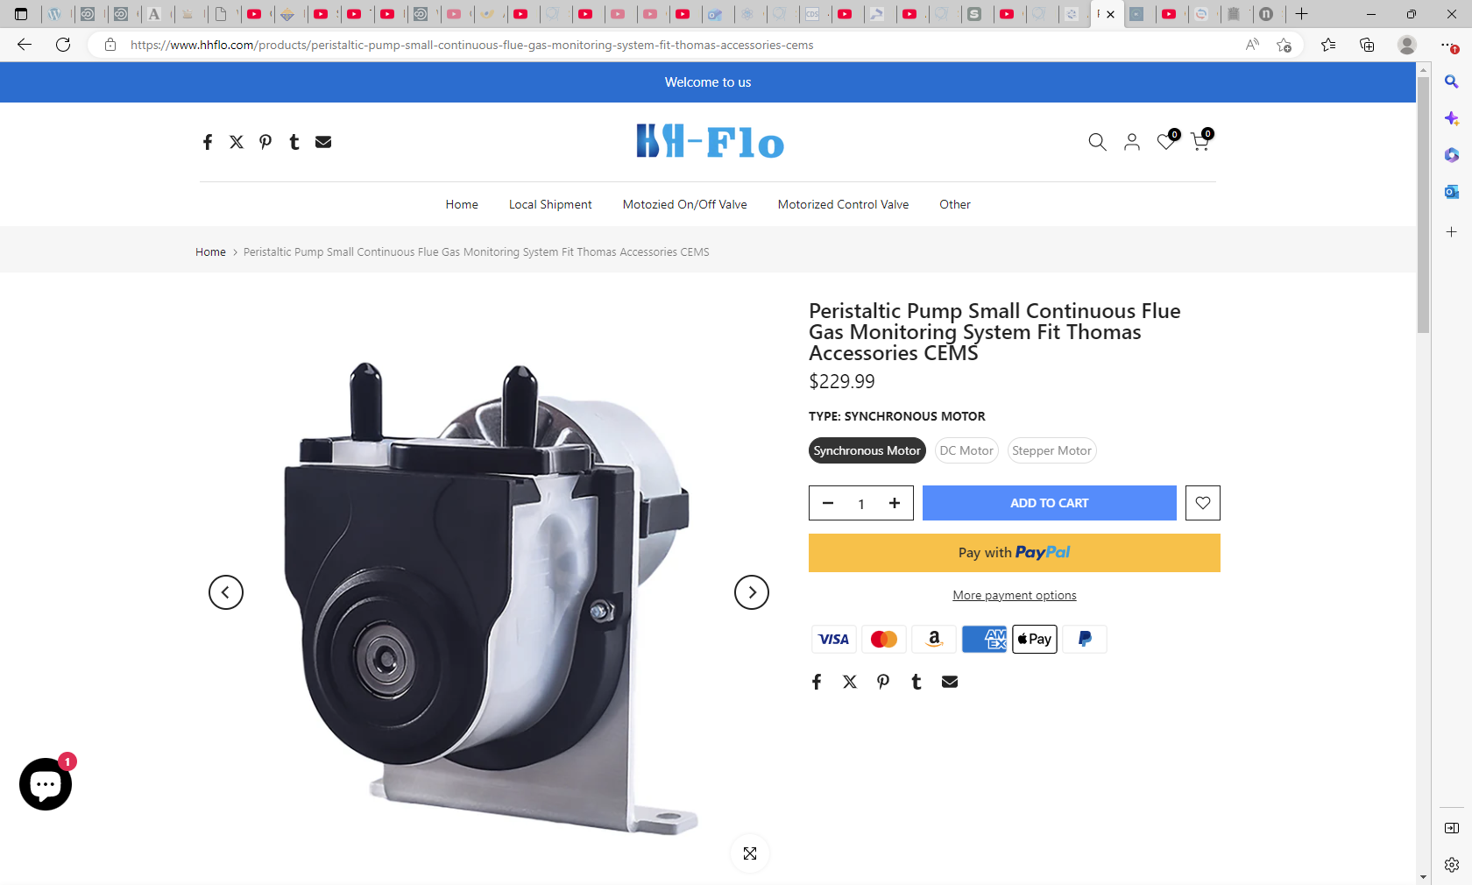
https://www.hhflo.com/products/peristaltic-pump-small-continuous-flue-gas-monitoring-system-fit-thomas-accessories-cems

Slide 4
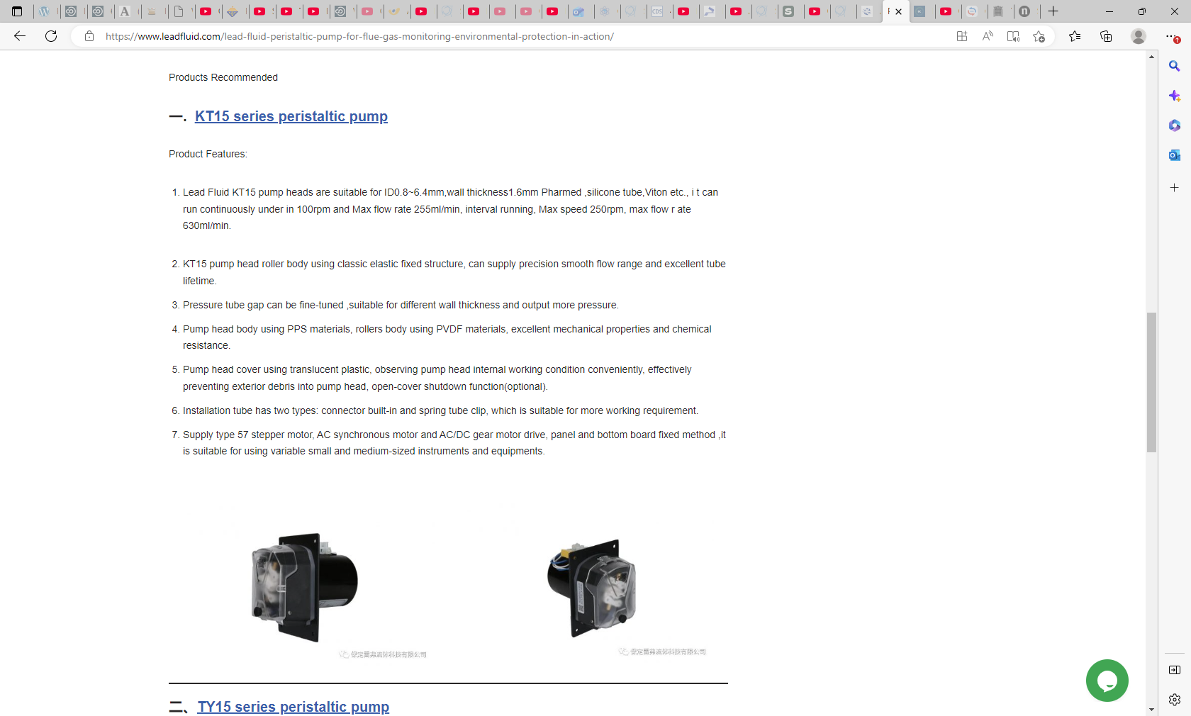
https://www.leadfluid.com/lead-fluid-peristaltic-pump-for-flue-gas-monitoring-environmental-protection-in-action/

Slide 5
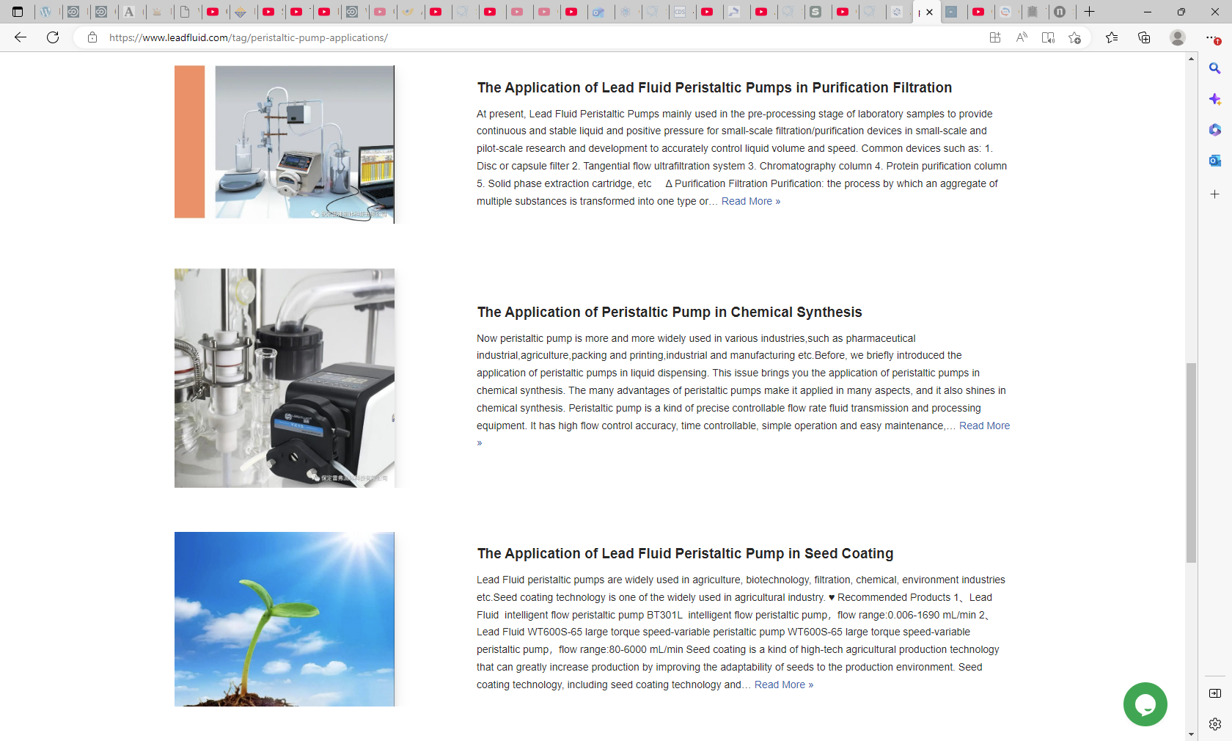

Slide 6
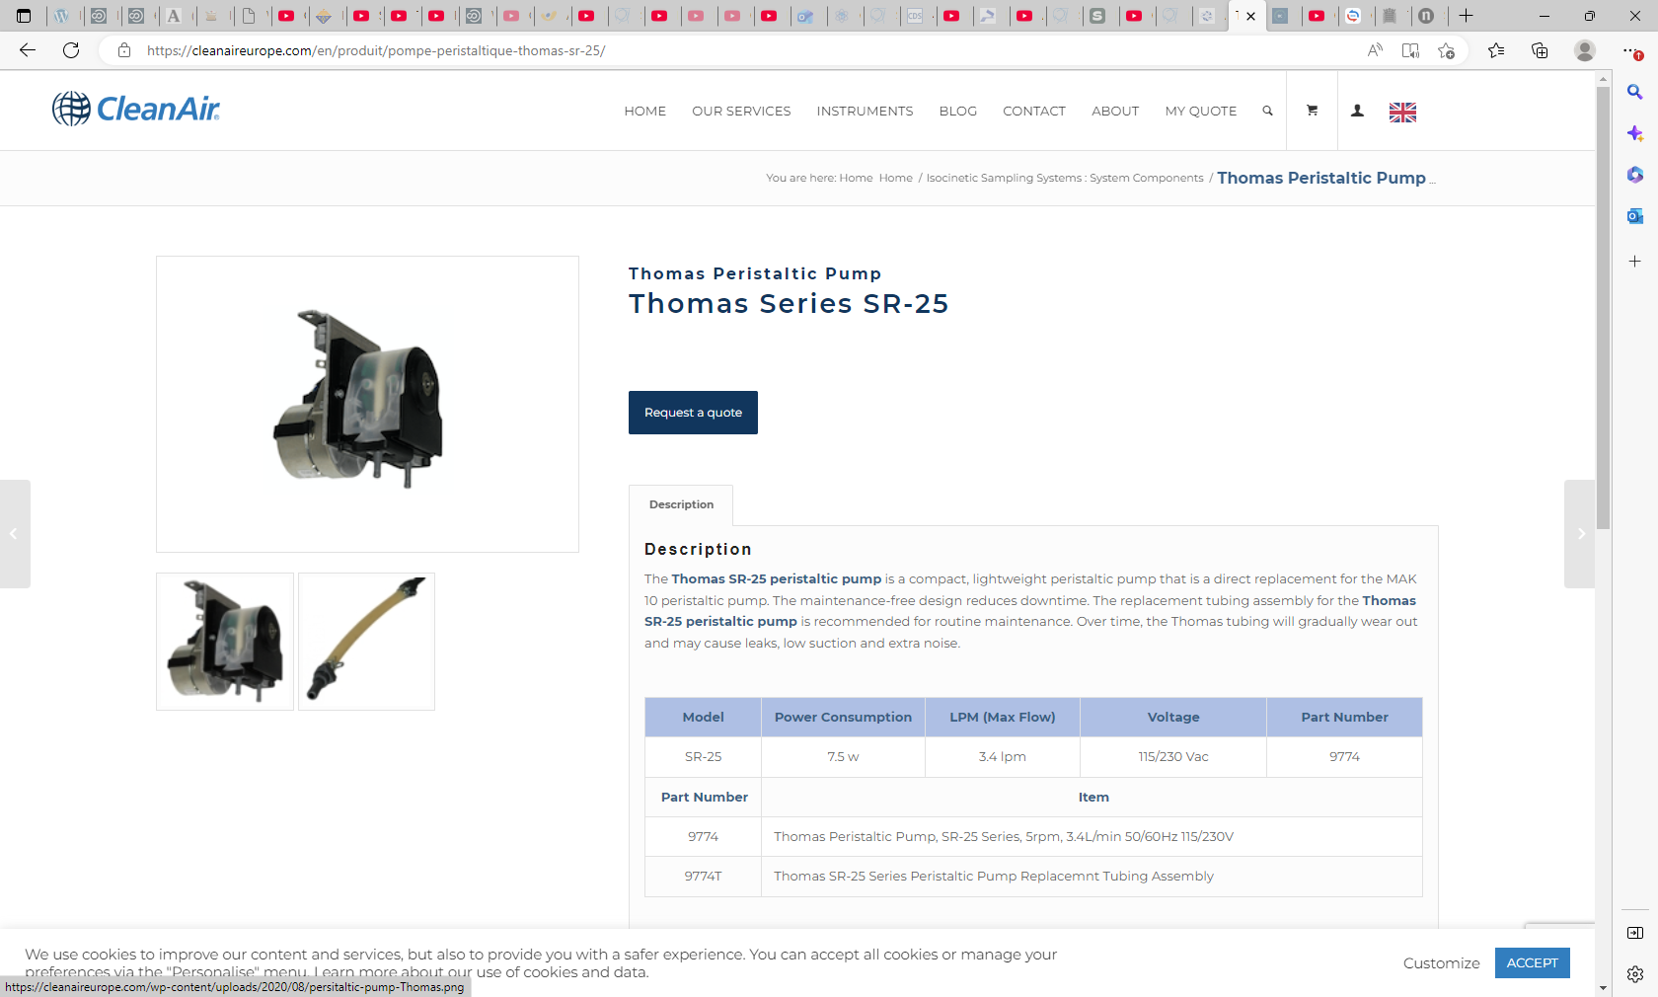
https://cleanaireurope.com/en/produit/pompe-peristaltique-thomas-sr-25/

Slide 7
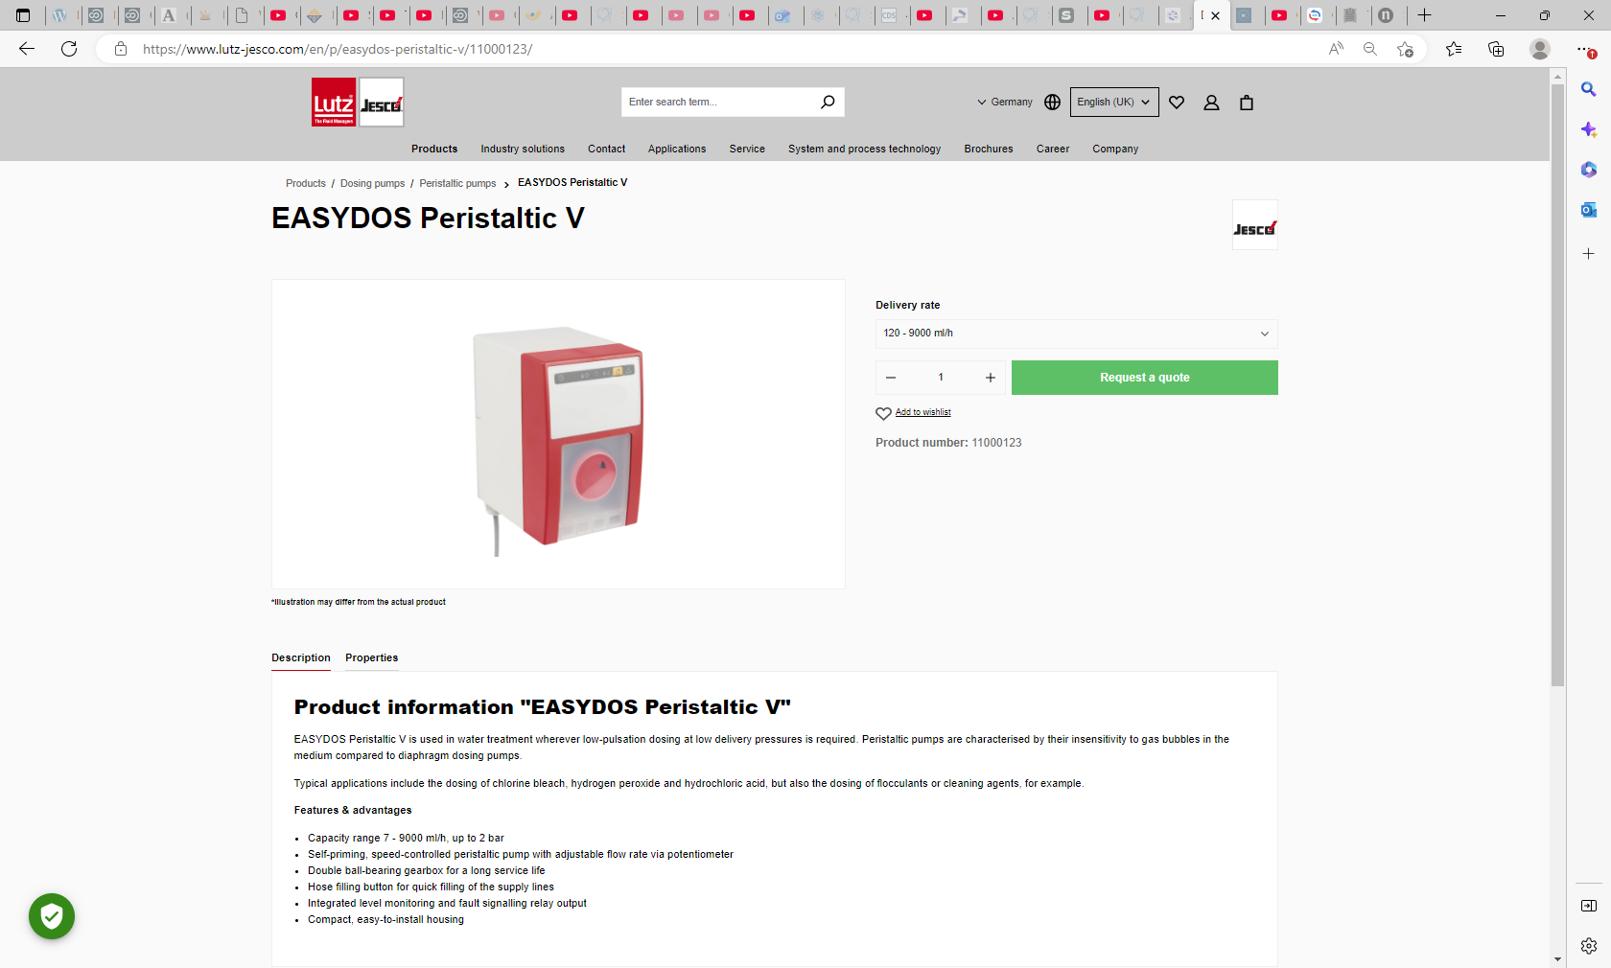
0.007l/hr !!!

Slide 11
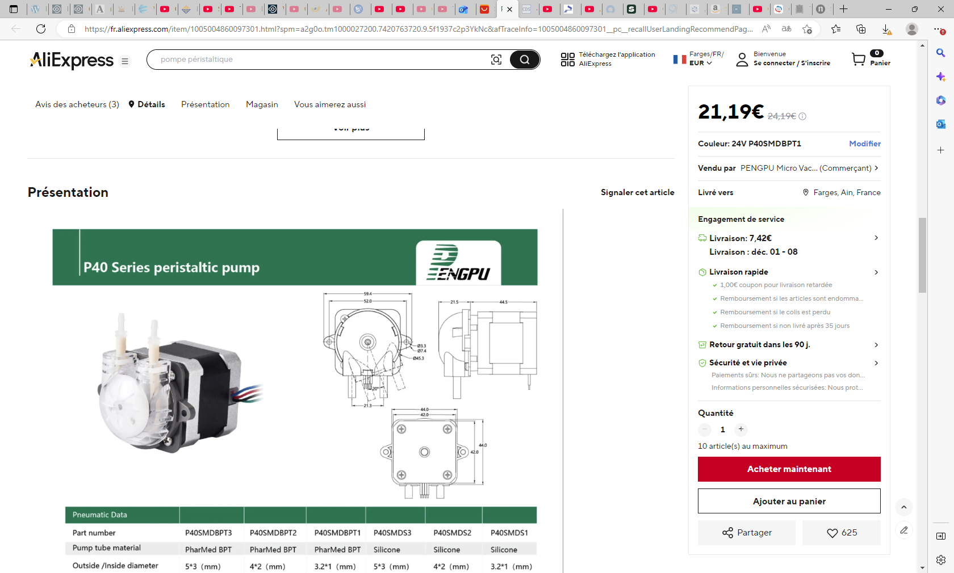
https://fr.aliexpress.com/item/1005004860097301.html?spm=a2g0o.tm1000027200.7420763720.9.5f1937c2p3YkNc&afTraceInfo=1005004860097301__pc__recallUserLandingRecommendPage__ZsmlVqd__1764000077471&aecmd=true&gatewayAdapt=glo2fra

Slide 12
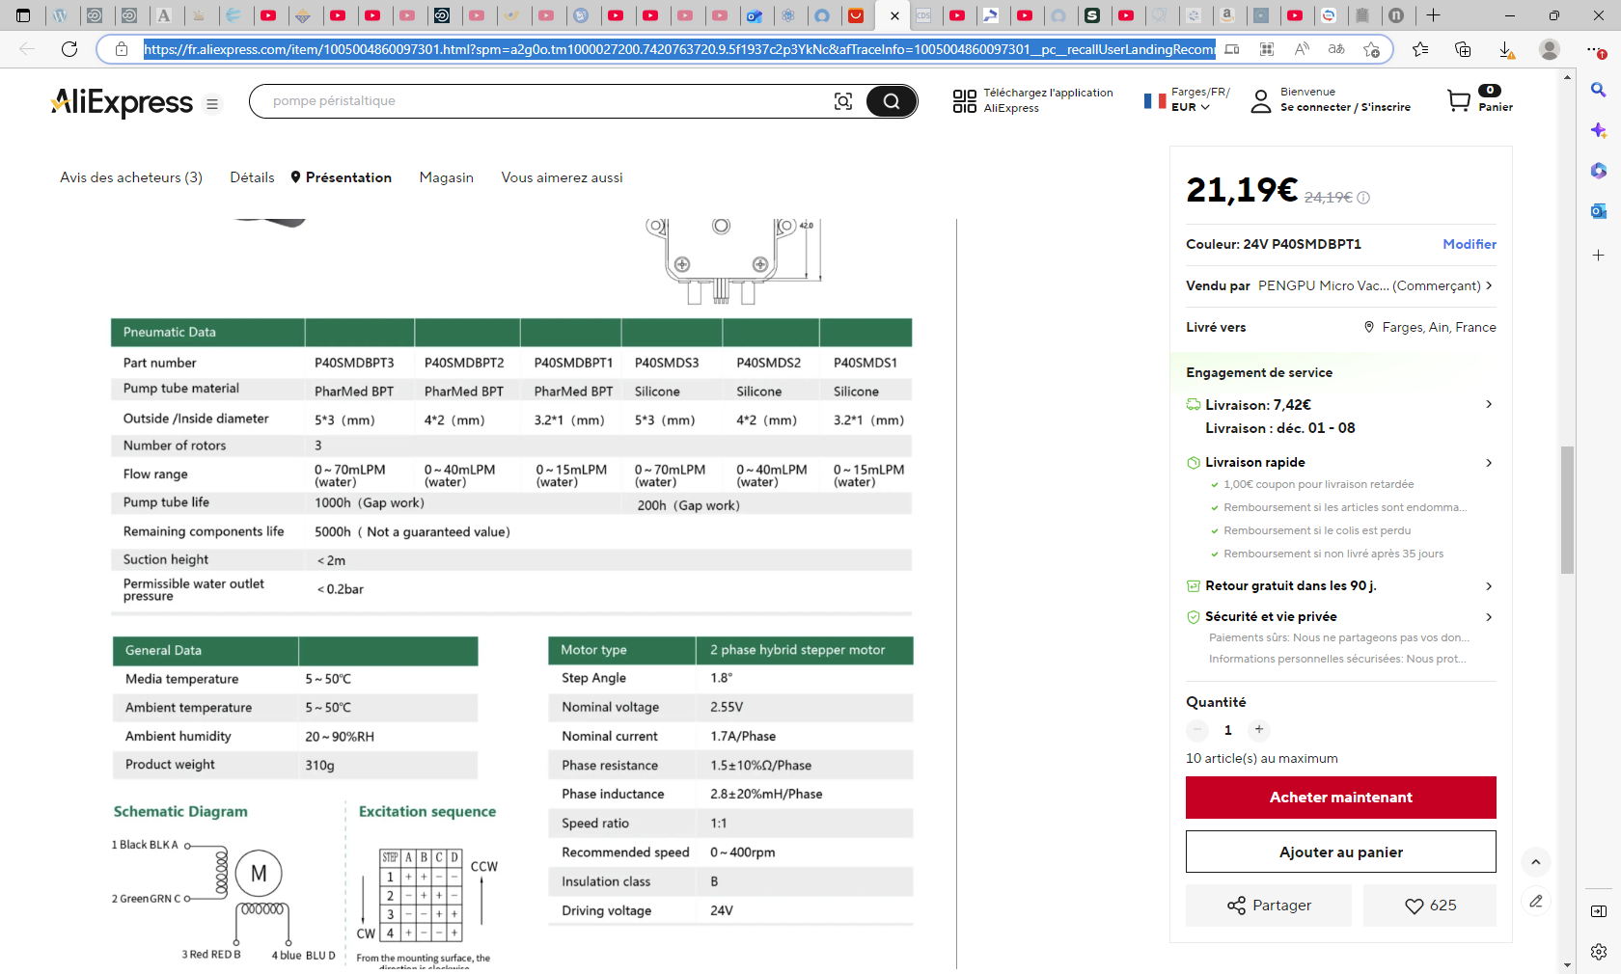

Slide 13
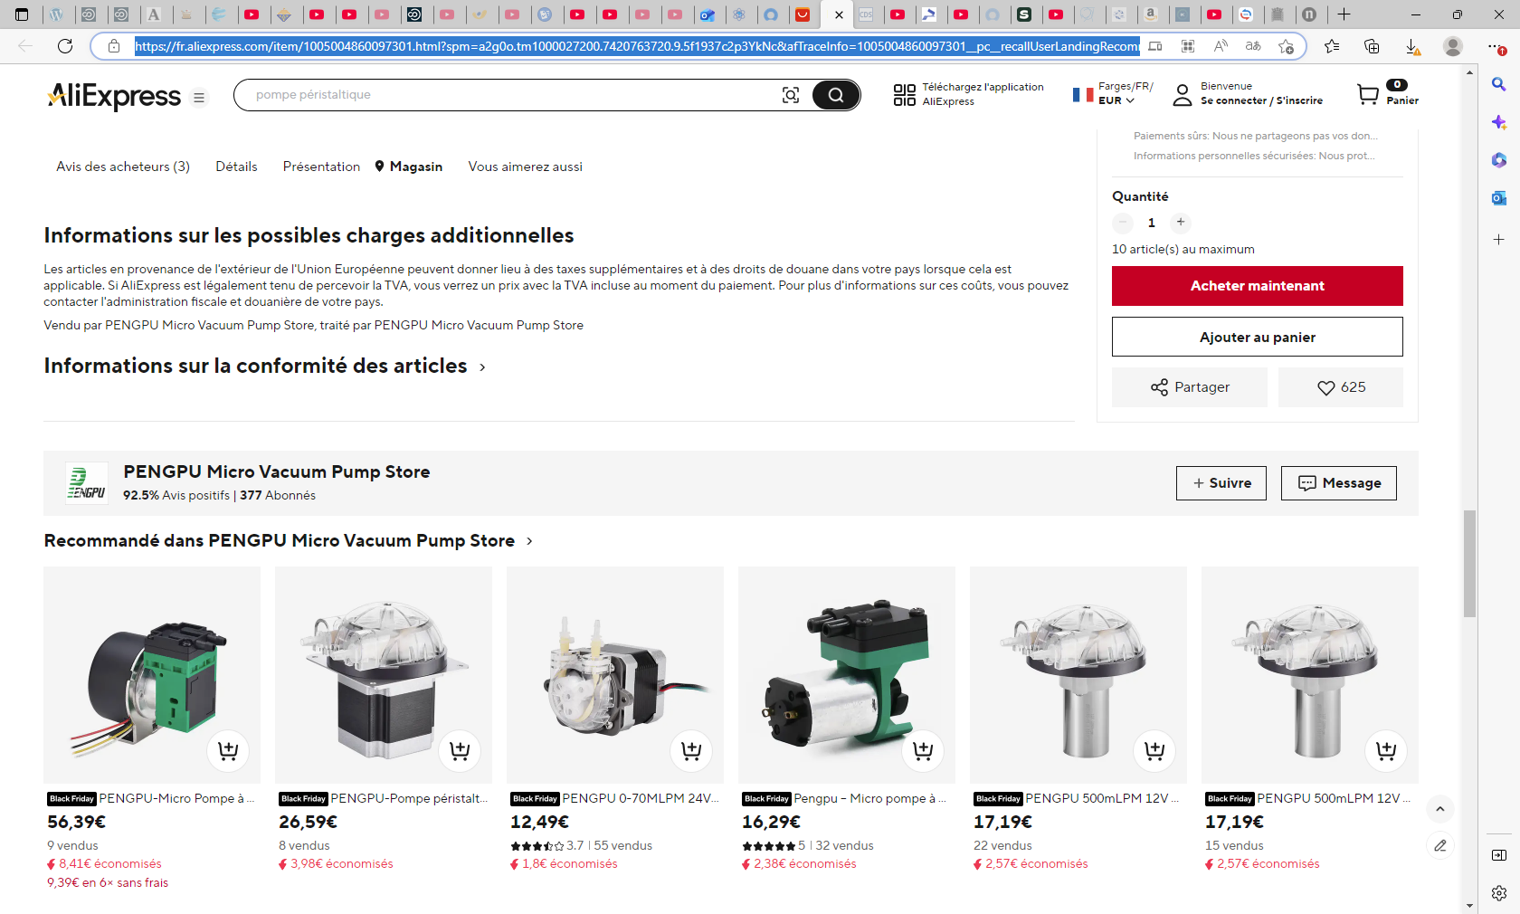

Slide 14
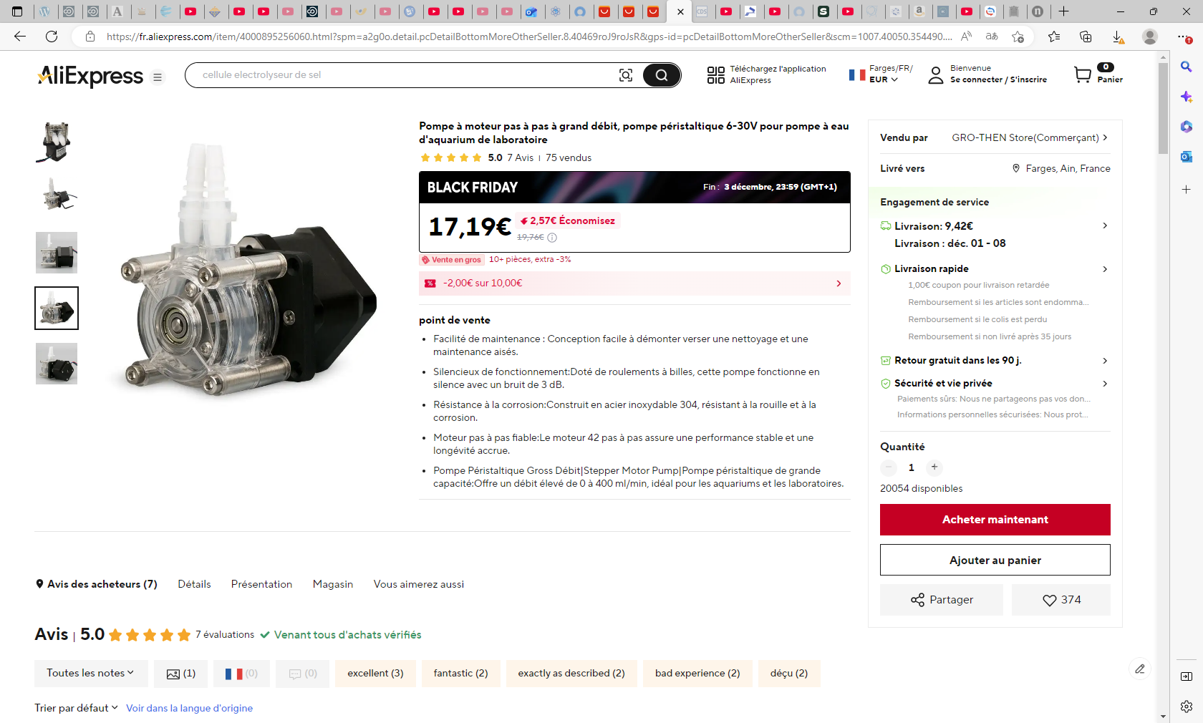
Pompe à moteur pas à pas à grand débit, pompe péristaltique 6-30V pour pompe à eau d'aquarium de laboratoire - AliExpress 13

Slide 15
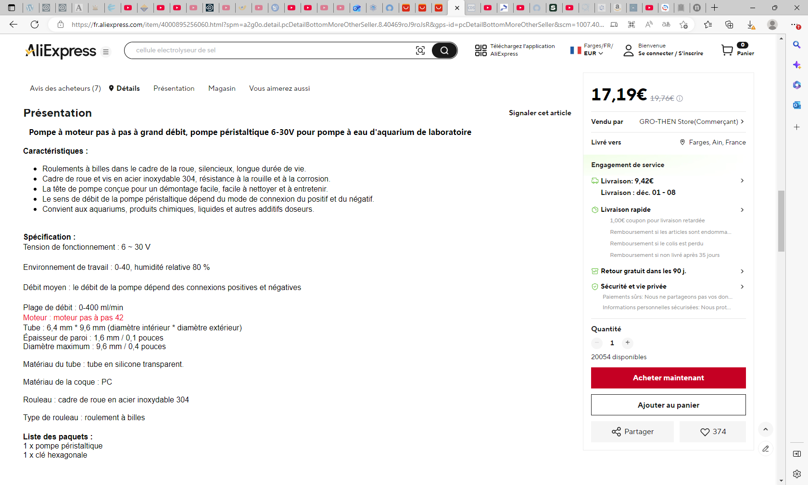

Slide 16
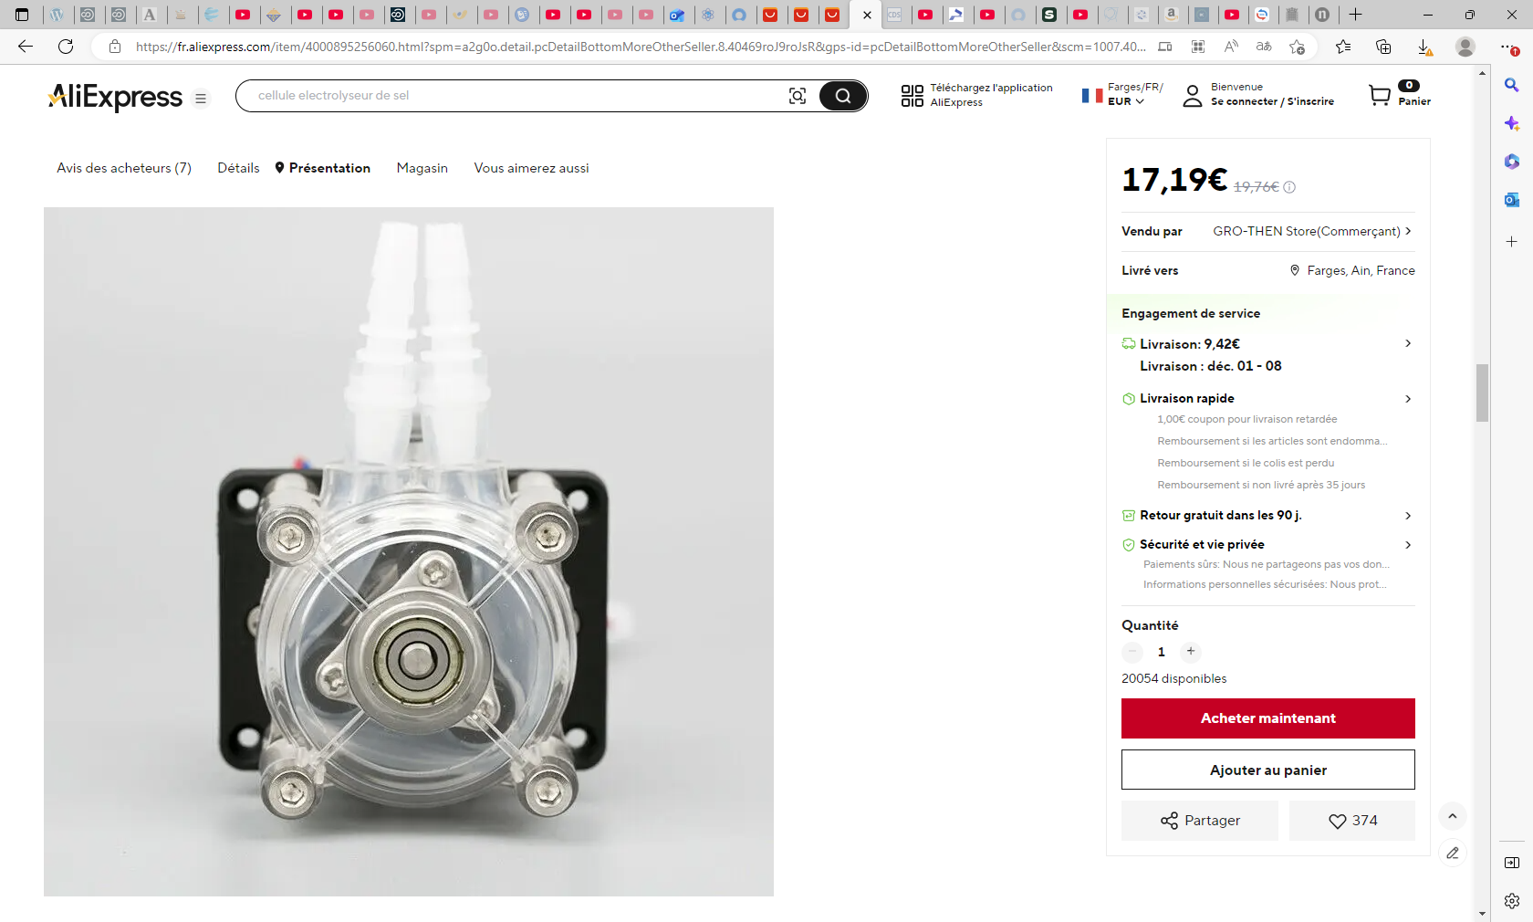

Slide 19
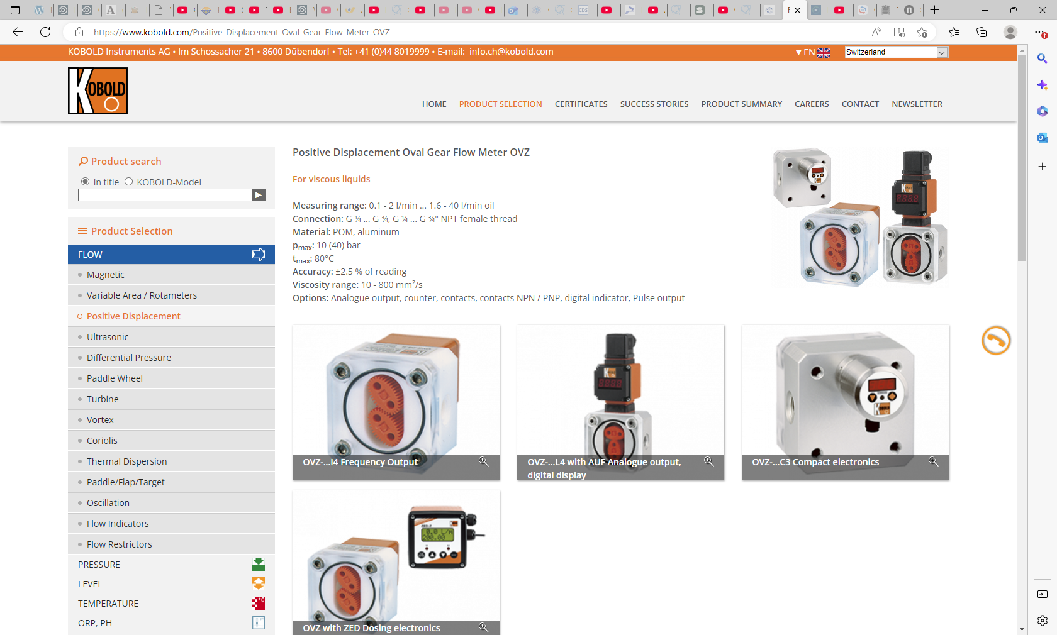
https://www.kobold.com/Positive-Displacement-Oval-Gear-Flow-Meter-OVZ

