Slide 1
Incremented gas control
Ian
24 Nov 2025

Slide 2
Argument to go from continuous flow control to incremental flow.
Mehadi showed me a Youtube of a guy mixing gases for his laser using one of those cushion pads used to lift furniture. I was not really impressed as it looked rather crude given the precision we are looking for 0.1% of 10 [litres/hr] = 0.01 [l/h]
However I thought a bit and asked the question can we make it on a far smaller scale AND use the principle of a “positive displacement pump” (PDP) meaning incremental flow.
Then I asked the question what is a type of pump that uses PDP, gear pumps etc, but does not contaminate the gases…..
There, why not try a peristaltic pump, as used for blood transfusion. A quick search reveals that we are not the first to use this for gases and that ~10 times better than what we need is commercially available. See “Easydos” in the following notes.
Namely 0.007 [l/h]
The PDP also has a major advantage in terms of the calibration but I will let Mahdi come up with his own understanding of this aspect.

Slide 3
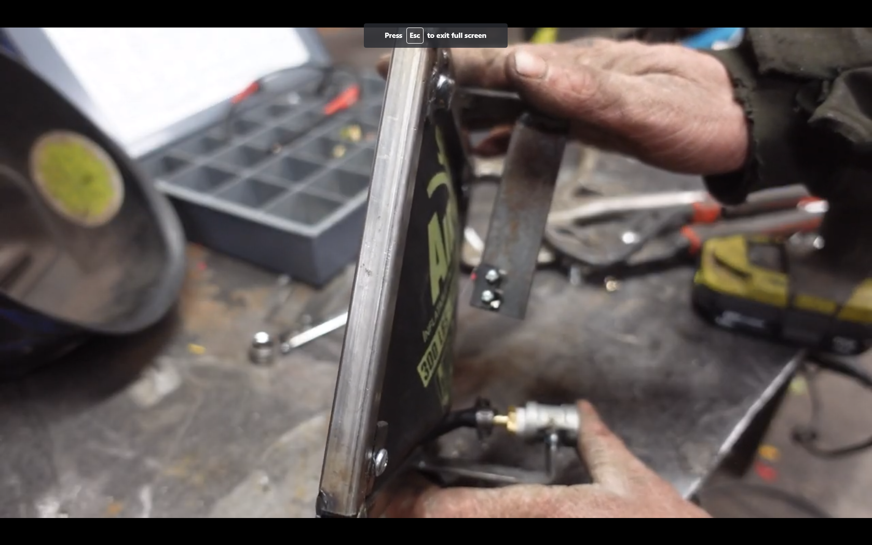
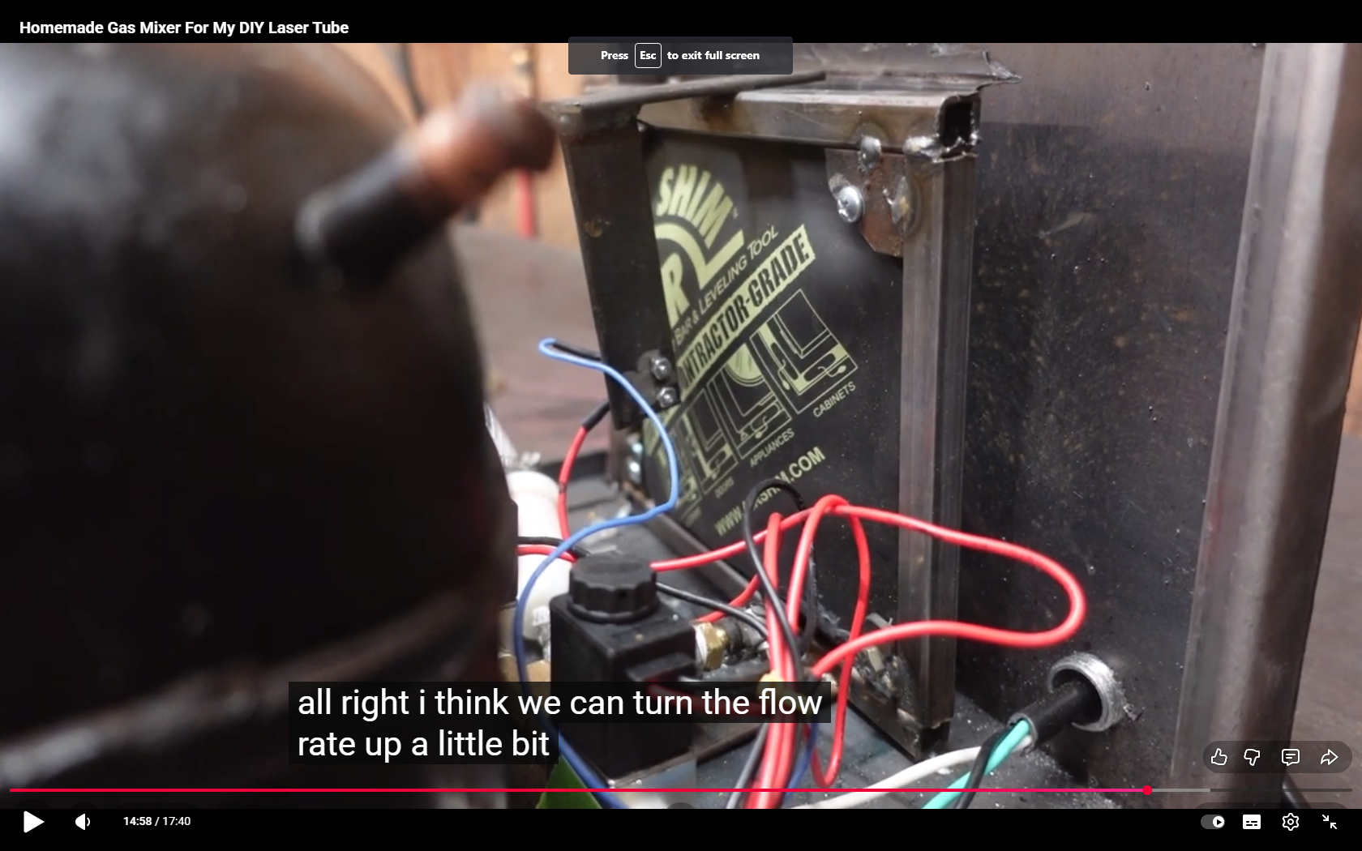
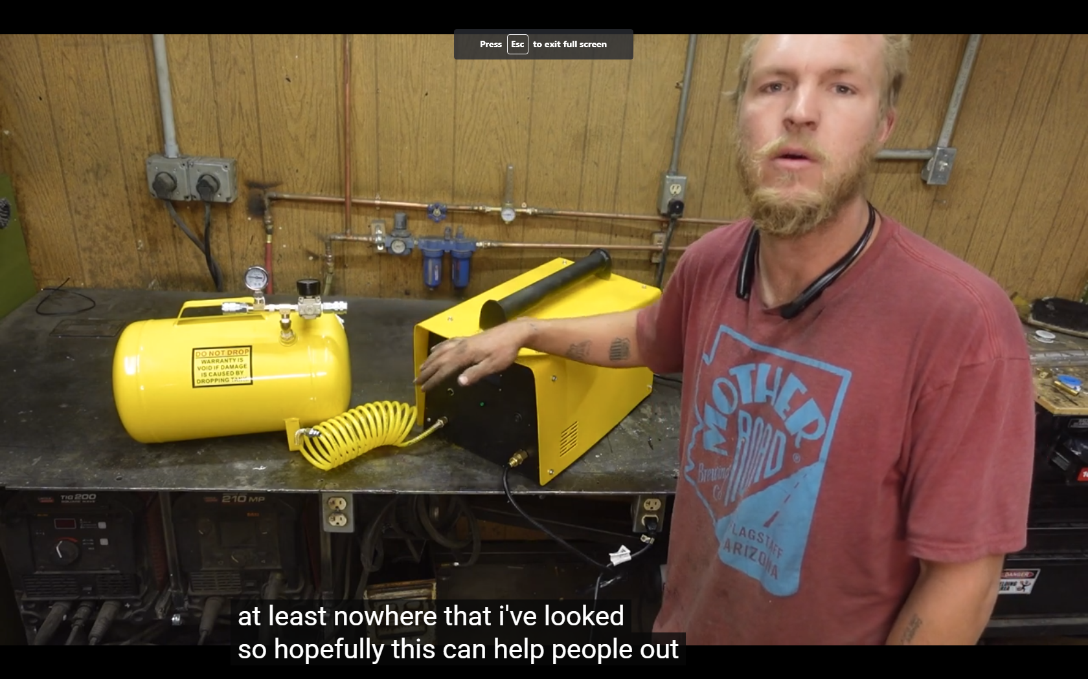
https://www.youtube.com/watch?v=Ax7xlcFS2QY

Slide 4
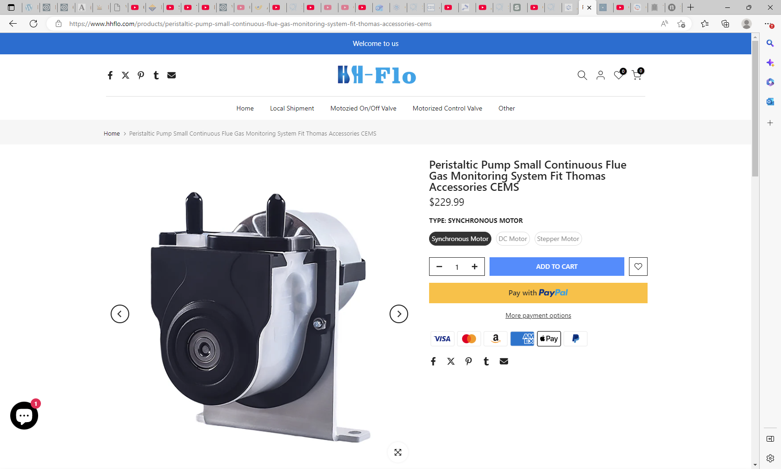
https://www.hhflo.com/products/peristaltic-pump-small-continuous-flue-gas-monitoring-system-fit-thomas-accessories-cems

Slide 5
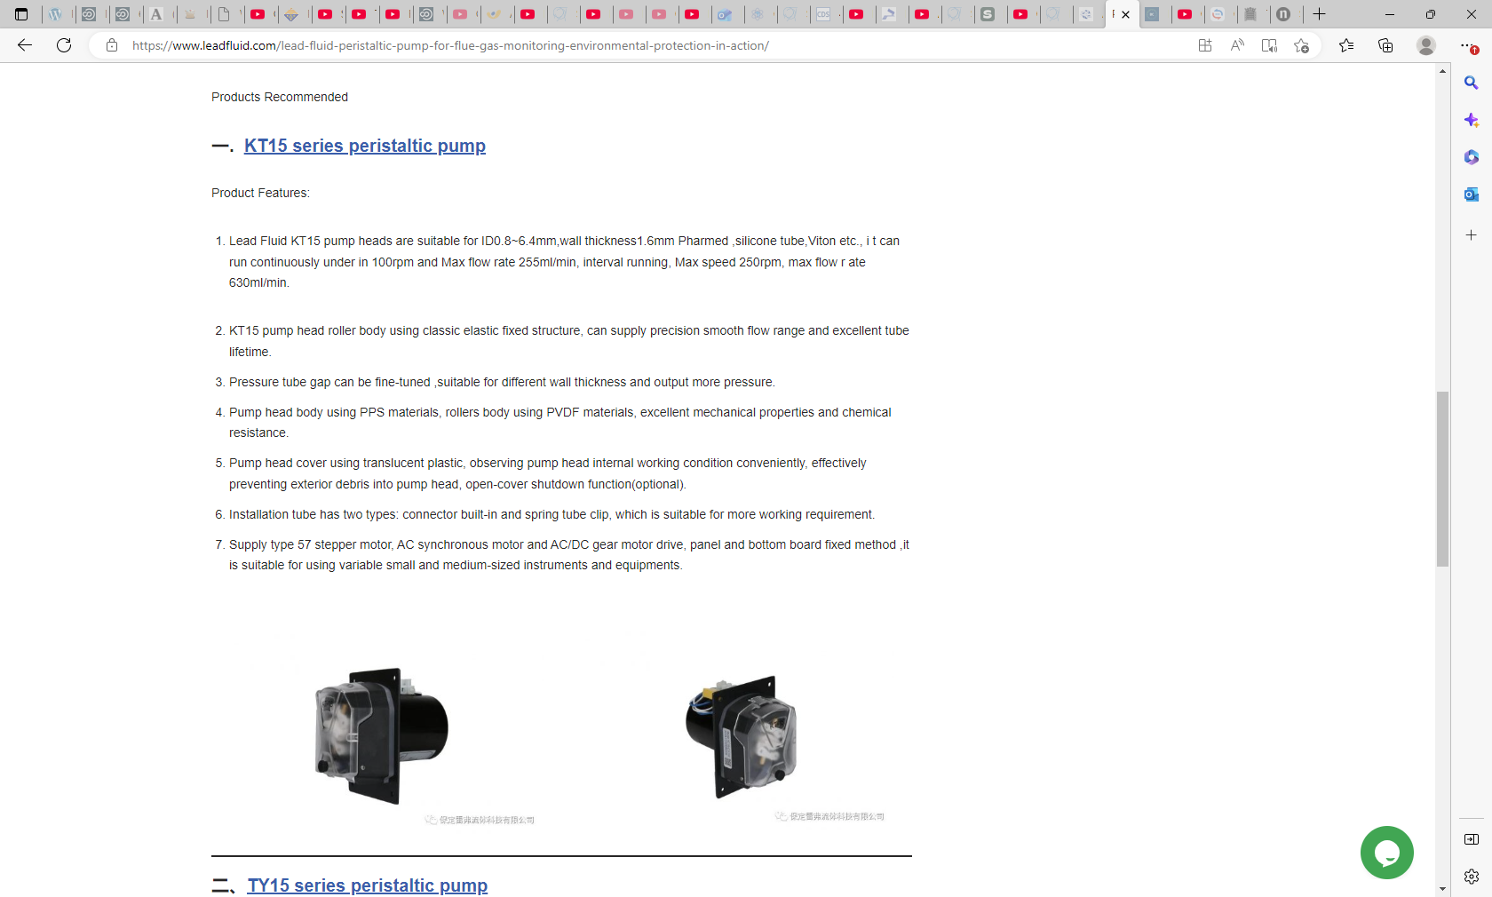
https://www.leadfluid.com/lead-fluid-peristaltic-pump-for-flue-gas-monitoring-environmental-protection-in-action/

Slide 6
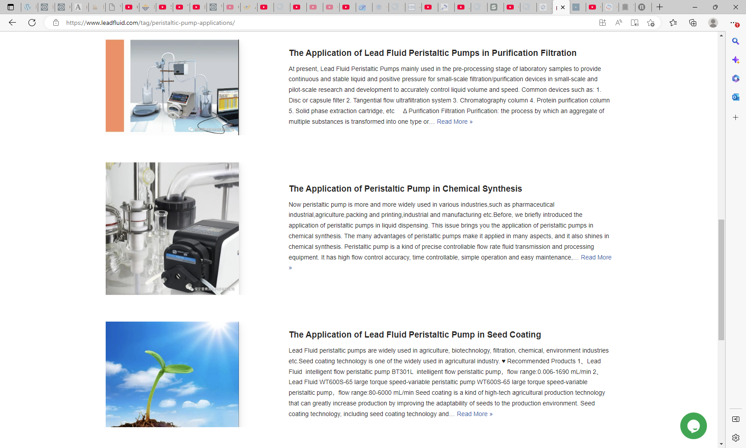

Slide 7
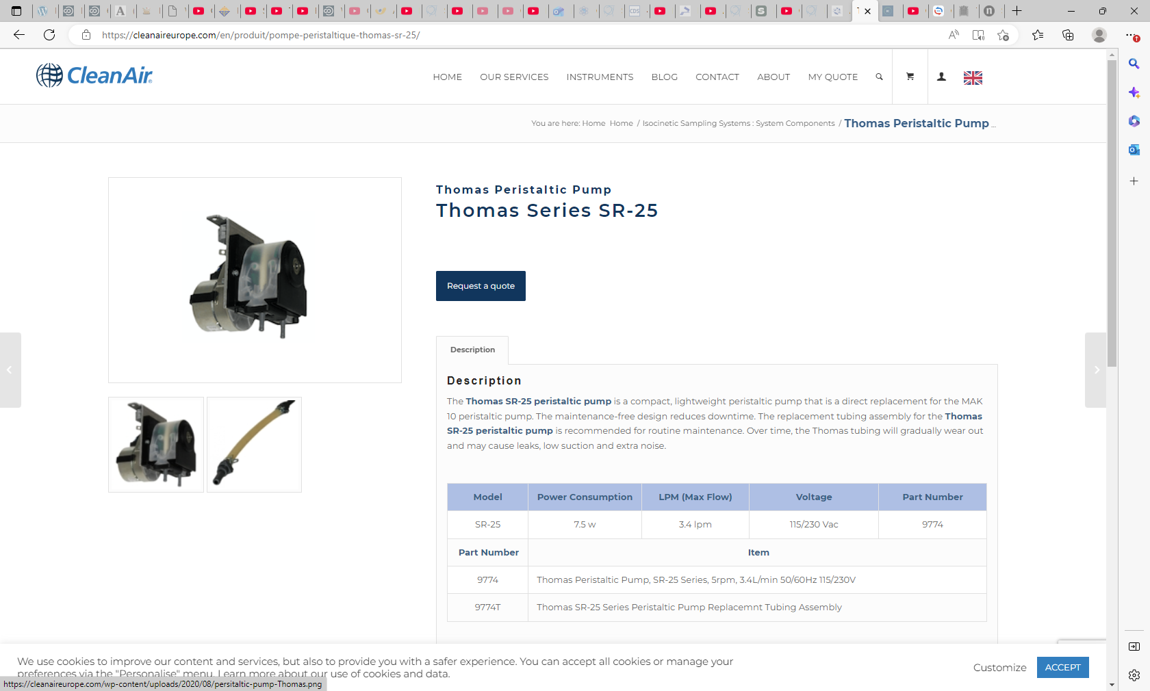
https://cleanaireurope.com/en/produit/pompe-peristaltique-thomas-sr-25/

Slide 8
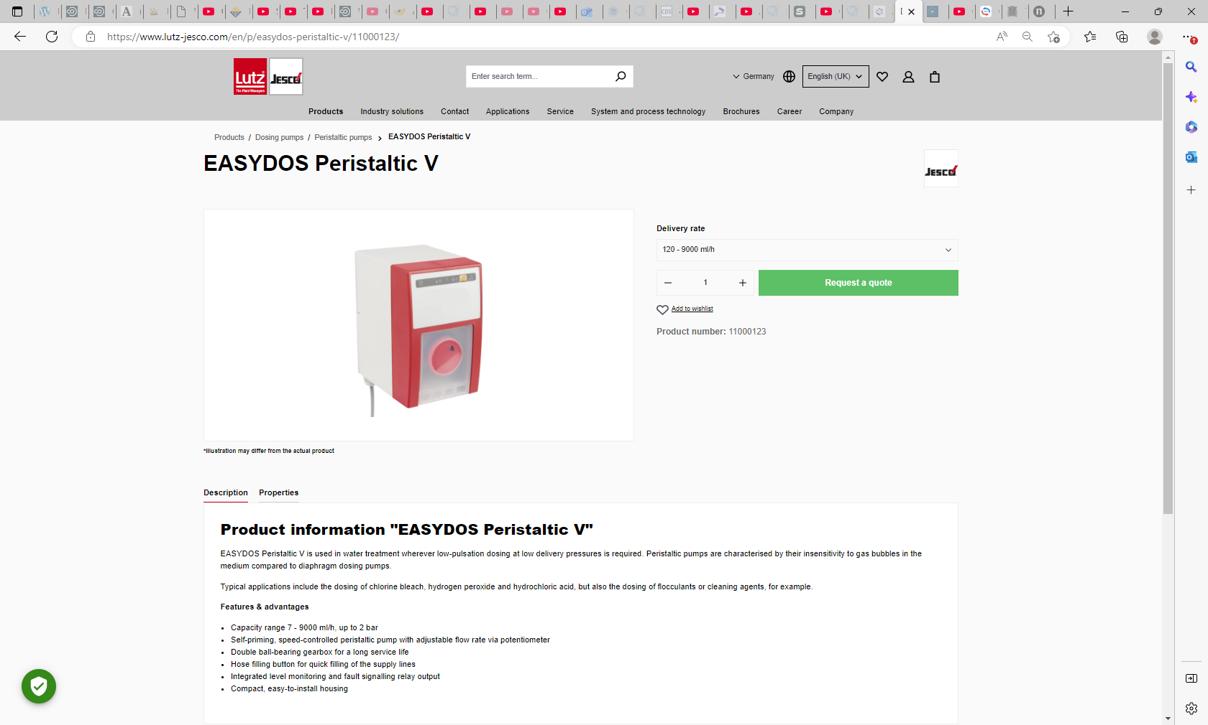
0.007l/hr !!!

Slide 11
Cheap sources of peristaltic pumps

Slide 12
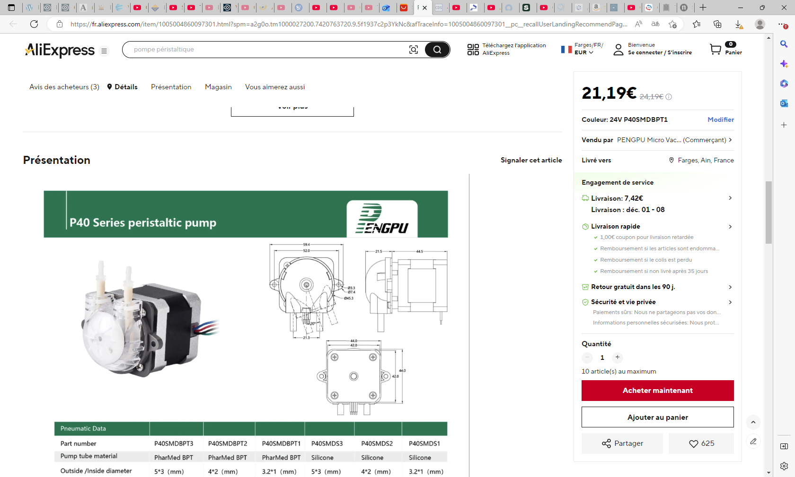
https://fr.aliexpress.com/item/1005004860097301.html?spm=a2g0o.tm1000027200.7420763720.9.5f1937c2p3YkNc&afTraceInfo=1005004860097301__pc__recallUserLandingRecommendPage__ZsmlVqd__1764000077471&aecmd=true&gatewayAdapt=glo2fra

Slide 13
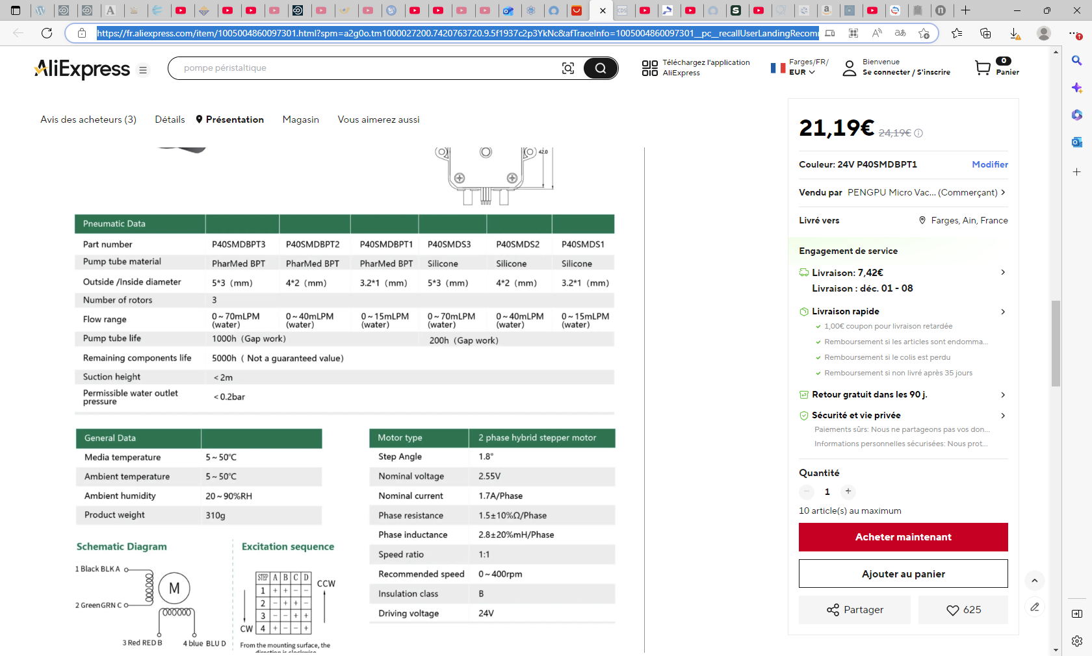

Slide 14
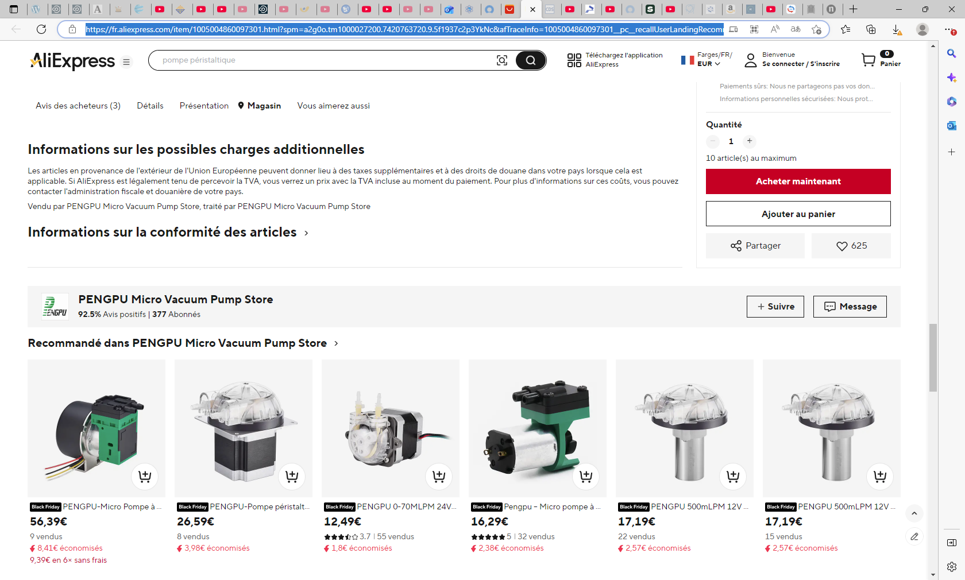

Slide 15
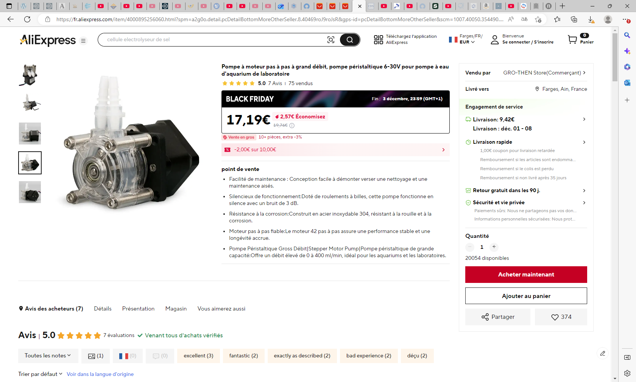
Pompe à moteur pas à pas à grand débit, pompe péristaltique 6-30V pour pompe à eau d'aquarium de laboratoire - AliExpress 13

Slide 16
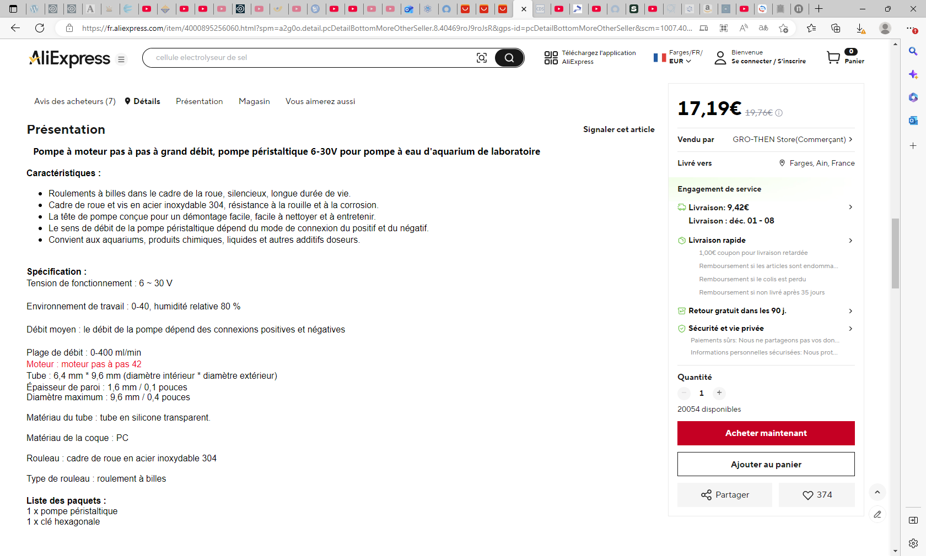

Slide 17
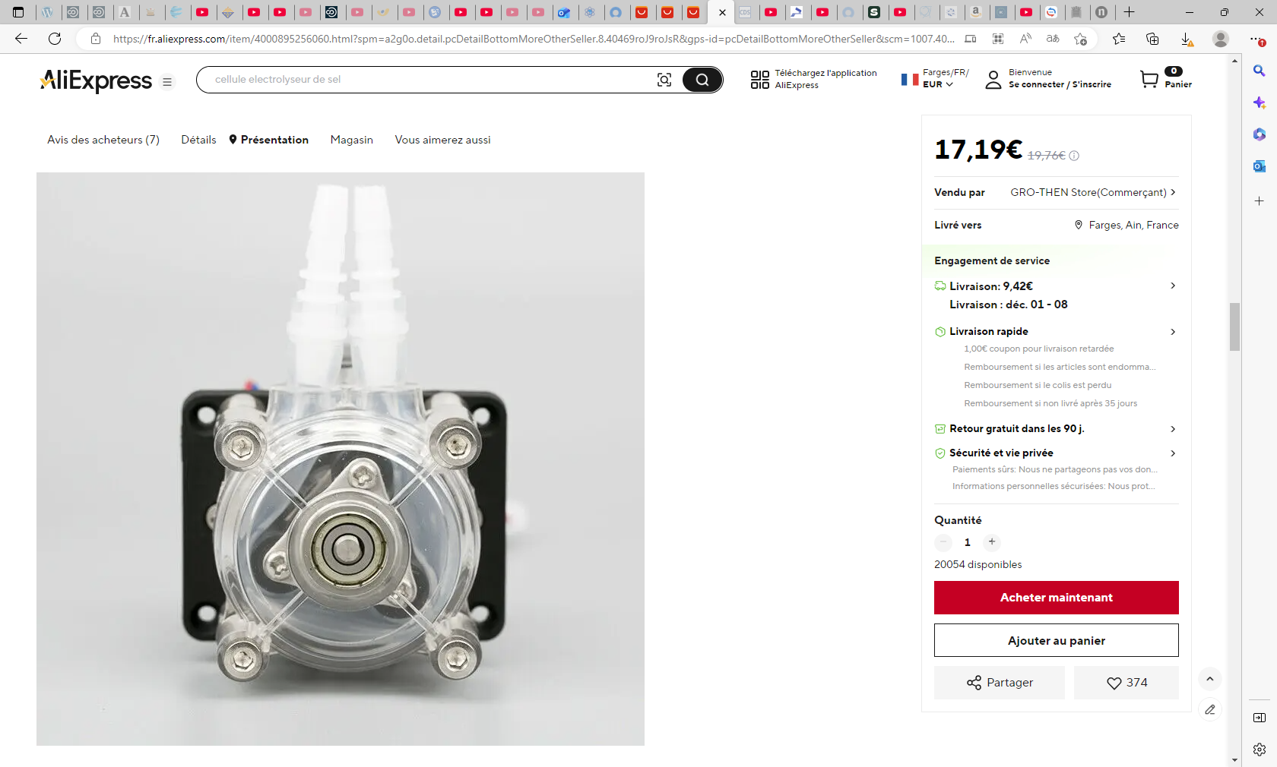

Slide 18
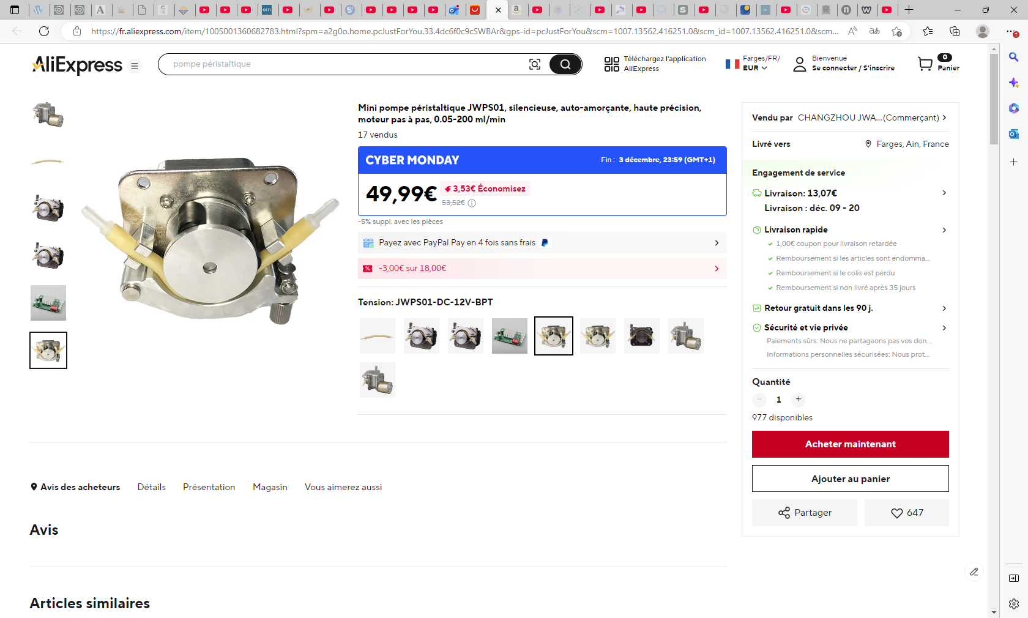
Mini pompe péristaltique JWPS01, silencieuse, auto-amorçante, haute précision, moteur pas à pas, 0.05-200 ml/min - AliExpress 13

Slide 24
Alternative PDPs

Slide 25
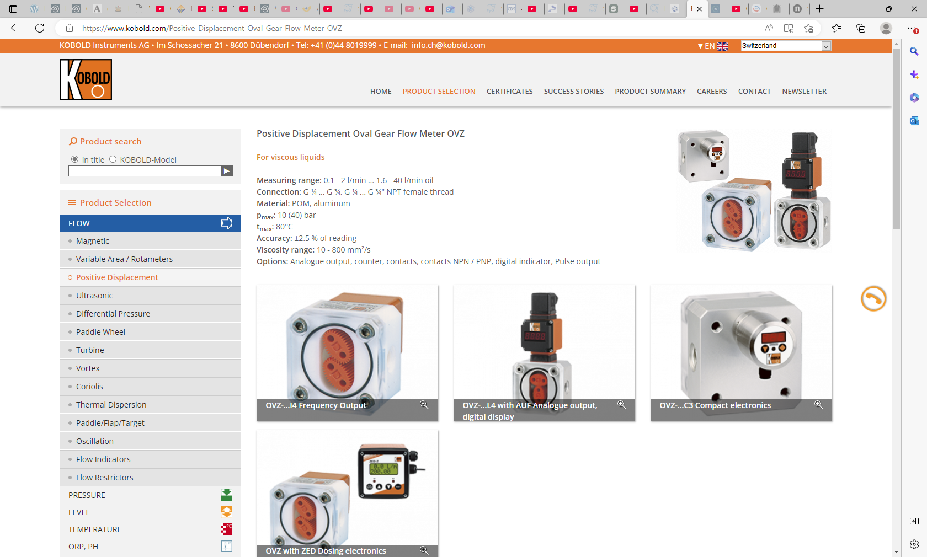
https://www.kobold.com/Positive-Displacement-Oval-Gear-Flow-Meter-OVZ

