Slide 1
NA61 MRPC test
Vadim Babkin, JINR
25/01/2017

Slide 2
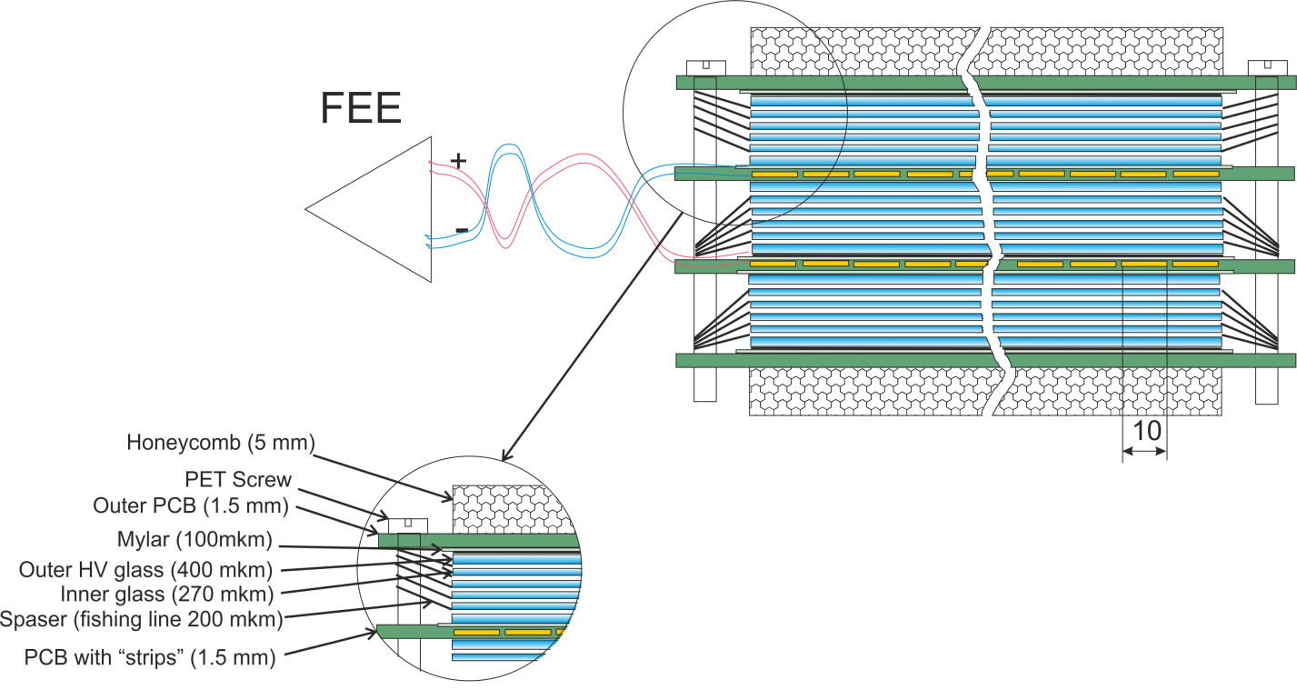
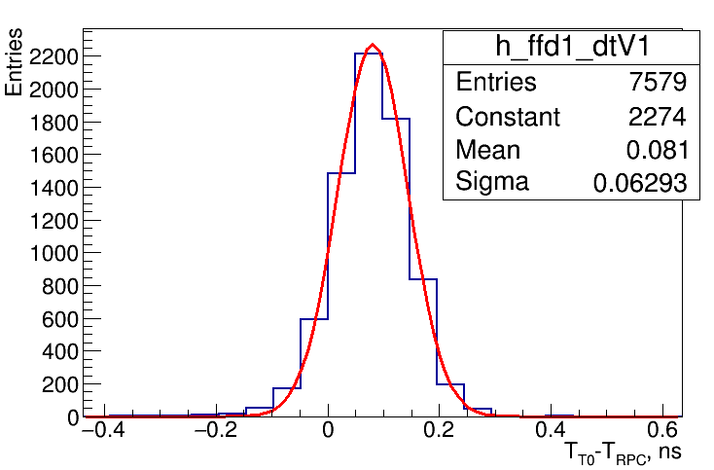
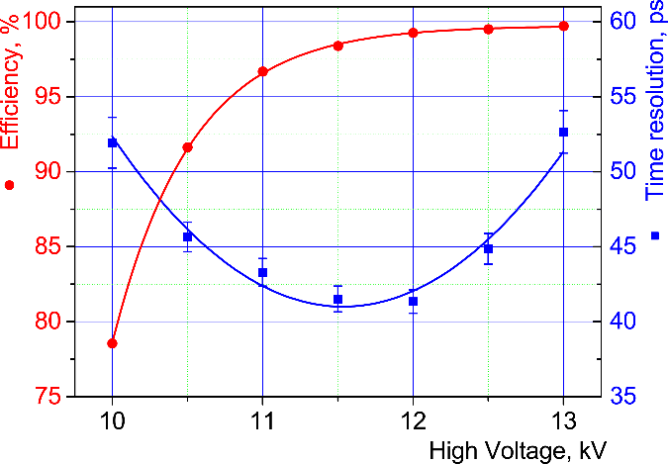
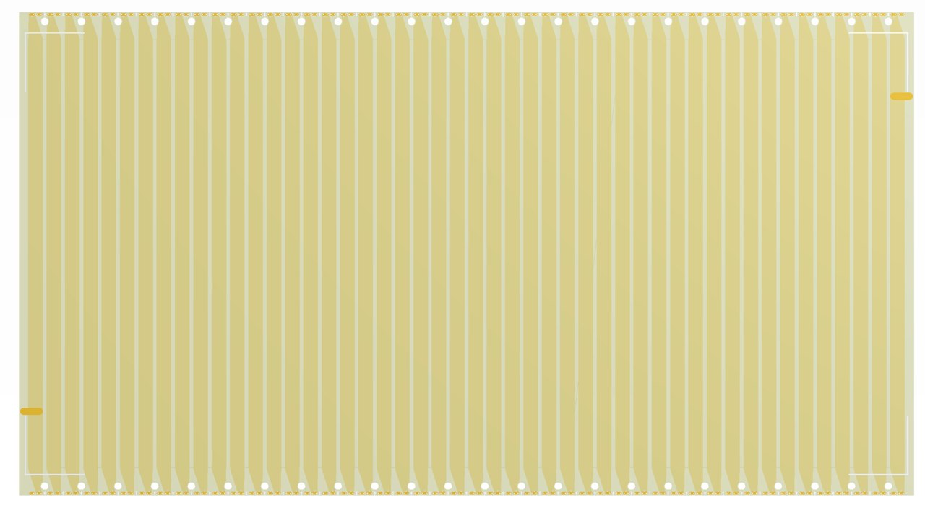
Triple-stack MRPC with strip readout (600x300 mm)
Triple-stack MRPC cut view
300 mm
48 strips (step - 12.5 mm)
Inner readout board with 48 strips

Slide 3
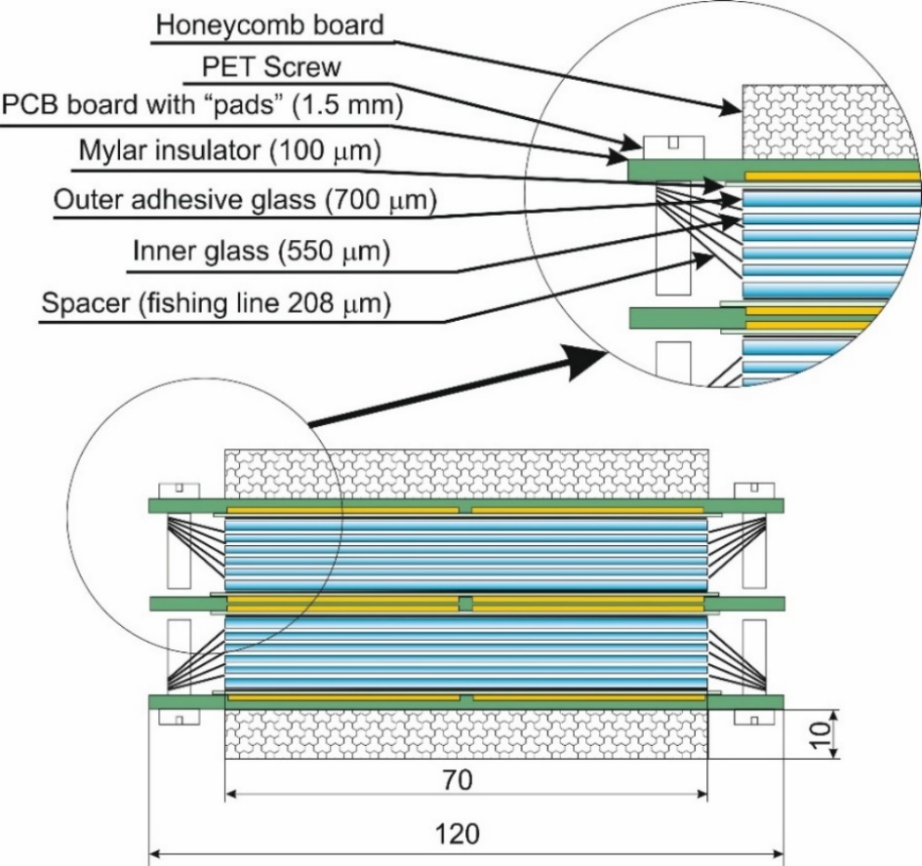
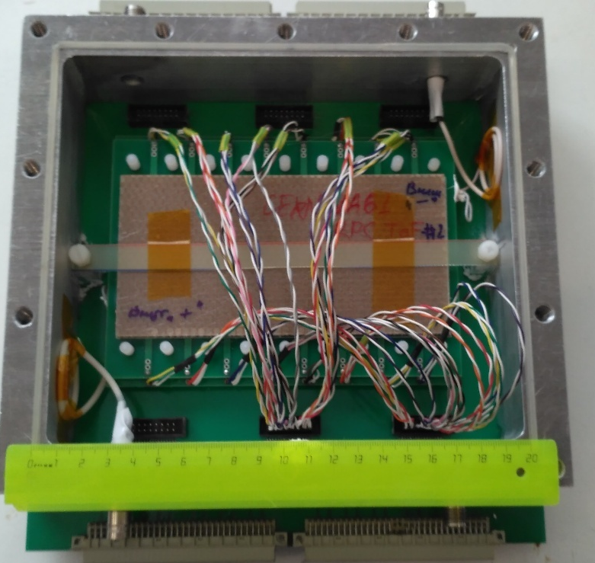
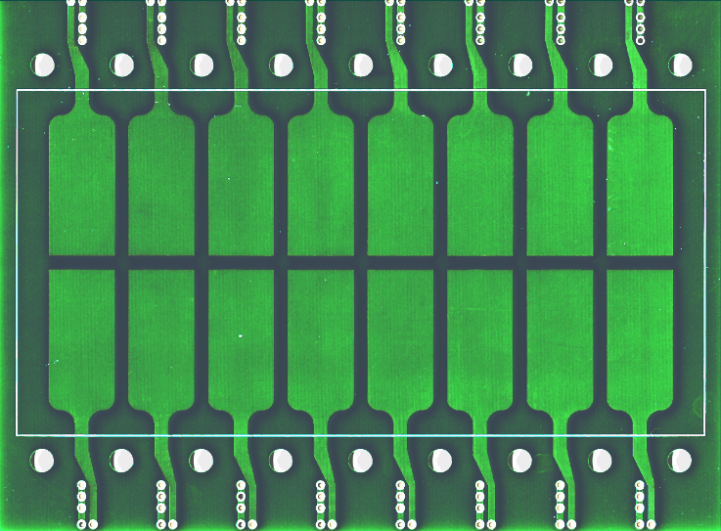
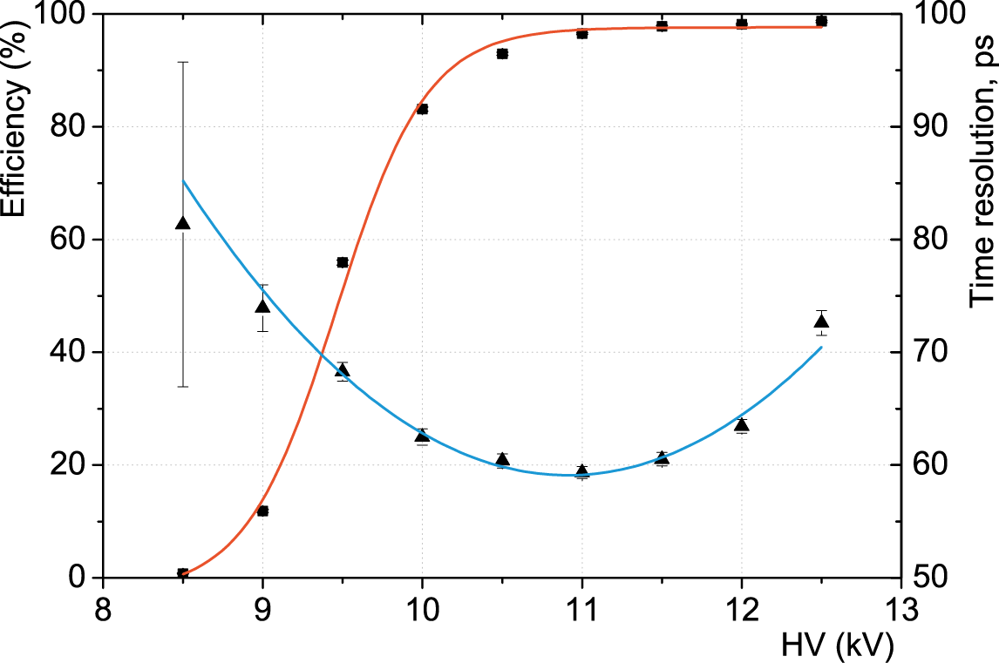
Double-stack MRPC with pad readout (150x75 mm)
32 mm
15 mm

Slide 4
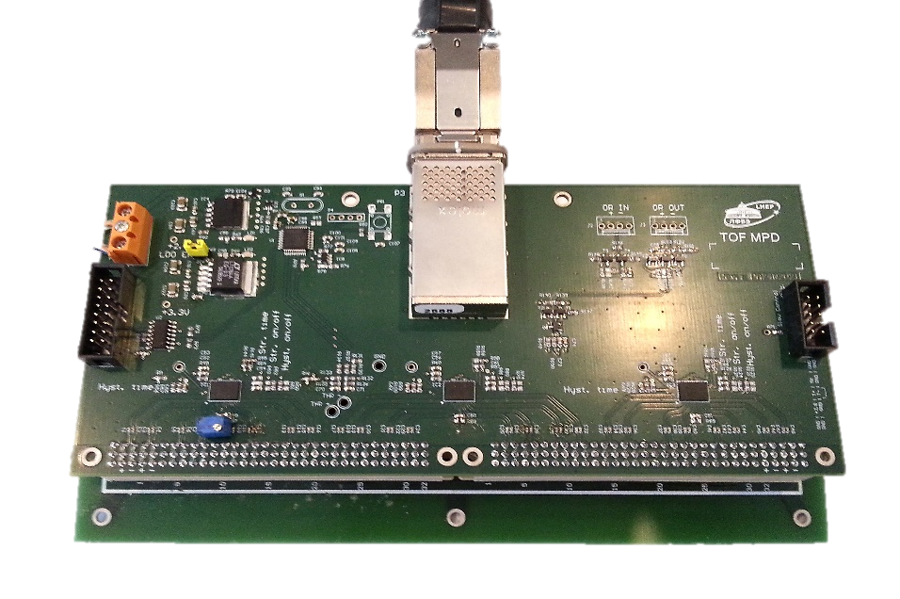
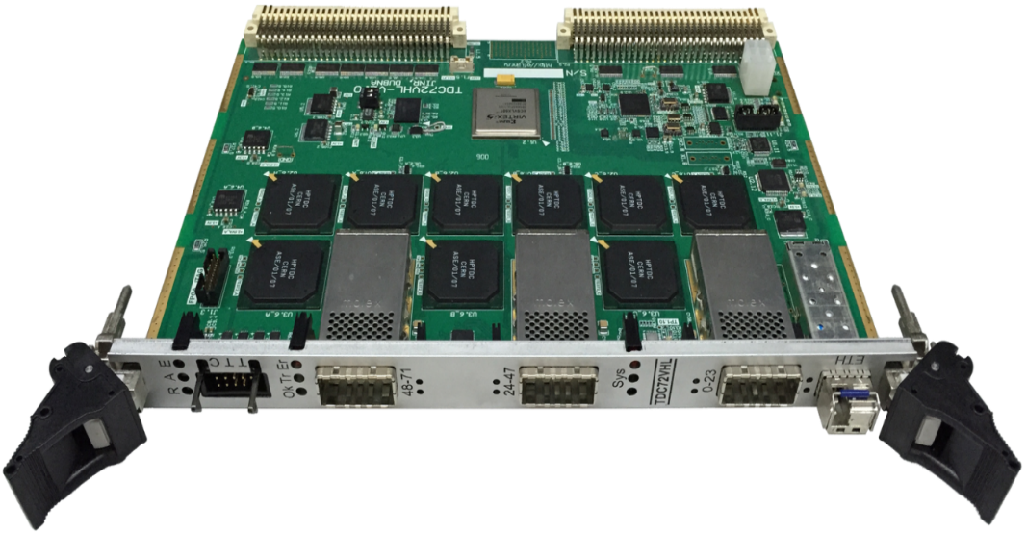
Readout electronics
NINO based 24-channels preamplifier-discriminator board PA24N2V2I
72-channels VME time-to-digital converter TDC72VHL
“On board” slow control with 8-bit
ultralow power MCU STM8L152C8T6:
preamplifier voltage control & monitoring;
preamplifier thresholds control;
board temperature monitoring ±0.5 °С;
gas volume temperature monitor;
GUI for control&monitoring
VME64x interface;
TDC type: timestamping HPTDC chip;
Input: differential 100 Ω (LVDS);
Resolution: ~ 25ps bin size (σ_{t} ≈ 20 ps);
Time synchronization by the White Rabbit

Slide 5
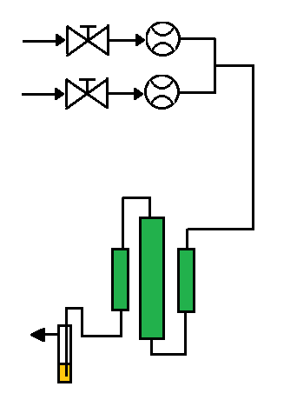
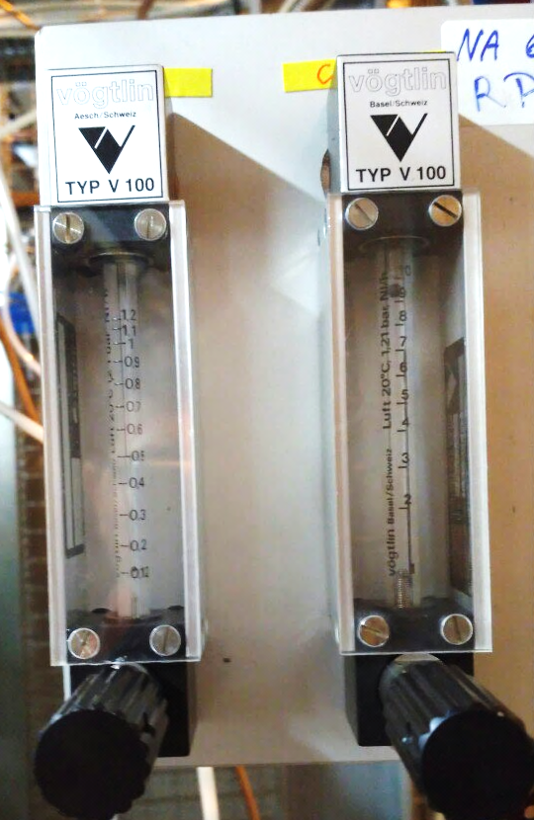
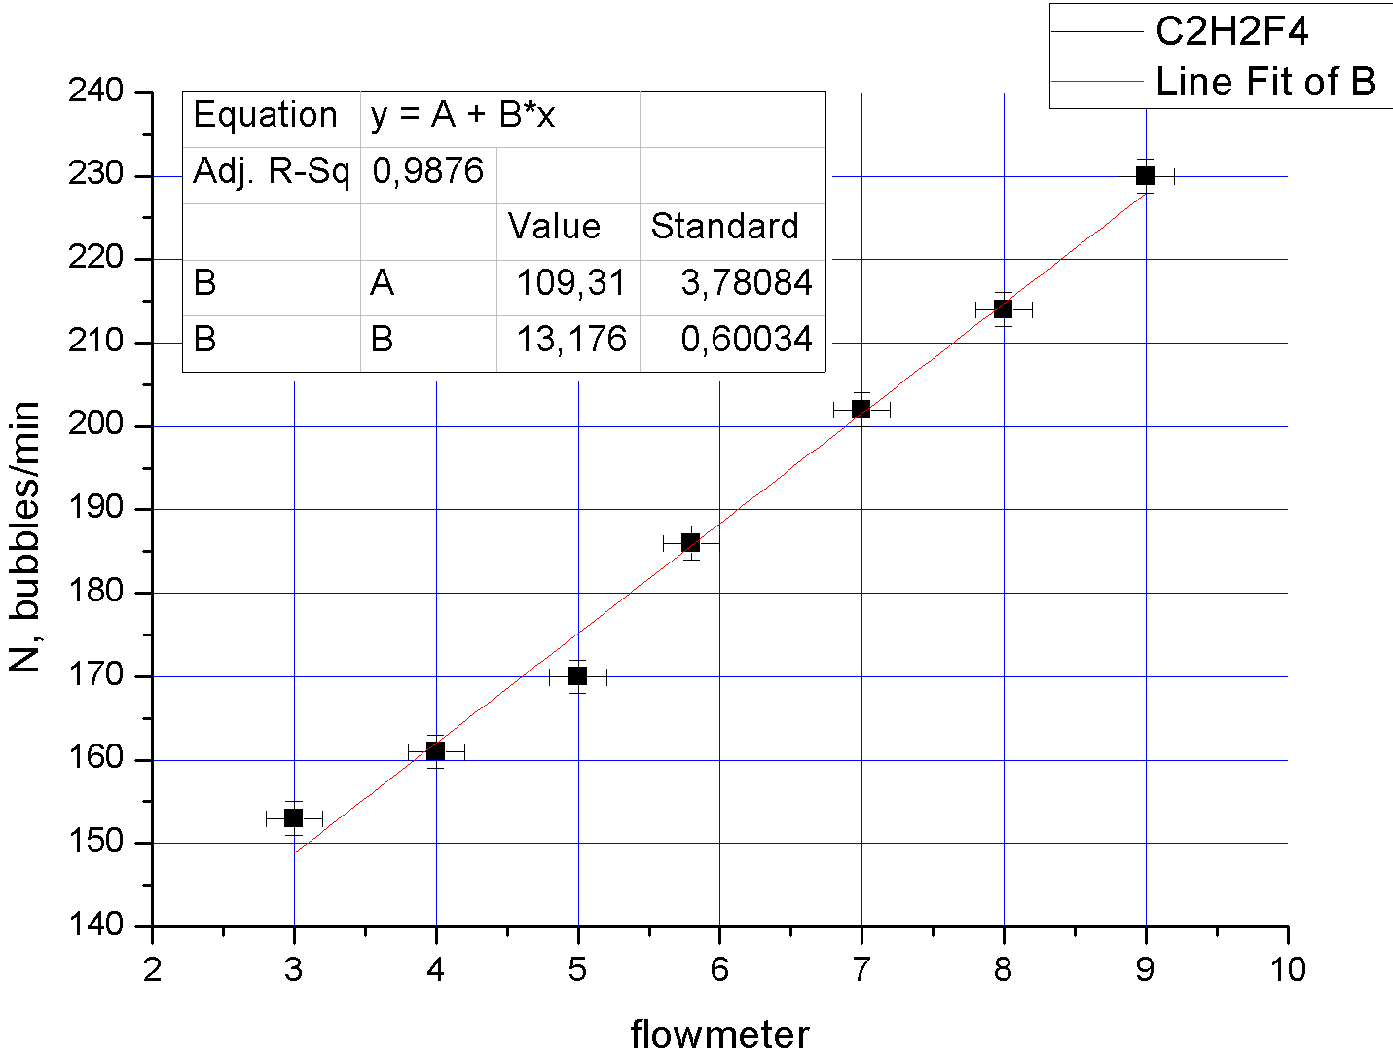
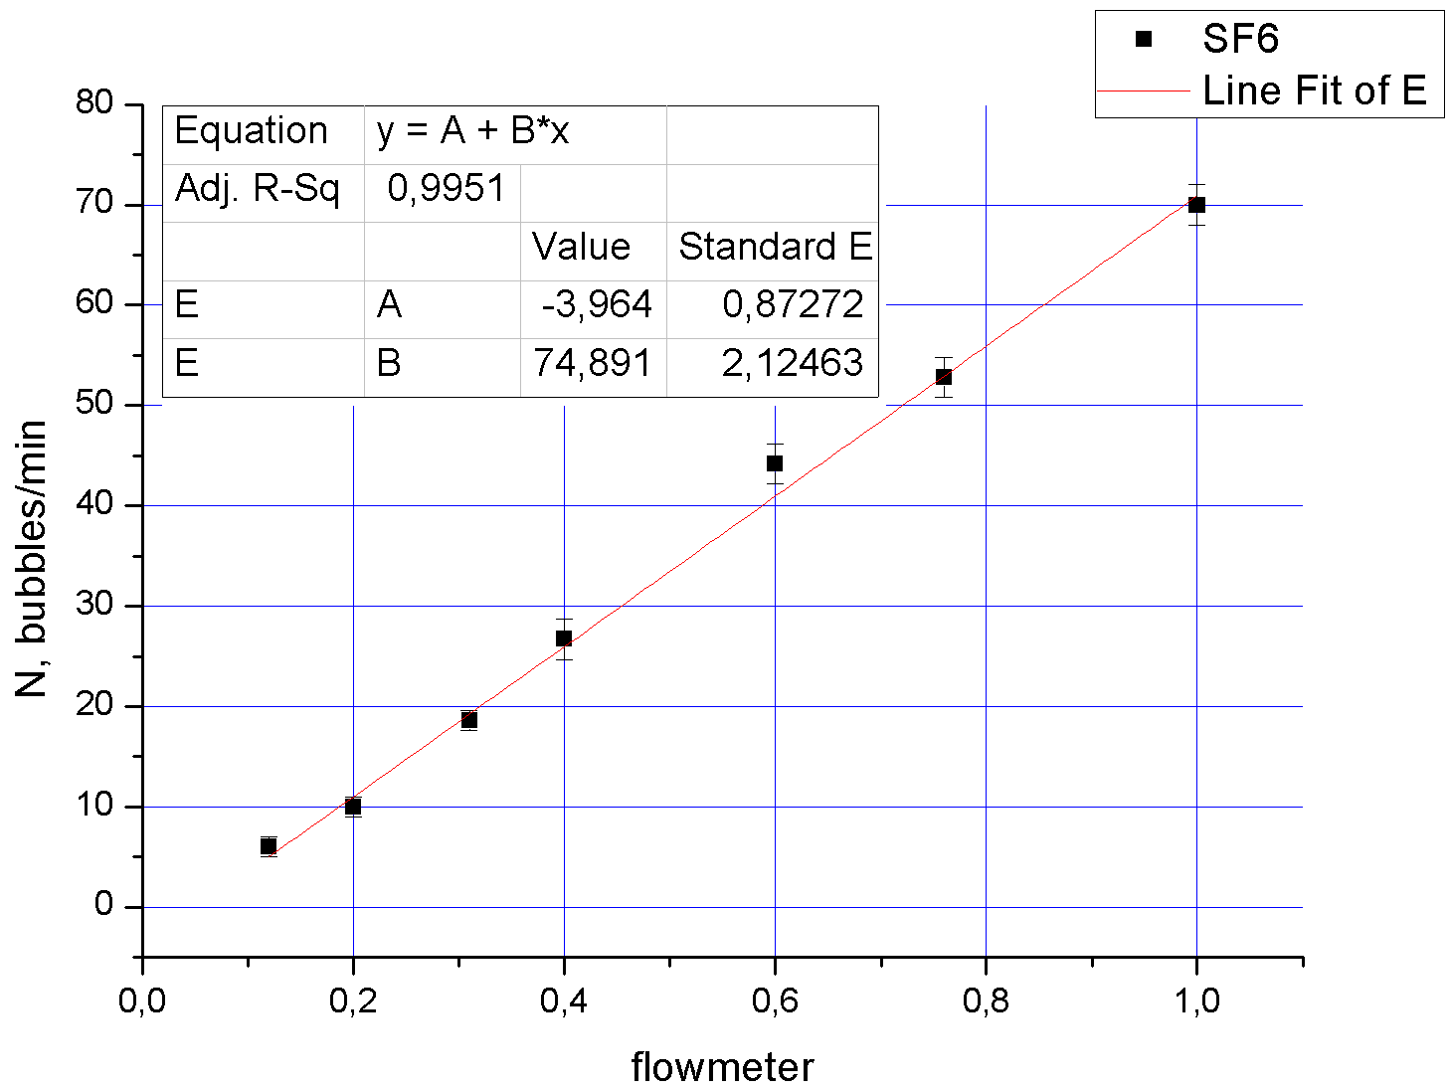
Test setup (gas distribution system)
C2H2F4
SF6
Pressure regulator
Flow controller
Bubbler
Atmosphere
Gas mixture for the current test – C₂H₂F₄ + SF₆ (95/5)
Total volume (taking into acc. volume of the detector) is ~17 l
Estimated release of greenhouse gas mixture into the
atmosphere (with average flowrate of 3 l/h) is around 120 l

Slide 6
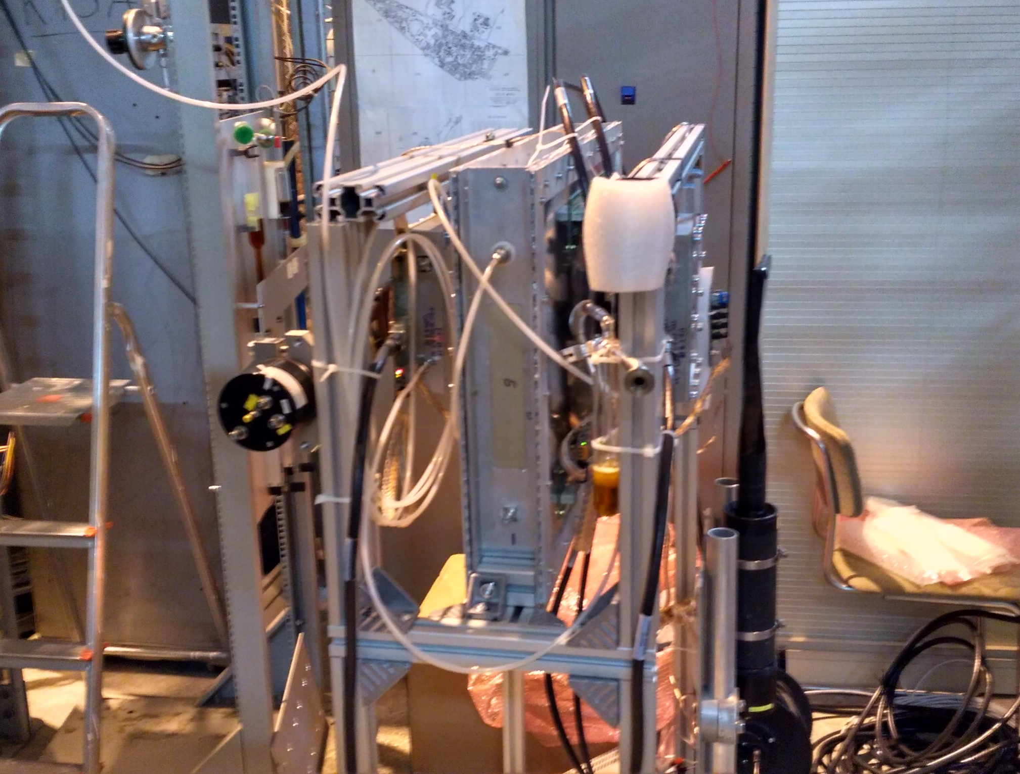
Test setup (mechanical construction)

Slide 7
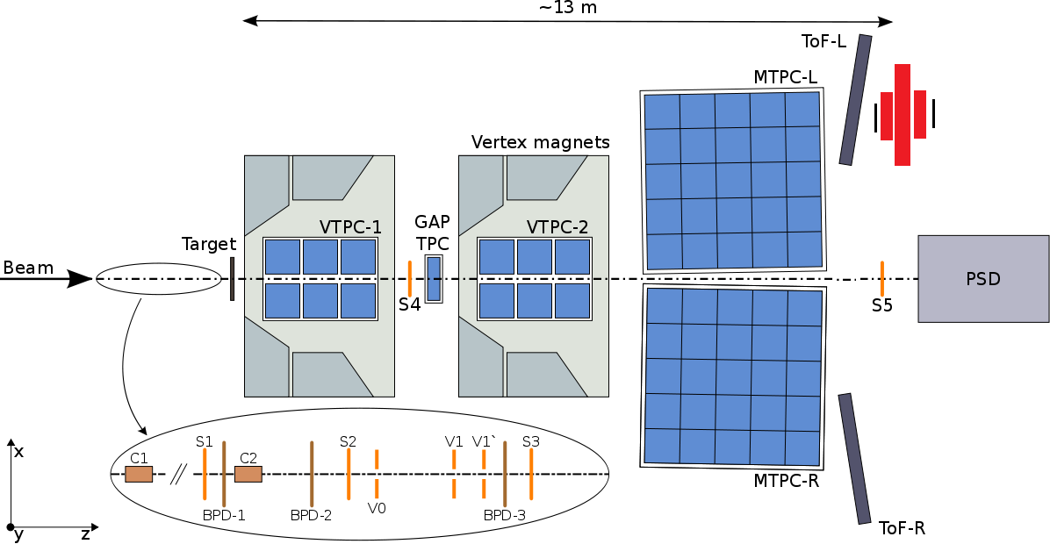
Location of the test setup in the NA61 area
MTPC HUT
SRPC
SR2
SR1
PRPC2
PRPC1
2.5 m

Slide 8
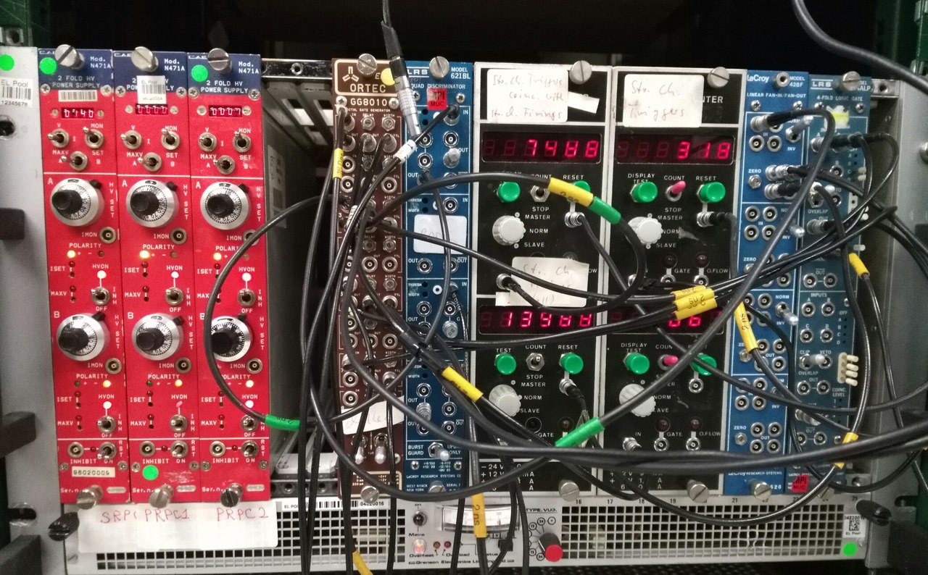
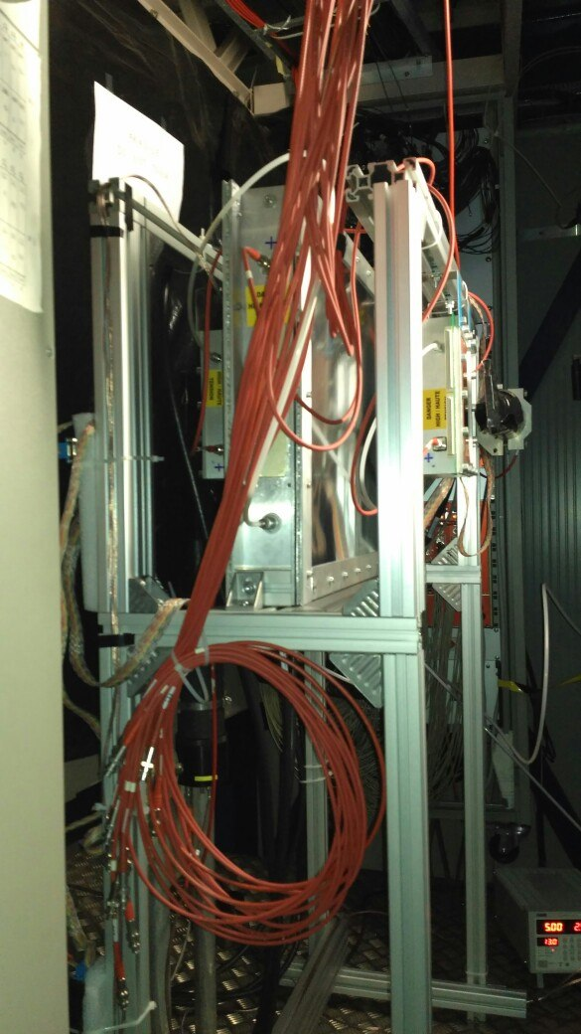
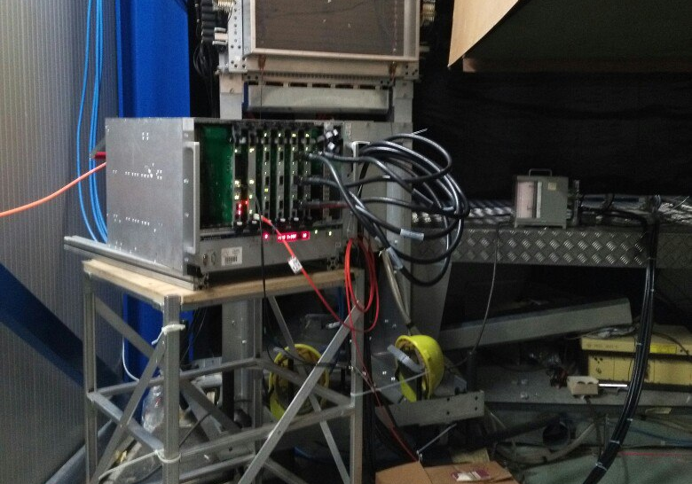

Slide 9
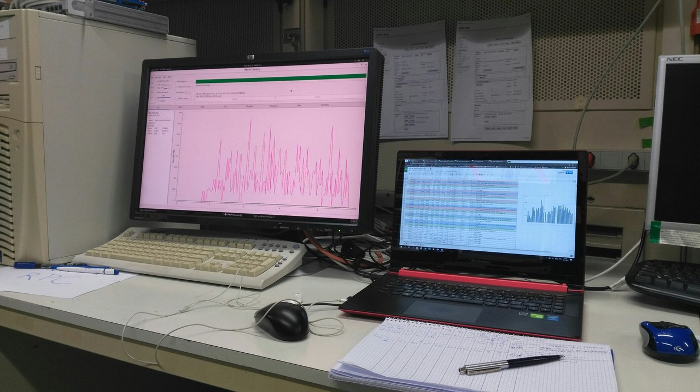
36 hours data taking
Total collected data – 19 files (280 MB) ~ 1000000 events
1 file with T2 trigger (~100000 events)

Slide 10
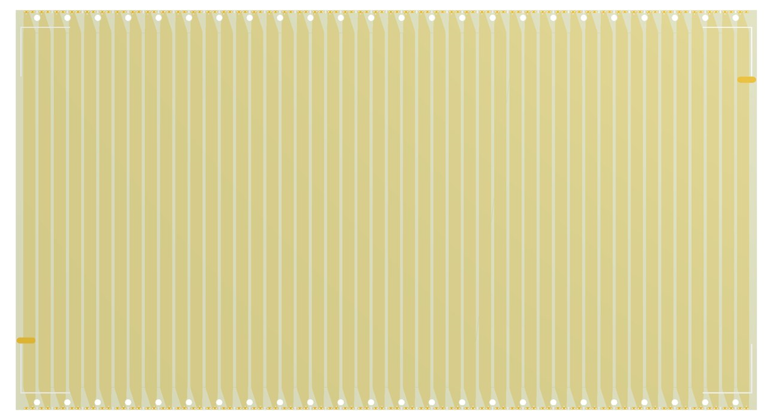
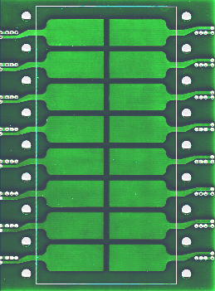
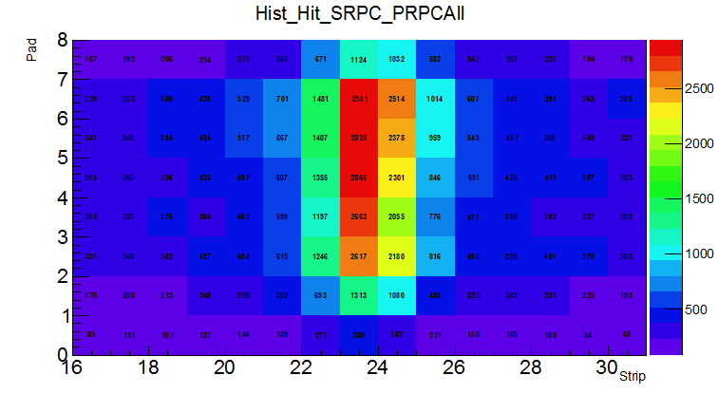
Trigger
Scintillator
Counter

Slide 11
Measurement procedure
For straight tracks
For all tracks
One pad
All 16 pad
Two strips
All 48 strips
One pad
All 16 pad
Different momentum
Same TOF base
One TOT correction
Different momentum
Different TOF base
One TOT correction for all channels

Slide 12
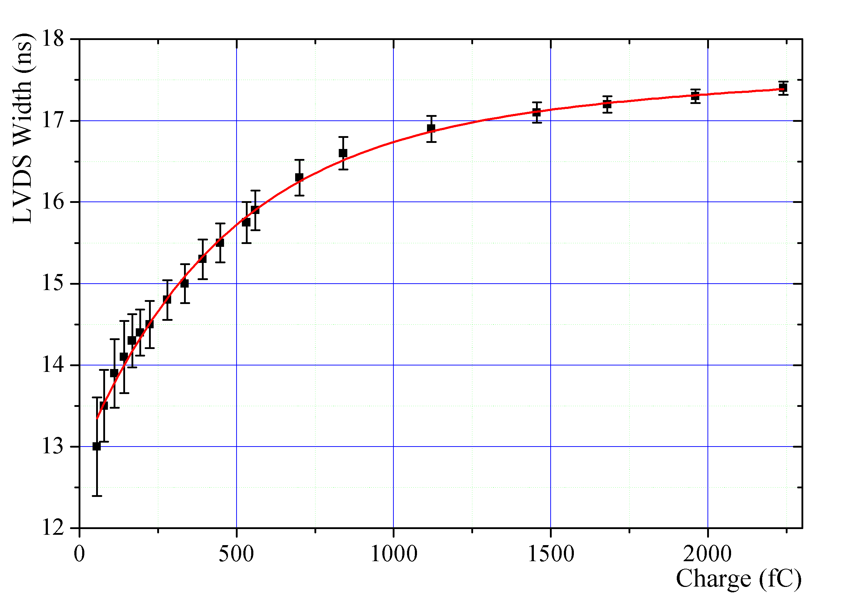
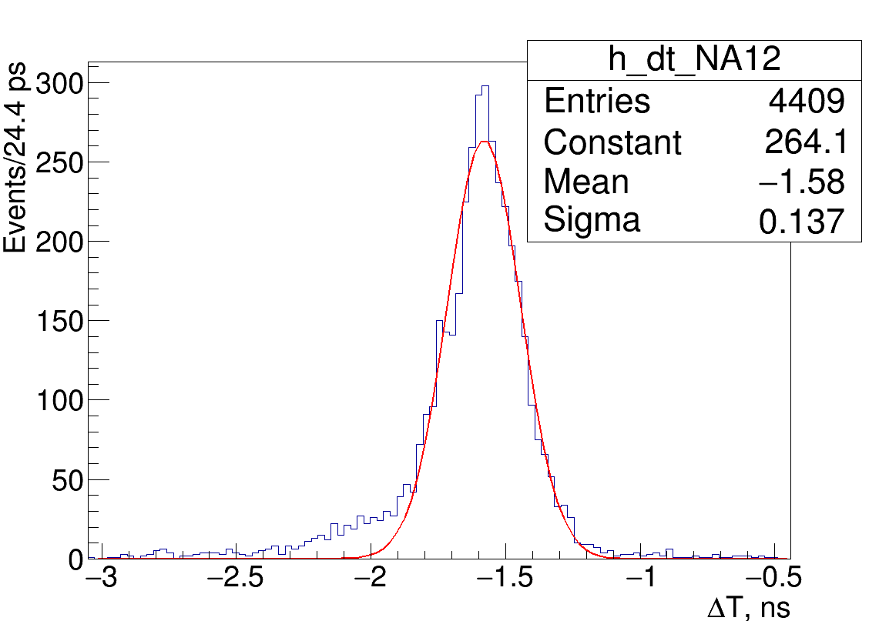
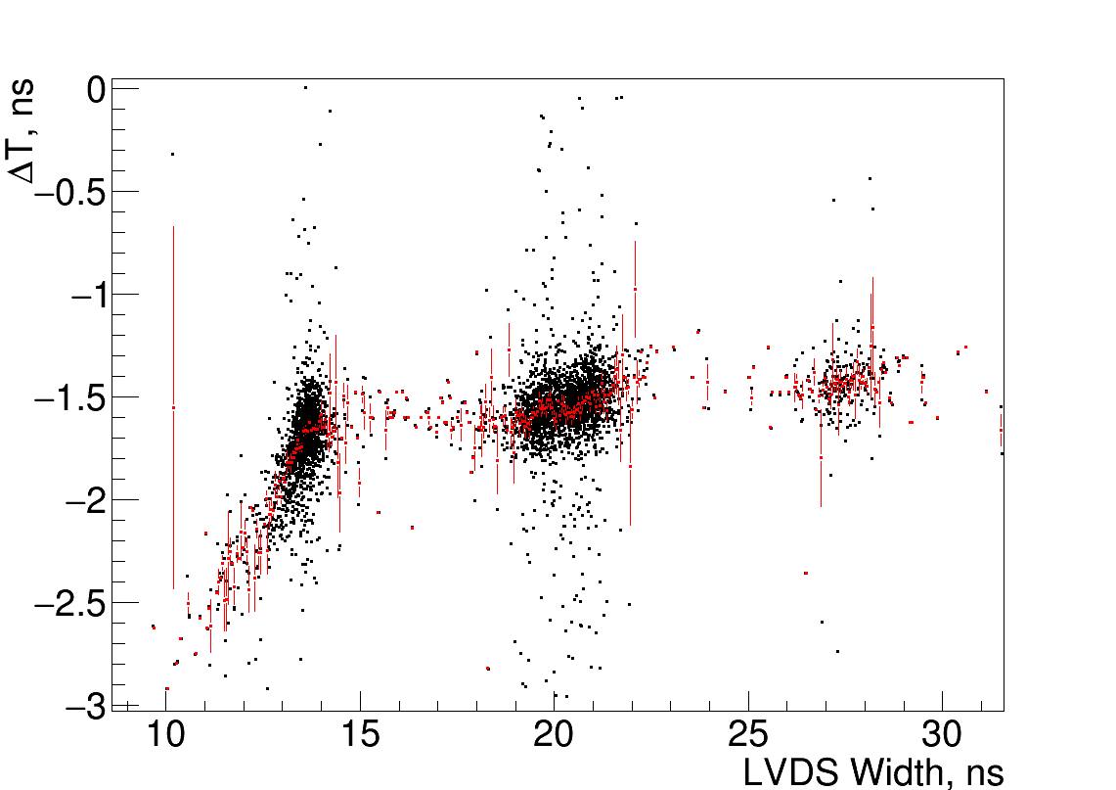
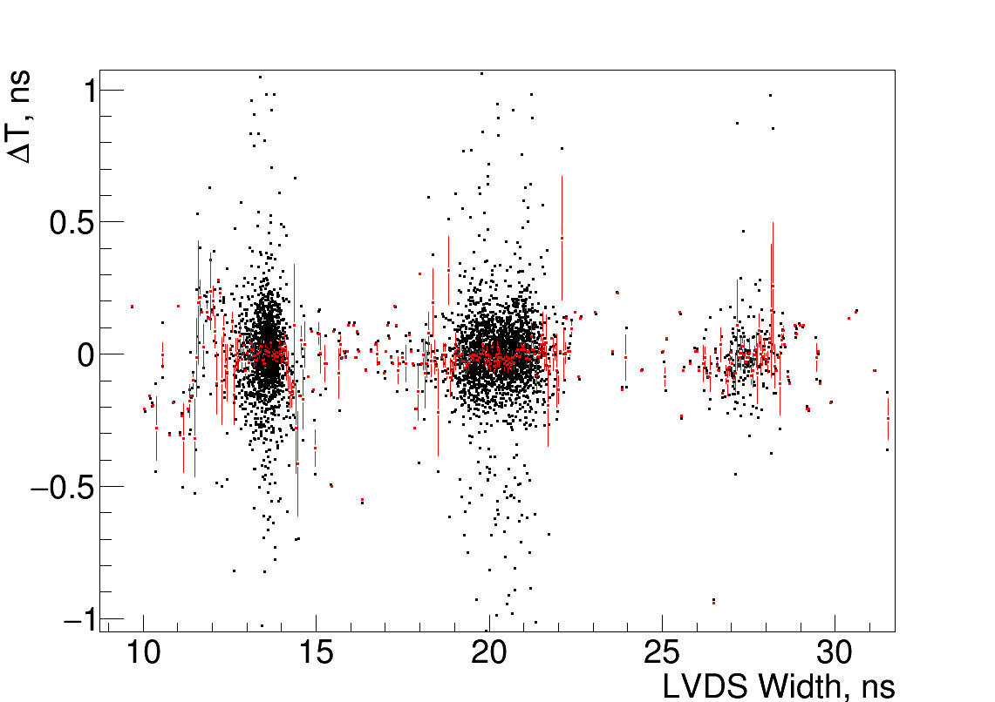
Time over threshold correction
Before TOT correction
After TOT correction

Slide 13
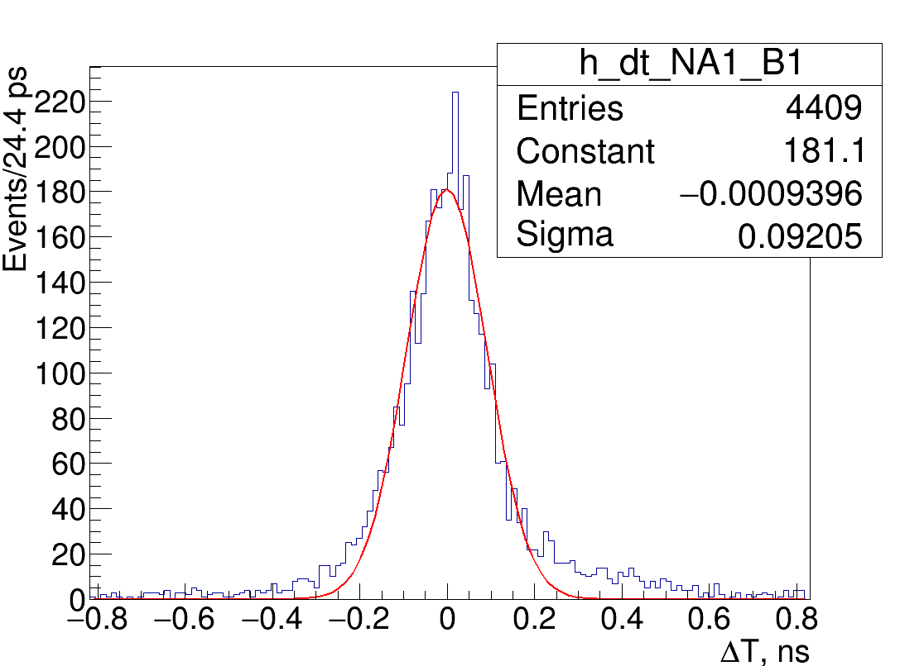
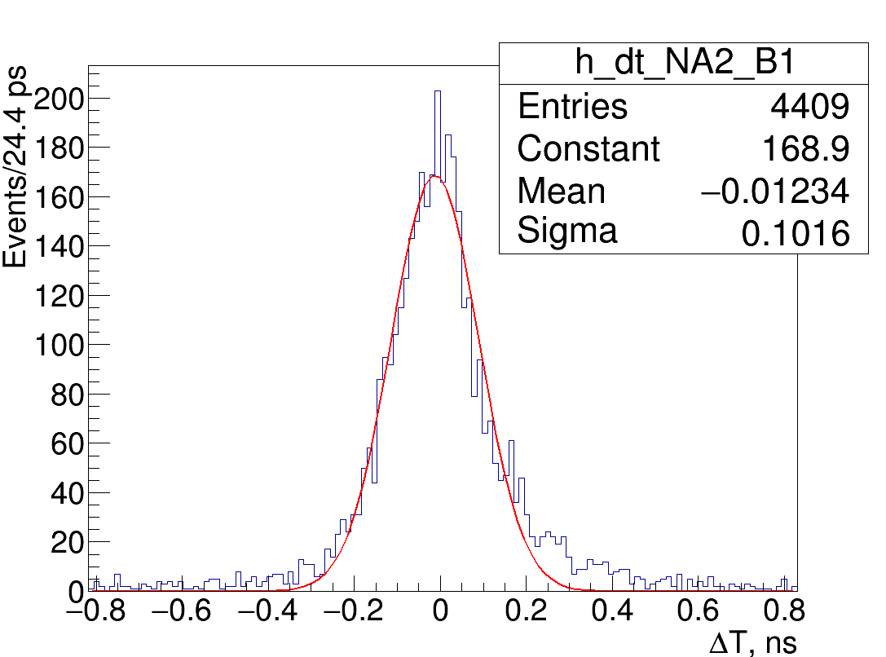
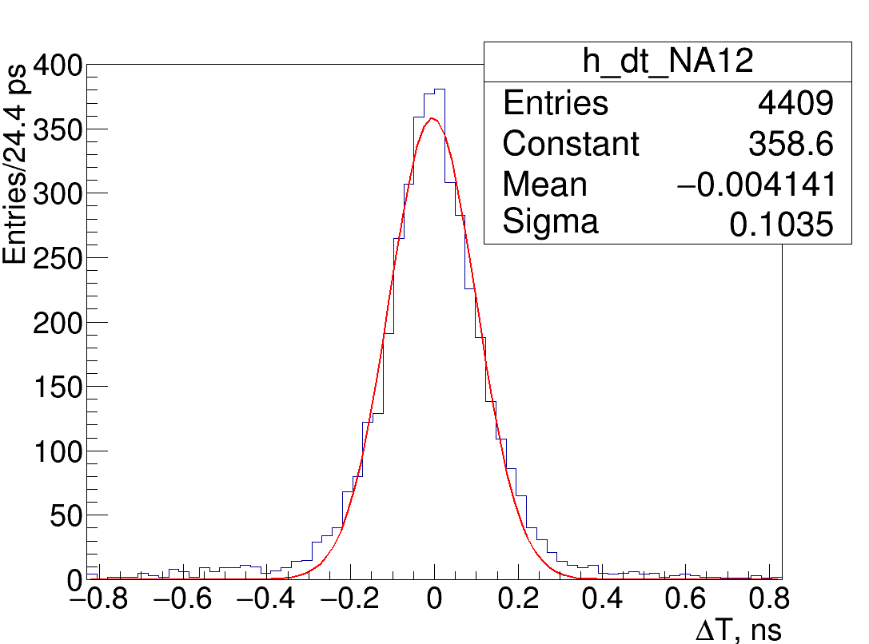
Time resolution for all tracks (11.25 kV)
$$\left\{\begin{aligned}σ_{p1}^{2}+σ_{s}^{2}={92.1}^{2} ps \\ σ_{p2}^{2}+σ_{s}^{2}={101.6}^{2} ps \\ σ_{p1}^{2}+σ_{p2}^{2}={103.5}^{2} ps\end{aligned}\right.$$
$$σ_{p1}=66.7 ps −Pad 1$$
$$σ_{p2}=79.1 ps −Pad 2$$
$$σ_{s}=63.6 ps −Strip$$

Slide 14
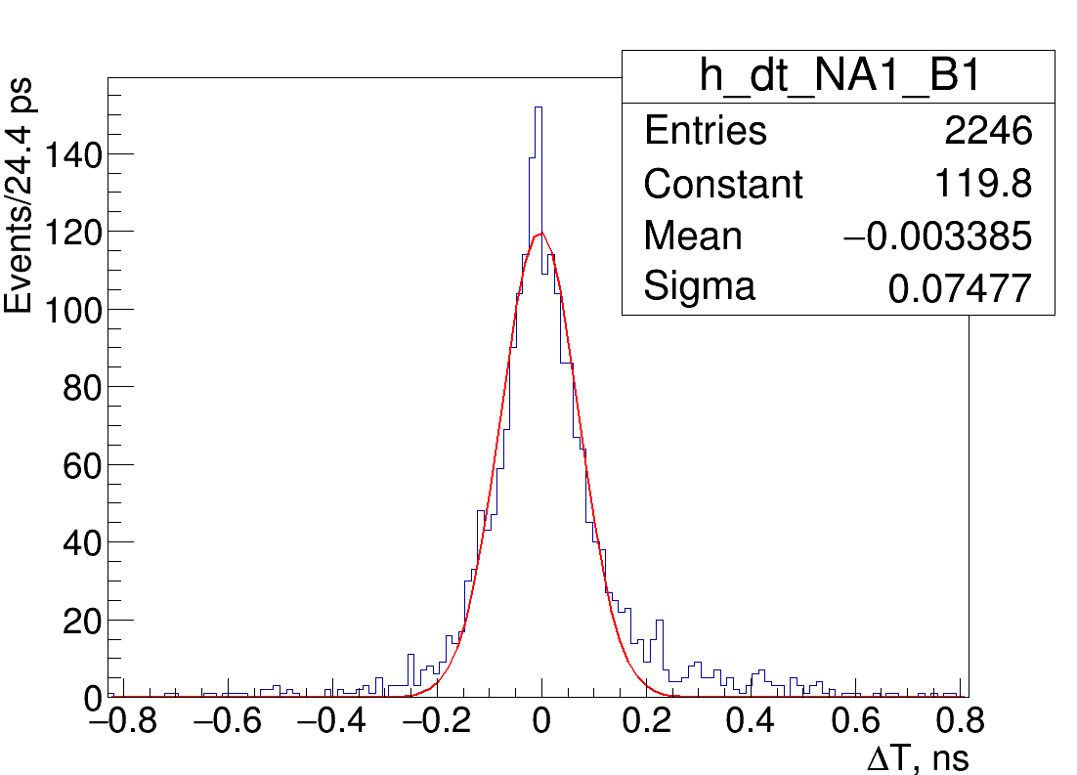
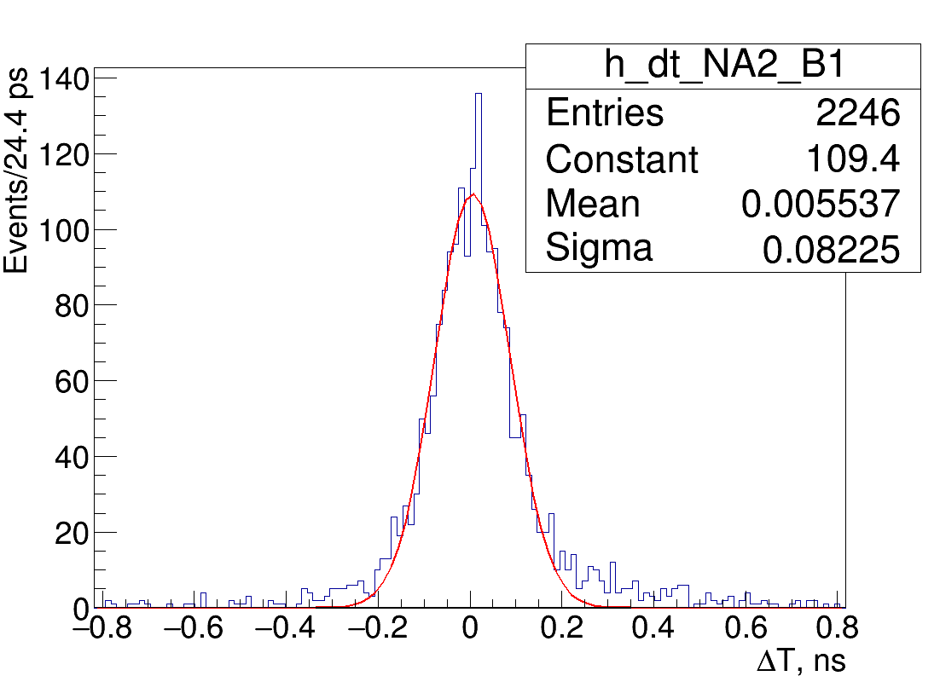
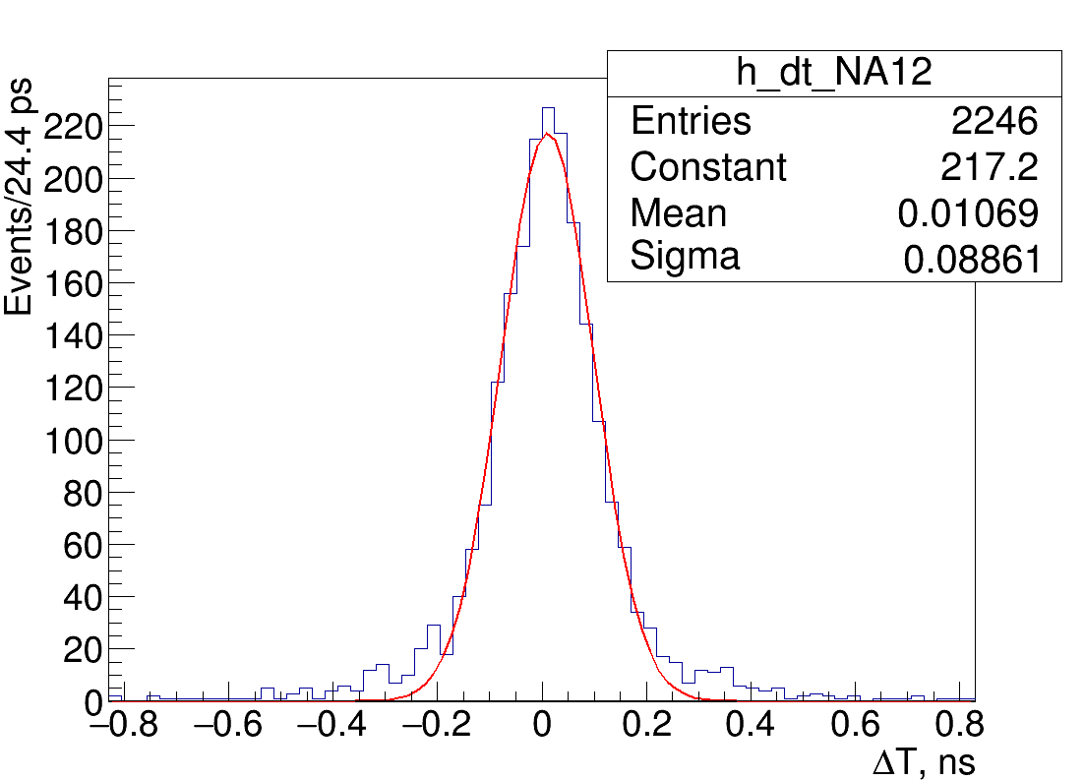
The best time resolution for straight tracks (11.25 kV)
$$\left\{\begin{aligned}σ_{p1}^{2}+σ_{s}^{2}={74.8}^{2} ps \\ σ_{p2}^{2}+σ_{s}^{2}={82.3}^{2} ps \\ σ_{p1}^{2}+σ_{p2}^{2}={88.6}^{2} ps\end{aligned}\right.$$
$$σ_{p1}=57.8 ps −Pad 1$$
$$σ_{p2}=67.2 ps −Pad 2$$
$$σ_{s}=47.5 ps −Strip$$

Slide 15
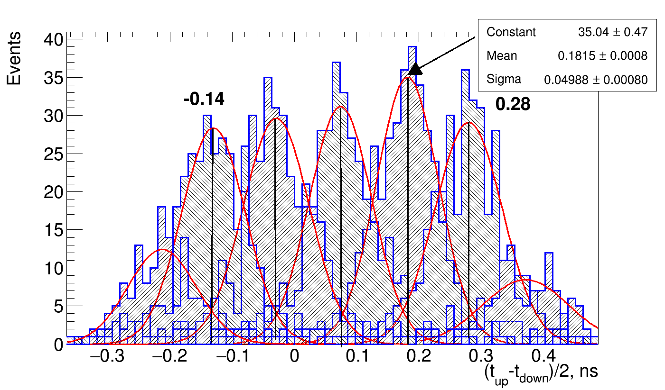
Position resolution of the strip MRPC
Time difference T_{up} – T_{down} in accordance of particle position.
Each peak – image of the pad on the strip (pitch of pads is 1.75 cm).
Signal velocity on the strip – (0.28+0.14)/4 = 60 ps/cm.
Position resolution of the strip MRPC can be evaluated from distribution for one pad:
Can be improved with TOT correction
Measured σ_{spatial}
of the pad
σ of uniform
distribution
of the pad

Slide 16
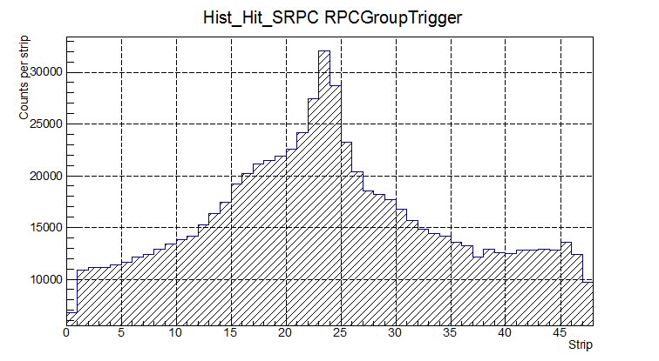
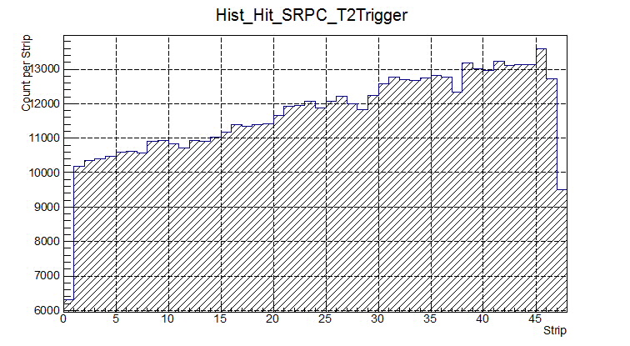
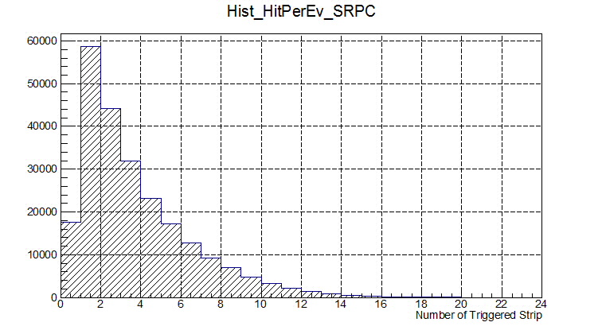
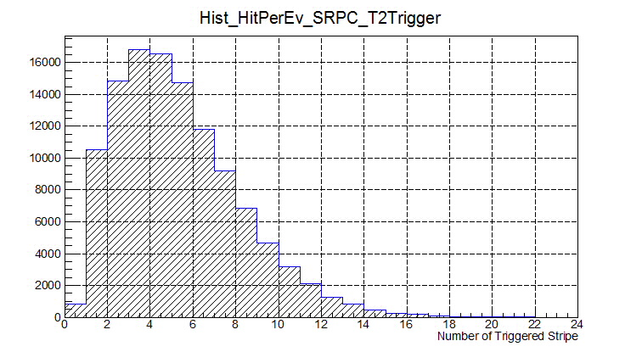
RPC Group own trigger
Pb+Pb (30 GeV/u)
T2 (Central Collisions)

Slide 17
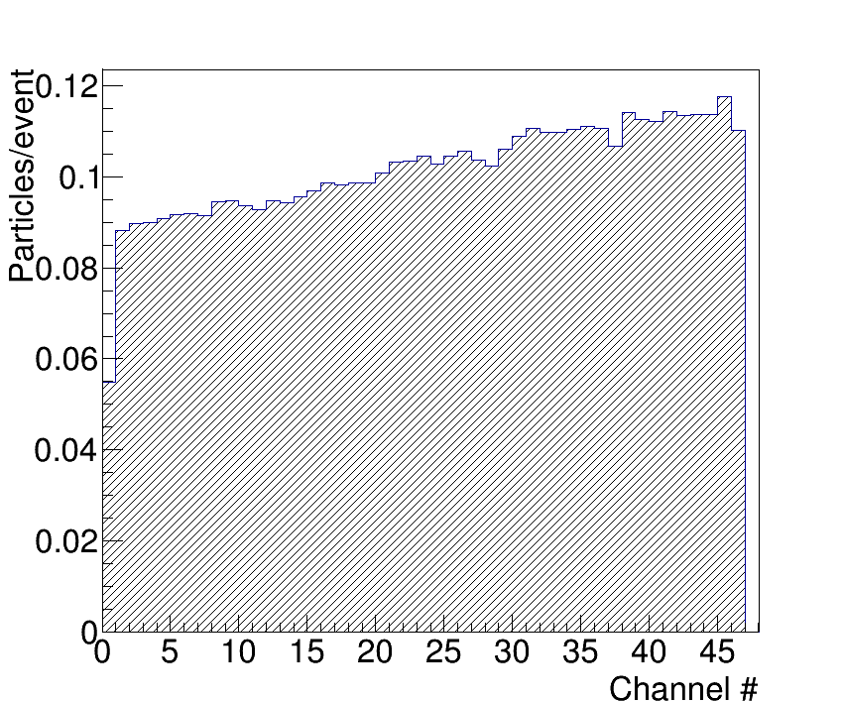
Occupancy estimation…
~ 10% of occupancy

Slide 18
Preliminary cost estimation
 | Price/ch, € | Price/1m², k€ (576 ch)
FEE (NINO base) | 12 | 6.9
TDC (HPTDC base) | 32 | 18.4
Detectors (48 strips, 96 ch) | 15 | 8.6
Crates, signal cables | 52 | 30.0
LV, HV, cabling | 16 | 9.2
Space frame, mechanical construction, gas box | 7 | 4.0
Total | 134 / channel | 77.1 k$ / 1 m²

