Slide 1
Gas mixing calibration by counting bubbles !
Ian, taken from NA61 slides on mRPC
By V. Babkin
https://cernbox.cern.ch/s/KGTLVzci0s9fZaG
18 July 2023

Slide 3
Method
Set up the system as shown ready for chamber operation. Choose the calibrated glass tubes to correspond to the approximate ratio of the desired mixture, in this case 95:5 ~ 20:1. This can be taken for a low value, say 0.2l/h of the SF6 (range 0.1-1.3l/h) and a high value (say 4l/h)of the R134a (range 0.5-5l/h)
Turn on the R134a gas supply.
Adjust the flow controller (Rotameter) to the lowest graduated value and count the bubbles in 1 or 10 minutes. Repeat 10 times.
Adjust the flow controller to the next graduated value and repeat the bubble count.
Continue to the highest value.
Stop the gas.
Repeat for the SF6 and any other gases if required.
Plot the data and obtain the calibration factor for each graduated value of each gas. See below plots made by NA61 collegues Vadim Babkin and communicated by
.
Chambers

Slide 7
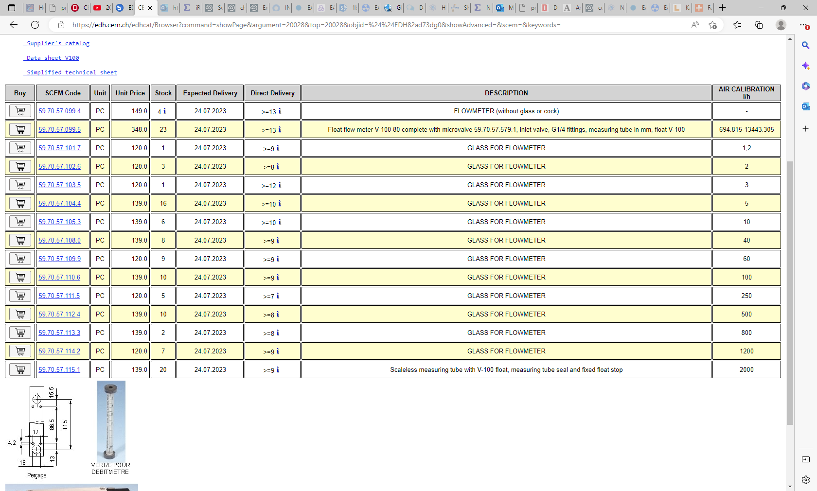

Slide 8
https://www.researchgate.net/publication/41592514_Bubble_counter_system_for_monitoring_gas_flows_in_hadron_calorimeters_and_muon_chambers

Slide 9
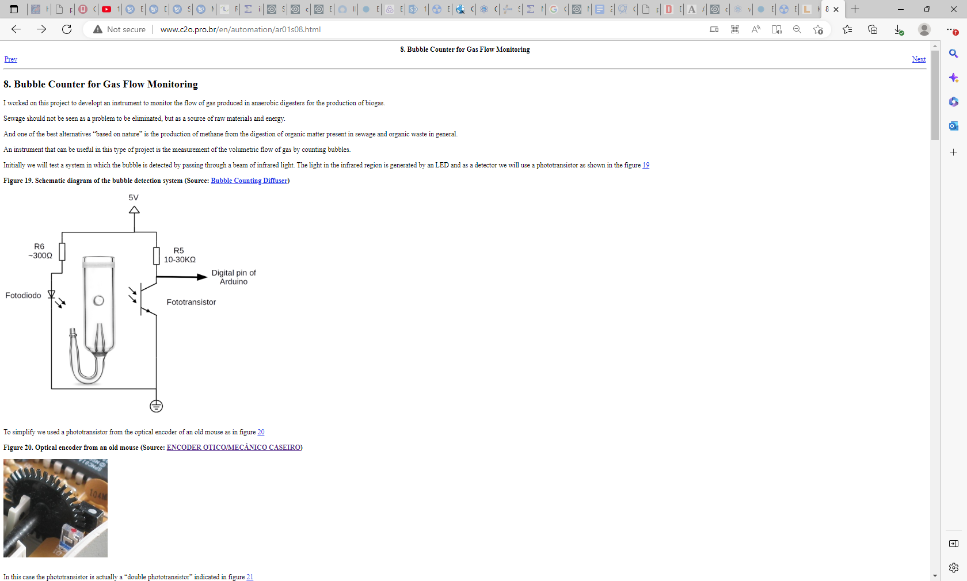
http://www.c2o.pro.br/en/automation/ar01s08.html

Slide 10
https://www.housedillon.com/posts/homebrew-bubble-counter/

Slide 11
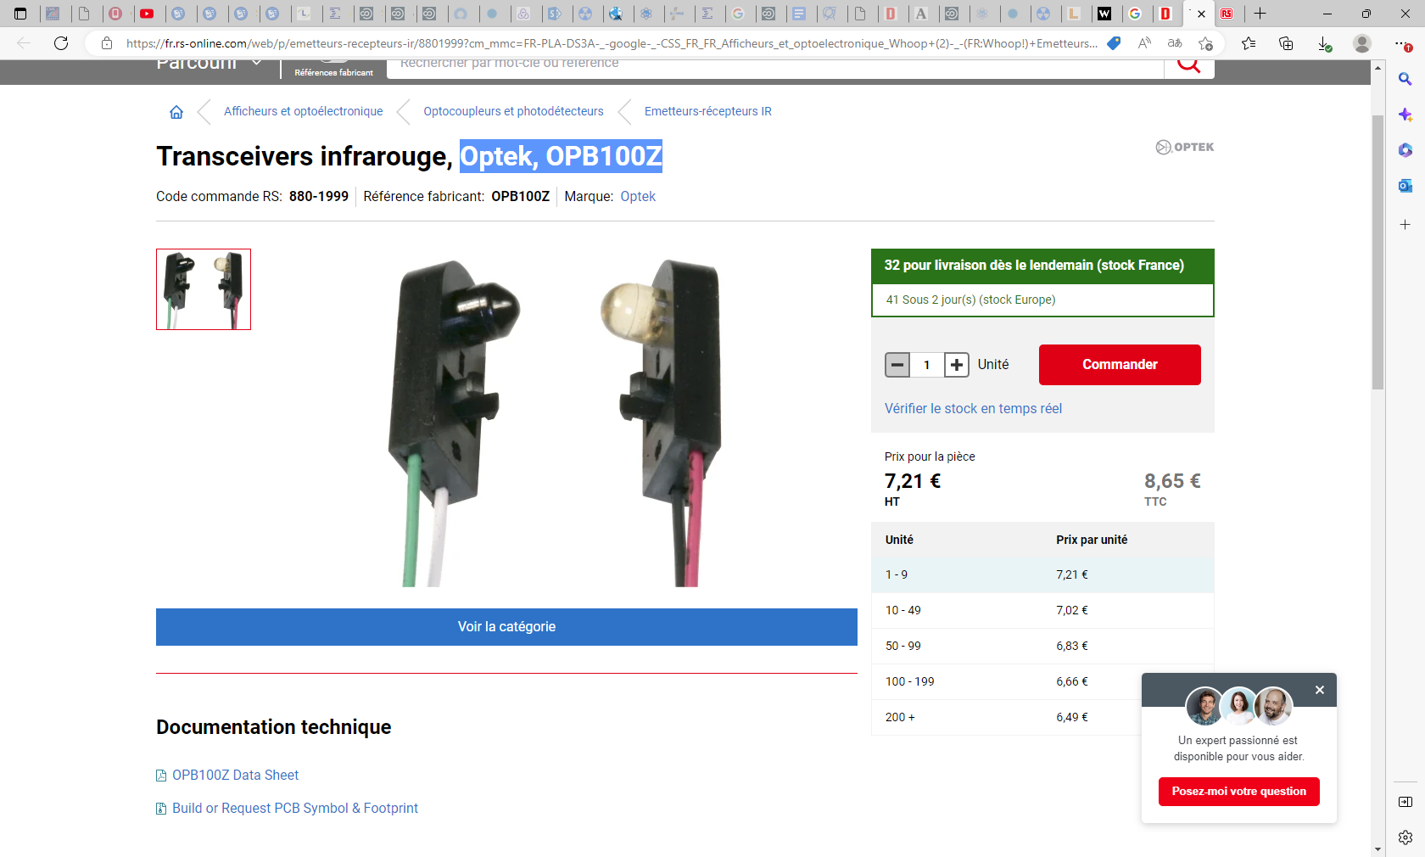

Slide 13
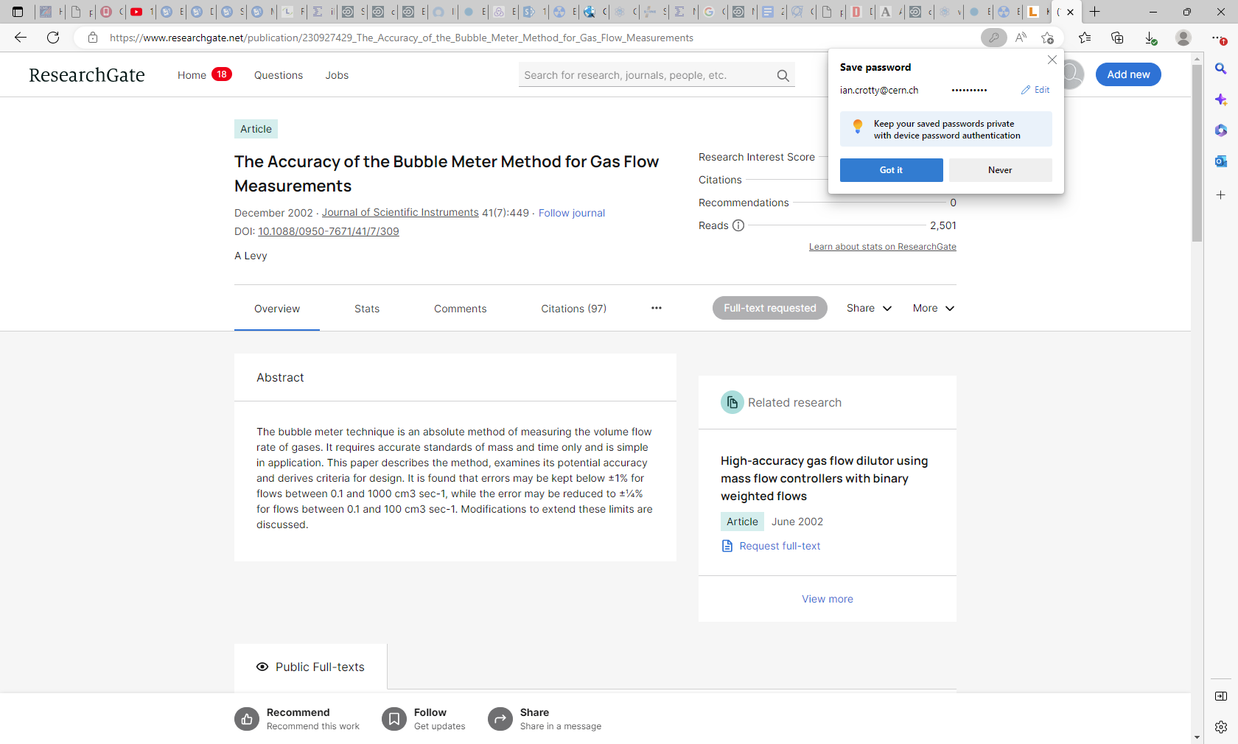
https://www.researchgate.net/publication/230927429_The_Accuracy_of_the_Bubble_Meter_Method_for_Gas_Flow_Measurements

