Slide 1
Ambient P5 UXC
2 Nov 2015
All plots are taken over 10 days duration unless otherwise stated

Slide 2
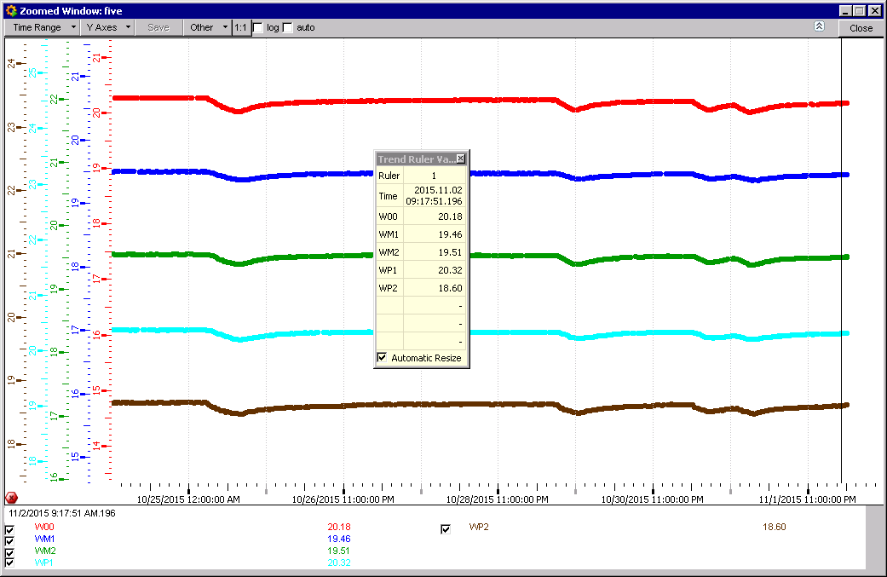
RB Temperatures

Slide 3
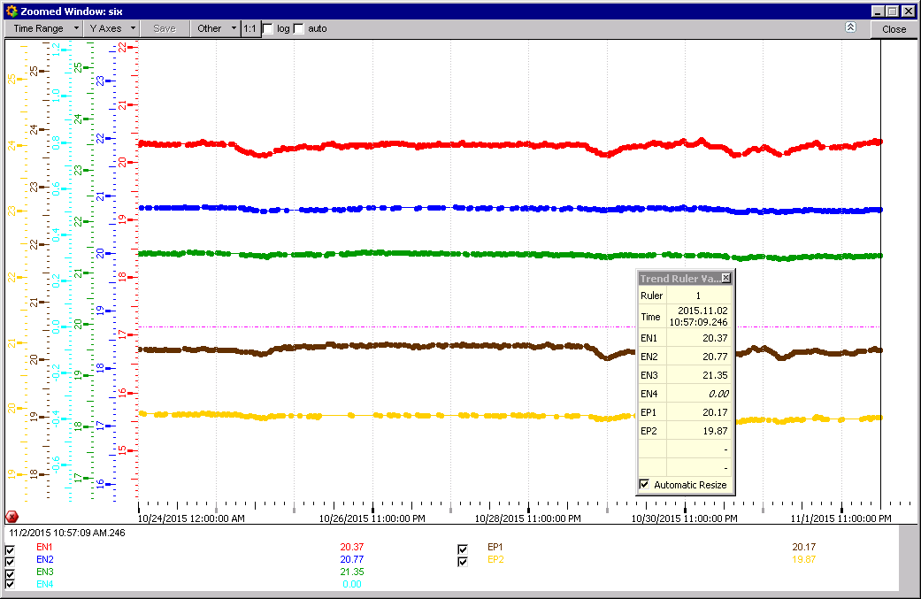
RE Temperatures

Slide 4
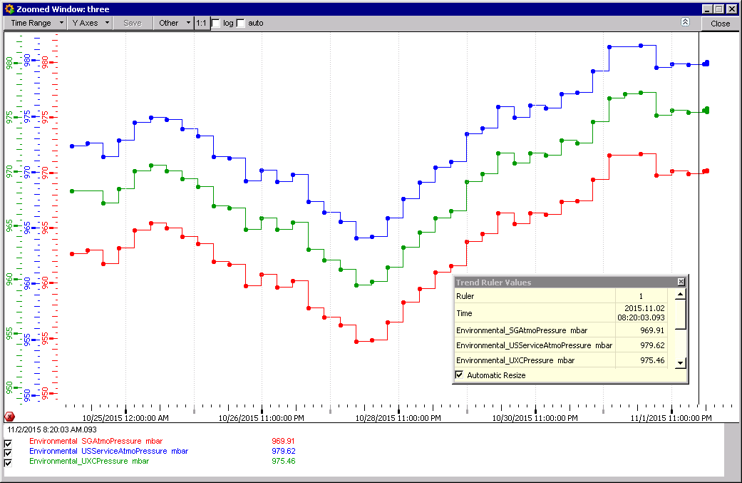
Abs Pressure differences surface & caverns
4 mbar difference maintained between USC & UXC so avoiding contamination

Slide 5
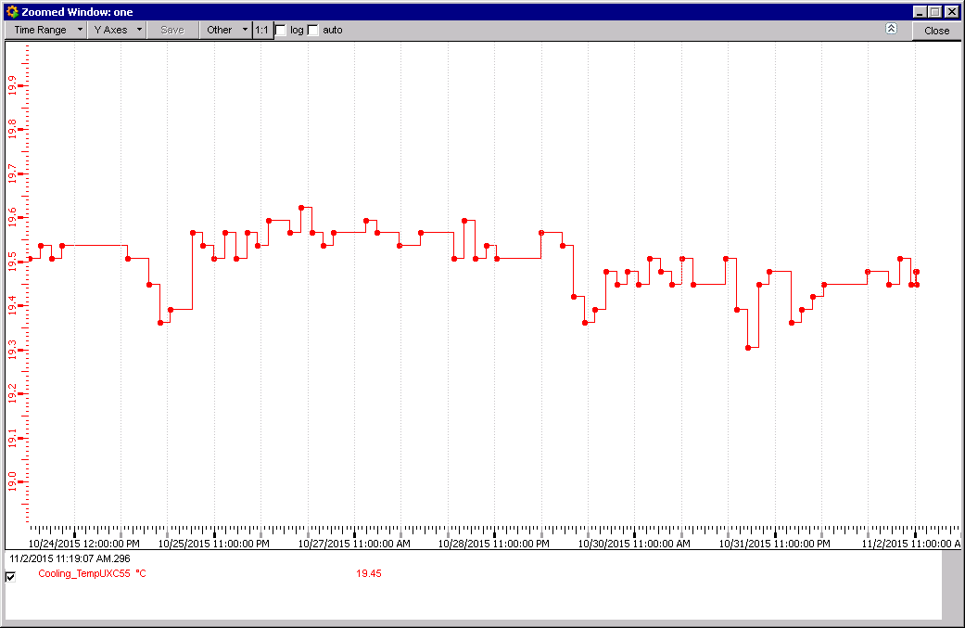
Ambient temp UXC55 cavern

Slide 6
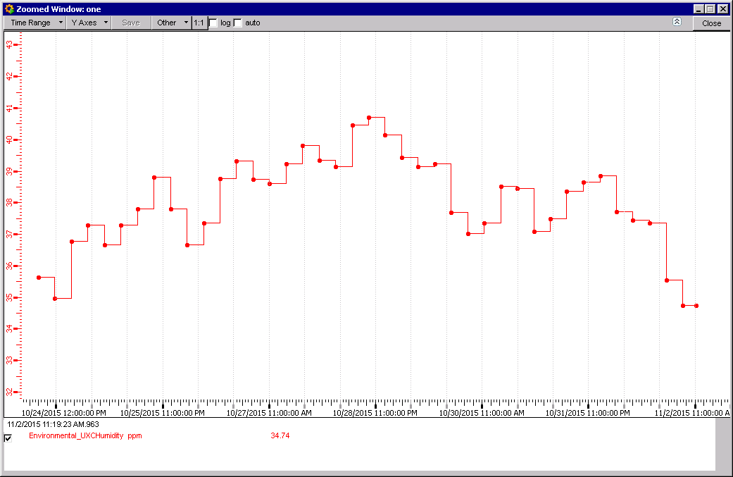
Ambient RH UXC55 cavern
RH is low as the temperatures on the surface are low.

Slide 7
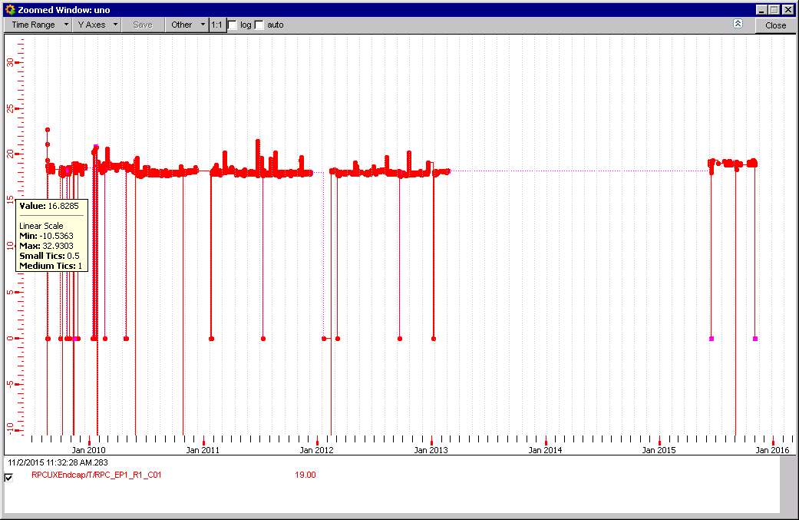
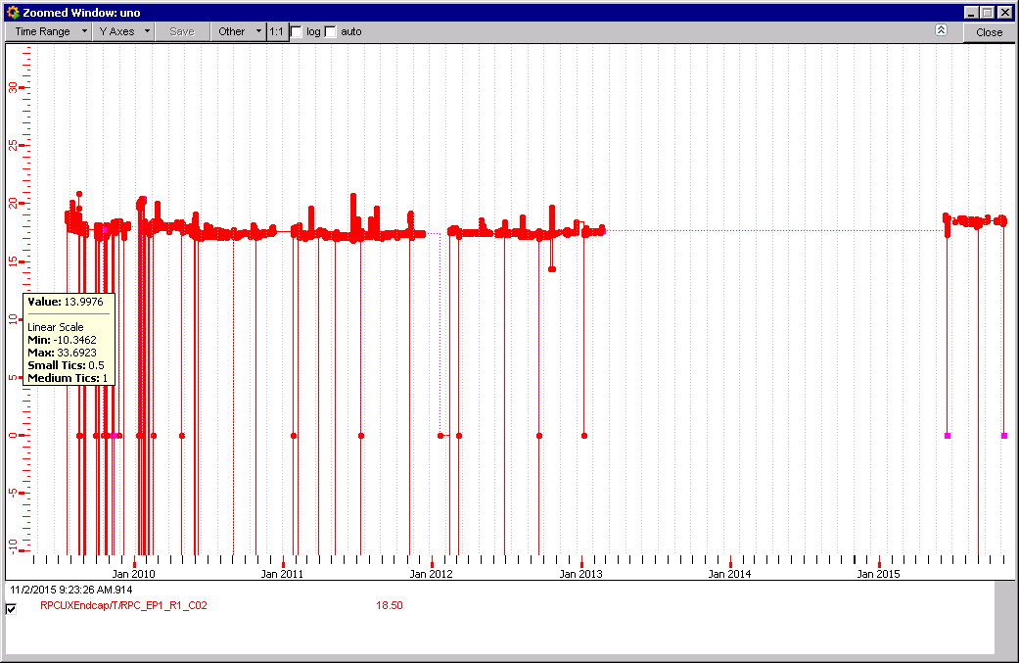
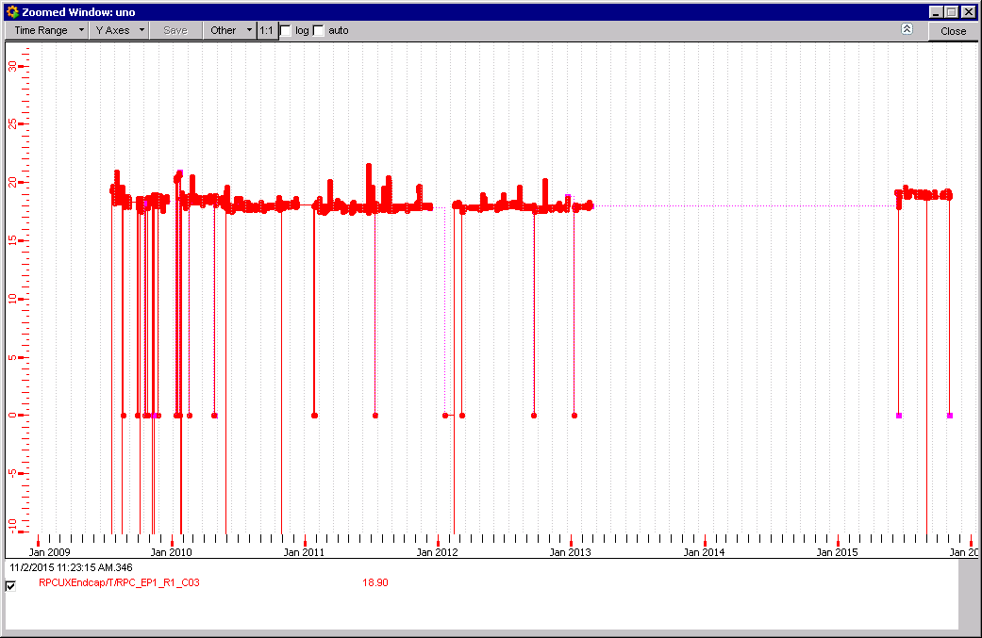
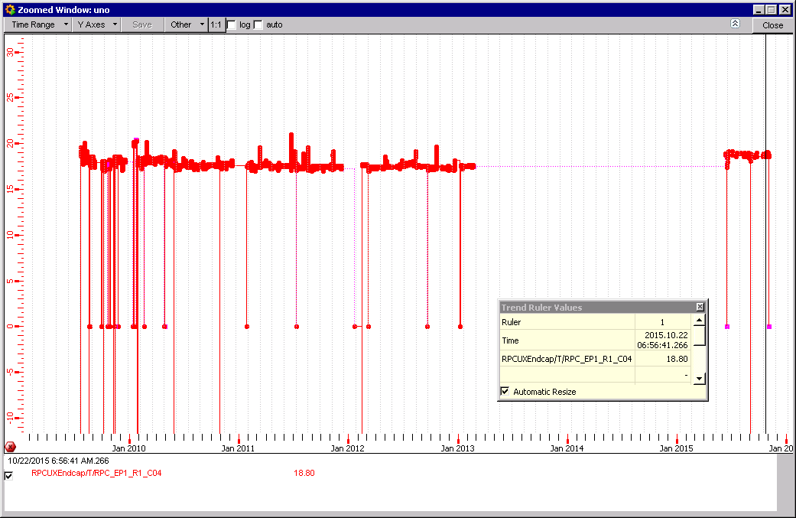
Time since Jan 2010
RE1/1 chambers Temperatures.
Temp. very cool & stable at 19degC

Slide 8
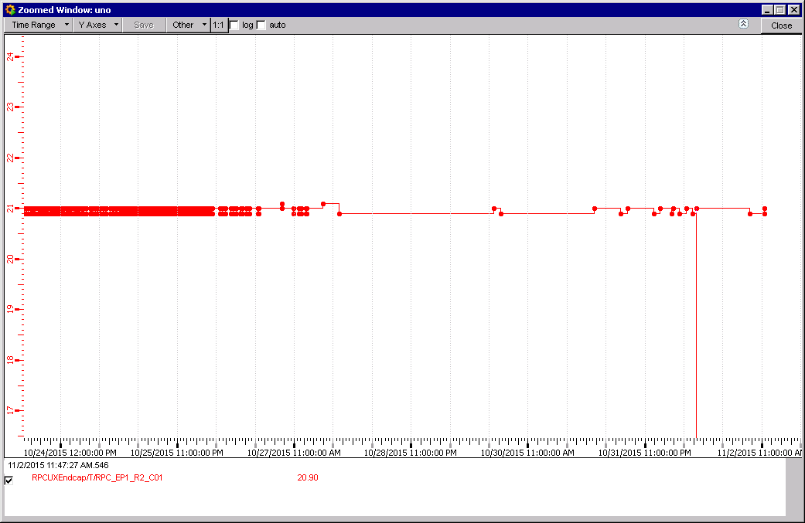
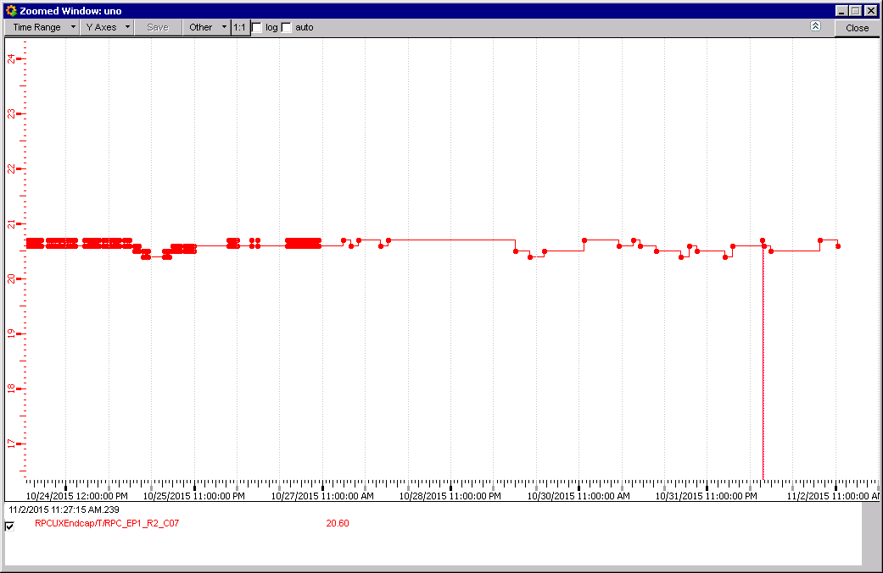
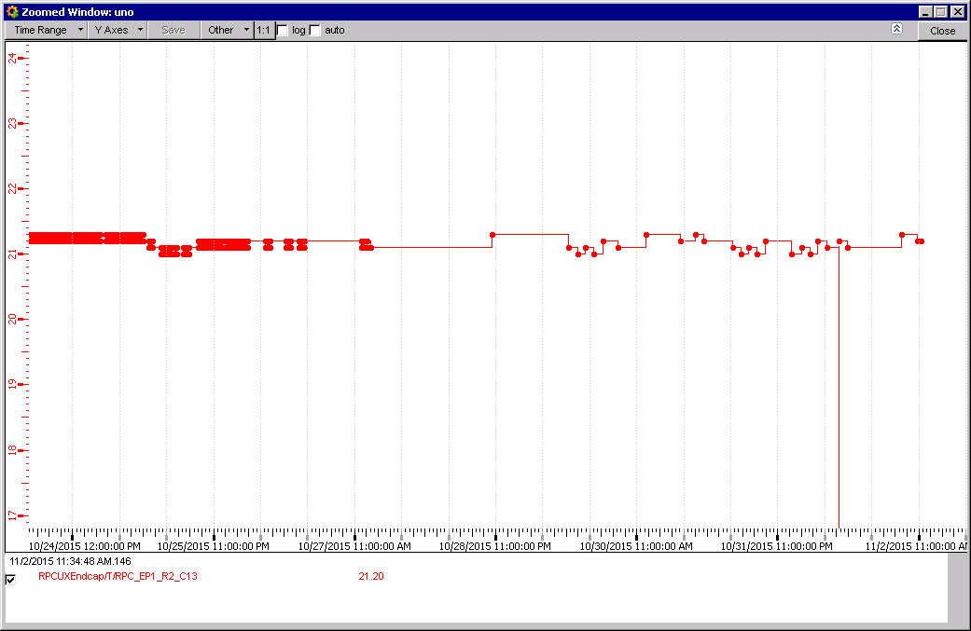
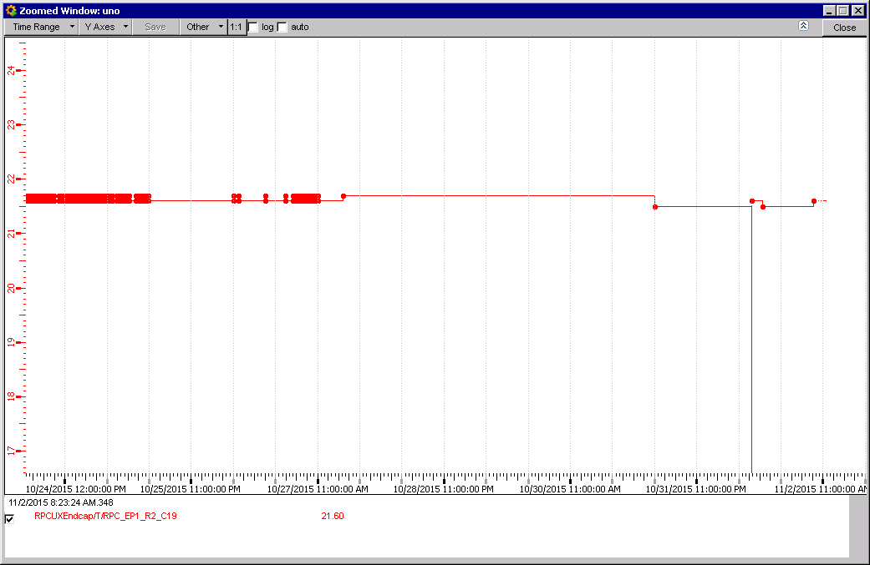
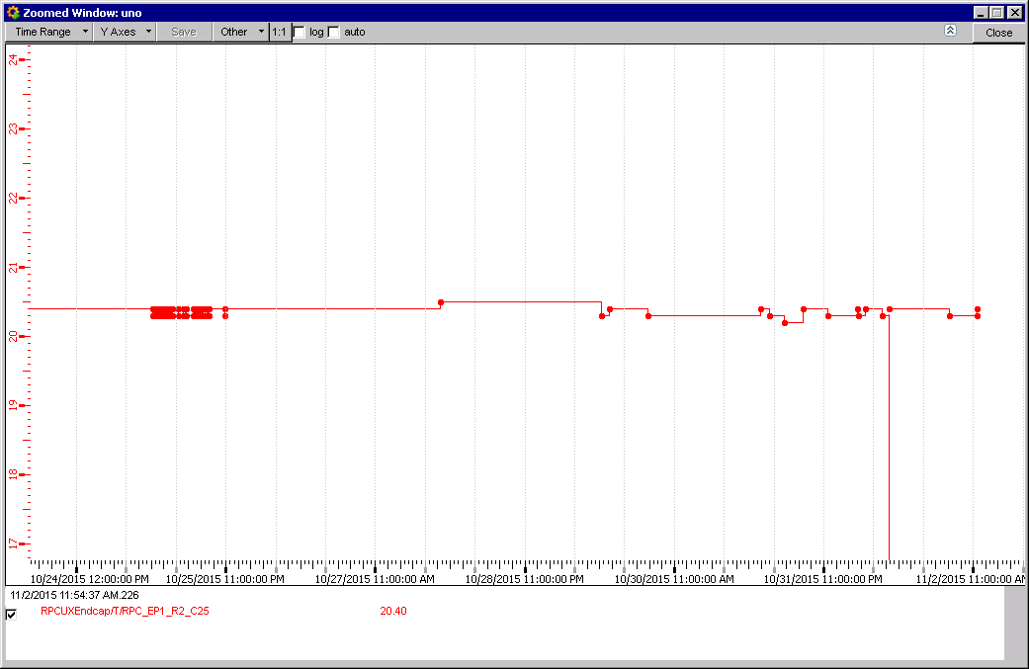
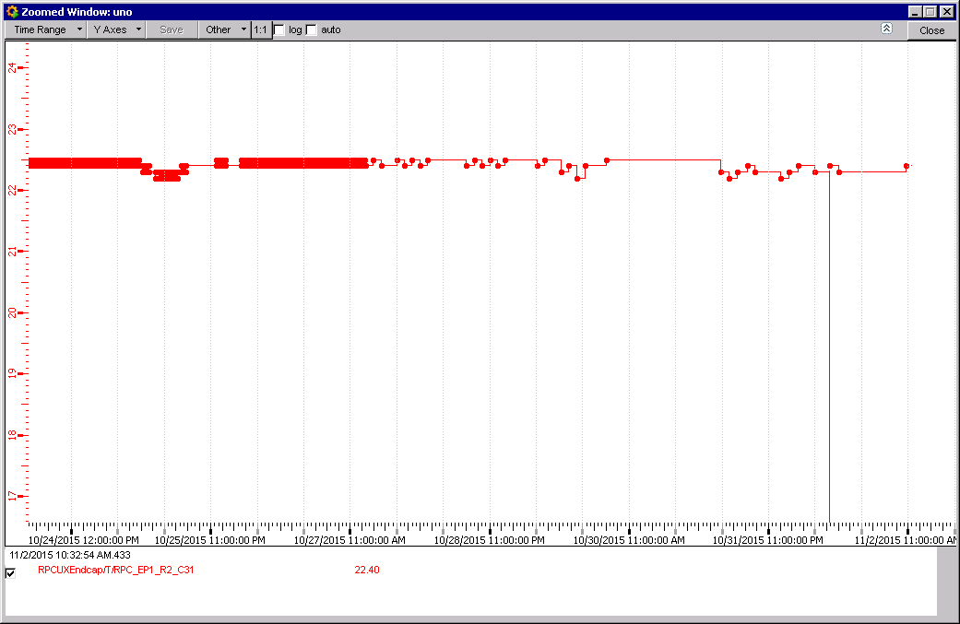
RE+1/2/01 Temp. 20.9degC
RE+1/2/07 Temp. 20.6degC
RE+1/2/13 Temp. 21.2degC
RE+1/2/19 Temp. 21.6degC
RE+1/2/25 Temp. 20.4degC
RE+1/2/31 Temp. 22.4degC

Slide 9
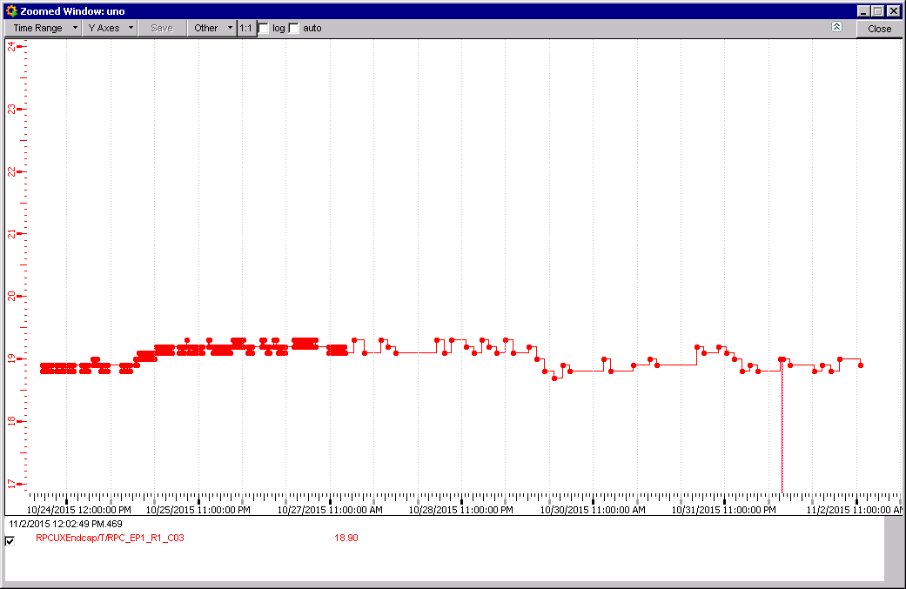
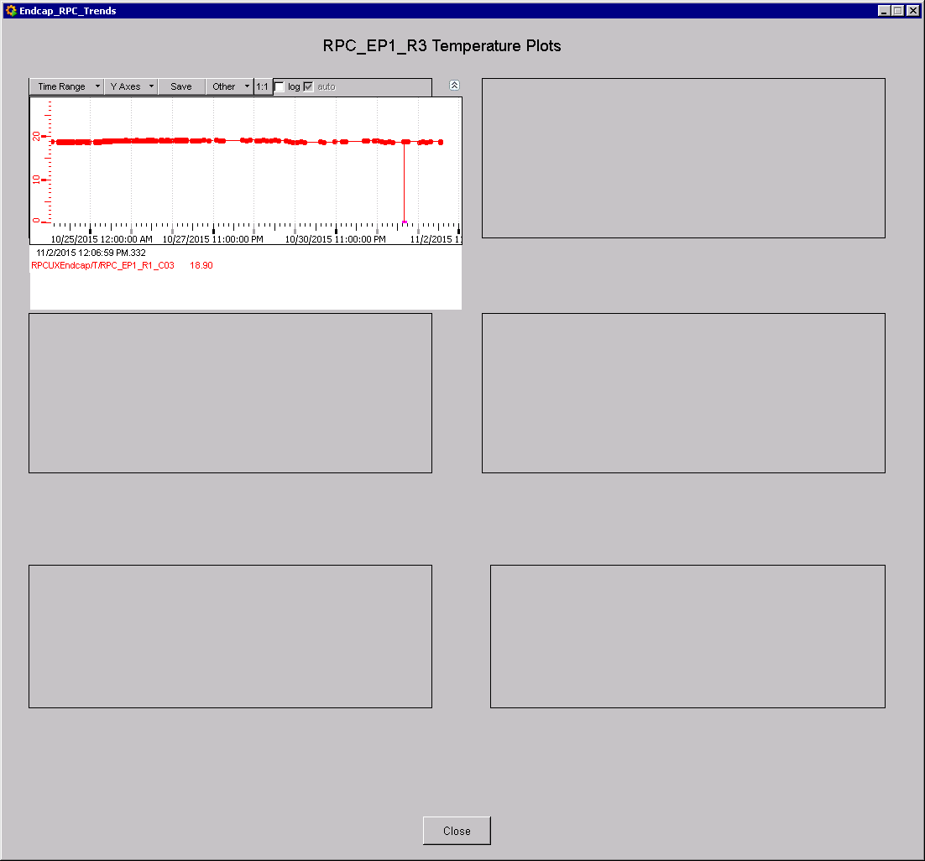
RE+1/3 Temperatures
RE+1/3/03?? Temp. 18.9degC
RE+1/3 only one sensor is logged with an incorrect name RE+1/1/03

Slide 10
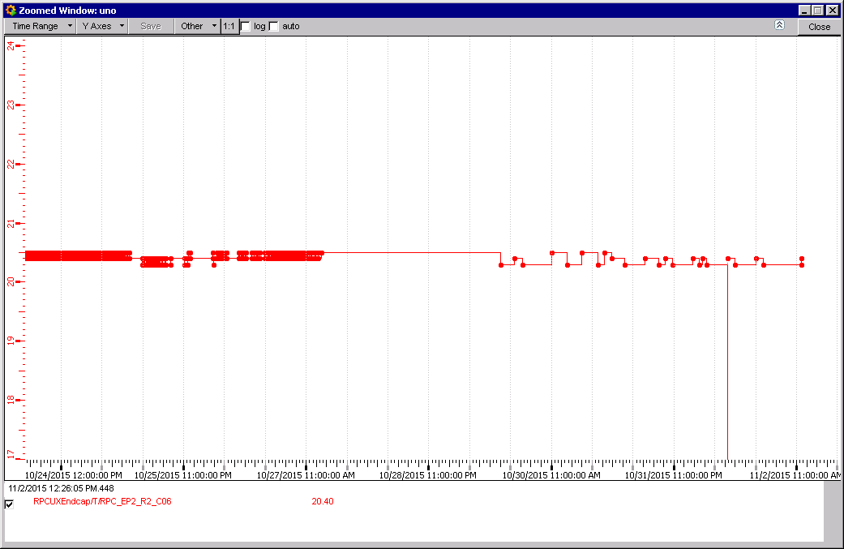
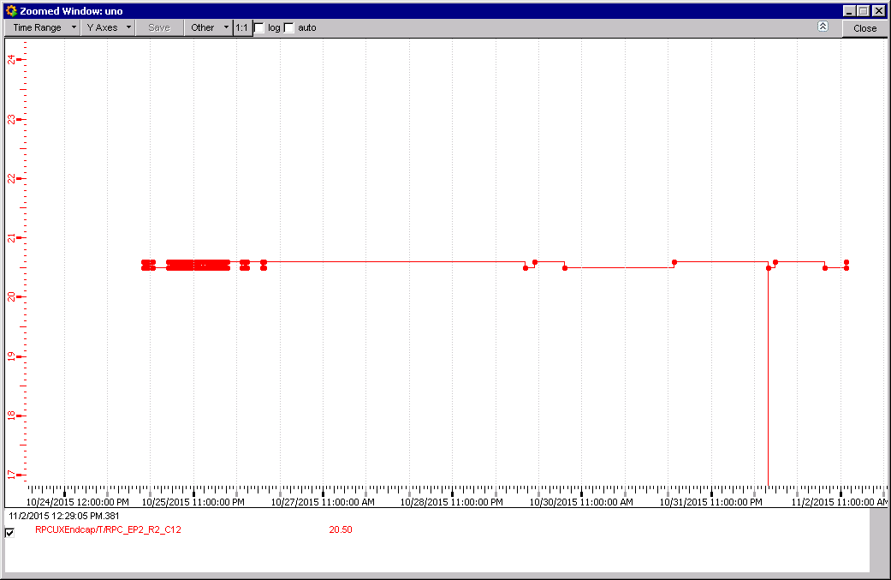
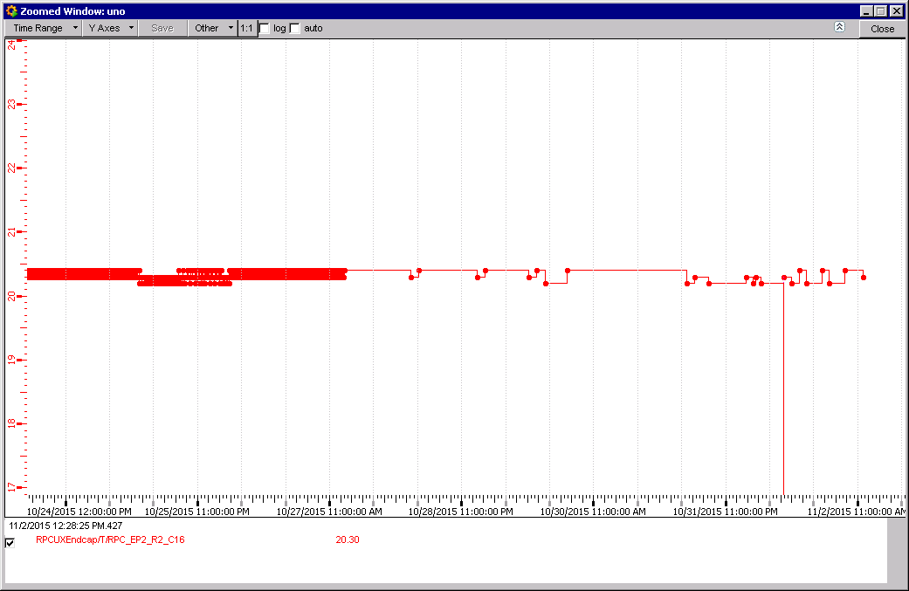
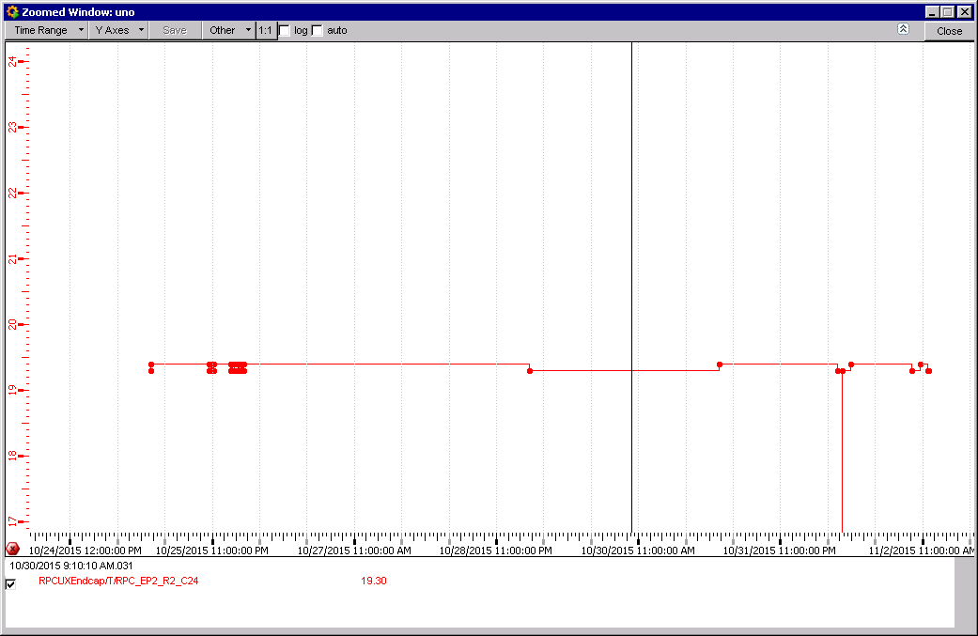
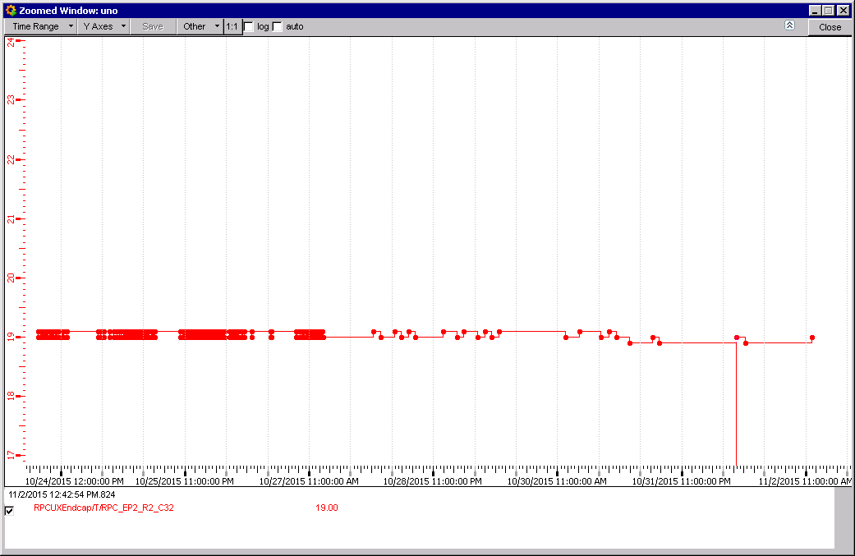
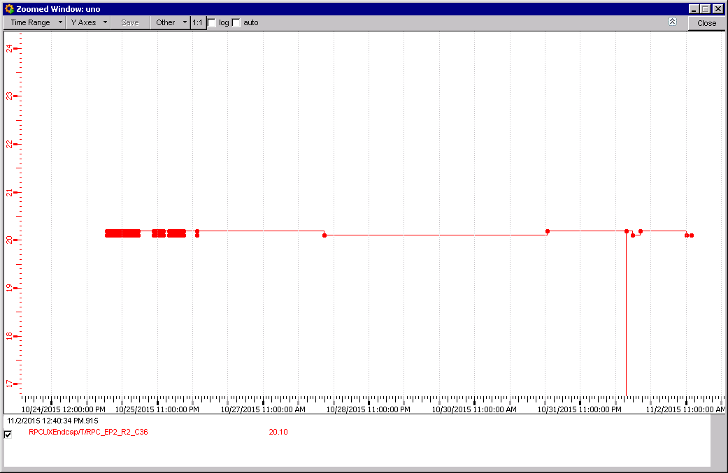
RE+2/2/06 Temp. 20.4degC
RE+2/2/12 Temp. 20.5degC
RE+2/2/16 Temp. 20.3degC
Cooler temps in the Near bottom region
RE+2/2/36 Temp. 20.1degC
RE+2/2/24 Temp. 19.3degC
RE+2/2/32 Temp. 19.0degC

Slide 11
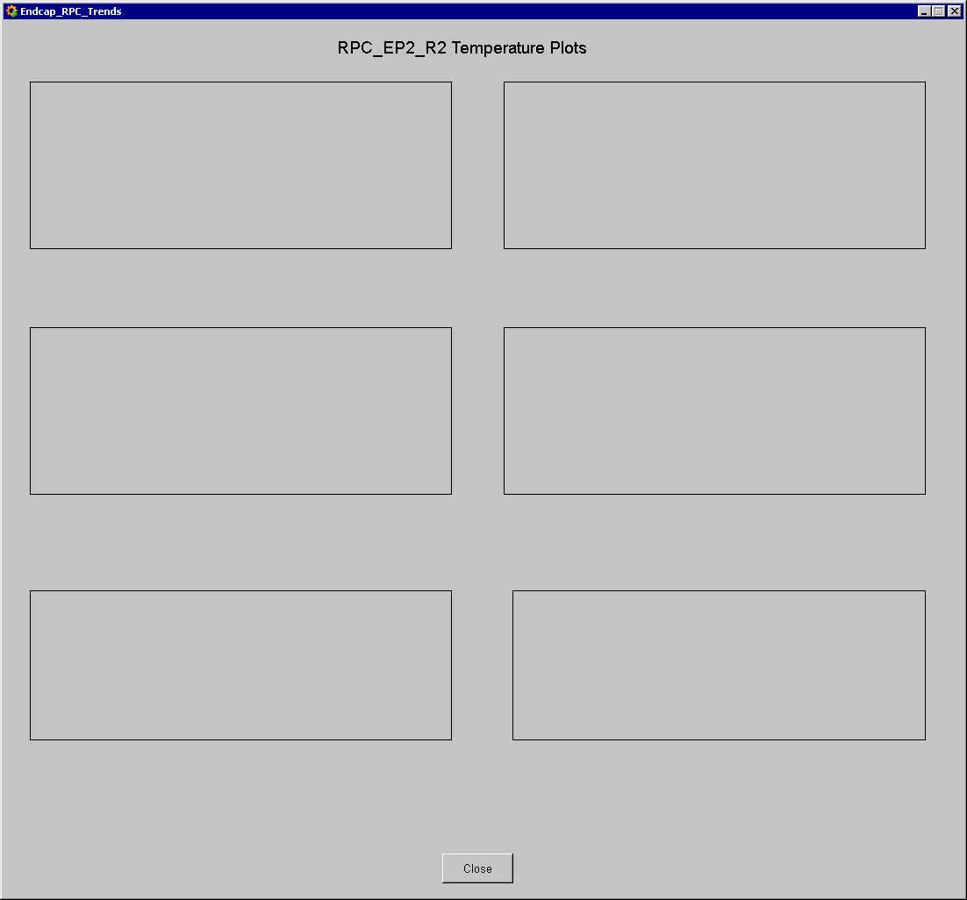
RE+2/2 & 3 Temp. FOS not available

Slide 12
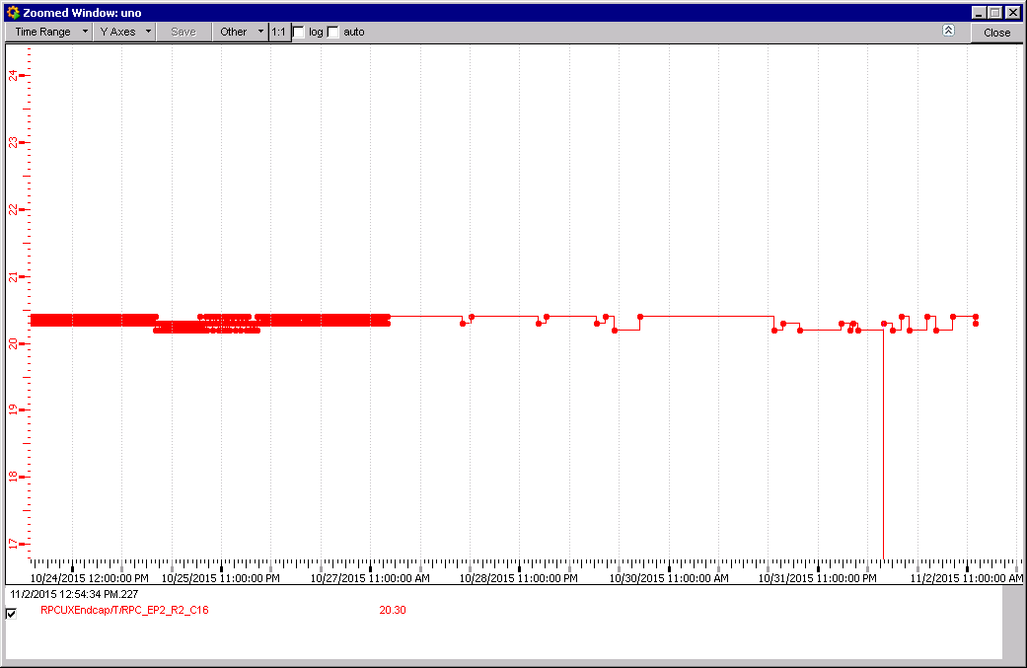
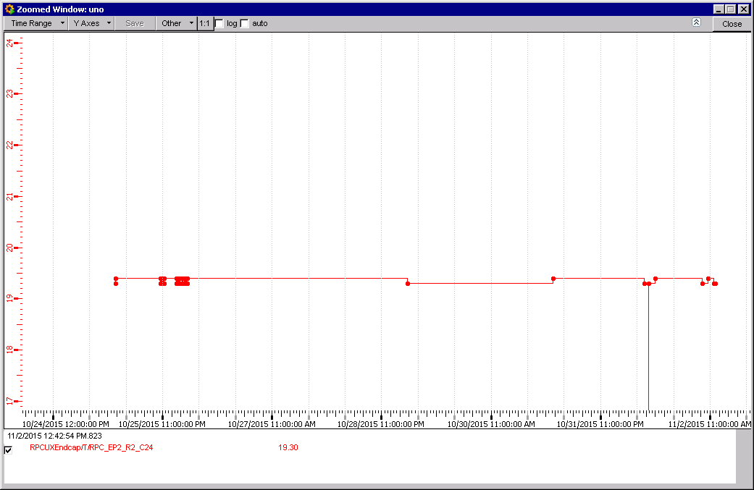
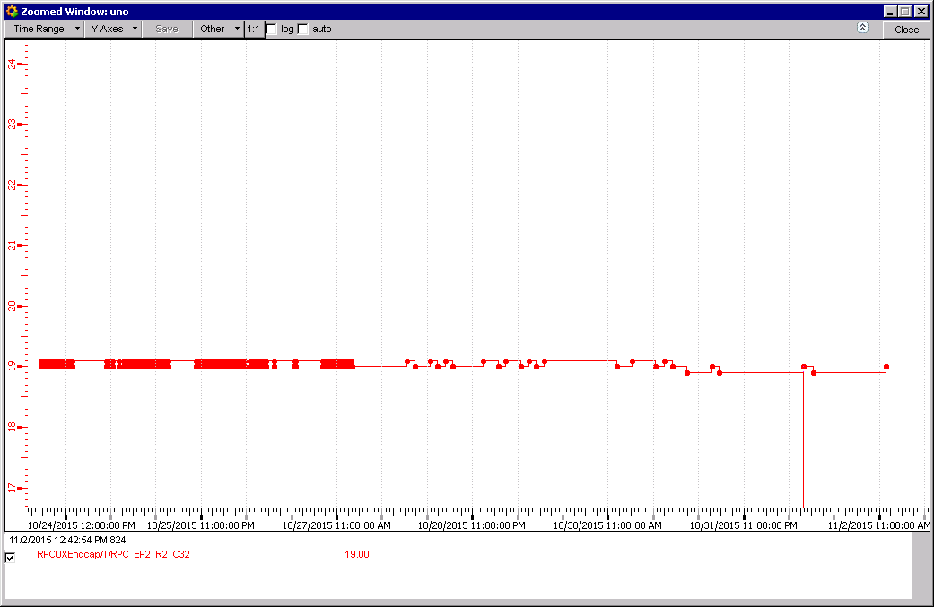
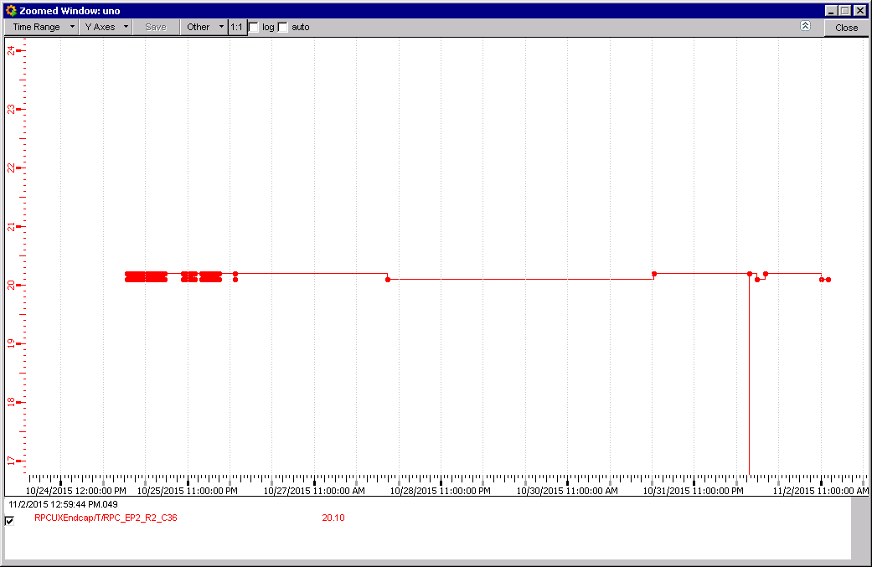
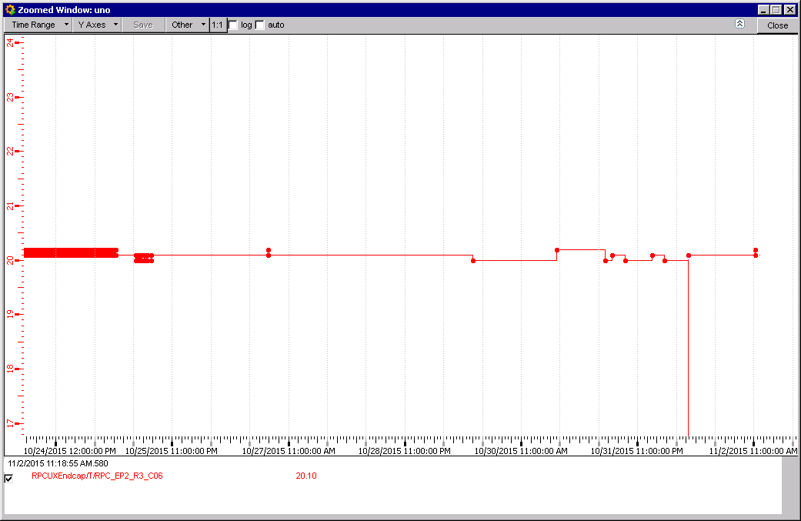
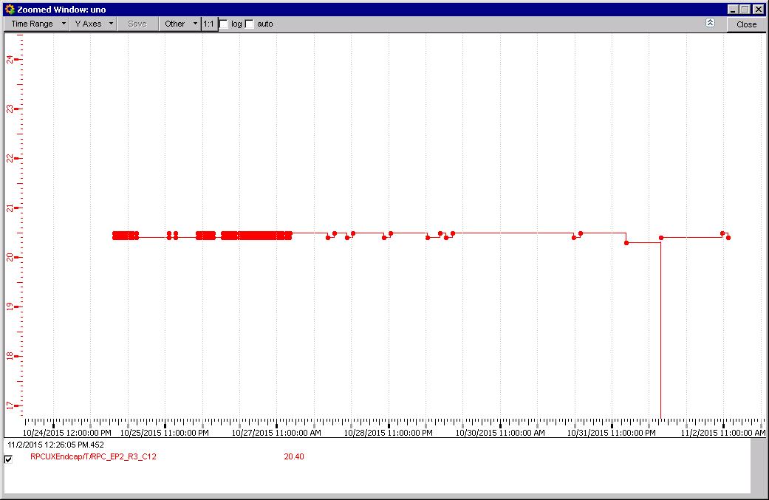
Cooler temps in the Near bottom region
RE+2/3/16 Temp. 20.3degC
RE+2/3/024 Temp. 19.3degC
RE+2/3/32 Temp. 19.0degC
Wrong naming RE2/2 rather than RE3/2
RE+2/3/36 Temp. 20.1degC
RE+2/3/06 Temp. 20.1degC
RE+2/3/12 Temp. 20.4degC

Slide 13
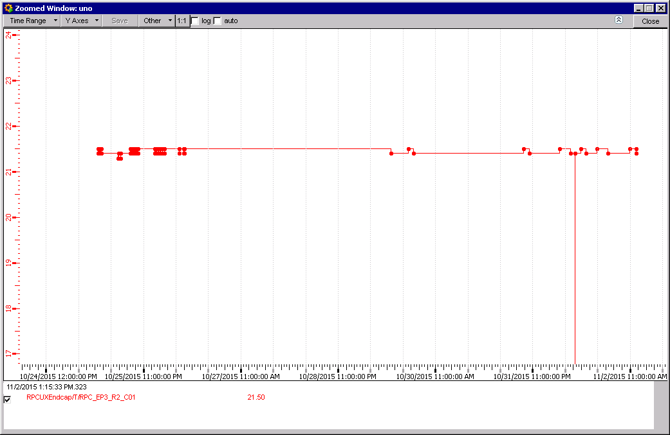
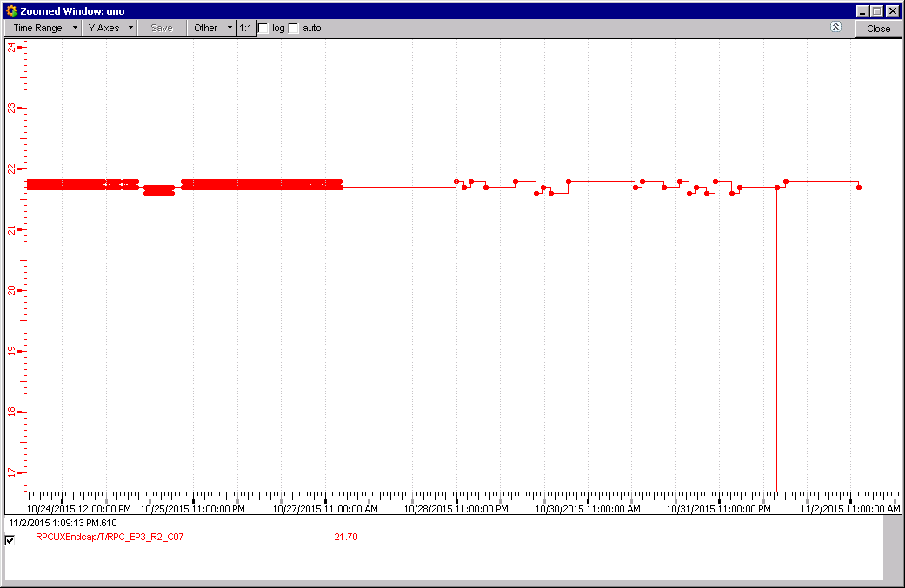
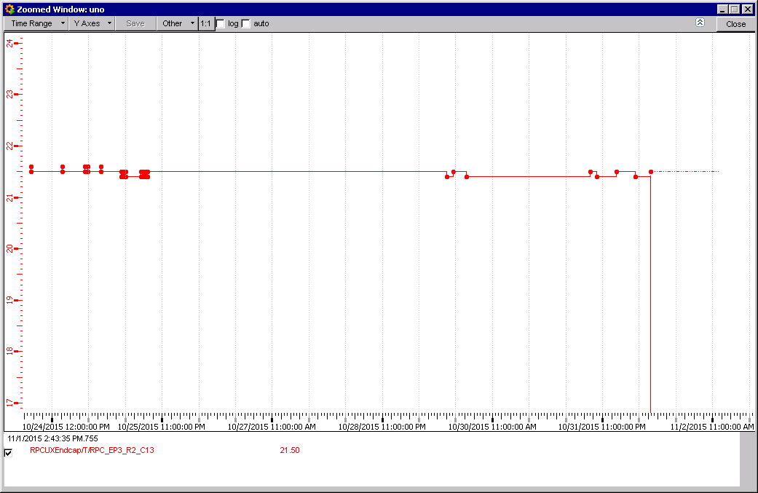
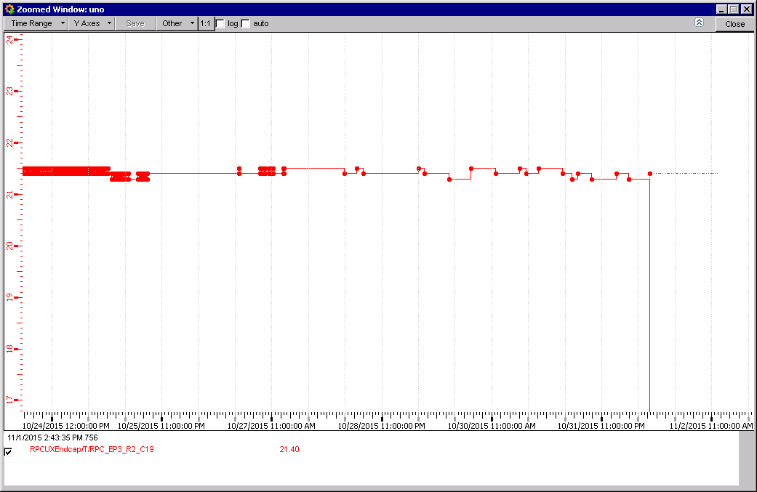
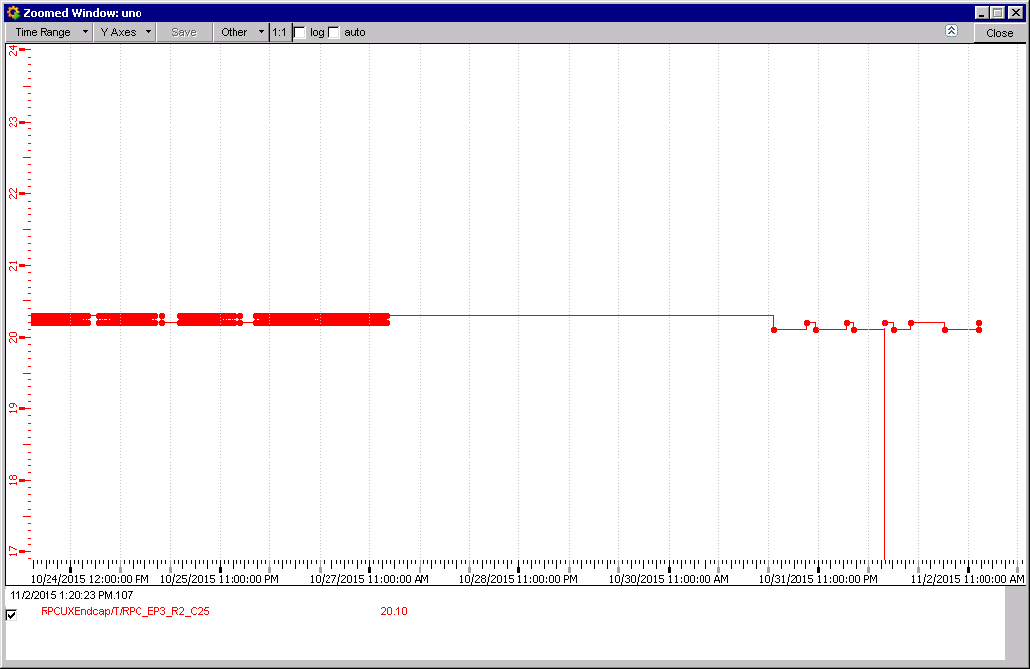
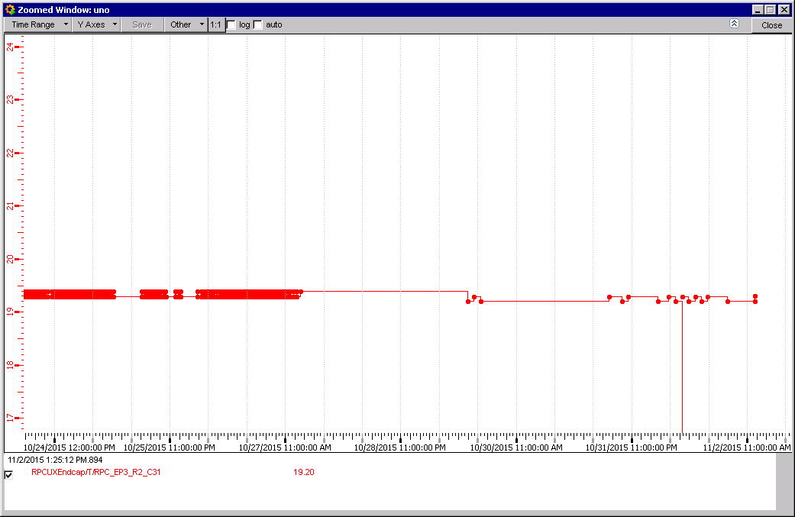
RE+3/2/01 Temp. 21.5degC
RE+3/2/07 Temp. 21.7degC
RE+3/2/13 Temp. 21.5degC
RE+3/2/25 Temp. 20.2degC
RE+3/2/31 Temp. 19.2degC
RE+3/2/19 Temp. 21.4degC
Cooler temps in the Near bottom region

Slide 14
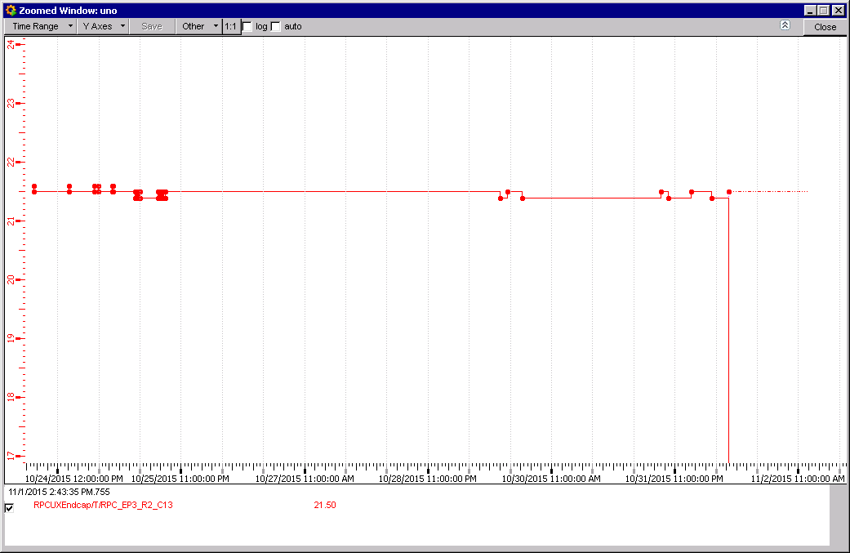
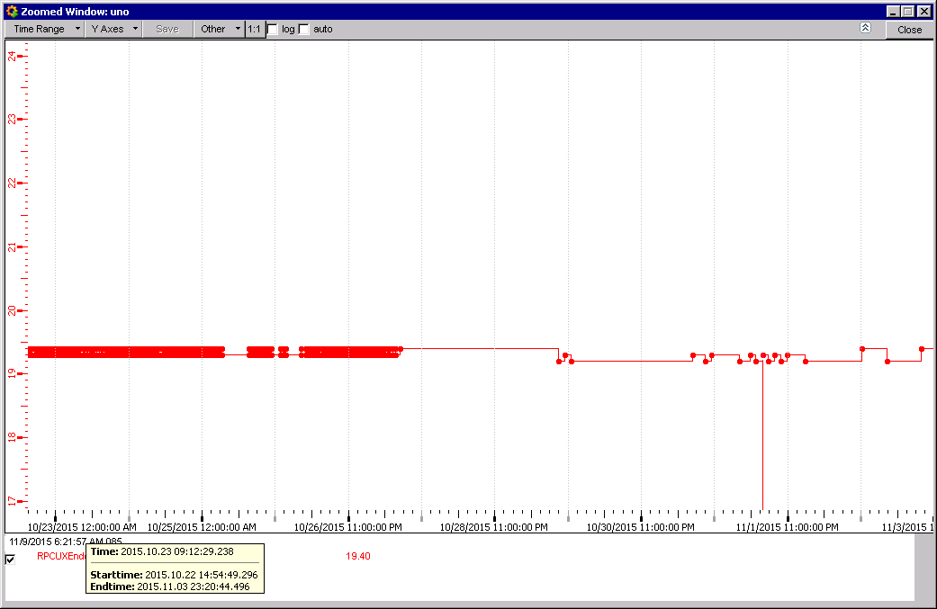
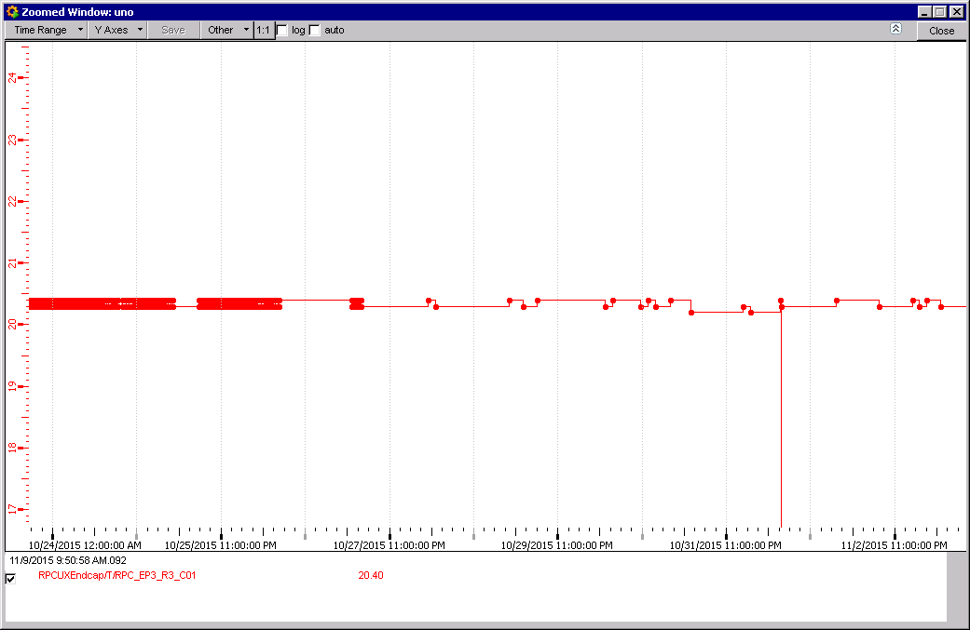
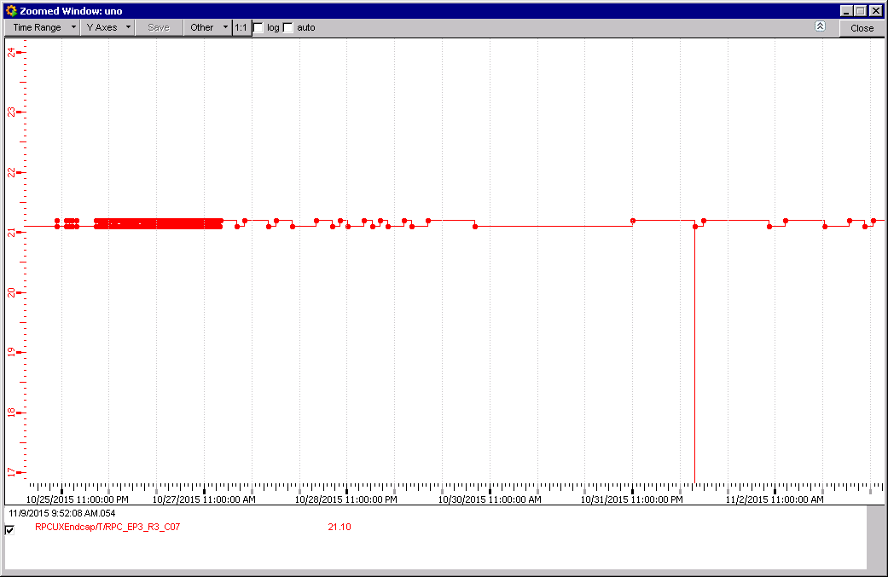
Wrong naming RE3/2 rather than RE3/3
RE+3/3/25 Temp. 20.2degC
RE+3/3/13 Temp. 21.5degC
RE+3/3/19 Temp. 21.4degC
RE+3/3/31 Temp. 19.4degC
RE+3/3/01 Temp. 20.4degC
RE+3/3/07 Temp. 21.1degC

Slide 15
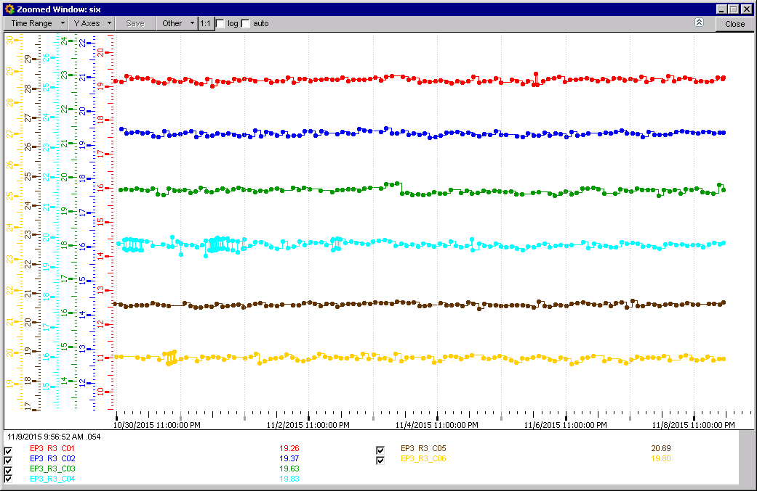
FOS temp Sensors
RE+3/3/1-6 Temp. 19.2-20.7degC

Slide 16
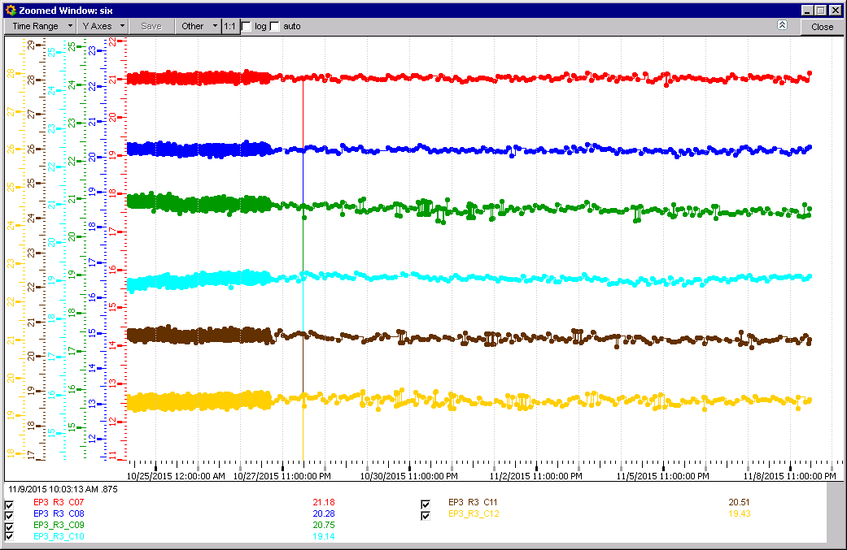

Slide 17
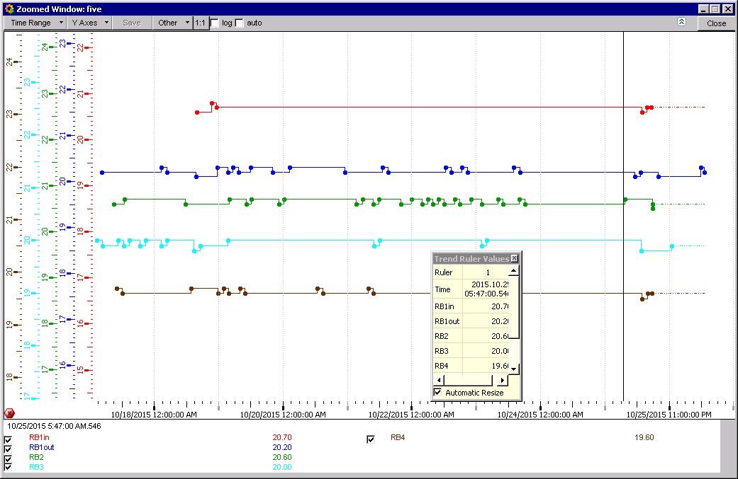
Temperatures. Wheel Zero Sector 12

Slide 18
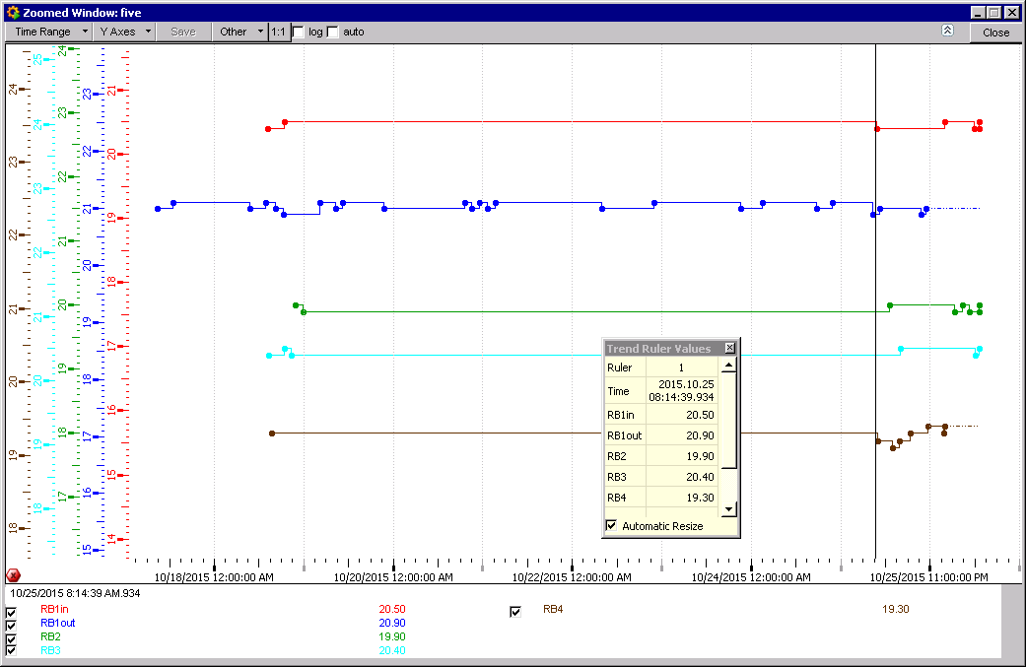
Wheel 0 Sector 8

Slide 19
We have lost RE+3, instead it is marked RE-4

Slide 20
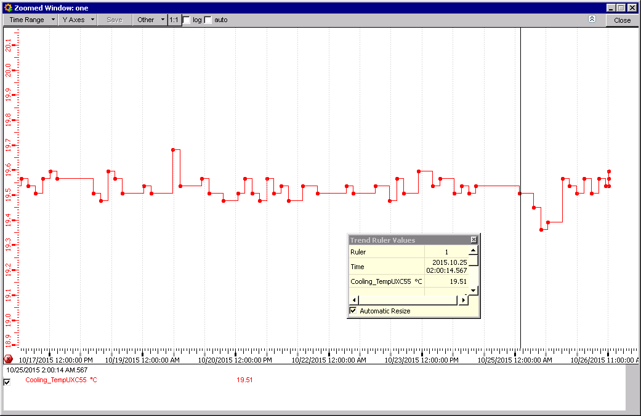
UXC55 Ambient Temperature
Temp drop on Sunday ?

Slide 21
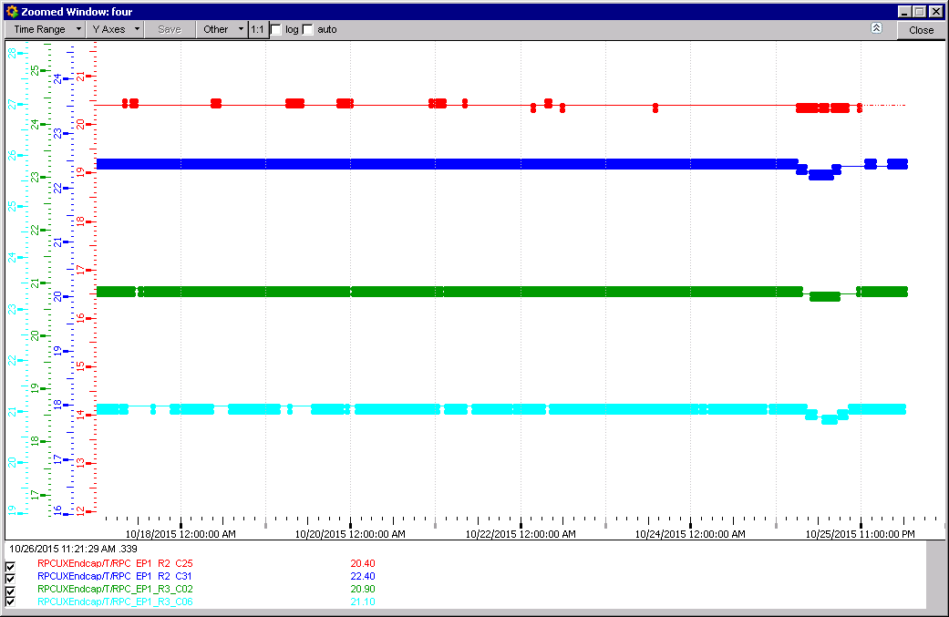
YE+1 also see the Sunday drop in Temperature between the yokes.

Slide 22
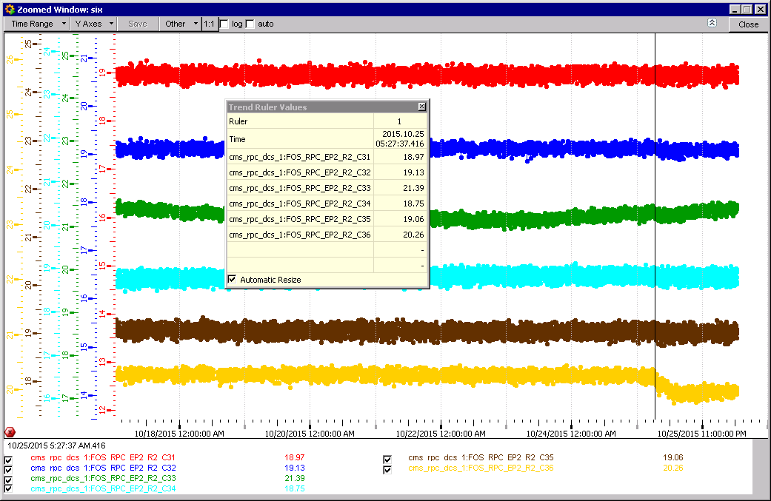
RE+2 FOS sensors
Individual FOS temperatures. Only one shows the temp. drop.

Slide 23
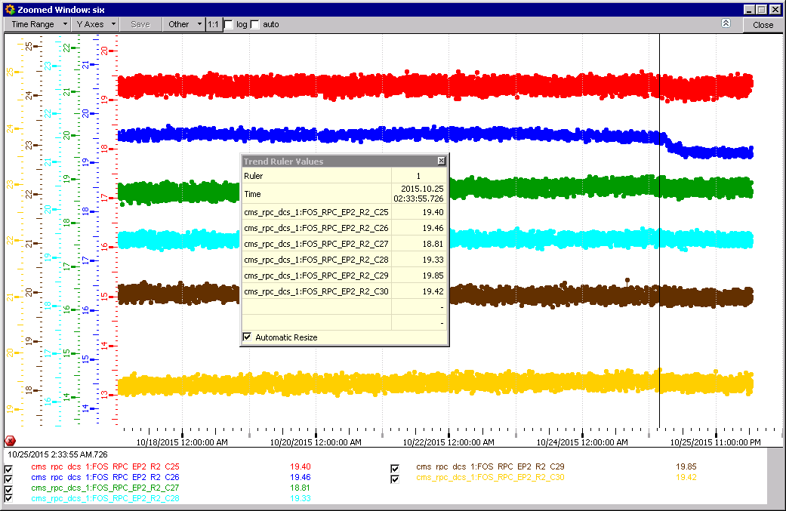

Slide 24
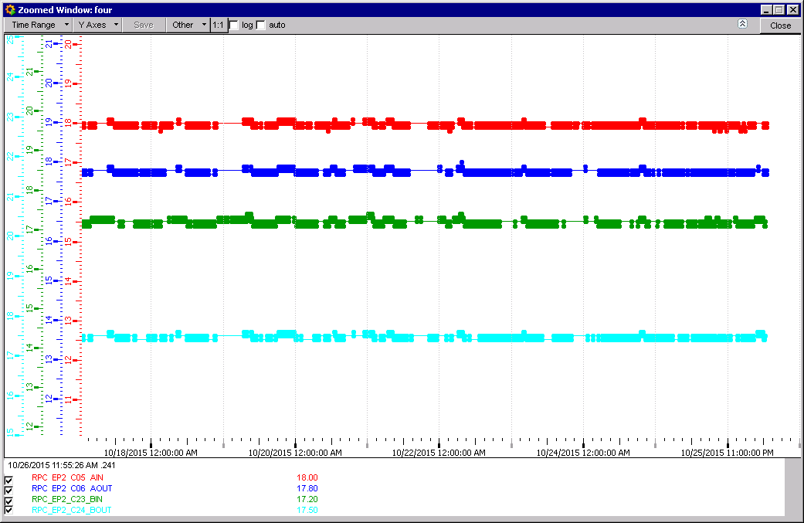
Coolant temperature RE+2

Slide 25
Conclusion
Stable temperatures.
The temperature in RE+3 is still missing
Pressure between cavern maintained, safety reasons.
There are 2 temperatures on each RE1/1, only reading one !
RE+1/3 only one of 6 temp. sensors are logged !
RE+2/2 & 2/3 individual plots FOS not available.
RE+2 & 3 Temperatures are lowest in the near bottom region.
RE- will be looked at for next week.

