Slide 1
CMS envronment
Ian
13 June 2016

Slide 2
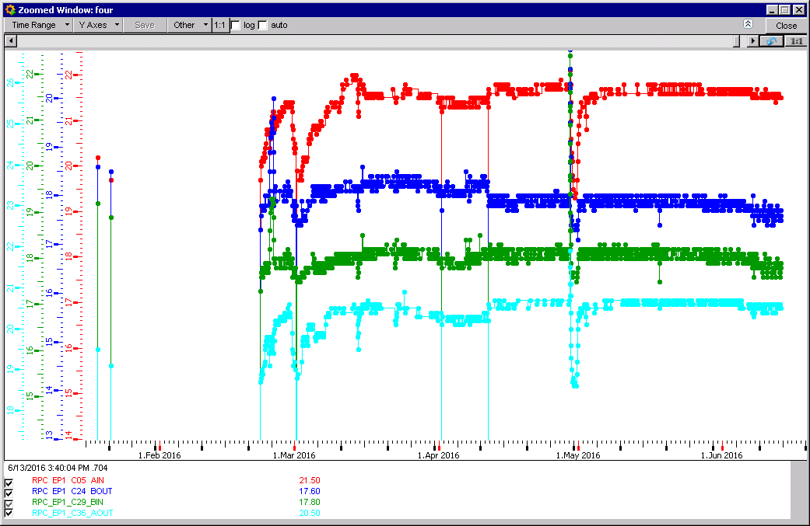
Un explained temperature decrease

Slide 3
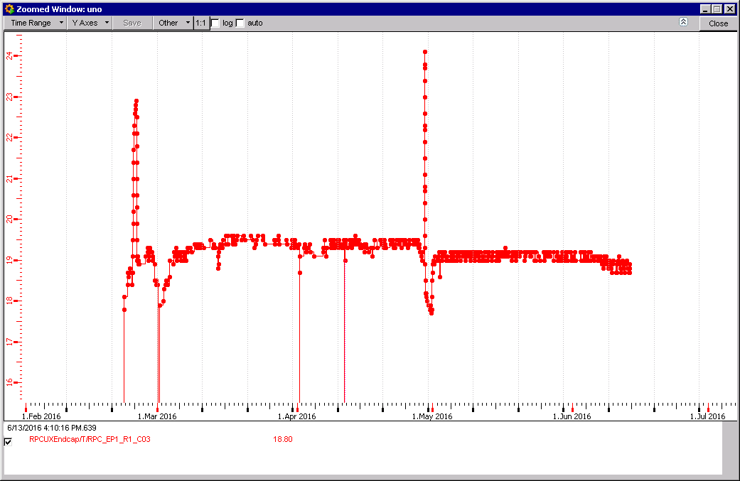
RE1/1 illustrates coolant temp. drop

Slide 4
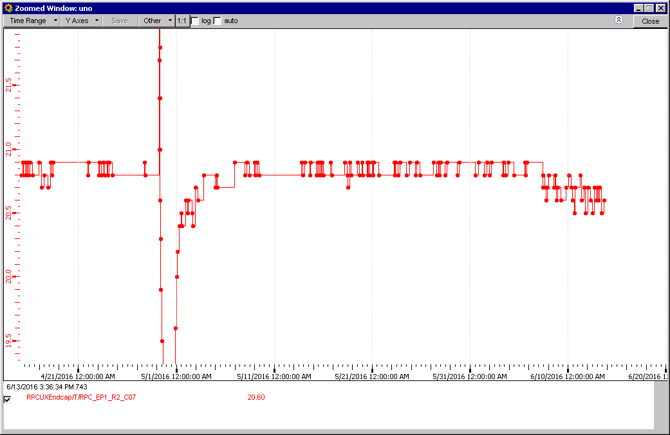
RE+1/2/07
Temp. drop

Slide 5
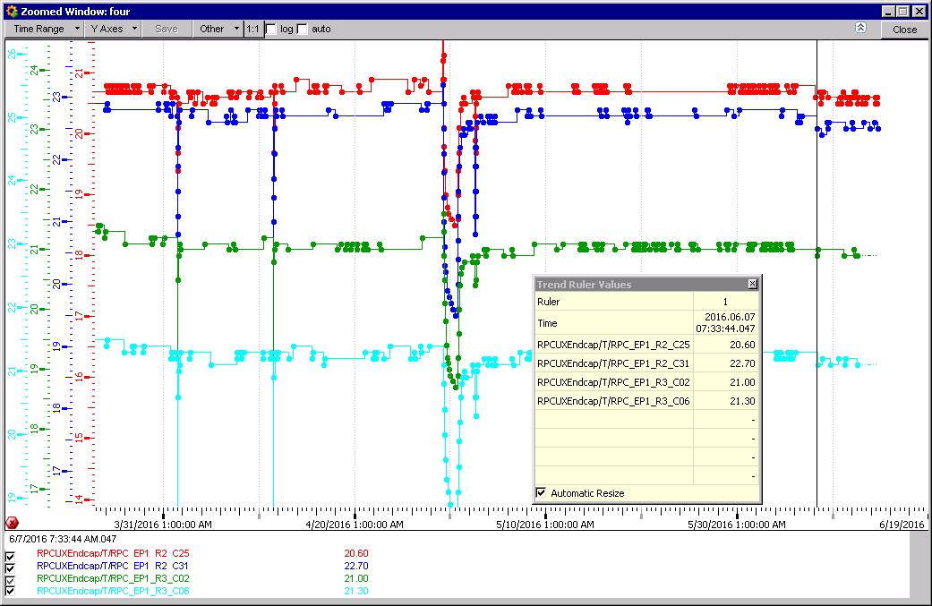

Slide 6
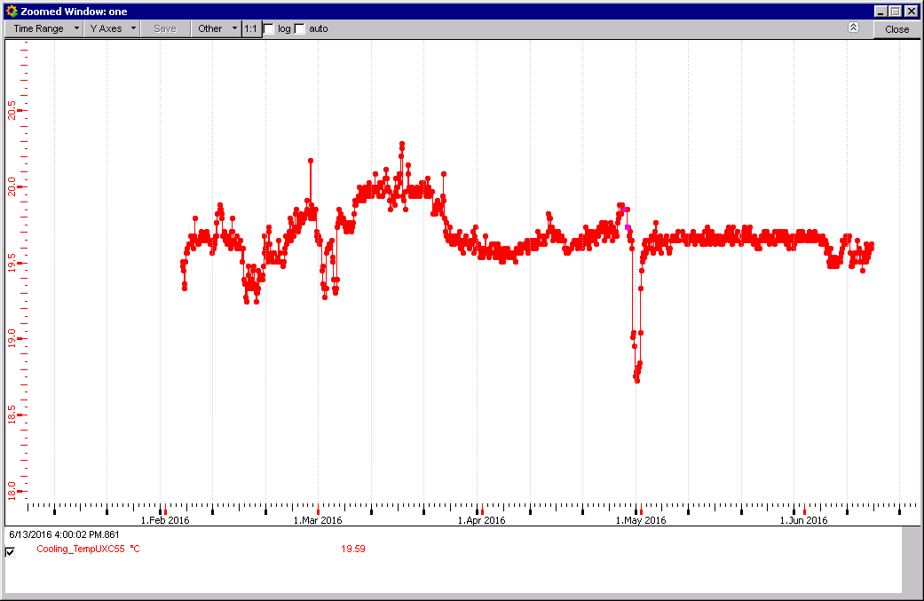
UXC temperature

Slide 7
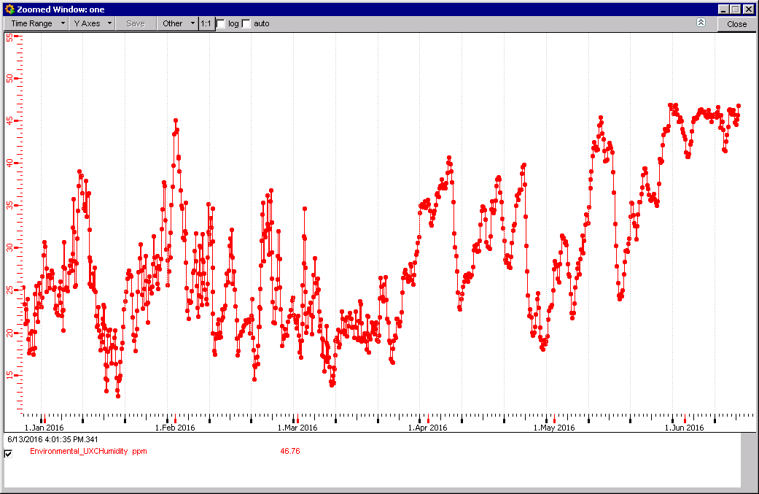
UXC Humidity
Upper cutoff

