Slide 1
Cooling iRPC FEB
Progress and steps
Ian
23 Feb 2024

Slide 2
Check that the Huber chiller , now 13 ? Years old does the job of cooling down the 100W load
See photos and plots from Mohammed
Plan to attach rack to floor
Time to instrument the first step with temp and mass flow rate to equate power loss to delta T, Cp and flow rate
See Arduino ( No ESP33 ?) programme and initial trial comp air , with Zubayda.
This is also the step to making the interlock on flow failure for the final system
Calibration of the flow meter against elevated reservoir and analogue flow meter.

Slide 5
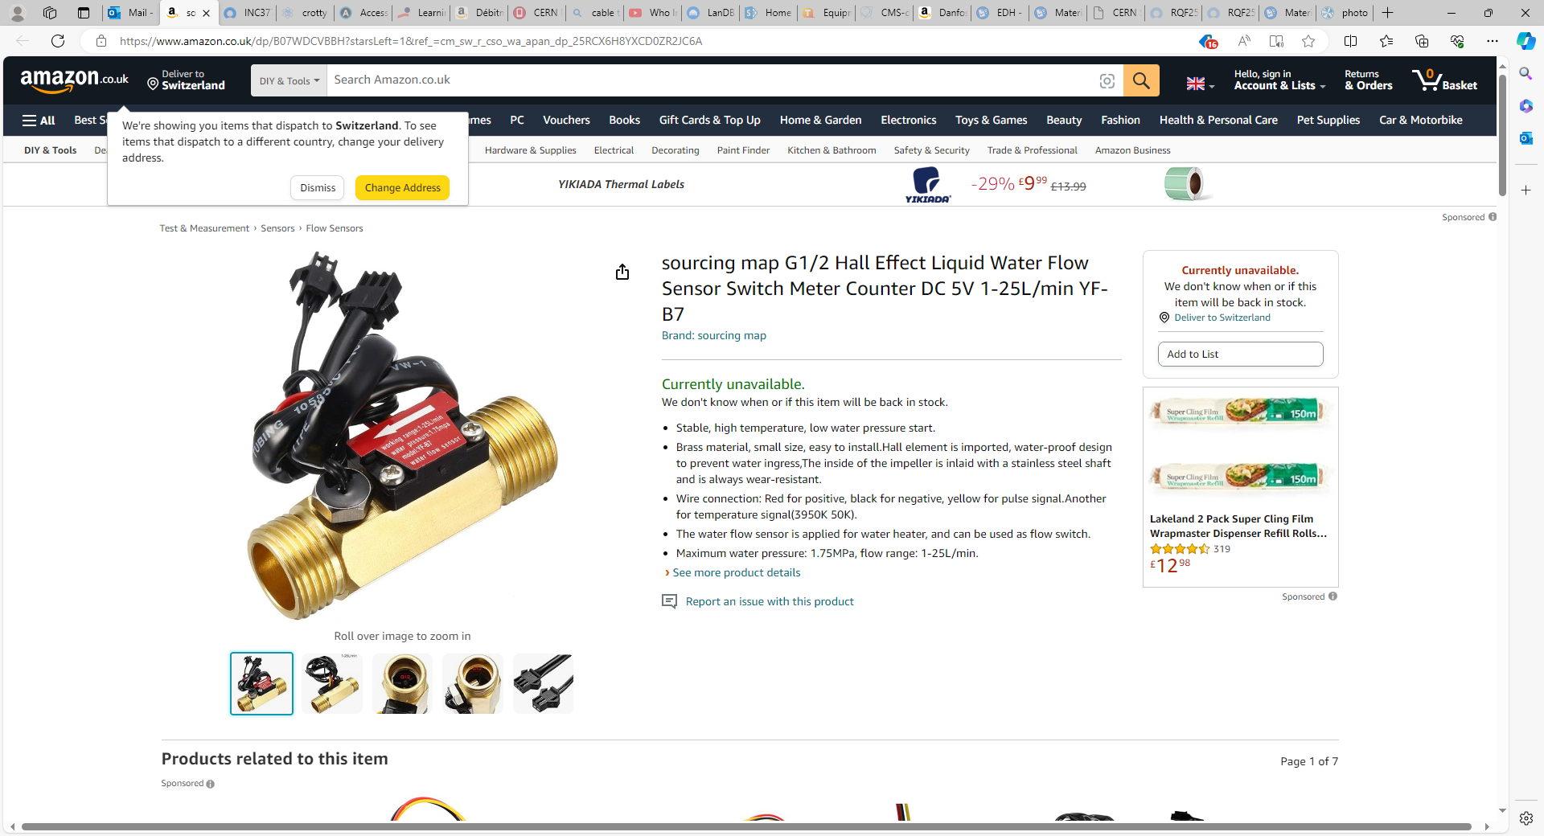
Model YF-B7

Slide 6
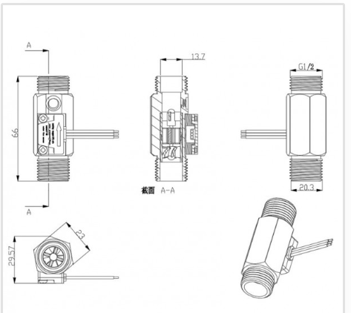

Slide 12
Students giving assistance
Zubayda
zubayda.eve.kofi@cern.ch
Lucia sanchez
lucia.eiriz.sanchez@cern.ch
Mohammed
mohammad.ahammad.ali@cern.ch
Their responsible here;
Robert Philip Keatch

