Slide 1
Cooling for iRPC Electronics with 2 phase searator
Ian Crotty
15 Oct. 2023

Slide 2
Specification;
Water Flow rate >2 [l/h] total flow 8 [l/h]
Water temp. 16-17 [degC]
Power dissipated to air and/or water for 1 FEB per chamber 25[W] = Total 100[W]
4 chambers at a time in stand
Individual connect and disconnect
Visible flow indication
Interlock on cooling failure to cut LV power crate with software interrupt based on FEB temp. Giving two interlocks.

Slide 3
Cooling Circuit Schematic
Supply
3 way Valve
“L” type
Comp Air purge
Return
3 way Valve
“L” type
Chiller
2 phase separator

Slide 4
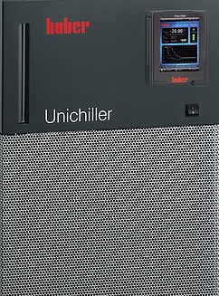
Distribution manifolds
Graphical Representation
Ret.
Sup.
iRPC
Cosmic Stand
Cooling Rack

Slide 5
To do list;
Full details of the design.
Bill of material.
Total cost material.
Assembly cost.
Check operation of 12 year old chiller, use resistive load.
Build with leak test.
Commission with dummy load.
Commission with chambers in purge.

Slide 6
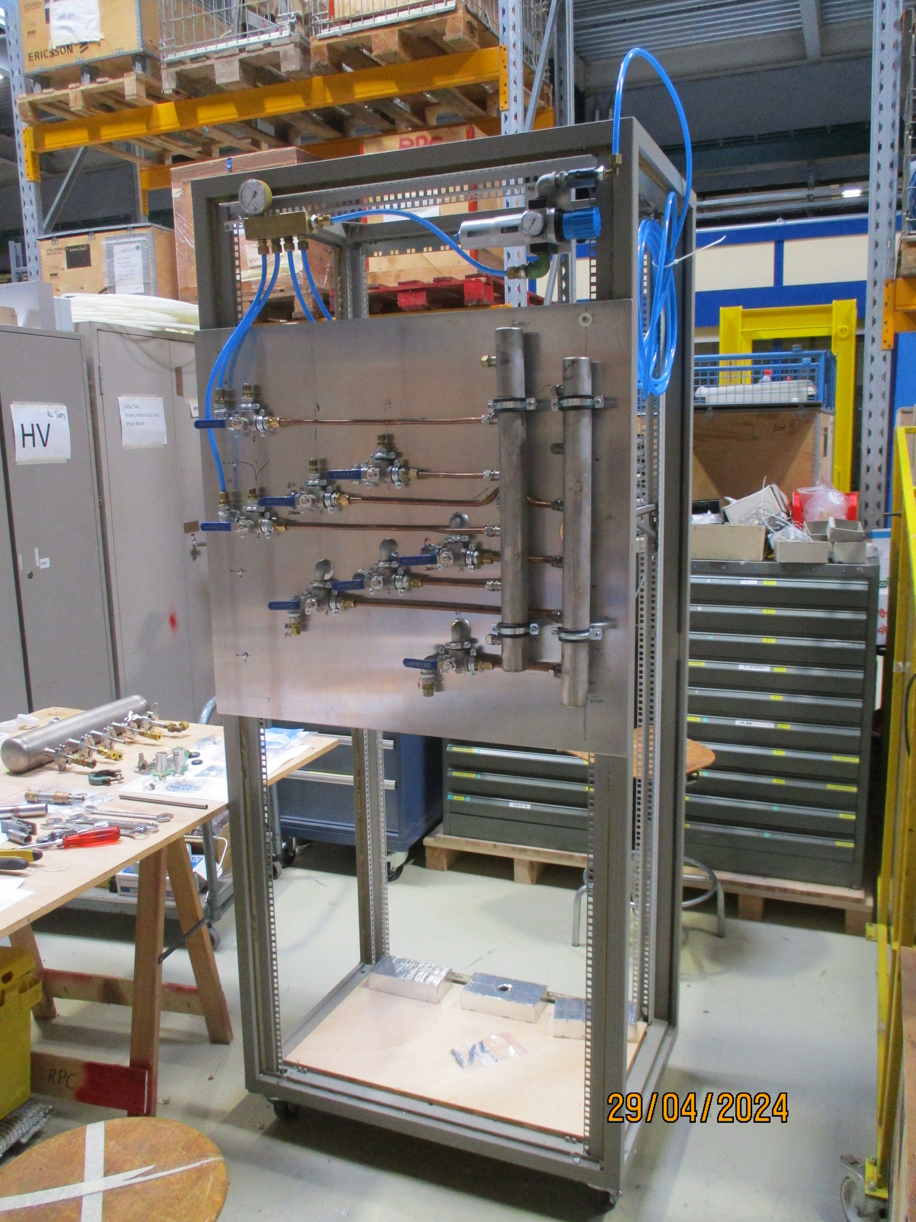
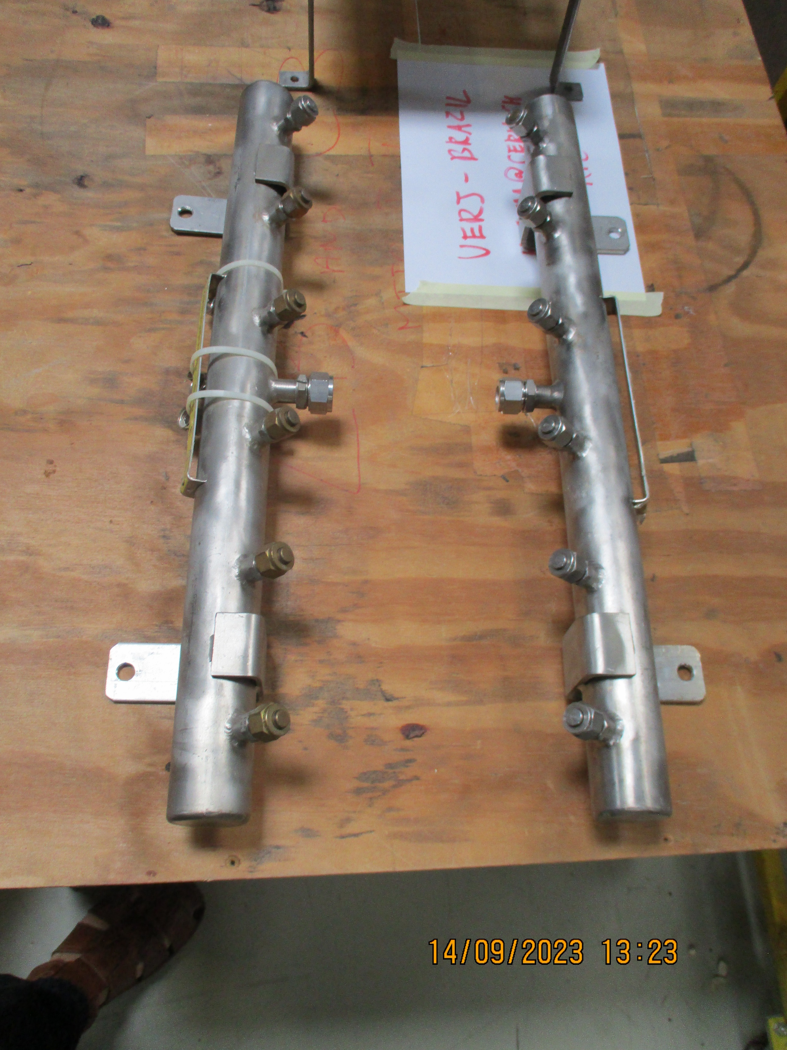
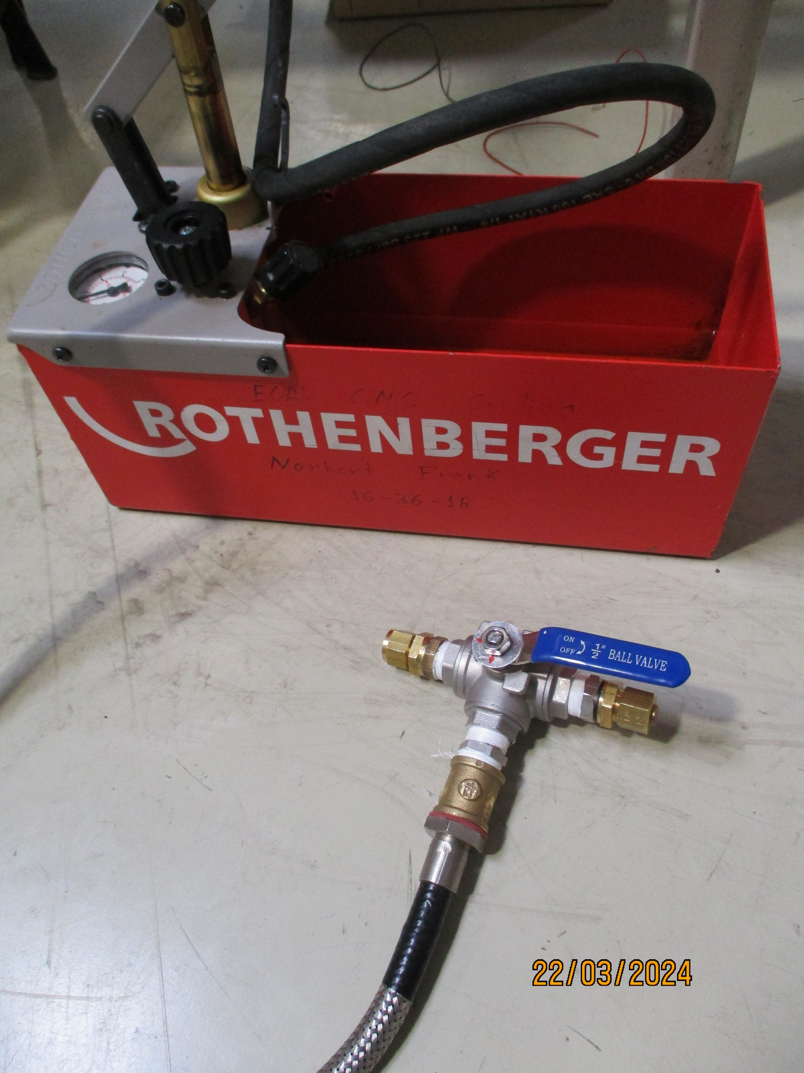
Manifolds recuperated by Anton
Piping on front of main panel almost complete
Pressure test for chinese 3 way valves

Slide 7
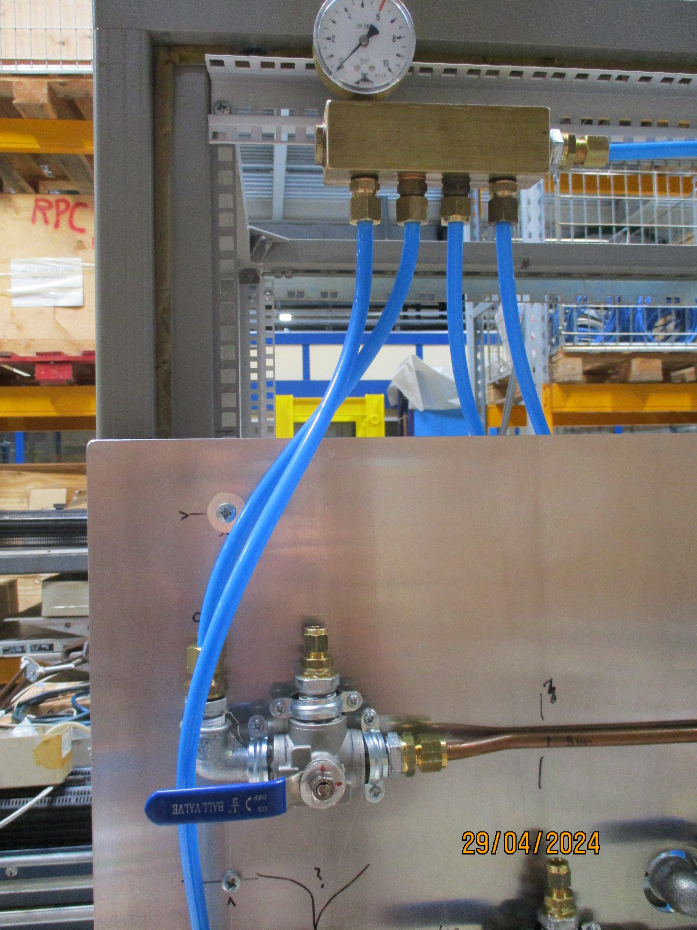
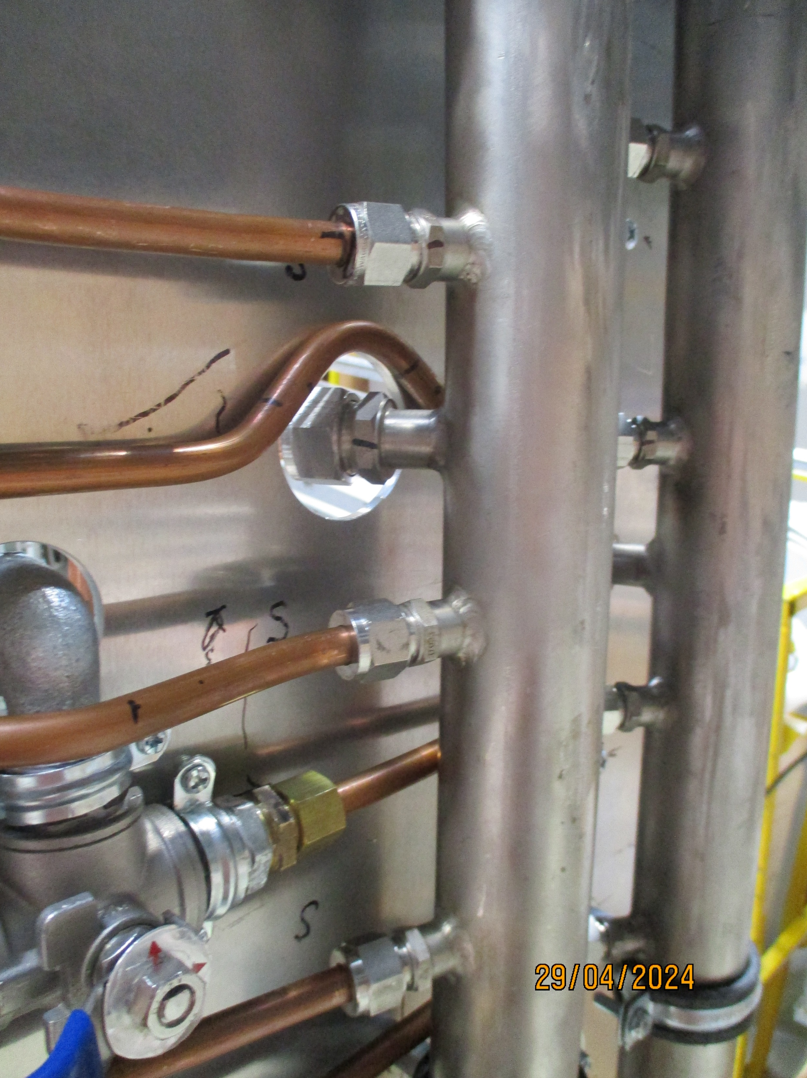
Progress on piping
End April 2014

Slide 8
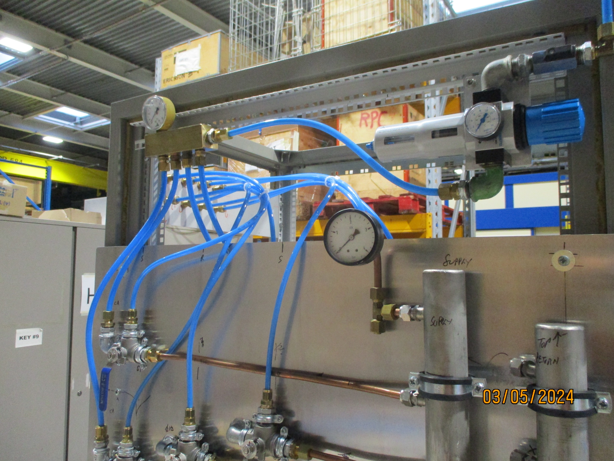
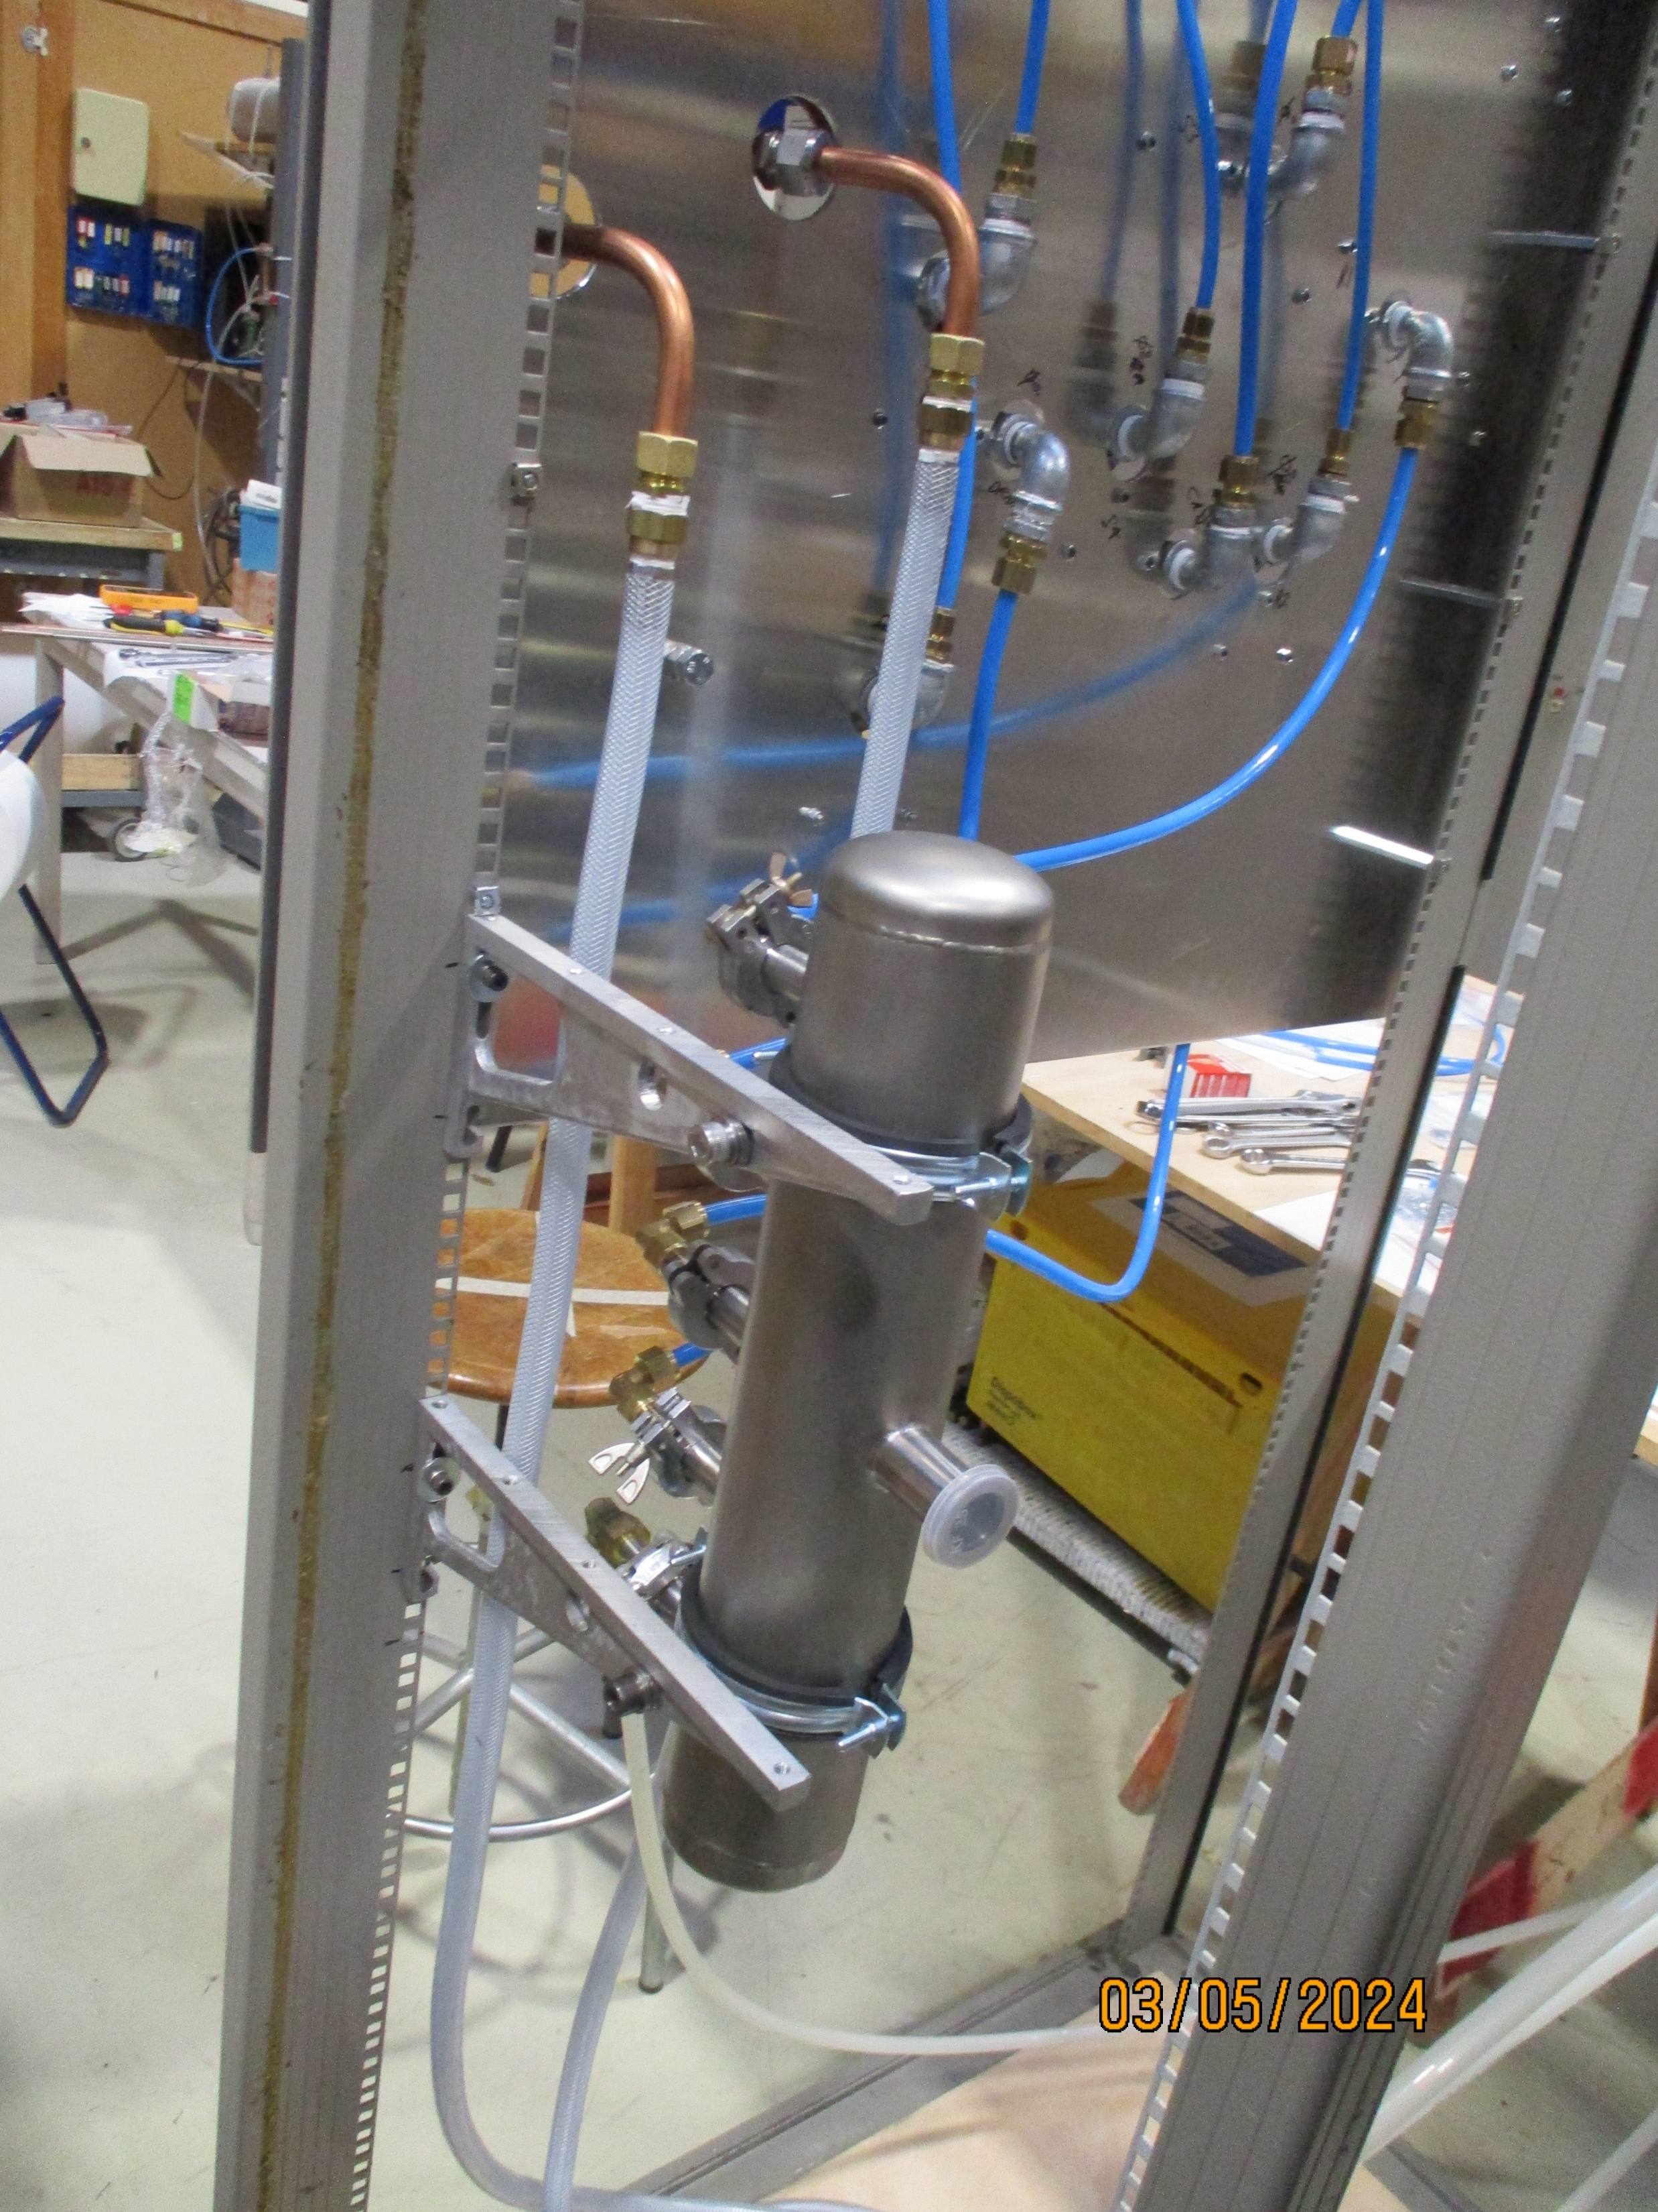
Air supply to purge
& PP for chamber supply and return
2 phase separator

Slide 9
To do list for 17 may 2024
Finish bypass between Manifolds
Do pressure/leak test
Prepare 2nd level 2 phase separator
Commission and install lines from rack to chambers

Slide 10
Mehar will order these pieces
Email sent 29 Aug 2023 @ 1851hrs
Problem with the ss ones as you can only ask one at a time !! Can he solve this ?

Slide 11
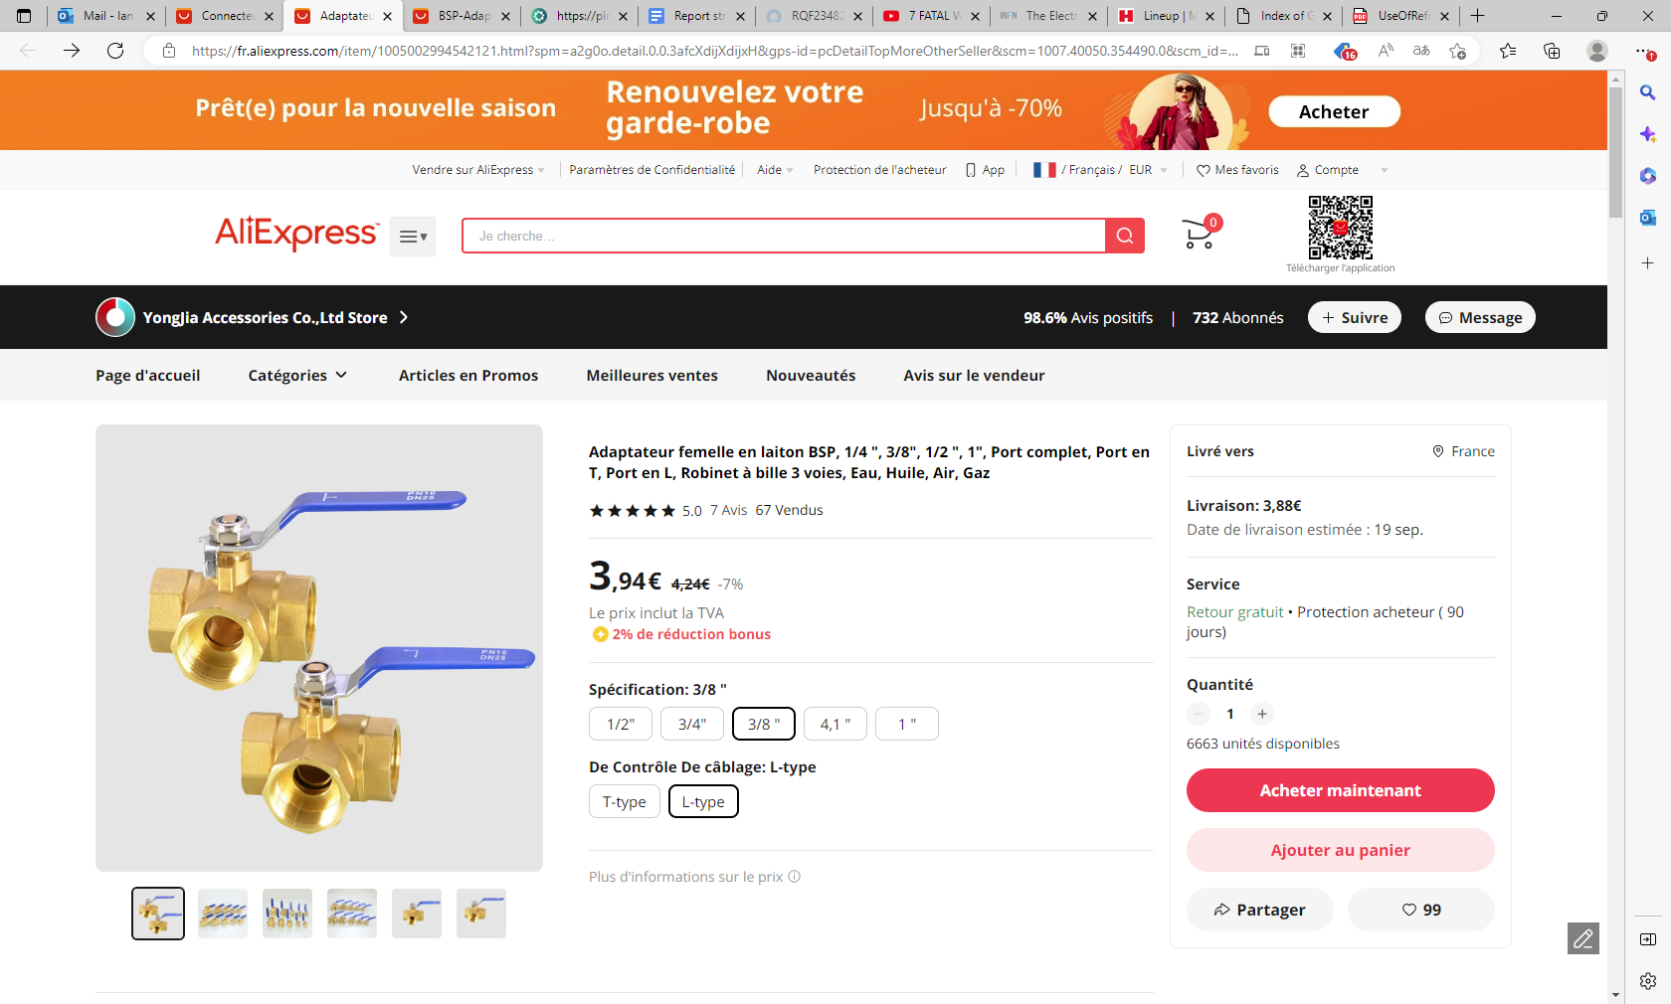
https://fr.aliexpress.com/item/1005004159976049.html?spm=a2g0o.cart.0.0.7007378dtwcZbG&gps-id=shoppingCartRecommend&scm=1007.13440.311564.0&scm_id=1007.13440.311564.0&scm-url=1007.13440.311564.0&pvid=daff6c3c-779e-4b04-9636-30ff911a1882&_t=gps-id:shoppingCartRecommend,scm-url:1007.13440.311564.0,pvid:daff6c3c-779e-4b04-9636-30ff911a1882,tpp_buckets:668%232846%238111%231996&pdp_npi=4%40dis%21EUR%213.42%213.25%21%21%213.62%21%21%40210318e816933264222027899e5629%2112000028233201753%21rec%21FR%21%21A

Slide 12
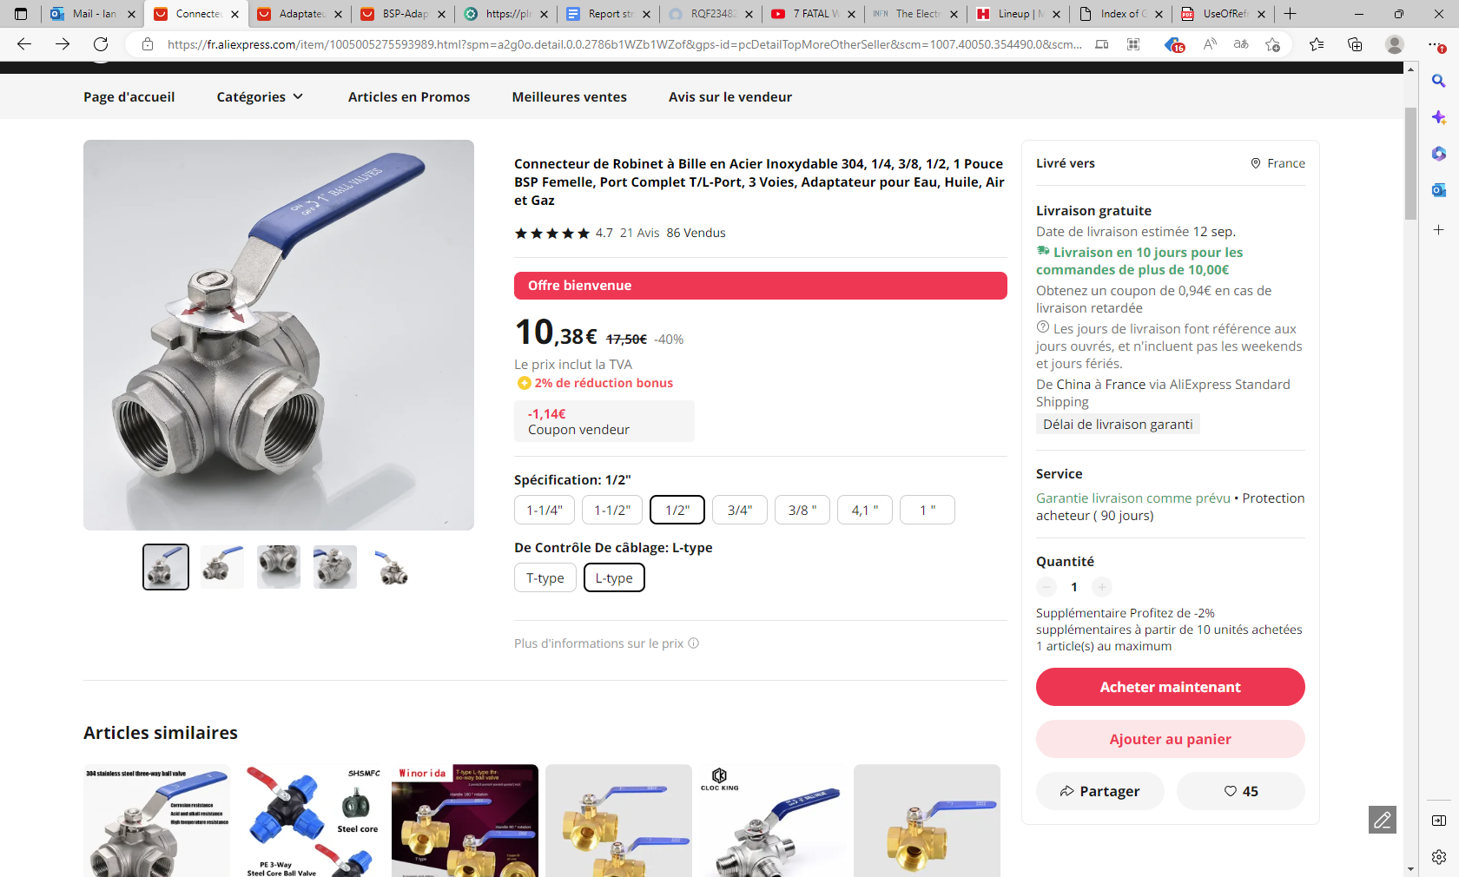
https://fr.aliexpress.com/item/1005005275593989.html?spm=a2g0o.detail.0.0.2786b1WZb1WZof&gps-id=pcDetailTopMoreOtherSeller&scm=1007.40050.354490.0&scm_id=1007.40050.354490.0&scm-url=1007.40050.354490.0&pvid=d2249927-0b40-40fa-8e93-1c07912419ce&_t=gps-id:pcDetailTopMoreOtherSeller,scm-url:1007.40050.354490.0,pvid:d2249927-0b40-40fa-8e93-1c07912419ce,tpp_buckets:668%232846%238111%231996&pdp_npi=4%40dis%21EUR%2115.59%218.75%21%21%21120.30%21%21%40210318e816933265459688913e5629%2112000032451146813%21rec%21FR%21%21A

