Slide 1
Compressed air cooling through FEB cooling circuit
OR a leak free cooling system
Ian
31.08.21

Slide 2
Schematic of a thermal load and it’s cooling circuit
Thermal load
Power in Watts
Copper conductor/sheet
Cooling fluid flow rate
in mass per unit time
Heat transfer
Heat extraction
Fluid temp inlet T_{in}
Fluid temp outlet T_{out}
Copper pipe
There are 2 areas of interest of heat transfer.
From the load through the copper sheet, a thermal resistance. See I.Bagatori
And the heat that is extracted from the area by the flowing fluid .
Equilibrium is reached when heat generation = ALL heat losses.
Resultant temperatures of each element are established.
The latter case is looked at below.

Slide 3
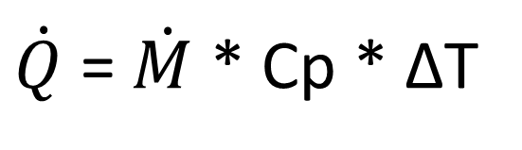
Fluid mass flow rate
[kg/s]
Temperature difference, between inlet & outlet
[degree C]
Parameters to play with;
Power is 25W per FEB
Mass flow rate can be varied.
Thermal capacity is either that of water or air
Delta T will vary along the length of the cooling system .
The absolute entry temp is important .
The higher the fluid temp. the lower the power extracted from the FEB.
There are 3 orders of magnitude of difference in heat extraction capability between Water and Air ! This will not be easy.
$\dot{Q}$ = $\dot{M}$ * Cp * ∆T
Dissipated Power
[Watts]
Thermal capacity of fluid
[kJ/kg.K]

Slide 4


Calculate the flow for air to achieve an acceptable delta T.
CMS RE cooling 2 litre H2O/min
For water
Q dot [watts] 50 [W]
M dot [kg/s] 2 [litres/min]
Cp Heat Capacity of water = 4.184 [kJ/kg.degC]
Calculate Delta T [degC] = 0.362 [degC] basically no gradient along the cooling circuit
If only 0.2 [litres/min] = 3.62 [degC]
Or 0.1 [litres/min] = 7.24 [degC] perhaps an acceptable gradient
For Air
Q dot [watts] 50 [W]
M dot [kg/s] To be found [litres/min]
Cp Heat Capacity of Air [kJ/kg.degC] = 1.0035 [kJ/kg.degC]
Assume Delta degC = 10 [degC] Similar gradient to above
Calculated mass flow rate of air = 4.98 [g/s]
Air density = 1.225 [kg/m3] @ 15[degC]
Volume flow rate = 14.6 [m3/hr]
$\dot{Q}$ = $\dot{M}$ * Cp * ∆T
$\dot{Q}$ = $\dot{M}$ * Cp * ∆T

Slide 5
The flow of air in the pipe will result in heat extraction from the load (resistance). This heat extraction will be a function of the temperature difference between the cooling fluid and the resistance at each point along the pipe.
This extraction of heat will produce a gradient along the length of the pipe.
Additional heat can be extracted by increasing the former temperature difference by taking the inlet fluid below ambient, meaning a chiller !
Can a chiller be built at the entry and onto the chamber ?

Slide 6
The principle values of interest and the importance of sub ambient fluid inlet temp.
Delta “T” for heat extraction. Load to fluid
Temperature [degC]
Temp. Amb. Fluid outlet
Temp load
Temp. chilled Fluid inlet
Temp. Ambient Fluid inlet
Slopes and proportions are not to scale.
Temp, chilled Fluid inlet
Distance along pipe

Slide 7
The air, in this case, can be chilled before the entry to the chamber.
A thermodynamic refrigeration cycle is required. In this case the circuit is not closed on a “local” scale.
The infrastructure at CERN can be used for the compressor and the condenser is the piping to the building.
Heat out
Condenser
Expansion valve
Compressor
Evaporator
Building infrastructure
Heat in
The expansion valve is at the PP and the evaporator are on the chamber
Chamber

Slide 8
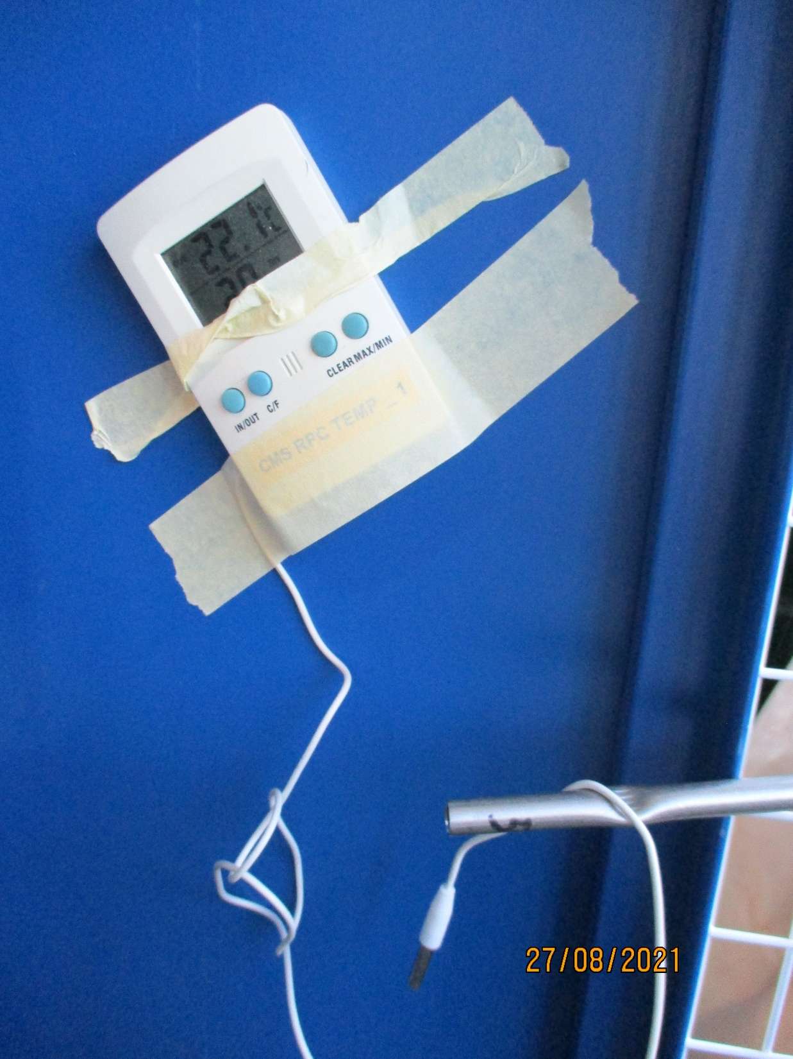
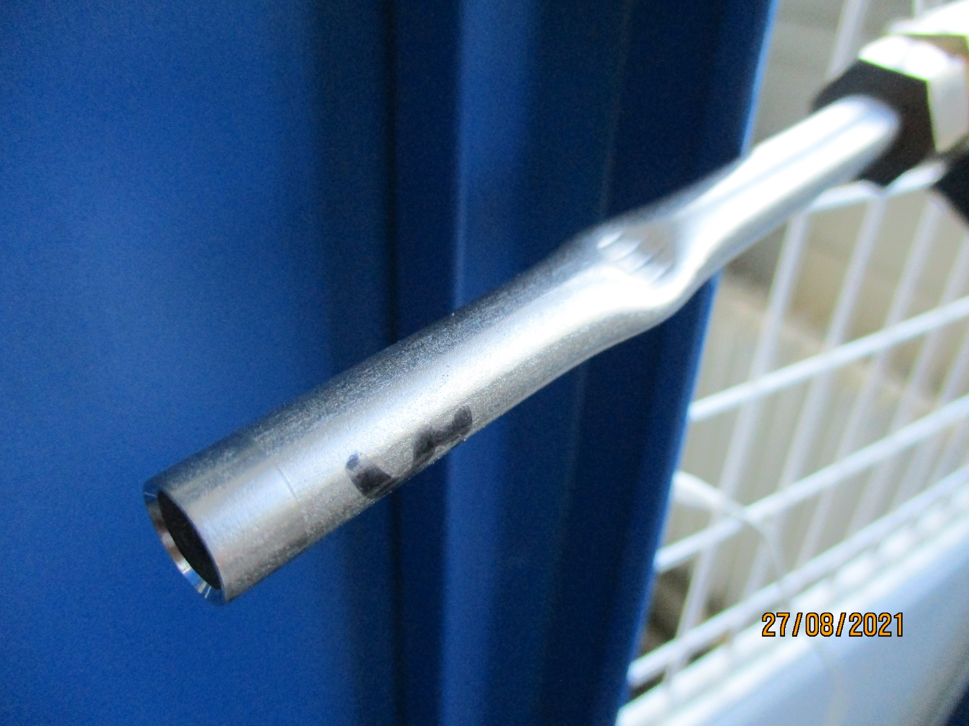
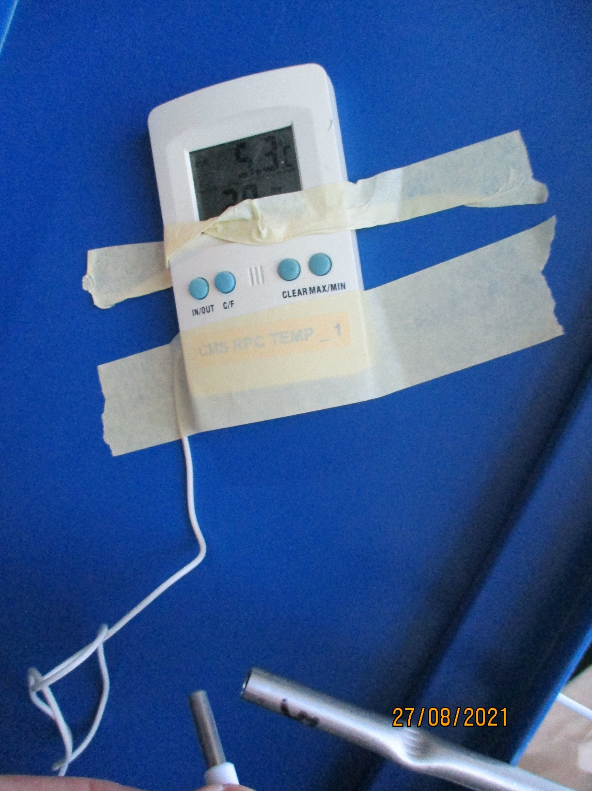
Illustration of passive cooling of ambient compressed air.
Sub zero temperatures can be obtained.
Temperature reduction of 17 degC through the first attempt with expansion valve. No optimisation

Slide 9
Schematic of set-up
4 locations used to measure the external temp. of the resistors
Expansion valve
L = 2x1.27m Cu. Pipe 8x6mm
02
01
Air in
10.5cm
03
04
Air out
Pipe length not shown in full
Cu pads 13 on each length = 26.
22 pads equipped with 100 Ohm resistors
Cu. Pads 50 x 30 x 3mm pitch between ~100mm
2 pads for entry air and exit temperatures measurements with IR Fluke pistol

Slide 10
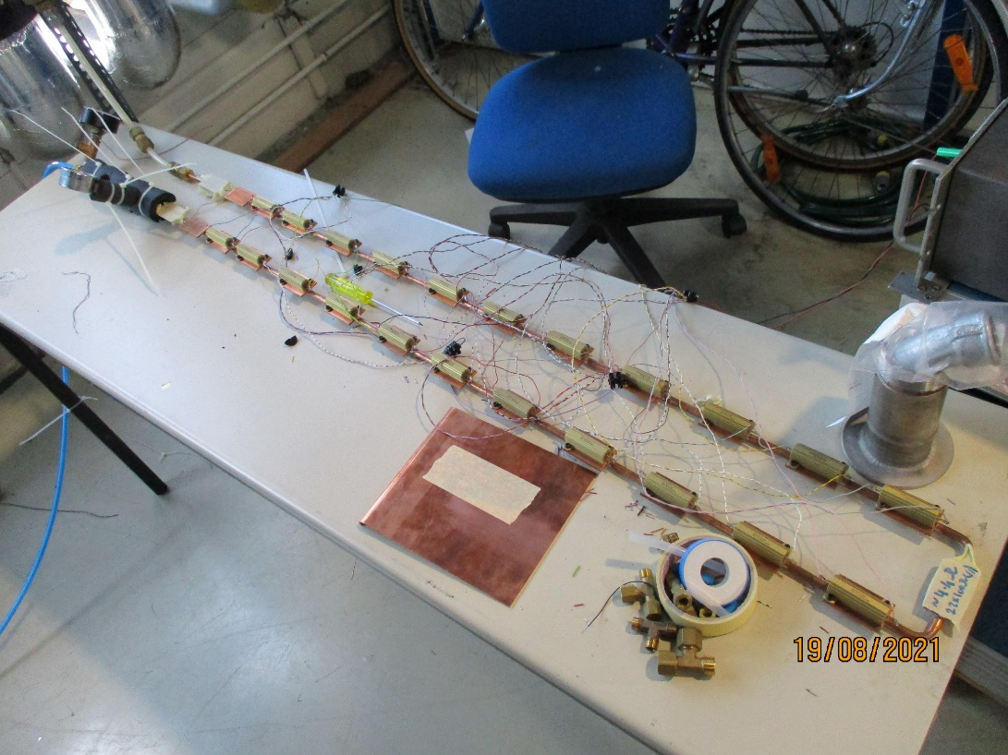
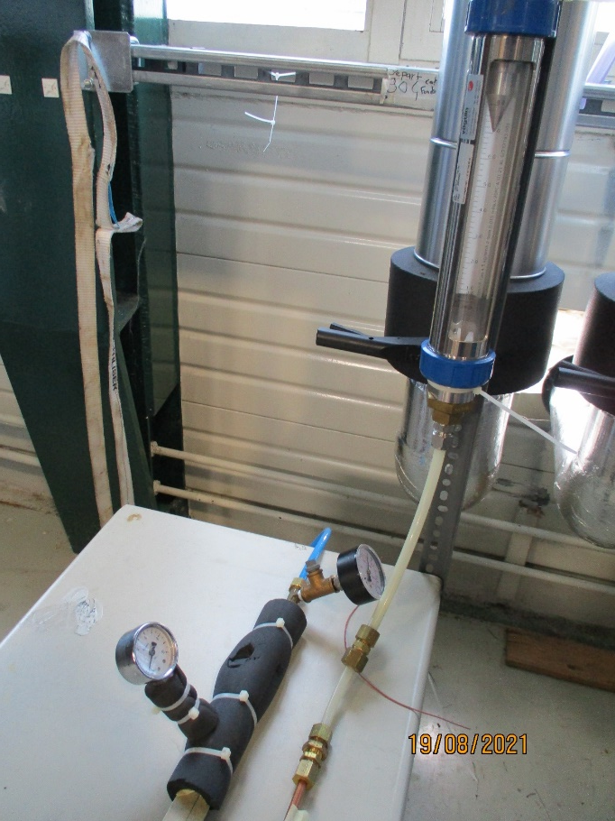
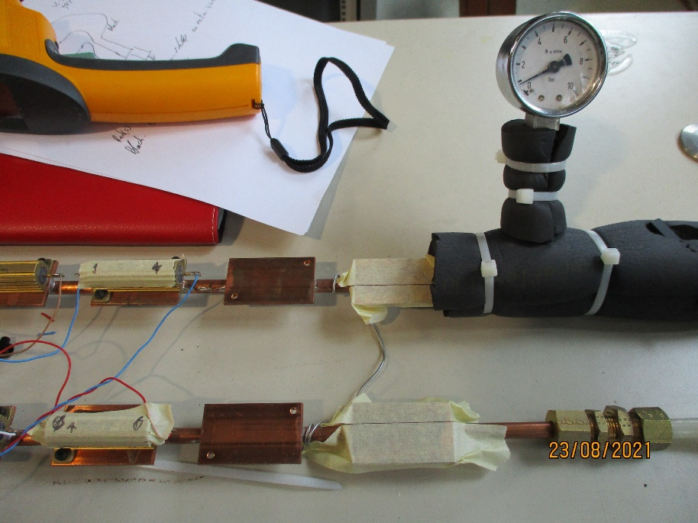
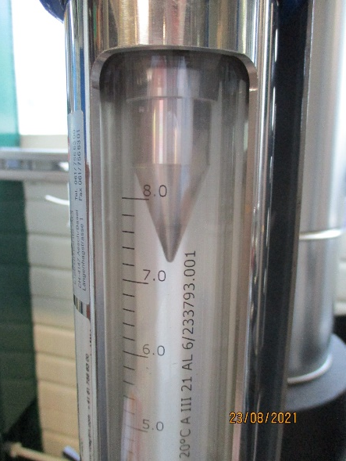
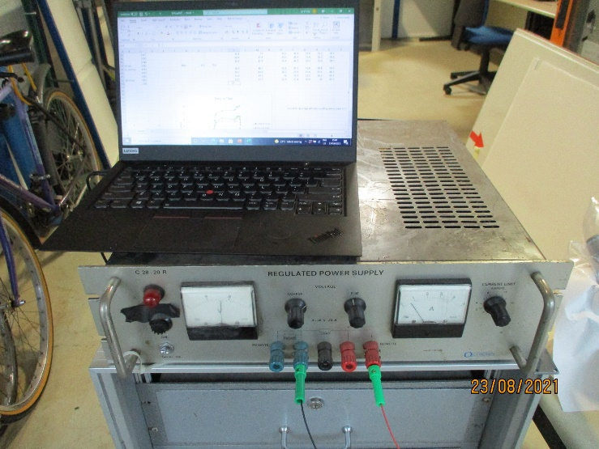
Layout of copper pipe and 22 resistors
Air entry with expansion valve, and exit with flow meter
Temperature measurement points.
Using IR pistol
Entry temp.
Exit temp.
Air flow meter [m3/hr]
Power supply and manual DAQ

Slide 11
Power on.
Air flow on
Power on.
Air flow on
Power on.
Air flow on
Power off
Cooled resistor surface temp
Exit air temp.
Exp. air temp.
Amb. air temp.

Slide 12
Delta T, cooled to uncooled >20degC
Power on
Power off
Delta T, Inlet to outlet ~9degC
Cooling air off
Cooling air on

Slide 13

Calculated extracted heat from test installation
Cp Heat Capacity of Air [J/kg.degC] = 1.0035 [kJ/kg.degC]
Air density = 1.225 [kg/m3]
Air entry temp. = 22 [deg C]
Exit air temp = 31 [deg C]
Vol. flow rate ~ 10 [m3/hr]
Calculated mass flow = 3.4 [g/s]
Removed heat @ Delta T of 9 degC = 30.7 [W]
The remaining 20W is convected and radiated away.
Nota. The inlet & outlet temperatures are NOT the fluid temperatures
$\dot{Q}$ = $\dot{M}$ * Cp * ∆T

Slide 14
Conclusions
Compressed air cooling through the cooling circuit reduces the temperature of the resistors, from 55degC, by >20degC
The use of the compressed air circuit available through out CERN, not dry air, can cool tens of watts of heat load with a delta T of around 10 degrees for free.
Optimisation of the expansion valve opening will produce better results, only one setting tried as the flow meter dynamic range was insufficient.
Compressed air can be cooled by > 17degC
Measure the flow rate with more appropriate flow meter.
The inlet & outlet air temperature should be established.
The noise level is similar or less than an average rack when the exhaust is “silenced” and vented outside.
The cooling due to uncooled comp air should be measured to establish the cooled air component of the heat extraction.

Slide 15
Notes

Slide 16
Notes

Slide 17
Look at delta air on and air off >20degC
Repeatable results before and after air on , off
Illustrate cooling using nozzle , try and obtain freezing ! Partially done
explain temp increase around circuit
Outlet temp jumps UP when cooling comes back on !
Impact of airflow to cool hot uncooled resistors
Air quality on cooling.
Long time , >60mins, to stabilise with no cooling.

Slide 18
Or use the expansion of the air after an obstruction to obtain sub ambient cooling as in the pressure released from a tyre valve !
OR
We squirt it directly onto the FEB through some nozzles, forced air convective cooling !!

Slide 19
1.27m
10.5cm
Cu pads 13 on each length = 26.
22 pads equipped with 100 Ohm resistors
Cu. Pads 50 x 30 x 3mm pitch between ~100mm

Slide 20
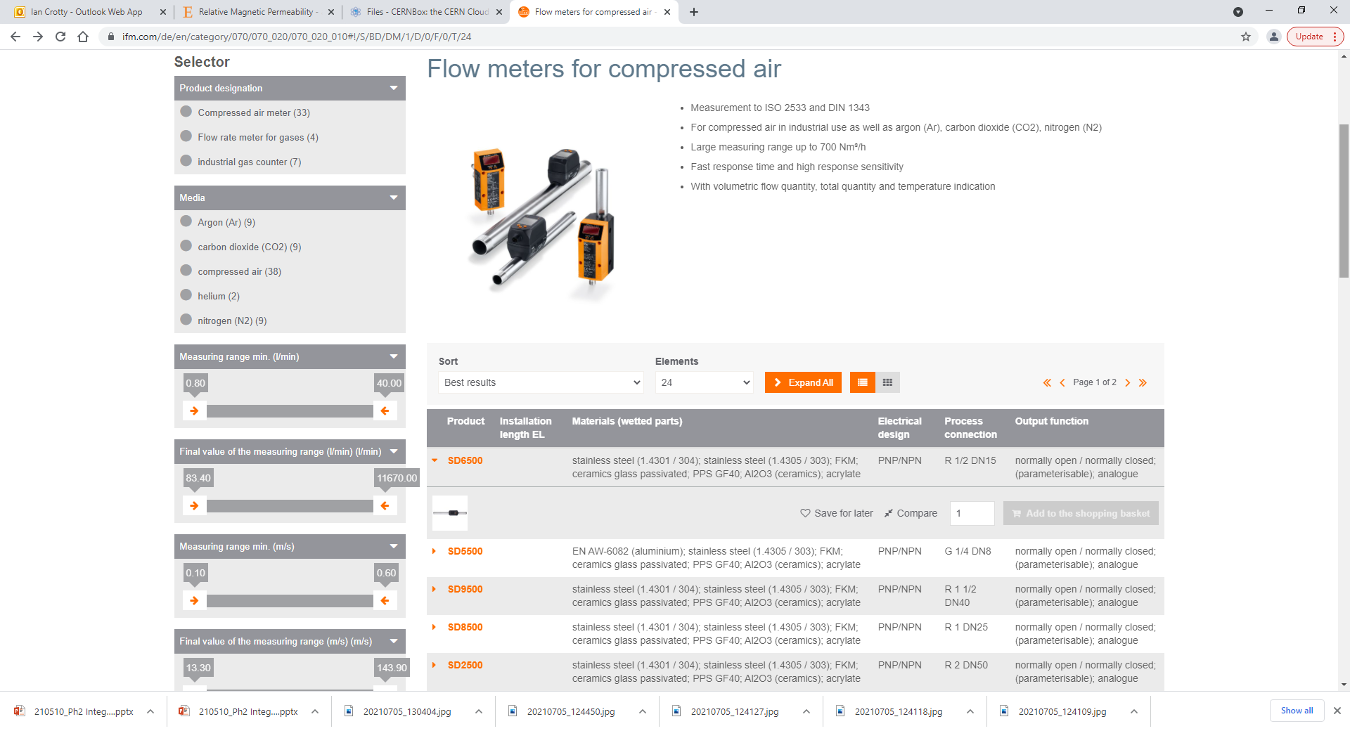
https://www.ifm.com/de/en/category/070/070_020/070_020_010#!/S/BD/DM/1/D/0/F/0/T/24

Slide 21
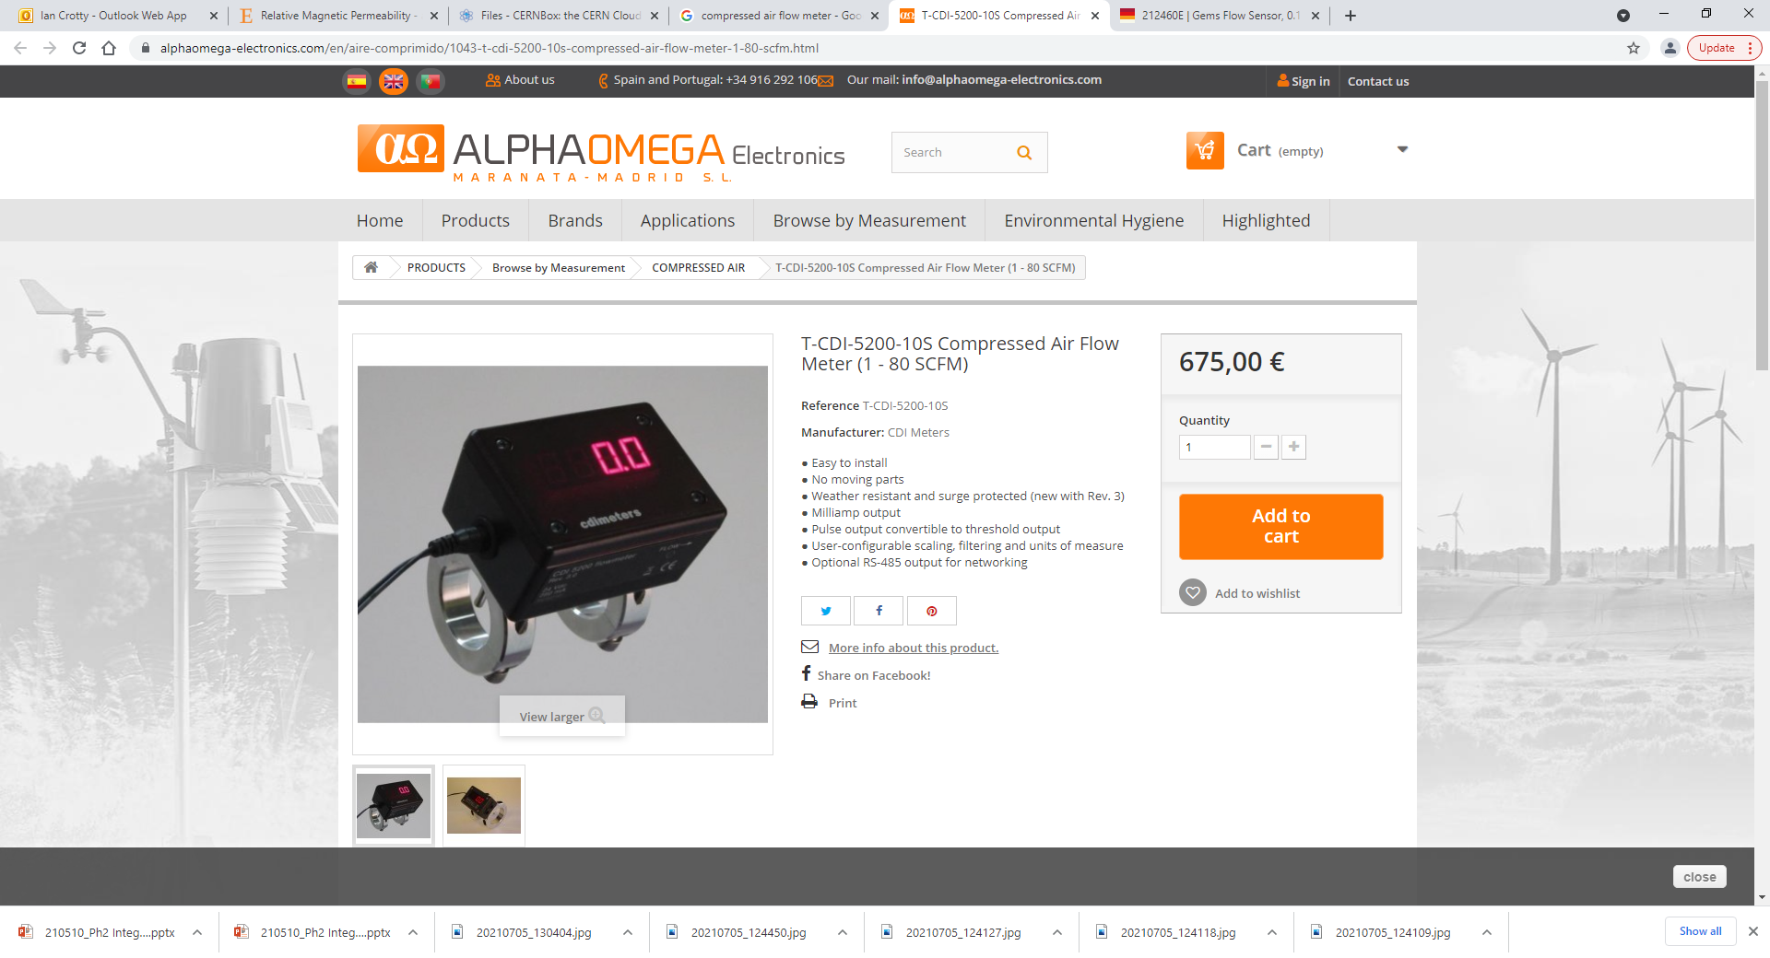

Slide 22
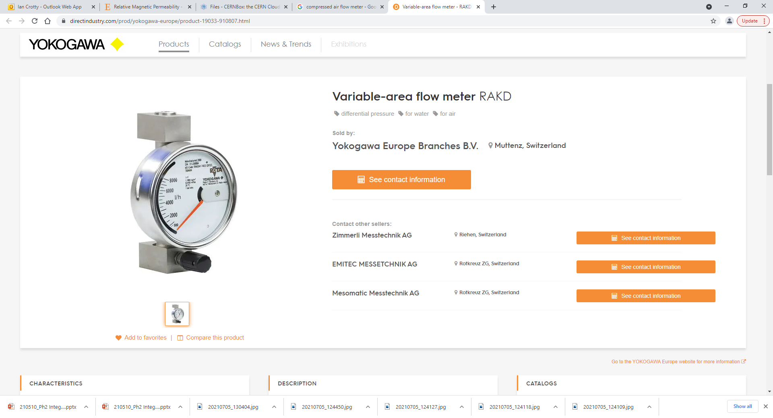
https://www.directindustry.com/prod/yokogawa-europe/product-19033-910807.html

Slide 23
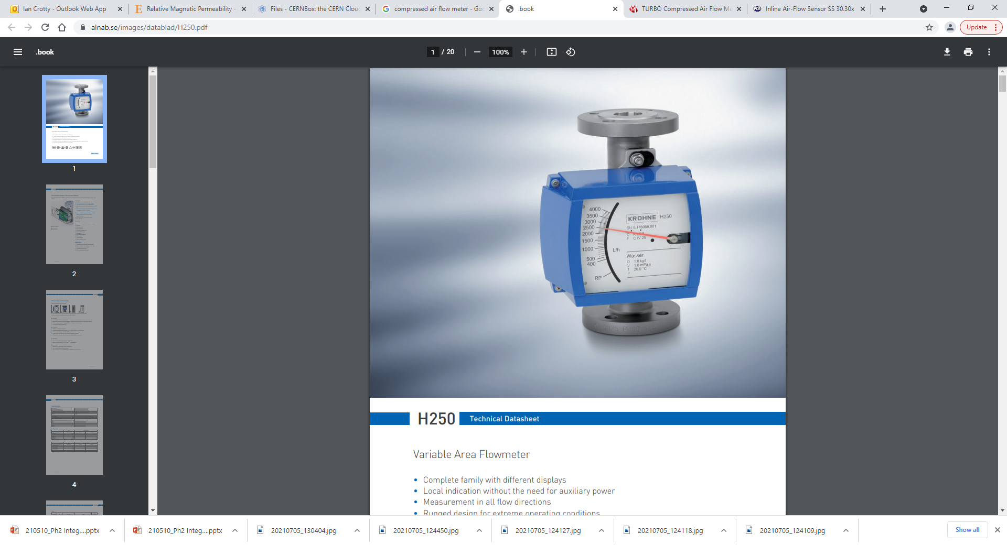
https://www.alnab.se/images/datablad/H250.pdf

Slide 24
https://us.krohne.com/en/products/flow-measurement/flowmeters/variable-area-flowmeters/h250-m40/

