Slide 1
Comp air ccoling through cooling ciruit
Ian
15.07.21

Slide 2
Calculate the flow for air to achieve the same delta T as 2LitreH2O/min as in CMS RE cooling
Q = M * Cp * Delta T
Q [watts] 50 [W]
M [kg/s] 2 [litres/min]
Cp Heat Capacity of water [J/kg.degC] = 4.184 [kJ/kg.degC]
Calculate Delta degC
Delta T [degC] > 0.358 [degC]
If only 0.2 [litres/min] > 3.58 [degC]
Or 0.1 [litres/min] > 7.17 [degC]
For Air
Q = M * Cp * Delta T
Q [watts] 50 [W]
M [kg/s] To be found [litres/min]
Cp Heat Capacity of Air [J/kg.degC] = 1.0035 [kJ/kg.degC]
Delta degC = 7.17 [degC]
Mass flow rate in air = xxxx [kg/s]
Air density = 1.225 [kg/m3] @ 15[degC]
Volume flow rate >

Slide 3
Or use the expansion of the air after an obstruction to obtain sub ambient cooling as in the pressure rel;eased from a tyre valve !
OR
We squirt it directly onto the FEB through some nozzles, forced air convecvtive cooling !@!

Slide 4
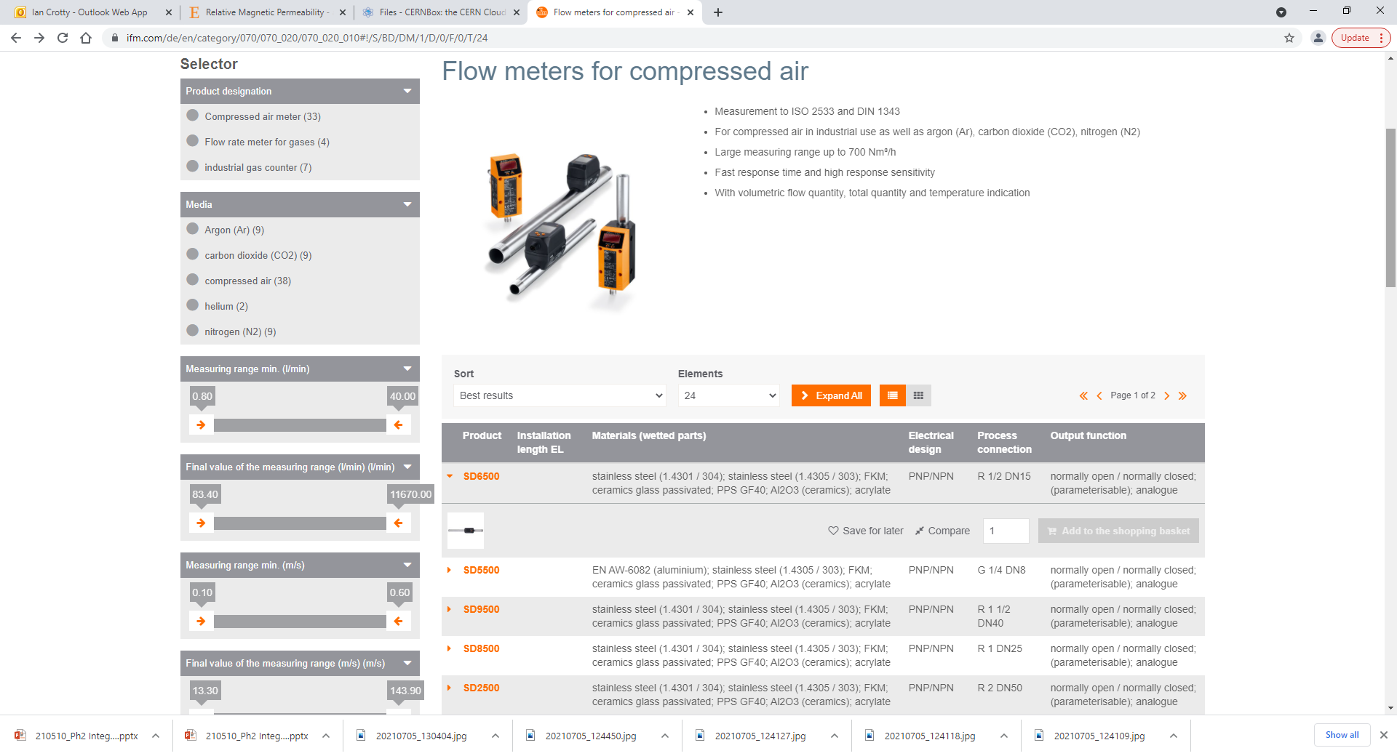
https://www.ifm.com/de/en/category/070/070_020/070_020_010#!/S/BD/DM/1/D/0/F/0/T/24

Slide 5
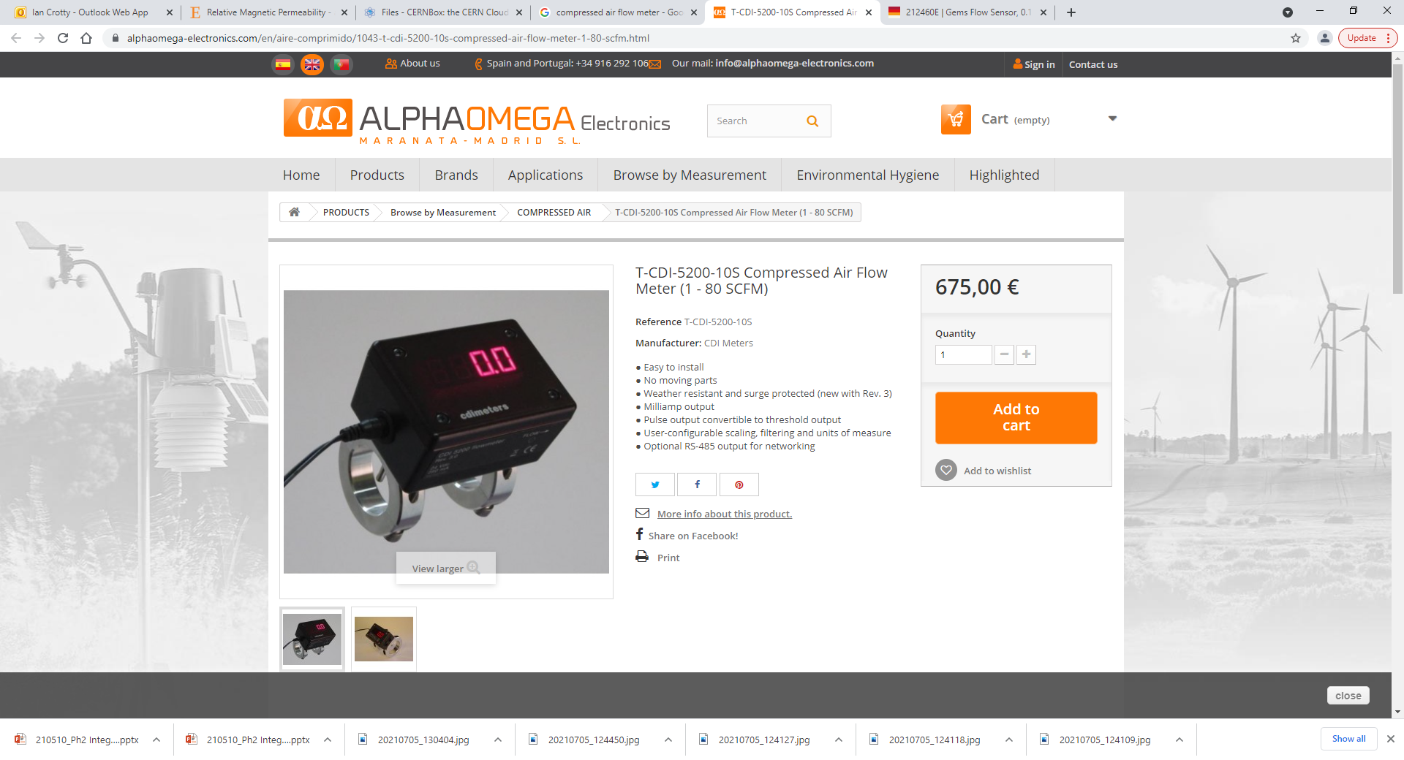

Slide 6
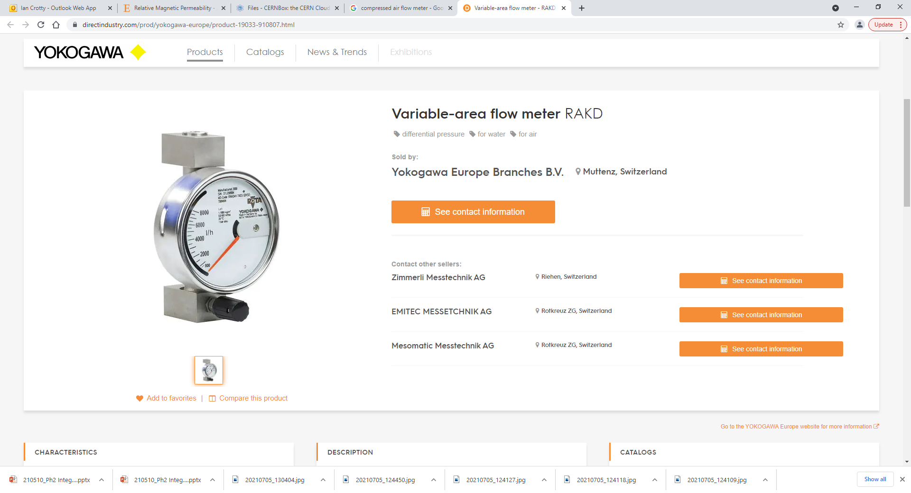
https://www.directindustry.com/prod/yokogawa-europe/product-19033-910807.html

Slide 7
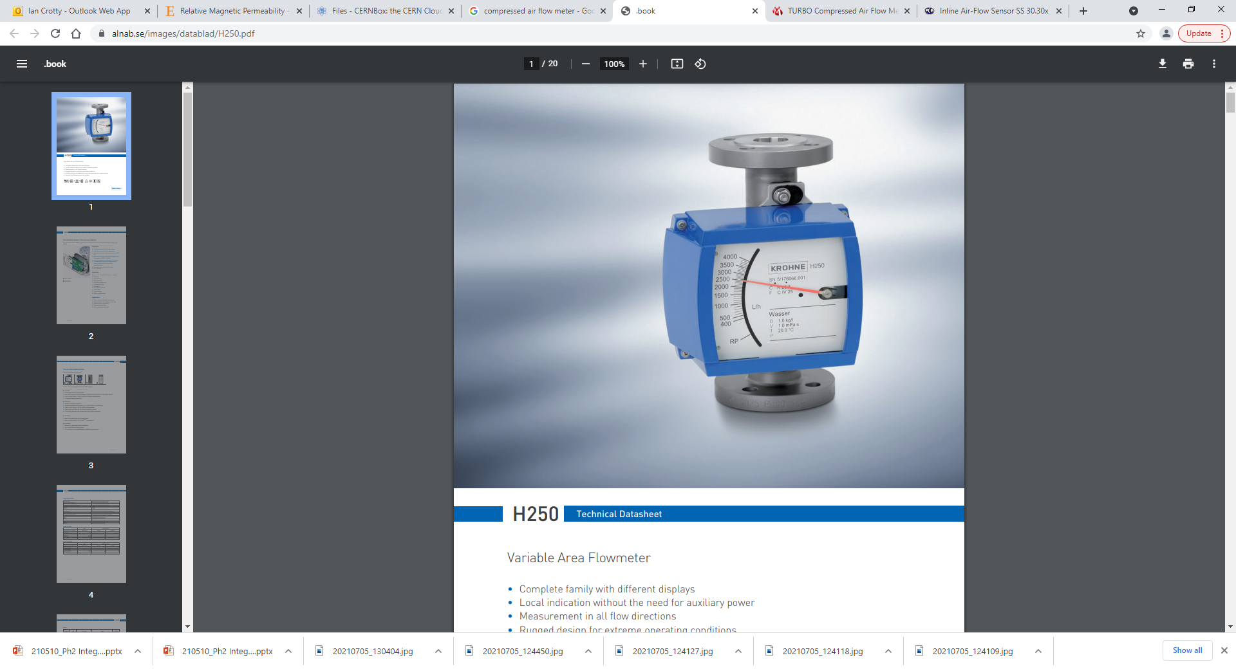
https://www.alnab.se/images/datablad/H250.pdf

Slide 8
https://us.krohne.com/en/products/flow-measurement/flowmeters/variable-area-flowmeters/h250-m40/

