Slide 1
The comment “as the pressure increases the flow decreases” from last week’s meeting. Apparently not intuitively correct.
The explanation……
Ian, 5 June 2019

Slide 2
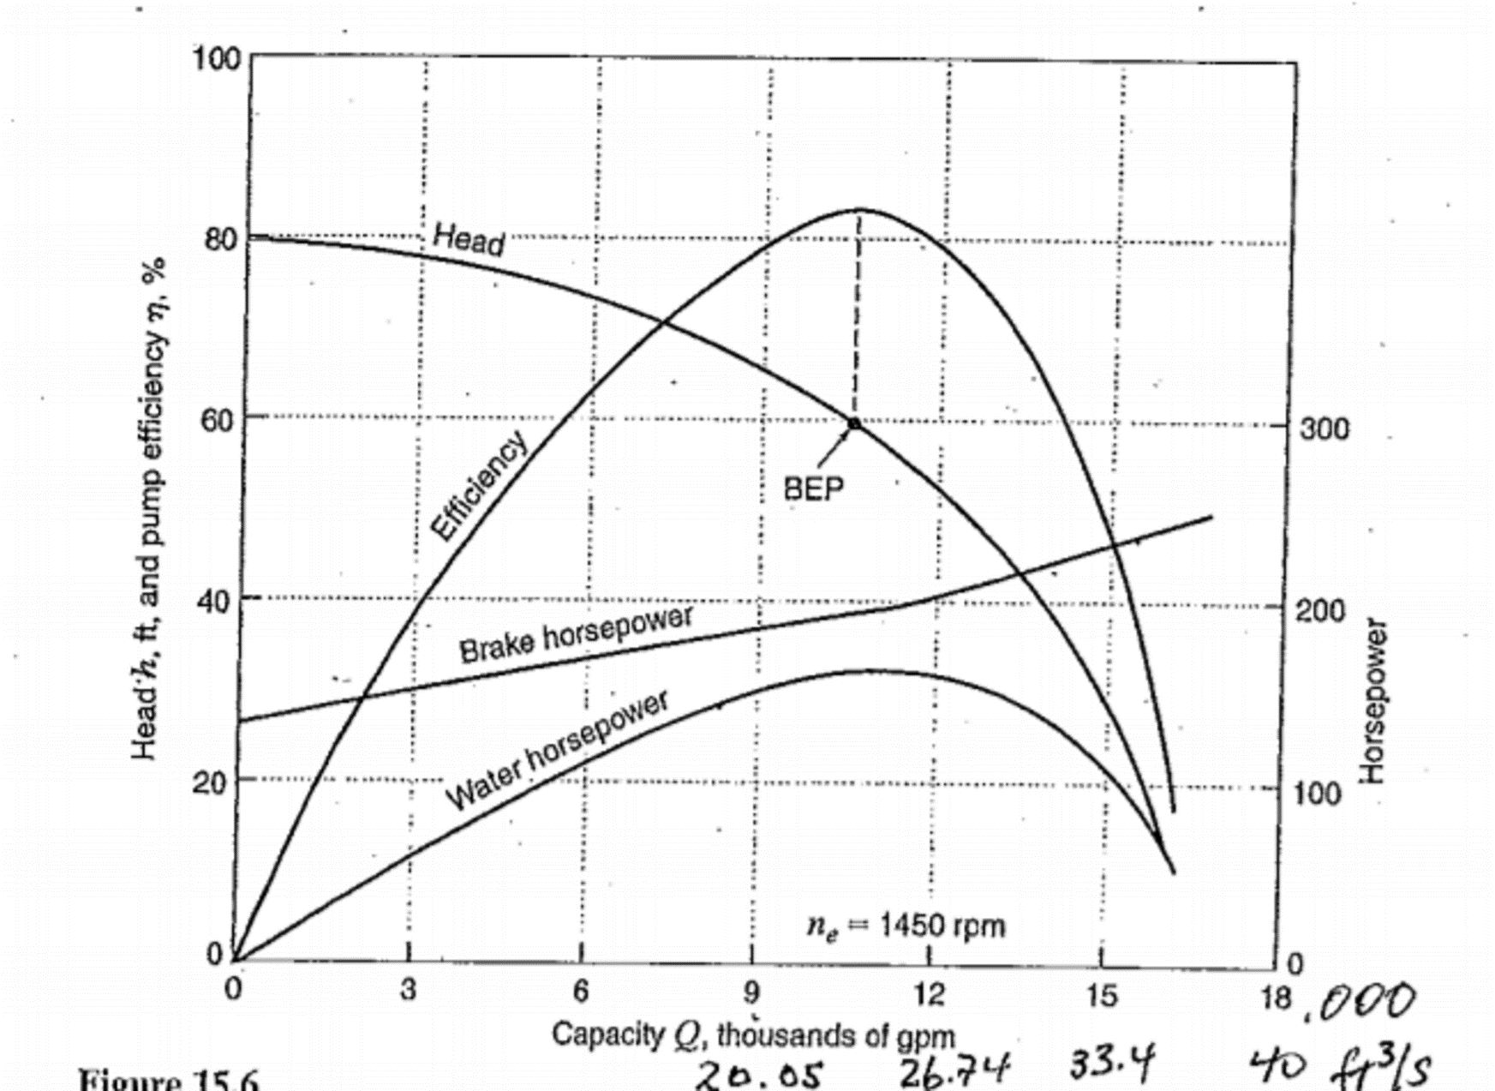
A typical plot giving an impeller type pump characteristics
We need the “Head” curve to understand the flow rate versus
the head or pressure drop.
The H-Q plot.

Slide 3
Choices from Pump Curve
Taco Ta Model 1548
https://www.youtube.com/watch?v=Jfi1PD73Vmk
The first 3 minutes should be watched
Decreasing the impedance with more parallel circuits and/or larger x-section from 6” to 8” pipe.
So the “head “ or the “back pressure” that the pump sees is now less and so the flow rate increases.

Slide 4
Conclusion
Do studies with additional circuits in parallel.
Do studies with lower impedance flow limiters.

Slide 5
Further material

Slide 6
https://www.youtube.com/watch?v=PJPzvPqf9YI
3.49 system characteristics
4.23 system decides the operating point of the pump.

Slide 7
For an in depth study
Fluid Mechanics: Dimensionless Pump Performance (25 of 34)
https://www.youtube.com/watch?v=bc8OzIp2gwM

Slide 8
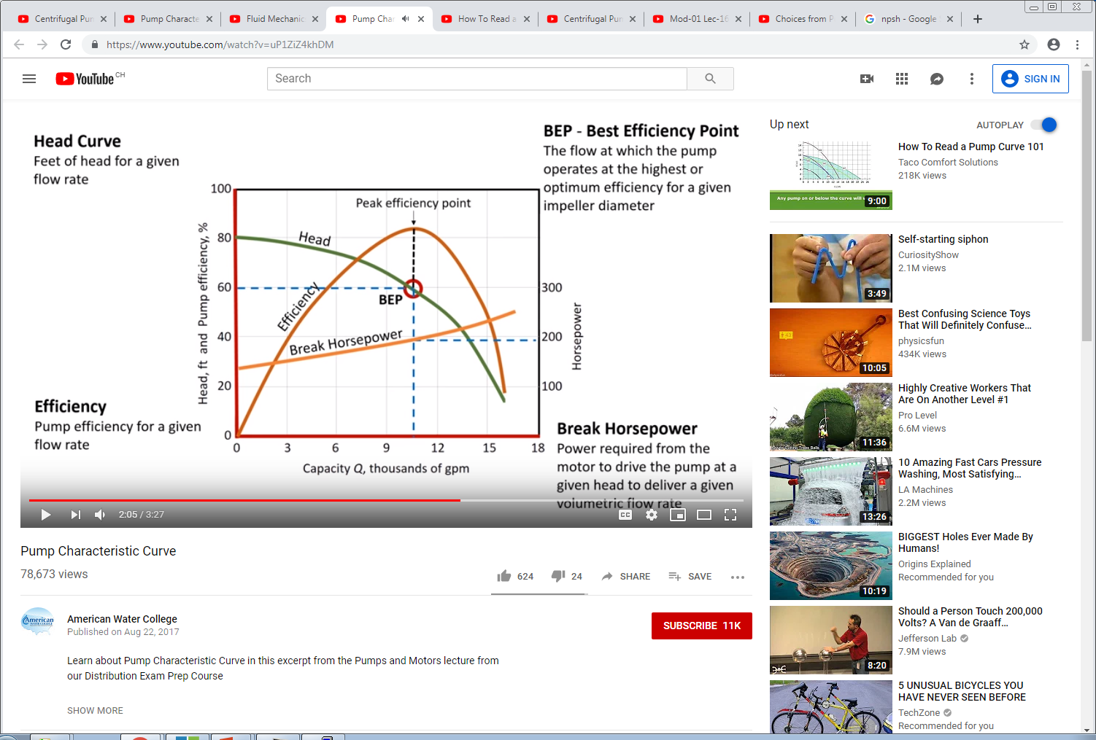
https://www.youtube.com/watch?v=uP1ZiZ4khDM

