Slide 1
Legris compression fittings. Can they be put on brass cylinder fitting eg Swagelok
Ian
3 Oct 2022

Slide 2
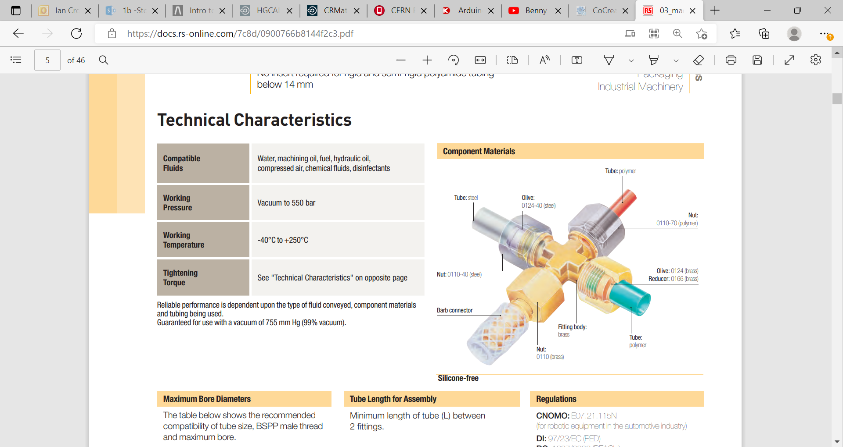
Brass ferrule onto Brass tubbing
https://docs.rs-online.com/7c8d/0900766b8144f2c3.pdf
Page 5-6

Slide 3
Lubricate the fitting

Slide 5
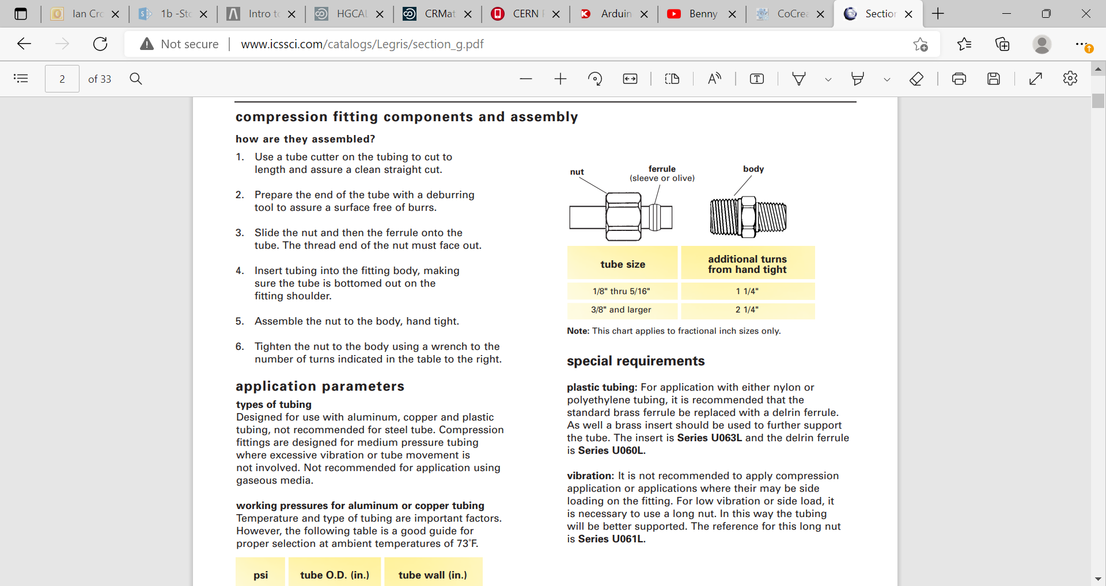
http://www.icssci.com/catalogs/Legris/section_g.pdf

Slide 6
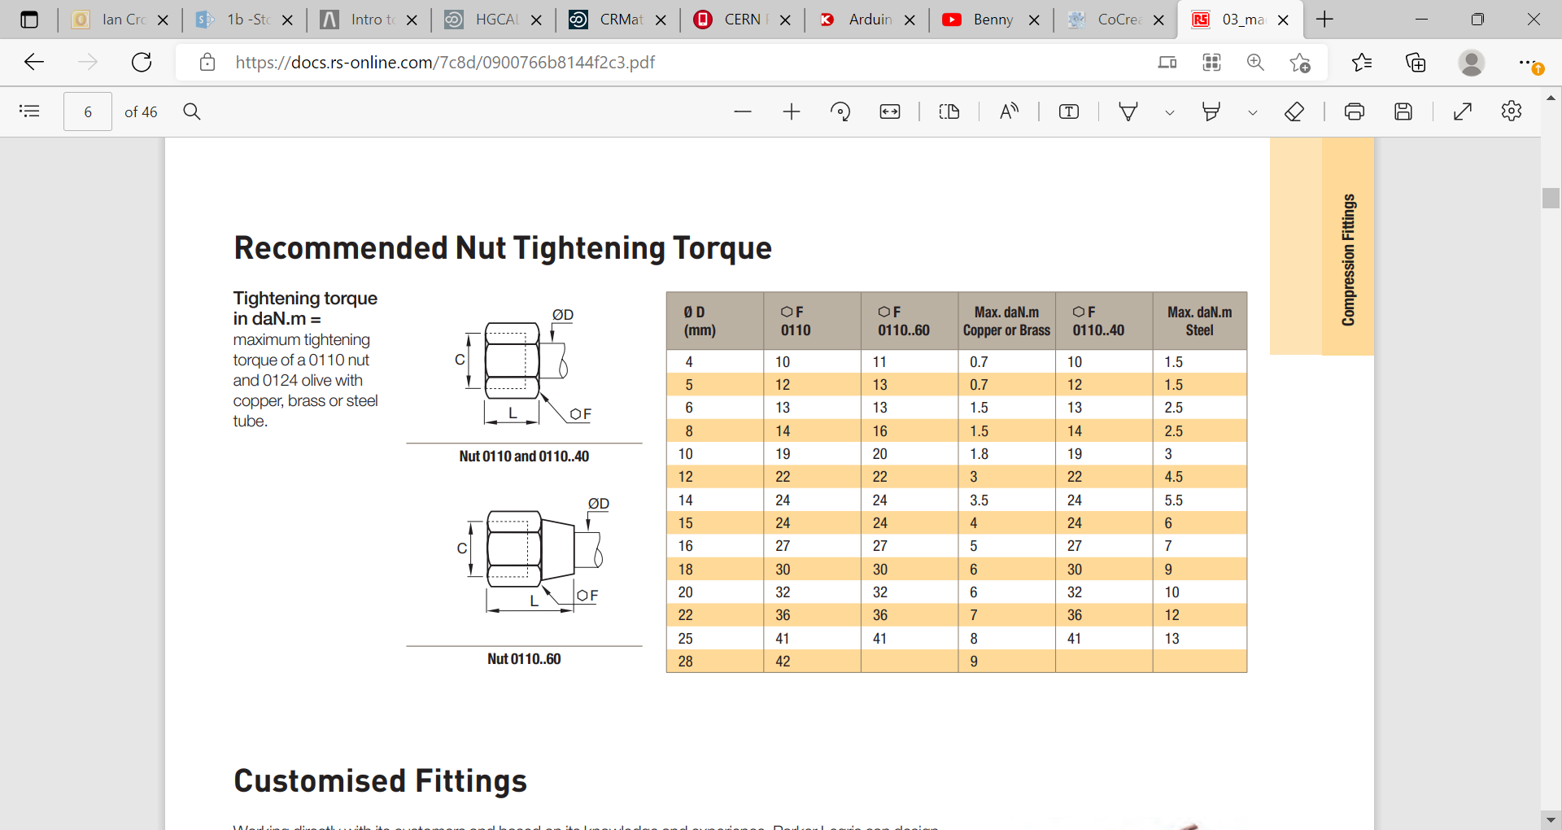
https://docs.rs-online.com/7c8d/0900766b8144f2c3.pdf

Slide 7
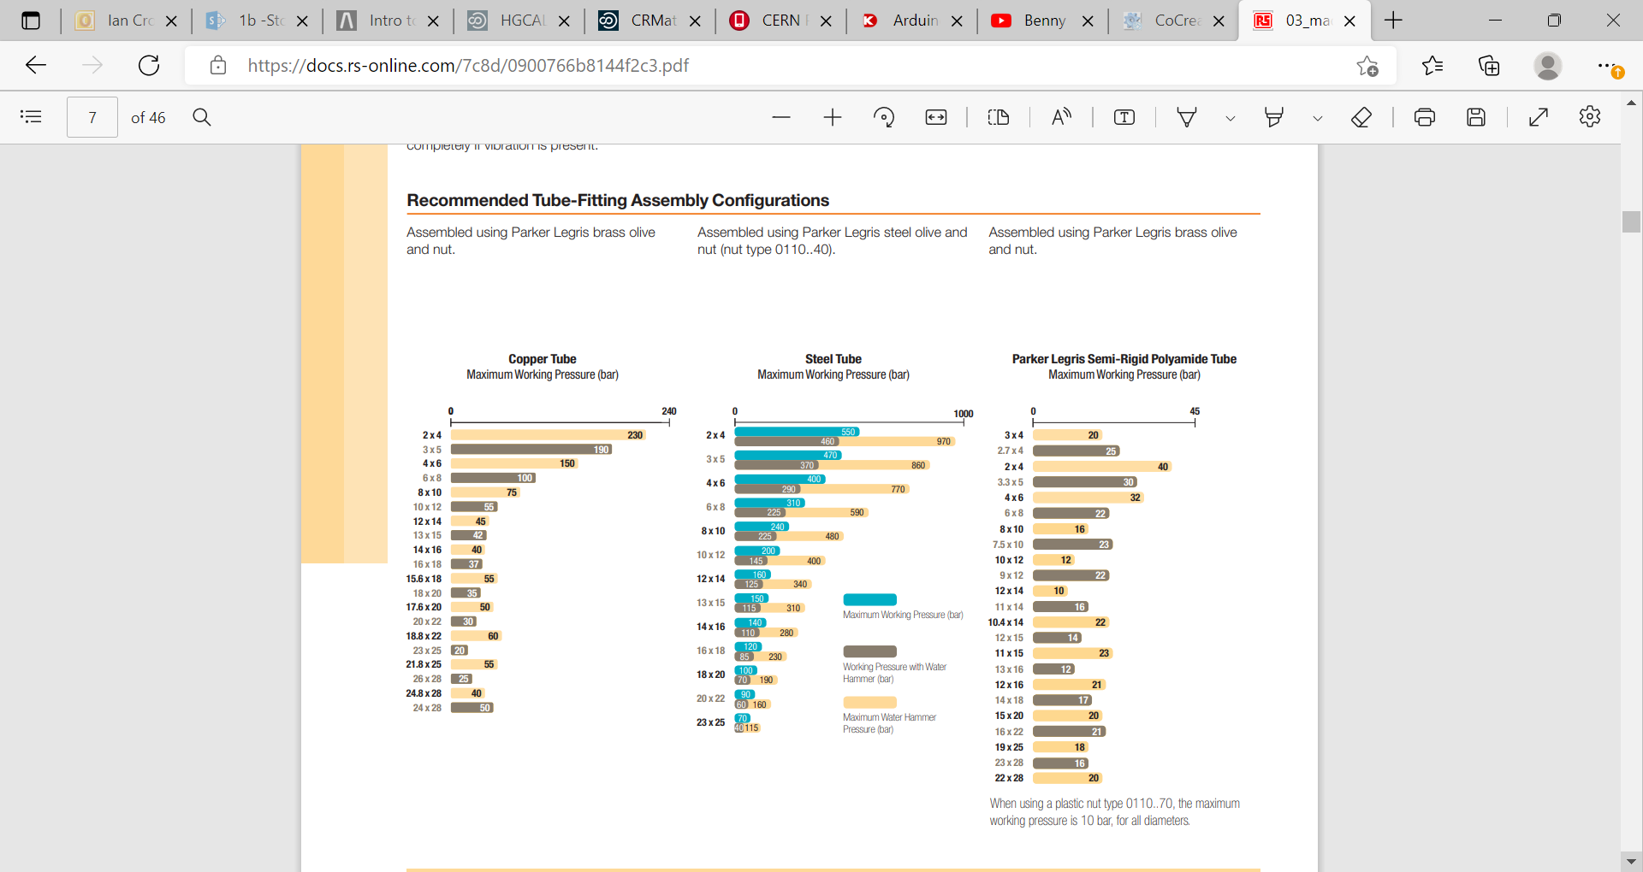

Slide 8
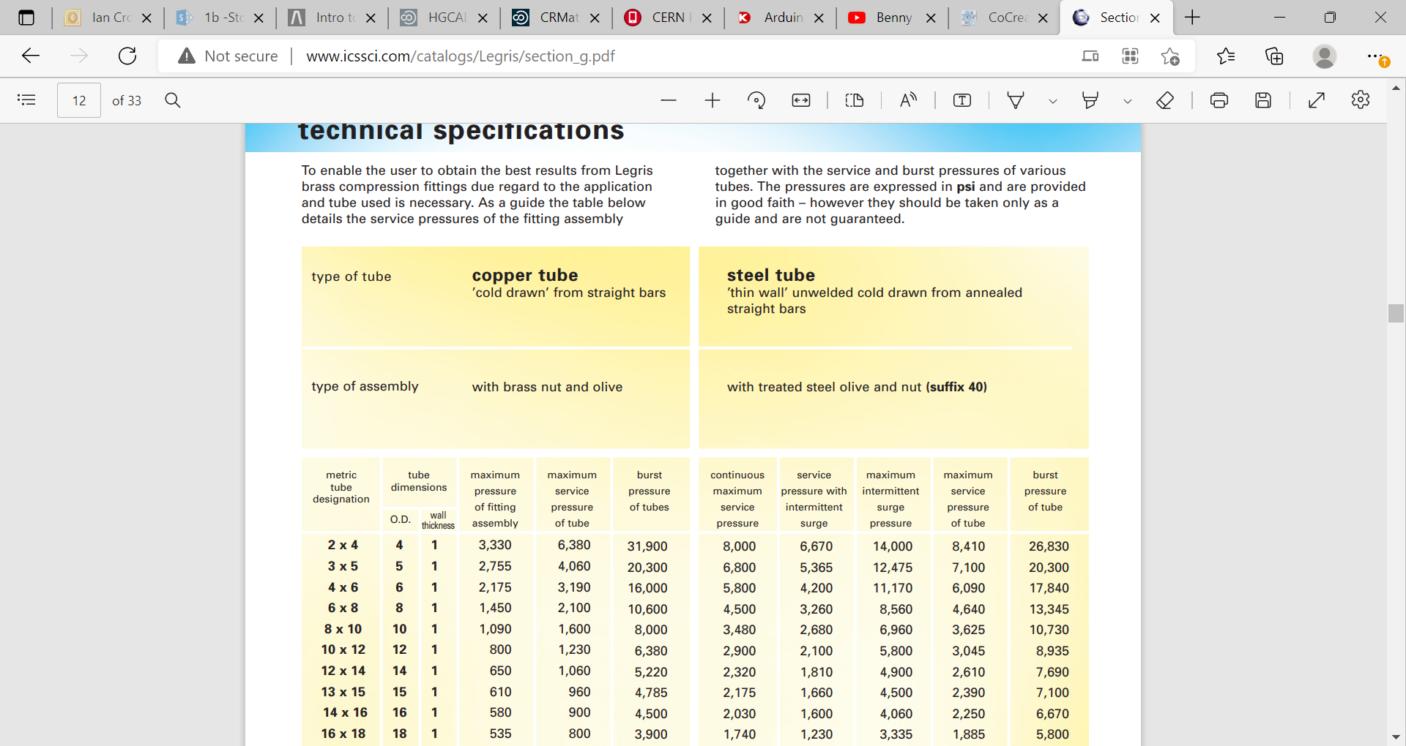

Slide 9
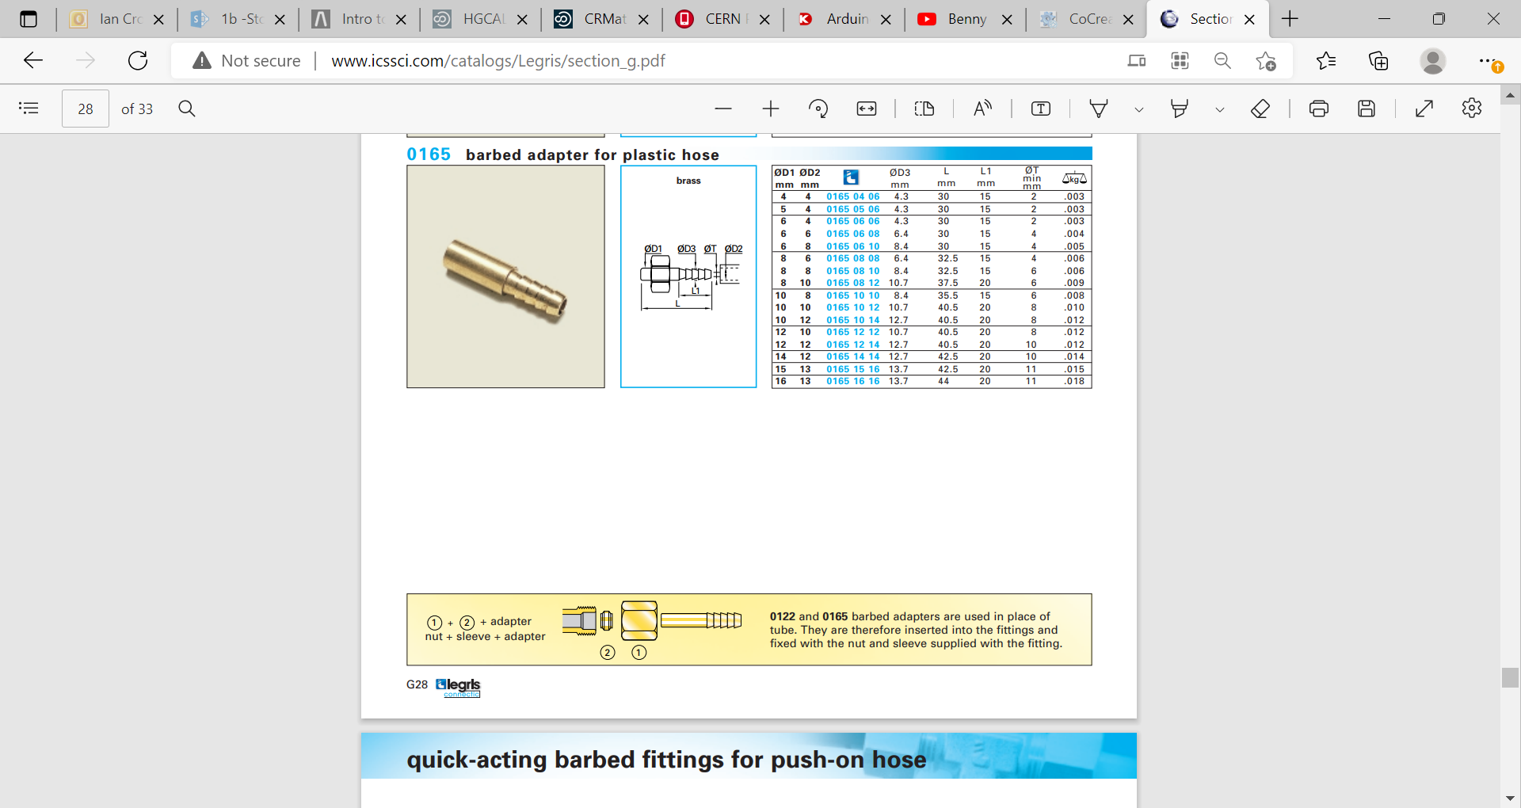
Brass ferrule onto Brass tubbing

Slide 10
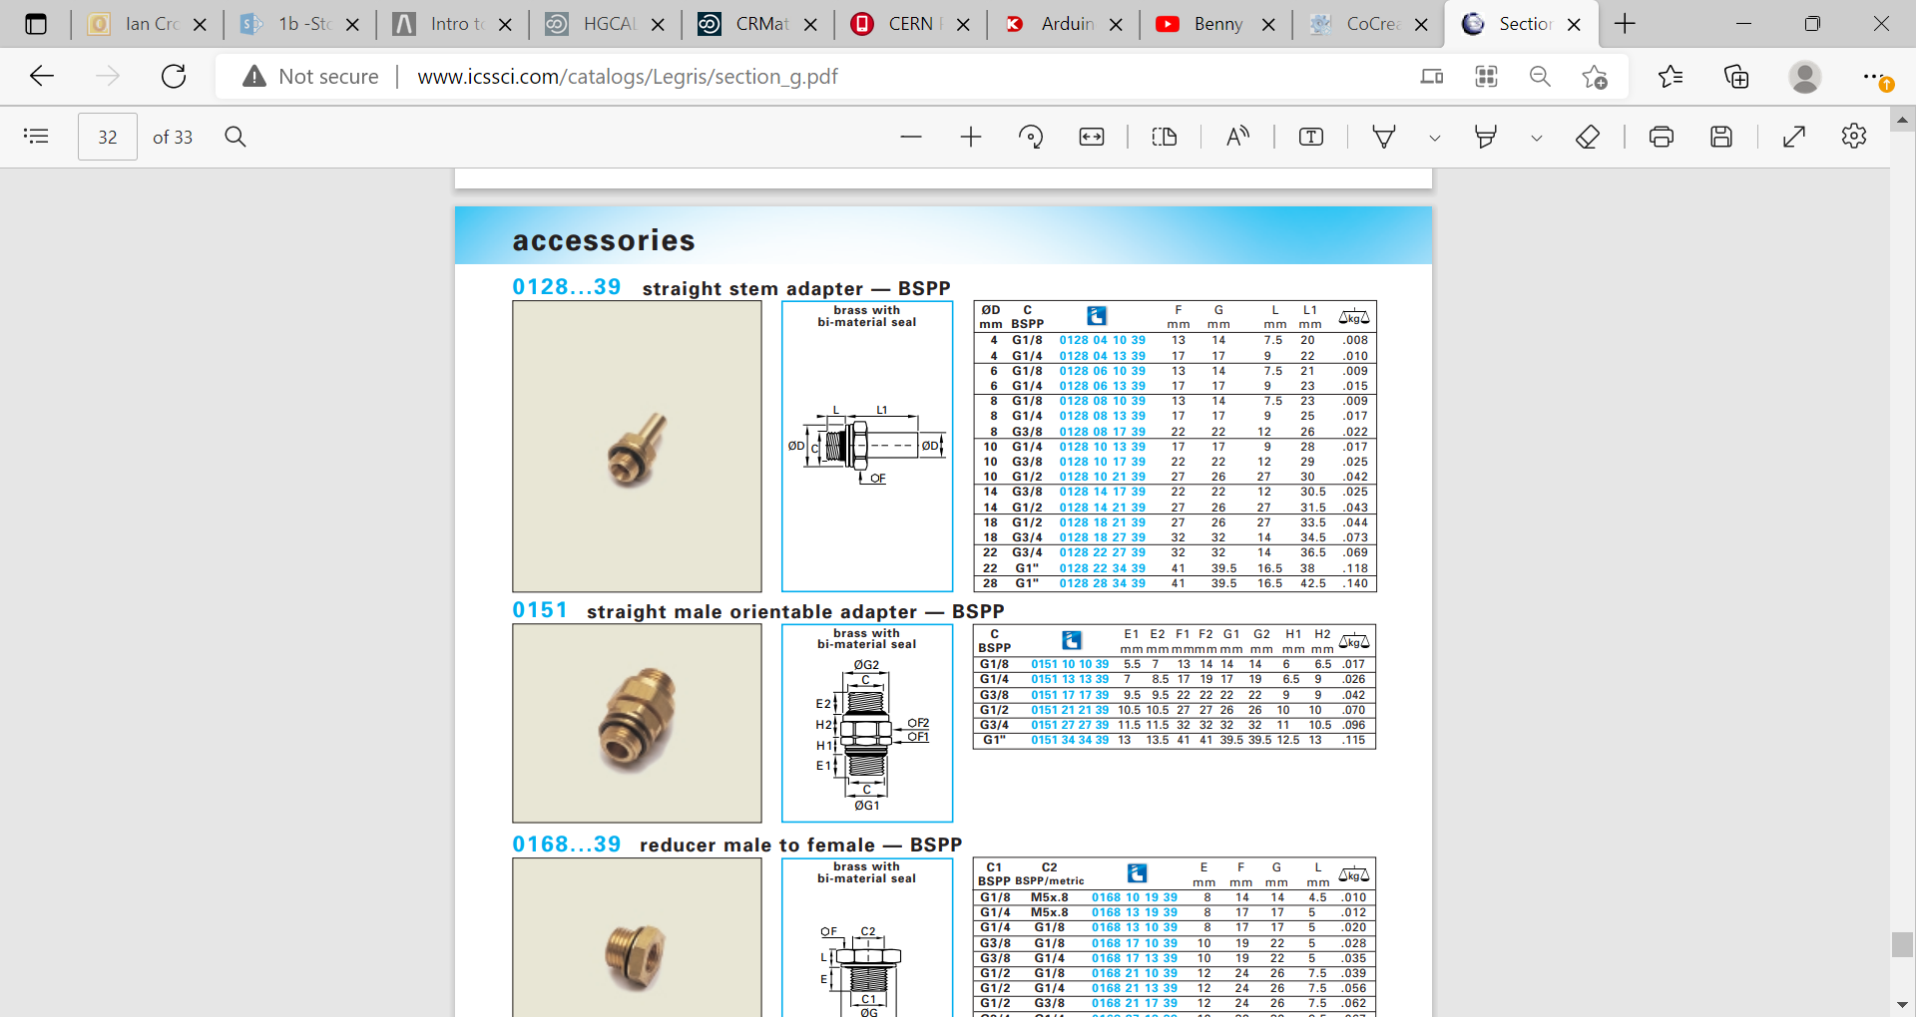
Brass ferrule onto Brass tubbing

Slide 11
https://www.swagelok.com/downloads/webcatalogs/en/ms-13-151.pdf
Groove in brass cylindrical end

Slide 13
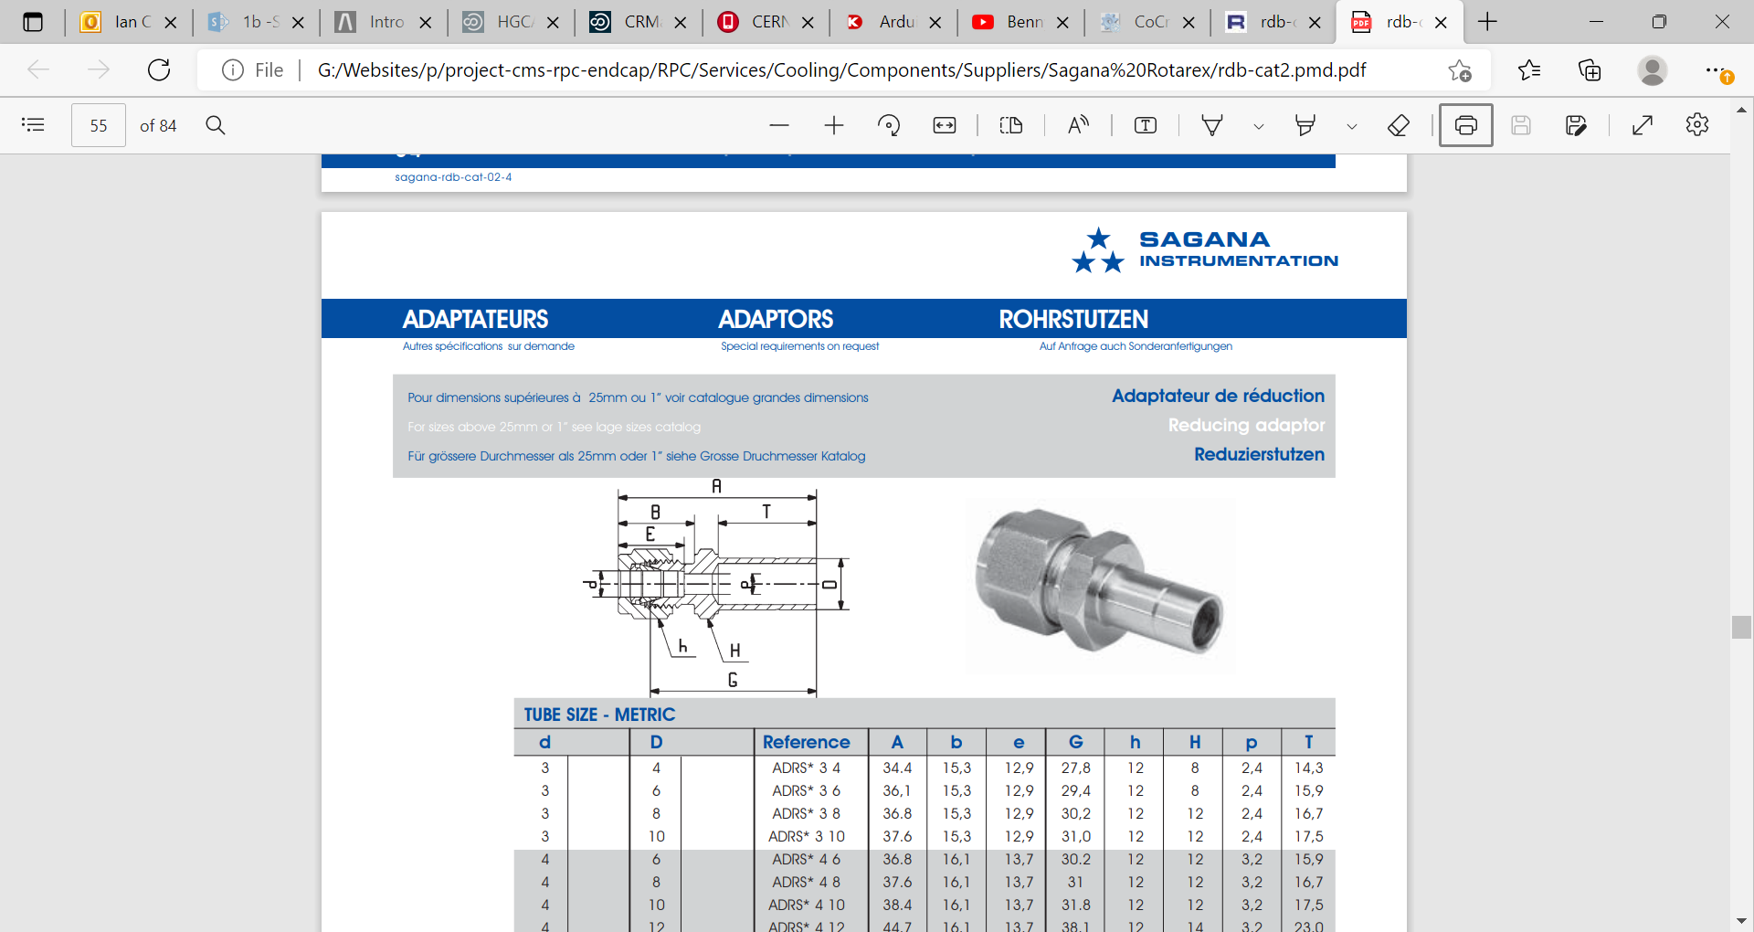
http://www.rotarex-gmbh.de/data/kataloge/katalog_sagana_klemmringverschraubungen.pdf

