Slide 1
Other tools for inserting barb unions into Hose

Slide 2
CMS special “
“Koul Tool” version

Slide 3
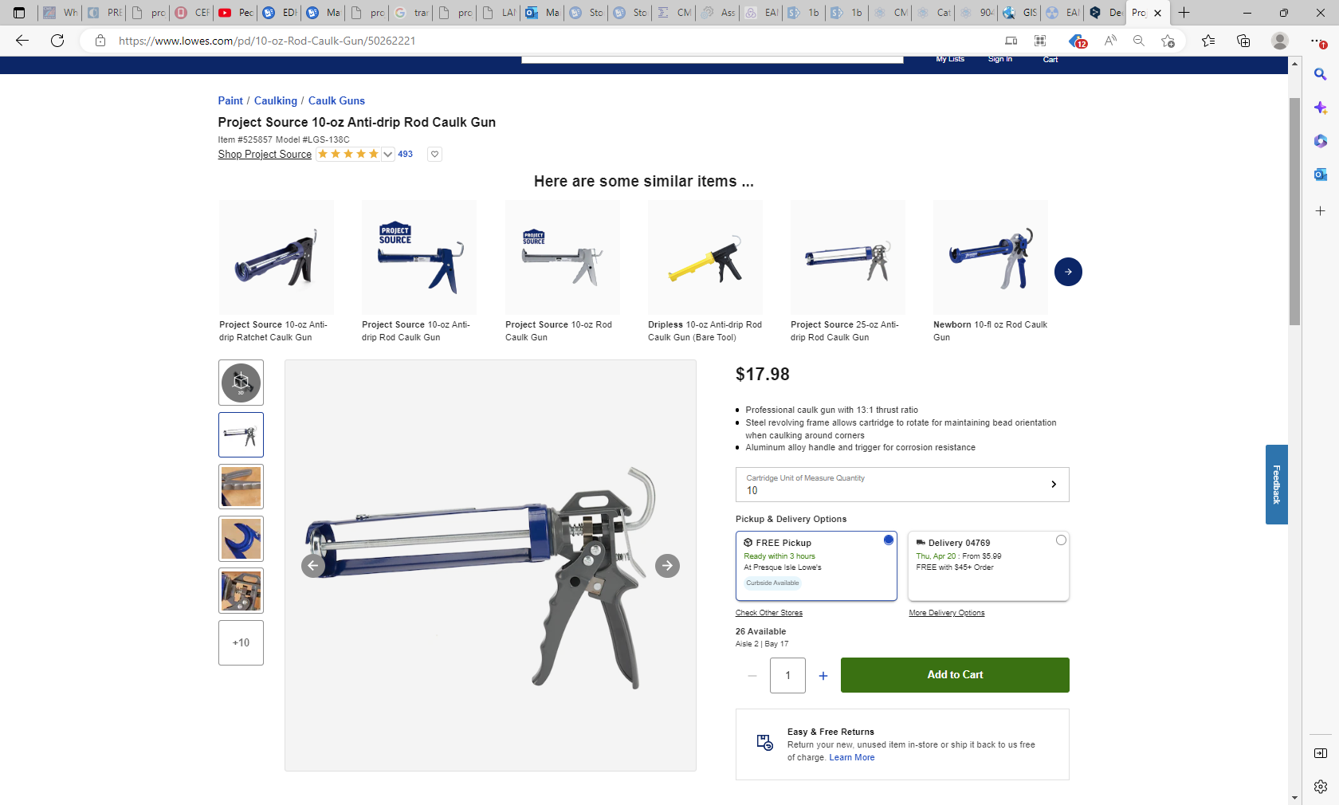
https://www.lowes.com/pd/10-oz-Rod-Caulk-Gun/50262221

Slide 4
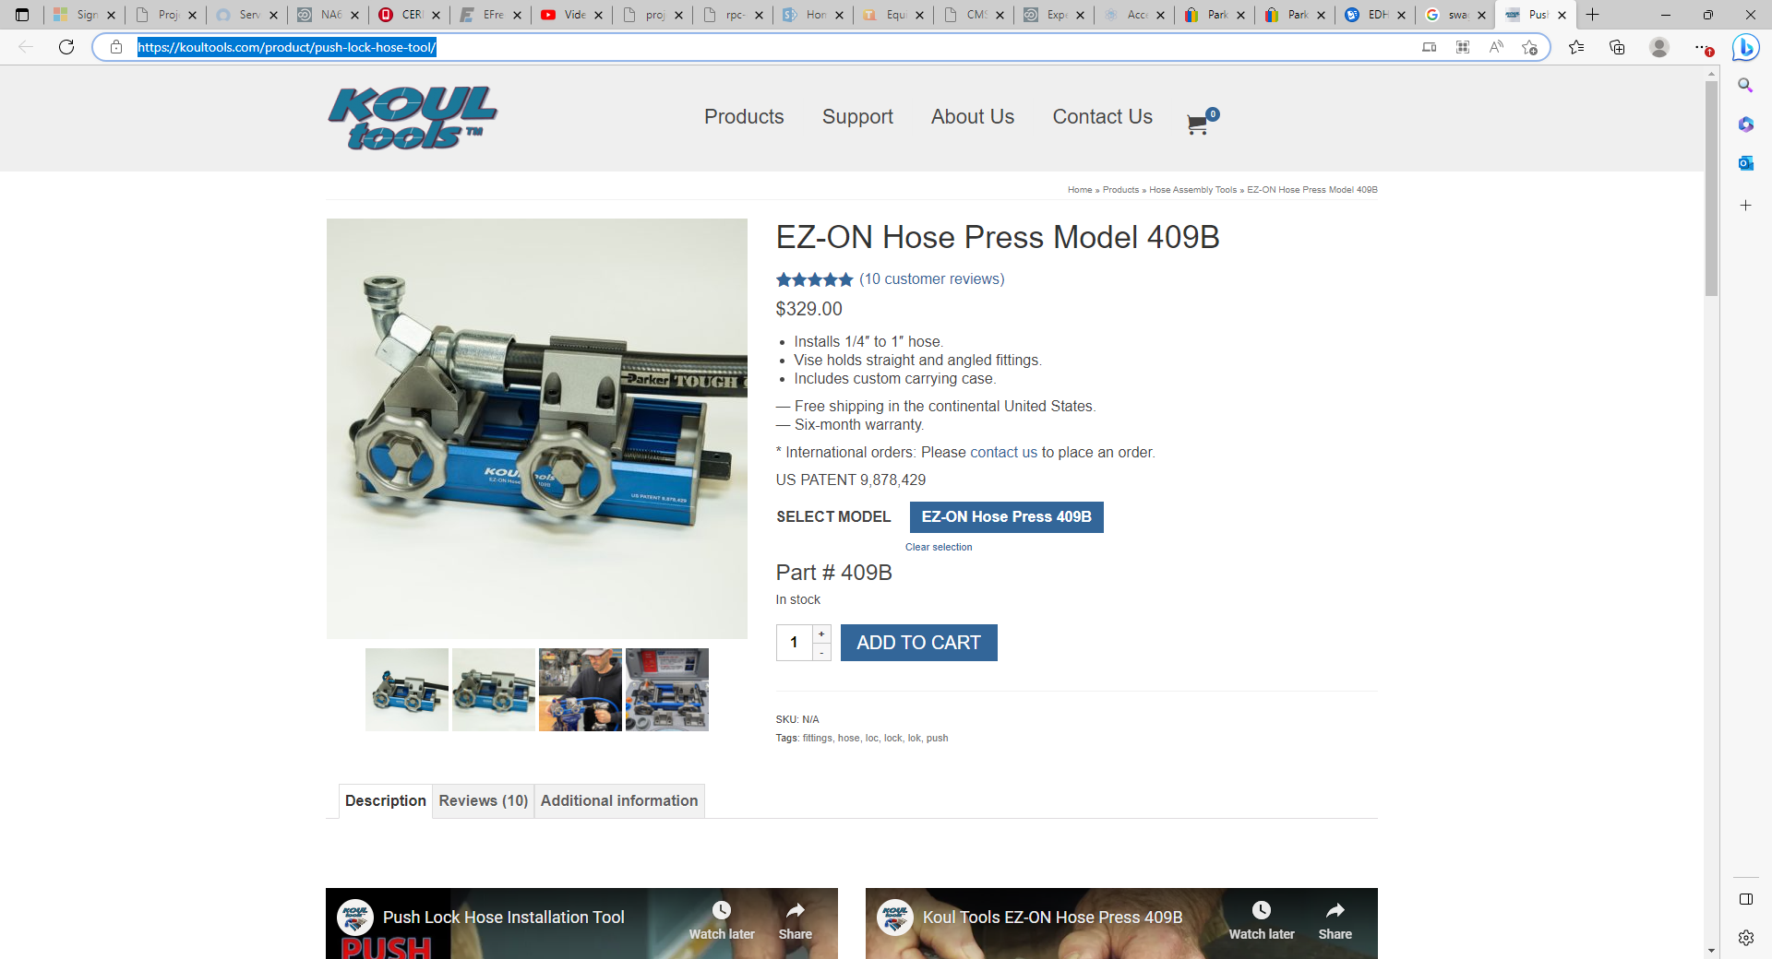
Push Lock Hose Tool | Barbed Fittings | Koul Tools

Slide 5
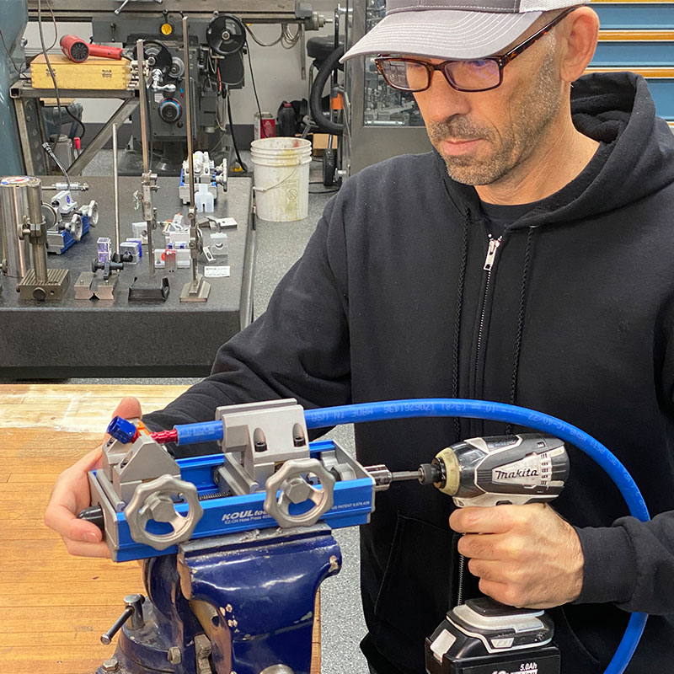
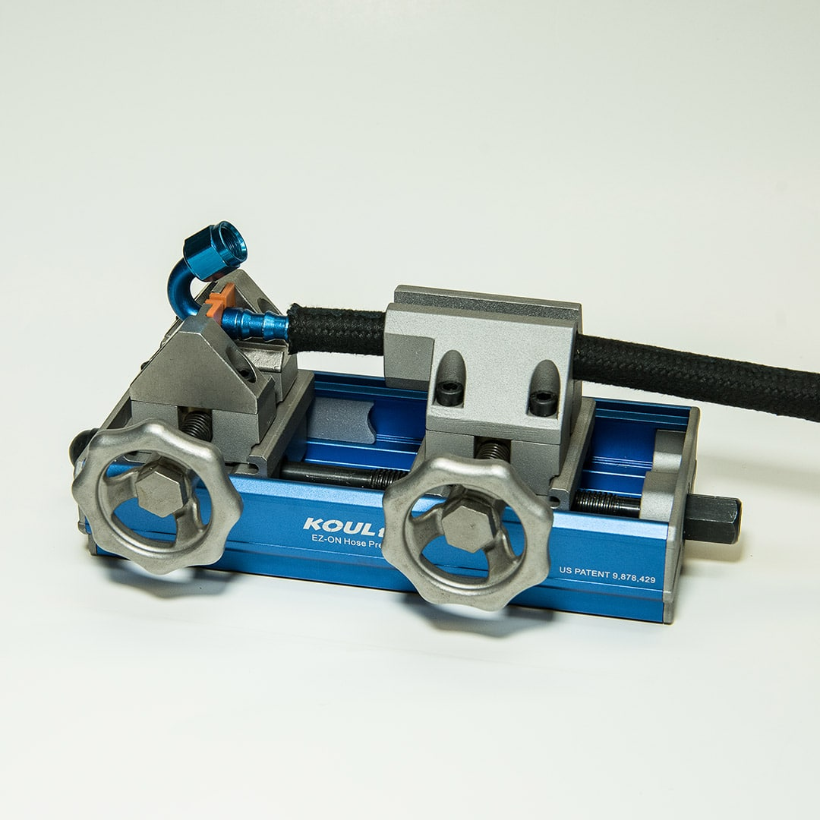
https://www.youtube.com/watch?v=a-zwXwePKrs

Slide 6
Tubes International
https://www.youtube.com/watch?v=_F9i5q5qG78

Slide 7
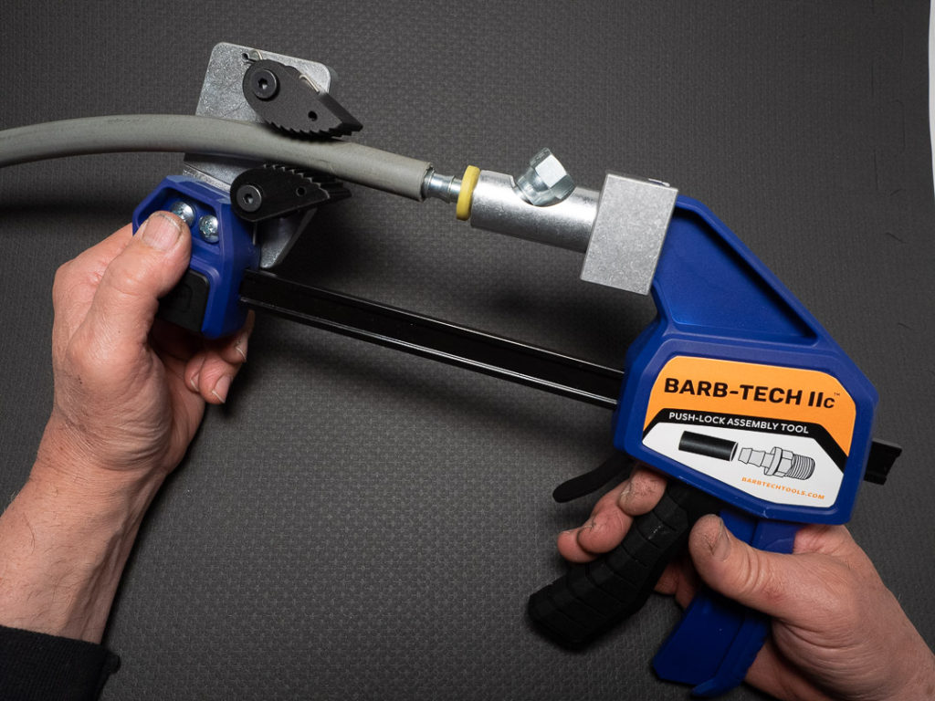
https://www.barbtechtools.com/benefits-of-hose-assembly-tool/
https://www.youtube.com/watch?v=Txqgcg3bKqY

Slide 8
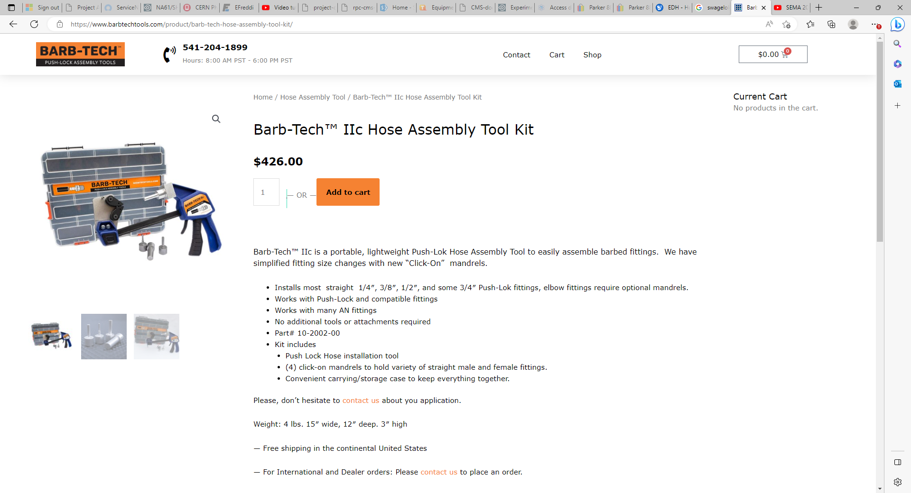

Slide 9
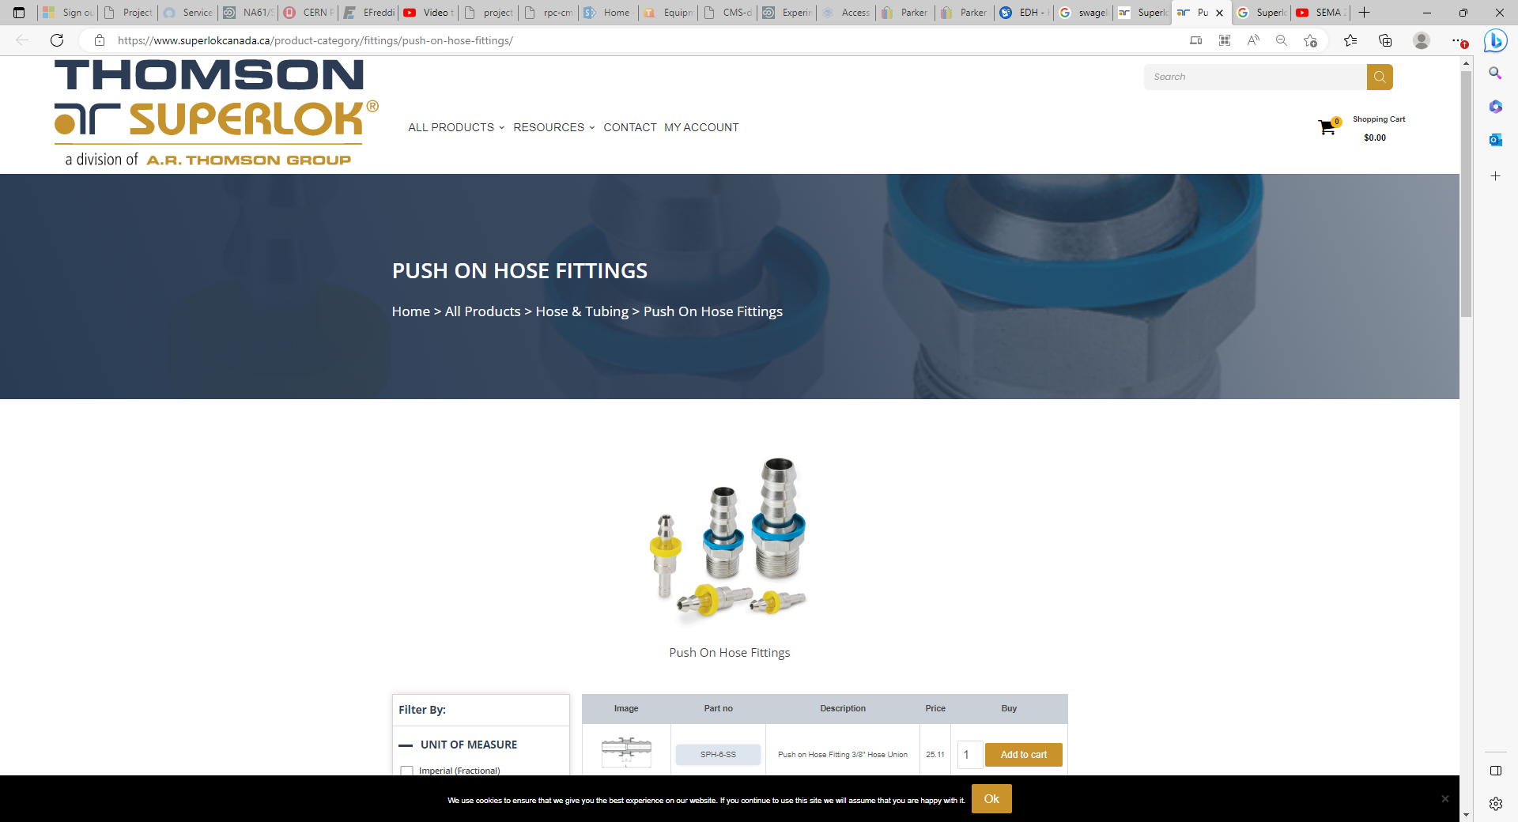
Superlok Push-On Hose Fittings

Slide 10
With lubrication

Slide 11
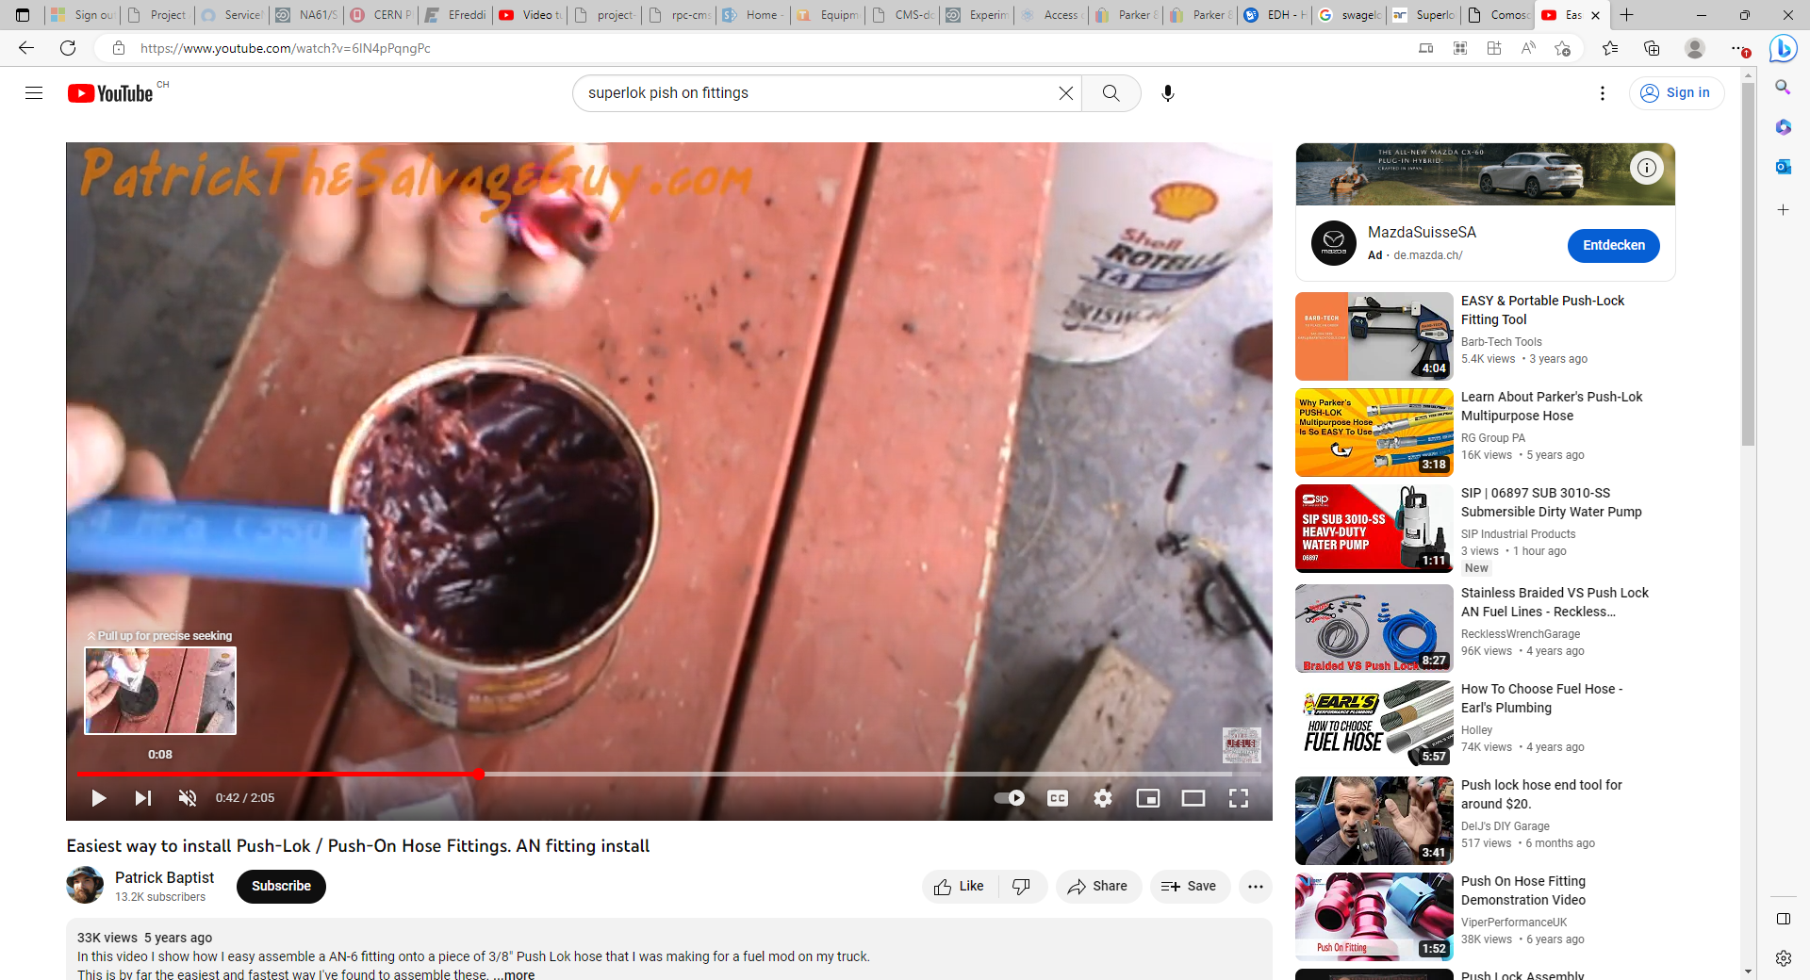
https://www.youtube.com/watch?v=6IN4pPqngPc

