Slide 1
Tool to insert unions into Flexible hose such as Parker “Push-Lok”
Ian
14 April 2023

Slide 2
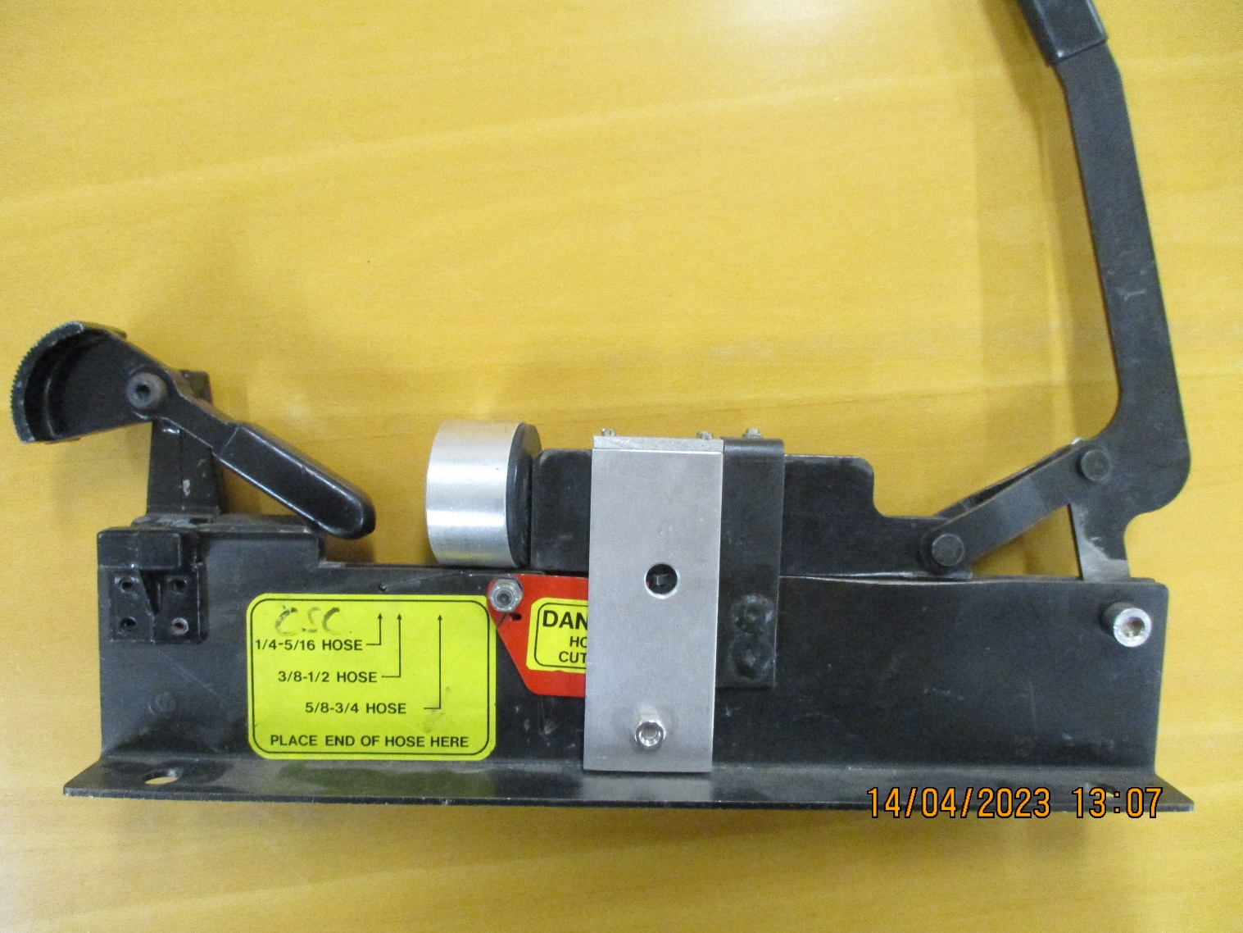
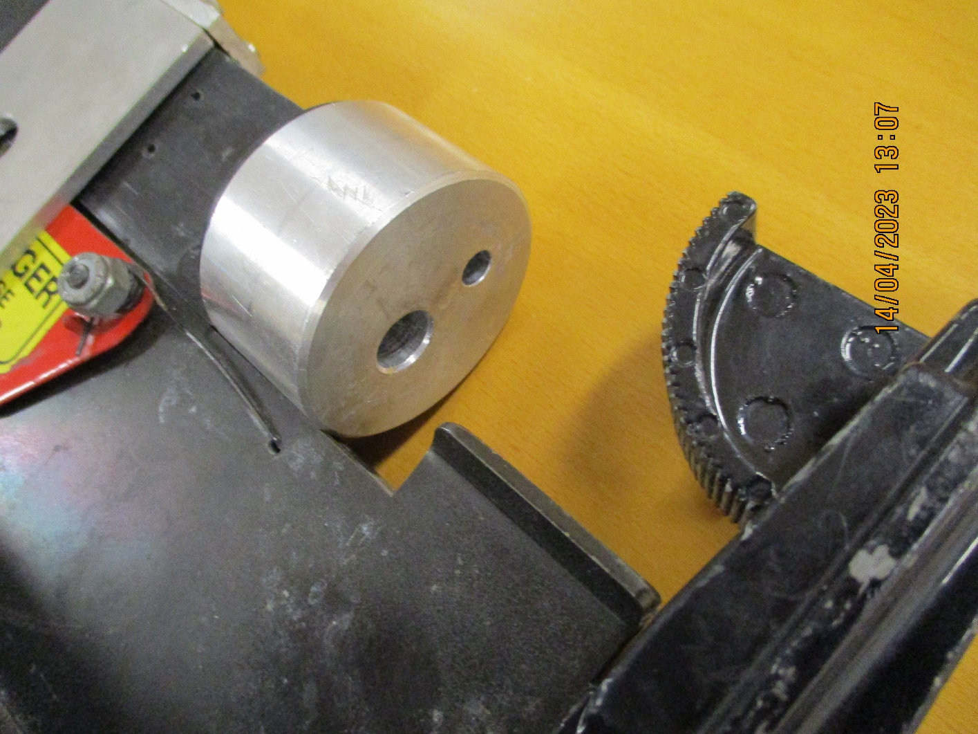

Slide 3
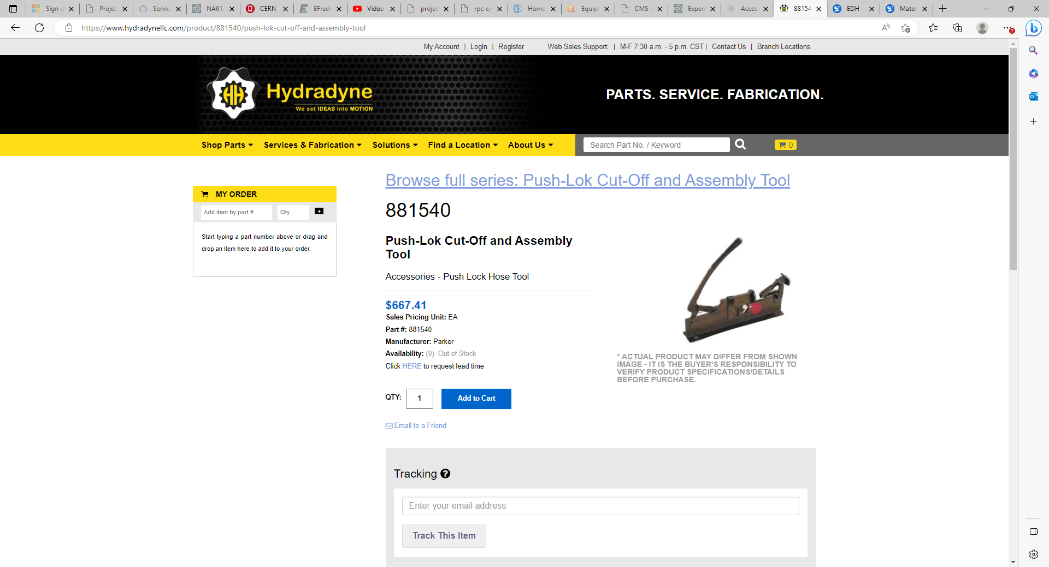
https://www.hydradynellc.com/product/881540/push-lok-cut-off-and-assembly-tool

Slide 4
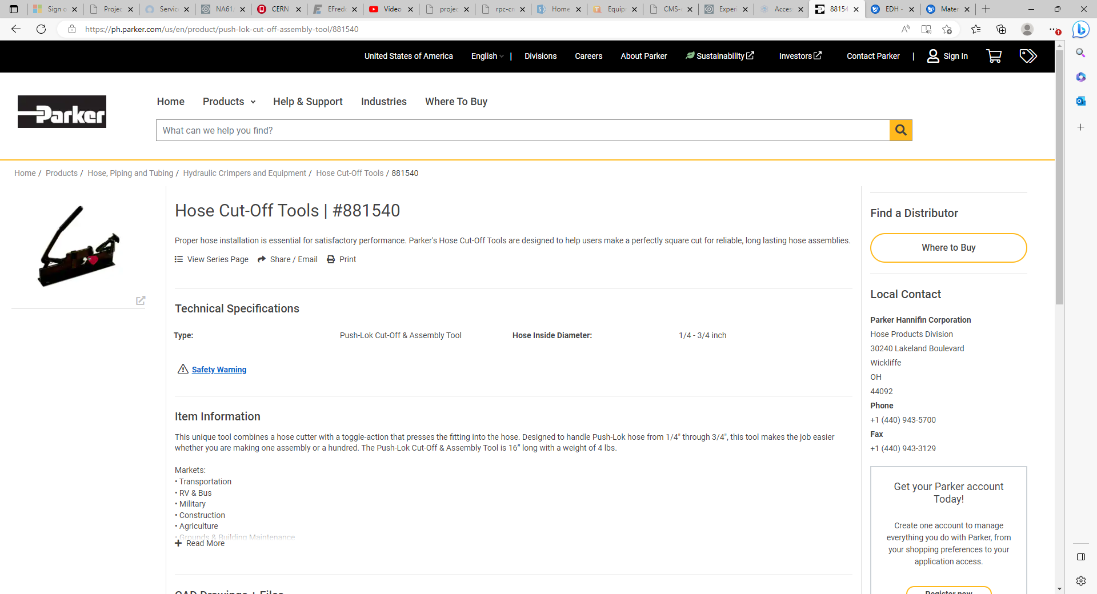

Slide 5
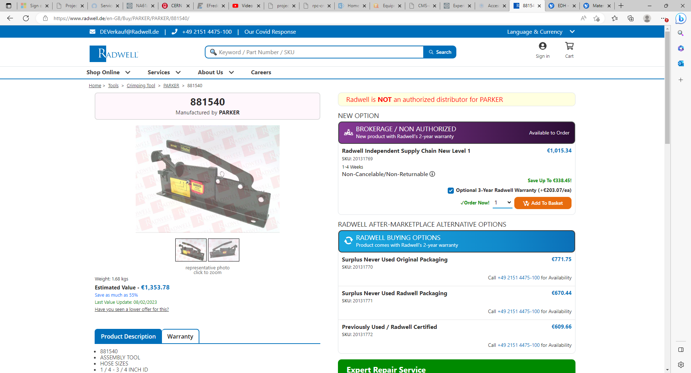
https://www.radwell.de/en-GB/Buy/PARKER/PARKER/881540/

Slide 6
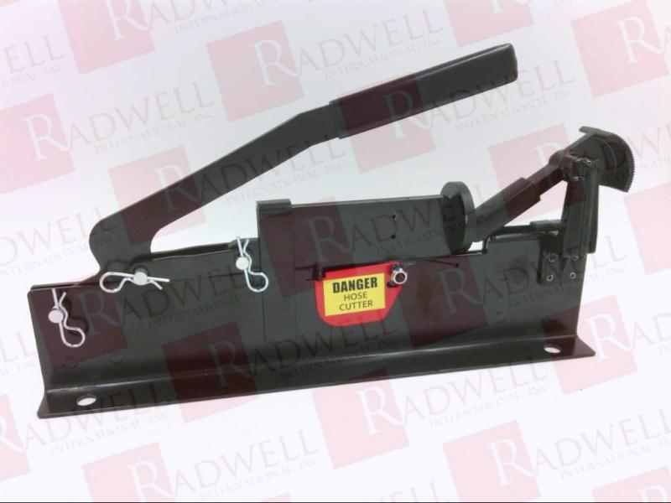

Slide 7
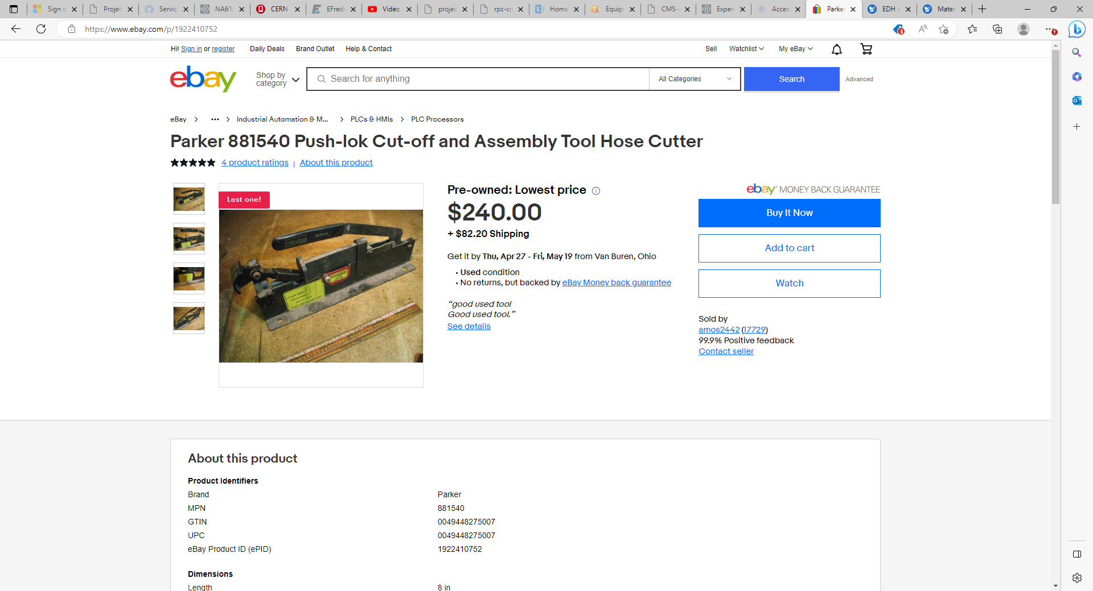

Slide 8
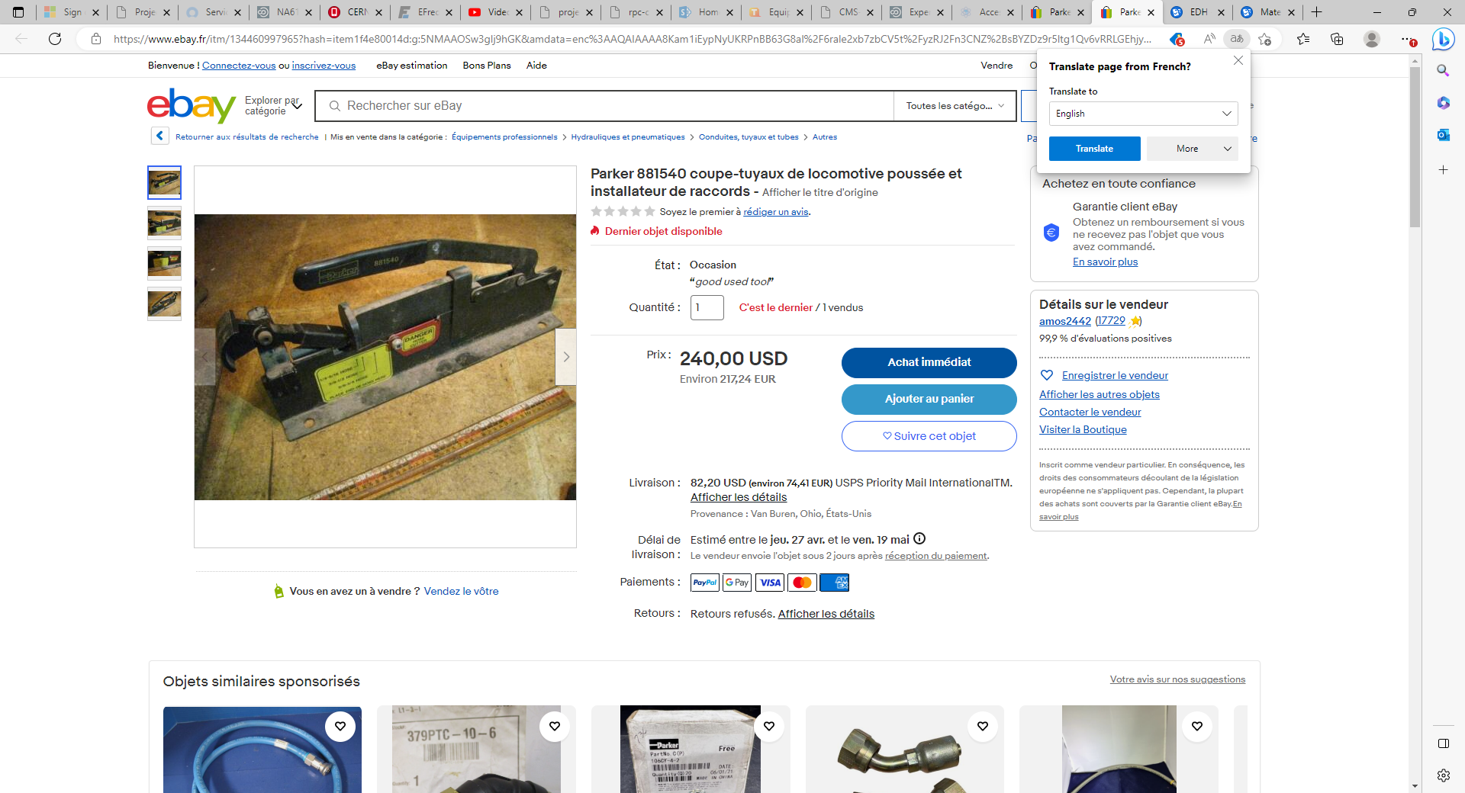
Parker 881540 coupe-tuyaux de locomotive poussée et installateur de raccords | eBay

