Slide 1
Pipe clamps
Ian
3 Oct 2024

Slide 2
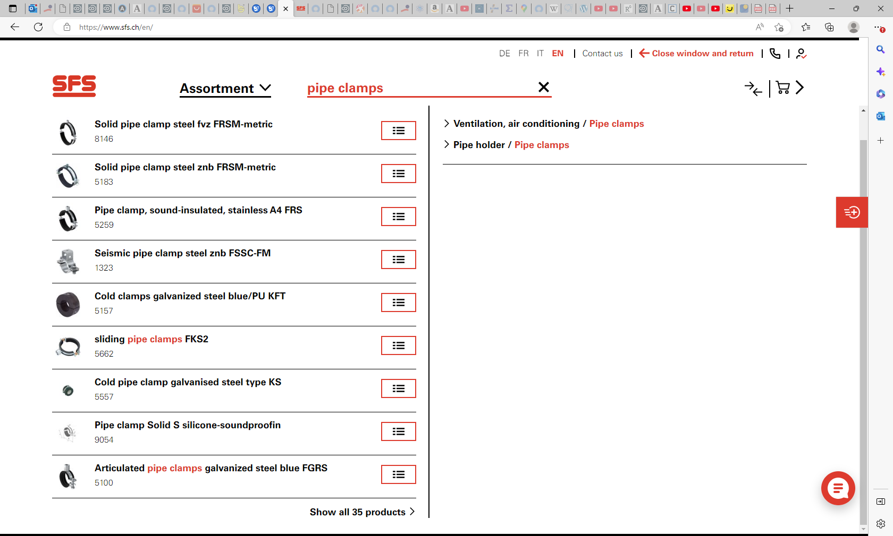

Slide 3
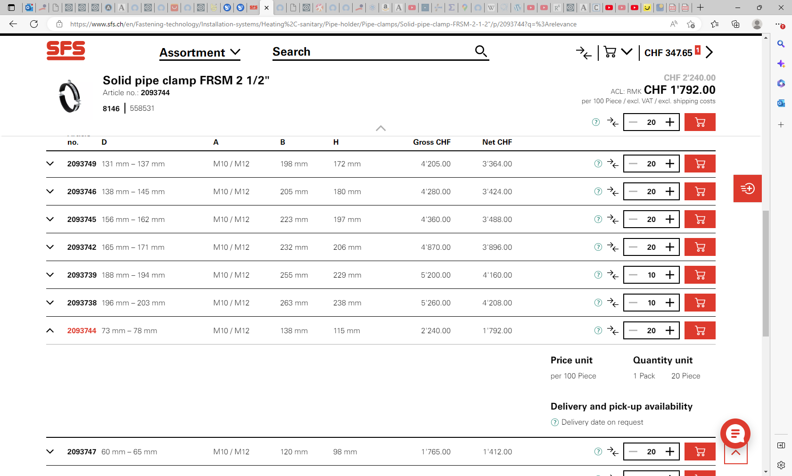
⁣FISCHER Solid pipe clamp steel fvz FRSM-metric | SFS

Slide 4
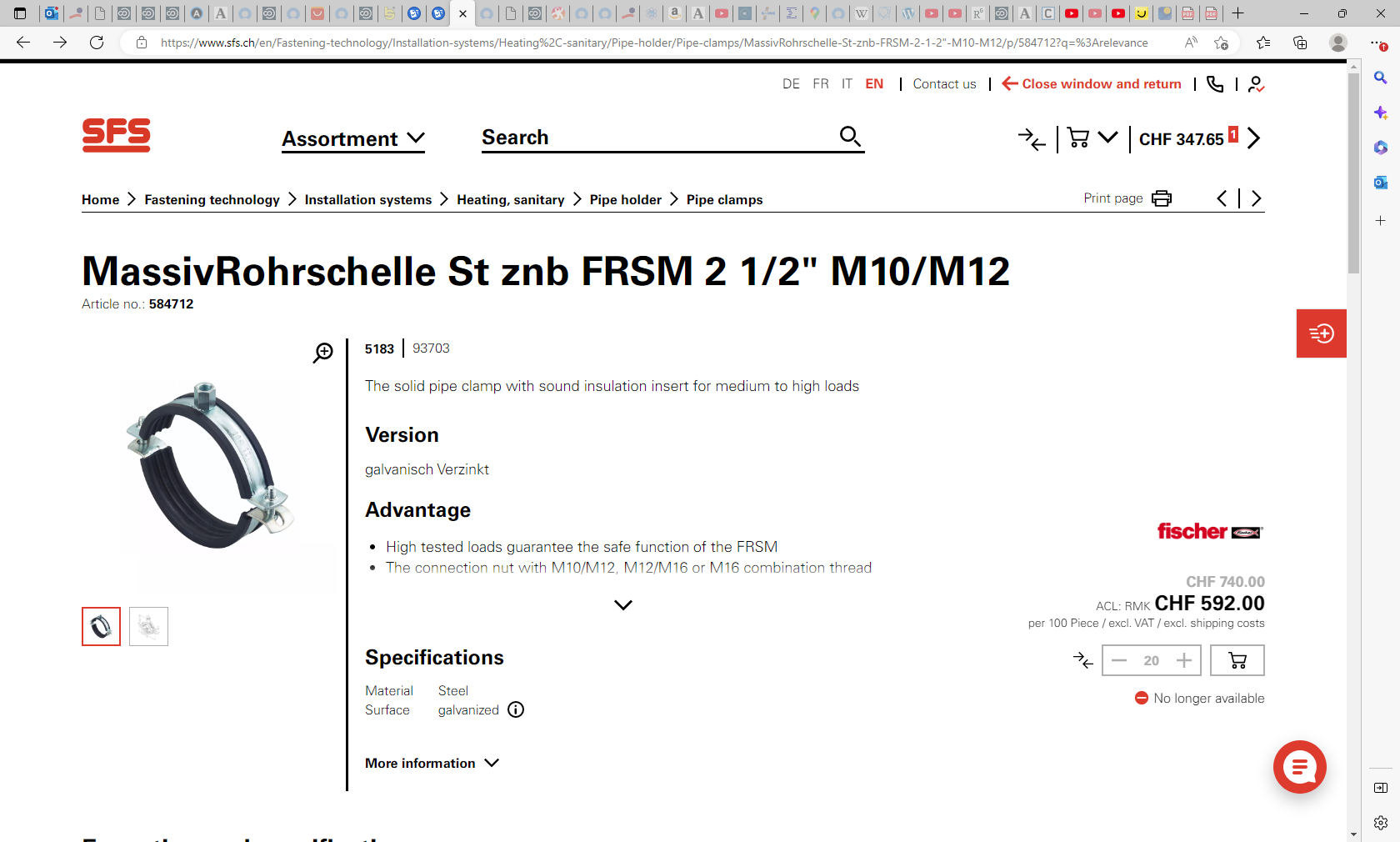
⁣FISCHER MassivRohrschelle St znb FRSM 2 1/2" M10/M12 | SFS

Slide 5
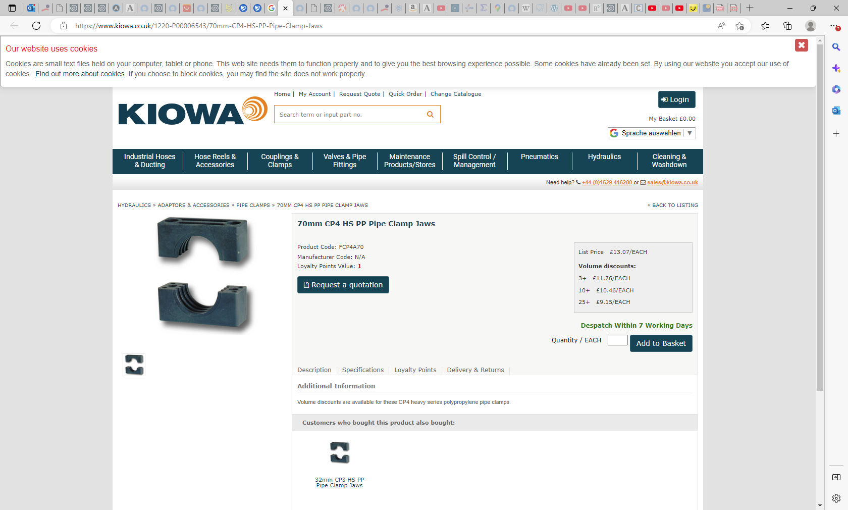
70mm CP4 HS PP Pipe Clamp Jaws
https://www.kiowa.co.uk/1220-P00006543/70mm-CP4-HS-PP-Pipe-Clamp-Jaws

Slide 6
70mm Clamp Bodies (PP - Green) - Group 7 Standard Series | 770-PP (hydraulicmegastore.com)

Slide 7
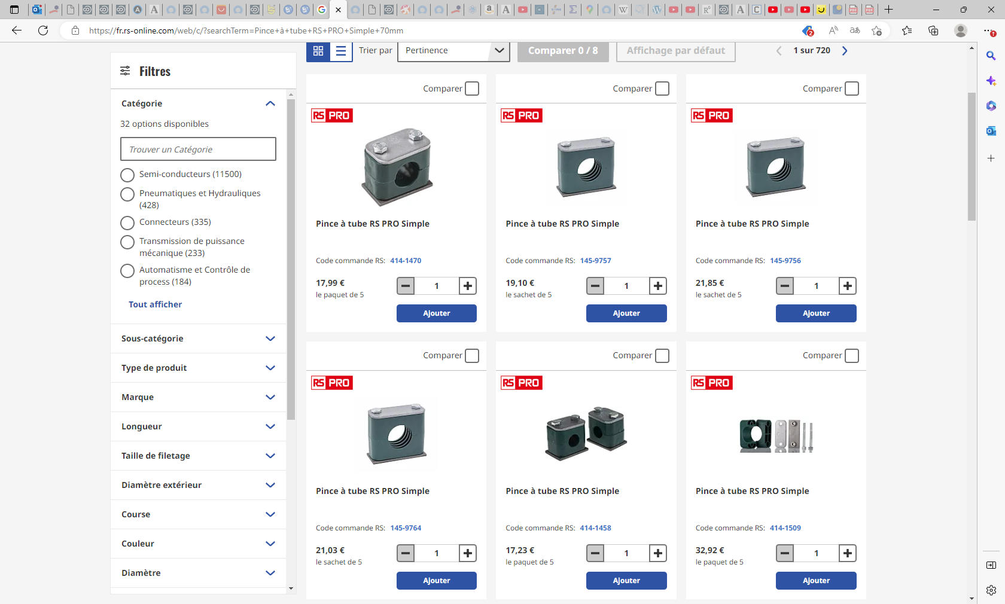

Slide 8
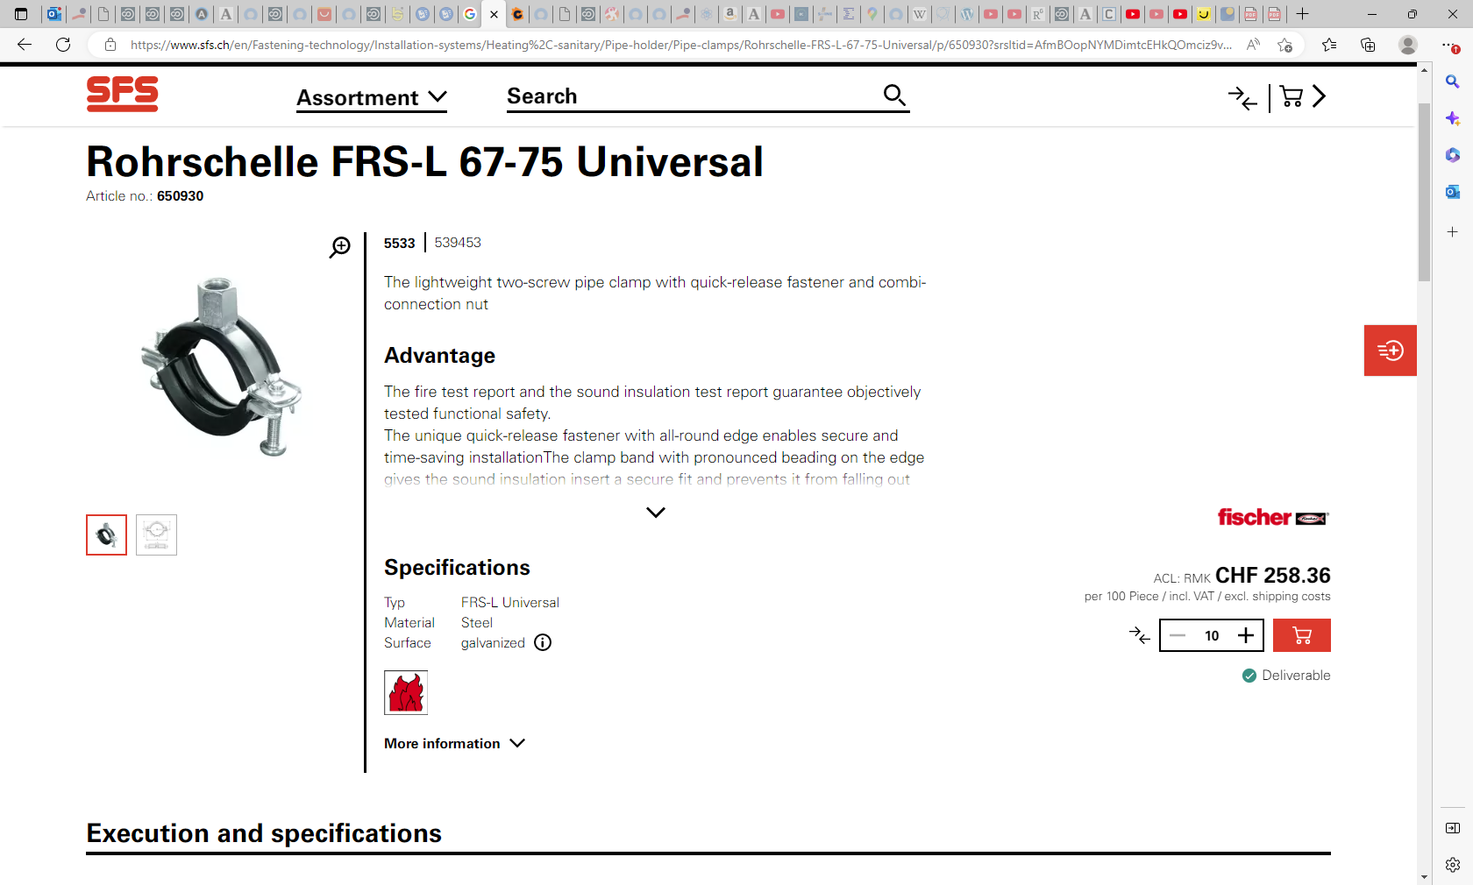
650930
pic_prod_S080108_1480.eps
fischer SM Rohrschelle FRS-L St znb
pic_prod_S080108_1480.eps
fischer SM Rohrschelle FRS-L St znb
5533
539453

Slide 9
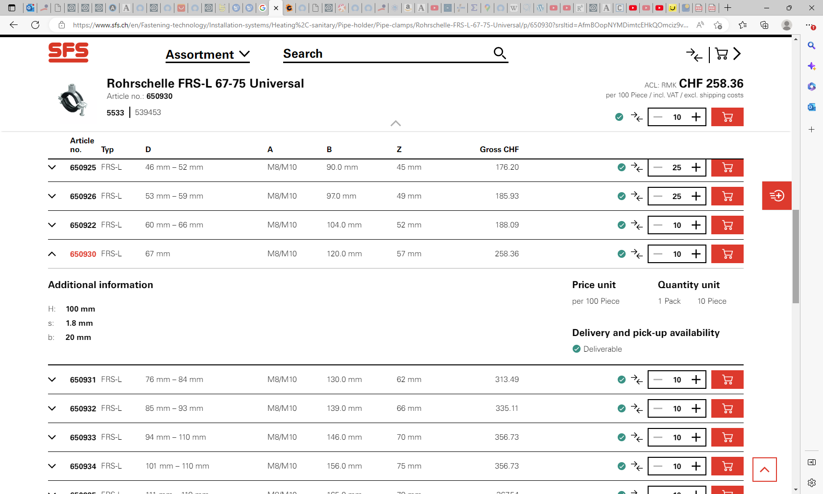

Slide 10
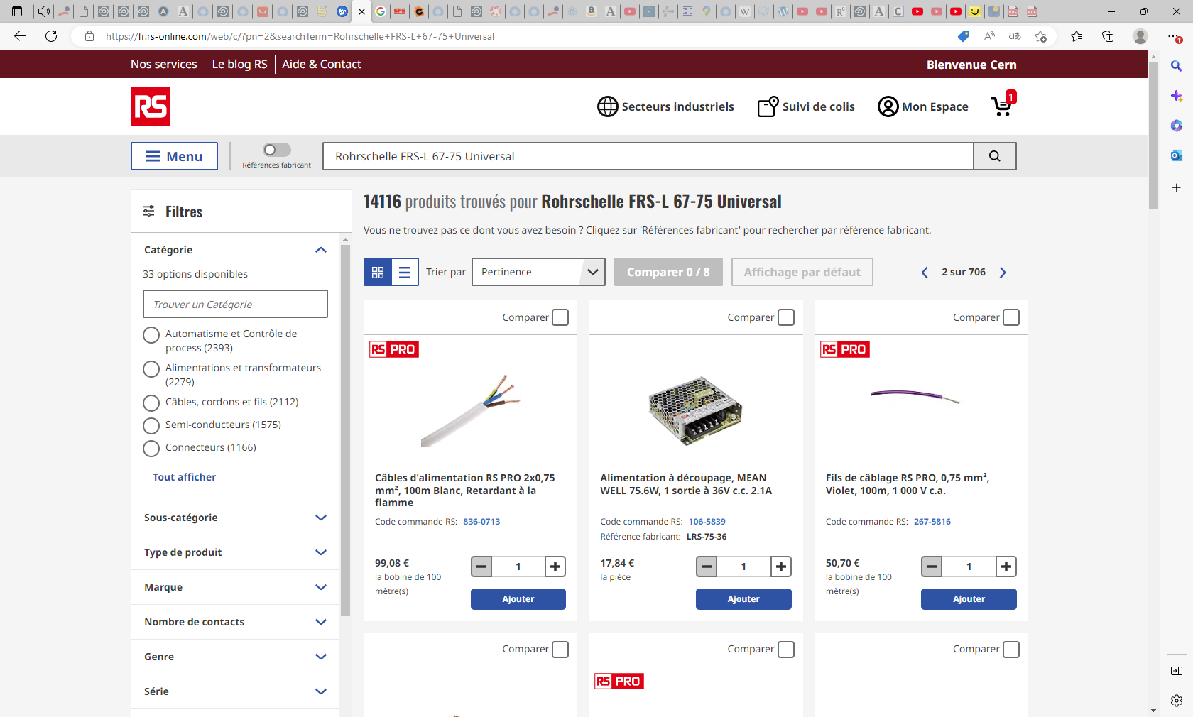
Unable to find in RS EDH with any of the 3 reference numbers

Slide 11
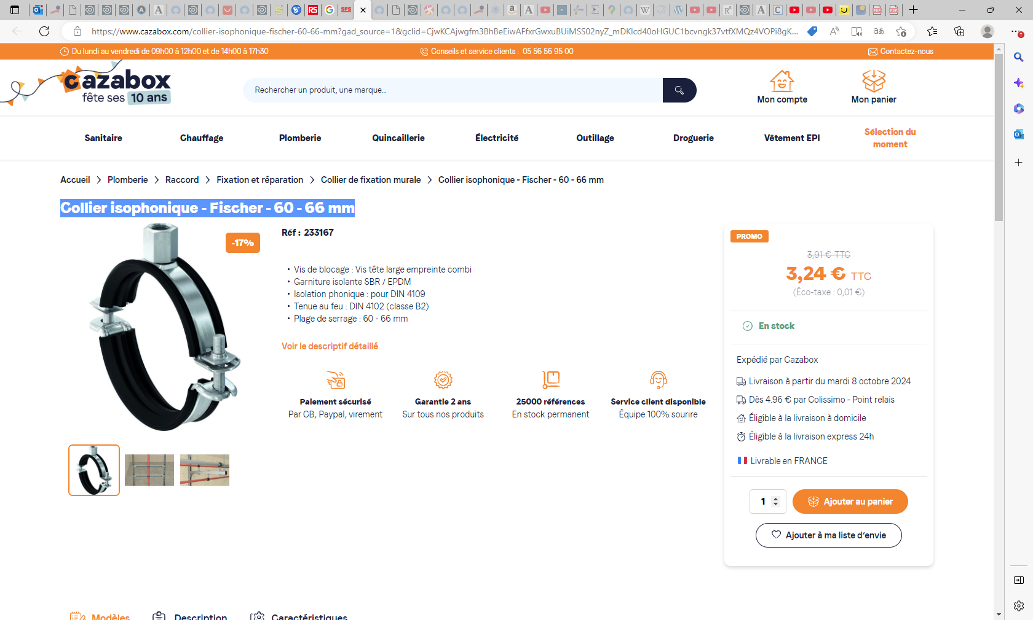
Collier isophonique - Fischer - 60 - 66 mm (cazabox.com)

