Slide 1
HV(8kV) ECL “1” Generation
Ian
13 Aug 2025

Slide 2
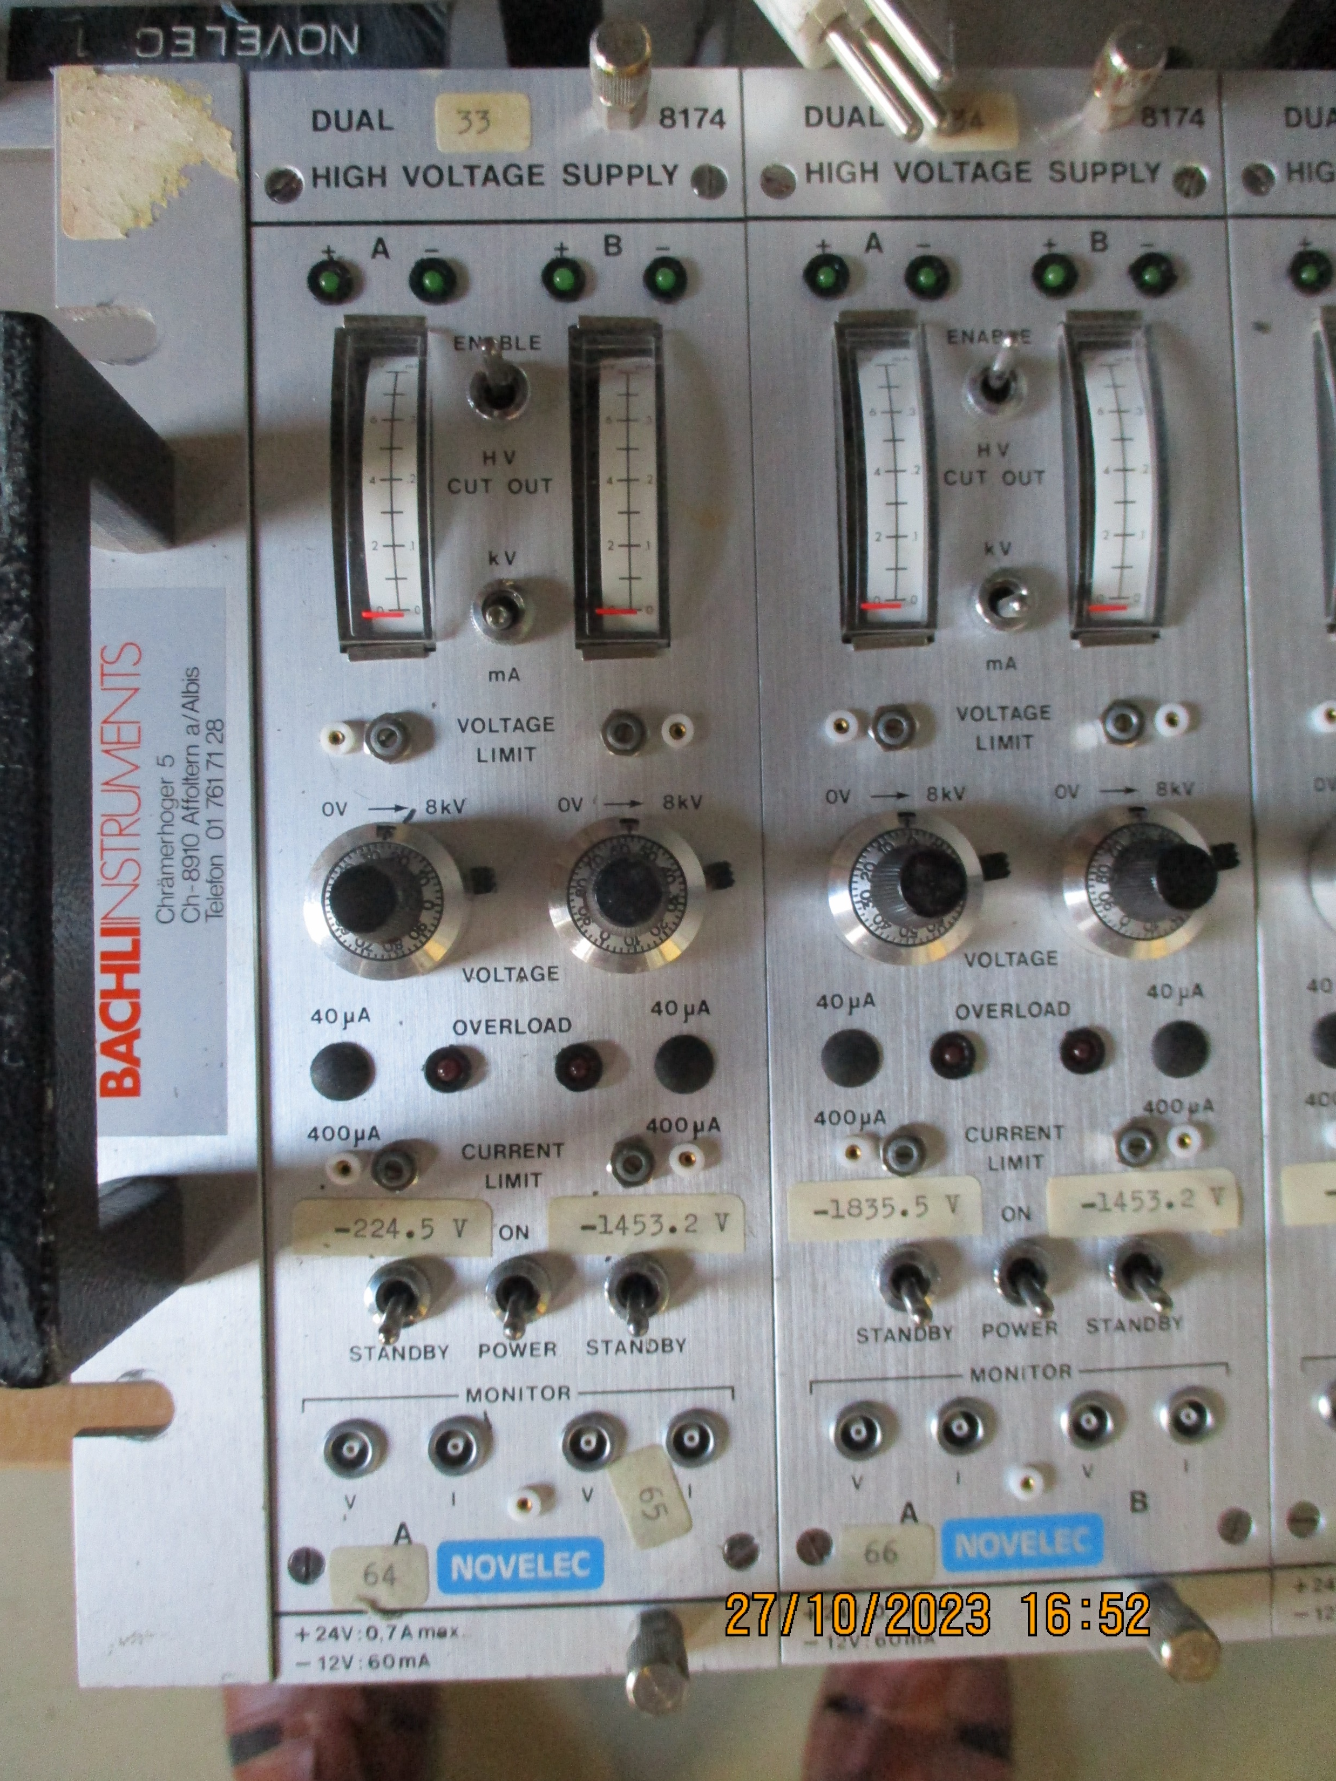
HV module photos

Slide 3
Sali Dapi
His V. divider version in a NIM bin

Slide 4
Sali ‘s version of the instructions for these intriguing modules

Slide 5
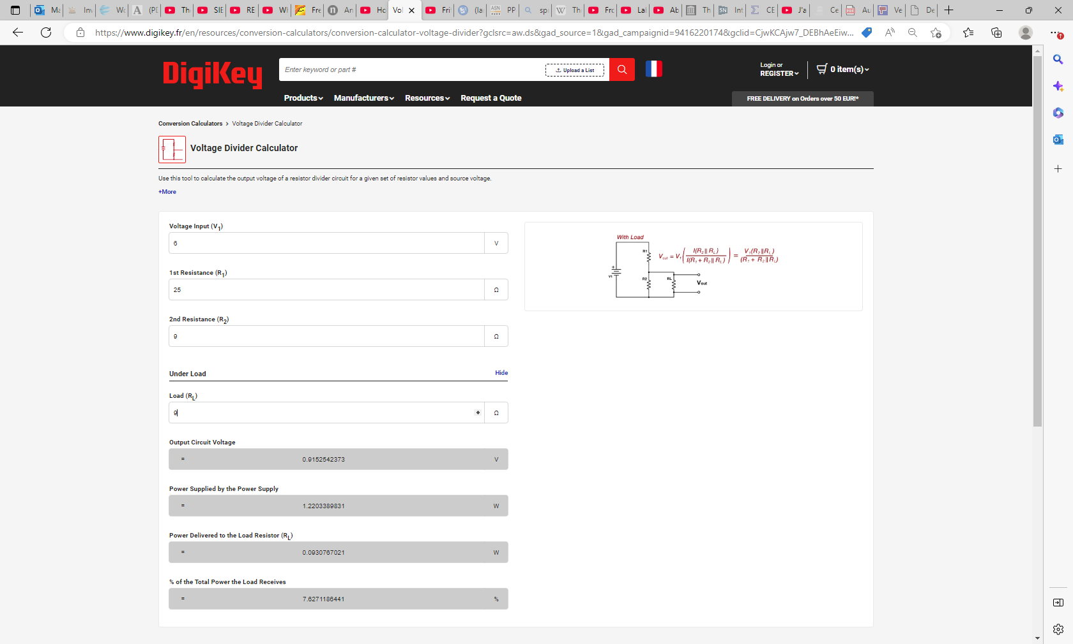
Voltage Regulator Calculator
Voltage Divider Conversion Calculator | DigiKey

Slide 6
Voltage regulator

Slide 7
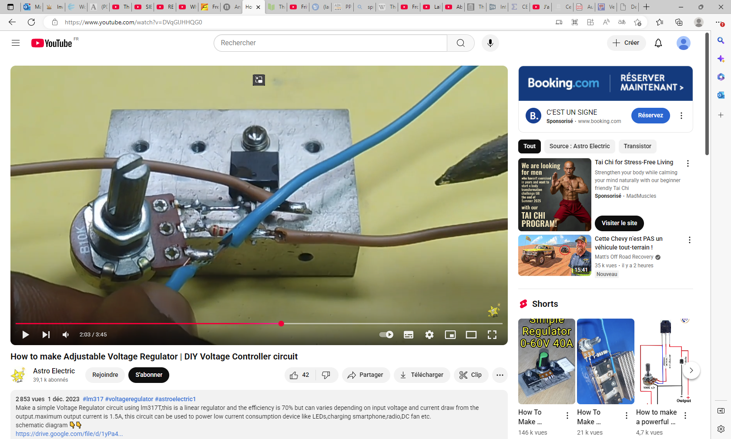
https://www.youtube.com/watch?v=DVqGlJHHQG0

