Slide 1
Interfaces and neighbour region of the New Flexible chains
Cable management on X4 level of YE1 tower
C. Penadés 24/09/18

Slide 2
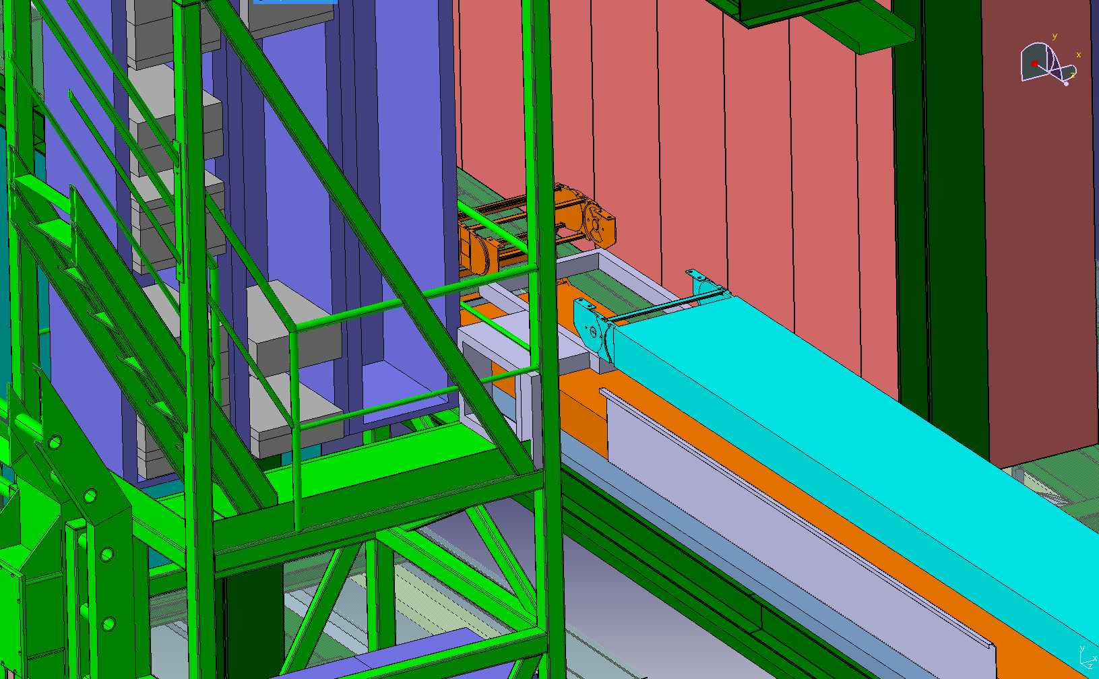
Movable point. End bracket and YE1 attachment

Slide 3
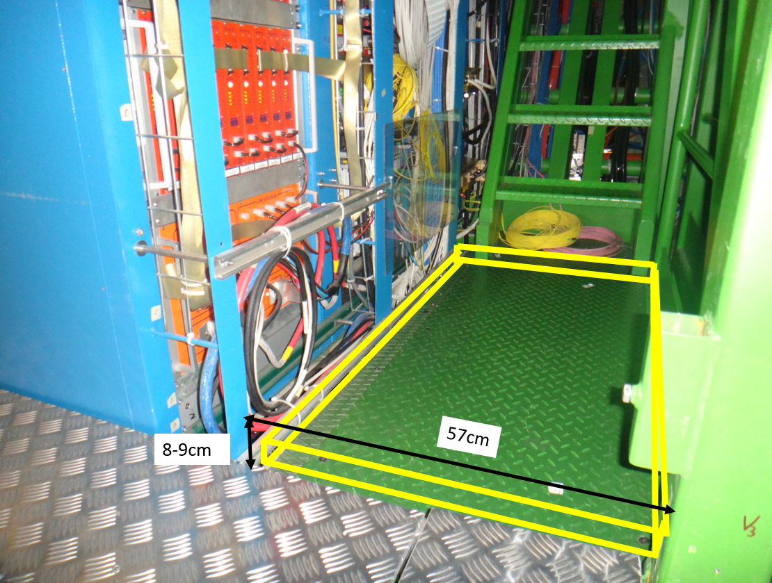
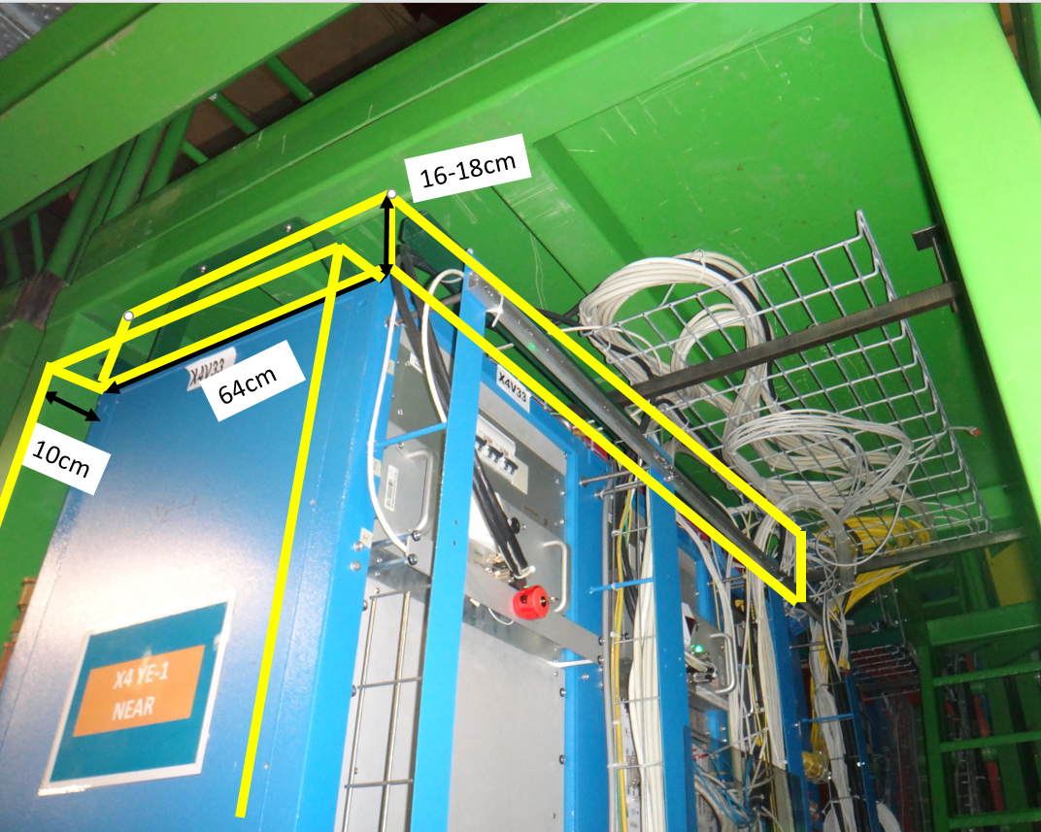
YE1 tower routing options

Slide 4
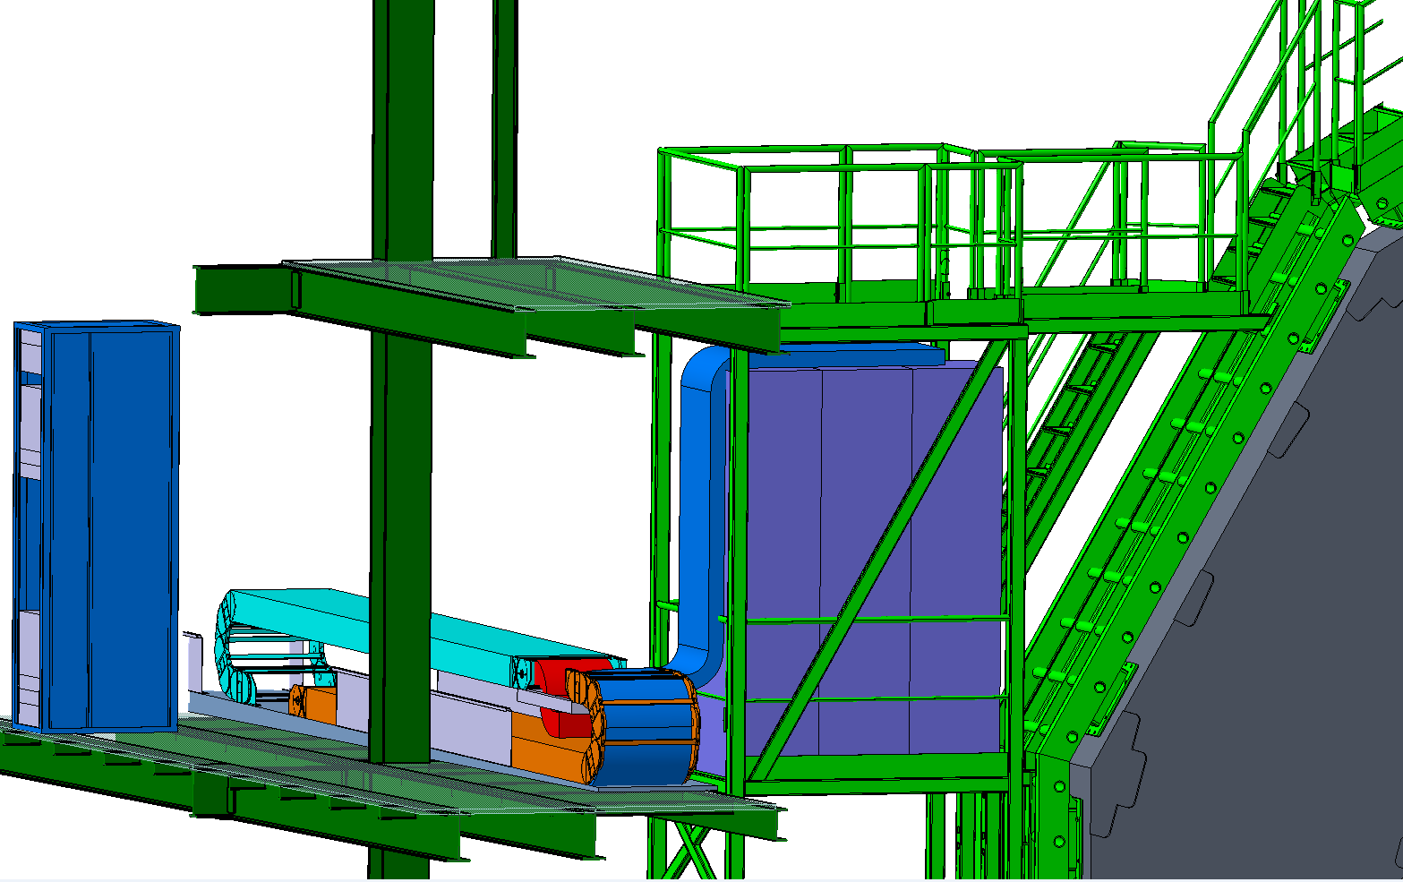
YE1 routing options. Along the Side of the rack

Slide 5
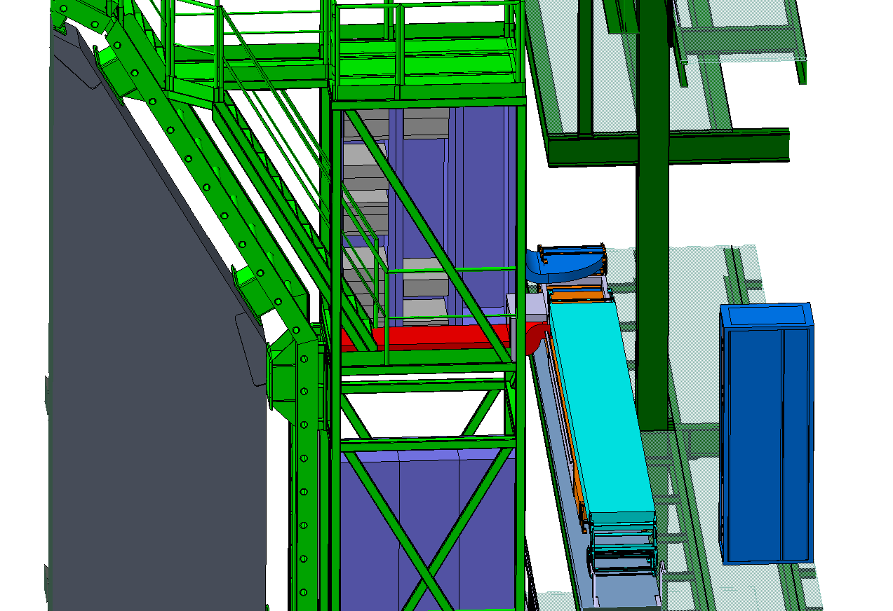
YE1 routing options. YE1 Raised Floor

Slide 6
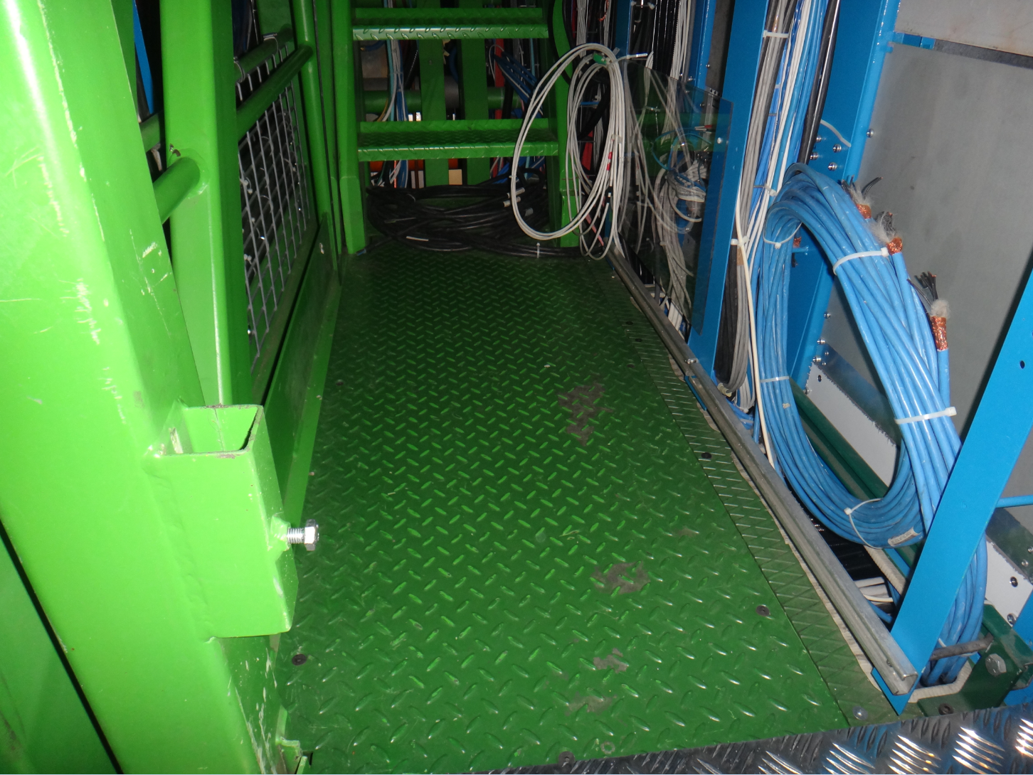
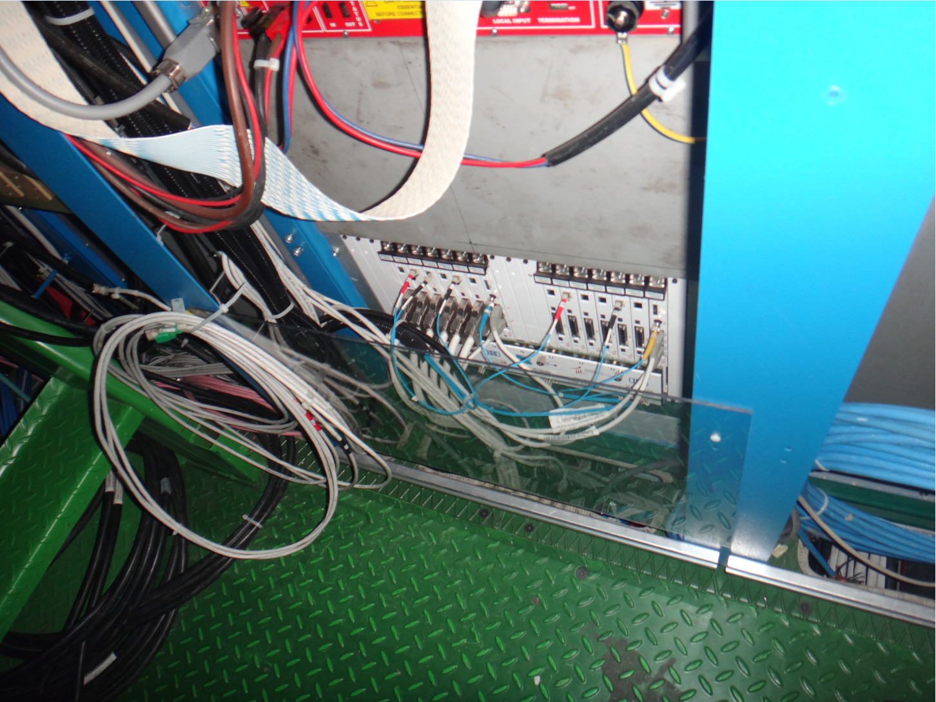
Racks in YE1 tower FAR -

Slide 7
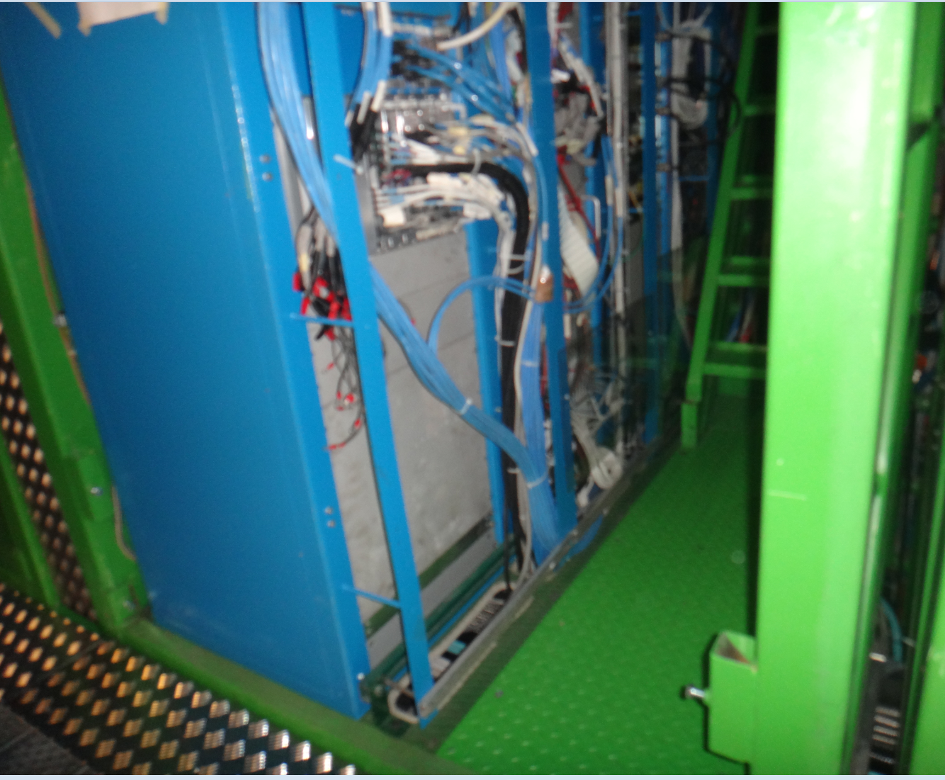
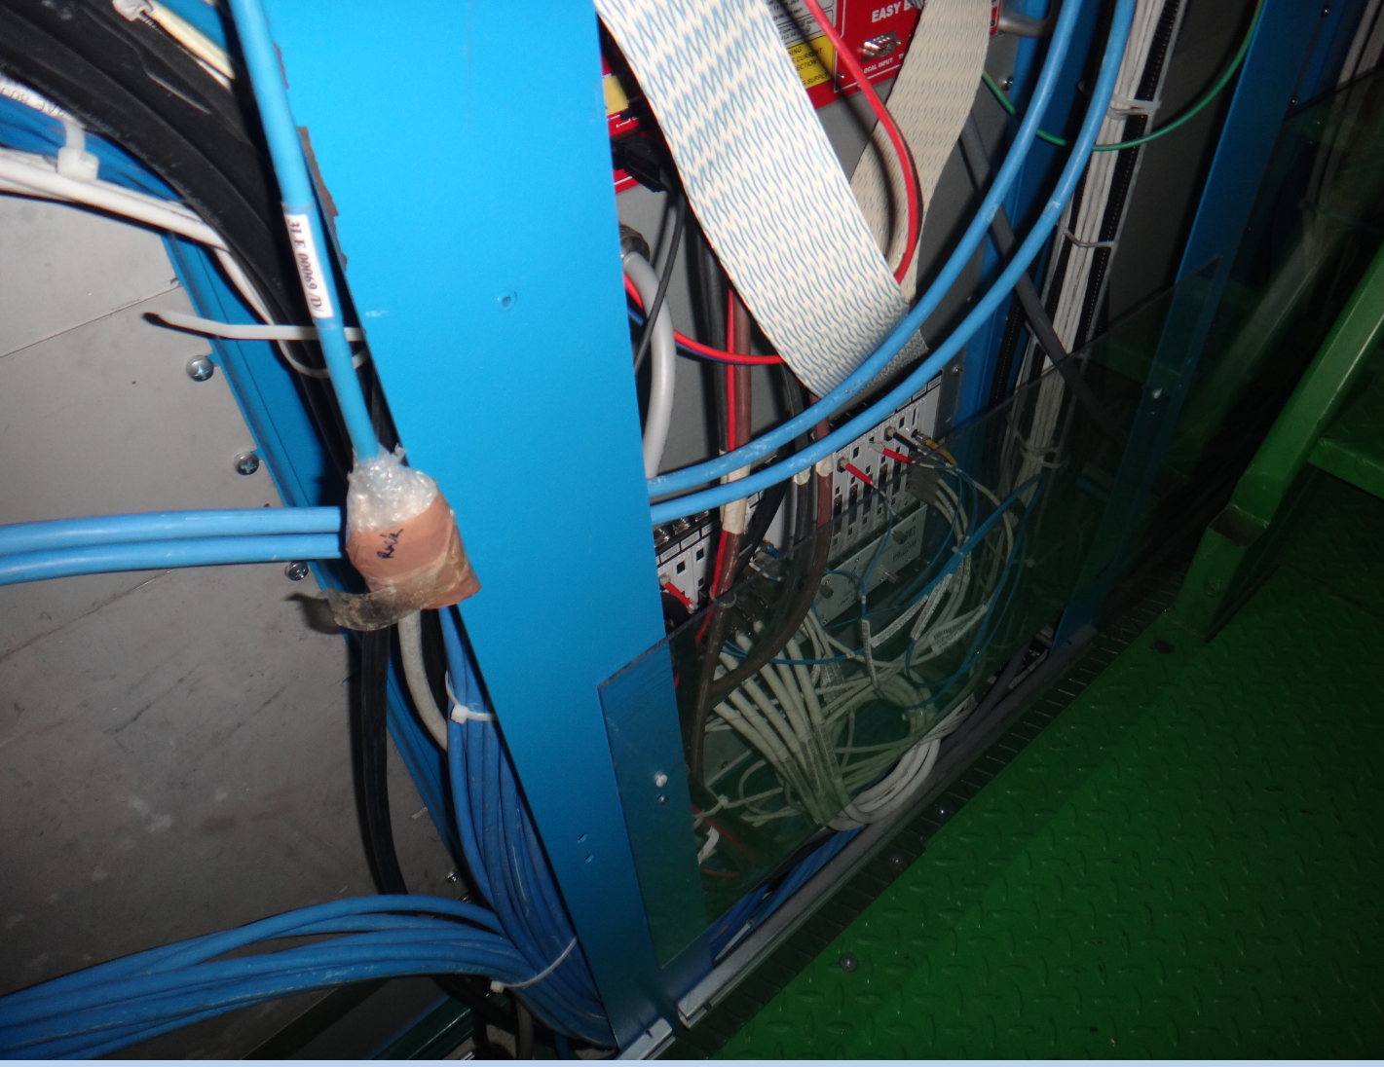
Racks in YE1 tower FAR +

Slide 8
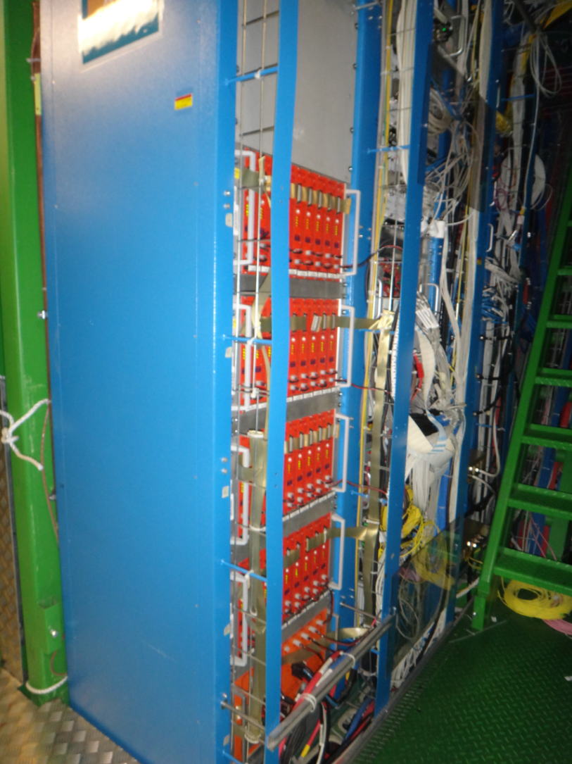
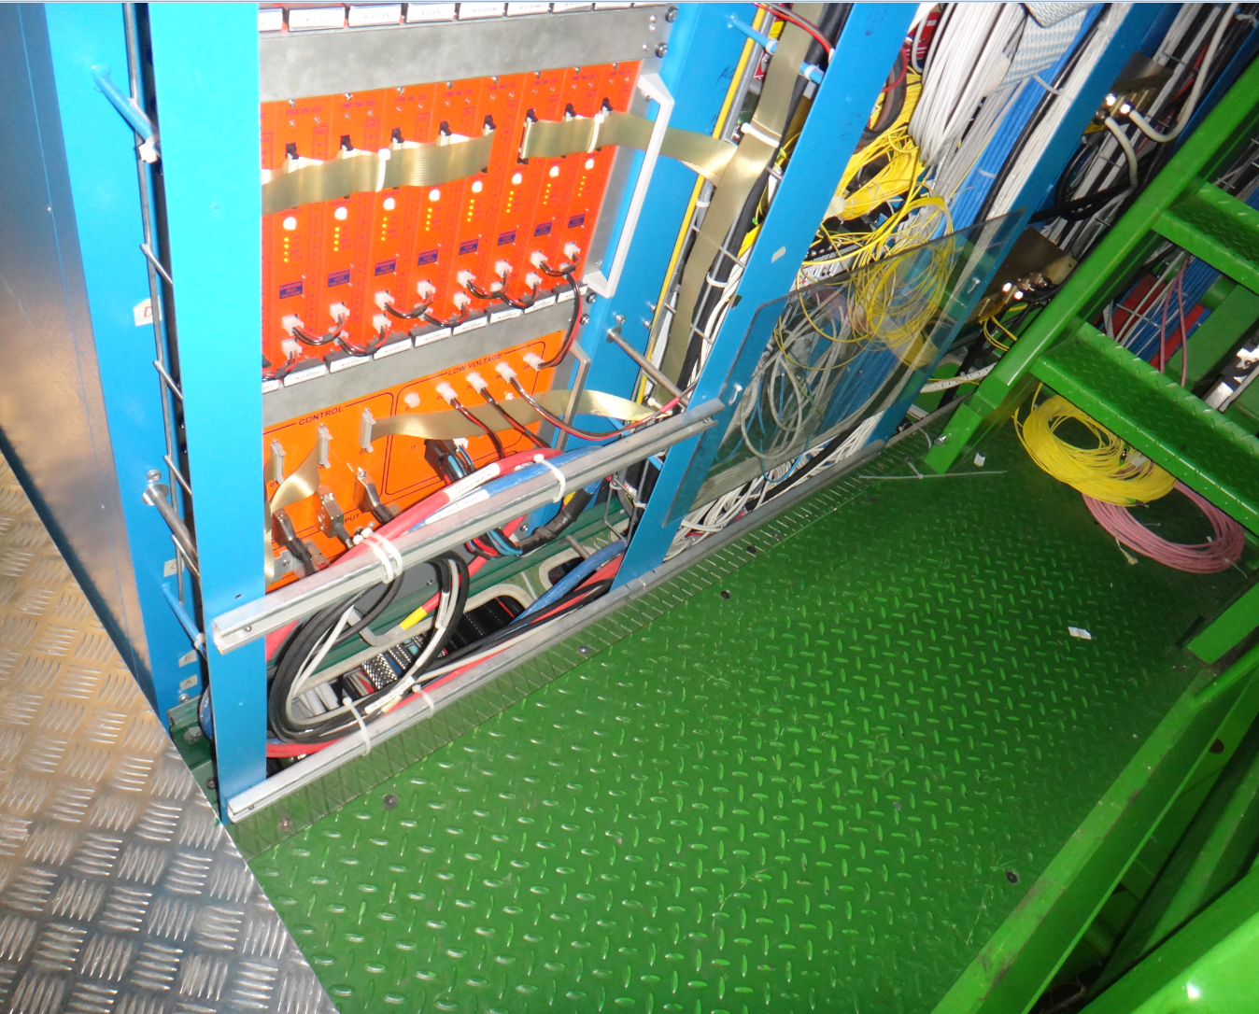
Racks in YE1 tower NEAR -

Slide 9
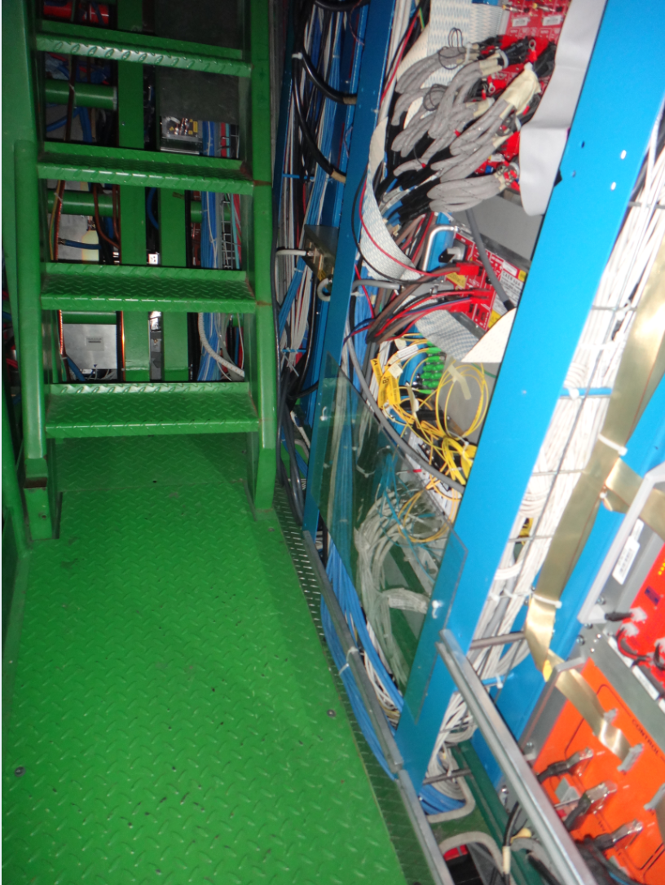
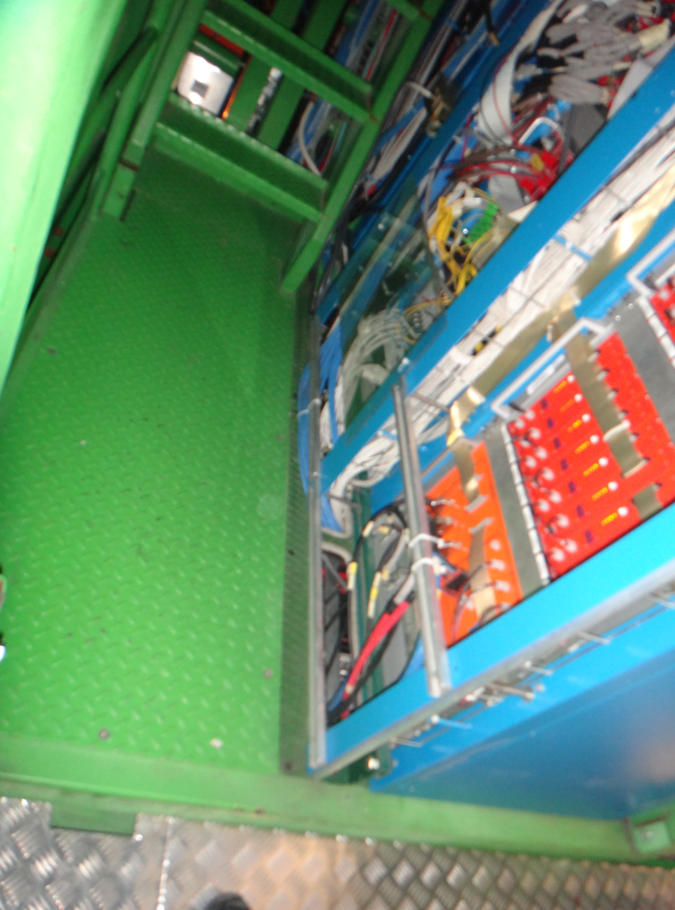
Racks in YE1 tower NEAR +

Slide 10
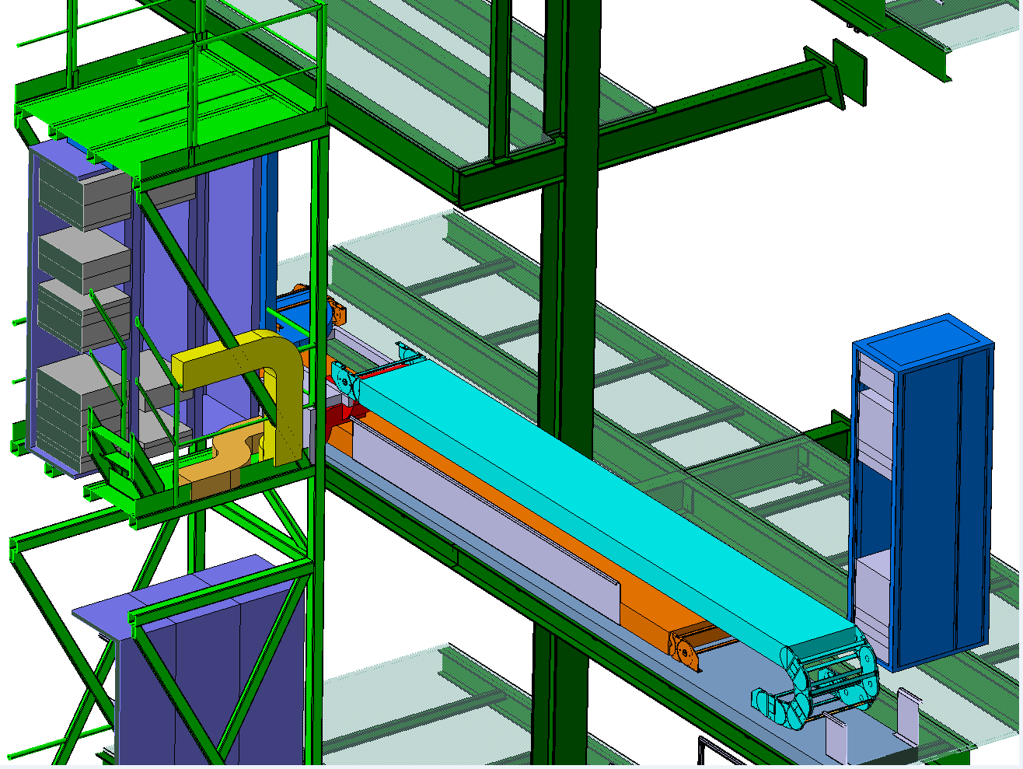
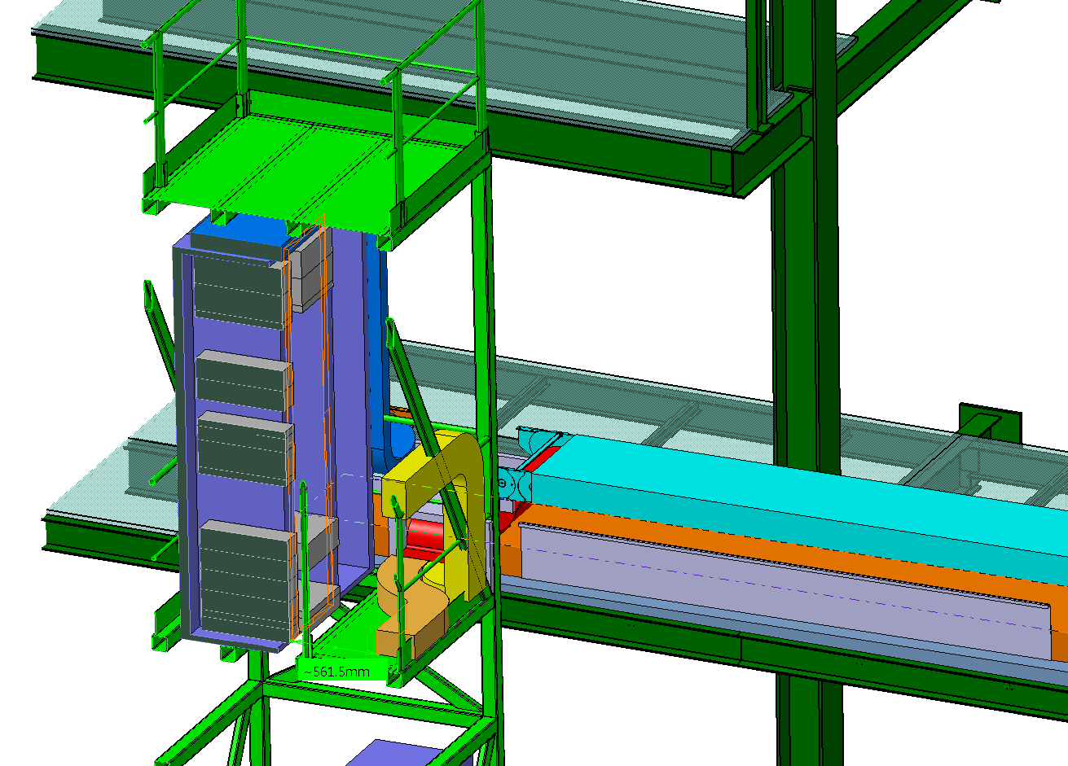
YE1 routing options. Splitting on floor

Slide 11
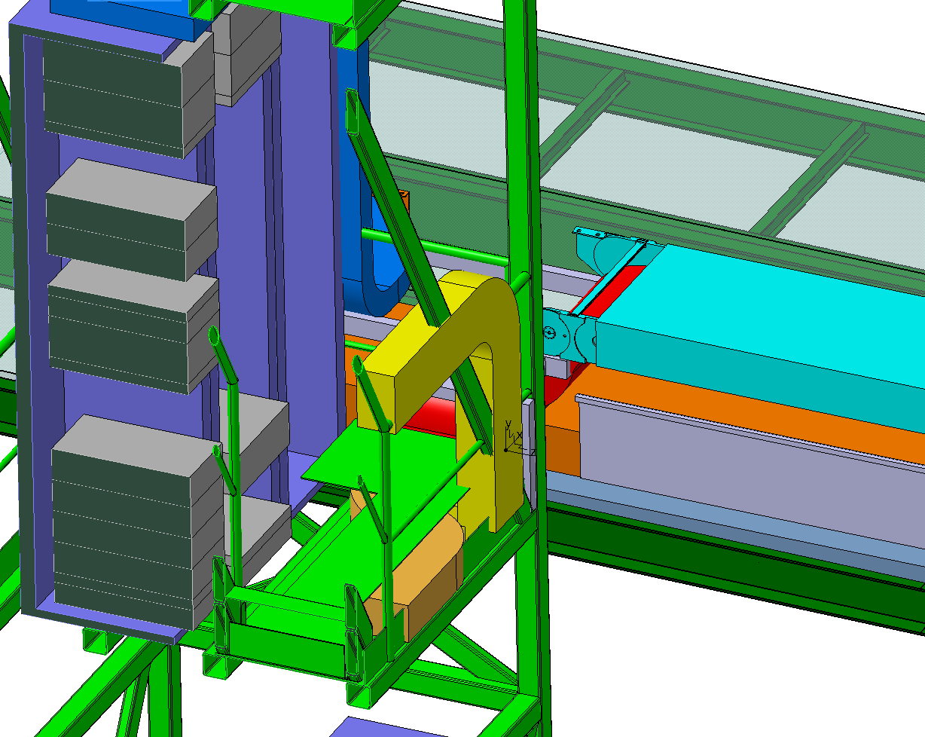
YE1 routing options. Raised floor with opening to access 2nd Rack
25cm

Slide 12
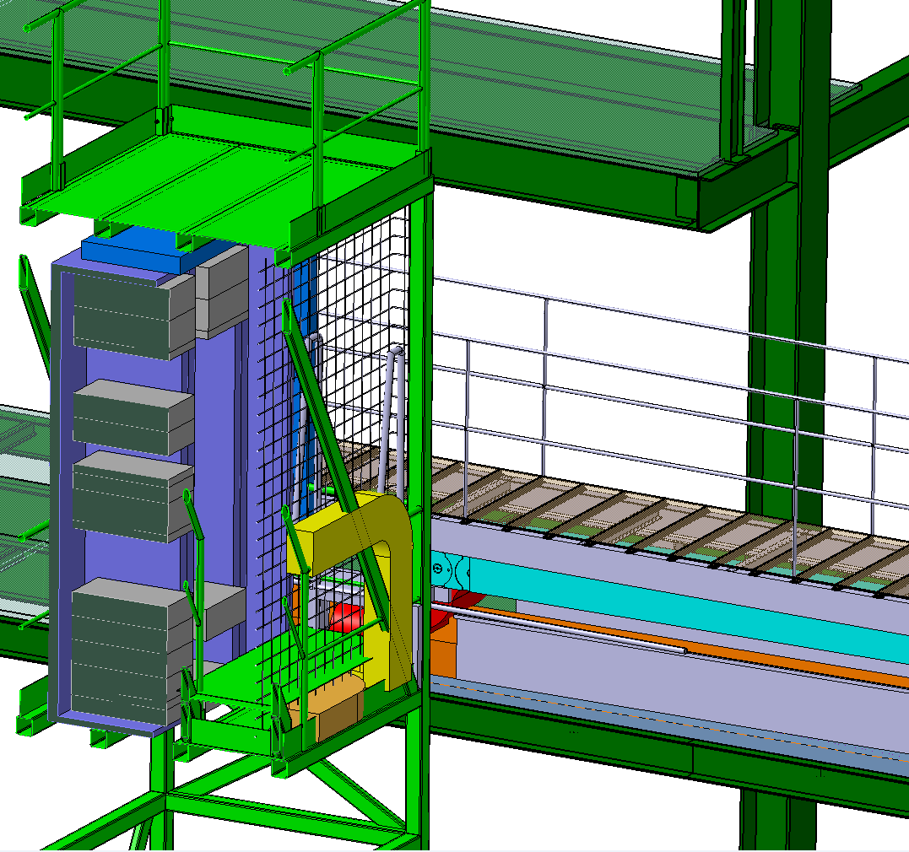
Cable management and access to tower

Slide 13
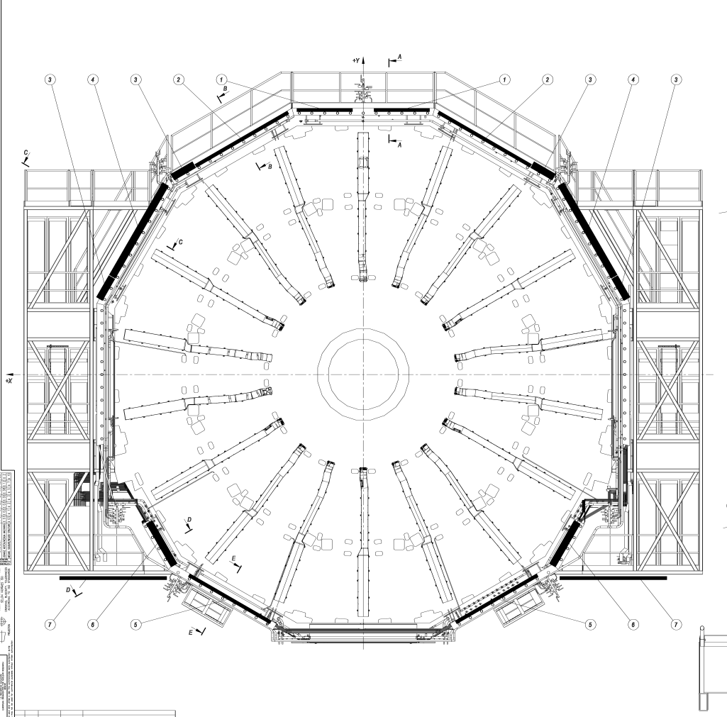
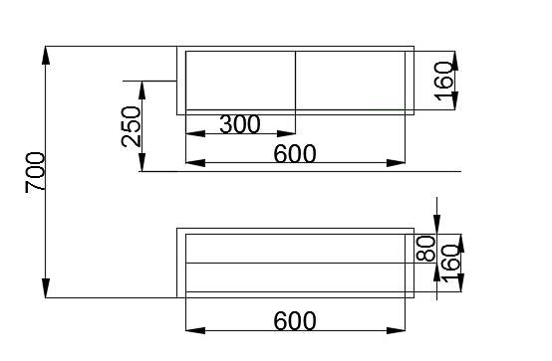
Cable chain space allocation as destination point
YE1 False floor-
Lower sectors
YE1 side mesh-Medium sectors
YE1 False floor-lower/Medium sectors
YE1 rack side- Upper sectors

