Slide 1
Transparency of HPL A quick qualitative look
Ian
6 Jan 2019

Slide 2
The sun is low in the winter and in this area with the Jura mountains in the West it is rare to have the sun rays so low.
By chance it was observed that a piece of HPL left outside was not completely opaque to the sun light even in the evening an hour or so before sun set.
What follows are some different views of the same panel, 1656mm x 902mm. That appear to be a type 2 of perhaps RE4 SM production
The photos are all time stamped to help understand the changing lighting conditions

Slide 3
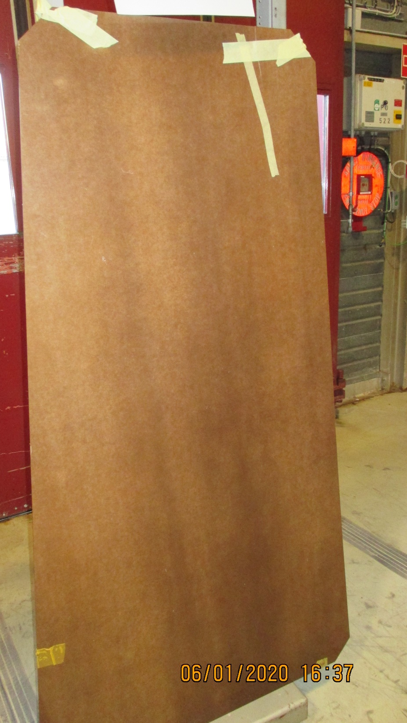
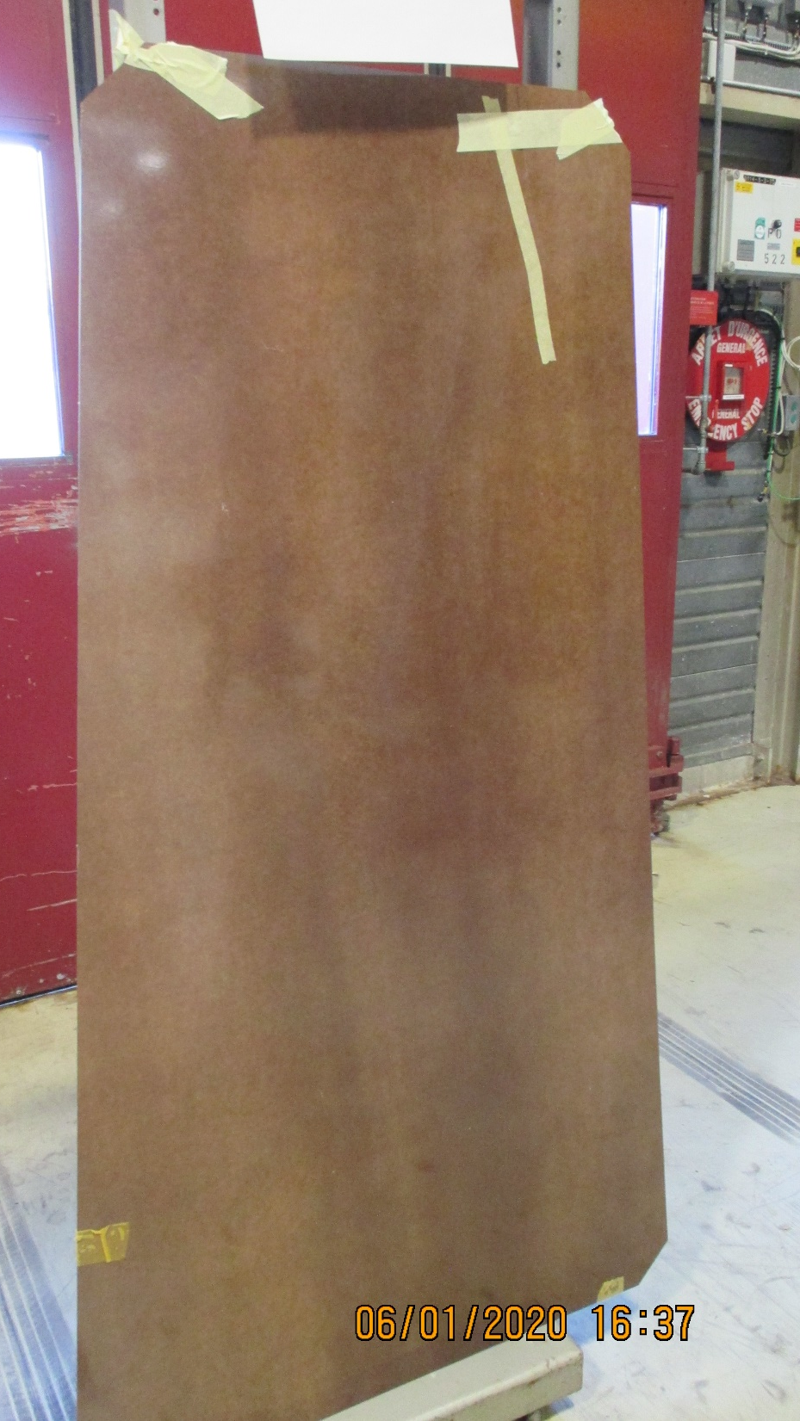
Inside
Lighting is important.
On the left is a photo of the HPL panel taken with flash
On the right is the same panel with no flash
There are 2 vertical (or longitudinal) streaks on the surface that are darker than the rest
Notice the yellow tape in the bottom LH corner.

Slide 4
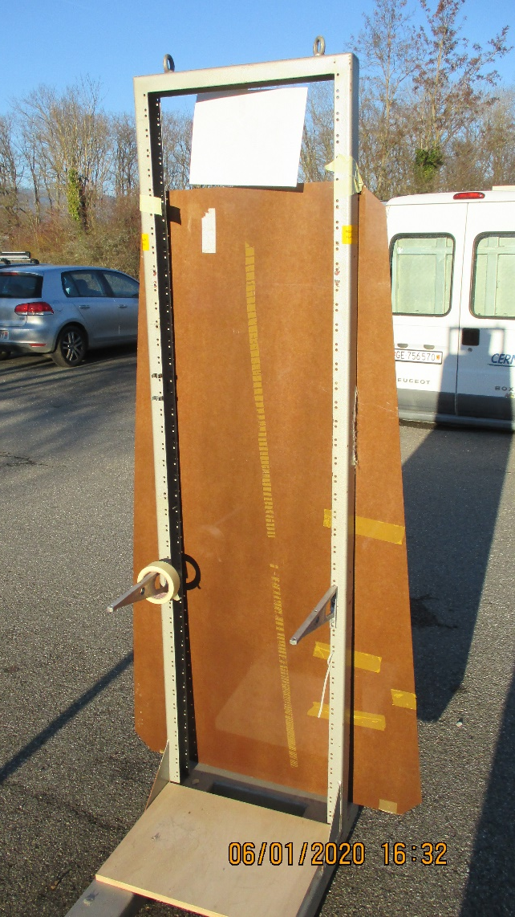
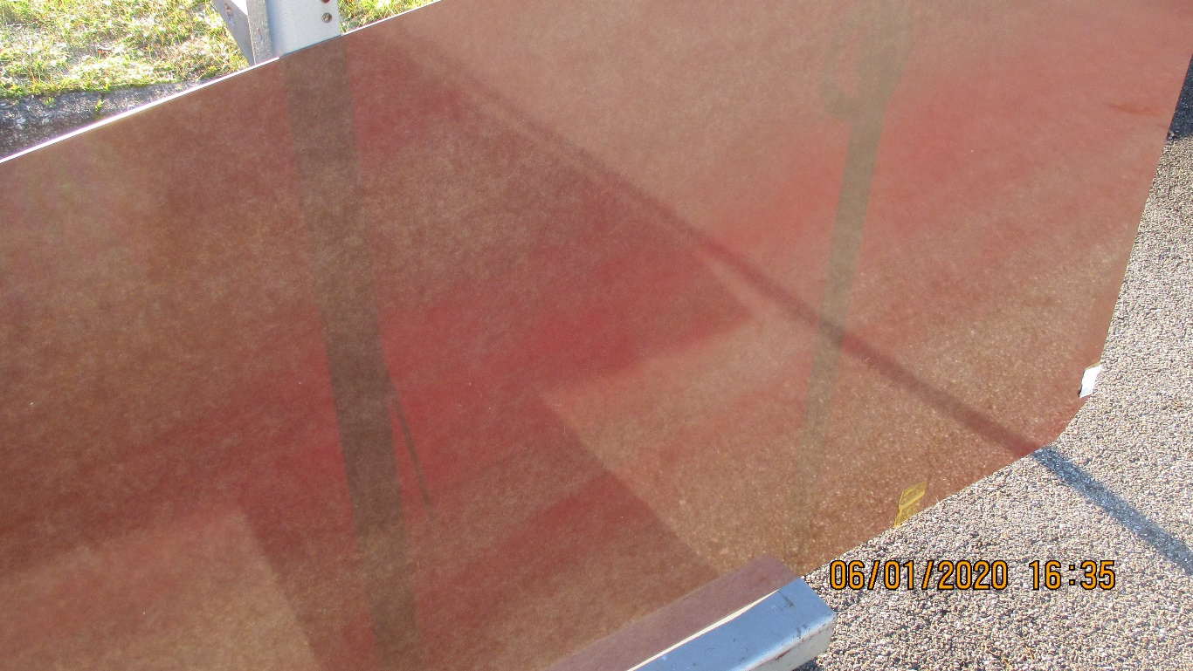
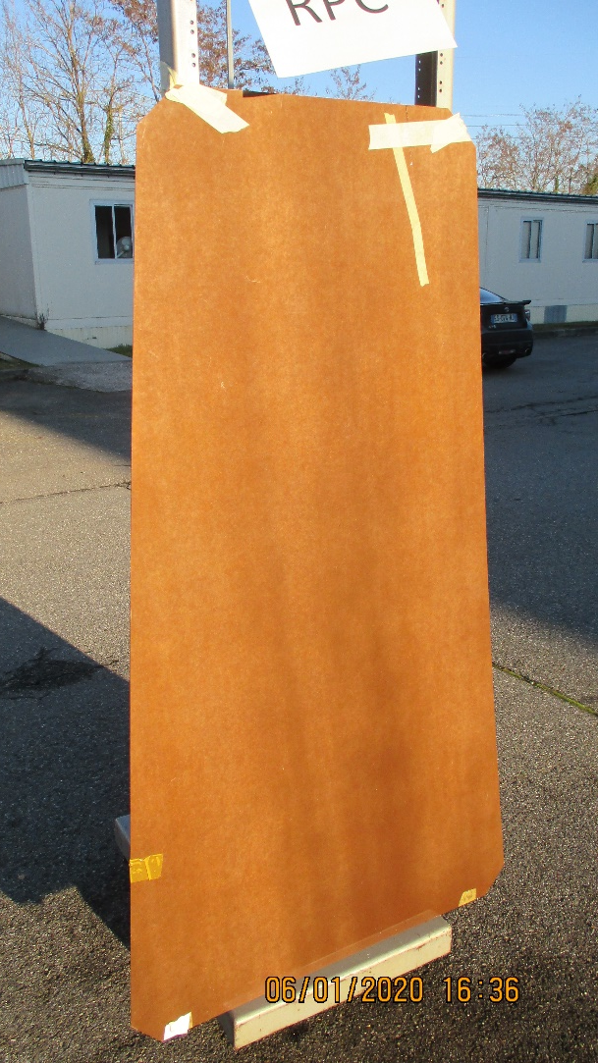
Outside
The panel is exposed to the sun.
Again the two vertical streaks perhaps less visible.
The panel has been turned about a horizontal axis and is seen from “behind” looking towards the sun
Here the two vertical members of the rack are quite visible through the HPL.

Slide 5
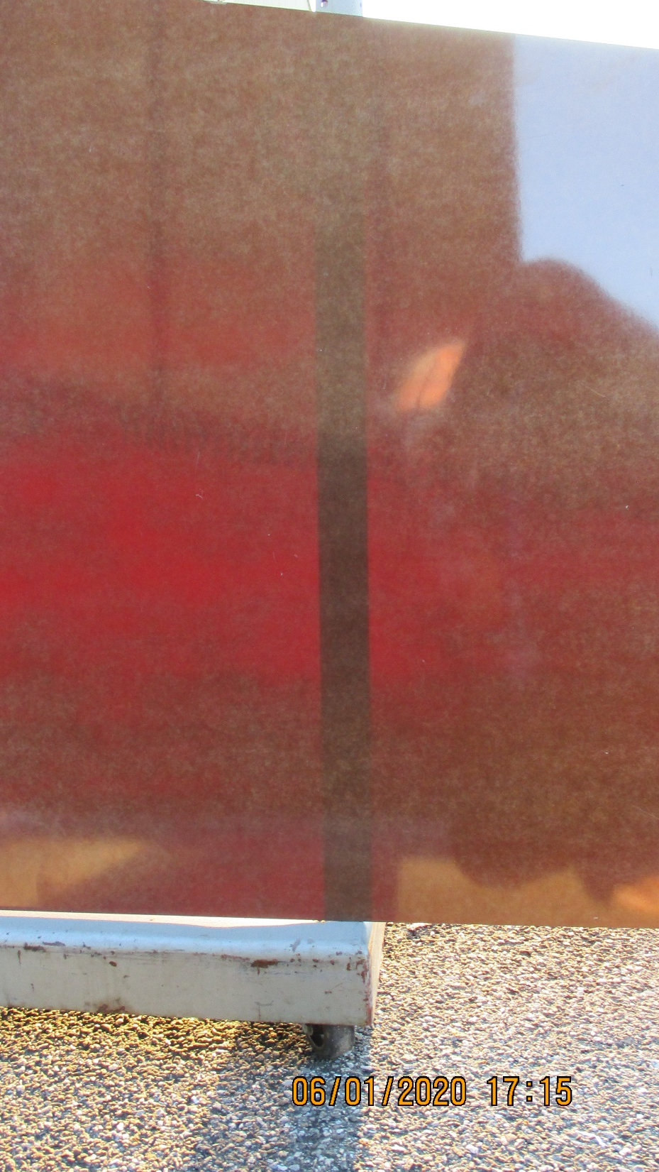
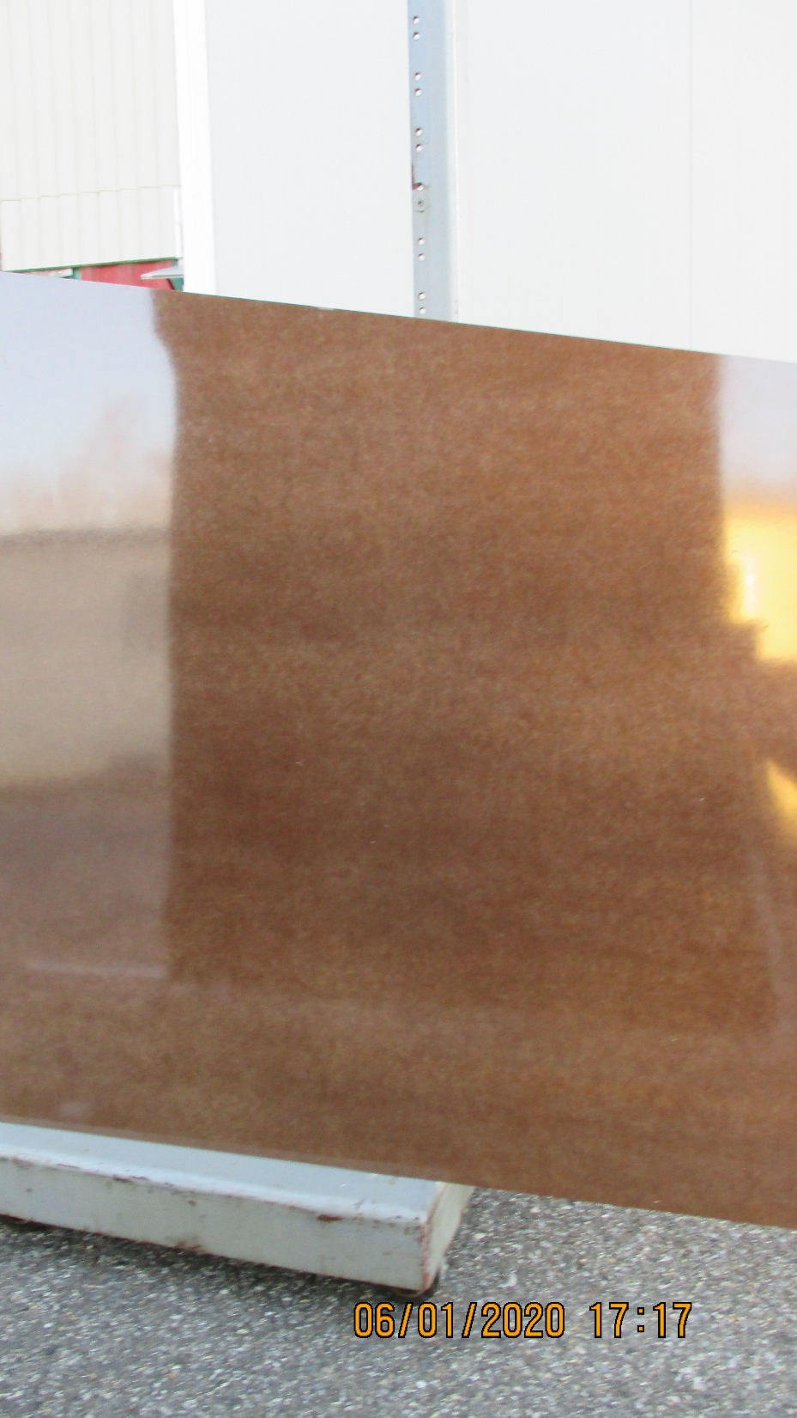
Again looking towards the sun.
On the left the panel is exposed and the two streaks, now horizontal are visible.
On the right the panel is outside but in the shadow of the building. Again the two horizontal streaks are visible with lighter areas on each side and between.
Red (LHS) corresponds to dark (RHS)

Slide 6
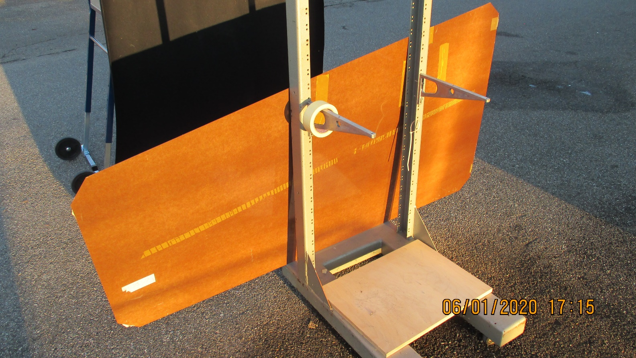
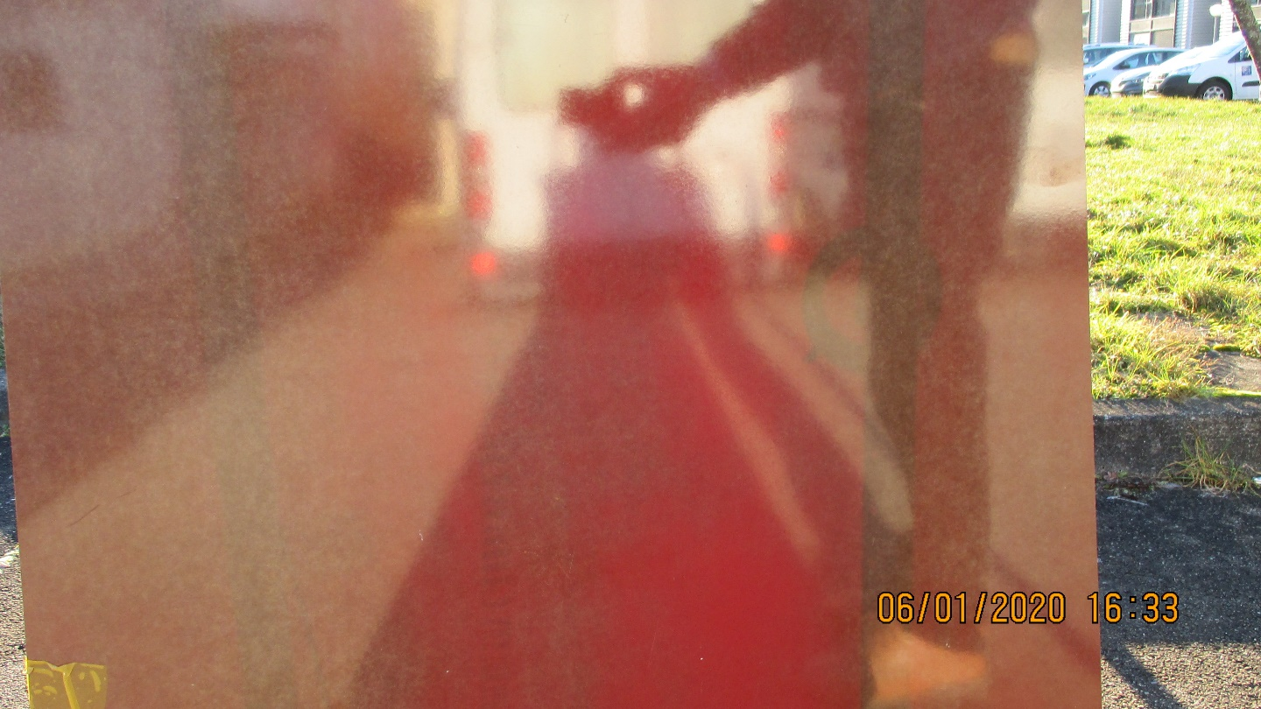
Reflections from the HPL , due to their high gloss, pose a problem in obtaining photos that clearly show the different colour grades across the panel .
A black cloth was hung downstream of the HPL in an attempt to cut out reflections but was insufficient in size and anyway the camera and operator are still there !

Slide 7
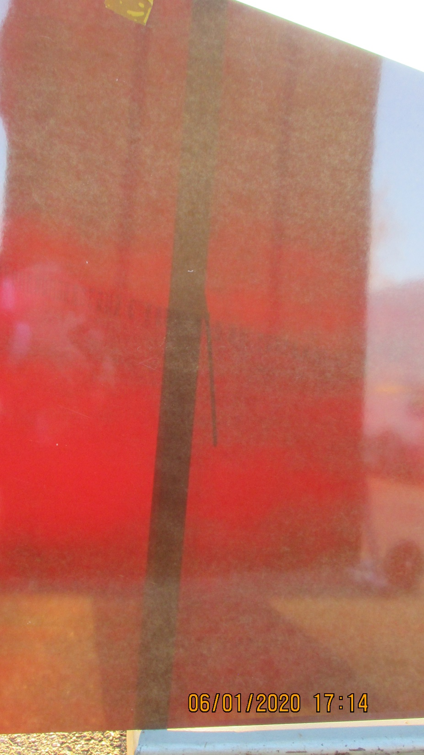
The rack frame is visible as a vertical dark line.
The yellow tape is in the top left corner, mentioned earlier.
The two red streaks are horizontal (longitudinal).
Interestingly the lighter areas are also visible, normally they appear more predominantly with incident light.
The black cloth material is indicated
Black cloth material

Slide 8
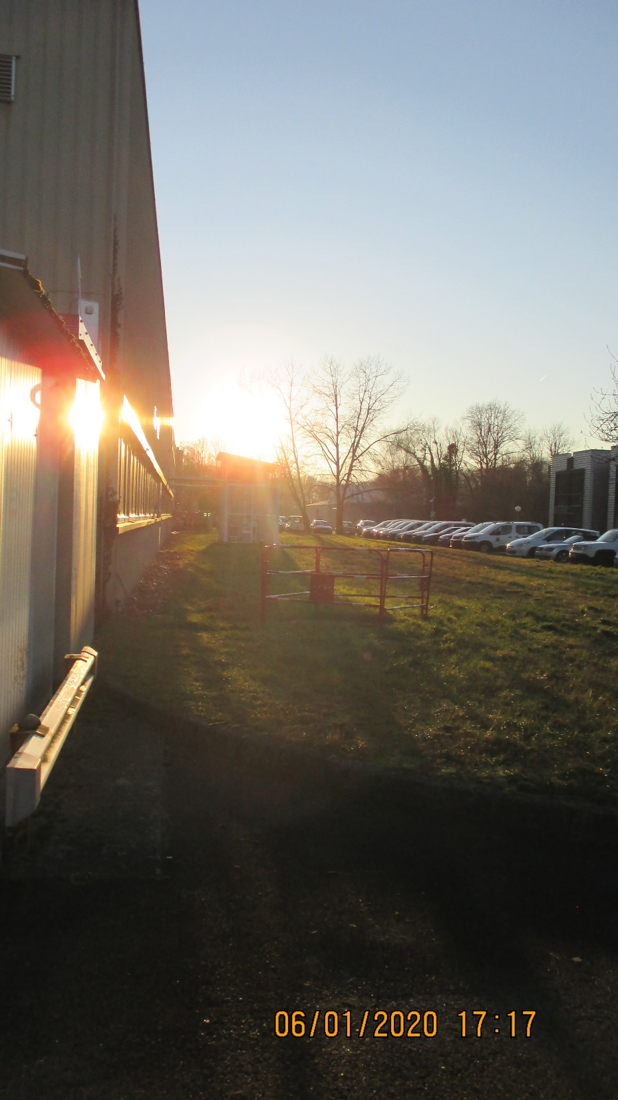
The sun has almost gone below the horizon

Slide 9
Some questions………
What does the redness in the exposed panel represent ? Is it more Phenolic resin ?
Colour intensity is an “X-ray” view through the panel indicating different composition ?
The lighter areas of the unexposed panel are indicating a higher paper cellulose concentration wrt the phenolic ?
If the above is true then how can this be explained.
Is this a tool to look for homogeneity across the panel ?
Transmitted light intensity may be used to compare panel to panel.

