Slide 1
Oil thickness and viscosity
Ian
Jan 2019

Slide 2
Viscosity

Slide 3
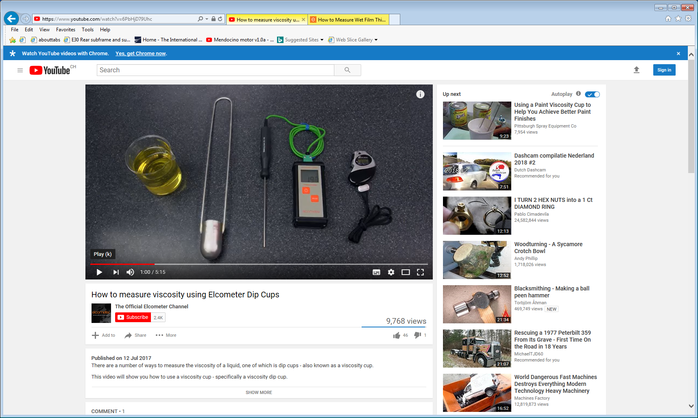
https://www.youtube.com/watch?v=6PbHjD79Uhc

Slide 4
thickness

Slide 5
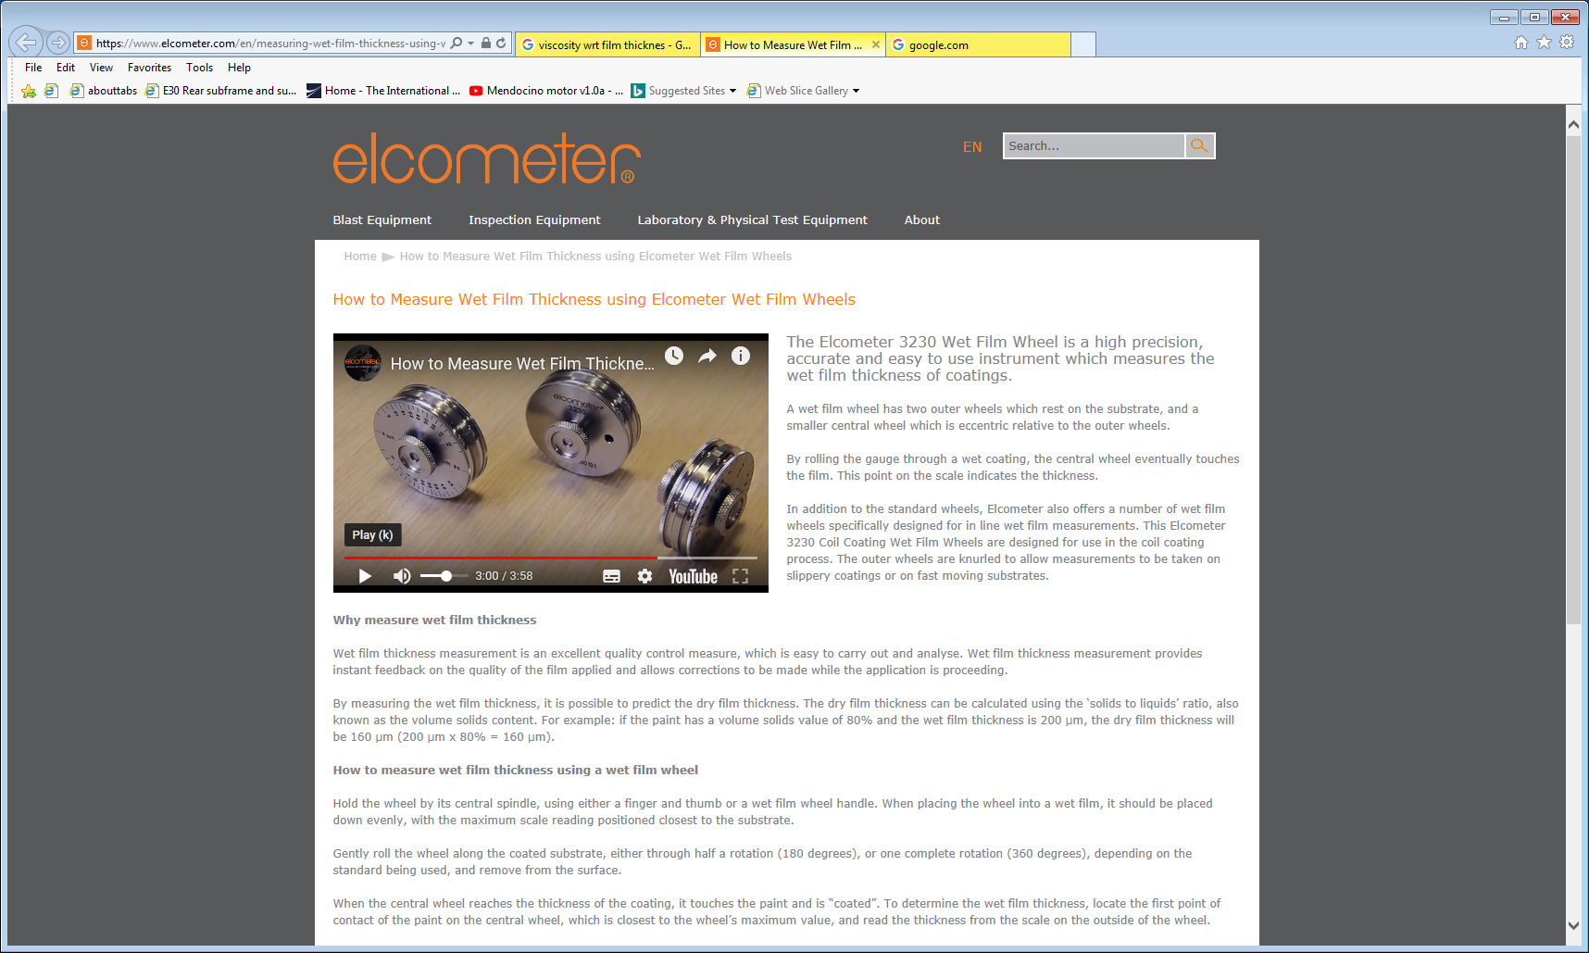
https://www.elcometer.com/en/measuring-wet-film-thickness-using-wet-film-wheels.html

