Slide 1
RCC (Resistive Cylindrical Chamber)
R.Cardarelli , A.Rocchi and
RCC collaboration
INFN sez. Tor Vergata
RPC meeting, CERN 26/09/2022

Slide 2
Introduction
the experimental observation of the increase in temporal resolution with the decrease in the thickness of the gas gap led to the introduction of RPC with thin gaps, however this involves a decrease in efficiency, to overcome this problem multigap MRPC was introduced.(Crispin Williams, Paolo Fonte et alt)
A possible solution to increase the efficiency of the RPC is to increase the pressure with the same thickness of the gap, this solution is possible only by introducing a cylindrical geometry. (Roberto Cardarelli)
N°1 CERN RPC 2022

Slide 3
Detector with almost uniform electric field but different geometry
RPC
RCC (Resistive Cylendric Chamber)
Low pressure solution
High pressure solution
Mono-gap planar geometry
Cylindrical mono-gap geometry
Multi-gap planar geometry
Gas gap
N°2 CERN RPC 2022

Slide 4
RCC structure
graphite
Bakelite
foam
copper
Gas gap
N°3 CERN RPC 2022

Slide 5
Electric field in cylindrical geometry
In fig (1) the Emax trend is graphically represented as a function of the ratio R1 / R2
From (1) it is clear that the electric field E reaches its greatest value on the surface of the inner cylinder, that is for r = R1, while as r increases it decreases until it reaches its smallest value at r = R2; ie on the surface of the outer cylinder
There are two cases:
for R2 / R1 <(1 / e) we have the gas discharge rate at Townsend
for R2 / R1> (1 / e) we have the spark rate
E_{max}
R₁
r
R₂
R₁/R₂
1
fig1
fig2
(1)
E=(V/r)/log(R₂/R₁)
(2)
E_{max}=(V/R₁)/log(R₂/R₁)

Slide 6
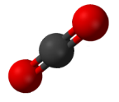
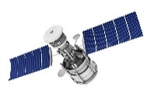
Cylindrical Geometry: Why?
The gas pressurization would allow to:
Increase the gas target density, with a consequent increase in intrinsic efficiency
→ MRPC time response with thin single gap configuration
→ light eco-friendly CO₂ based gas mixtures
Use the detector in hostile environments such as space
The electric field gradient, depending on the polarization allows to
Contribute to the gas discharge quenching
→ new eco-friendly gas components
Increase the charge collection efficiency enhancing the multiplication in the initial part of the gas gap
Study the dependencies and optimize the time resolution
-
Negative gradient
Negative polarity
Positive gradient
Positive polarity
N°6 CERN RPC 2022

Slide 7
Different gradient for different d_{n}/D_{n}
three identical pairs of detectors with 0.3 mm gas gap and different radius of curvature
D1=18
d₁
D2=16
D3=8
N°9 CERN RPC 2022

Slide 8
Electrons valence evolution RCC and RPC
Negative polarization
Positive polarization
e⁻
e⁻
^{Ne-}
α*d
Meek condition
d
d
N°7 CERN RPC 2022

Slide 9
Avalanche evolution in the RCC and RPC and pront charge calculated with Ramo’s theorem
electron
N₁=1
d₁=5
N₁=1
d₁=5
Ion SF6⁻
N₂=2
d₂=4/5
N₂=2
d₂=4/5
N₃=4
d₃=3/5
N₃=4
d₃=3/5
N₄=8
d₄=2/5
N₄=8
d₄=2/5
N₅=16
N₁=1
d₅=1/5
N₅=16
N₁=1
d₅=1/5
Q=Q₀∑ N_{i}*d_{i} = 15,4/31 Q₀
Q=Q₀∑ N_{i}*d_{i} = 18,3/31 Q₀
Saturated evolution
Geometric effect
Q=Q₀∑ N_{i}*d_{i} = 13/31Q₀
1*5+2*4/5+4*3/5+8*2/5+16*1/5=15.4
Exponential evolution
1*5+2*4/5+4*3/5+6*2/5+8*1/5=15.4
Saturated evolution with SF6
The comparison of the prompt charge for three case:
Exponential evolution of the electrons avalanche negative polarization in the RCC
Saturated evolution of the electrons avalanche positive polarization in the RCC
Saturated evolution of the electrons avalanche in the RPC with SF6
N°8 CERN RPC 2022

Slide 10
Cylindrical bakelite electrode resistivity for material available CERN magazine
$ρ=4,3 ×{10}^{12}$ Ω cm

Slide 11
Cylindrical geometry
The cylindrical geometry is very interesting in the case the external pressure is different respect to the internal gas gap pressure, two important cases:
The external pressure is very low, application in space
The internal pressure of the gas gap is very high, for instance 2-10 bar,
this high pressure is useful to increase the performance of the
detector in the range of ps time resolution , high
efficiency per single gas gap and spatial resolution (30-50 um).
N°5 CERN RPC 2022

Slide 12
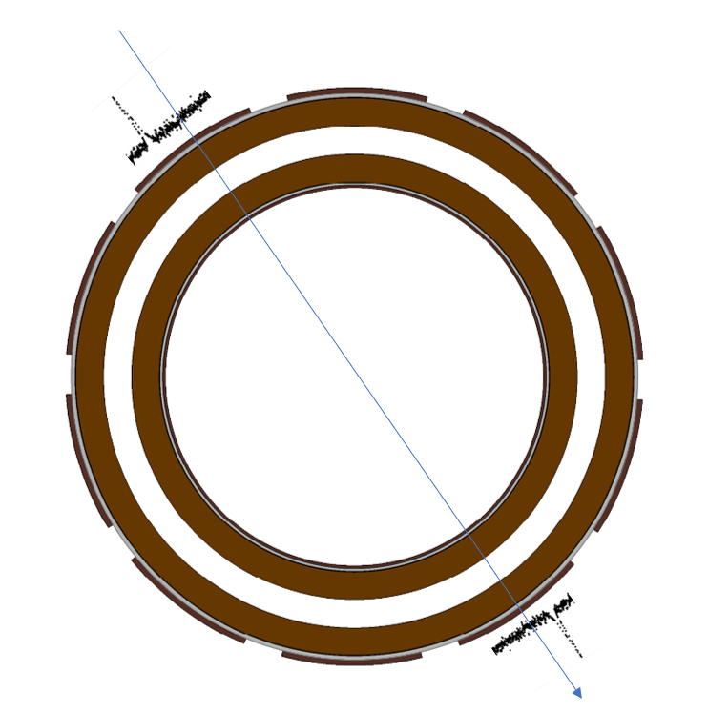
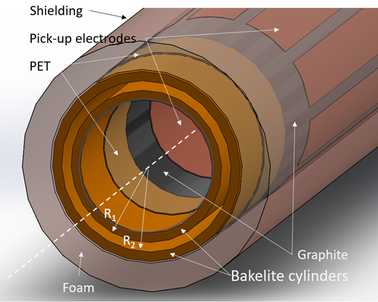
Prototypes
RPC Cylindrical chamber with 1 mm gas gap:
Feasibility study of Resistive Chylindrical chambers
Effcet of the electric field gradient on the detector performance
RPC Cylindrical chamber with 0.2 mm gas gap :
Effcet of the gas pressure on the detector performance
RPC Cylindrical chamber with 1 mm gas gap, metallic ground electrode, integrated with MDT detector:
Feasibility study of Resistive Chylindrical chambers integrated with MDT detector (same gas mixture, same readout pick-up)

Slide 13
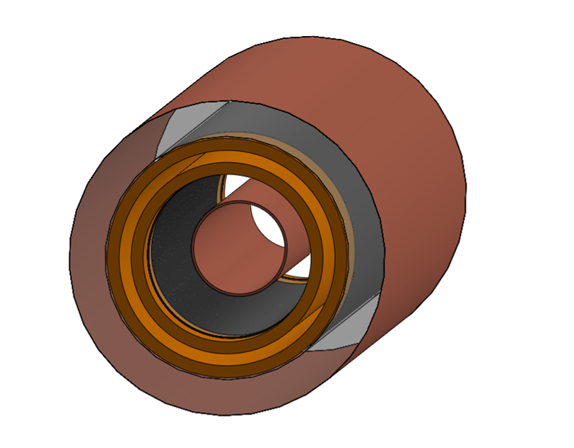
RCC 1 mm gap(experimental setup)
Bakelite
Shielding
Read – out RPC 200 um
Signals
Foam
Trigger: Scint 1 And Scint 2 And Scint 3
Graphite
Scintillator 1
Pick-up
Scintillator 2
Scintillator 3
RPC 0,2 mm

Slide 14
RCC 1 mm gap efficiency

Slide 15
RCC 1 mm gap (time of flight as respect to RPC 0,2 mm)
Polarization HV -
Polarization HV +
σ = 1.4ns
σ = 1.1ns

Slide 16
RCC Up-to 10 bar pressure resistant with contribution of Monaco university
Gas inlet
Gas outlet
o-ring
aluminum
N°4 CERN RPC 2022

Slide 17
RCC 0.2 mm gap R1=17,6 mm R2=18 mm(prototype design)
Electric field inside the gas gap with ∆V=+3000 V
$$E\left(r\right)=−\frac{V}{r log\frac{R_{1}}{R_{2}}}$$
Grafite
HV
Z_{L}
~ 5 cm
D₁ = 17,6 mm
D₂ = 18 mm
Gap = 0,2 mm

Slide 18
Efficiency x acceptance RCC 200 µm negative HV - CO2 100%
Efficiency plateau as function of the gas pressure
Efficiency knee as function of the gas pressure

Slide 19
RCC 0.2 mm gap (signals average)
Average profile of normalized signals

Slide 20
Aim of the test in G++ CERN facility
Negative polarization
-HV
Coaxial
Read-out
The test consists in demonstrating the correct functioning of the device with a quasi-planar cylindrical geometry
Furthermore, consists in characterizing the efficiency, the time response and the shape of the signals in the two polarization conditions. The prototype was designed to emphasize asymmetry, thanks to a non-negligible field gradient.
Under positive polarization conditions, multiplication is expected to occur mainly in the region close to the cathode, which can be described, to a rough approximation by a multiplication followed by drift model.
On the contrary, in negative polarization, multiplication increases as electrons approach the anode, roughly approximating a system characterized by drift followed by multiplication
Positive polarization
+HV
Coaxial
Read-out
N°10 CERN RPC 2022

Slide 21
MDT+RCC R1=16mm R2=18mm RMDT=14mm High Time Spatial resolution
Resistance 30 ohm
Out RCC
HV RPC
Wire MDT
Resistance 1Mohm
Graphite
Resistance 1Mohm
Aluminum tube
R2
Gas gap RCC
R1
HV MDT
Bakelite tube
Resistance 1Mohm
Out MDT
RMDT
Gas gap MDT
Copper tube
insulating tube

Slide 22
RCC + MDT
RCC time resolution
RCC Signals std_mixture
σ= 0.8ns

Slide 23
TOF with respect to the trigger signal MDT Ar-CO2 (86%-14%) vs RCC mix std

Slide 24
MDT Efficiency Ar-CO2 (86%-14%)
Pick-up on the wire
External pick-up

Slide 25
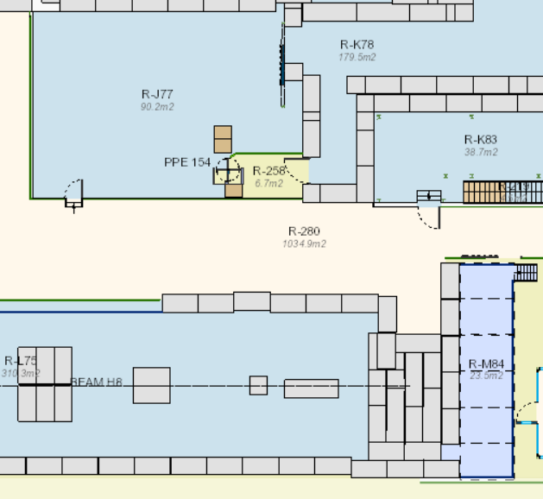
Experimental Facility
The test was carried out at the CERN SPS (H8 beam line), using the beam in parasitic mode.
The system was installed downstream from the beamline dump platform. Two different beam profiles were used: tertiary muon beam with a moment of $165 GeV/c$; secondary beam dumped in the upstream platforms with respect to the test platform (PPE168, PPE158 ... PPE138)
GIF++
Prep. Area
GIF++ Bunker
GIF++ Gas
Gas pipes
H8 beam
Secondary dumped beam profile
Tertiary muon beam profile
H8 line
Beam Dump
Set-up
$$\sim 20 cm$$
$$\sim 4 cm$$
N°11 CERN RPC 2022

Slide 26
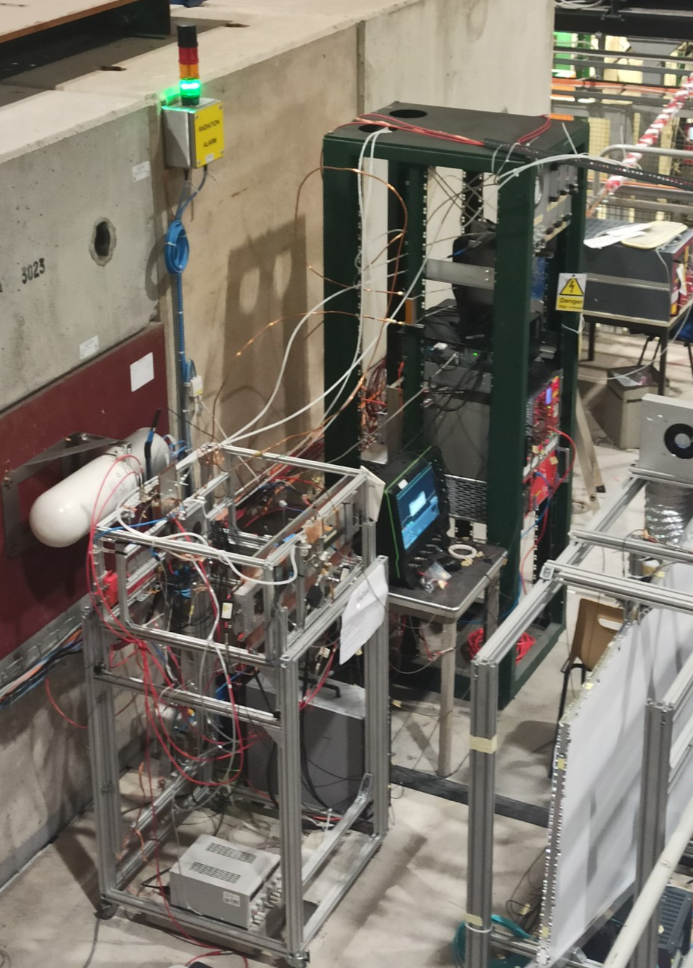
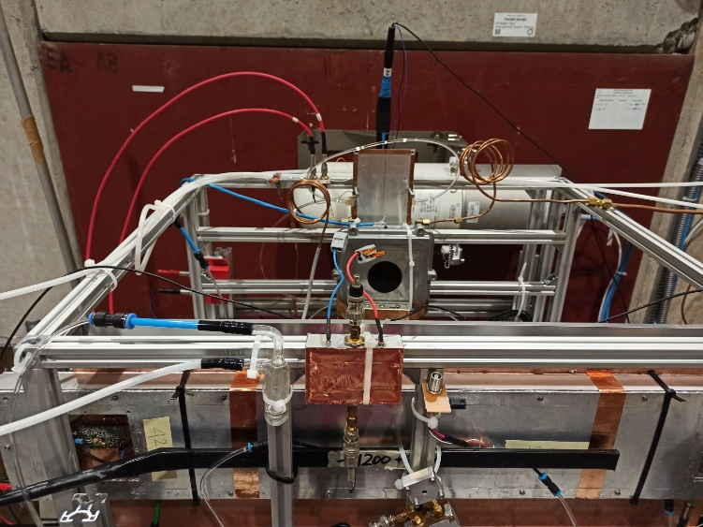
Experimental Set-up
The experimental setup consists of three scintillators used as triggers and other prototypes taken as reference. A UFSD silicon detector was coupled to the RCC to improve acceptance with respect to the trigger, nevertheless, given the small dimensions of the prototypes compared to the profile and the intensity of the beam, a compromise was chosen between geometric acceptance and trigger rate.
The DAQ device is the CAEN V1742 Digitizer (12 bit, 5 GS/s)
Radiation monitor
Resistive
Cylindrical
Chamber
Beam Dump
Setup
RPC 0.2 mm
RPC 0.5 mm
2xScintillators
Prototype 1
Silicon UFSD
Scintillator
Gas mixture: 94.7% TFE + 5% iC4H10+0.3%SF6
N°12 CERN RPC 2022

Slide 27
RCC under test at H8
Gas gap 1 mm
out
HV
R1
4 mm aluminum
R2
insulator
Bakelite
Graphite
copper

Slide 28
Efficiency with Front-End preamplifier
In this measure the UFSD pixel detector was used to optimize geometric acceptance at the expense of statistics .
A Front-end preamplifier with 1 GHz bandwidth and 50 Ohm input impedance has been used.
With the front-end electronics, even the configuration in positive polarity reaches excellent performance levels
N°13 CERN RPC 2022

Slide 29
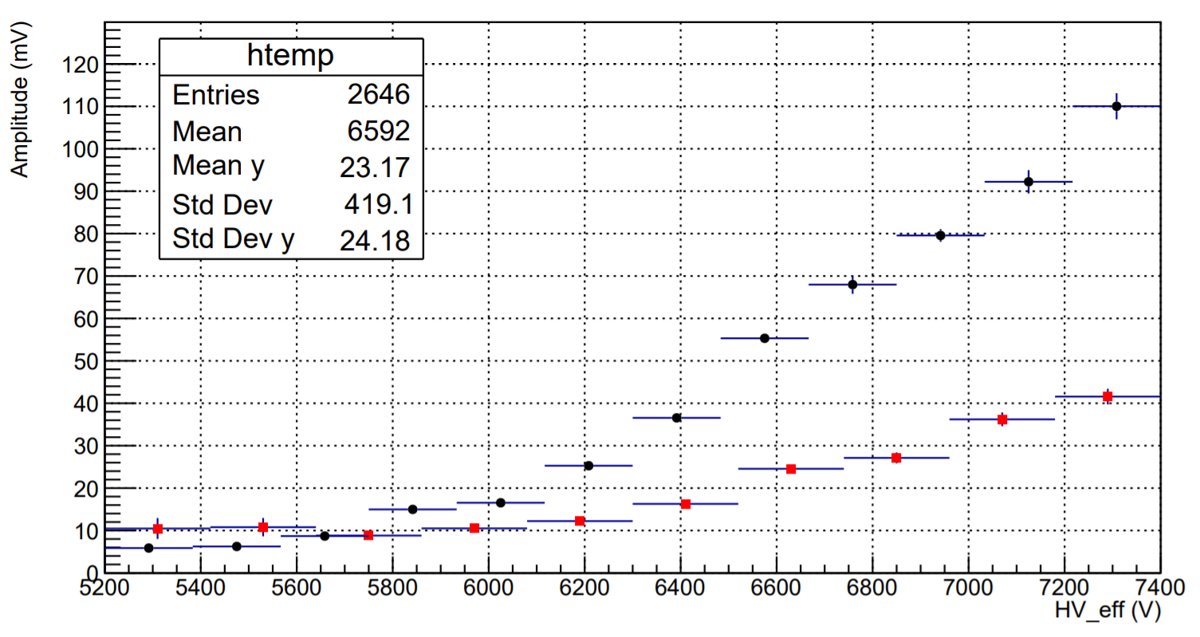
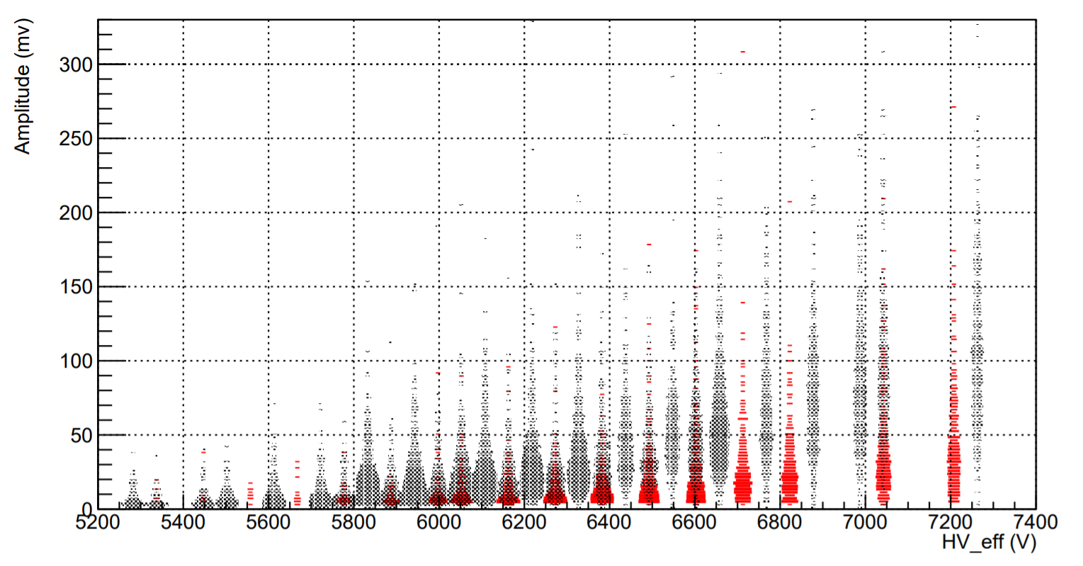
Amplitude distribution
The amplitude distributions of the signals reflect what has been observed in the measurement of efficiency. The signals produced under positive polarization conditions are significantly smaller.
Despite the very large amplitude of the signals, the temporal analysis shows that the working regime is that of a saturated avalanche
Negative
Positive
Negative
Positive
N°14 CERN RPC 2022

Slide 30
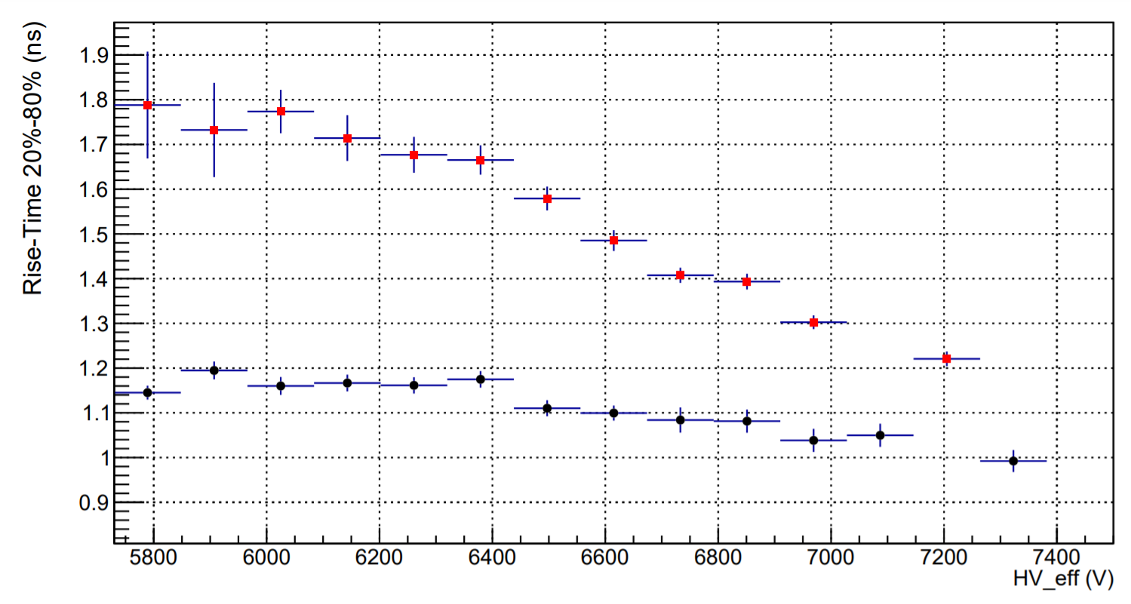
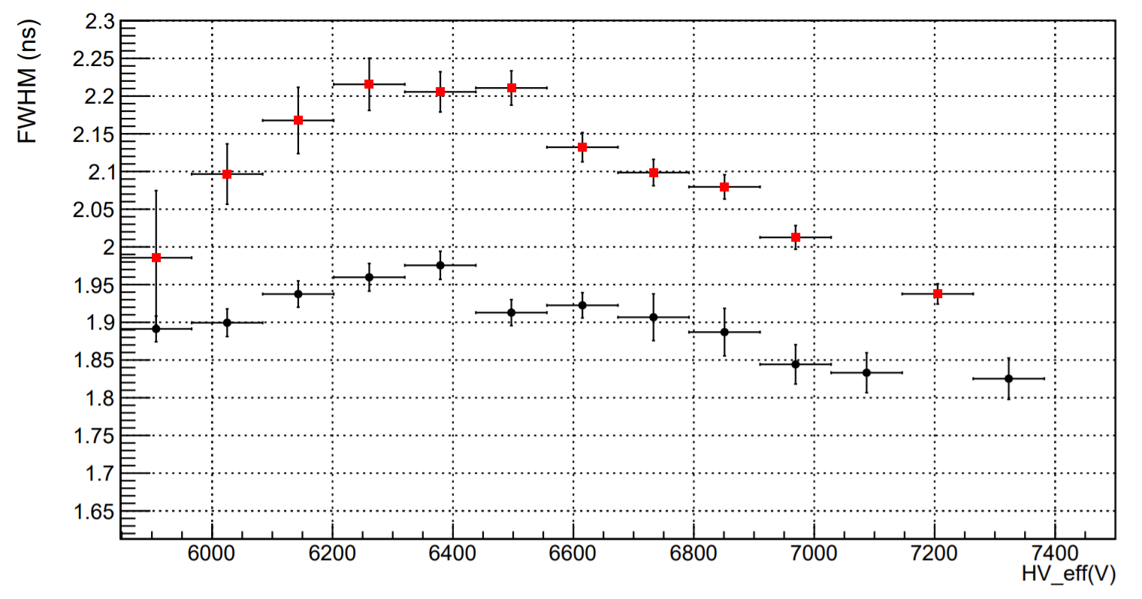
Time response (1)
Negative
Positive
The time response was characterized by measuring the crossing time of some set thresholds. Signals produced in positive polarity conditions are systematically larger. In this condition, the fall time is longer, as expected, meaning that the electrons produced near the cathode give a significant contribution to the signal. The rise time trend is affected by the fact that the signals in negative polarity are significantly faster
Negative
Positive
N°15 CERN RPC 2022

Slide 31
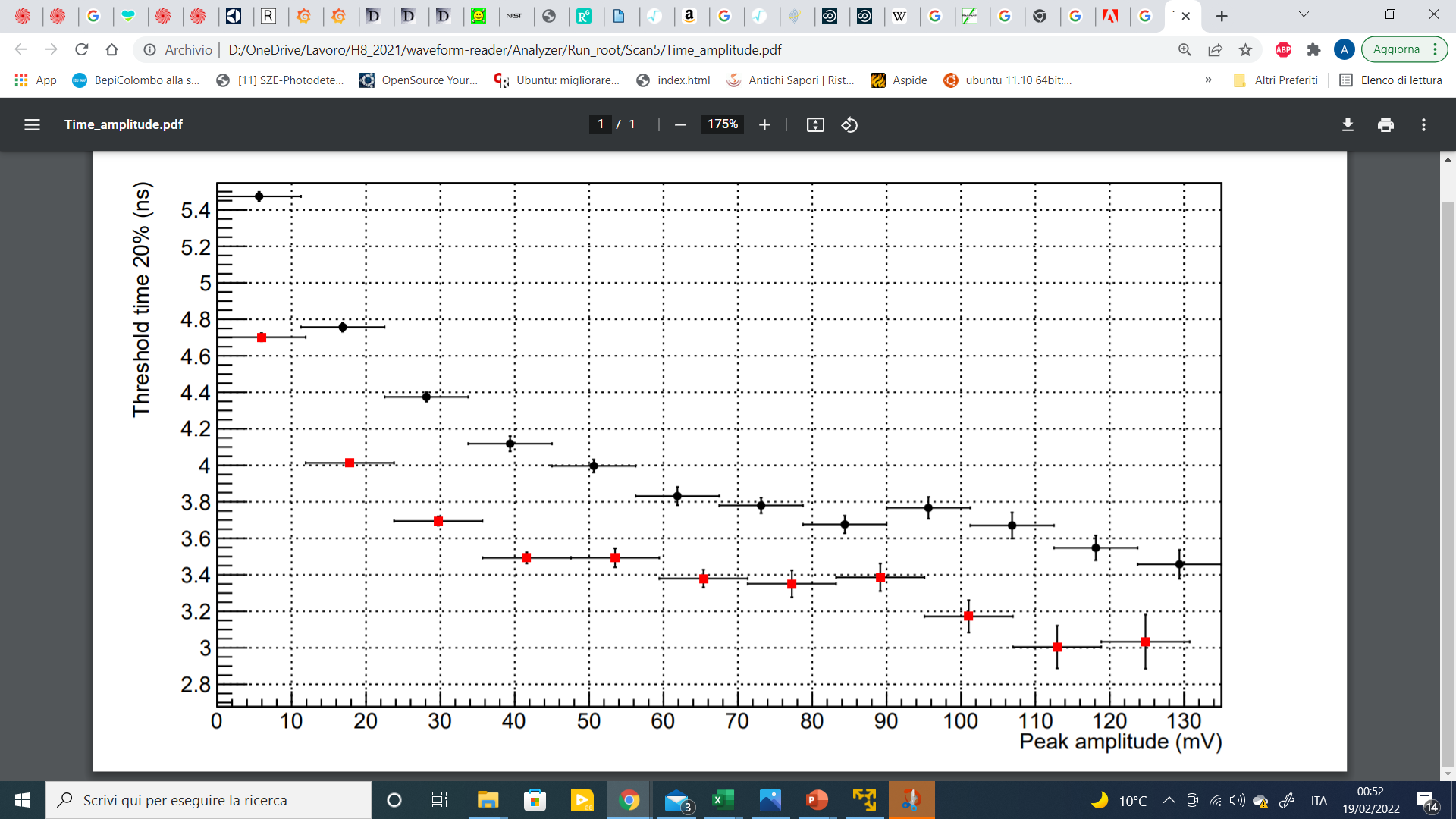
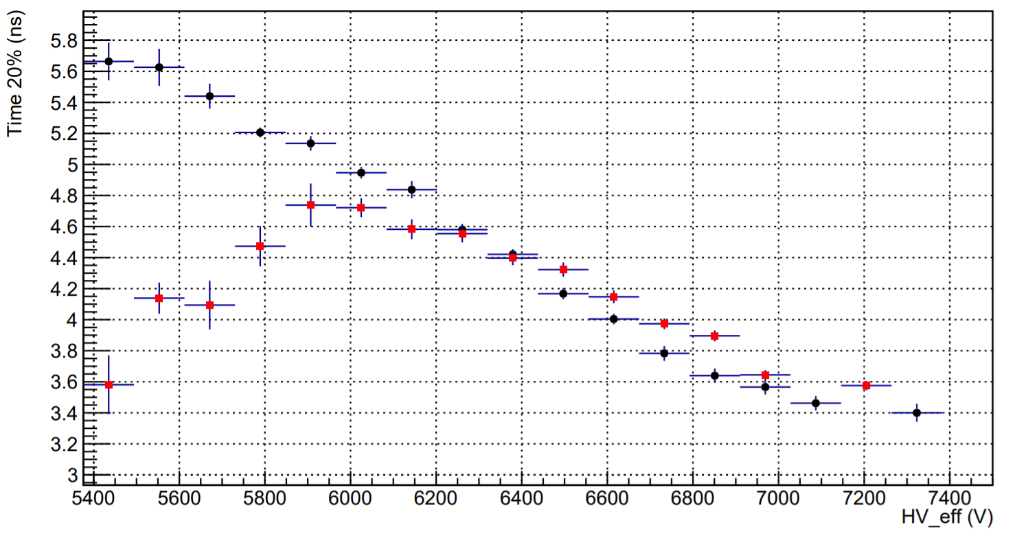
Time response (2)
Negative
Positive
The arrival time was measured using an RPC detector with two coupled 0.2mm gaps as a reference.
Since the amplitude of the signals at fixed voltage is significantly different between the two polarities, the arrival time has been studied as a function of the pulse amplitude.
It can be observed that with the same amplitude, the signals produced in positive polarity systematically anticipate those produced in negative polarity.
Negative
Positive
N°16 CERN RPC 2022

Slide 32
Time resolution
The time resolution was estimated by measuring the time of flight with respect to an RPC detector with 0.2 mm gas-gap whose time resolution is less than 170 ps.
The time resolution improve as the applied voltage increases and for high field values ​​it is systematically better in the case of positive polarization, in which multiplication occurs mainly near the cathode (behavior like that of a thinner gap).
negative
N°17 CERN RPC 2022

Slide 33
Future test for calorimetric application Scintillator + RCC High Time, spazial and Energy resolution
Resistance 30 ohm
Out RCC
HV RPC
Resistance 1Mohm
Graphite
Resistance 1Mohm
Aluminum tube
Gas gap RCC
Bakelite tube
Scintillator
PbW04
SiPM
Copper tube
insulating tube

Slide 34
Conclusions
The RCC is very promising detector for:
Tracking and timing in the future experiment requiring 50um, 10ps resolution
Large carpet in the space and in the future lunar sites
Easily use ecogas mixtures by exploiting geometric quenching and at least use a single gas such as CO2
High time resolution and high efficiency with a single thin gap by increasing the density of the active target with pressure instead of making a multigap detector.
RCCs are easily built in industrial way
N°19 CERN RPC 2022

