Slide 1
Sites for NA61
Ian
21 Nov 2022

Slide 2
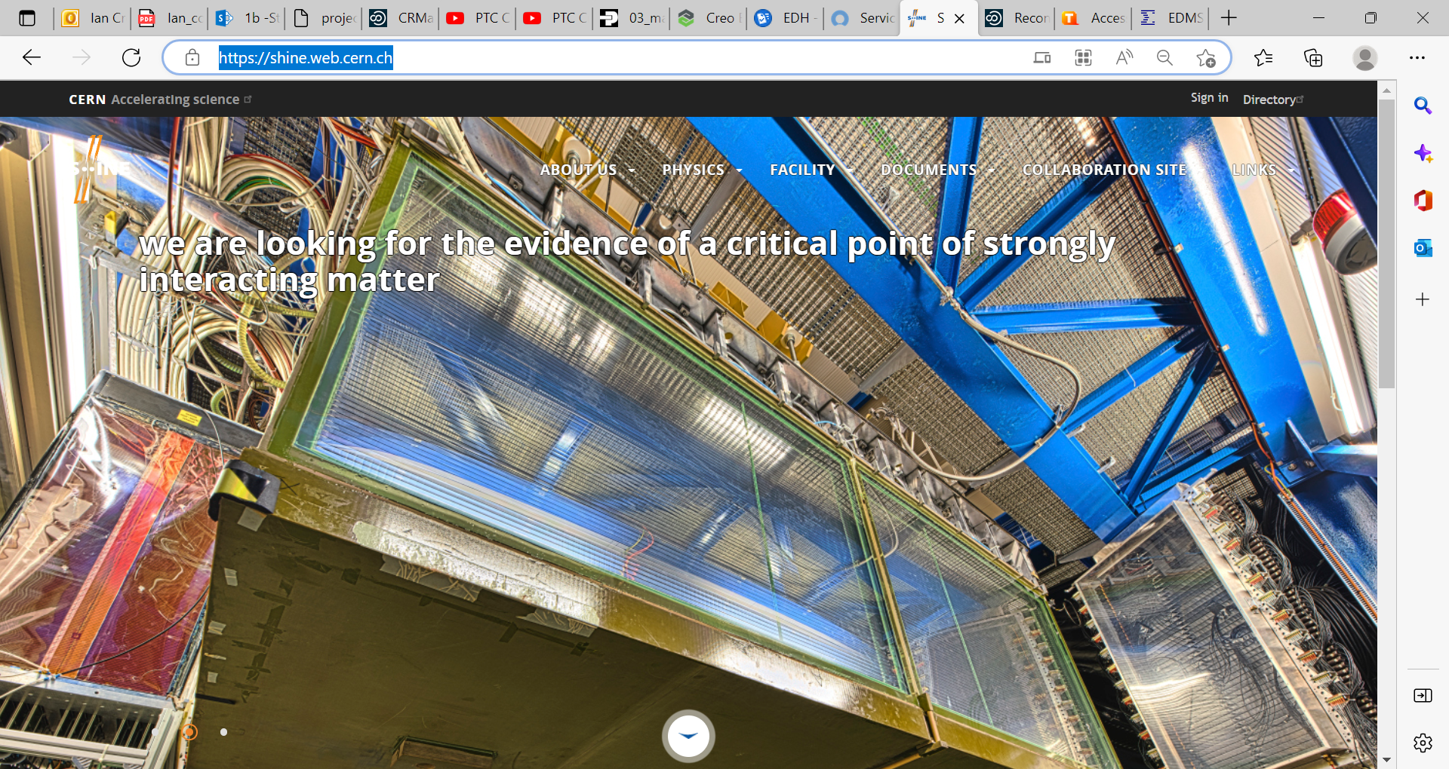
https://shine.web.cern.ch/

Slide 3
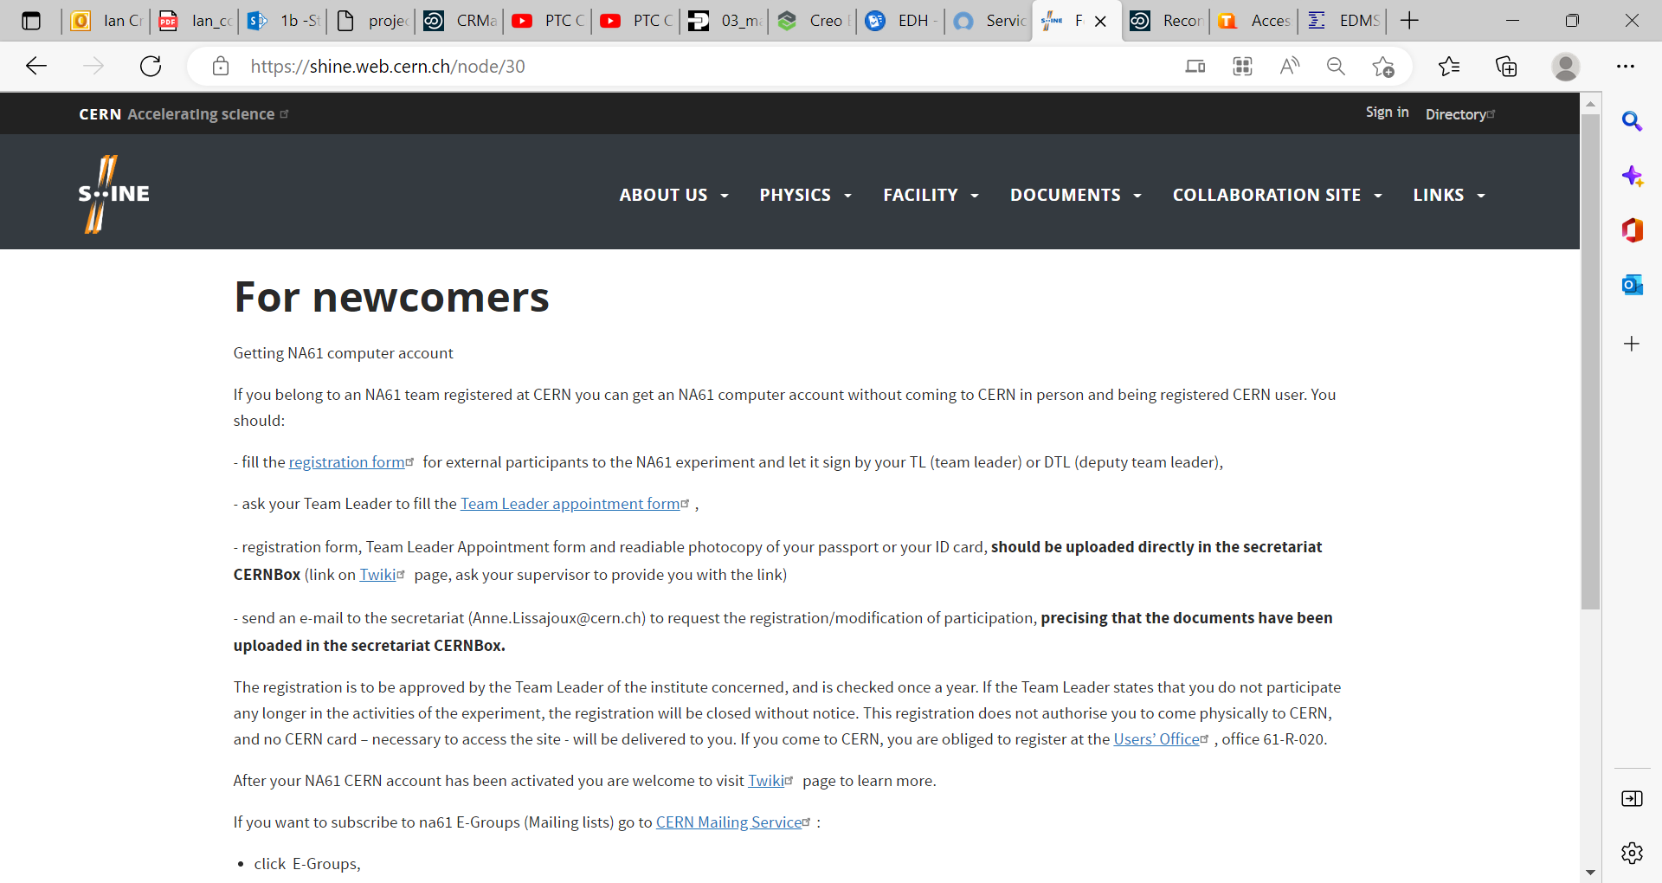
https://shine.web.cern.ch/node/30

Slide 4
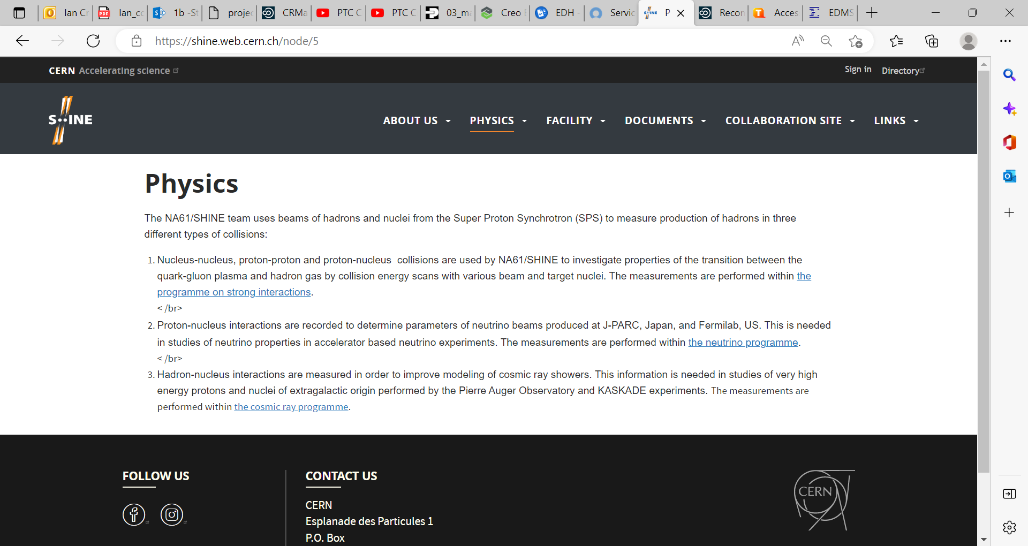

Slide 5
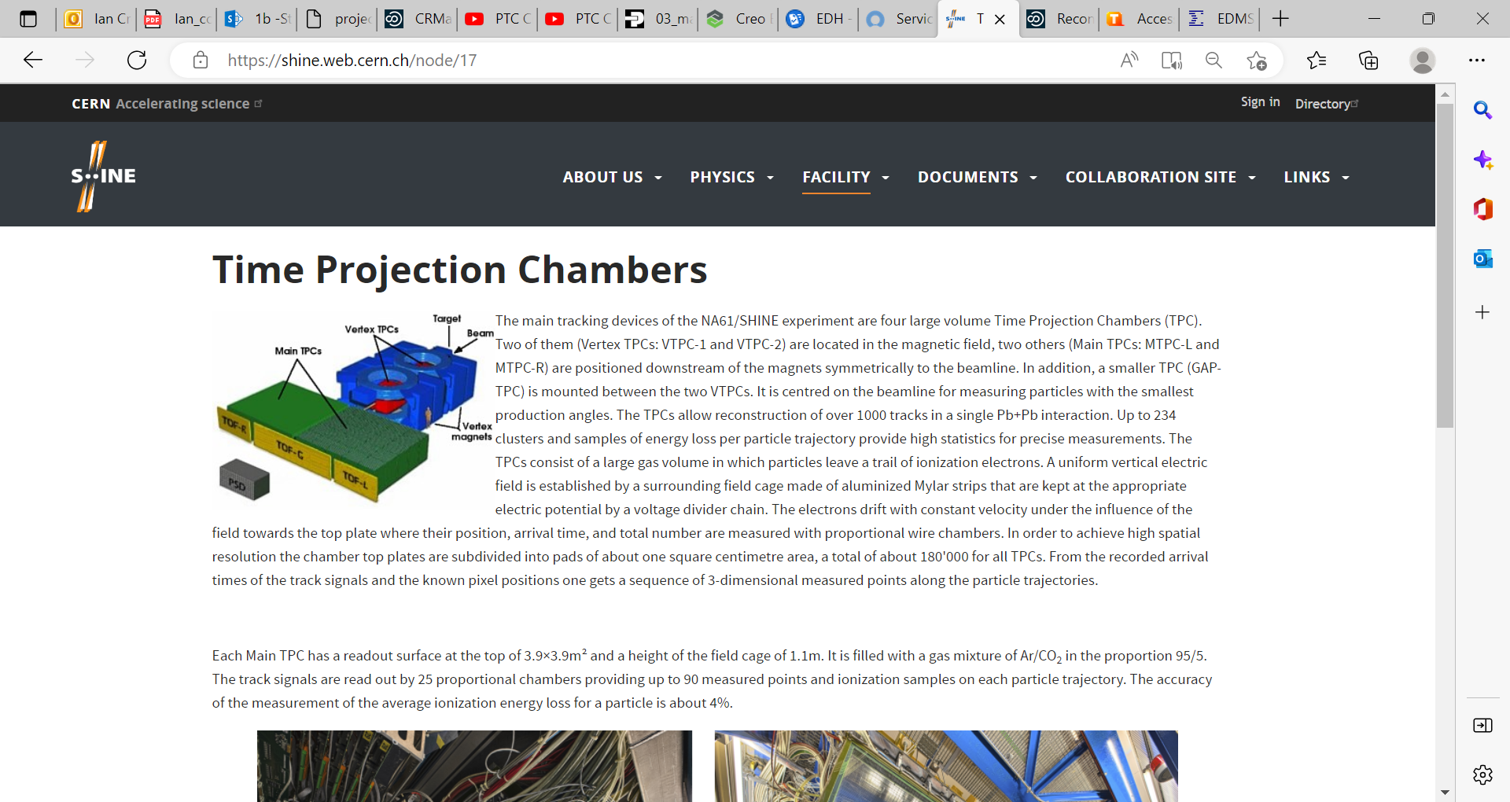
https://shine.web.cern.ch/node/17

Slide 6
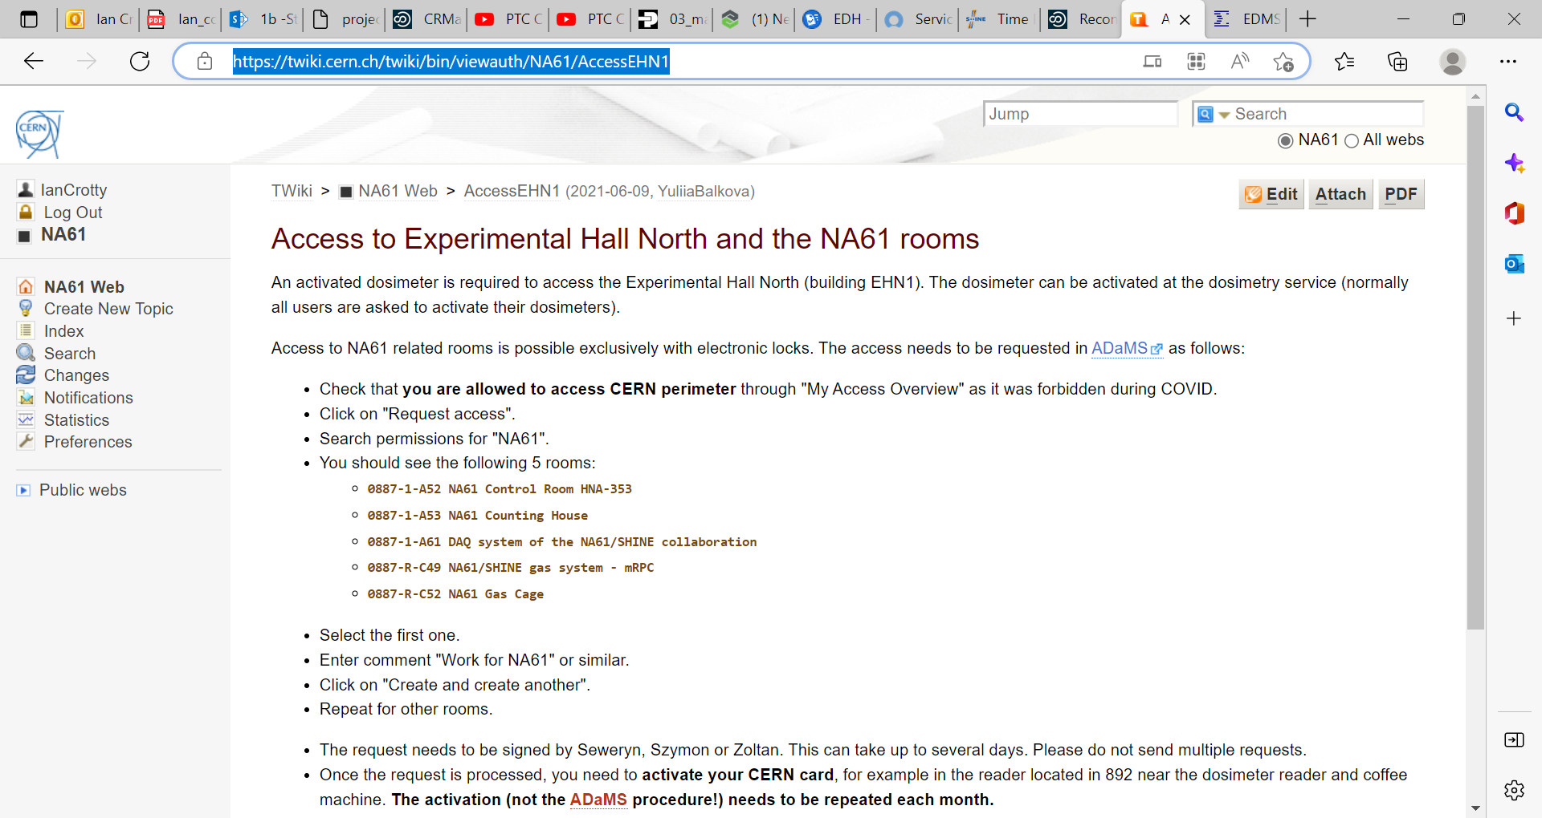
https://twiki.cern.ch/twiki/bin/viewauth/NA61/AccessEHN1

