Slide 1
CAMAC Modules their storage in the Flex
Ian
30 sept 2022

Slide 2
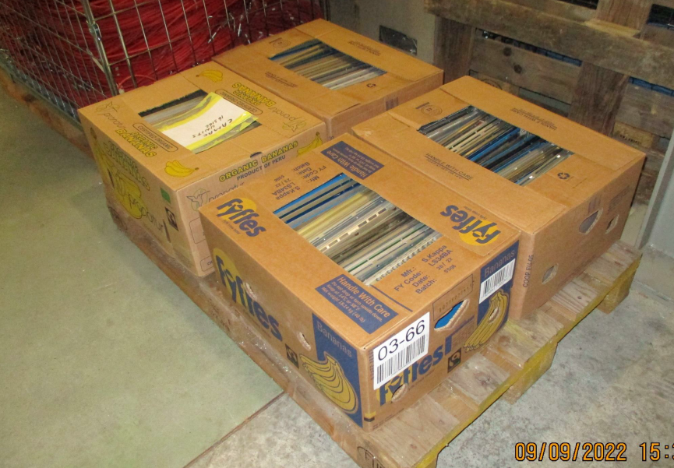

Slide 3
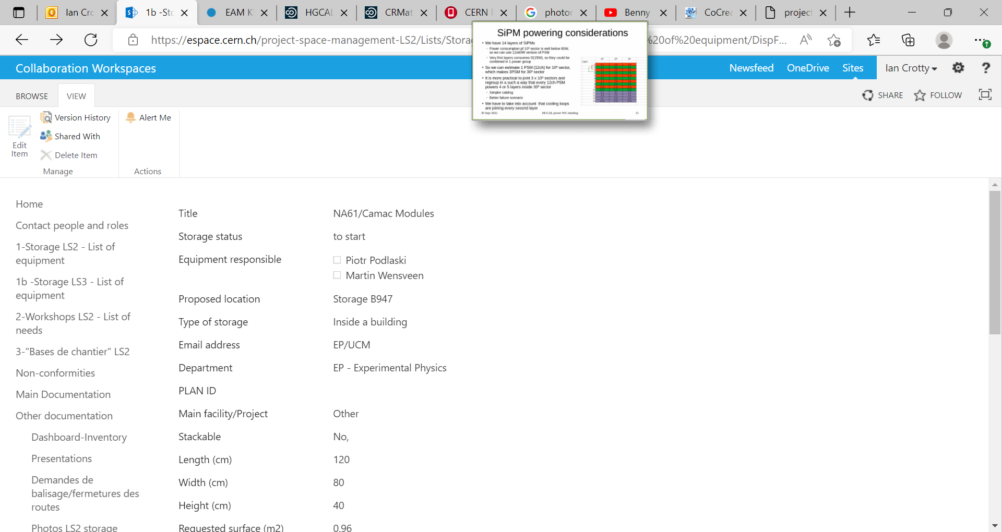
Made out on the 9 Sept 2022. Cedric said he would give me access to edit item.
The “edit item” box to allow the adding of the file giving details of the modules has not been available since I removed the file I had added but it said that the address was “fake” and I changed it.

Slide 4
Since 15 Sept when Cedric offered help I am coming back to him on the 30 sept 2022 after the NA61 and the RPC conferences.
Finally he understood that he had given rights to Martinus and Piotr but not to the person making the request , me Ian. Thia llaows me to make updates corrections on the file to add a file containing details of the contents.
Then I could not make out the TREC process as I had asked for storage and NOT the cern internal transport to 947 FLEX building.
The transport will be done today 11 Oct 2022, finally.

