Slide 1
Notes on FPSD Translation Mechanism. Dimensions and Torque
Ian
24 Feb 2023
LV-329
CR-043225

Slide 2
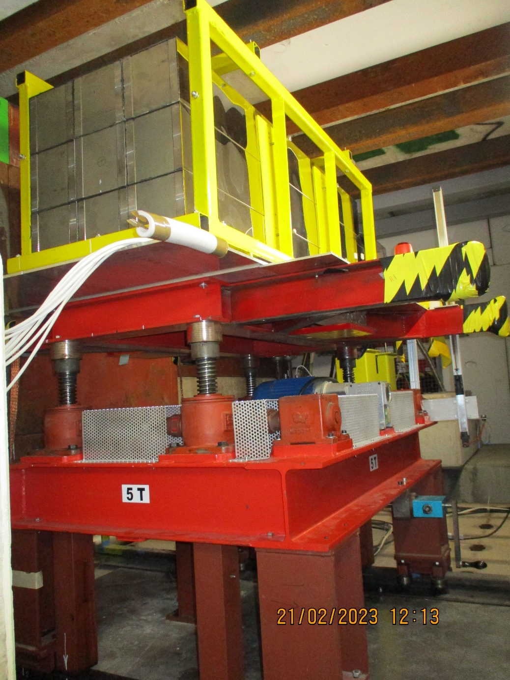
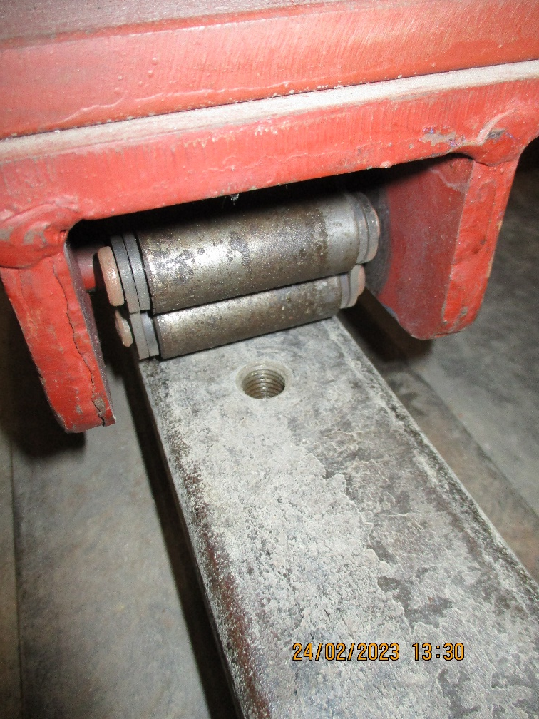
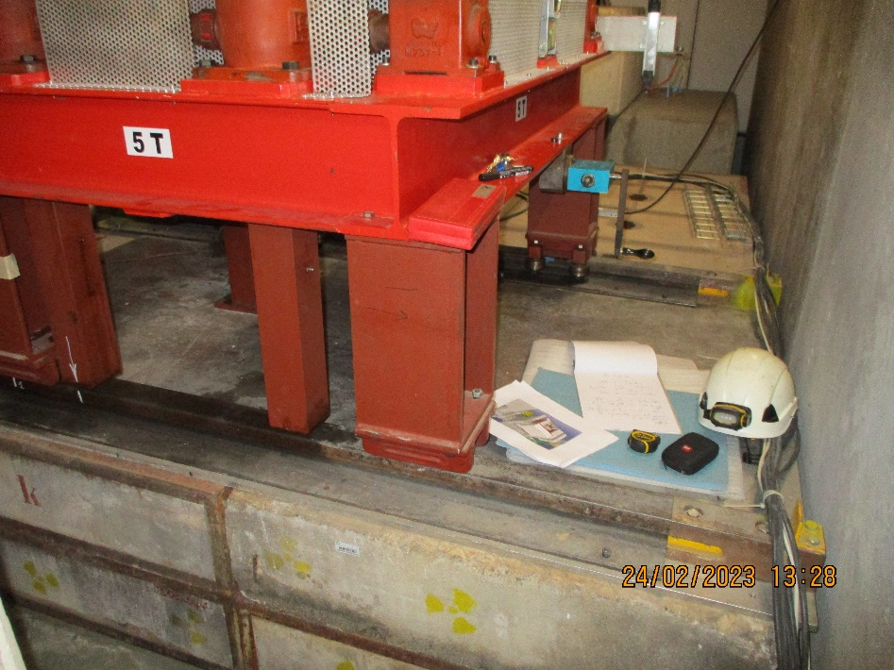
Trolley appears to roll on 3 of the 4 points . No contact on upstream Saleve.

Slide 3
View down stream
FPSD
Bunker walls
C
A
B
3 2 1 0

Slide 4
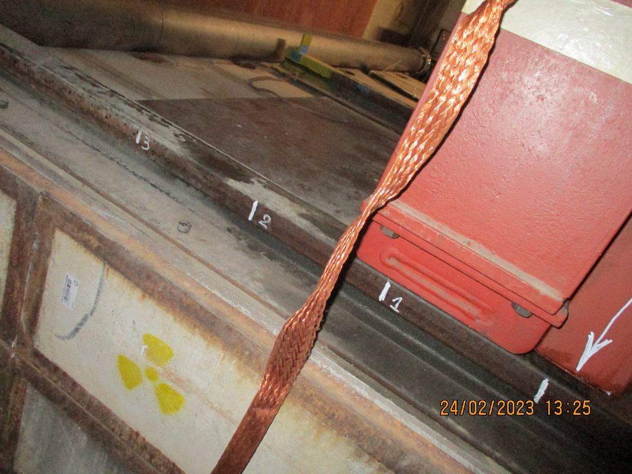
Measurements
Nota
0+ is the limit as defined by the static point on the concrete base.
3+ < is less than 40mm as the rails are no longer supported
The distances between the digits on the rail are ~ 200mm

Slide 5
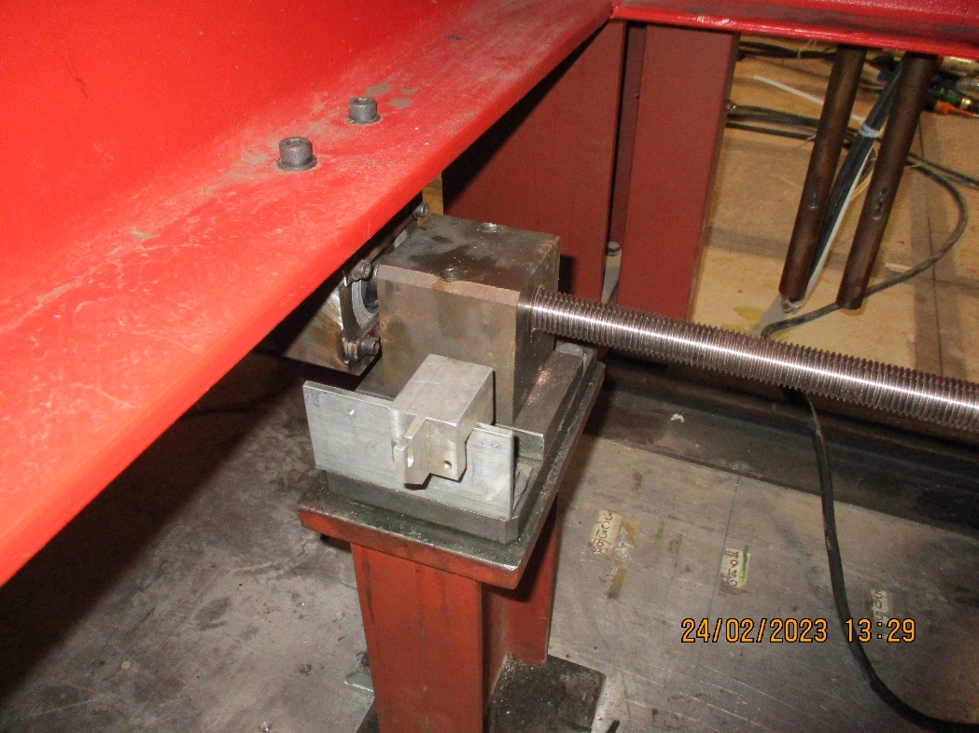
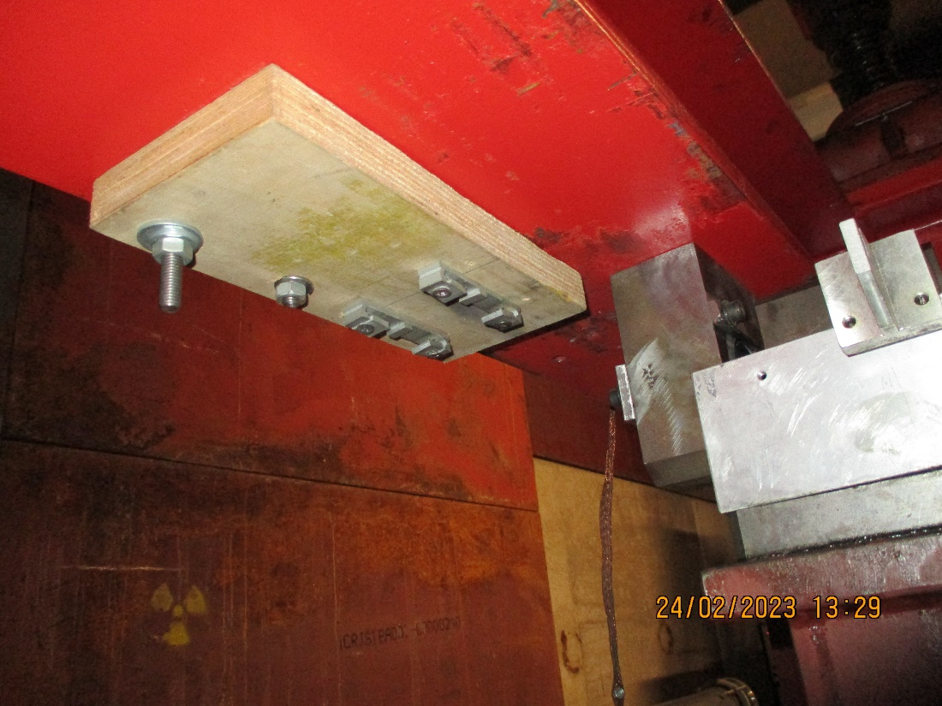
Some remnants of a visible measuring device ?
Even with motorized version a visible indication of position is useful and makes calibration easier.
Grease points could increase the life if added to the 3 points of this drive

Slide 6
Torque measurement

Slide 7
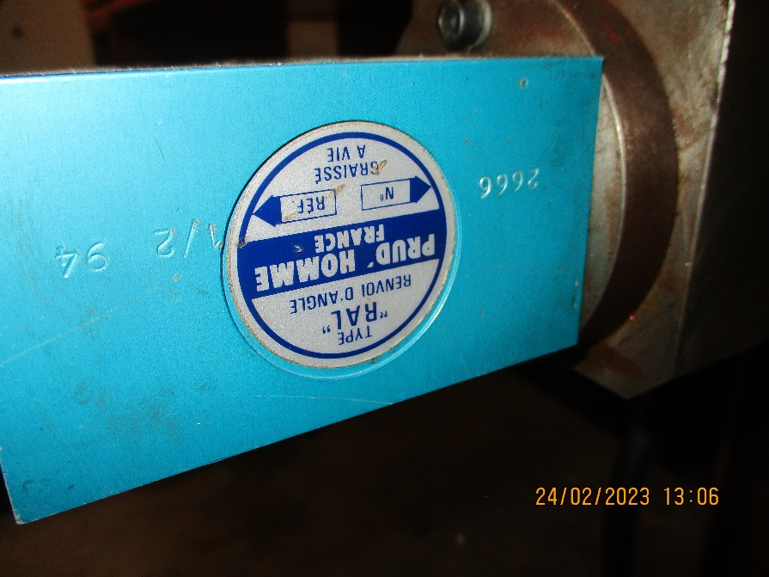
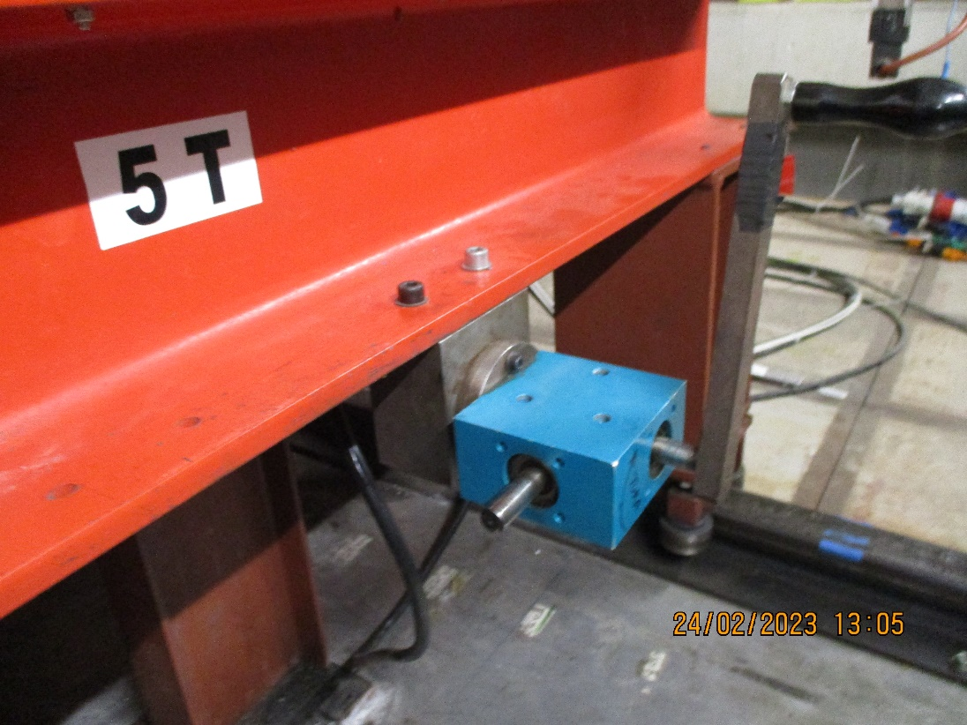
Transmission box with reduction and handle
195mm

Slide 8
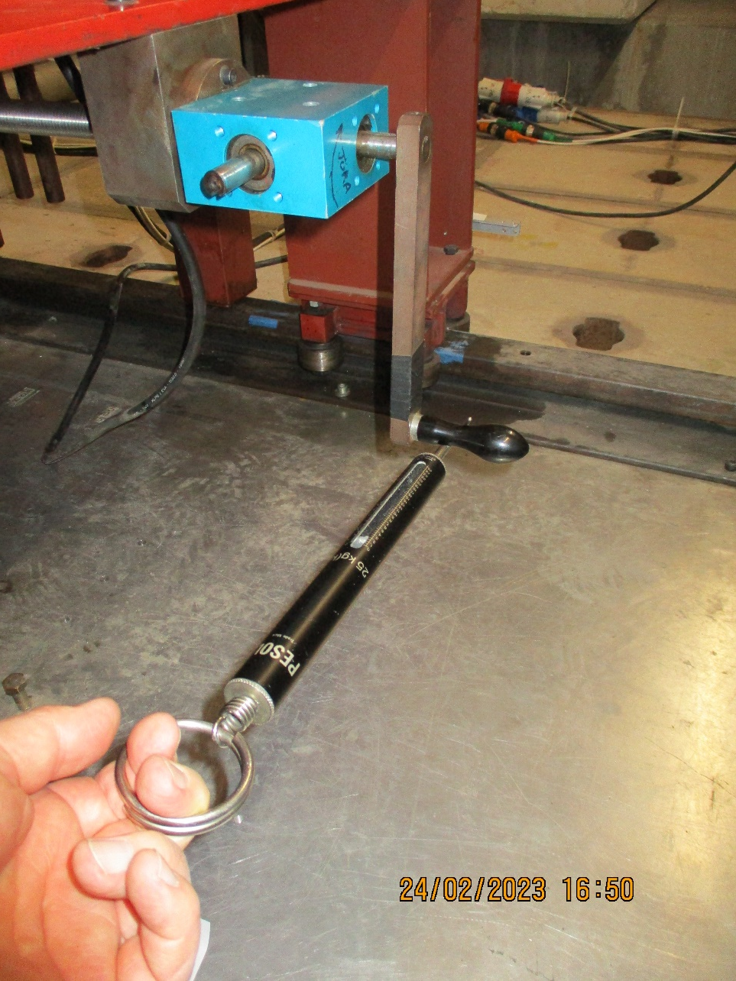
Bottom pull shown. Angular movement is ~ 20deg each side of vertical.

Slide 9
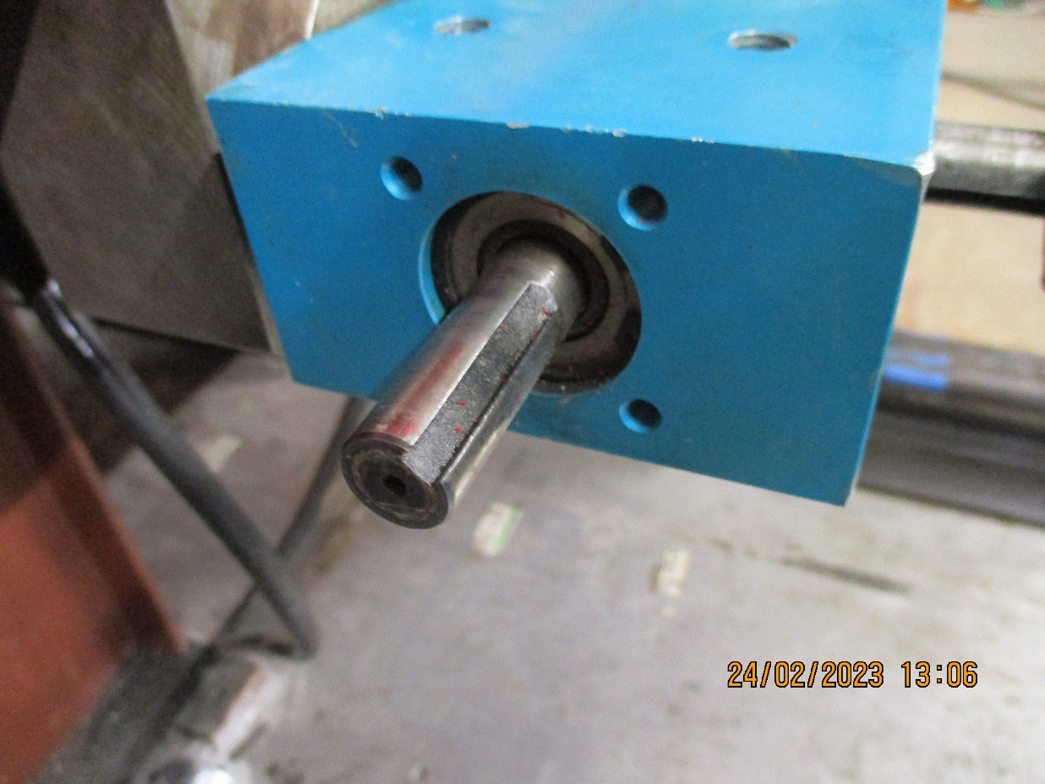
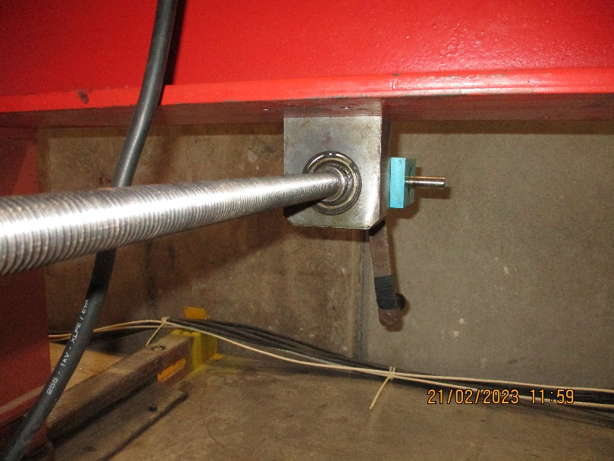
90 degree shaft is 2:1 wrt the longitudinal shaft with the lever/handle.
The one shown is dia. 15mm and L = 41mm
Key is 4.95mm wide

Slide 10
Better cable management

Slide 11
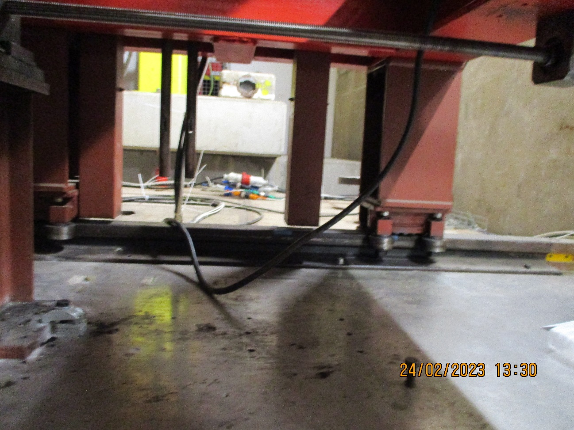
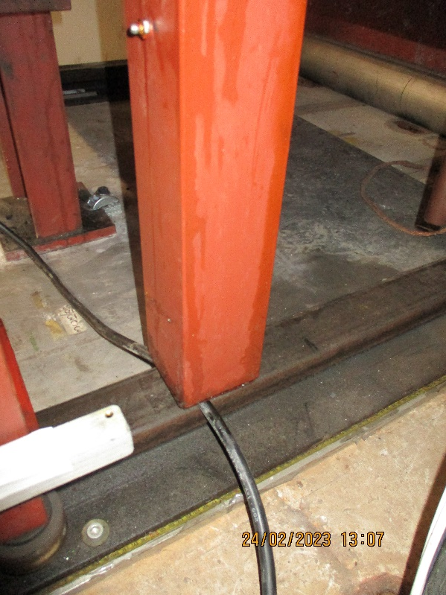
Some sort of cable guide/protection for the 2 motor cables
(and possibly the ground) should be provided. Cable chain is unnecessary ?

Slide 12
Vertical Drive

Slide 13
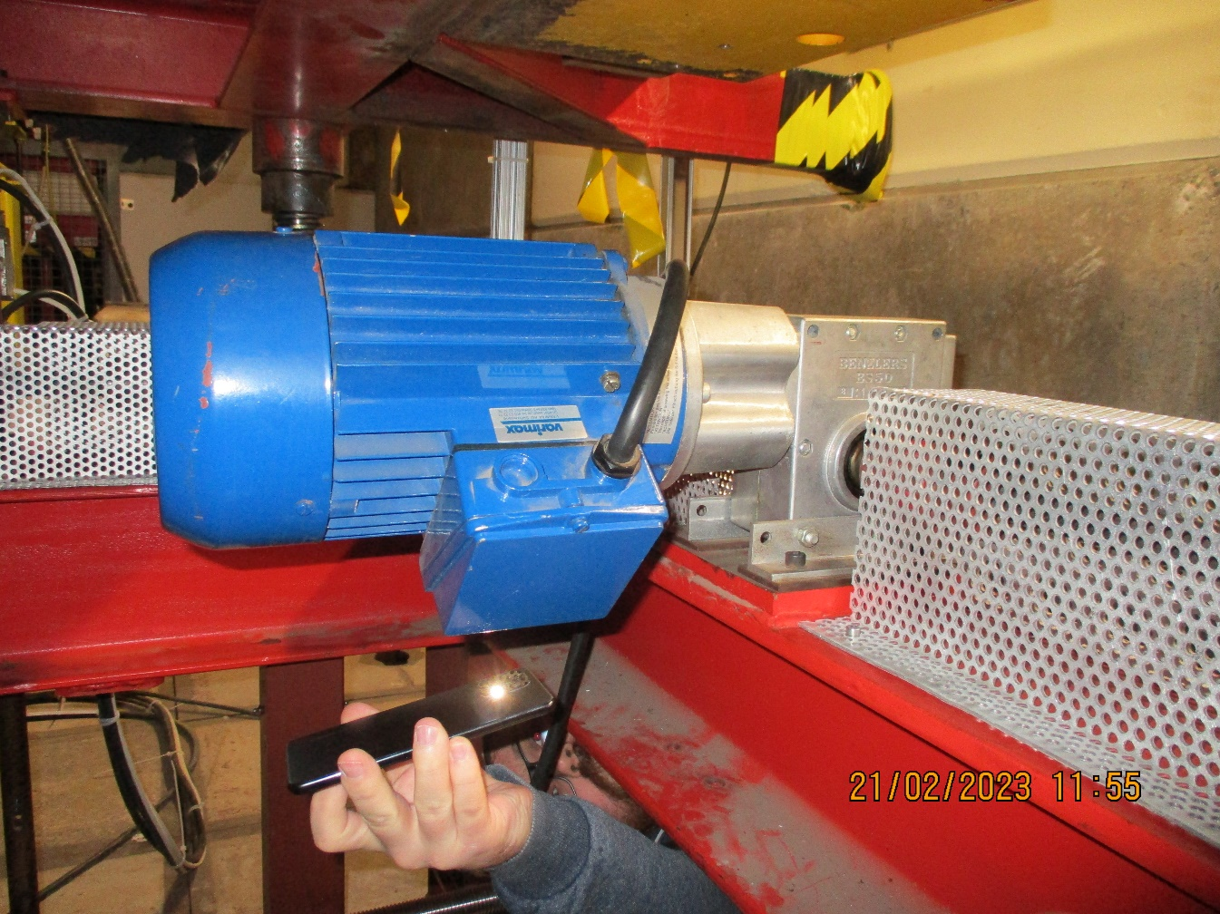
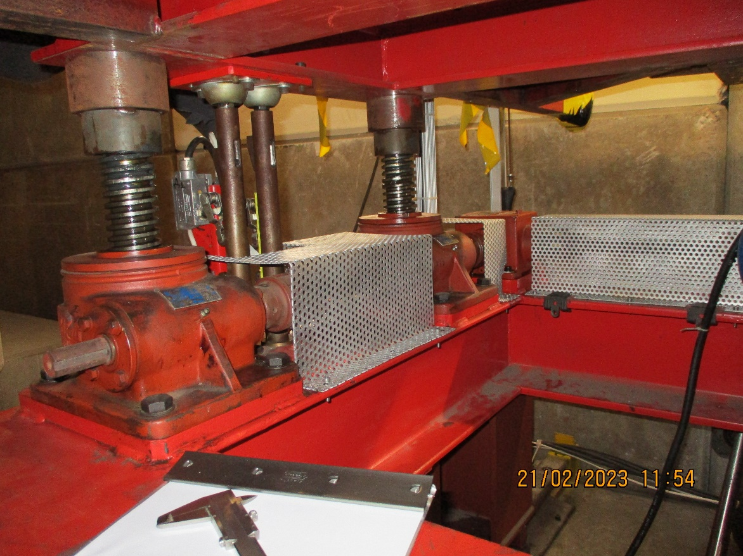

Slide 14
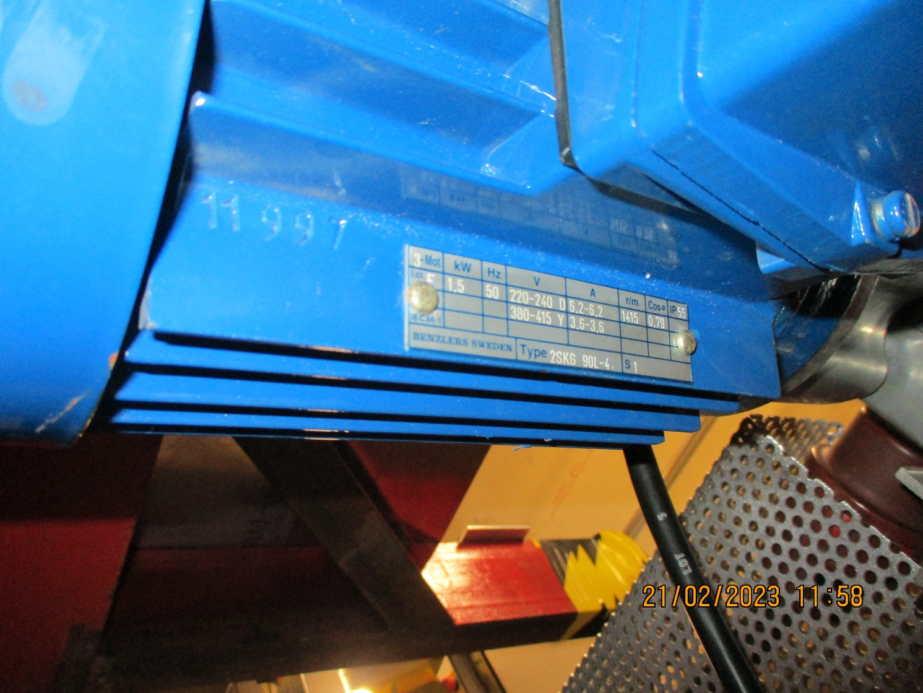


Slide 15
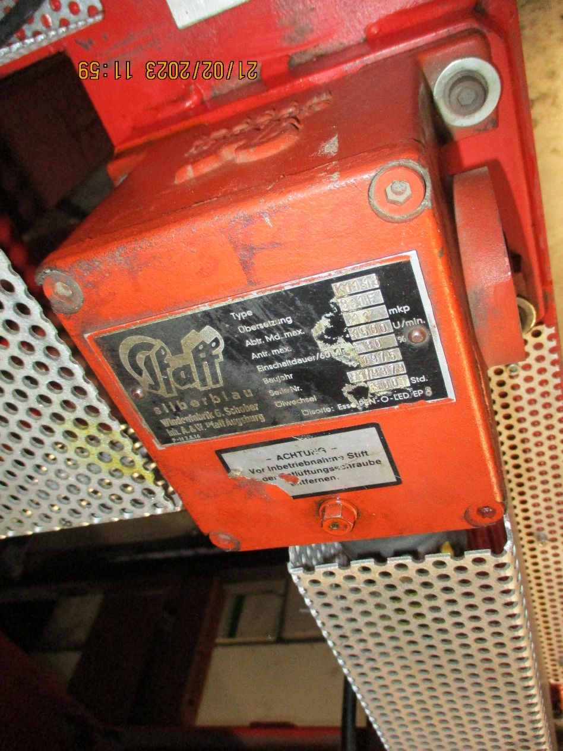
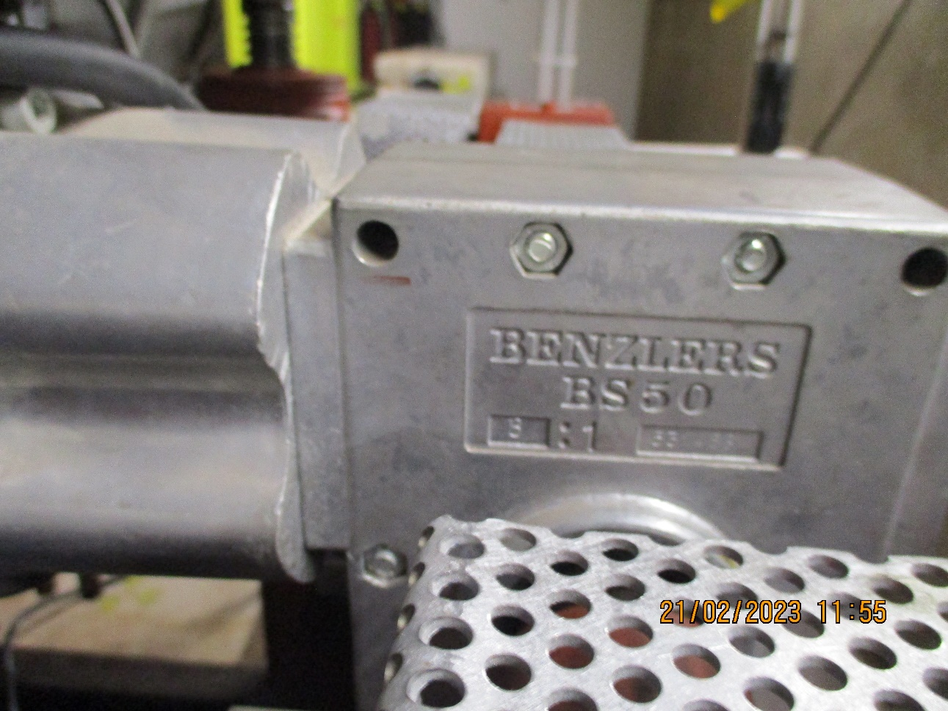

Slide 16
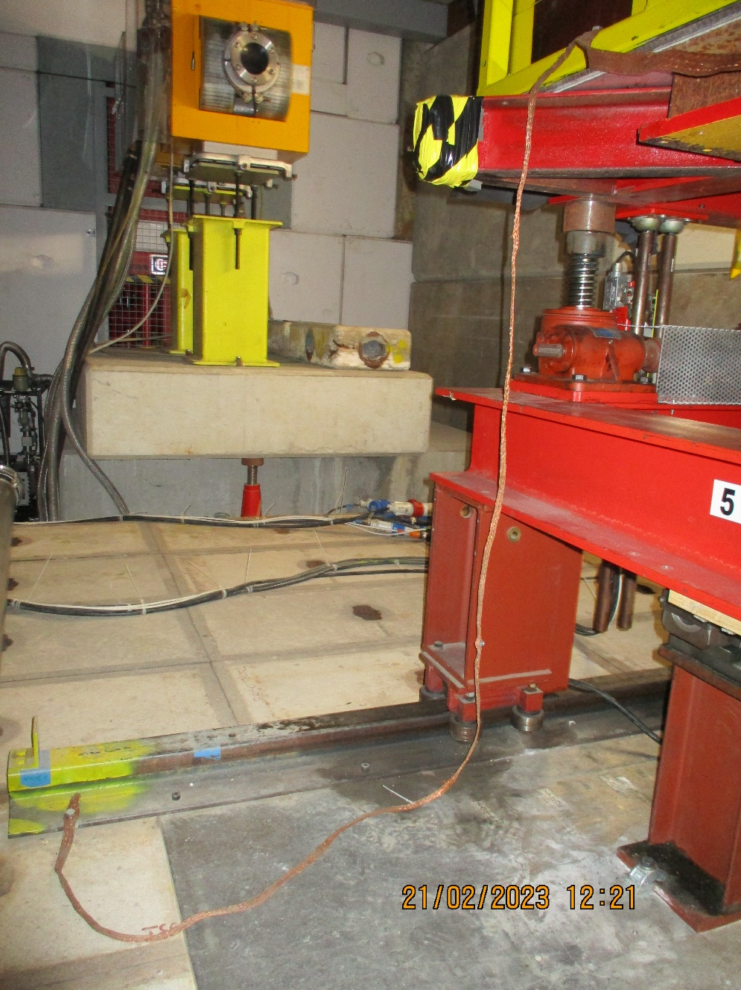
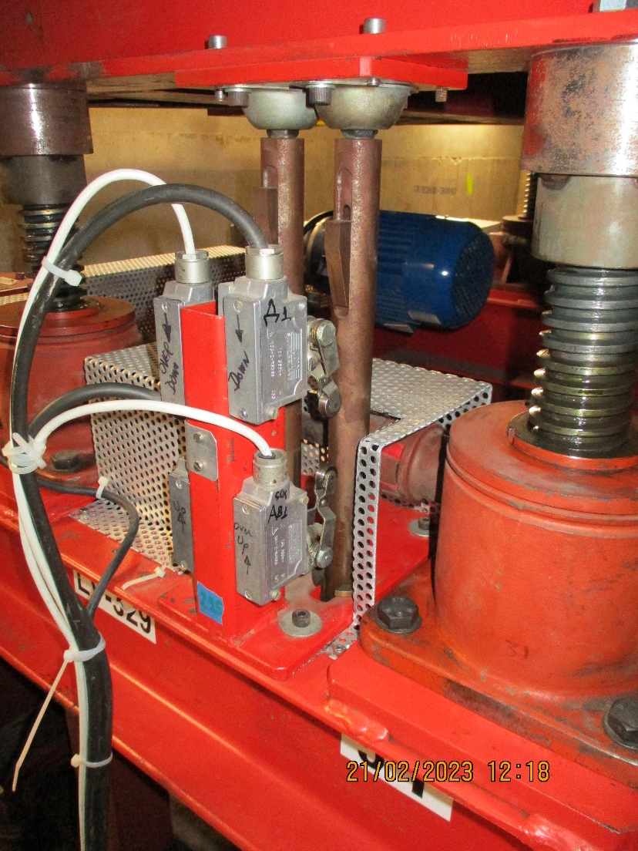
Ground connection loose

