Slide 1
Lawyers and social status, in Gex
Ian
25 sept 2020

Slide 2
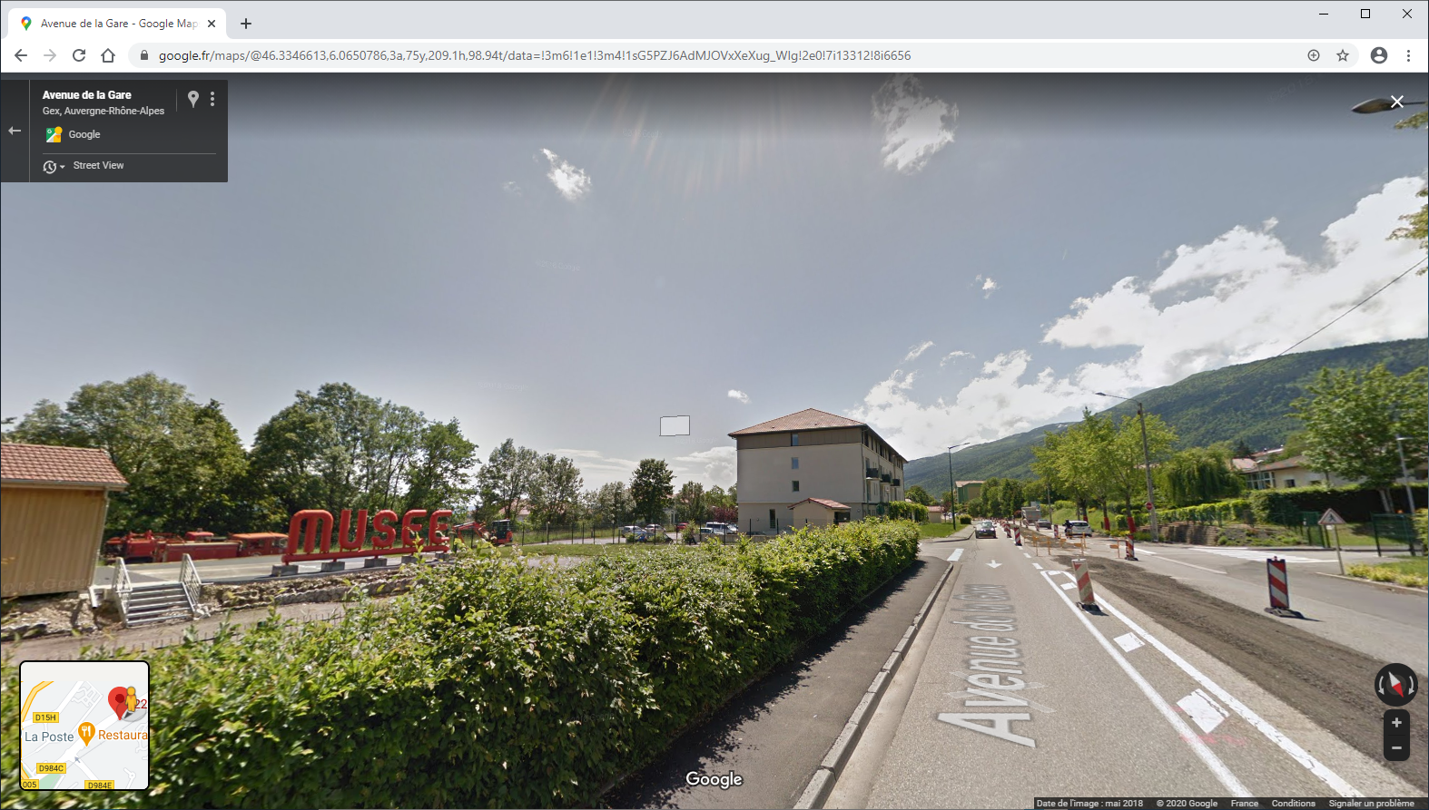
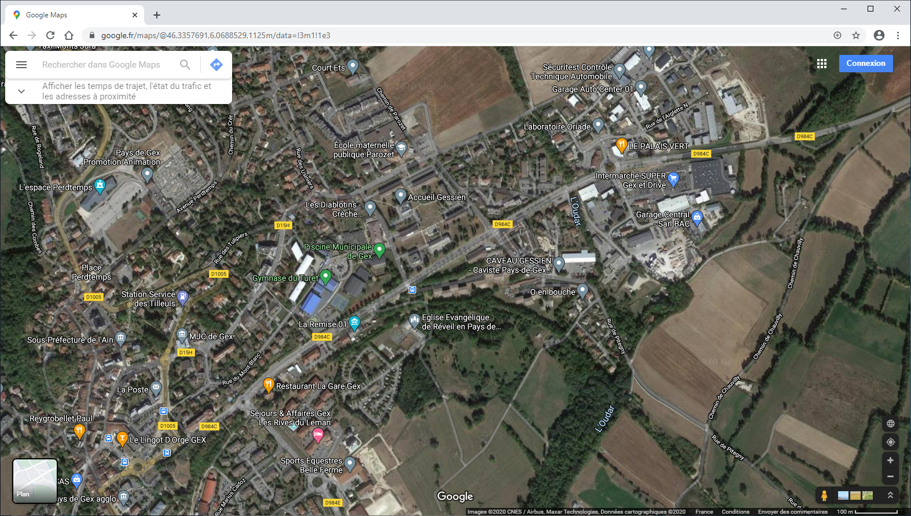
Point Accueil Solidarite, 228 Av. des Alpes, 01170, Gex. Tel; 0450415462.
46°20'02.9"N 6°03'51.6"E
46.334128, 6.064345
From what I understand you should go here, at least to start with. Perhaps you need a RDV here as well.
On the road (D984C) to Divonne 100m after the “Restaurent de la Gare”. And before the Musee des Pompiers.

Slide 3
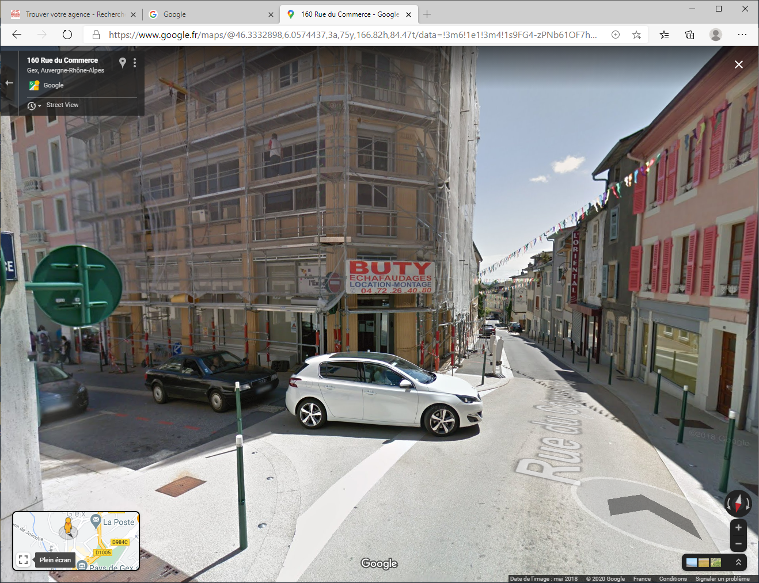
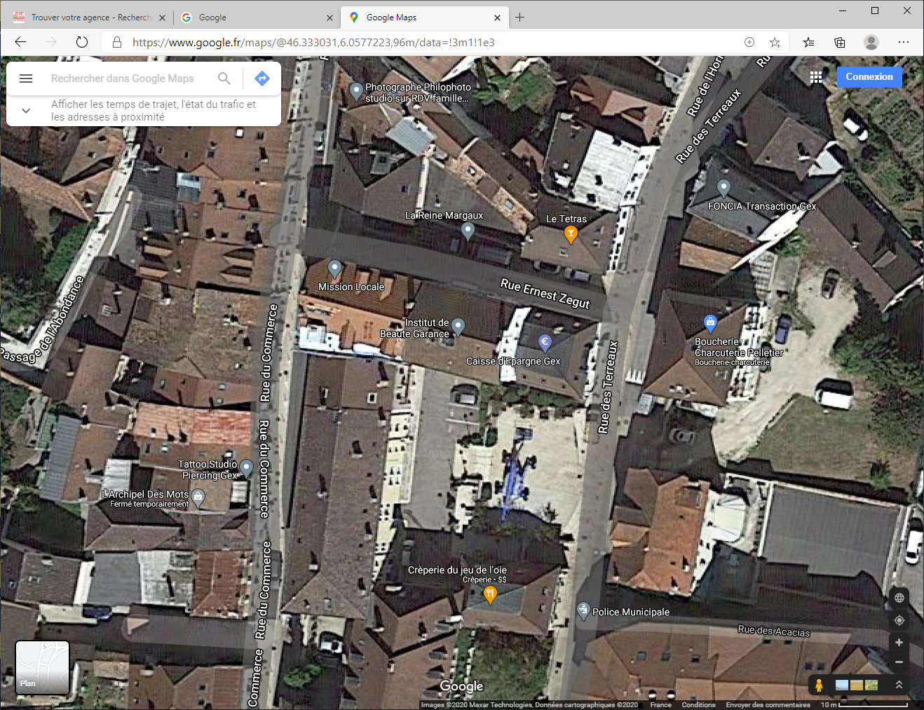
The lawyers
“Point d’access au Droit”
Junction of Rue Ernest and Rue du Commerce, Gex
46°19'59.6"N 6°03'26.6"E
46.333222, 6.057384
The access is only through this door and in a lift to the 1st floor. You can talk to lawyer for free. Normally 30mins max. You can go more than once if something is not clear.
You should call 0450413586 for a RDV.

