Slide 1
Sean & Vivian Crotty
Fix 00441295780798
Mobile; 00447922818 421

Slide 2
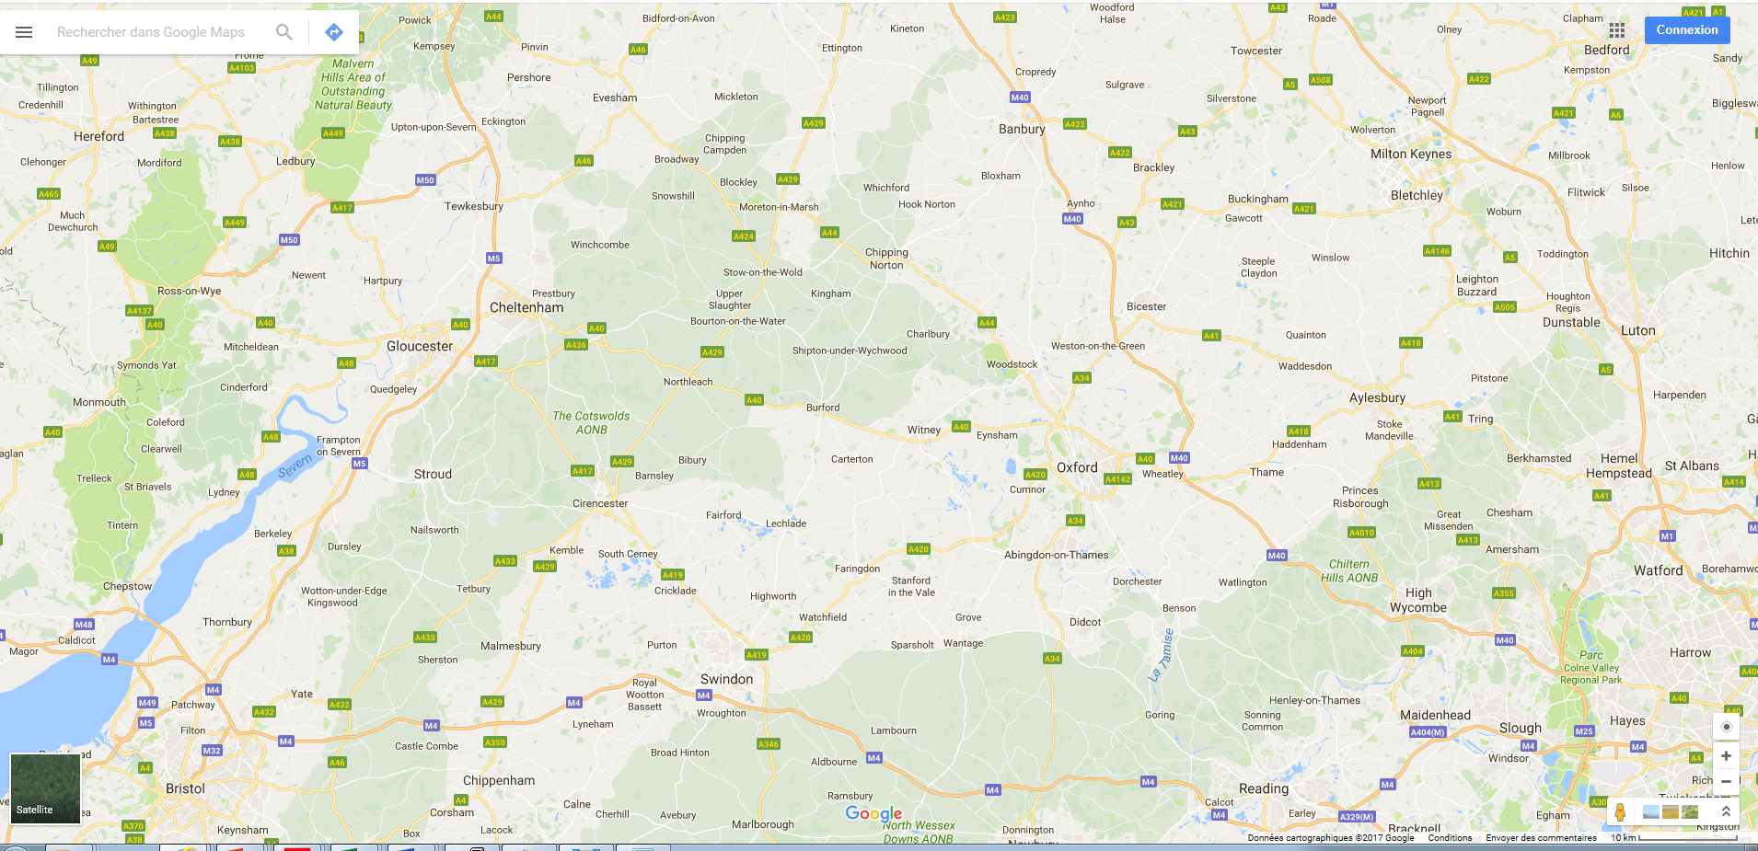

Slide 3
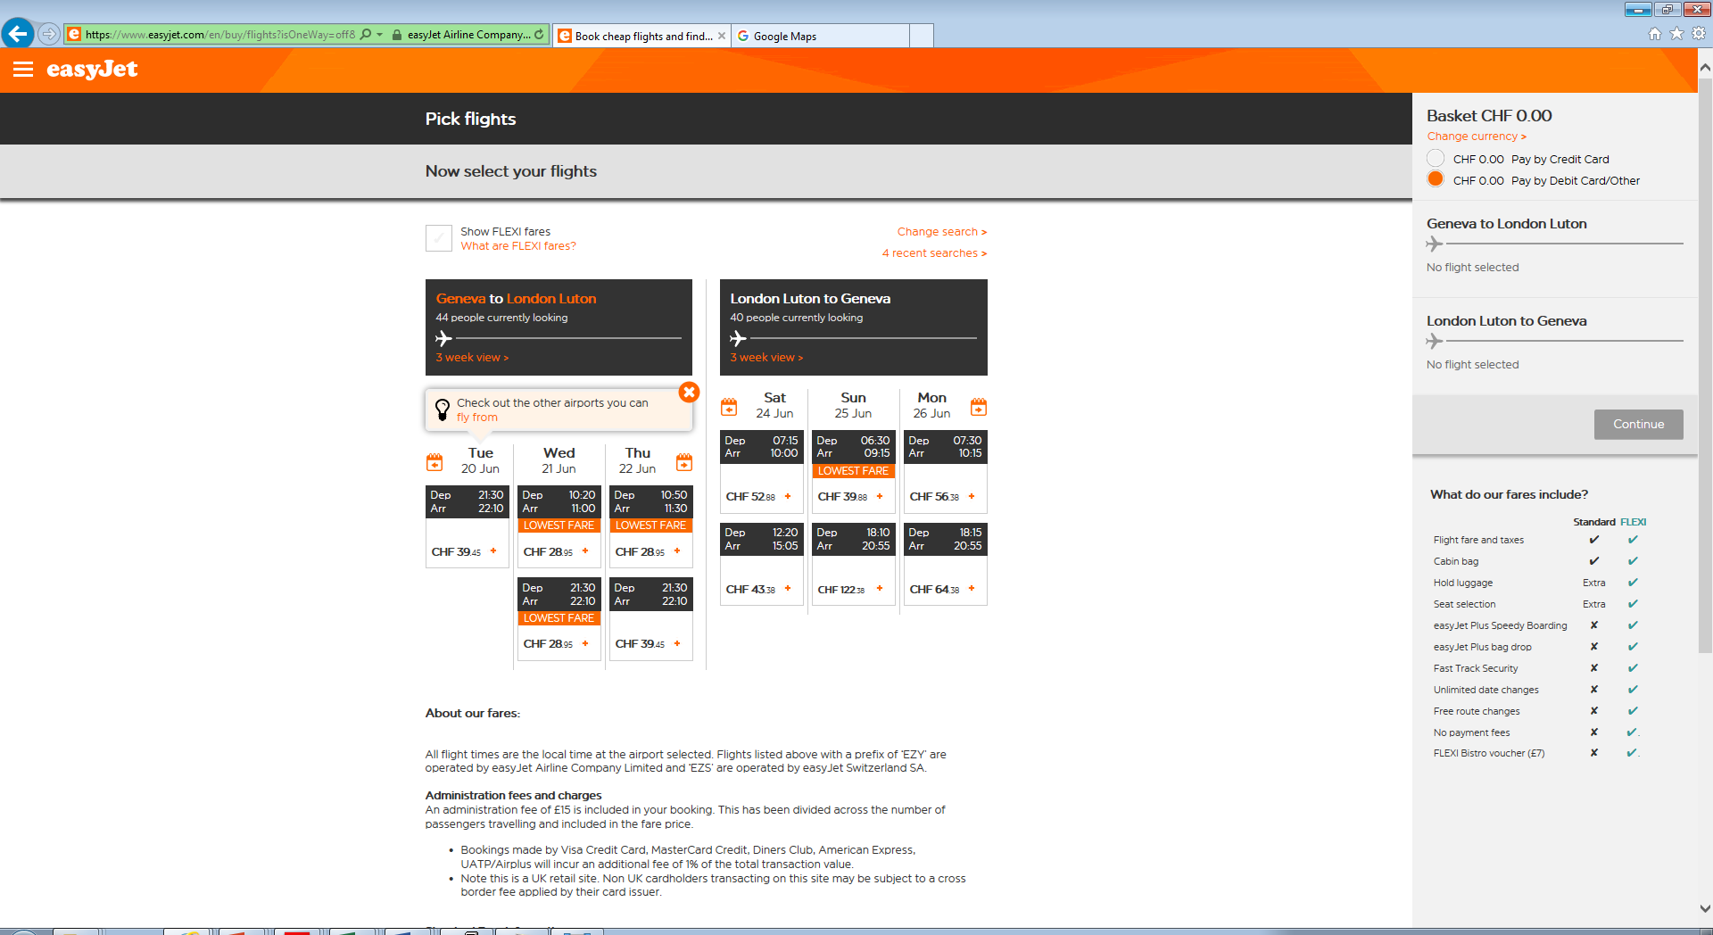
13 June @ 0830

Slide 4
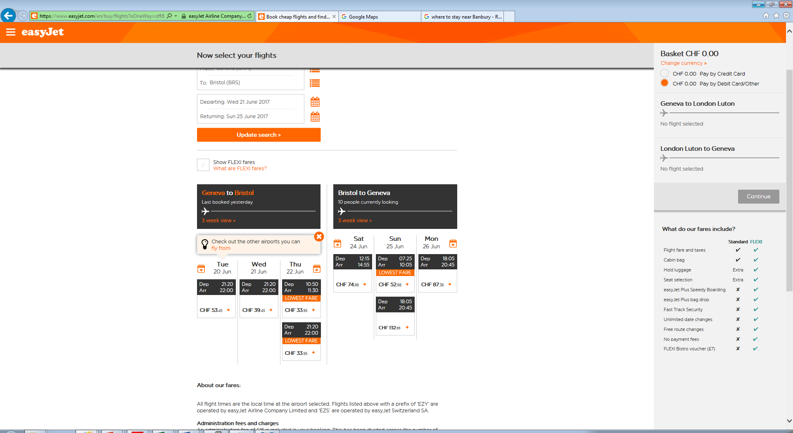

Slide 5
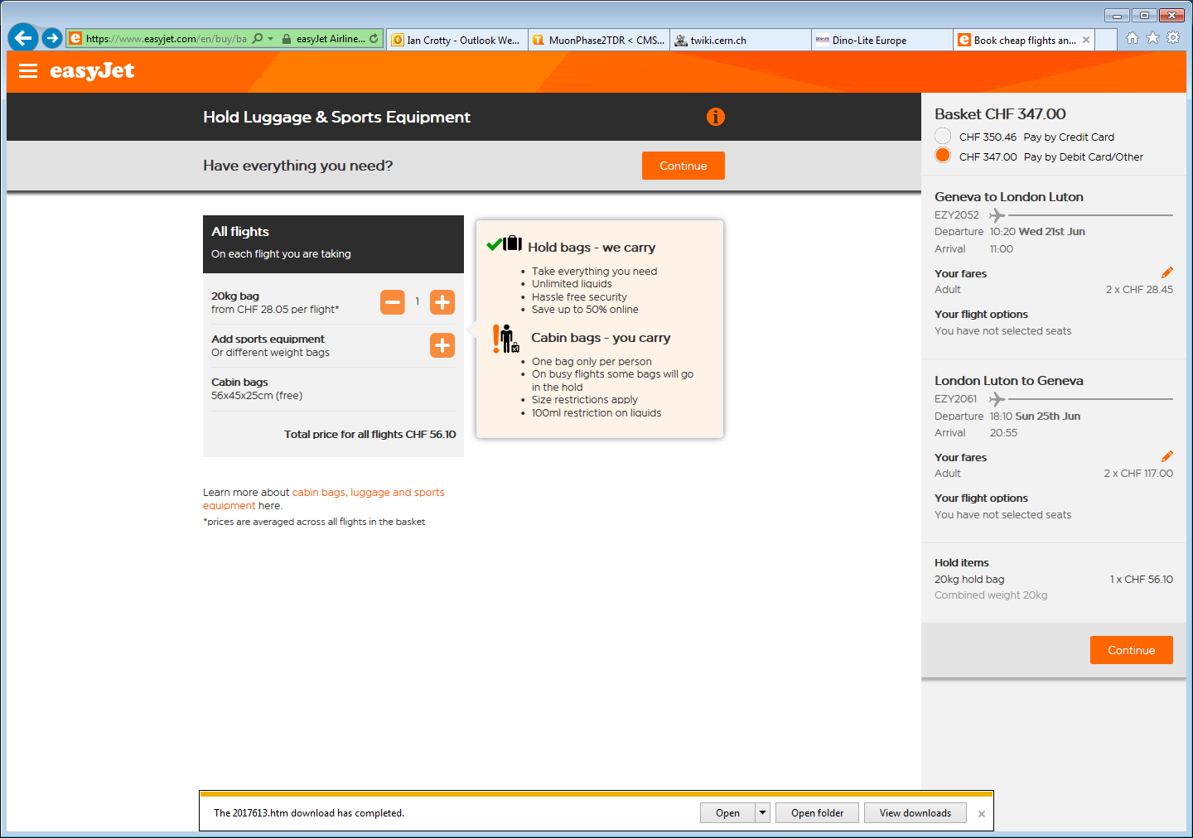
Finally the next day 14 June it is cheaper !
Your booking ESF1QHP is confirmed
14 June 2017 “ 1013am

Slide 6
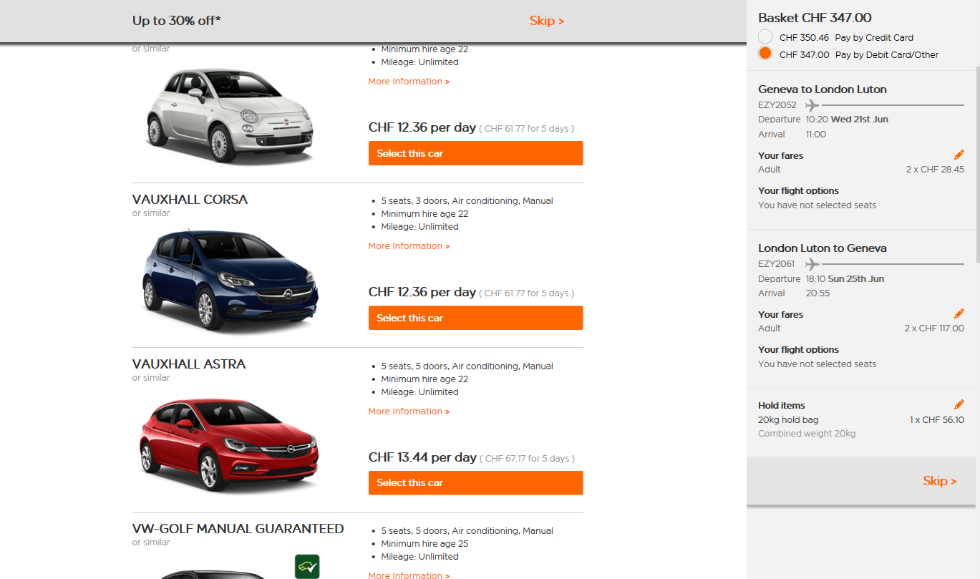

Slide 8
Insurance “damage waiver”
https://www.ubs.com/ch/fr/swissbank/clientele-privee/paiements-et-epargne/cartes/carte-credit-gold.html

Slide 9
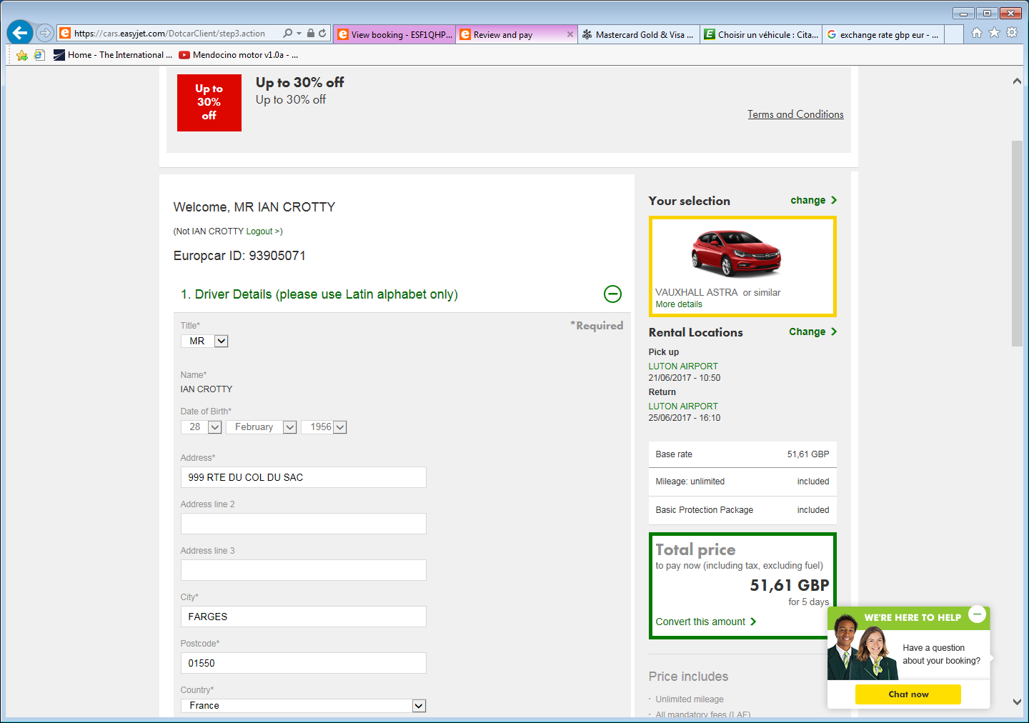

Slide 10
I did NOT activate Speedy Rental.
Notice the Card name and driver are not exactly the same. !!
New card requested.

Slide 13
Norwich area
The Honingham Buck, +44 1603 880393 ,
Park Farm Hotel, +44 1603 810264

Slide 14
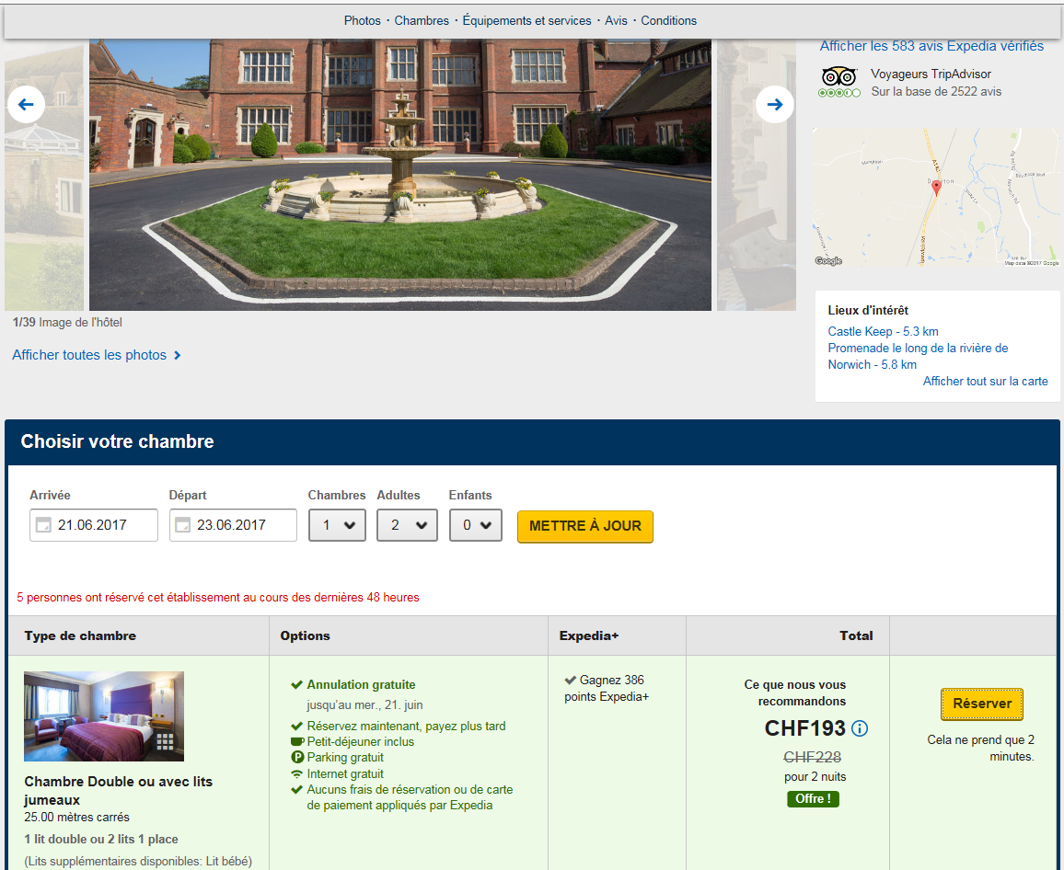
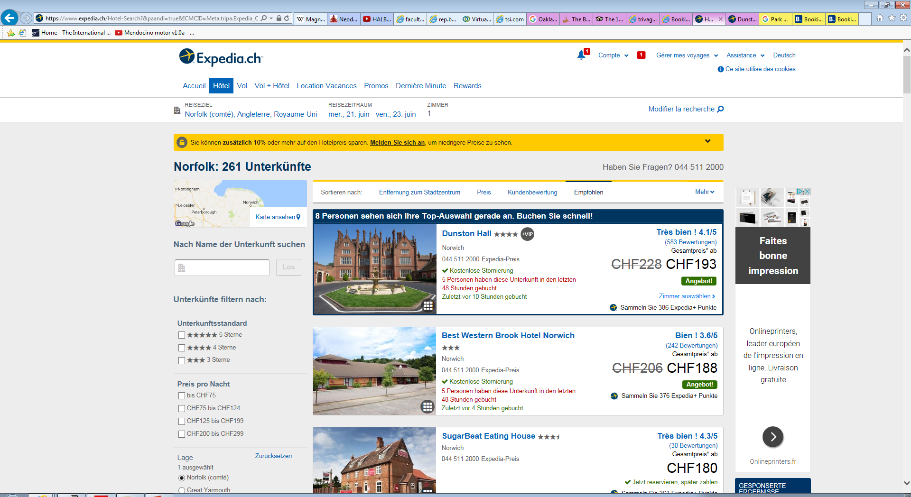
19.06.17

Slide 15
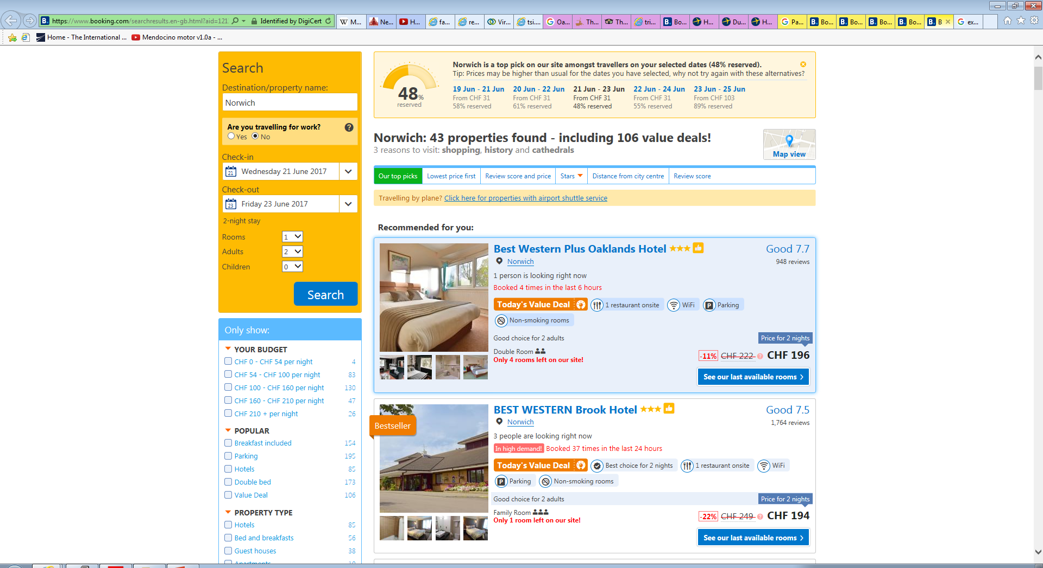
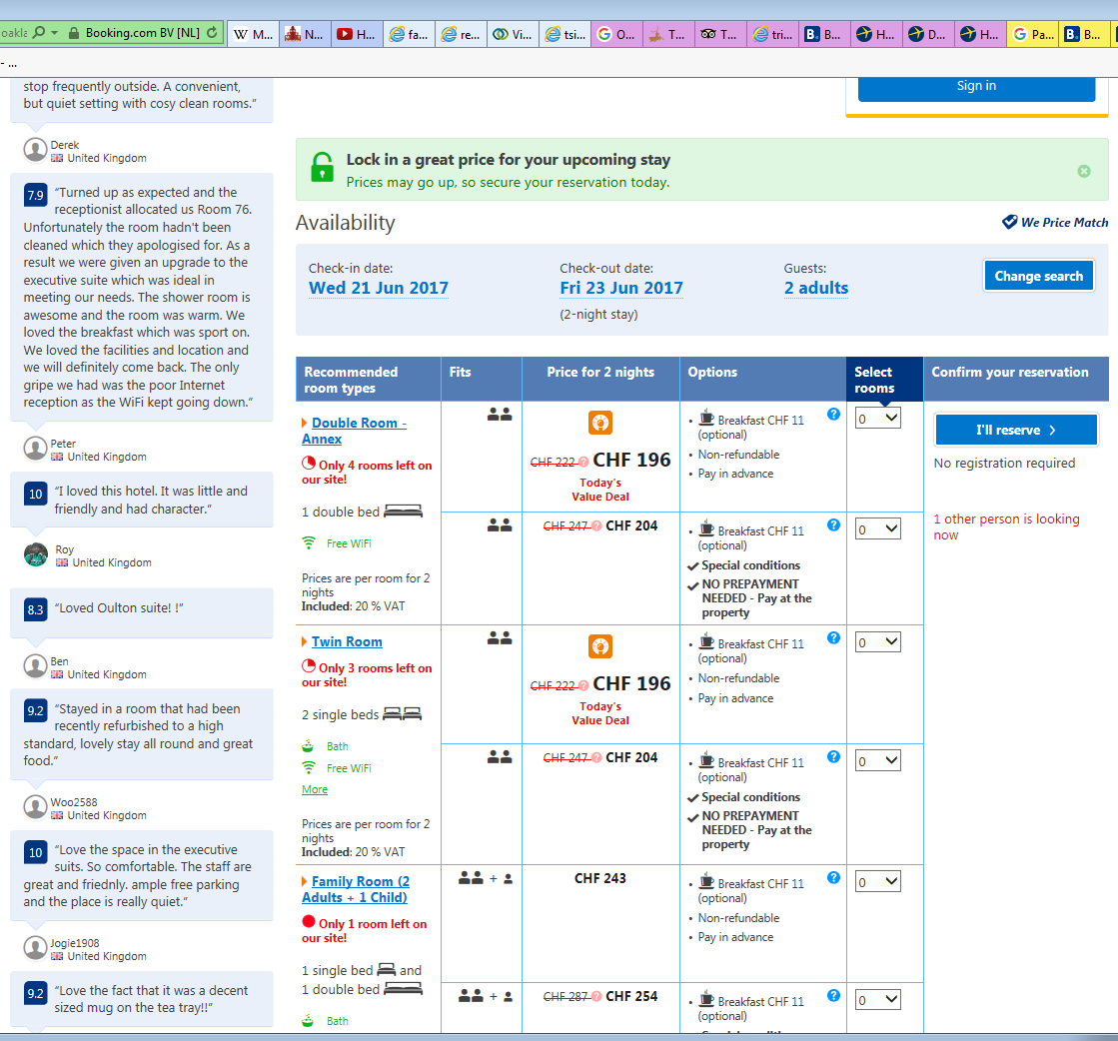
Best Western Plus Oaklands Hotel
+44 1603 434471
19.06.17
1223pm

Slide 16
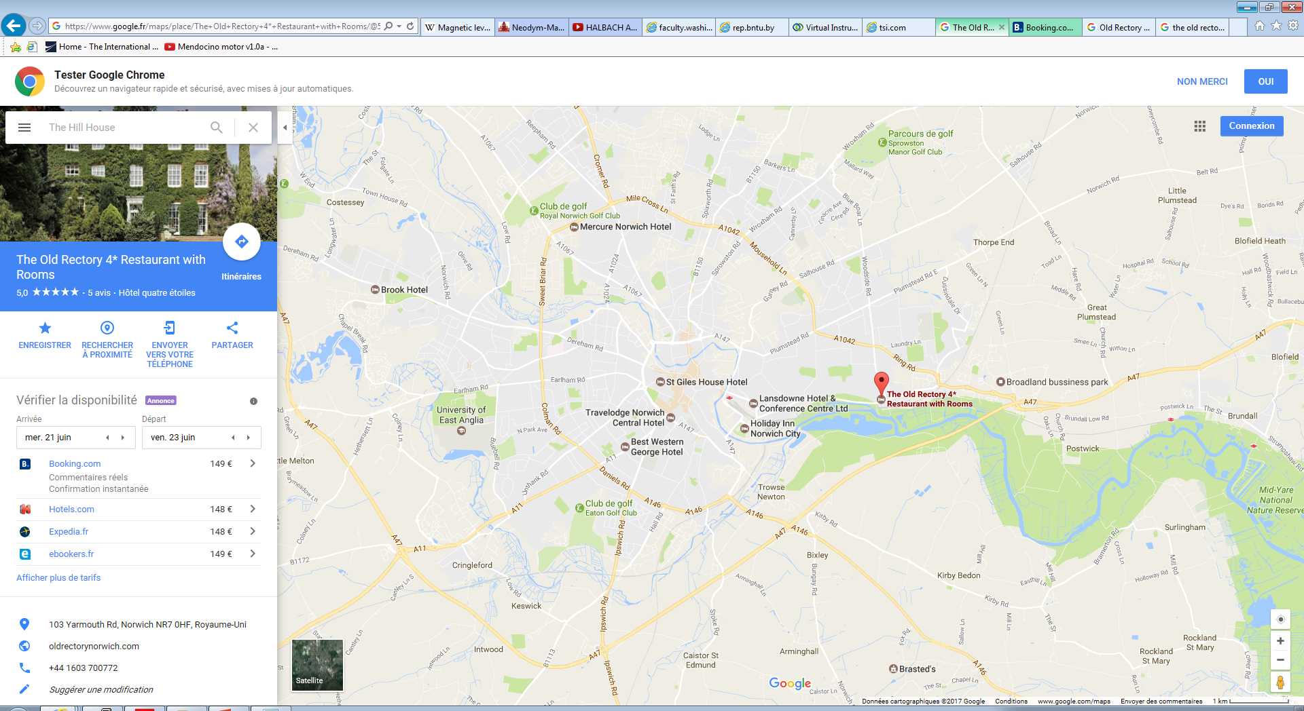
Attention there are x2 “Old Rectory , this one is 3star the other 4 star, closer to town.
4 Star

Slide 17
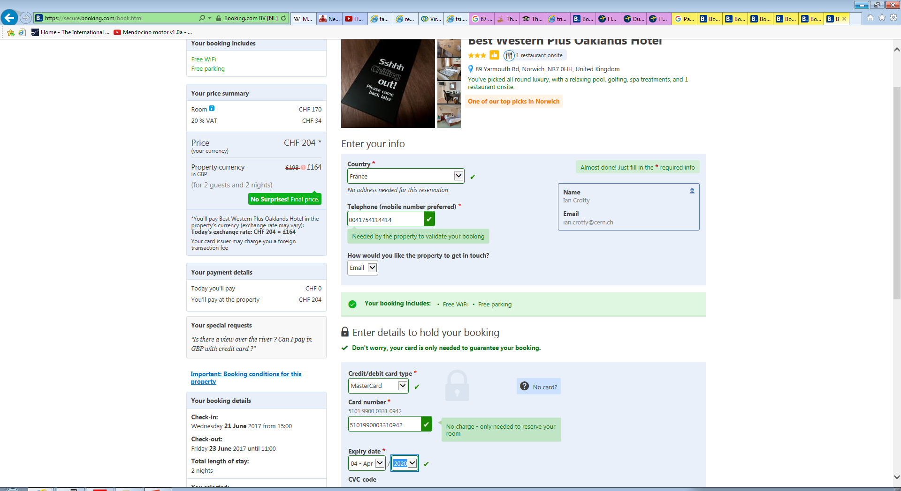
19.06.17
1240pm

Slide 18
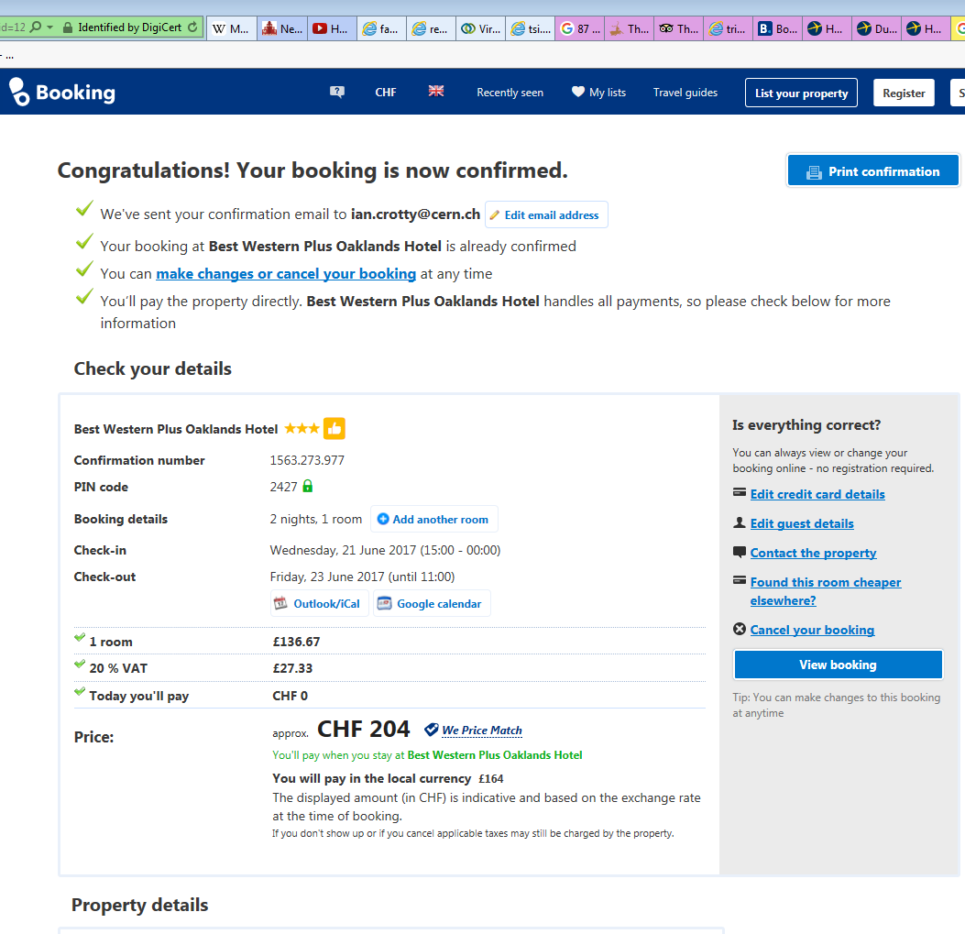
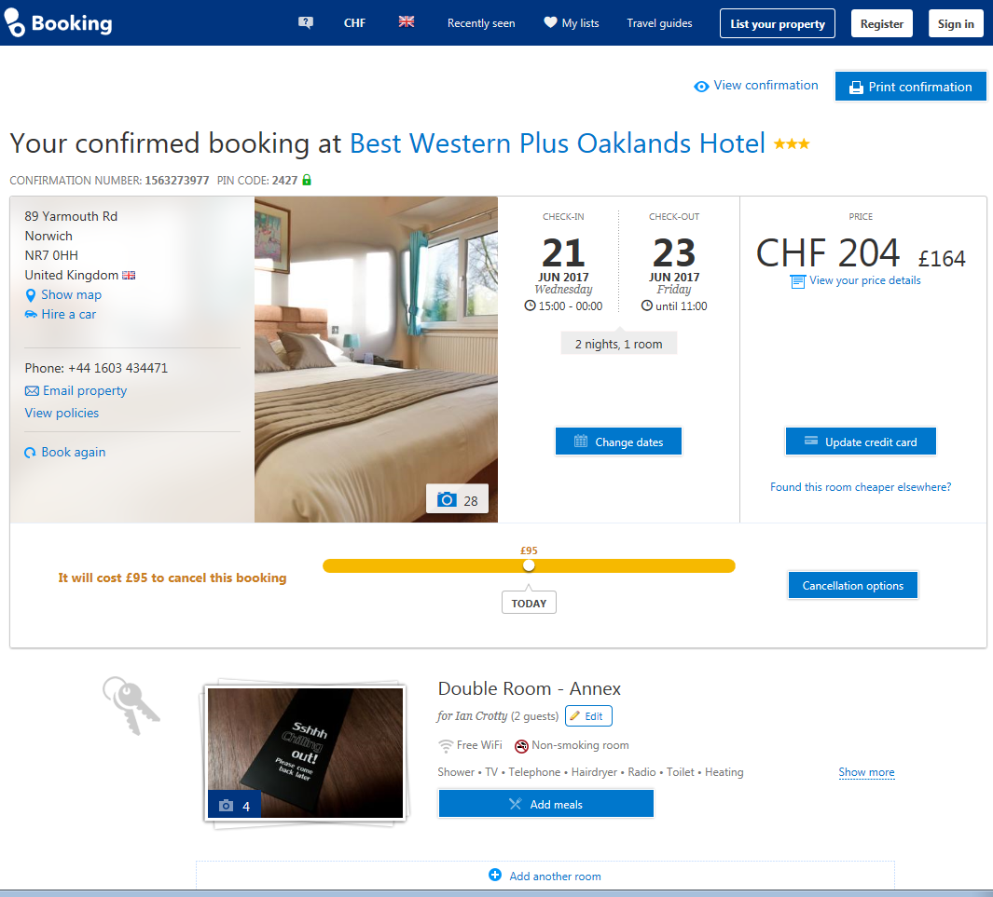
19.06.17
1254pm

Slide 19
http://www.cotswolds.info/accommodation/banbury-lodgings.shtml
http://www.bedandbreakfasts.co.uk/oxfordshire/banbury/
Booking.com

Slide 20
Mercure Banbury Whately Hall Hotel
The Deddington Arms 330GBP for 2 nights

Slide 21
130GBP on Friday night

Slide 22
http://www.bedandbreakfasts.co.uk/oxfordshire/banbury/
On the main oxford road. Noisy !

Slide 23
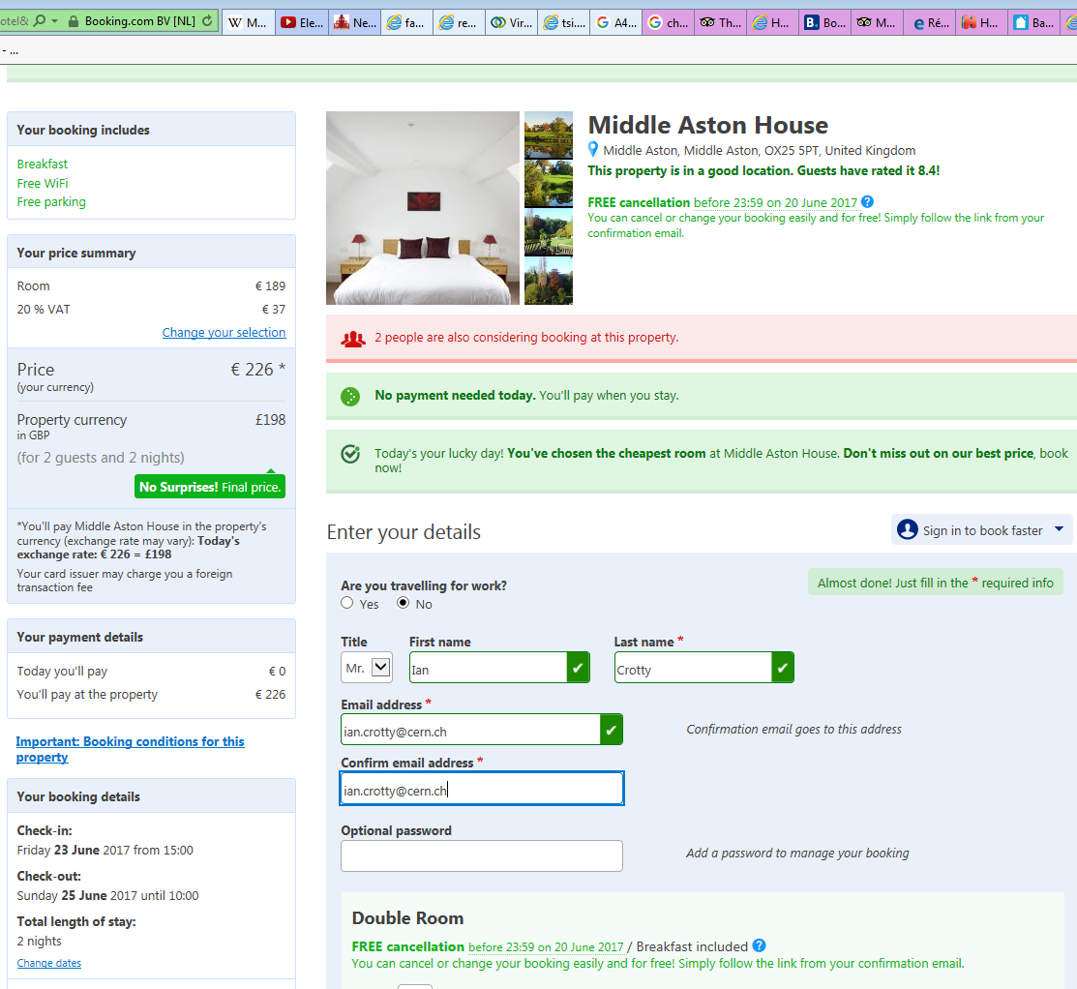

Slide 24
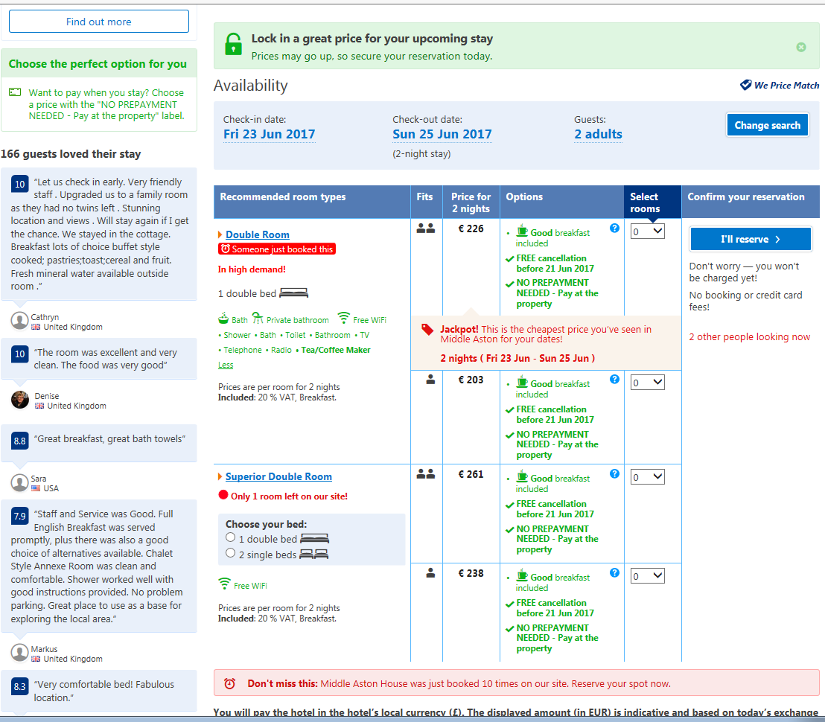

Slide 25
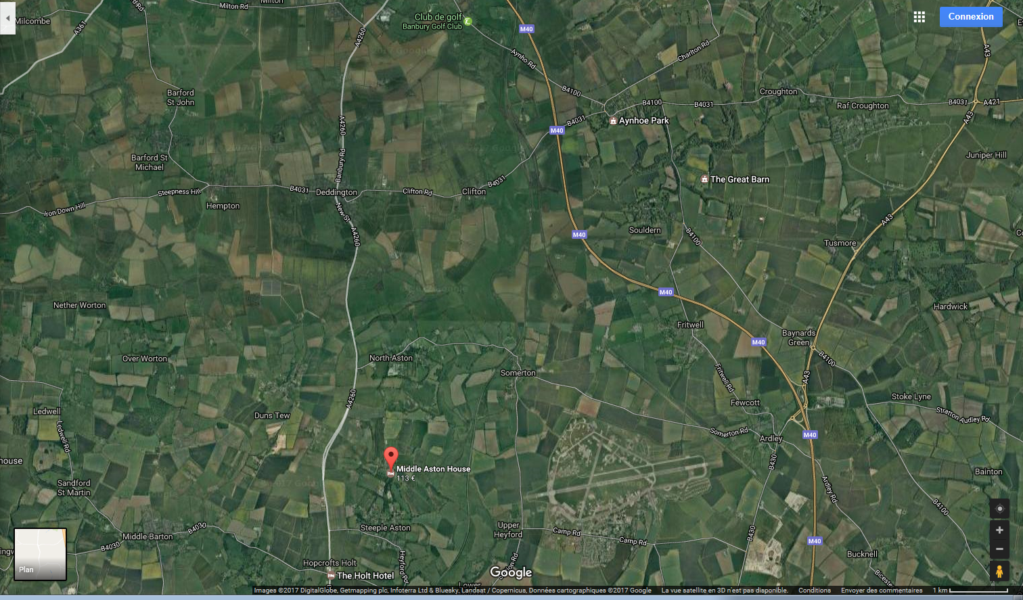
Banbury

Slide 26
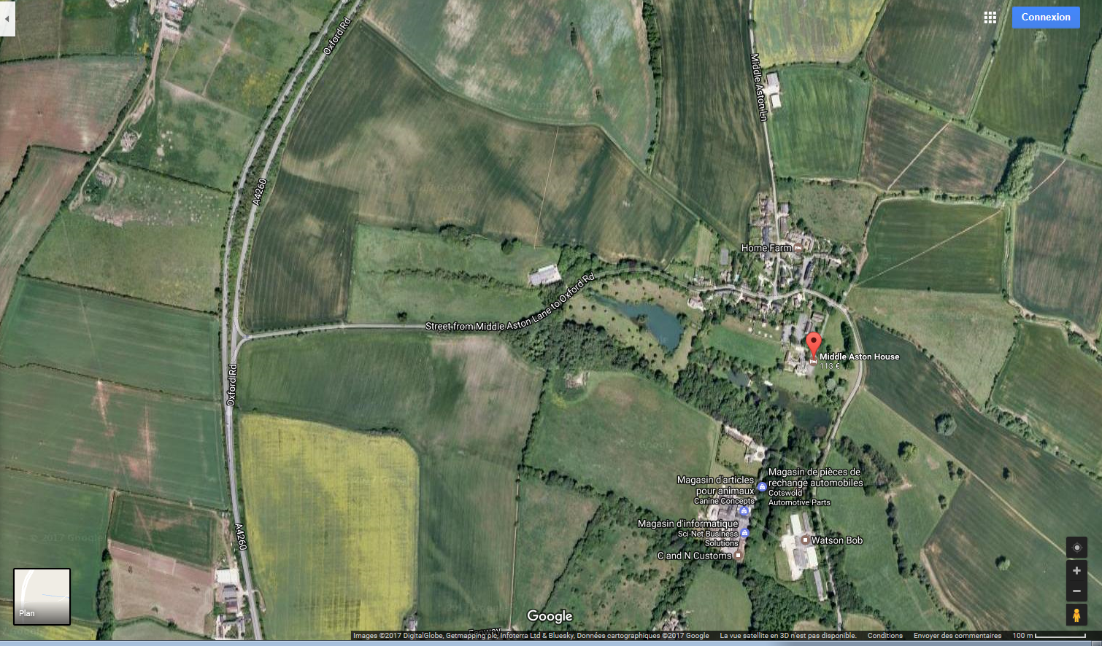

Slide 28
Bould Farm
Nr Idbury,
Chipping Norton,
Oxon
OX7 6RT
Tel: +44 (0)1608 658850
Fax: + 44(0)1608 658850
Email: meyrick@bouldfarm.co.uk
Gwyn Meyrick - 07977 441 904
Rob Meyrick - 07792 227 868
Andrew Meyrick andrew@fresurf.fr
From 85 GBP
Blenheim Palace

Slide 29
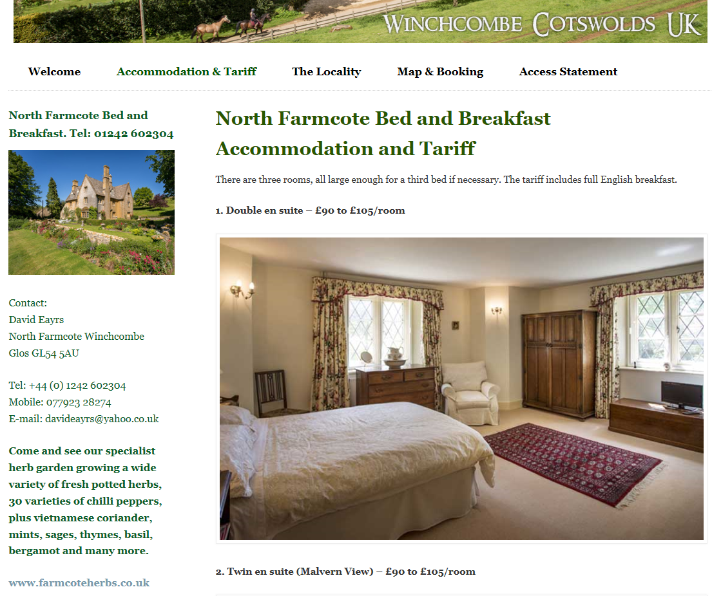
www.farmcoteherbs.co.uk

Slide 30
Ley Lines in the Norwich area.

Slide 31
Radar Museum near Norwich.
Honing
RAF Air Defence Radar Museum, Tuesdays, Thursdays and Bank Holiday Mondays, April to October inclusive.
Opening times are from 10.00-17.00

Slide 32
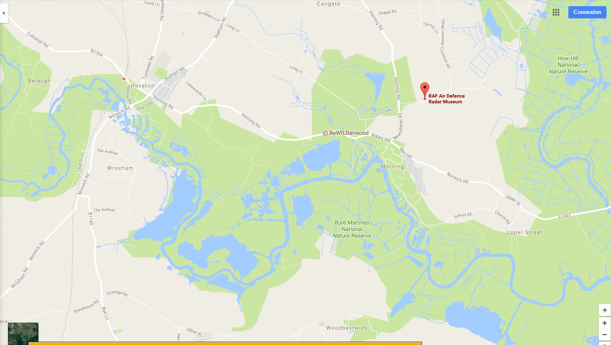

Slide 33
City of Norwich Aviation Museum, just north of the airport.
http://www.cnam.org.uk/
10-5pm except Mondays
4.5GBP/per

Slide 34
Ley lines in the Banbury area.

Slide 35
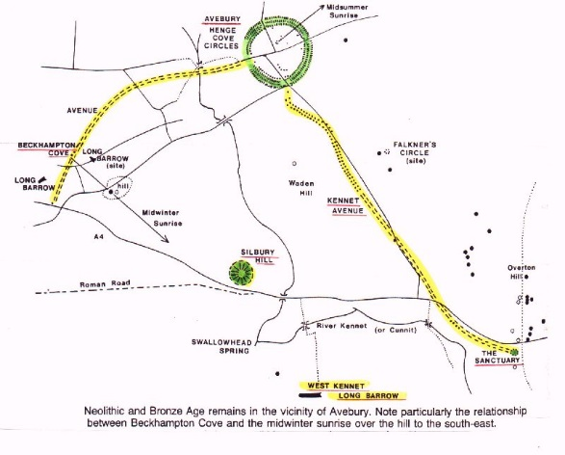
Long Barrow
Belas Knap is located on the hill overlooking Corndean a few miles out on the road to Andoversford.
West Kennet Long Barrow
Near Avebury henge and Silbury Hill just south of Swindon
http://www.avebury-web.co.uk/wk_lbarrow.html
http://www.thelongbarrow.com/
https://en.wikipedia.org/wiki/Long_barrow

Slide 36
Spit flight.

