Slide 1
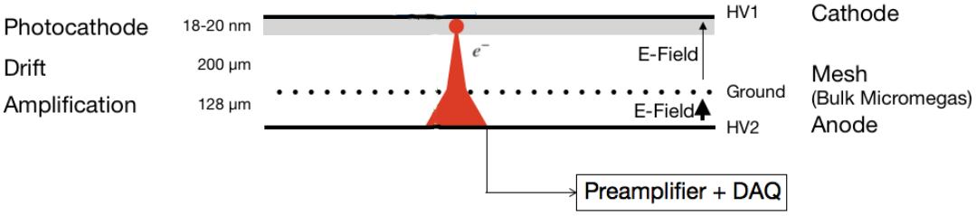
A data driven simulation study of the timing effects observed with the PICOSEC MicroMegas Detector
Konstantinos Paraschou & Spyros Eust. Tzamarias
Laboratory of Nuclear and Particle Physics
Aristotle University of Thessaloniki
Many thanks to Rob Veenhof for his help and collaboration
Study the response of a PICOSEC-MicroMegas to single photoelectrons, for different drift fields and the chamber filled with COMPASS (80% Ne + 10% CF₄ + 10% C₂H₆) gas.

Slide 2
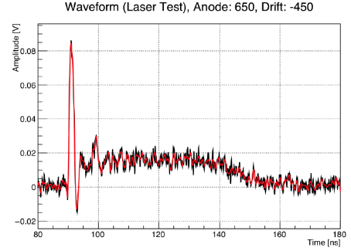
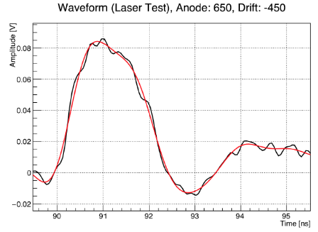
Typical PICOSEC-MICROMEGAS Waveform
(Experimental Data)
Black: Oscilloscope Data
Red: Fourier Filtered (Irrelevant)
Electron-peak amplitude
Integral
Electron-peak charge
Timing (20% software CFD)

Slide 3
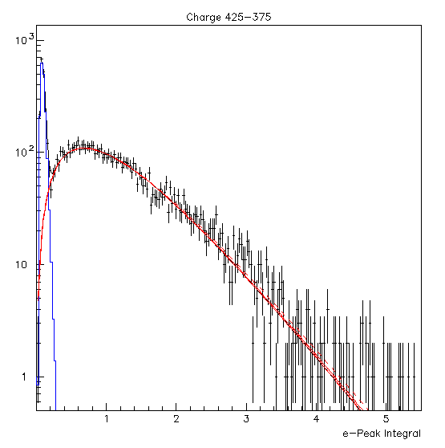
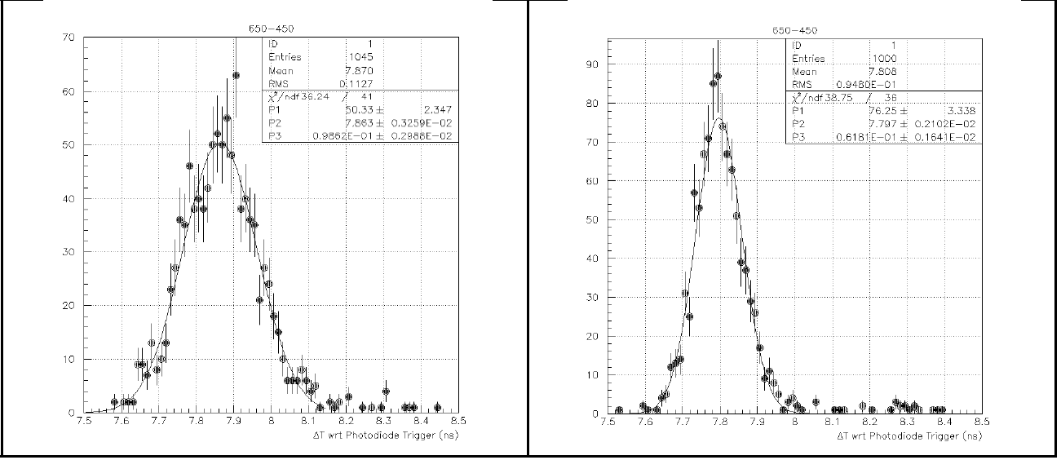


(Experimental Data)
The e-peak amplitude and e-peak charge distributions, corresponding to single photoelectrons, can be parameterized using the Polya Distribution (Red line).
The timing distributions, in narrow bins of e-peak charge (or amplitude) are Gaussians. However the mean and sigma values of the timing distributions are dependent on the size of the e-peak.
Mean = Signal Arrival Time (SAT)
Sigma = Time Resolution

Slide 4
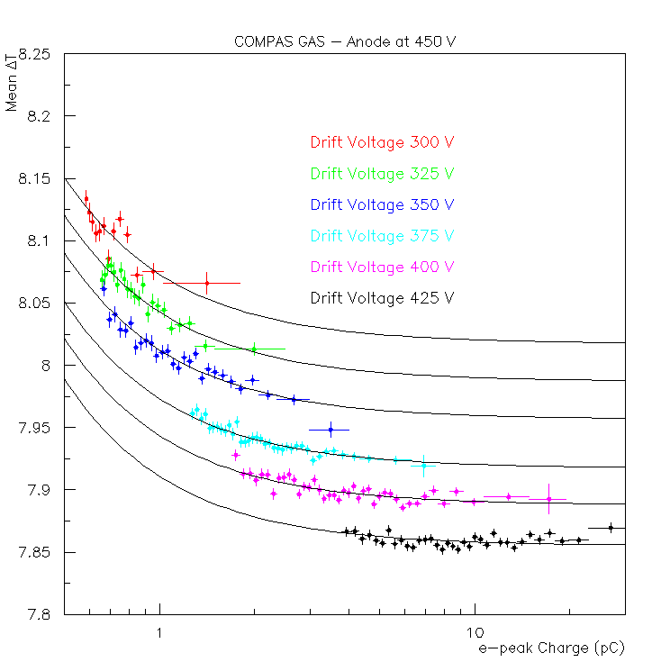
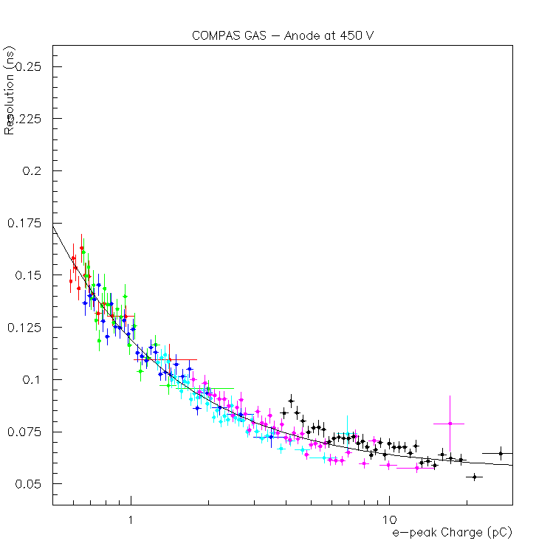

(Experimental Data)
1.) SAT vs charge shape is independent of Drift Voltage/Field!
2.) Large signals arrive earlier that smaller ones!
3.) Resolution vs charge is independent of Drift Voltage/Field!
Fig: Signal Arrival Time dependence on electron peak charge for different drift voltages
Fig: Time Resolution dependence on electron peak charge for different drift voltages
Both dependencies are parameterized with a function . b and w parameters are common to all drift voltages while a is common to all only for the resolution dependence.
Traditionally, the dependency of SAT on the electron peak charge is called “slewing” or “time-walk” and is a weakness of the timing technique which is used. We use a different name because the origin of this dependency is, in our case, physical.
Purpose of the simulation is to simulate these effects (1, 2, 3) and investigate the mechanism that produces them.

Slide 5
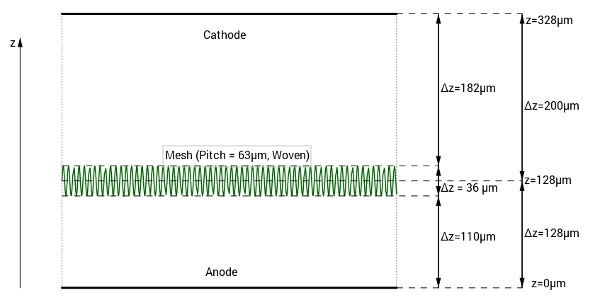
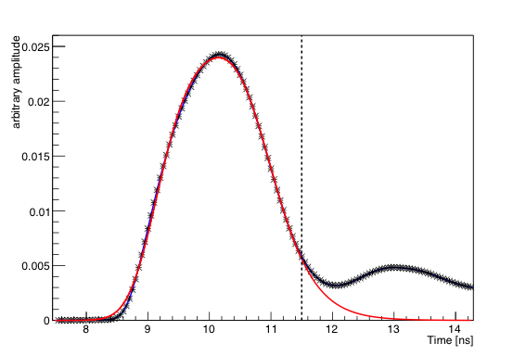

Used Garfield++ to simulate the PICOSEC detector’s response to single photoelectrons.
Gas is COMPASS mixture
(80% Ne + 10% CF₄ + 10% C₂H₆)
At 1010mbar pressure.
ANSYS model of mesh:
woven but not calendered
Drift gap = 200 μm
Amplification gap = 128 μm
Mesh Thickness = 36 μm
Amplification Voltage = 450 V → E = 35 kV/cm
Drift Voltage = 300-425 V → E in [15, 21] kV/cm
However, electronics, capacitance couplings etc., shape the pulse significantly. Using the technique presented by S. Tzamarias in the Open Lectures today, we fit the average shape of the experimental data with the average shape of the simulation to estimate the transfer function.
Black: Experiment
Red: Fit of Simulation Transfer function to Black
Before we search for the mechanism, we should check that the simulation gives comparable results with the experiment, and that the effects are actually present.

Slide 6
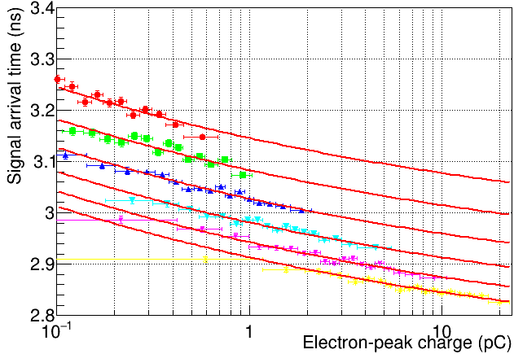
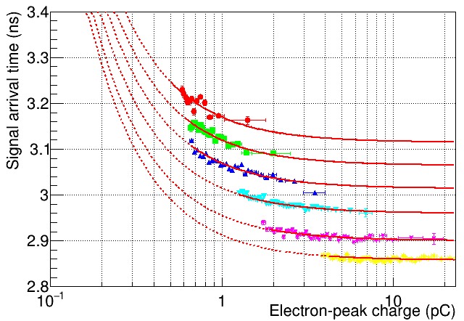
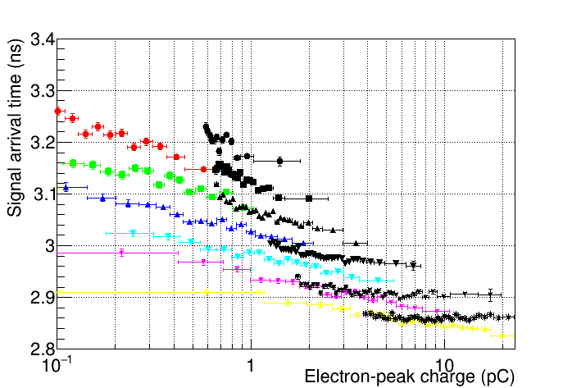
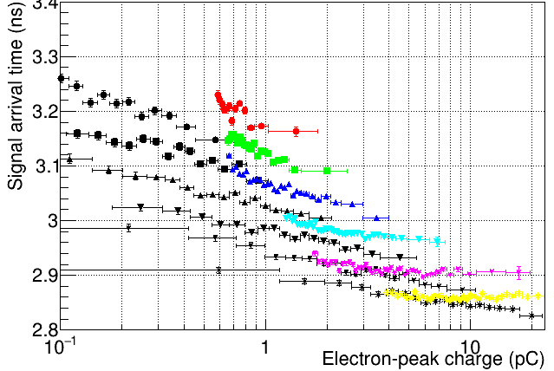
Signal Arrival Time
(vs charge)
Simulation
Experiment
Black = Experiment
Color = Simulation
Black = Simulation
Color = Experiment
Qualitatively, we reproduce the dependence.
Signal arrival times have been globally shifted.

Slide 7
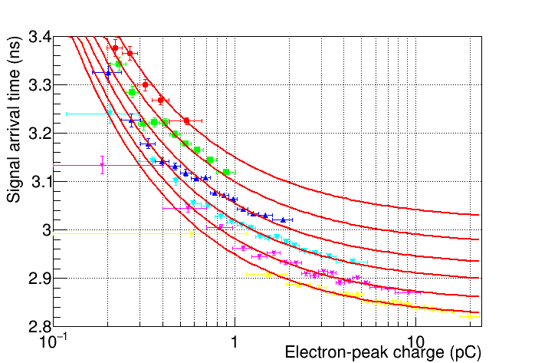
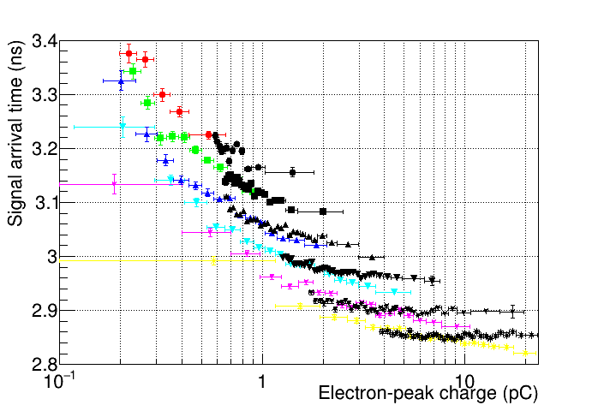
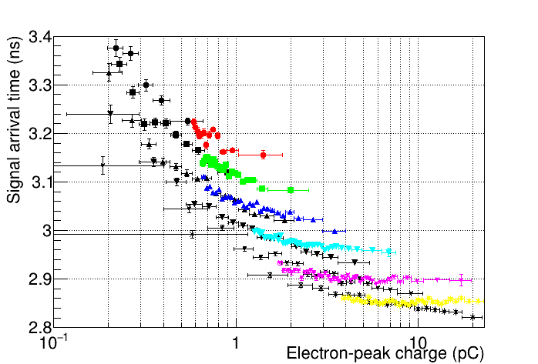
Signal Arrival Time
(vs charge)
Simulation
After noise
Experiment
+2.5 mV RMS
Uncorrelated,
Gaussian
noise
Black = Experiment
Color = Simulation
Black = Simulation
Color = Experiment
After including noise, the shape of the correlations come to much better agreement.
We can trim the parameters of the simulation to have an even better agreement, but it is not our purpose at this stage.
Signal arrival times have been globally shifted.

Slide 8
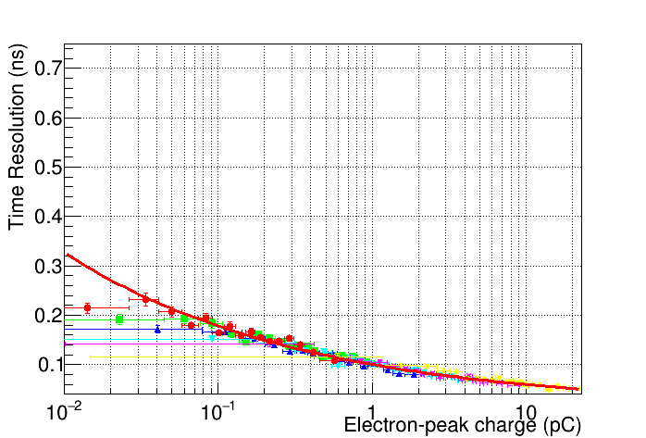
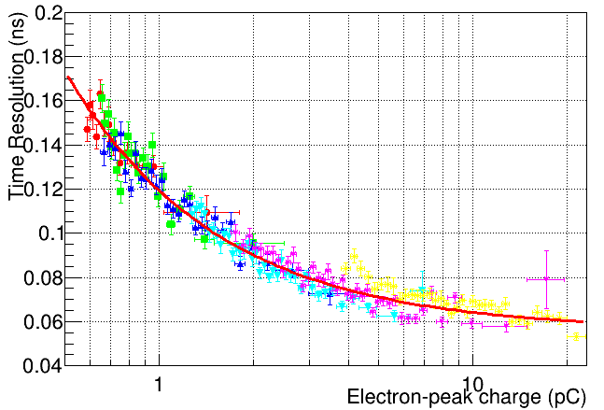
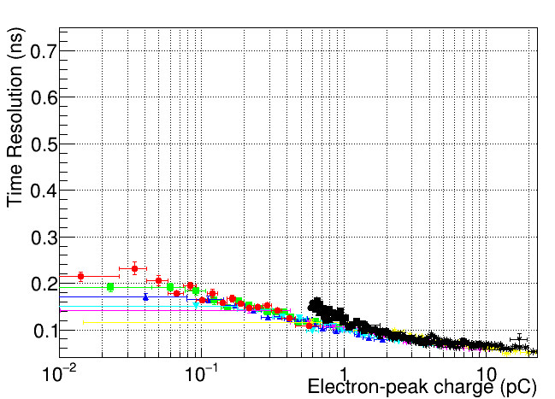
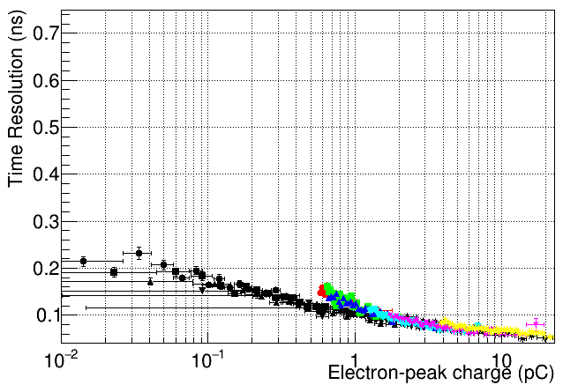
Timing Resolution
(vs charge)
Simulation
Before noise
Experiment
Black = Experiment
Color = Simulation
Black = Simulation
Color = Experiment
Again, we reproduce the effect qualitatively.

Slide 9
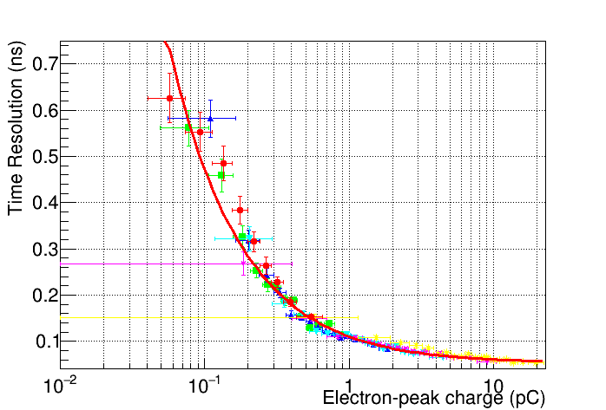
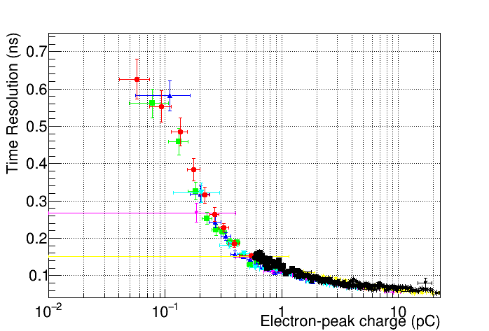
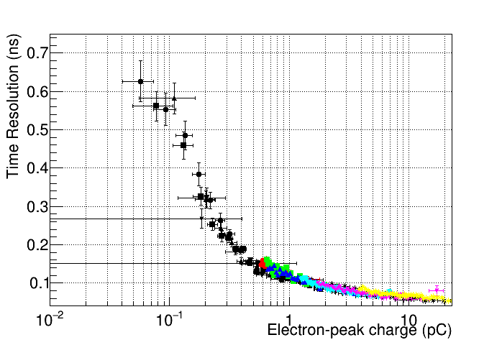
After noise
Timing Resolution
Simulation
Experiment
+2.5 mV RMS
Uncorrelated,
Gaussian
noise
Black = Experiment
Color = Simulation
Black = Simulation
Color = Experiment
The agreement is almost perfect by simply adding some noise.
Again, we can trim the parameters of the simulation to have an even better agreement, but it is not our purpose at this stage.

Slide 10
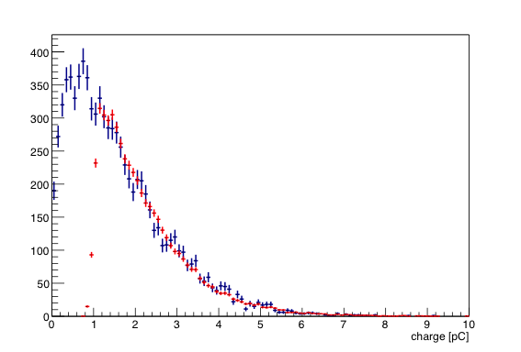
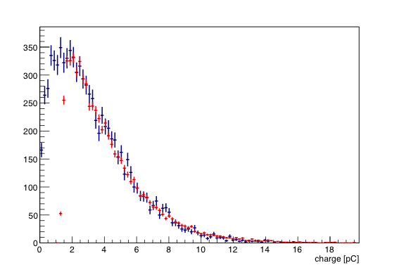
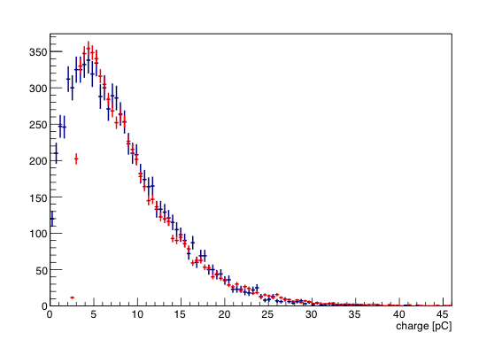
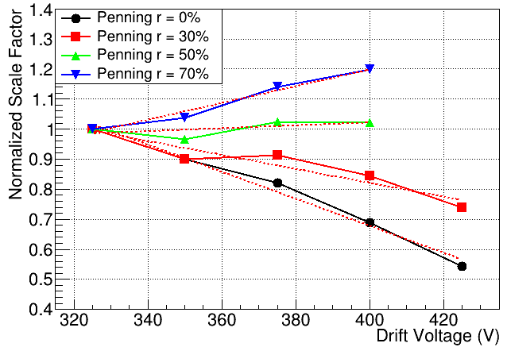
We have to scale the MC charge (or amplitude) predicted distributions in order to take into account the electronics' gains. We expected that by adjusting the scale factor at some drift operating voltage we should predict all the other distributions of events collected with the same anode but different drift voltages, WITHOUT any extra fine tuning.
However…
Experiment
Simulation
450-375
G=30.2
450-400
G=27.8
450-425
G=21.9
It is known that the COMPASS gas mixture has a significant penning effect. Until now this effect was ignored in the simulation. We consider different penning transfer rates to examine its behaviour.
Approximately, for a transfer rate r ≈ 50%, the scale factor is not dependent on the drift voltage setting.
Fig: Scale factor, G, as a function of drift voltage, divided by the scale factor at 325 V. Red dashed lines represent linear fits.

Slide 11
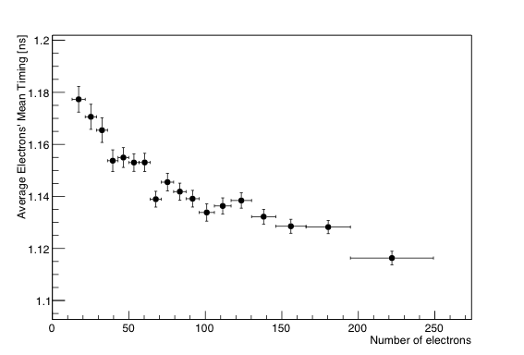
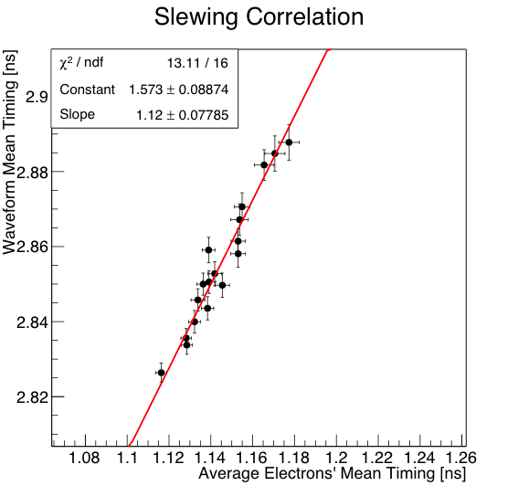
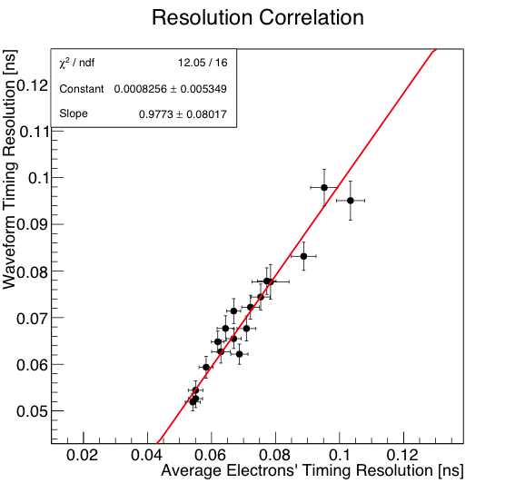
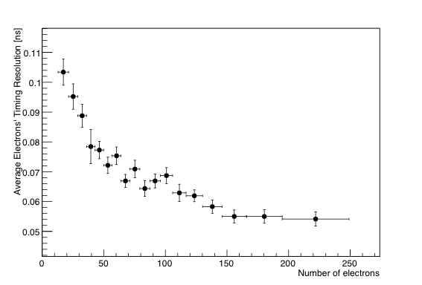
To find the physical mechanism which produces the observed timing effects, we observed that ultimately, the timing that is measured through the waveform analysis, is actually the mean time at which electrons are passing through the mesh.
Mean electrons’
arrival time
vs
Number of electrons
Mean SAT
Mean electrons’
arrival time spread
vs
Number of electrons
The mean value shift and the variation of the time distribution of all the electrons passing the mesh are 100% correlated (slope of linear fits equal to unity) with the Signal Arrival Time and Time Resolution dependence on the e-peak size measured by timing the e-peak pulses.
This is true for all the drift voltage settings.
Whether we measure the timing of the waveform,
or the mean arrival time at which electrons pass through the mesh,
we refer to a time which exhibits the same characteristics.

Slide 12
Cathode
d
L
Pre-ionization track
D
Length of the pre-amplification avalanche.
Mesh
Anode
Fig: Basic stages of the multiplication process. The initial
photoelectron, beginning at the cathode, scatters and drifts towards the
mesh/anode until a secondary electron is produced. At that point, the pre-
amplification avalanche begins its exponential development.
To investigate the mechanism we have to parameterize the simulation’s results in terms of a microscopic variable.
The variable we choose is the length of the pre-amplification avalanche, D.

Slide 13
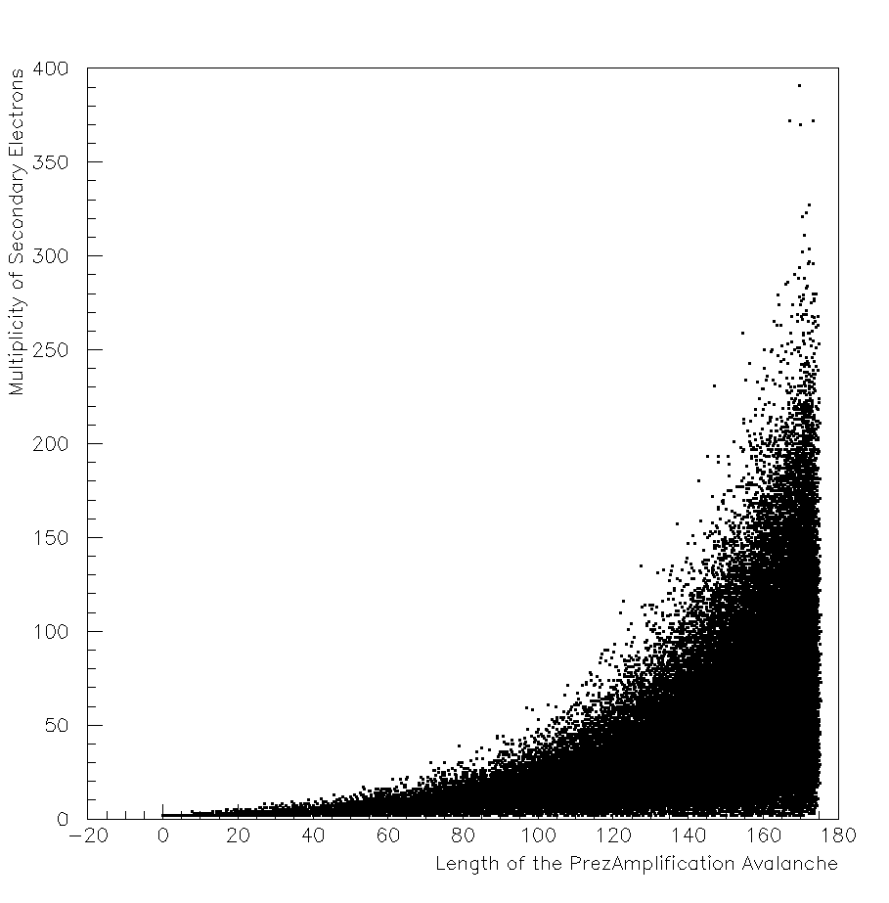
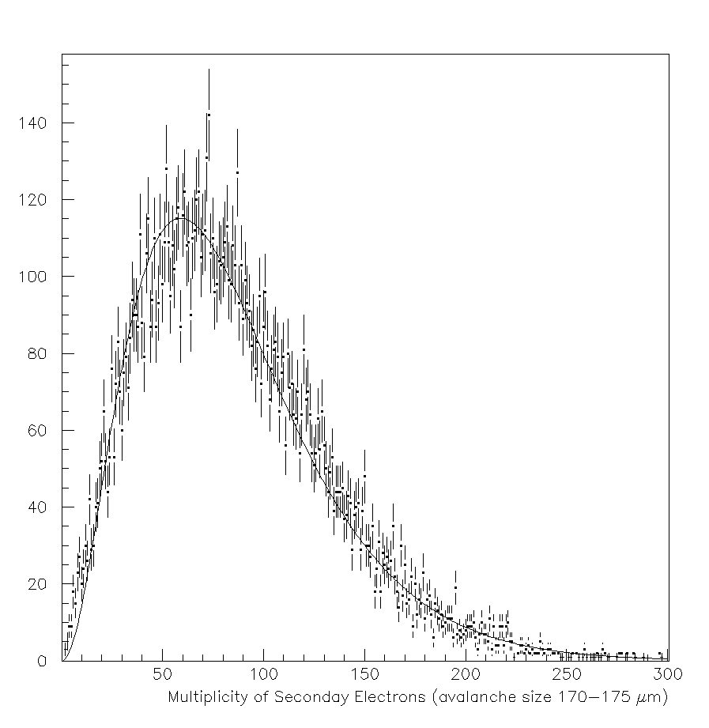
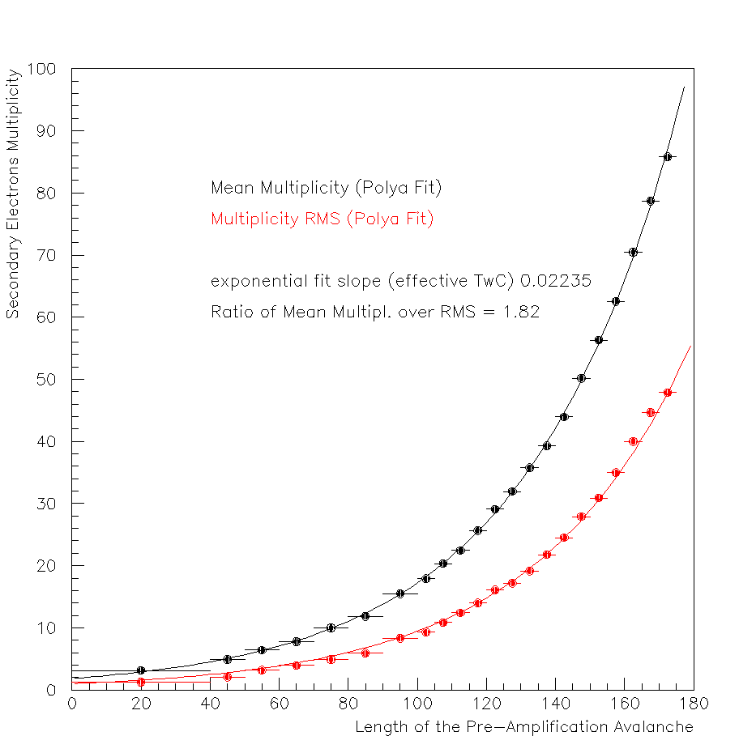
Drift Voltage = 350 V
Fig: Distribution of secondary electrons’ multiplicity for pre-amplification avalanche length in [170μm - 175μm]
Fig: Scatter plot of secondary electron multiplicity vs pre-amplification avalanche length.
In a small region of pre-amplification avalanche lengths, we parameterize the distribution of the number of secondary electrons with the Polya distribution.
We fit Polya distributions in all bins and find that both the Mean and the RMS values follow exponential laws with the same rate parameters.
This means that the shape parameter of the Polya remains constant across the multiplication process.
Fig: Mean and RMS values of Polya fits.

Slide 14
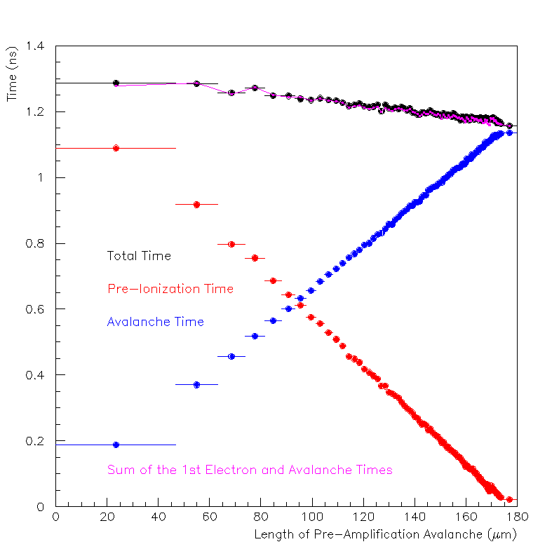
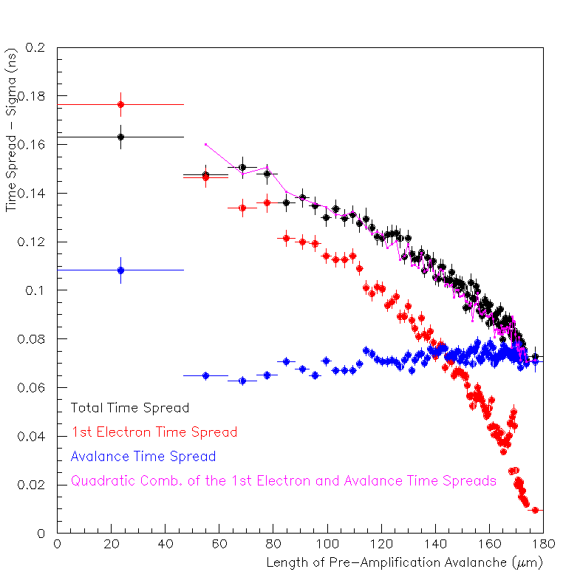
Drift Voltage = 350 V
Naturally, as the pre-amplification avalanche length increases, the time spent by the initial photoelectron decreases while the time duration of the avalanche increases.
Although the sum of their vertical distance components of the two phenomena is constant (always equal to the drift gap), the sum of the two times clearly depends on the length of the avalanche.
This means that, effectively, the photoelectron and the avalanche “drift” with different velocities.

Slide 15
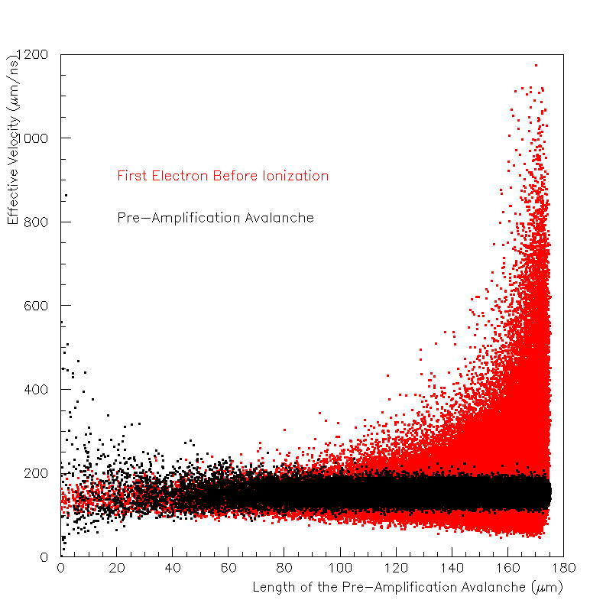
Drift Voltage = 350 V
The photoelectron before ionization and the avalanche, move with different speeds.
The avalanche seems to move with a constant
vertical speed.
The initial photoelectron before ionization moves much faster when the first ionization happens early (large avalanche lengths), and
gradually “thermalizes” to the effective speed of the avalanche.
Fig: Effective vertical velocity as a function of the length of the pre-amplification avalanche.
Naively thinking, the photoelectron must have a large initial velocity.
Initial energy is 0.1 eV (reasonable value)
Energy acquired in the field per micron is ~2 eV/μm
Mean free path is ~7 μm.

Slide 16
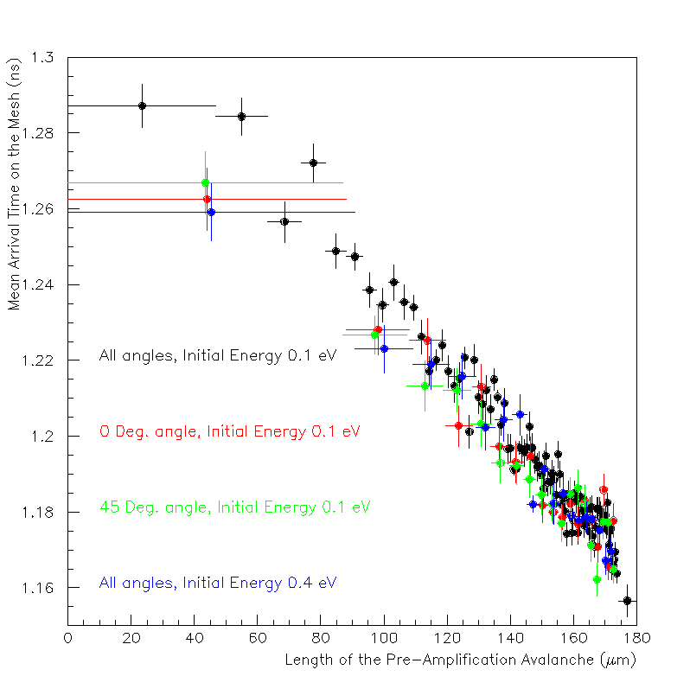
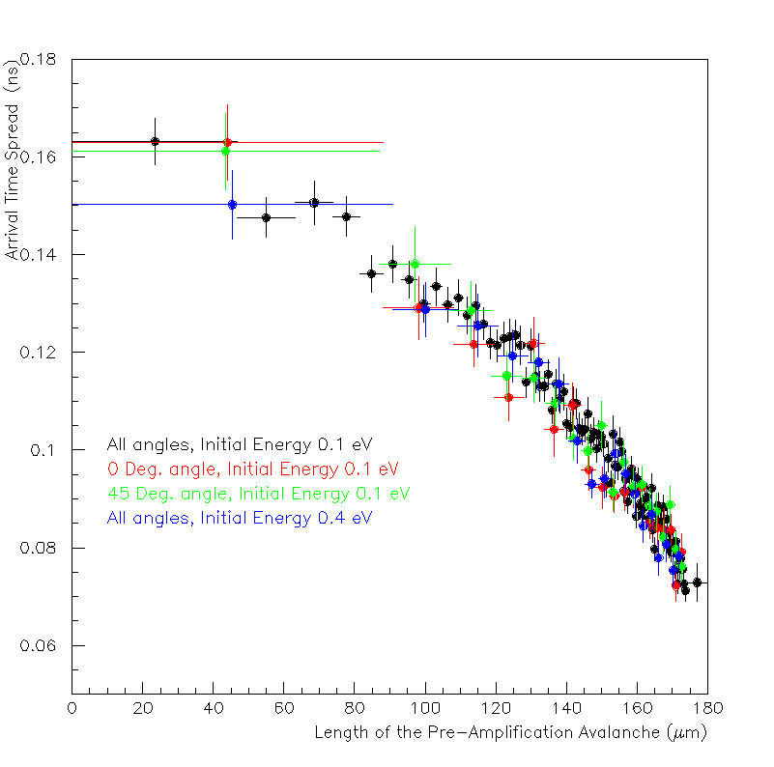
Drift Voltage = 350 V
We consider various initial conditions:
(black) isotropic direction of the emitted photoelectron from the photocathode with initial energy of 0.1 eV,
(red) photoelectrons emmited perpendicularly to the photocathode with initial energy of 0.1 eV, (green) 45º polar emission angle with initial energy of 0.1 eV,
(blue) isotropic emission direction with initial energy 0.4 eV.
Both the mean and sigma values exhibit the same dependence on the pre-amplification avalanche length for all the above mentioned initial conditions.
This indicates that initial conditions do not play a significant role in the observed timing dependencies.

Slide 17
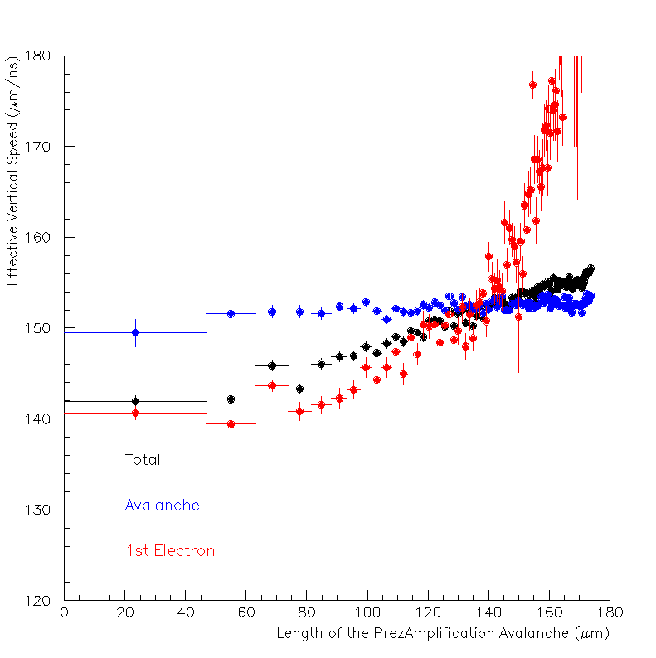
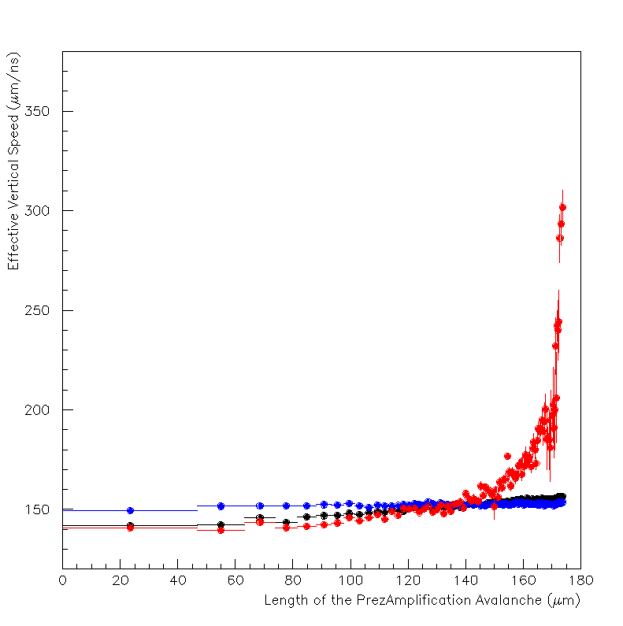
Drift Voltage = 350 V
Figs: Effective vertical speed vs length of pre-amplification avalanche. Same figs,
Left fig is zoom of right fig.
A peculiar effect is observed: the limit of the photelectron’s speed is lower than the average drift velocity of the avalanche for large paths.
The drift of the avalanche is a collective process in which the drift of many electrons is averaged.
The photolectron is alone, the contribution from the transverse movement cannot be averaged out.

Slide 18
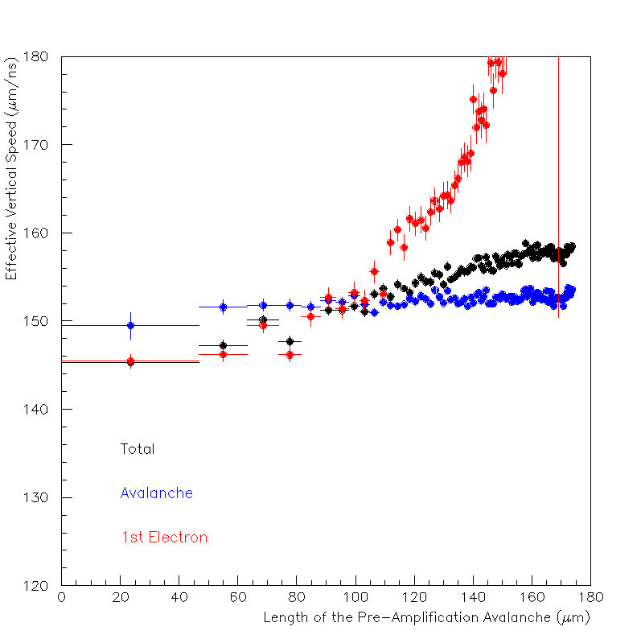
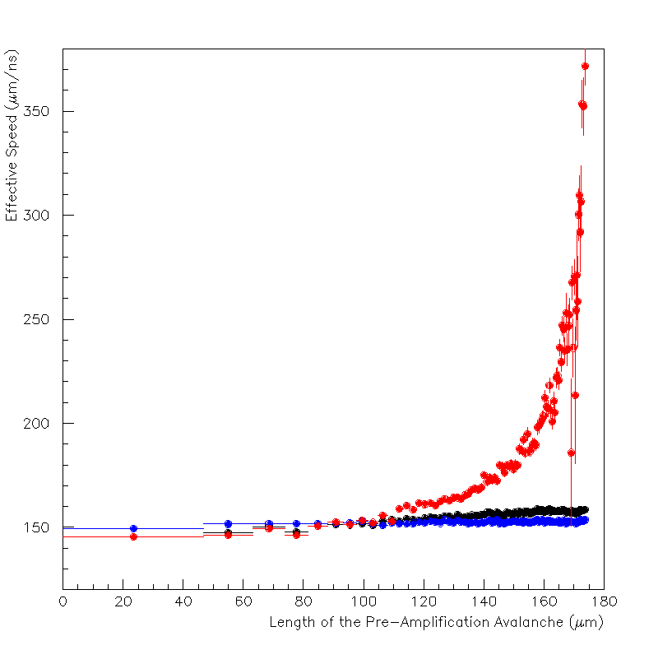

Drift Voltage = 350 V
Figs: Effective total speed vs length of pre-amplification avalanche. Same figs,
Left fig is zoom of right fig.
Therefore, we use the Euclidean 3D distance to compute the effective total speed.
Indeed, the total speed thermalizes (within statististical uncertainties) to the avalanche’s.

Slide 19
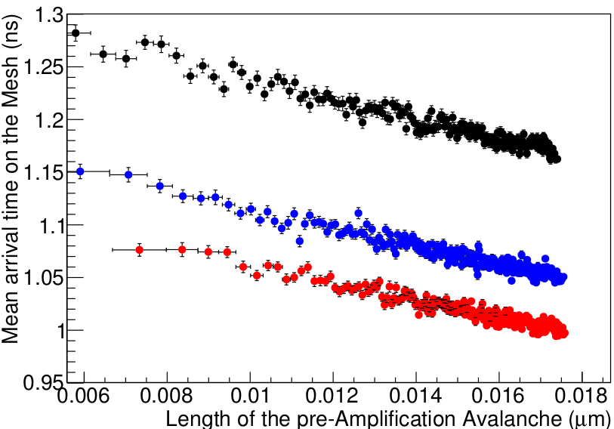
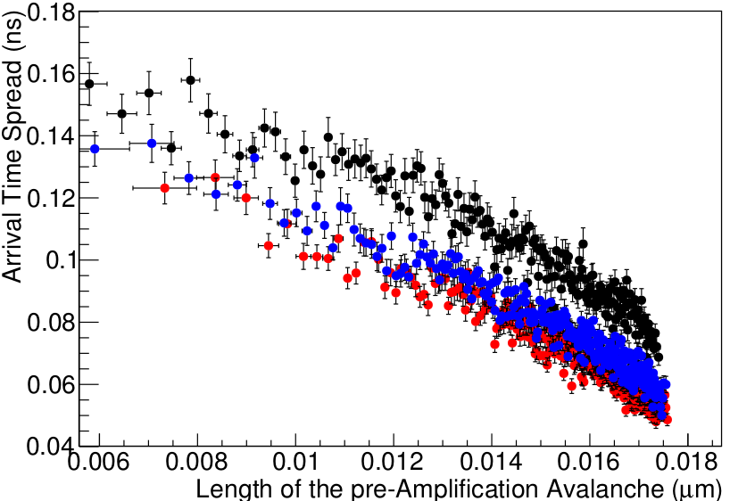
450-350 V
450-400 V
450-425 V
450-350 V
450-400 V
450-425 V
Fig: SAT vs length of pre-amplification avalanche
Fig: Resolution vs length of pre-amplification avalanche
Obviously, diffusion and the avalanche length (first ionization point or the Townsend a) depend on the Drift Field, e.g. the timing spread (resolution) vs the pre-amplification avalanche length relation depends strongly on the applied drift voltage.
Avalanches with the same length will not produce the same number of electrons if the drift field is different!
The length of the pre-amplfication avalanche is not an observable variable.
To compare with experimental results, we have to re-parameterize the simulated results.

Slide 20
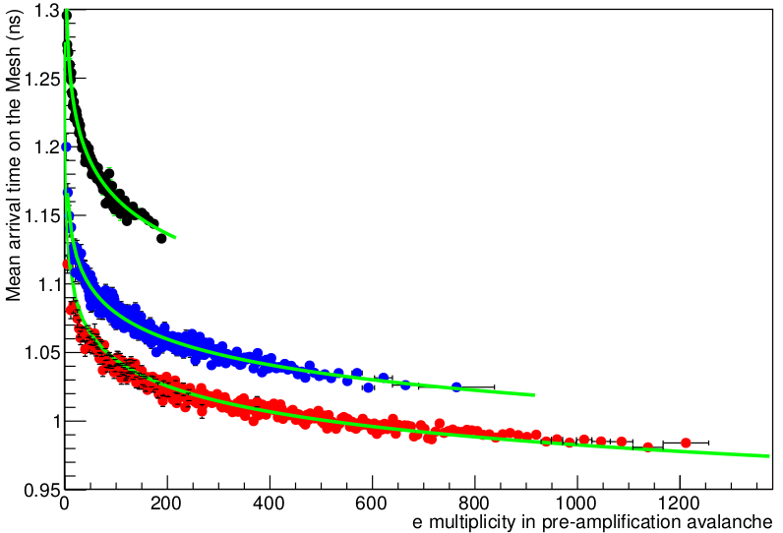
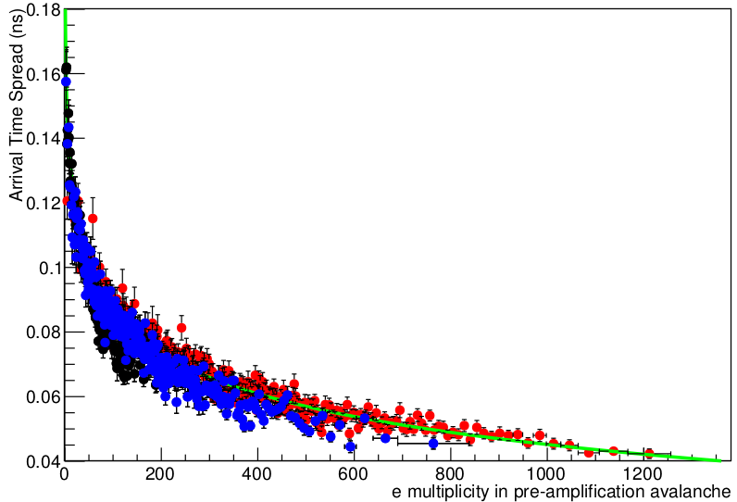
450-350 V
450-400 V
450-425 V
450-350 V
450-400 V
450-425 V
Fig: SAT vs secondary electrons’ multiplicity of pre-amplification avalanche
Fig: Resolution vs secondary electrons’ multiplicity of pre-amplification avalanche
The electron multiplicity in the pre-amplification avalanche is proportional to the observed electron peak’s charge.
Therefore, we choose this variable to check that the shape of the dependencies remain constant across different voltage settings.
The simulation predicts that the time dependence
of the timing characteristics on the e-peak size is independent of the drift
voltage settings.

Slide 21
Conclusions
We developed a simulation tool based on Garfield++ (using Magboltz) to study the SAT and Time Resolution dependence on the e-peak size, observed by studying the PICOSEC-MicroMegas response to single photoelectrons.
The simulation describes qualitatively the observed experimental effects and,
we have strong indications that by trimming the parameters of the simulation (noise, penning, etc) we can quantitatively reproduce the experimental results.
We have used this simulation to pinpoint the origin of the observed effects. We concluded that the observed effects are due to the dependence of the effective drift velocity of the primary photolectron with the distance at which it produces the first ionization with respect to its initial position.
We have concluded that the reason for which the timing resolution vs e-peak size does not seem to depend on the drift voltage, is that a larger drift field will make the time resolution smaller but will enlarge the charge distribution, keeping the dependence essentially the same across different drift fields.
I thank you for your attention.
Konstantinos Paraschou & Spyros Eust. Tzamarias
Aristotle University of Thessaloniki (AUTh)

Slide 22
Backup Slides

Slide 23
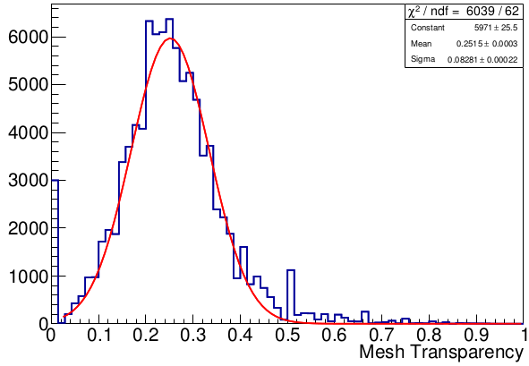
Number of Events
Anode Voltage: 450 V
Drift Voltage: 350 V

Slide 24
