Slide 1
Pressurised RPCs using air as a primary gas
Ian
2 March 2020

Slide 2
The number of primary electron-ion pairs
Name Atomic Mass Atomic number (Z) Atomic Weight Mass Mass Volumique Relative density Electro Neg.
[g/mol] [g/litre] gas (wrt air)
Argon 40 18 39.95 1.78
iC4H10 58 2.506
R134a 102 4.275(5.28) 3.25
Air 28.97
Nitrogen 14 7 14
Oxygen 16 8 1.43
Carbon Dioxide 44.01 1.87
Xenon 131 54 131 5.89
Conclusion the number of molecules per unit volume or mass of R134a is approx. 3 wrt the air. Therfore the pressure required is approx. 3 bar

Slide 3
https://courses.helsinki.fi/sites/default/files/course-material/4515373/lecture_gas_det.pdf

Slide 4
Pressure vessels

Slide 5
Pressure vessels
Thin shell, see theory
https://www.youtube.com/watch?v=Ja03J1RQ3Hw

Slide 6
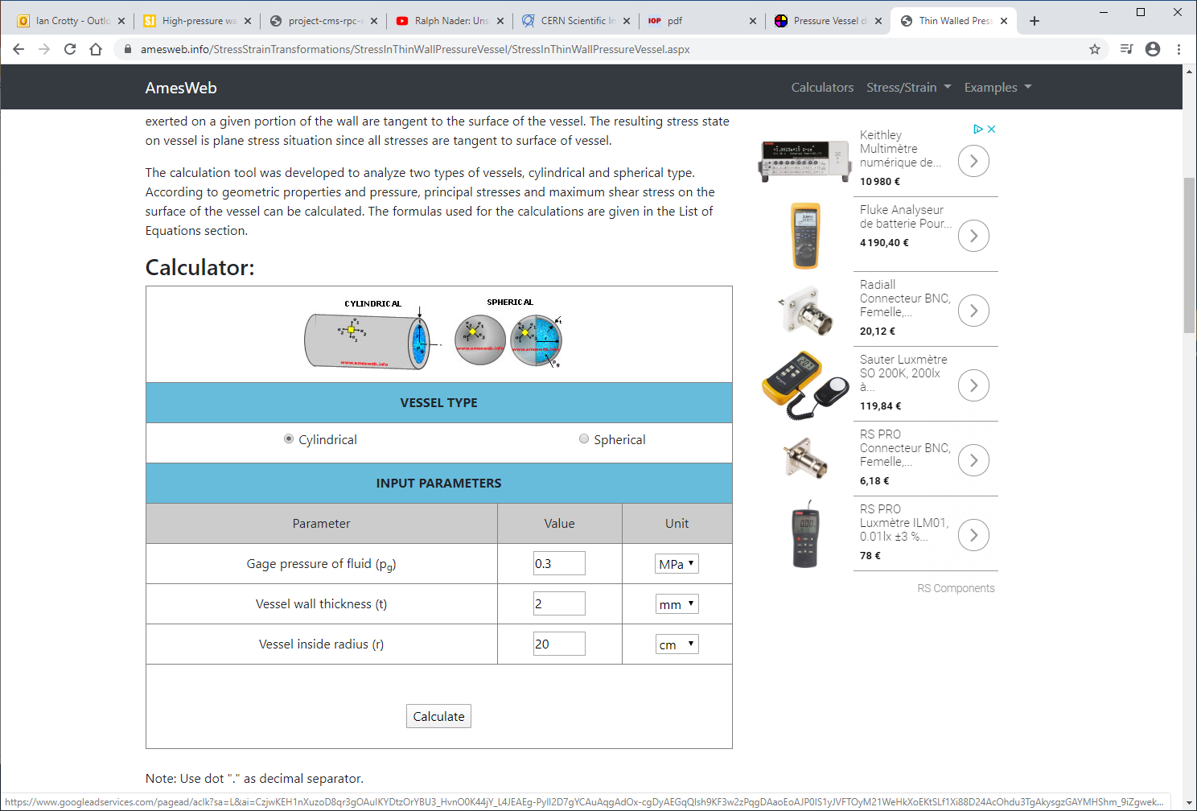
https://amesweb.info/StressStrainTransformations/StressInThinWallPressureVessel/StressInThinWallPressureVessel.aspx

Slide 7
Thin 1mm Alu sheet
Mill out the alu block for RPC gap
20mm
300mm
400mm

Slide 8
References
https://fr.wikipedia.org/wiki/1,1,1,2-T%C3%A9trafluoro%C3%A9thane
Gaseous radiation detectors. PAP328
https://courses.helsinki.fi/sites/default/files/course-material/4515373/lecture_gas_det.pdf

Slide 9
Contacts
Pressure vessels
Markus Brugger EN EA

Slide 10
https://www.nedal.com/wp-content/uploads/2016/11/Nedal-alloy-Datasheet-EN-AW-6082.pdf

