Slide 1
Conductive rubber
Ian
23 July 2020

Slide 2
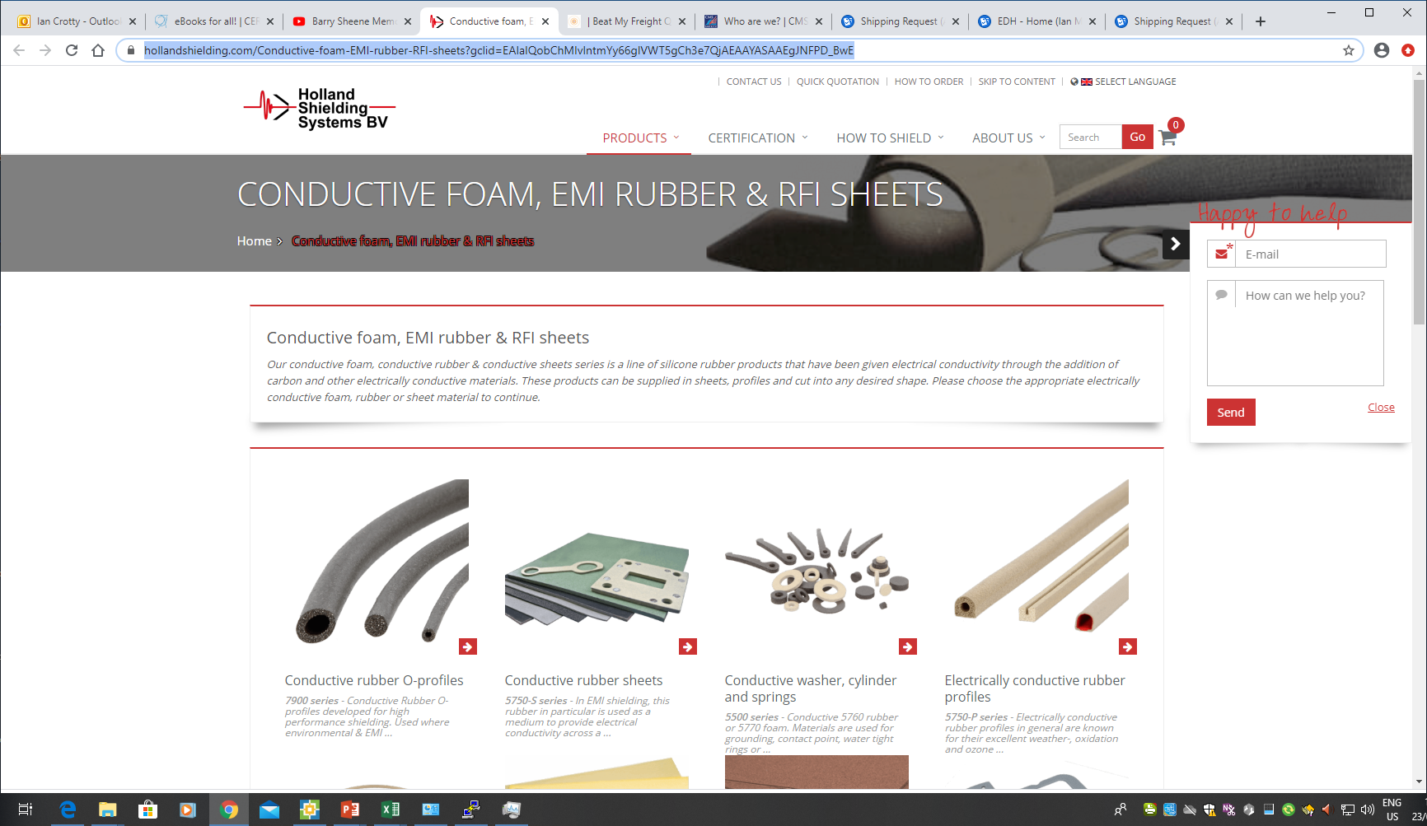
https://hollandshielding.com/Conductive-foam-EMI-rubber-RFI-sheets?gclid=EAIaIQobChMIvIntmYy66gIVWT5gCh3e7QjAEAAYASAAEgJNFPD_BwE

Slide 3
