Slide 1
DFS to CERN Box
Ian
28 oct 2021

Slide 2
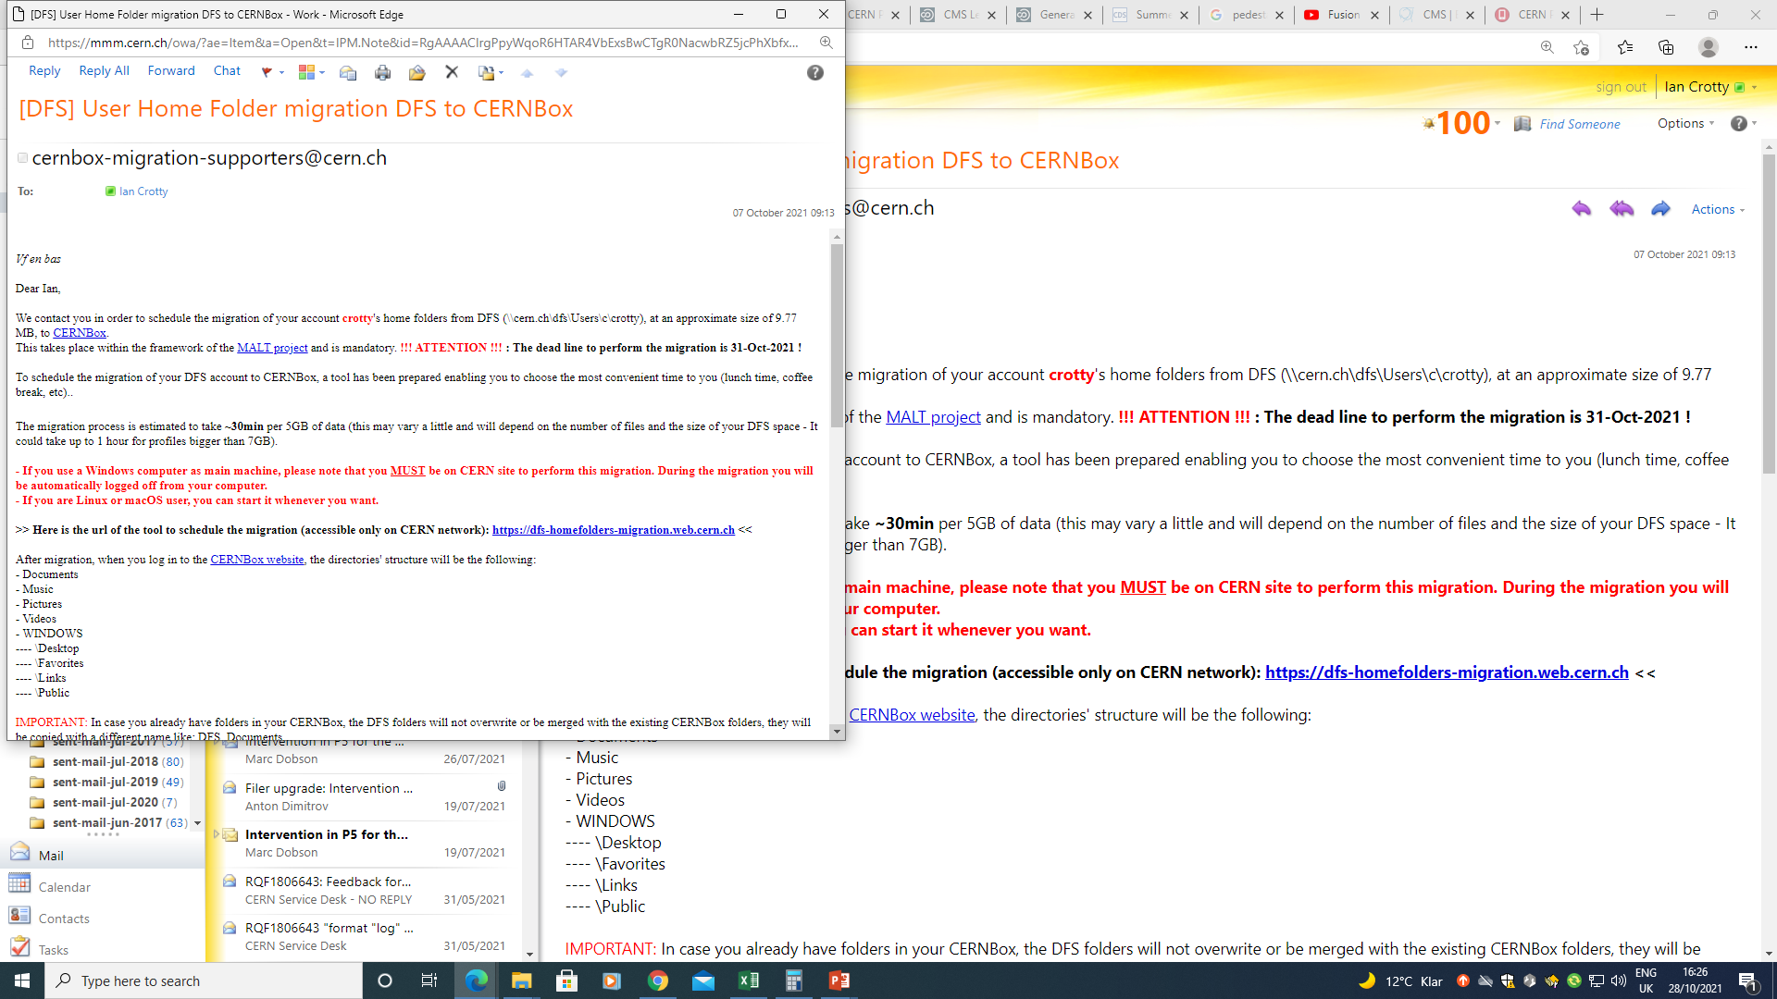

Slide 3
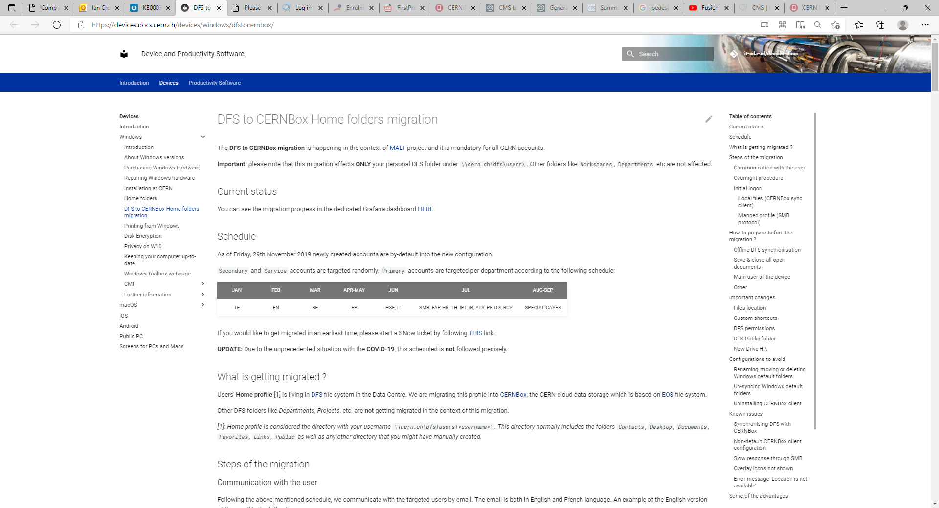
https://devices.docs.cern.ch/devices/windows/dfstocernbox/

Slide 4
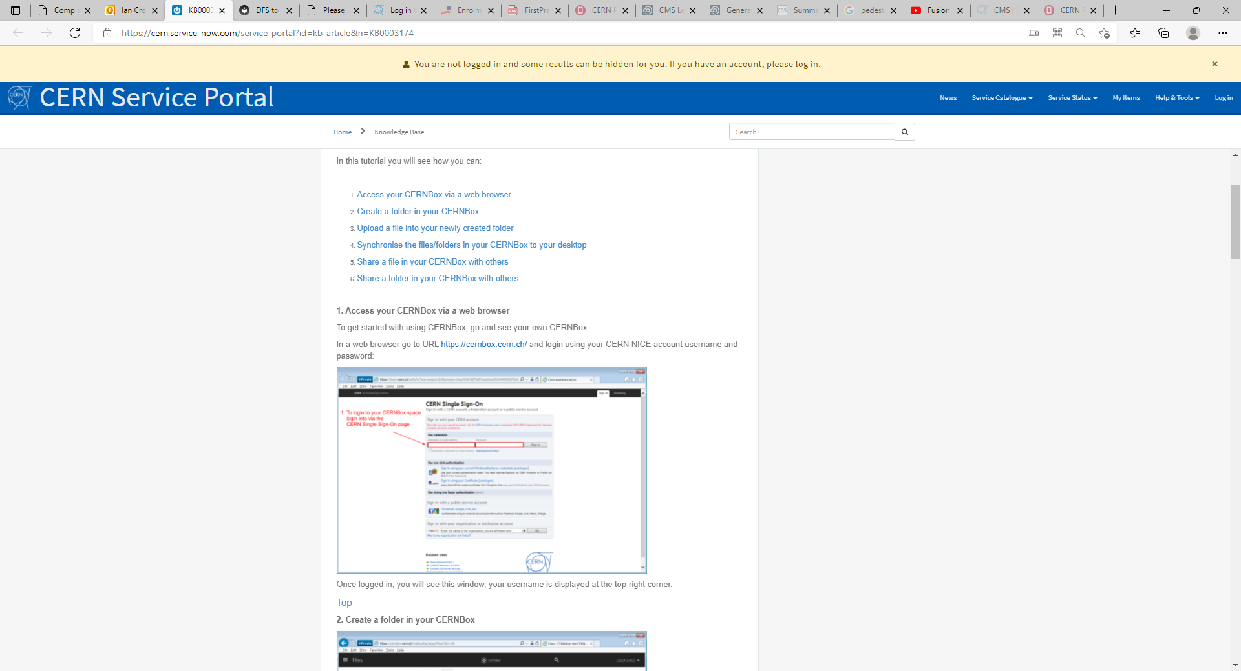
https://cern.service-now.com/service-portal?id=kb_article&n=KB0003174

Slide 5
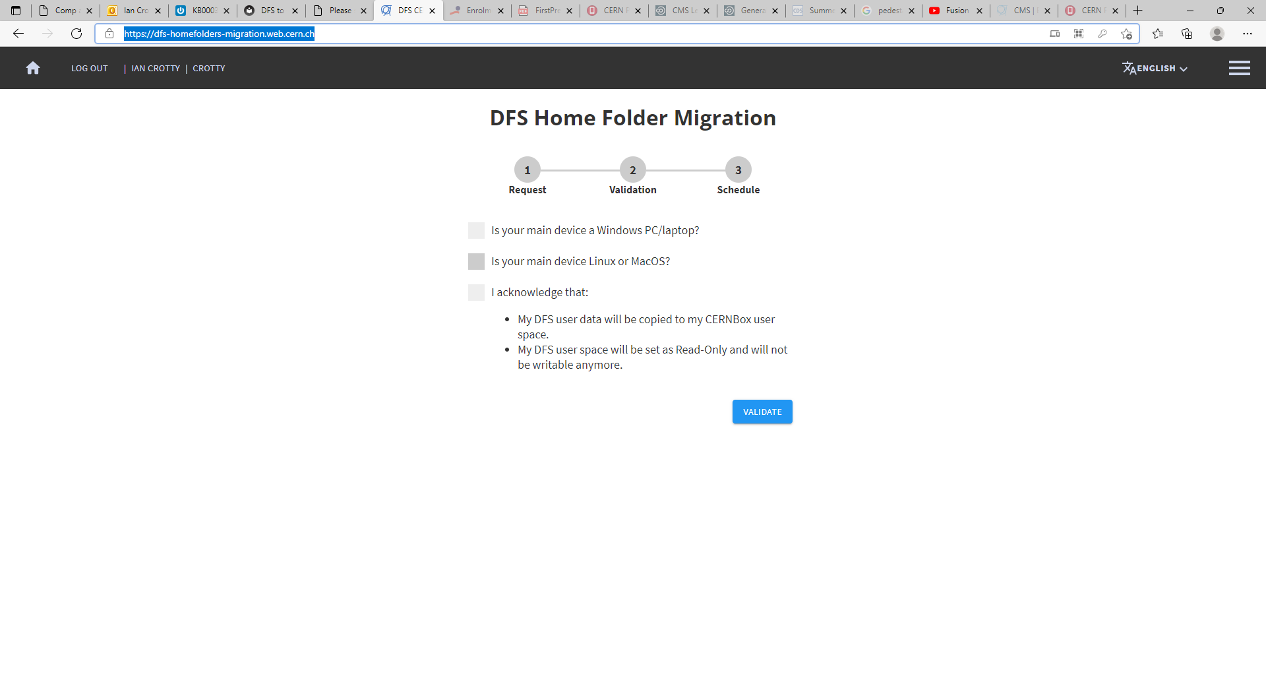
https://dfs-homefolders-migration.web.cern.ch/

Slide 6
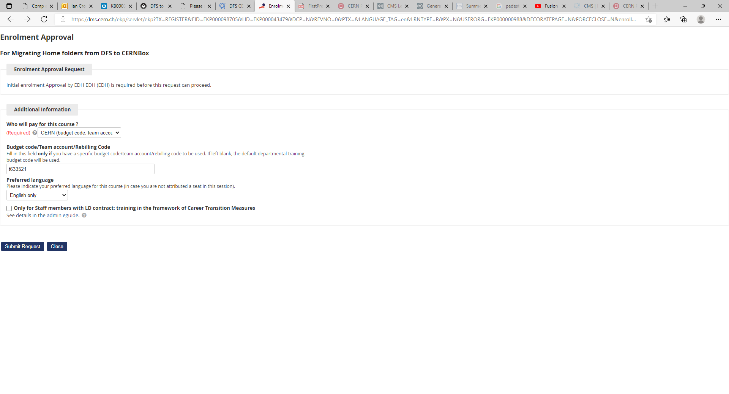
https://lms.cern.ch/ekp/servlet/ekp?TX=REGISTER&EID=EKP000098705&LID=EKP000043479&DCP=N&REVNO=0&PTX=&LANGUAGE_TAG=en&LRNTYPE=R&PX=N&USERORG=EKP000000988&DECORATEPAGE=N&FORCECLOSE=N&enroll=Enrol

Slide 7
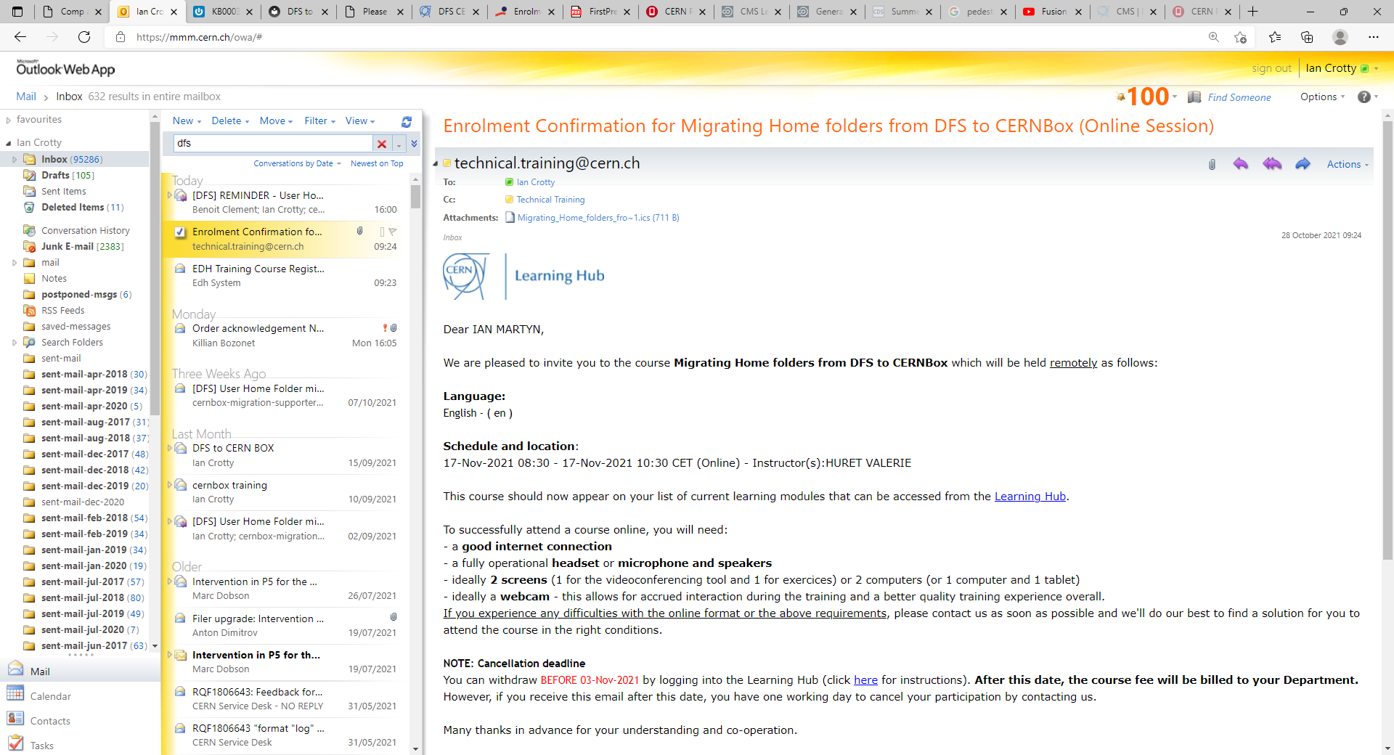

Slide 8
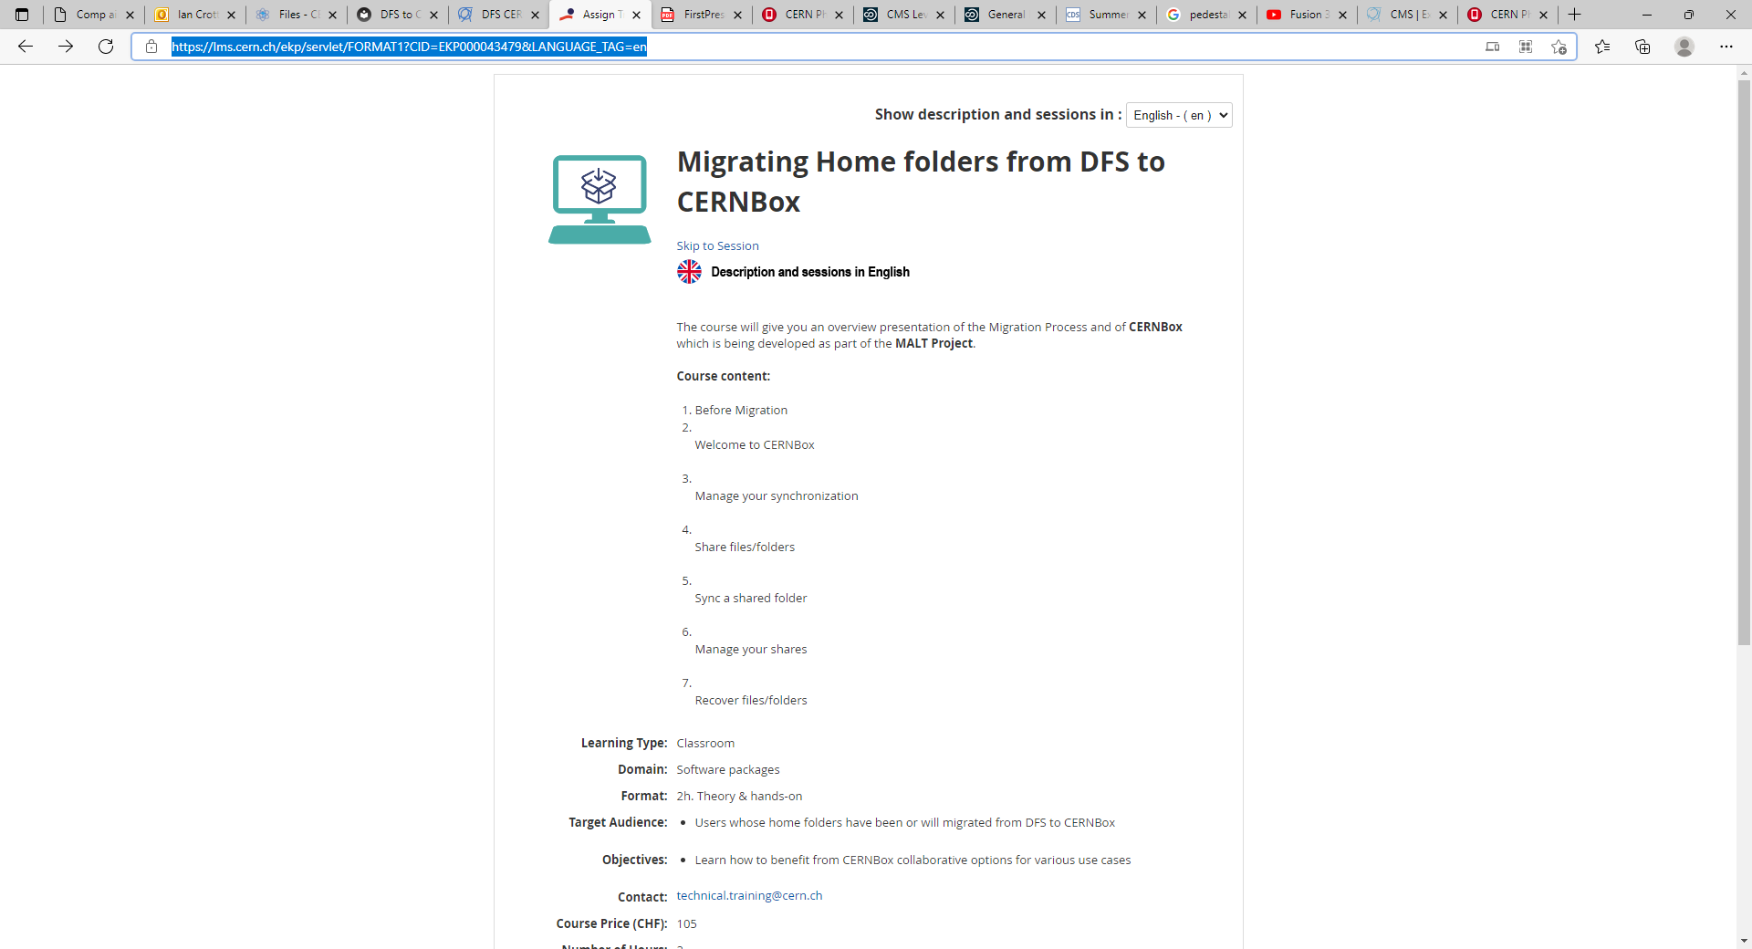
https://lms.cern.ch/ekp/servlet/FORMAT1?CID=EKP000043479&LANGUAGE_TAG=en

Slide 9
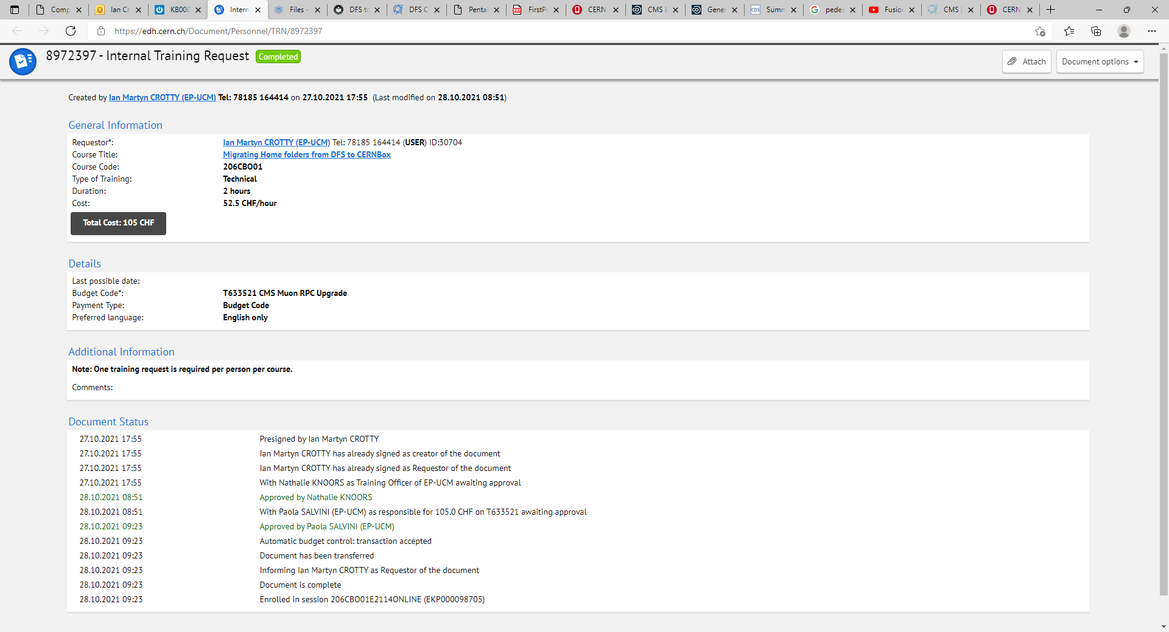

Slide 10
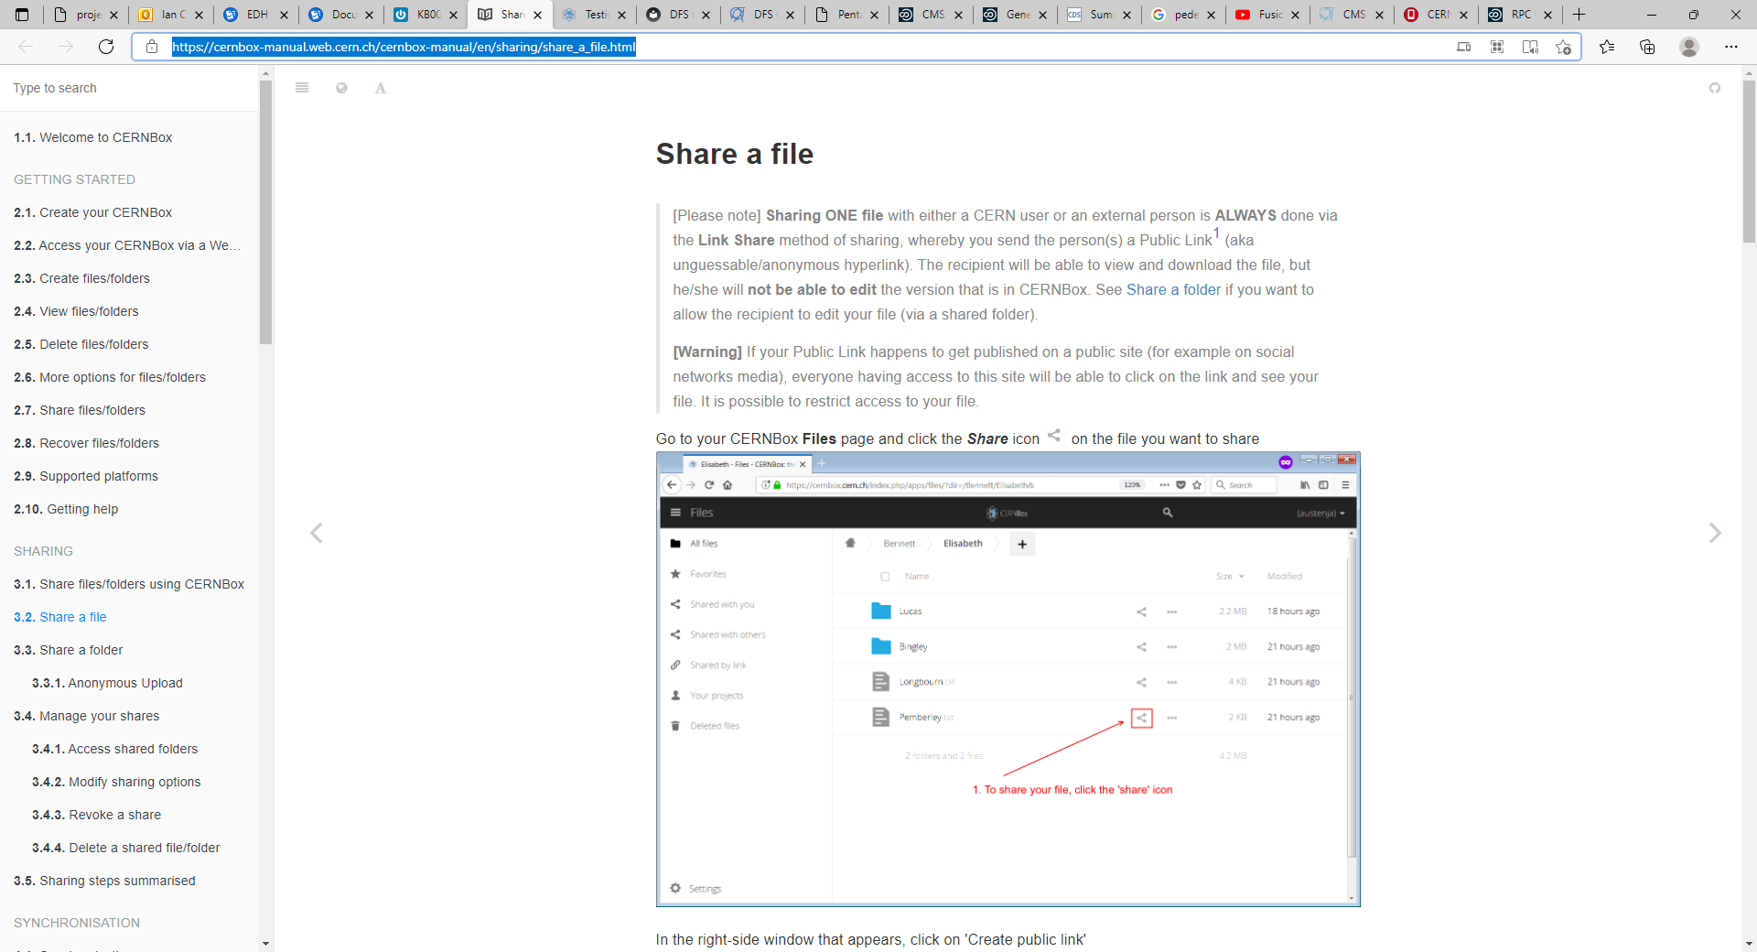
https://cernbox-manual.web.cern.ch/cernbox-manual/en/sharing/share_a_file.html

Slide 11
EOS
Host or mobile device ?
you can always access the latest version of your work files in CERNBox by making sure that the contents on your local host is being synchronised to your CERNBox.
Synced

Slide 13
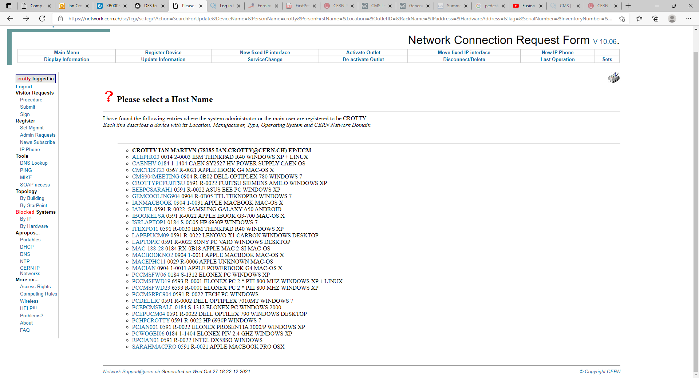
https://network.cern.ch/sc/fcgi/sc.fcgi?Action=SearchForUpdate&DeviceName=&PersonName=crotty&PersonFirstName=&Location=&OutletID=&RackName=&IPaddress=&HardwareAddress=&Tag=&SerialNumber=&InventoryNumber=&OperatingSystem=&Domain=

