Slide 1
Access to 687- R- L40

Slide 2
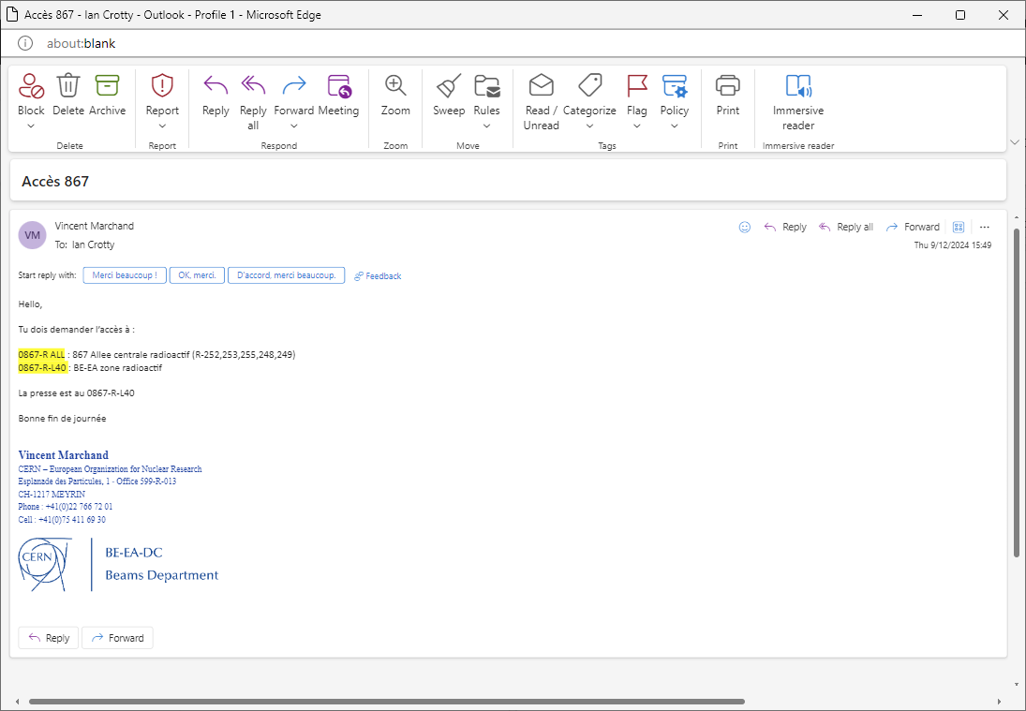

Slide 3
Vincent Marchand
​
Ian Crotty
​
Hello,
Tu dois demander l’accès à :
0867-R ALL : 867 Allee centrale radioactif (R-252,253,255,248,249)
0867-R-L40 : BE-EA zone radioactif
La presse est au 0867-R-L40
Bonne fin de journée
Vincent Marchand

Slide 4
Adams.cern.cj
Then option to “redirect”

Slide 5
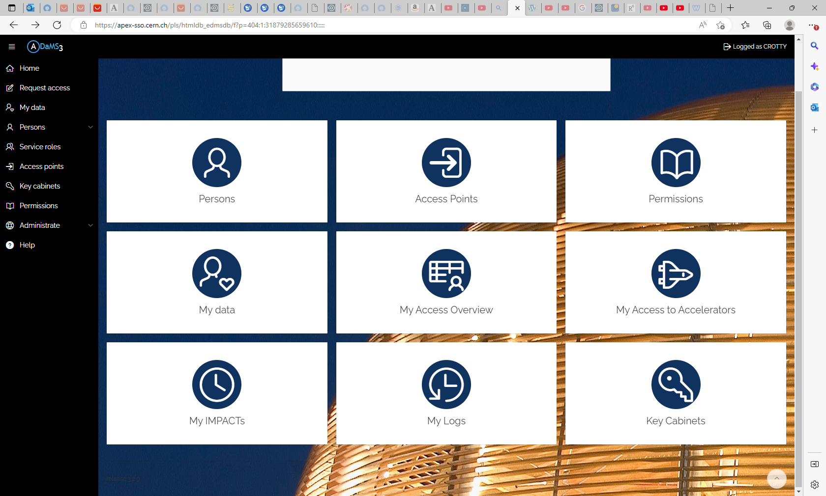

Slide 6
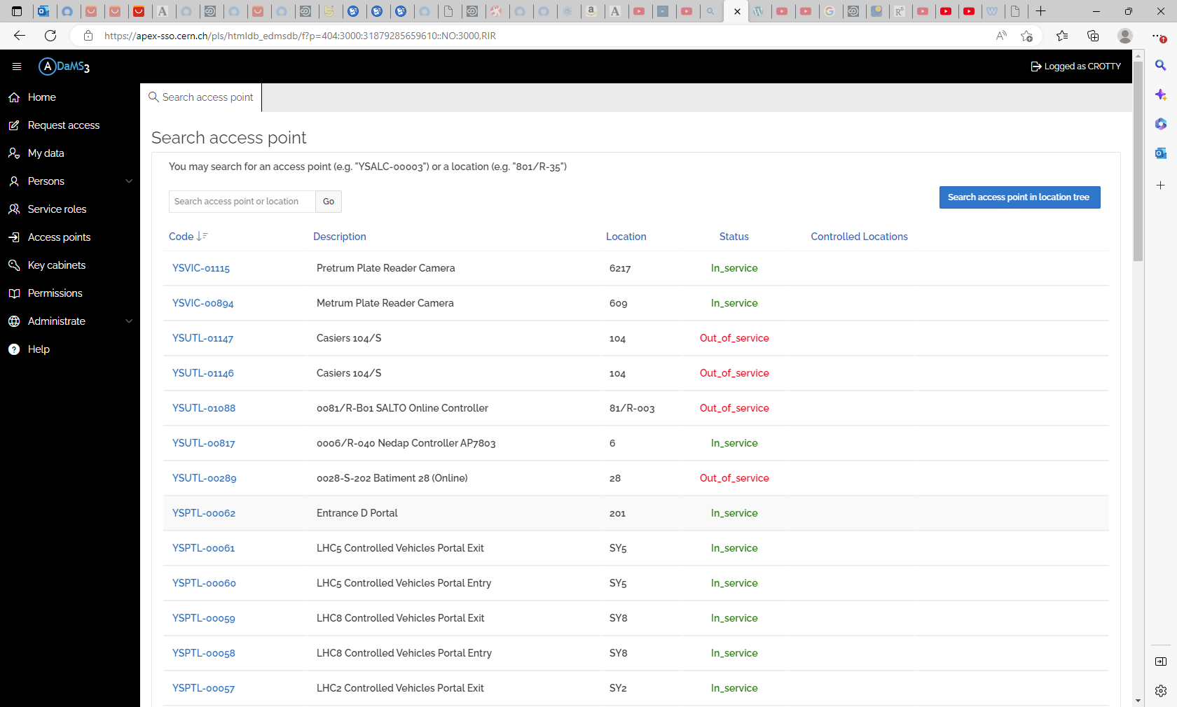

Slide 8
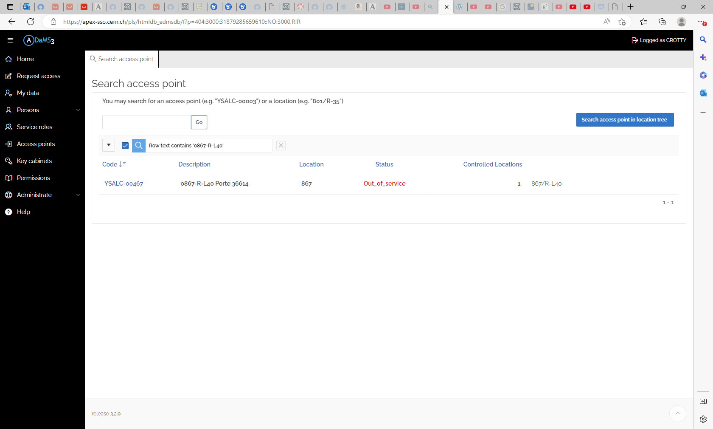

Slide 9
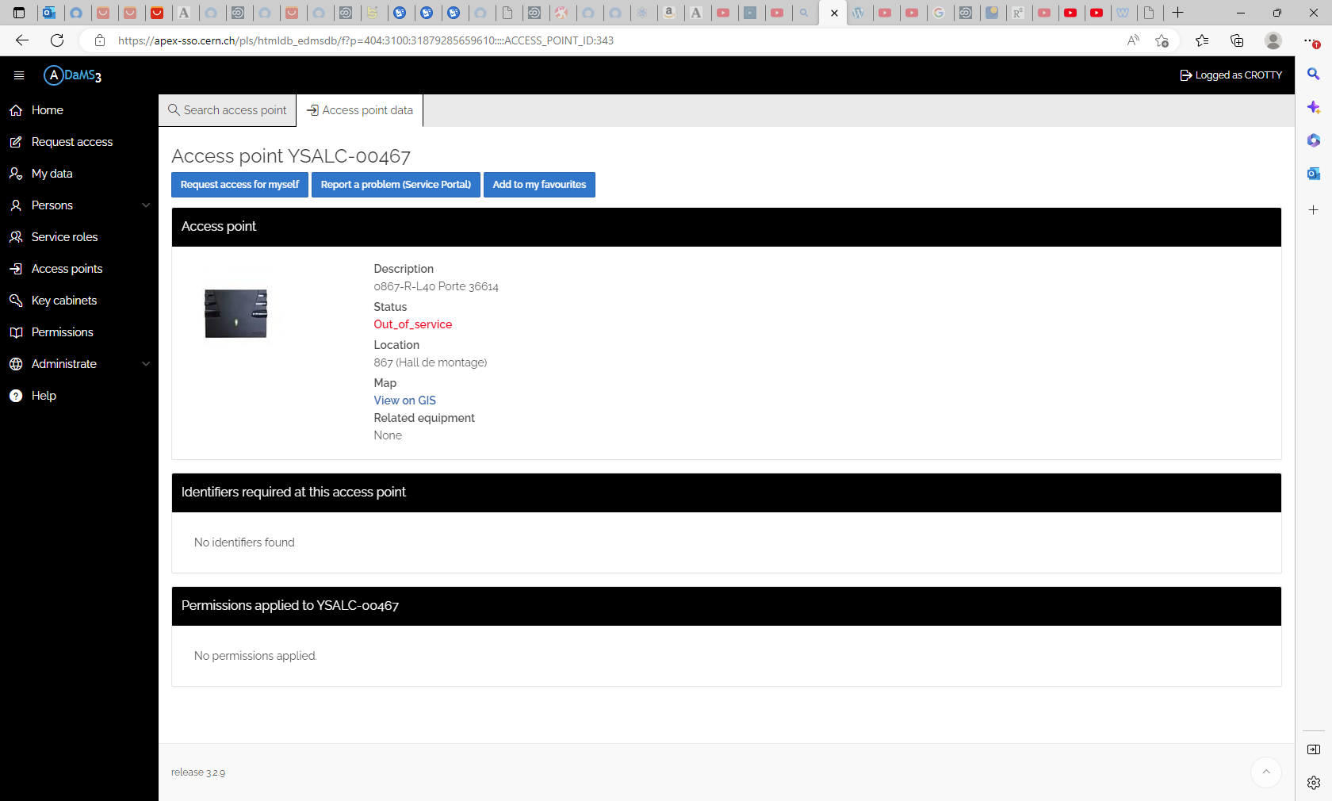

Slide 10
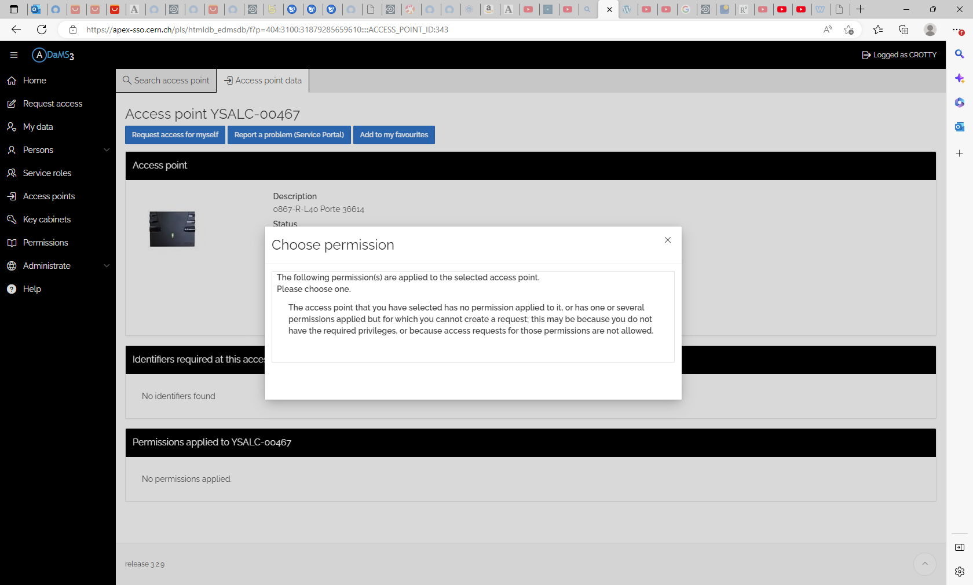

Slide 11
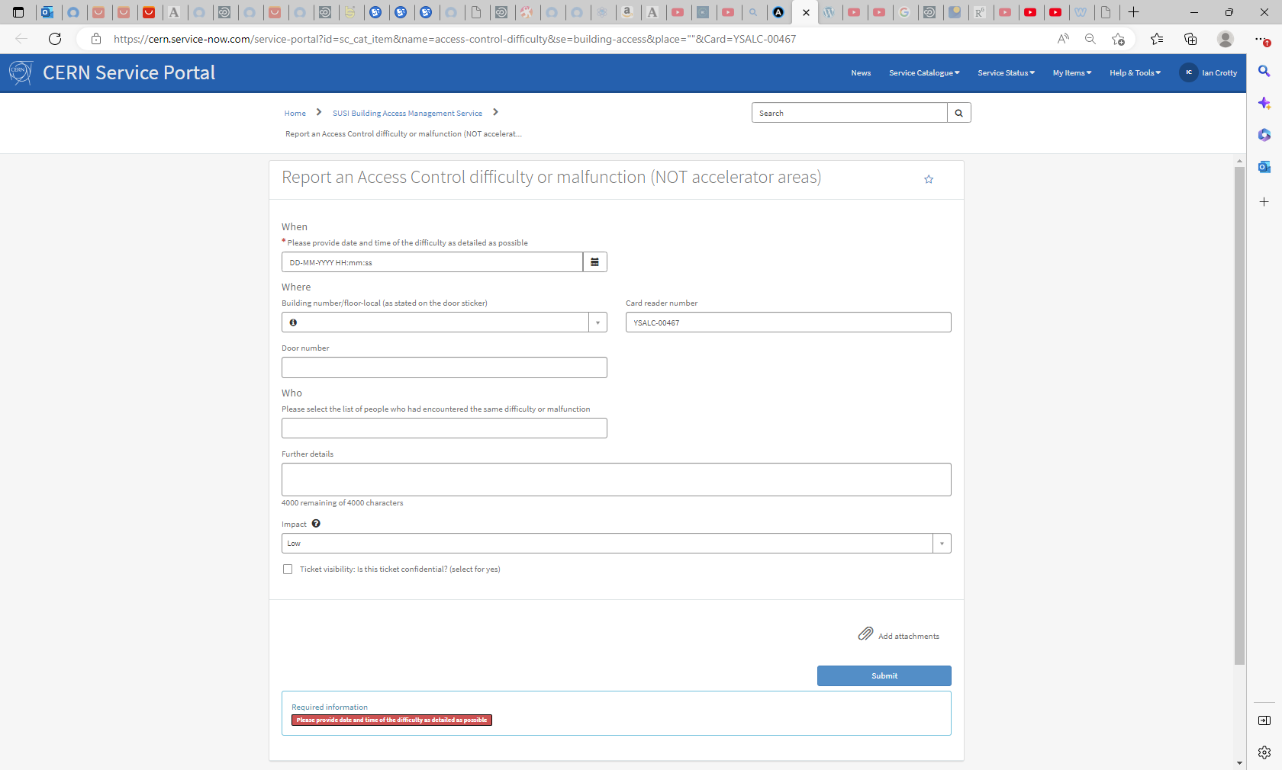

Slide 12
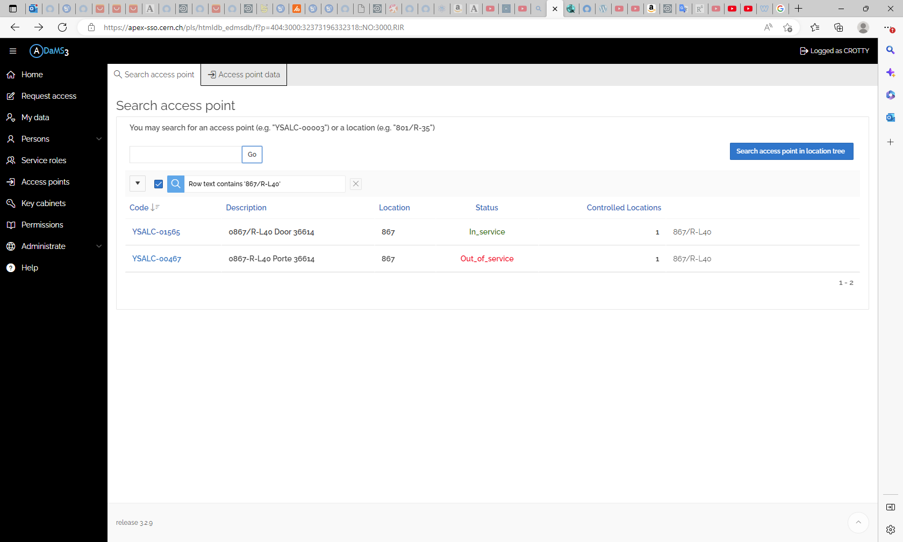
YSALC-01565
YSALC-00467

Slide 13
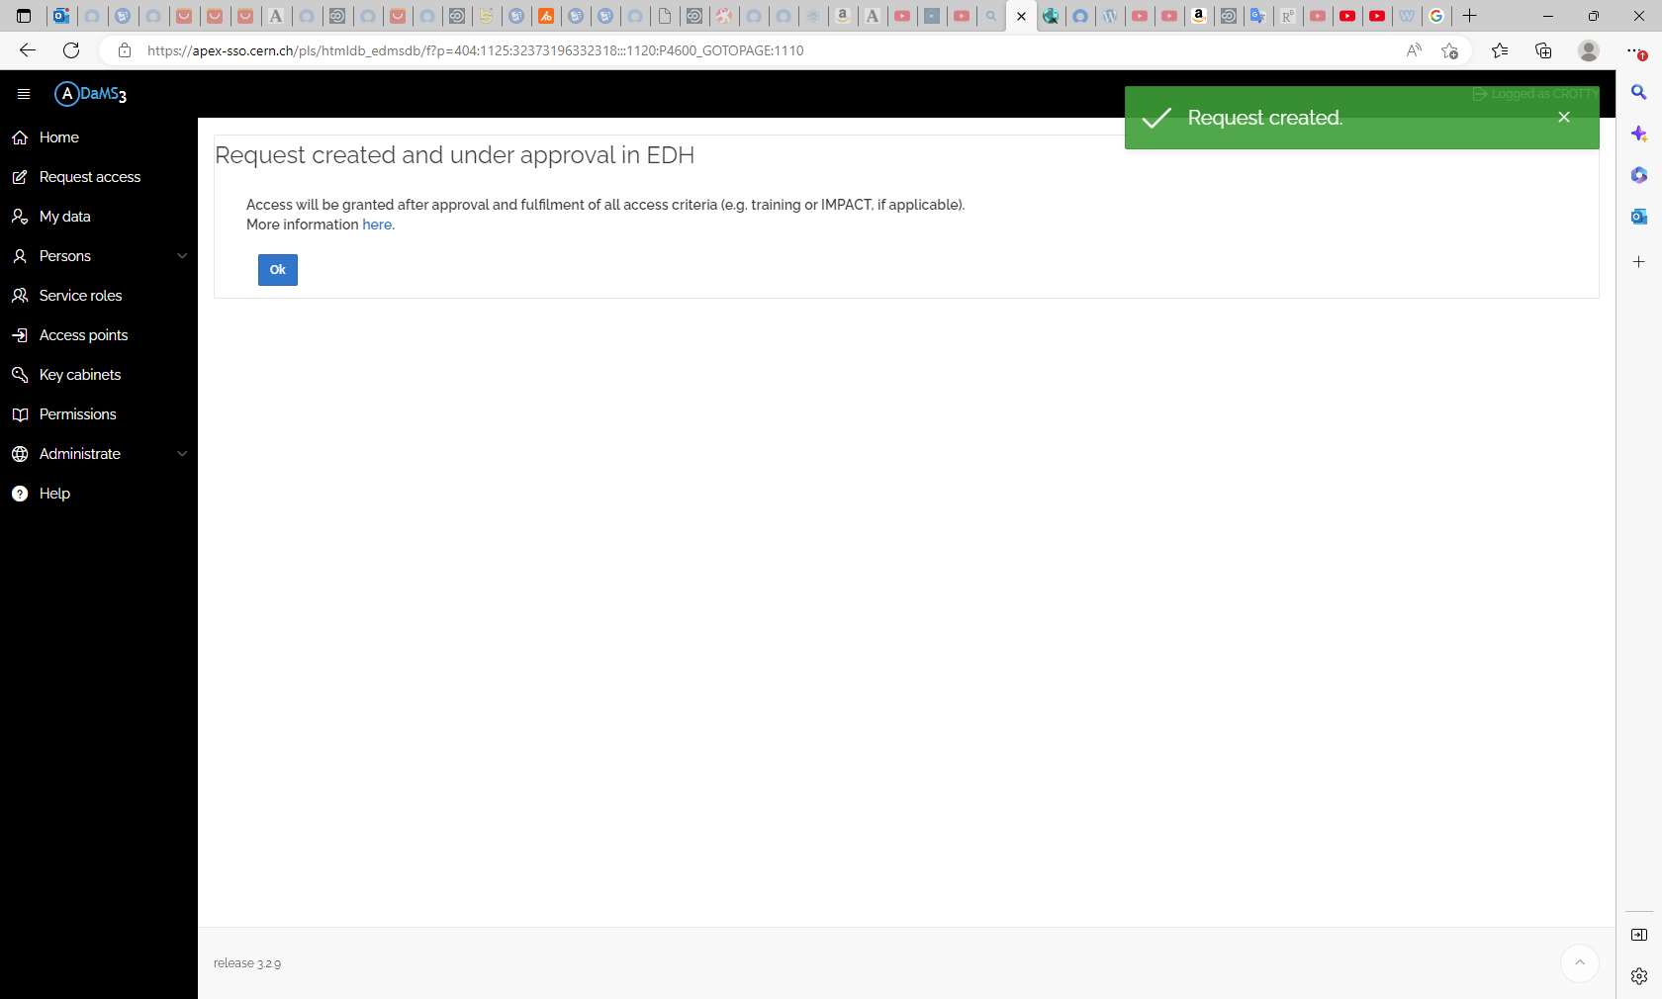

Slide 14
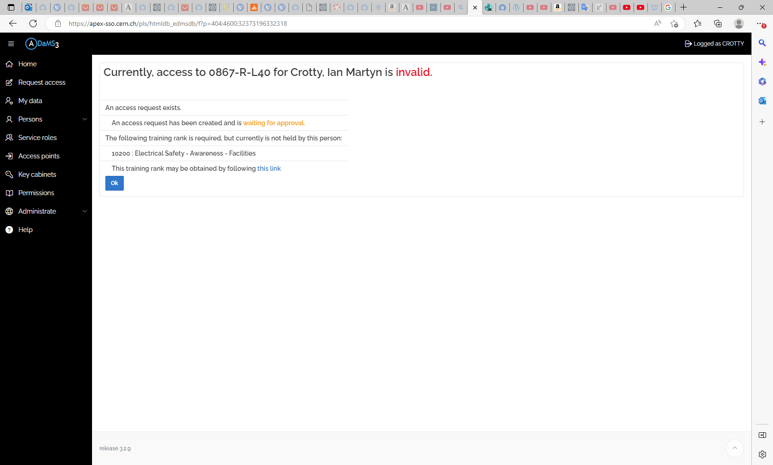

Slide 15
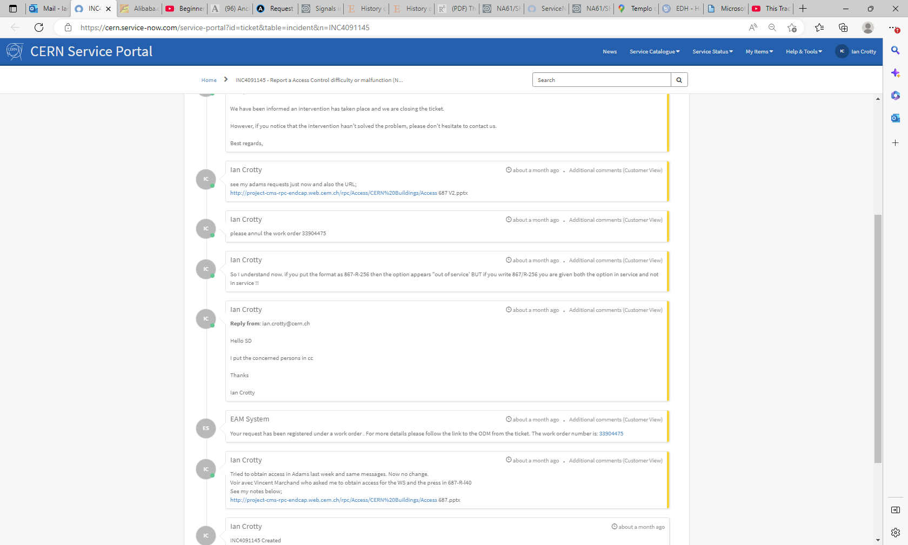

Slide 16
Ian Crotty about a month agoabout a month ago Additional comments (Customer View)
So I understand now. if you put the format as 867-R-256 then the option appears "out of service' BUT if you write 867/R-256 you are given both the option in service and not in service !!

Slide 17
Trying to extend access to WS
867/R-L40
On 23 Oct 2024
When access stops on 24 Oct 2024 !

Slide 18
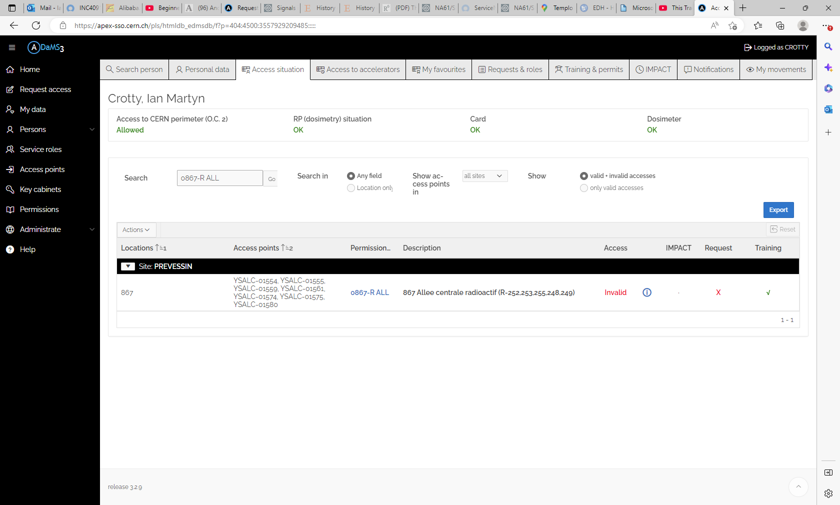

Slide 19
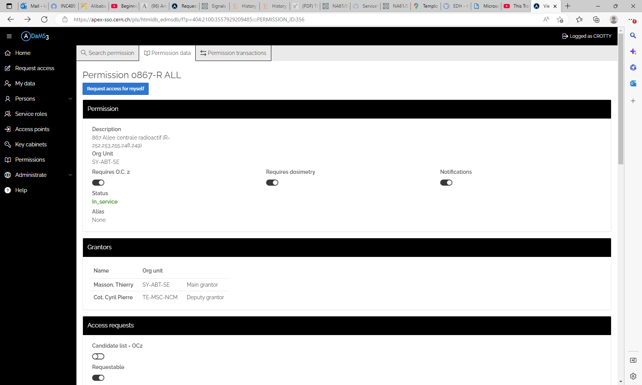

Slide 20
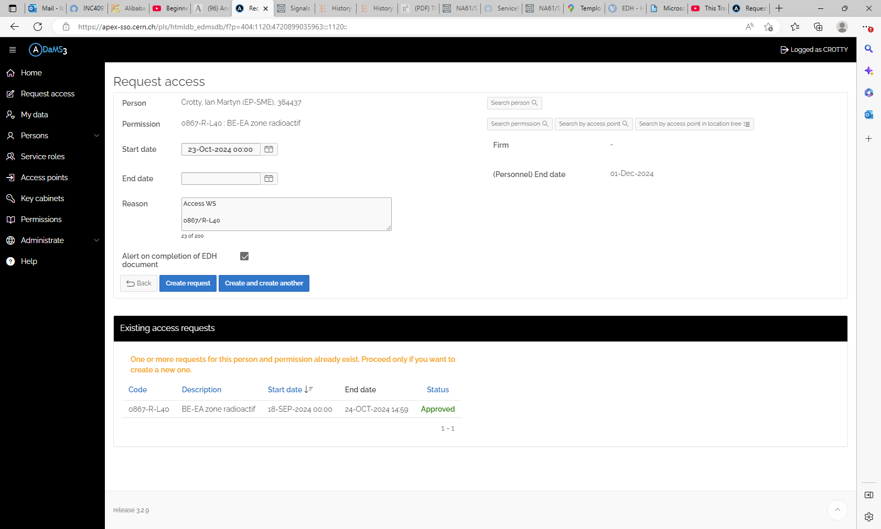

Slide 21
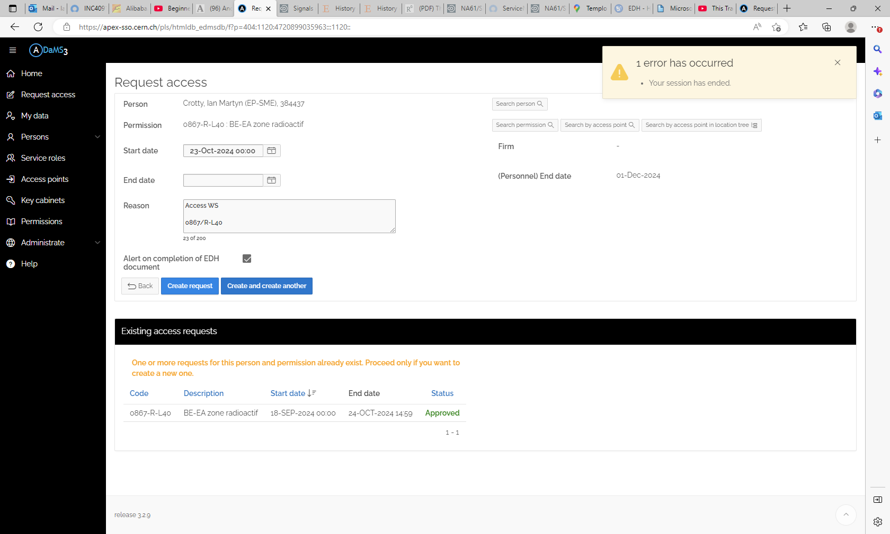

Slide 22
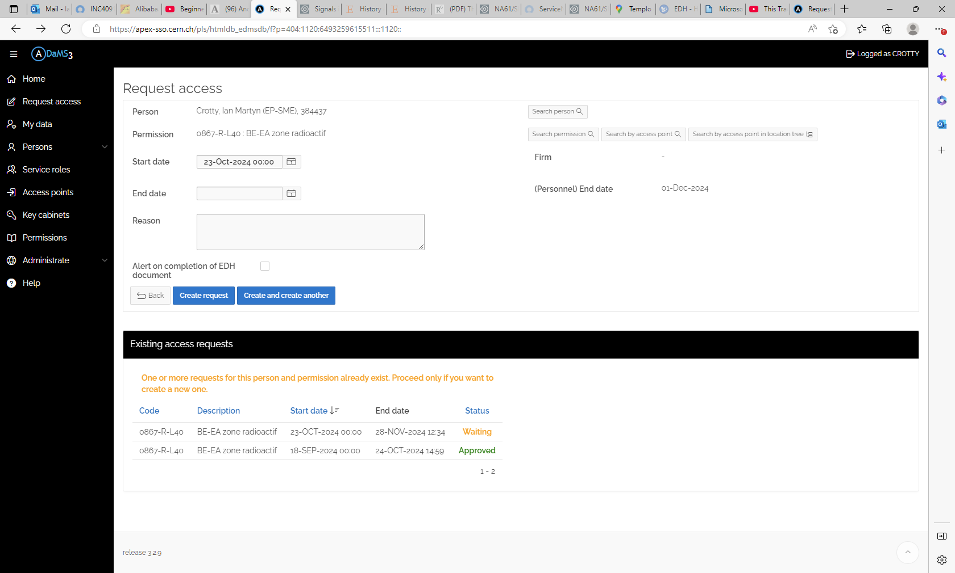

Slide 23
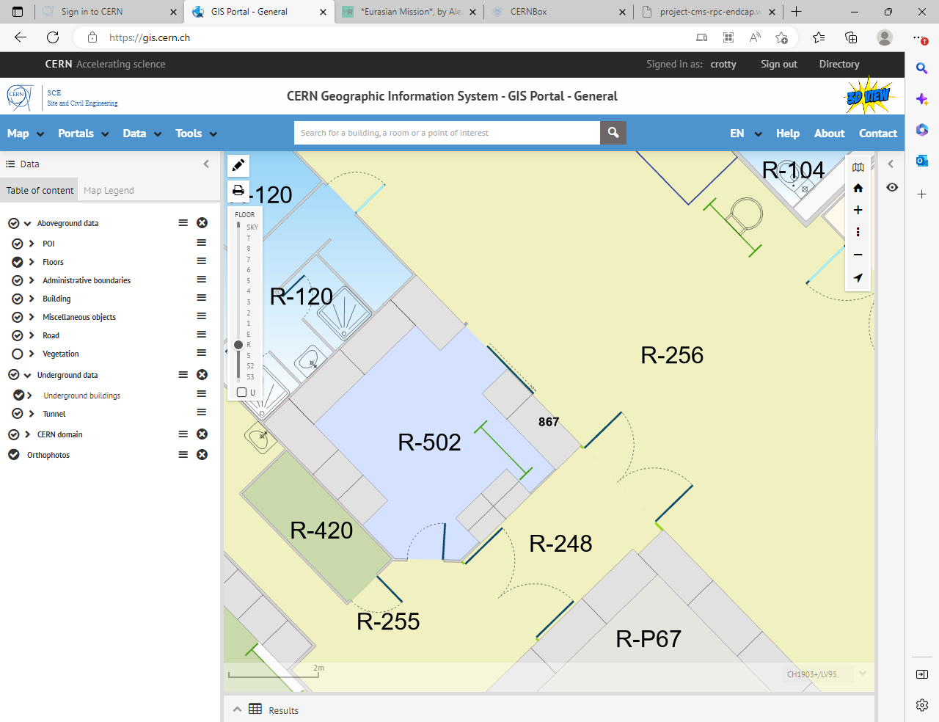

Slide 24
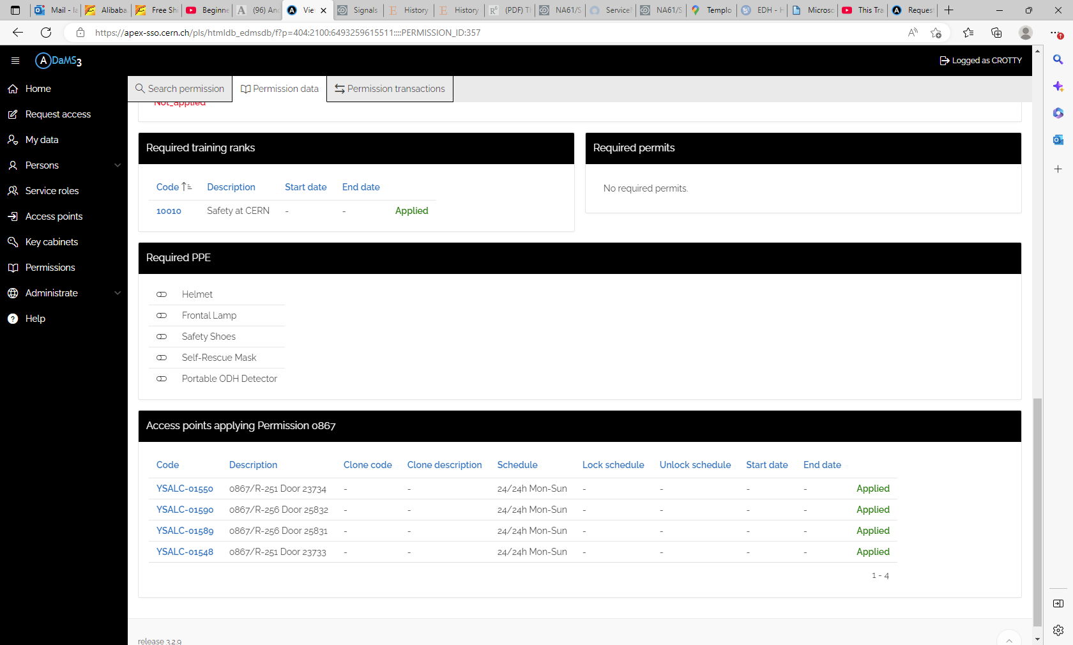

Slide 25
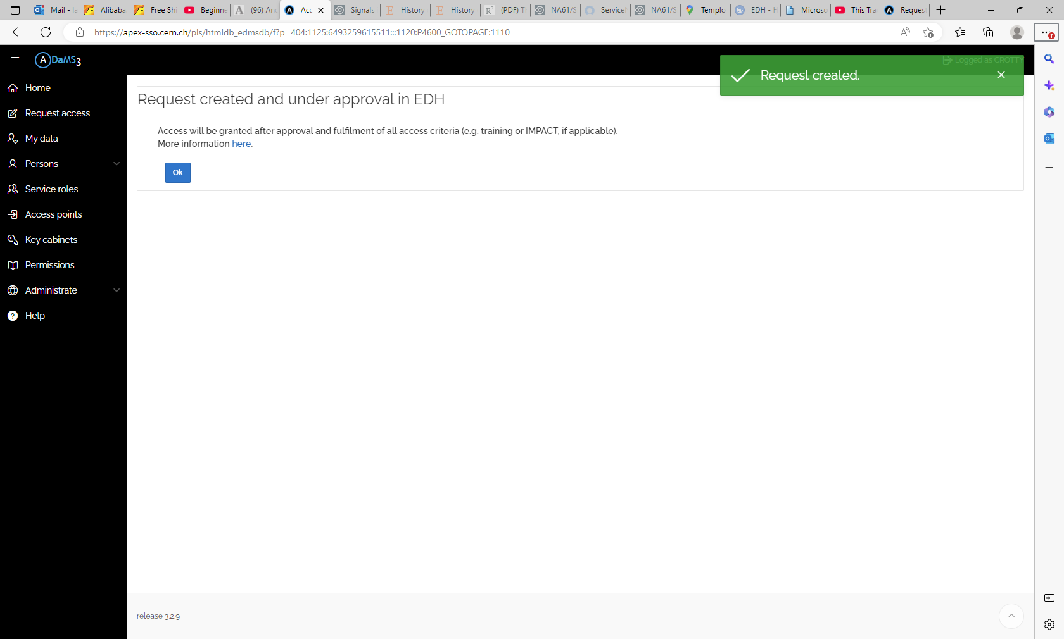

Slide 26
THERE ARE x3
Different requests to be made to have access to the 867/R-L40 WS

Slide 27
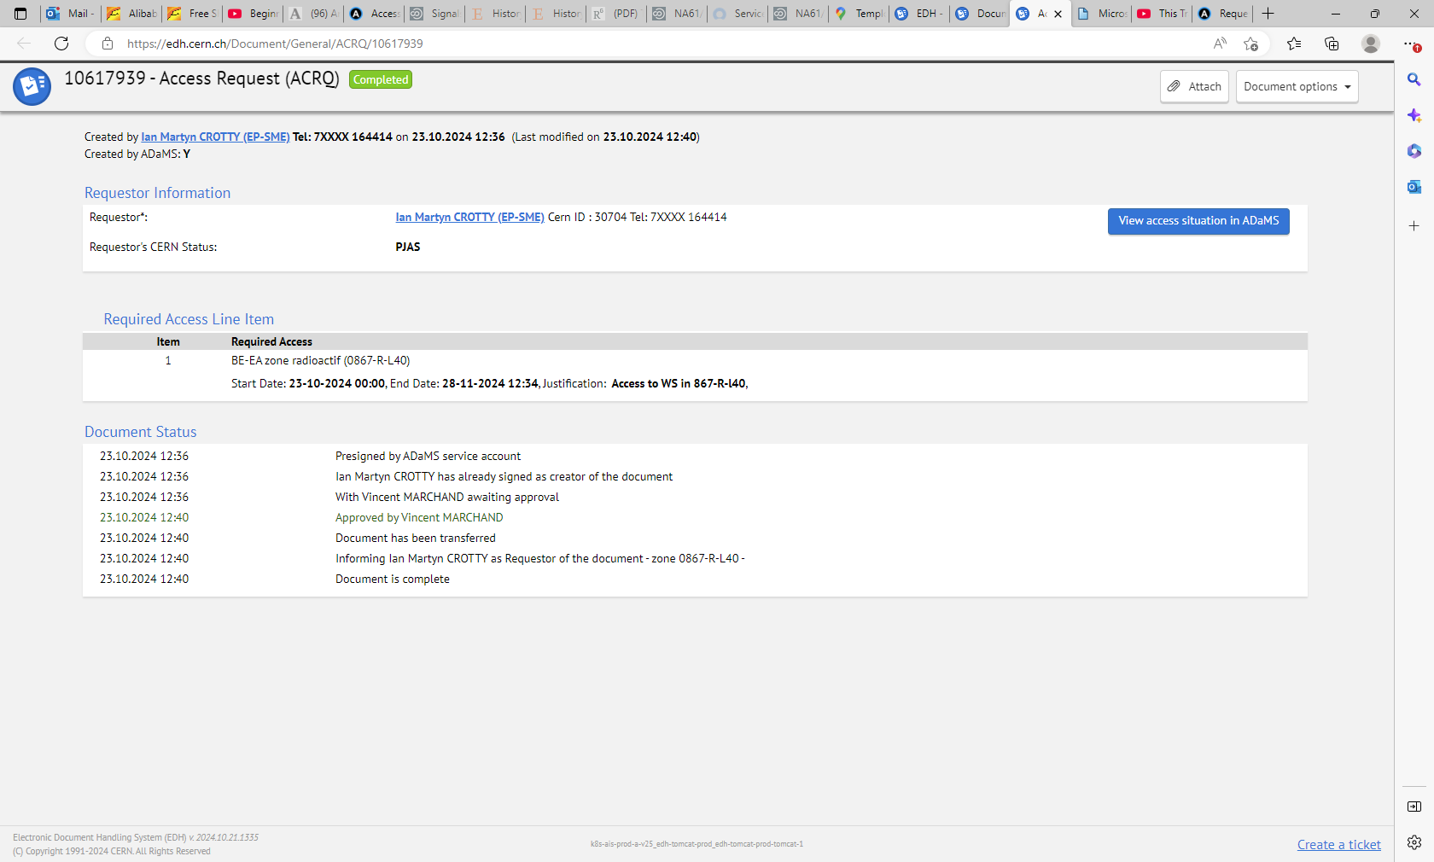

Slide 28
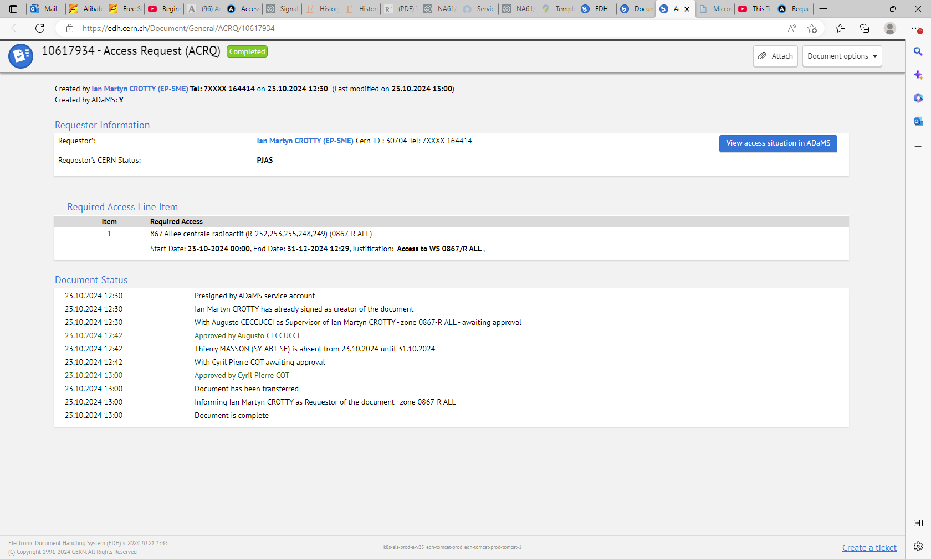

Slide 29
