Slide 1
Motor Generator
Ian
24 April 2023

Slide 2
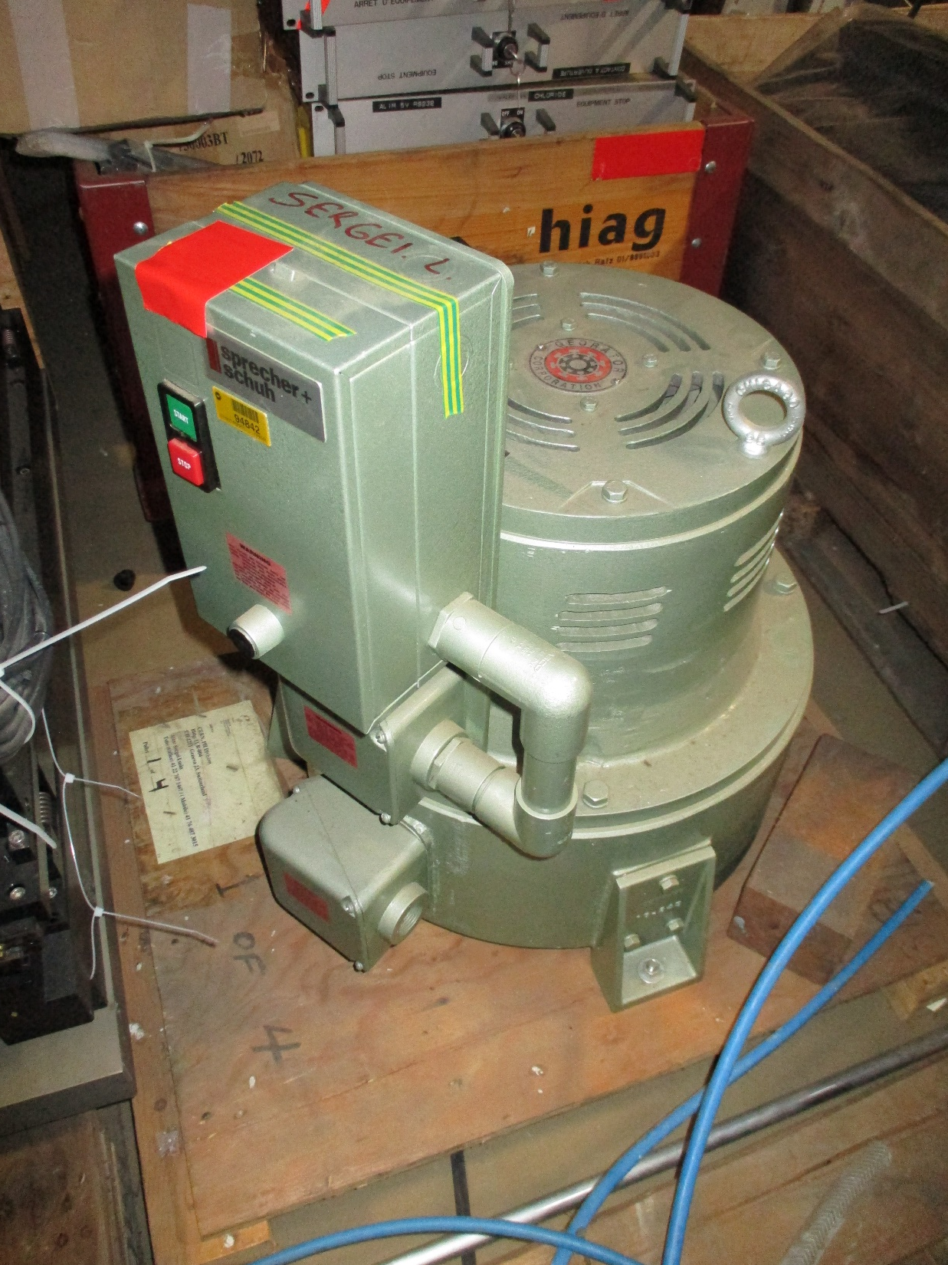
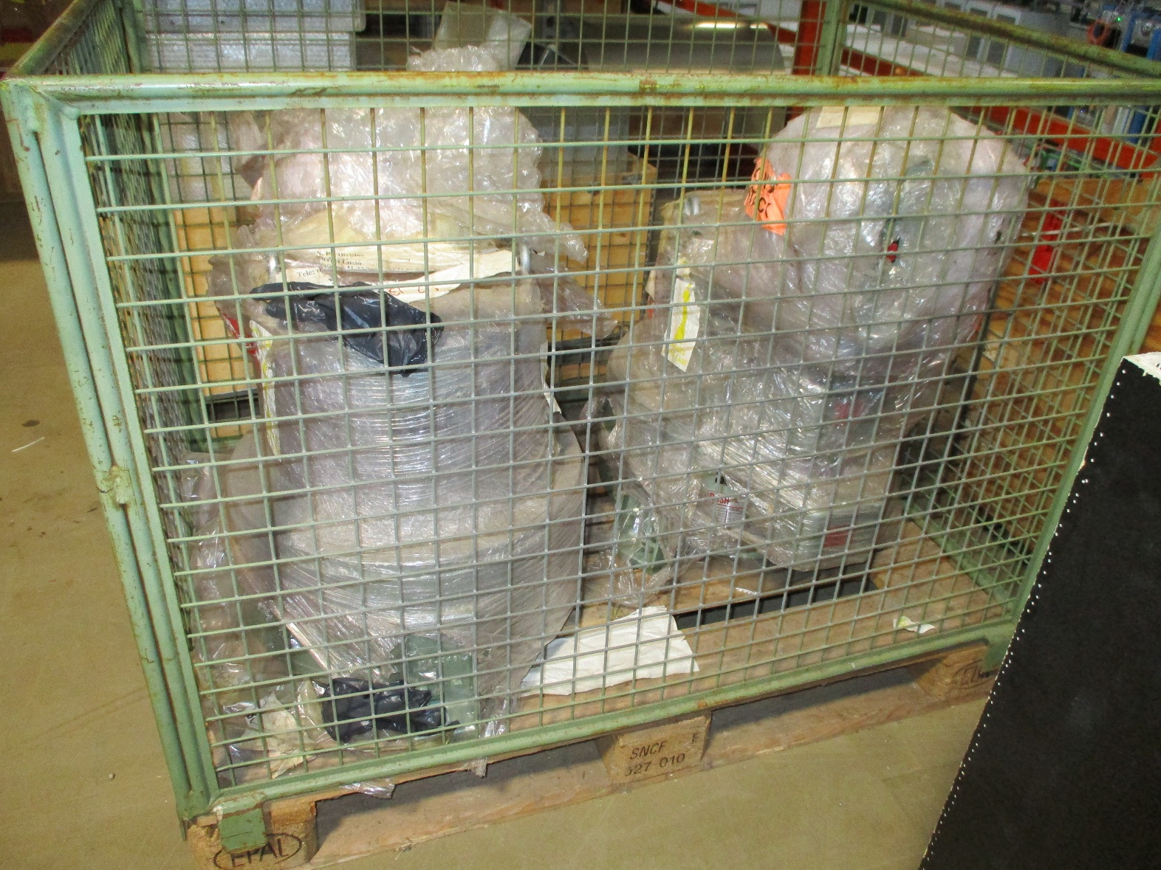
2nd and 3rd unused
First and used ?

Slide 3
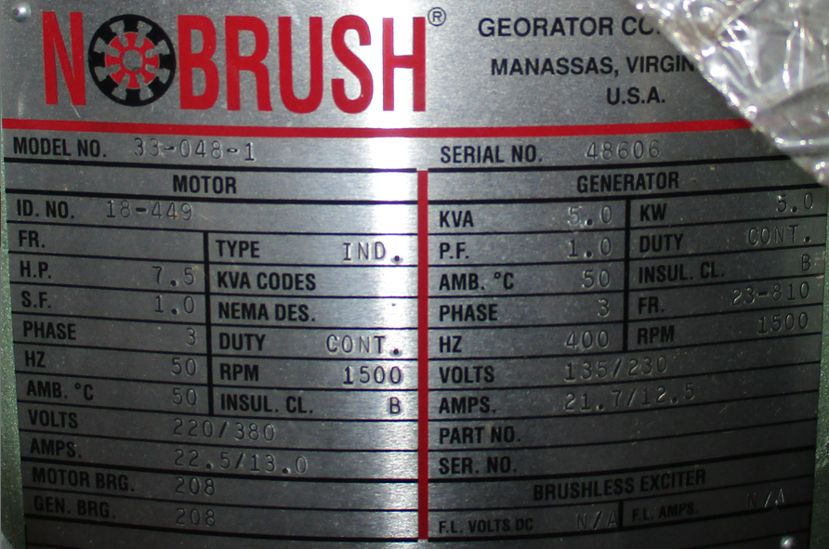
The used one, first of 3
NoBrush Georator Corporation
Manassas
Virginia, USA
Motor
Model No. 33-048-1 Serial No. 48606
ID. No. 18-449
FR Type IND.
HP 7.5 KVA Codes
SF 1.0 Nema Des.
Phase 3 Duty Cont.
Hz 50 RPM 1500
Amb. degC 50 Insul. Cl. B
Volts 220/380
Amps 22.5/13.0
Motor BRG. 208
Gen. BRG. 208

Slide 4
Generator
KVA 5.0 KW 5.0
PF 1.0 Duty Cont.
Amb. degC 50 Insul. Cl. B
Phase 3 Fr. 23-810
Hz 400 RPM 1500
Volts 135/230
Amps 21.7/12.5
Part No.
Serial No.
Brushless Exciter
F.L. Volts DC N/A F.L. Amps N/A

Slide 5
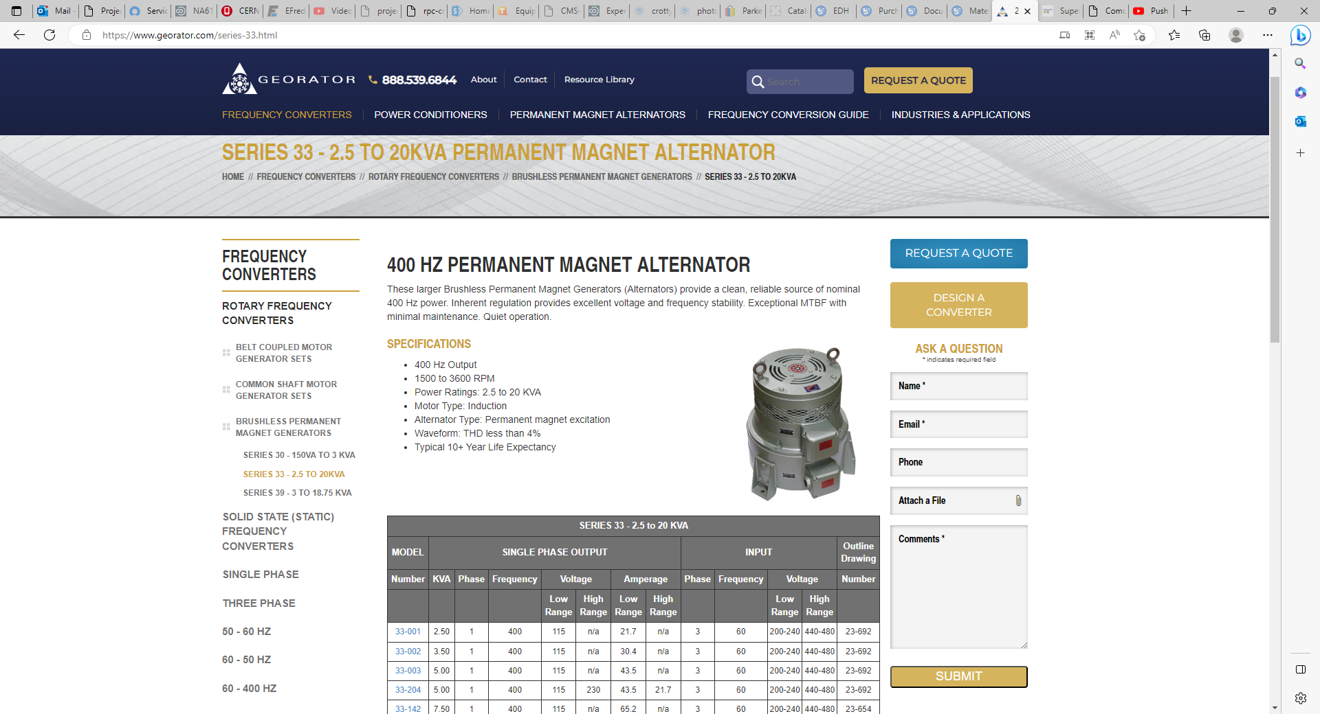
https://www.georator.com/series-33.html
200 kVA Frequency Converter - 400Hz Permanent Magnet Alternator | Georator Corporation

Slide 6
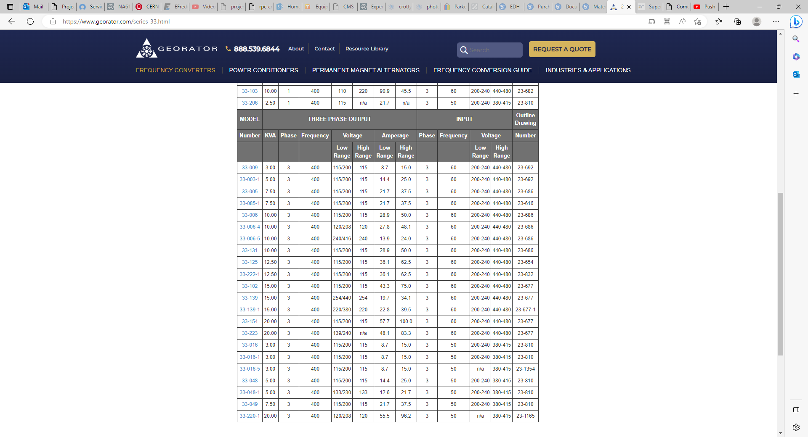

Slide 7
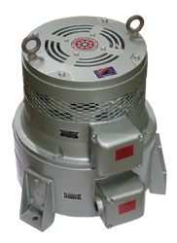
Net 130kg
Shipping 153kg

Slide 9
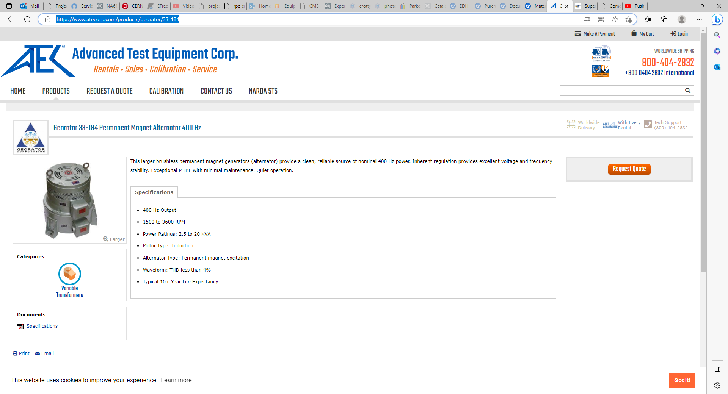
https://www.atecorp.com/products/georator/33-184

Slide 10
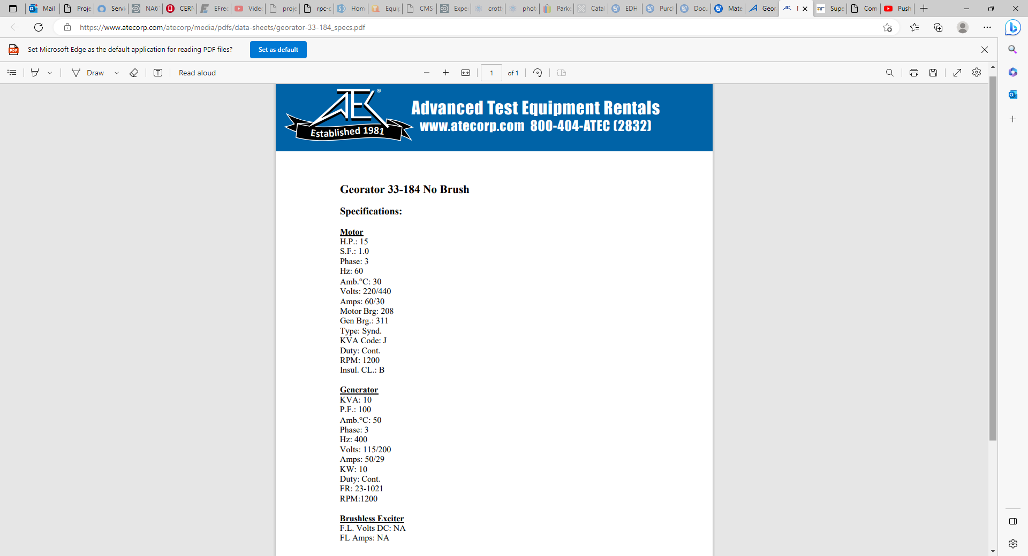

Slide 11
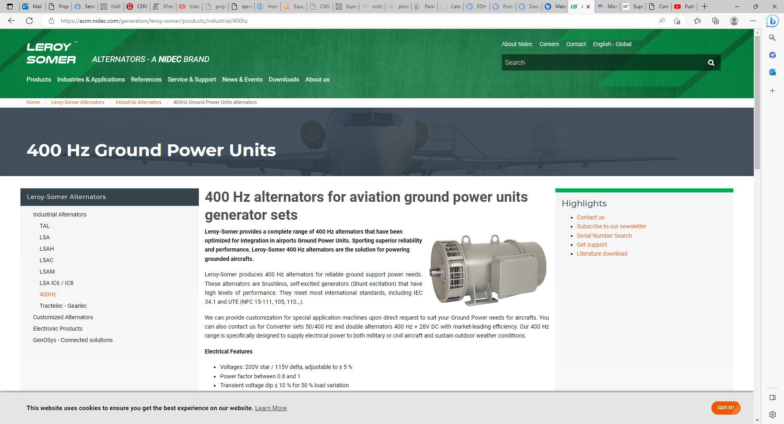
https://acim.nidec.com/generators/leroy-somer/products/industrial/400hz

Slide 12
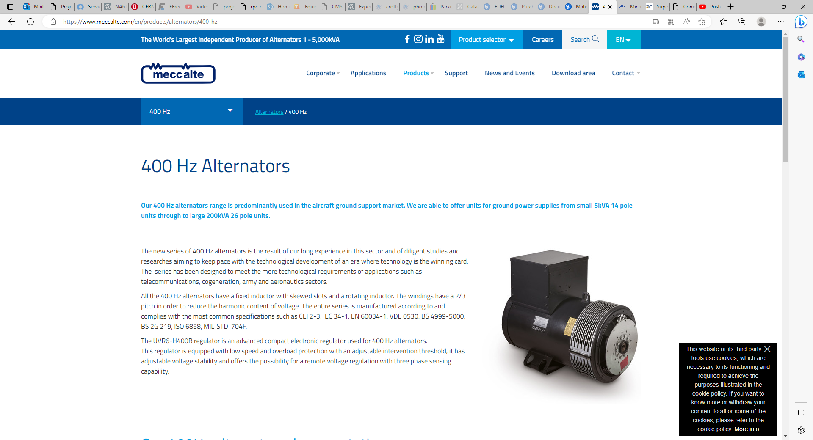
https://www.meccalte.com/en/products/alternators/400-hz

Slide 14
https://www.powerstream.com/400hz-tutorial.htm

Slide 15
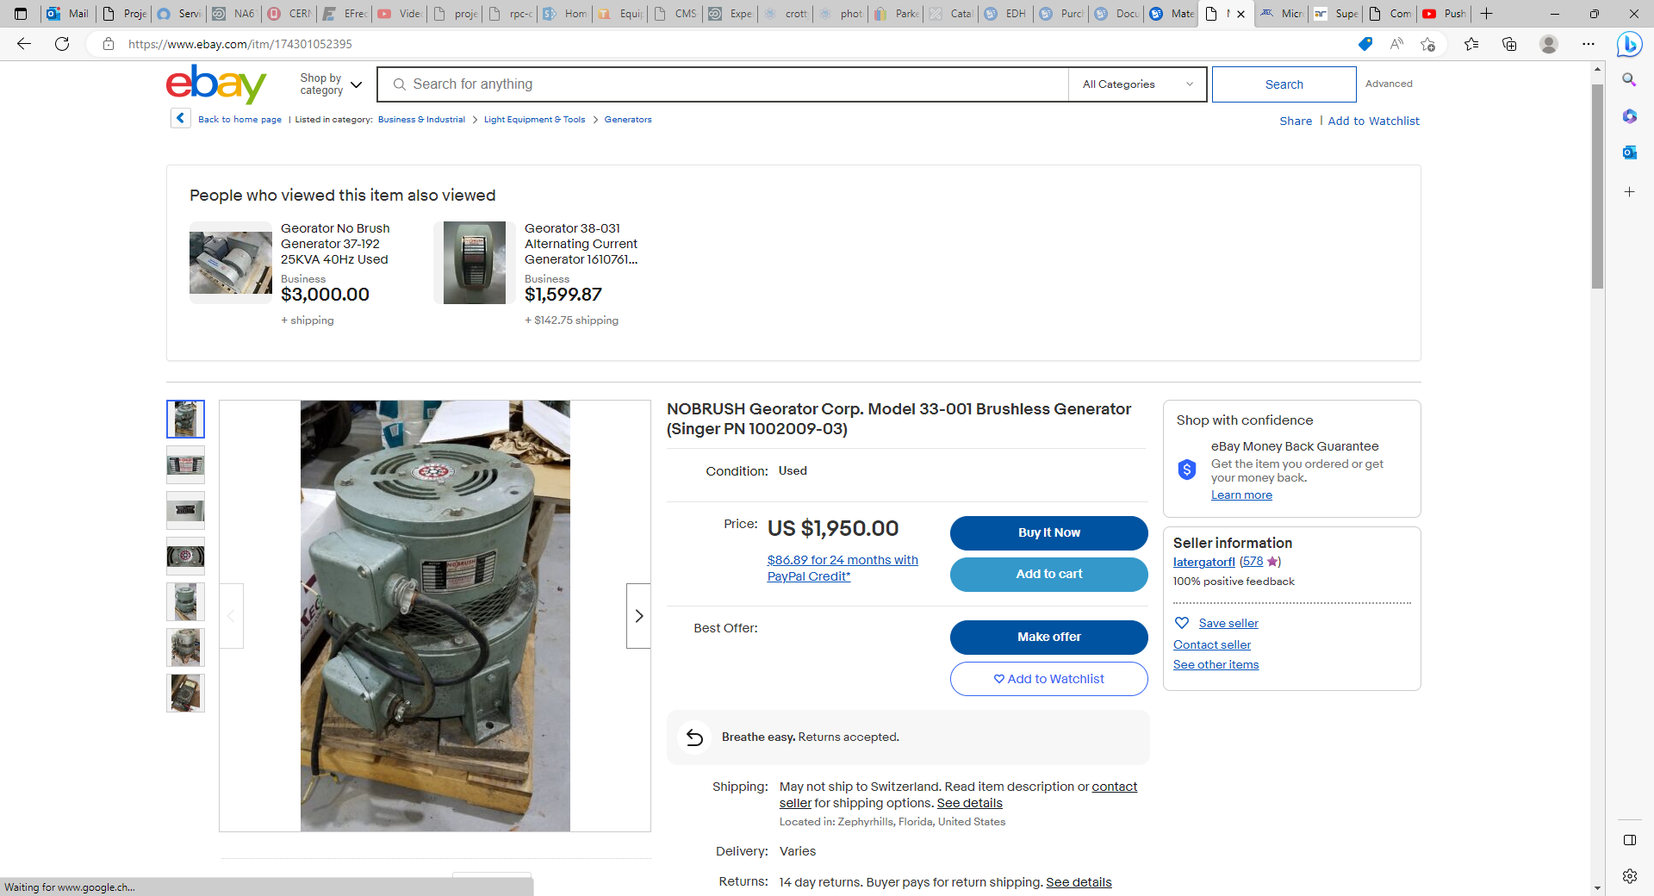
https://www.ebay.com/itm/174301052395

Slide 16
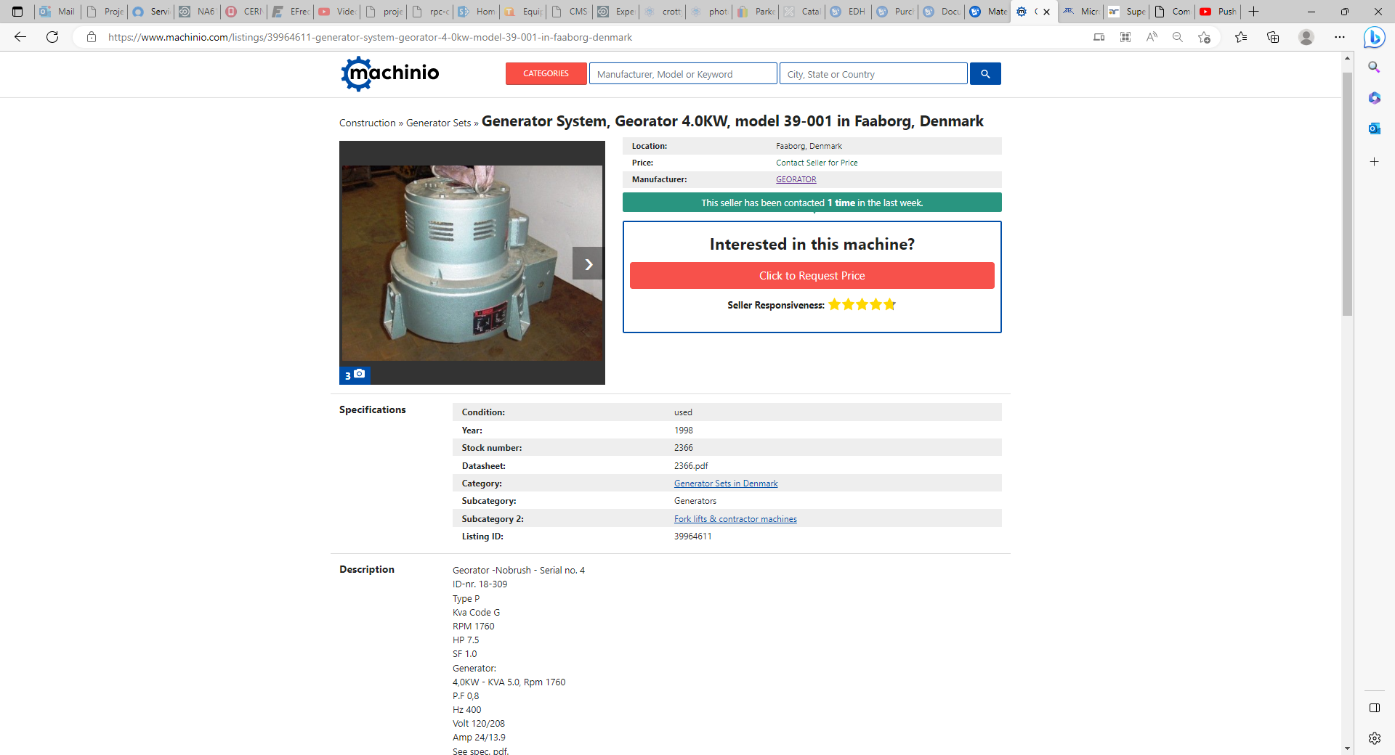
https://www.machinio.com/listings/39964611-generator-system-georator-4-0kw-model-39-001-in-faaborg-denmark

Slide 17
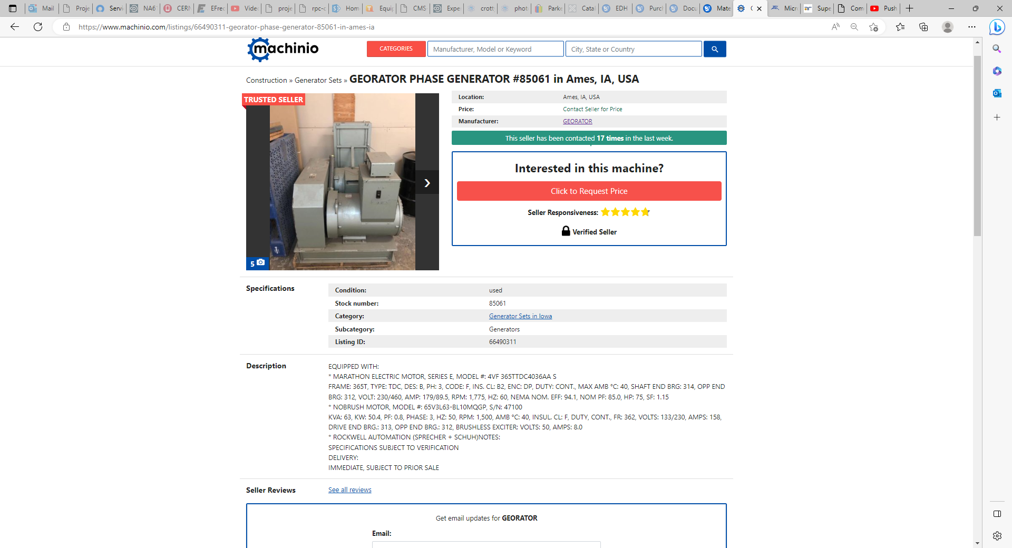
https://www.machinio.com/listings/66490311-georator-phase-generator-85061-in-ames-ia

Slide 18
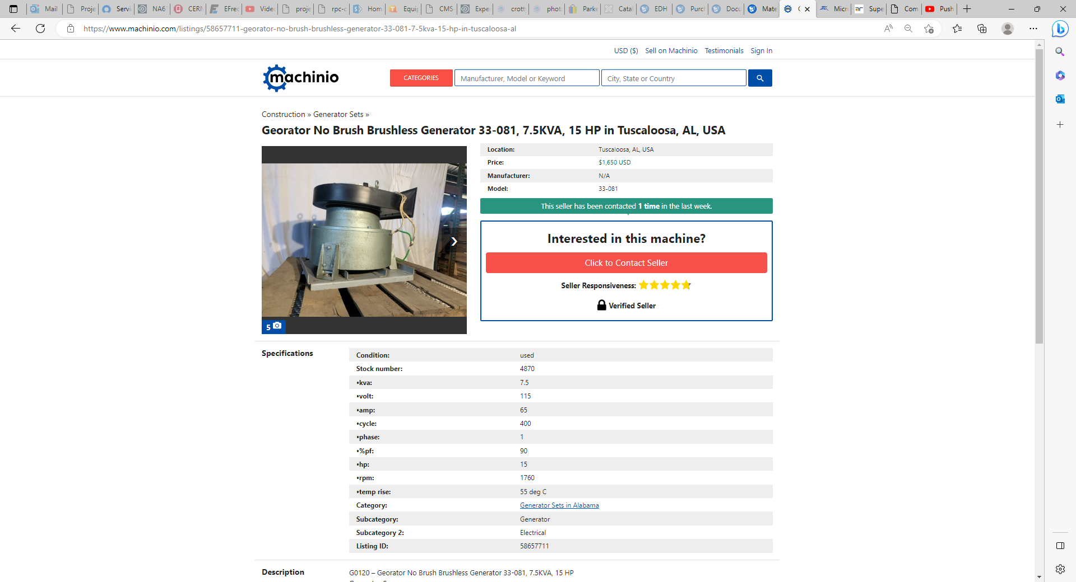
https://www.machinio.com/listings/58657711-georator-no-brush-brushless-generator-33-081-7-5kva-15-hp-in-tuscaloosa-al
Price:
$1,650 USD

Slide 19
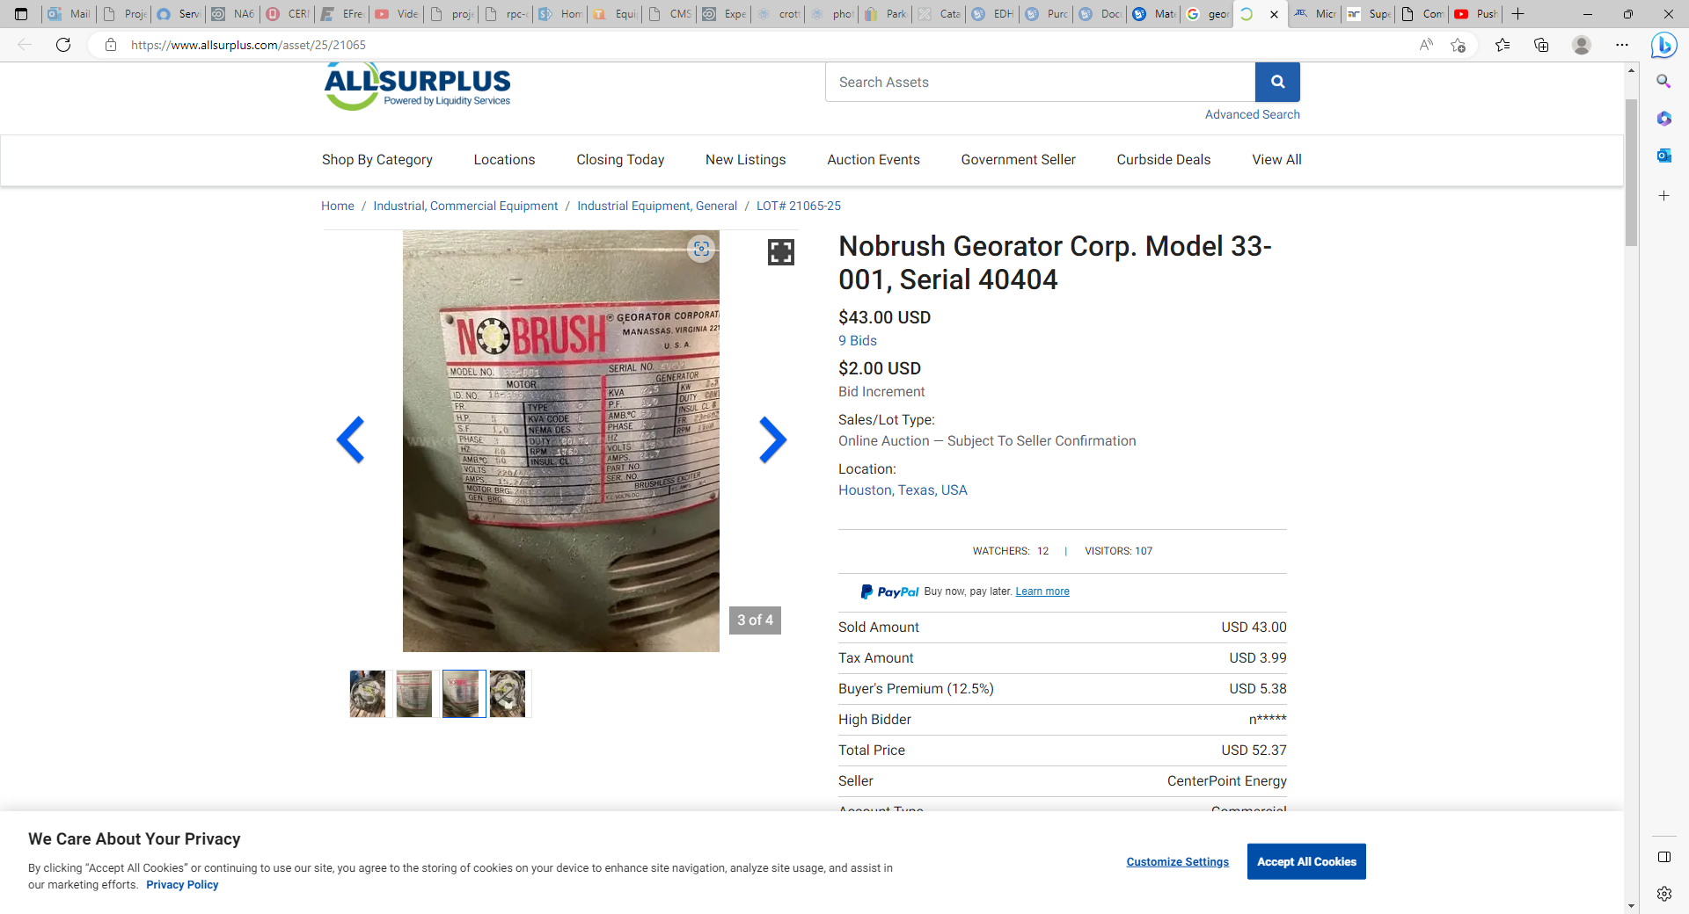
https://www.allsurplus.com/asset/25/21065

Slide 20
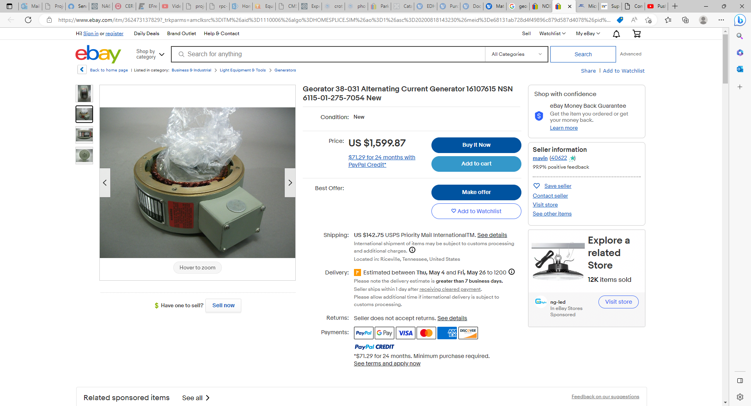
Georator 38-031 Alternating Current Generator 16107615 NSN 6115-01-275-7054 New | eBay

Slide 21
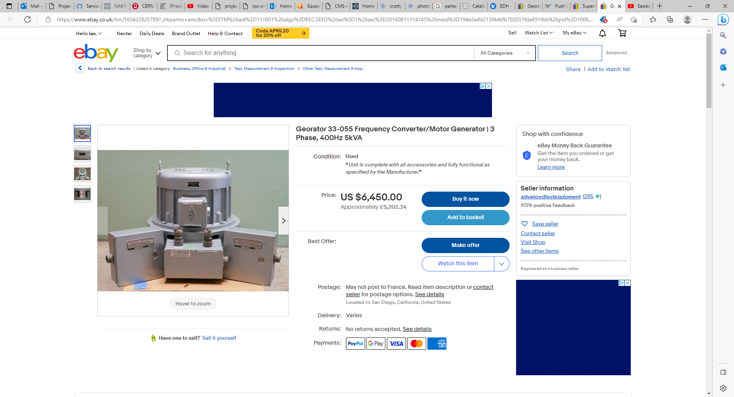
Georator 33-055 Frequency Converter/Motor Generator | 3 Phase, 400Hz 5kVA | eBay

