Slide 1
CoCreate Creo Elements, DirectModelling
Ian
24 oct 2022
With help from Ivan

Slide 2
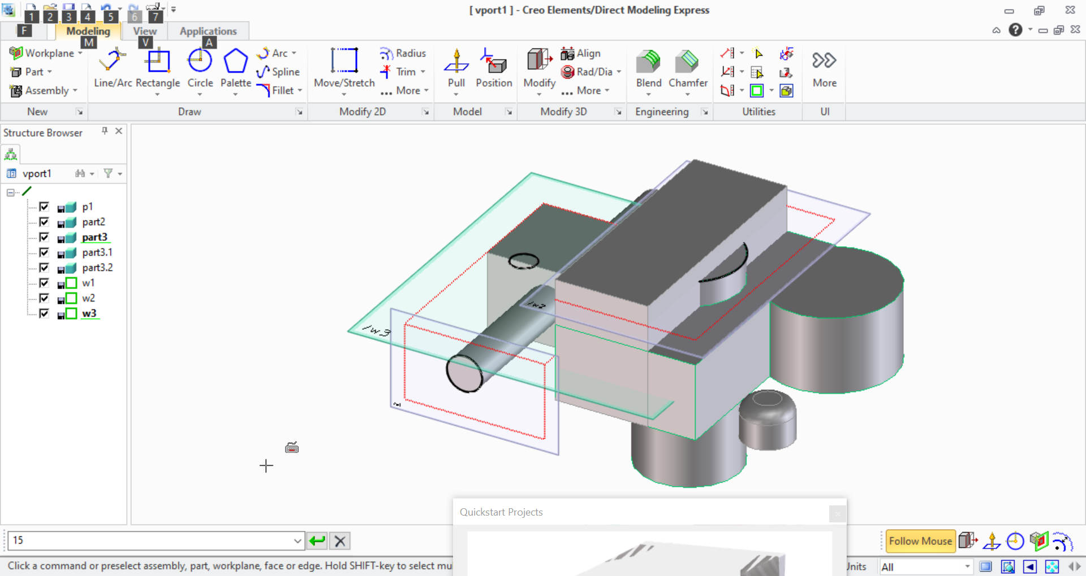

Slide 3
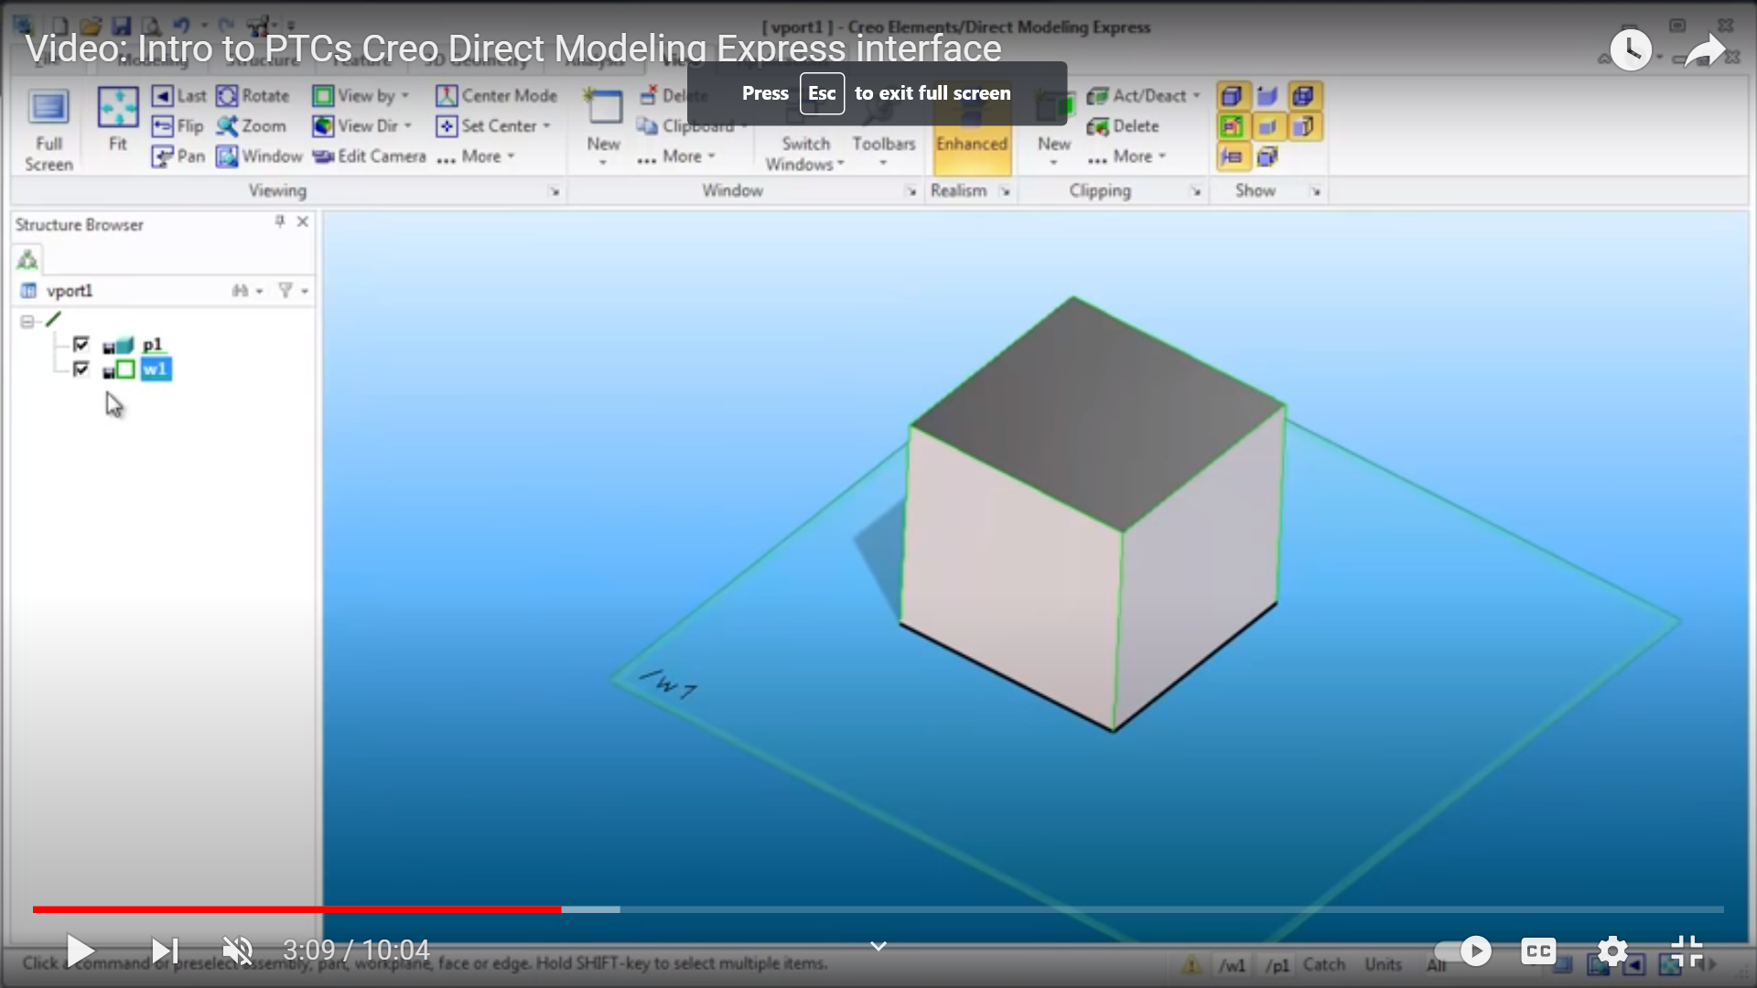
https://www.youtube.com/watch?v=hCPPFtoq2tU
UsingCreo

