Slide 1
Services and installation plan for RE3&4 Upgrade
Ian Crotty
(on behalf of RPC Collaboration and Anna)
Muon TIG meeting, 2 June 2016

Slide 2
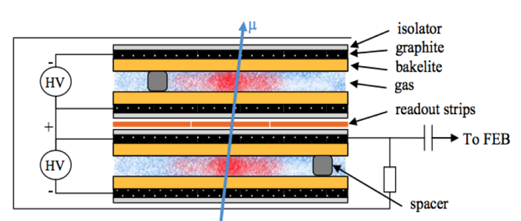
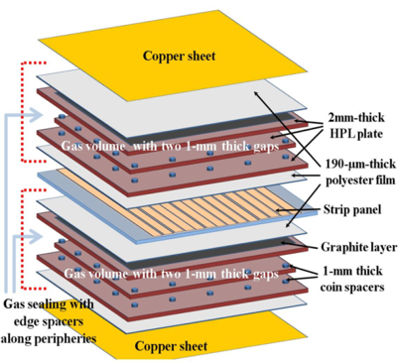
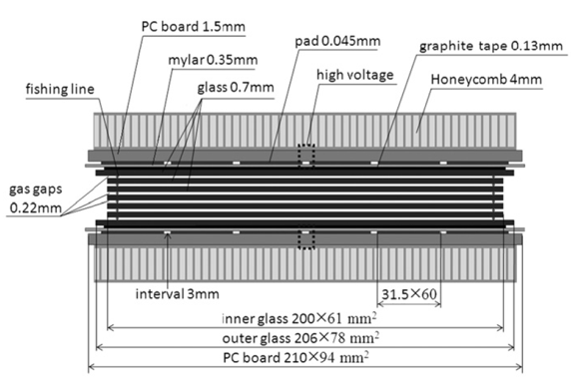
Improved RPC for RE3/1 and RE4/1
Standard double-gap RPC
Most of the services are not depending by the technology choice.

Slide 3
Topics addressed
Gas system
HV power system
LV power system
Signal system
Power dissipation
Service passages
Installation schedule

Slide 4
RPC Upgrade RE(3,4)/1 gas system
The gas supply from surface to USC gas room will be covered by the existing gas lines.
Taking into account the volume of the chambers and refresh rate of HL-LHC (1 volume change/hour, ~9l/h), 6 gas channels per disk are needed.
From USC gas room to the chambers: it can be used the present gas racks in UXC. No new gas racks are needed.
From gas racks to chambers: gas pipe needed.
  IN case of alternative gas mixture for the upgrade: to be installed a new mixer in SGX and new gas distributor in the USC gas room and new closed loop, new pipes from USC to the gas racks. The gas racks (racks 85, 67) have to be extracted and modified. This solution is not considered for the moment.

Slide 5
HV Power System for RE3/1 & RE4/1 (I)
Assume 20° chambers
  18 chambers per Endcap disk or 36 per station
  RE3/1 – 36 chambers
  RE4/1 – 36 chambers
Unique powering independent on detector technology
1 HV channel per chamber = 72 HV channels & 72 HV cables
  18 HV cables per disk, 36 HV cables per end
  18 HV cables in mCC per side & end
  RE3/1 & RE4/1 slots already available on X1 RE HV PP
  72 HV channels in 4 crates ➔ 18 channels (3 HV boards) per crate
  Upgrade present HV system from 4 to 6 crates in EASY chain
  More service power will be required (A3485S)
  This powering schema is valid for Double and Multigap design.
  Double gap design:
  1 HV connection, top and bottom layer powered separately.

Slide 6
HV needs
Umbilical cables USC > UXC
PP on YE1
Rack space in USC

Slide 7
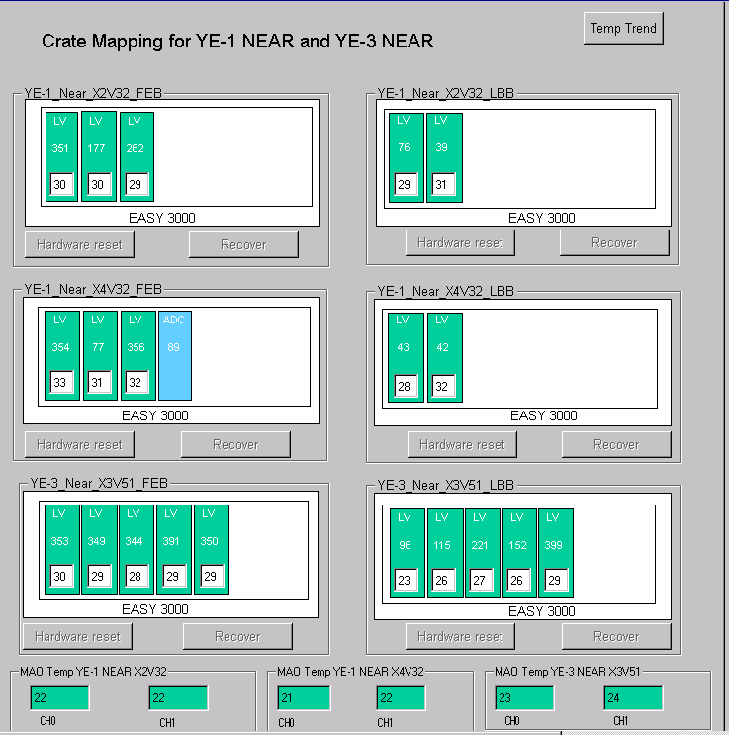
LV Power System Optimisation for RE3/1 & RE4/1
For each end && side we would need 2 A3016 LV boards to power the RE3/1 and RE4/1 chambers.
If we redesign the entire RPC LV system such that:
  We redistribute the LV power cables of 2 A3009
  boards into neighbouring 3 A3009 boards
then
  We will free slots for 2 A3016 boards for powering RE3/1 and RE4/1
Need 6U Rack space in each tower of YE3
OR
Re-mapping of LV cabling to give Crate space must be tested first
At present 1 LV A3009 channel powers 6 FEBs
which is ~30% of max channel power.
Assuming we double them after the power
redistribution, it will still continue to work in
optimal power regime ~60% of max power.
The real question is how to group the chambers into
LV board channels to keep some logical and physical
power distribution in phi… to be thought
In this scenario – no additional crates, branches and
rack space is required!

Slide 8
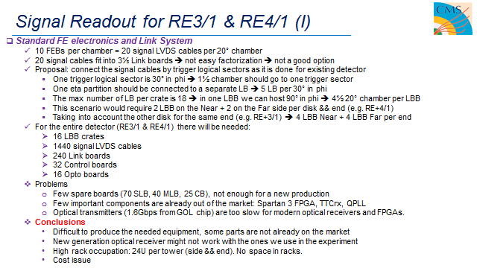
Significant cable section, cost and Rack space (24U)with original FEB/LBB system

Slide 9
Signal Readout for RE3/1 & RE4/1 (II)
New/Developing RPC FE electronics
  1 GBT optical link per chamber to transmit data to one data concentrator card per station ~1 W
  Data Concentrator Card: One card, common for one disk of 18 chambers, includes 18 + 2 spares = 20 GBT links
  and 1 FPGA to be located on the detector periphery.
  DCC in UXC or USC?
    UXC: shorter paths from detector to DCC
    USC: from DCC to USC would go 2 fibers instead of 18, but is length long for optical power losses?
  DCC output: 2 optical fibers: 1 trigger and 1 data link per disk.
  Rack space: No much space in racks is needed. The “Link system” is presented only by 2 DCC per end.
DCC, low power 40W/station
New FE is being investigated with greatly reduced space requirements in the crates and service section on yoke is clearly better with 72 FO instead of 1440 dia10mm signal cables.
Optical link goes to towers OR all the way to USC. Under study

Slide 10
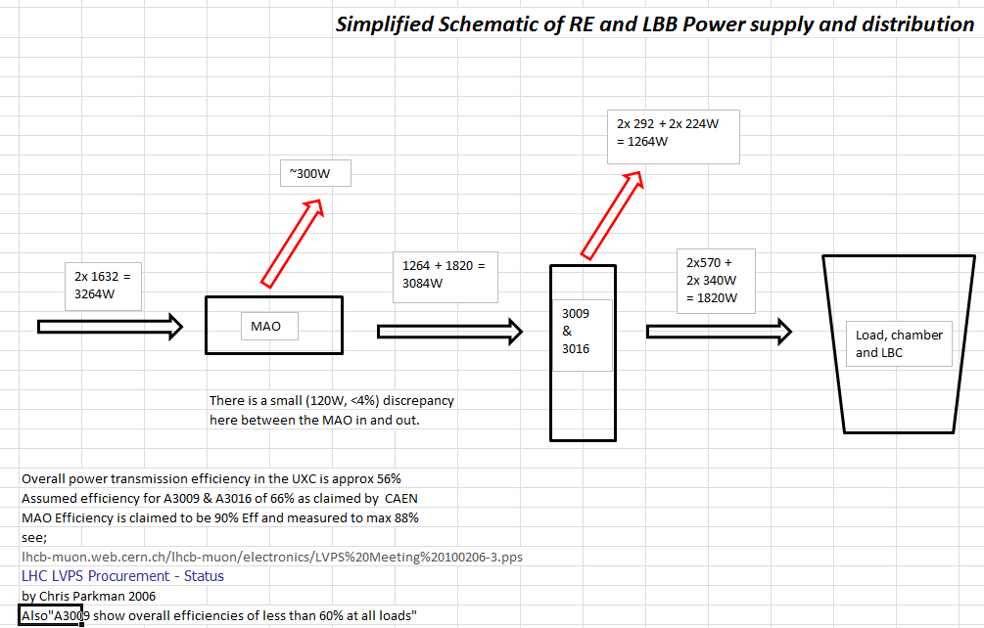
RE Electrical Power loads on one YE3 and dissipation.
Present Configuration
Cabling losses have not been included

Slide 11
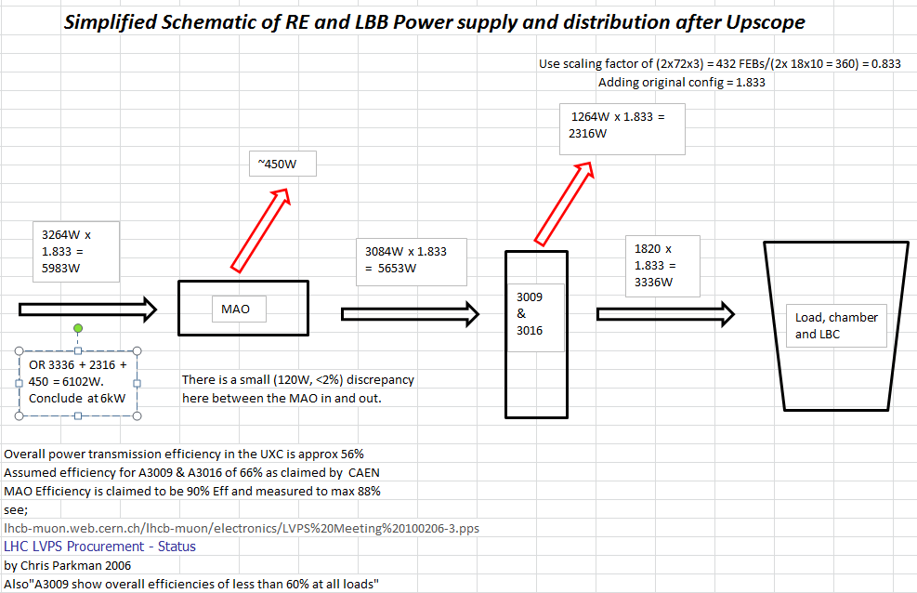
RE Electrical Power loads on one YE3 and dissipation.
Upgrade
Configuration
Cabling losses have not been included

Slide 12
Upgrade Power
Provisional values (1 YE)
Present configuration 3.3 kW
Upgrade configuration
Standard FEB 6kW
PETIROC (embed) 5.1kW
PETIROC (FPGA) 8.3kW
Values given include an estimate of the rack component loads and losses.

Slide 13
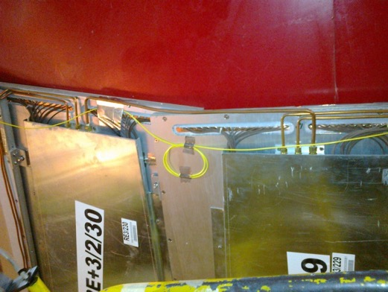
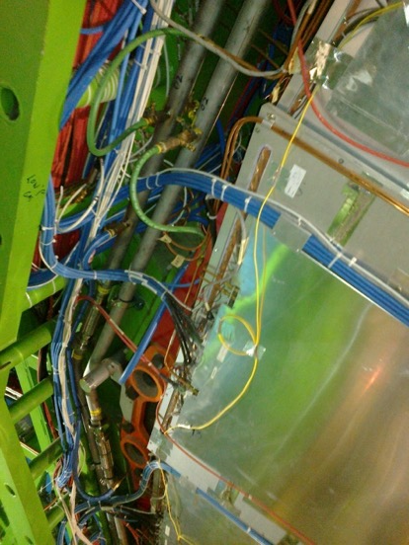
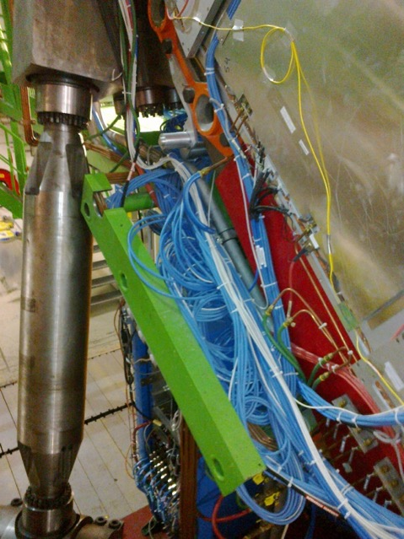
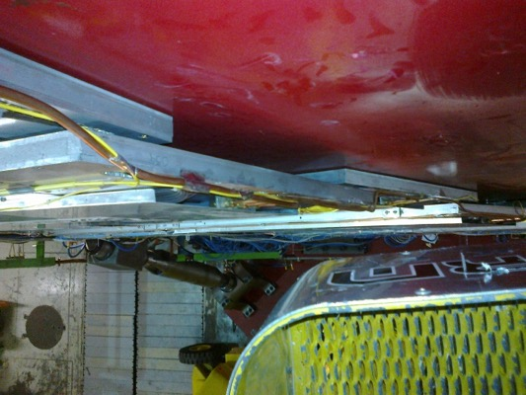
RE3/1 service passages
Space on the periphery is very limited
Service passage to the periphery is under the RE3/2 & RE3/3.

Slide 14
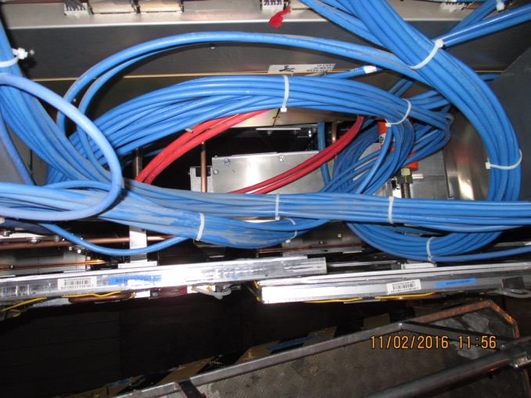
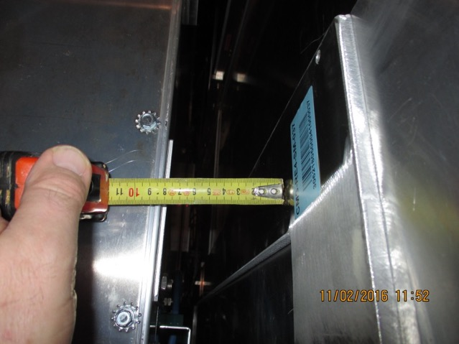
RE4/1 Service Passages
There are large passages under the CSCs that may or may not be useful. If not then services must transit over the RE4 SMs. This is not a good solution either as they are very flexible.
We will have to discuss with our CSC colleagues.

Slide 15
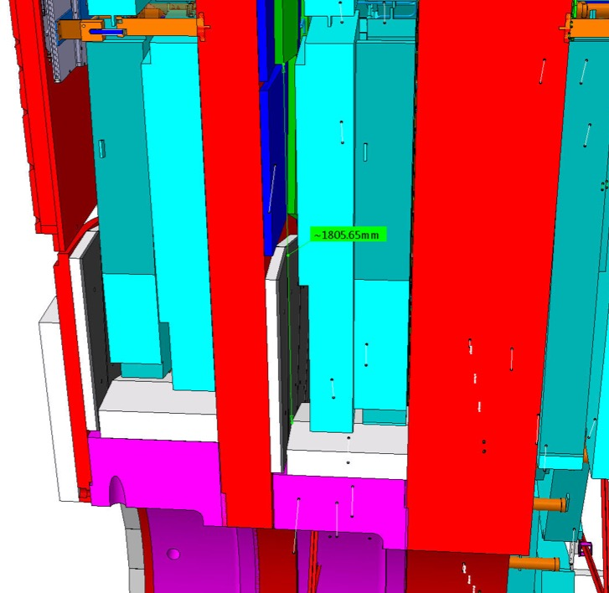
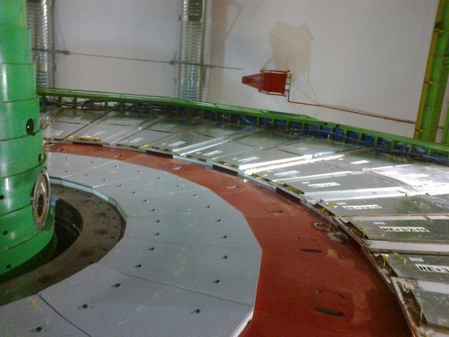
Envelope of RE3/1
Basic parameters
R Outer = 3302
R Inner = 1526
Delta = 1776
This area has to be studied and an envelope produced and agreed with Integration
Integration by Boki from IO

Slide 16
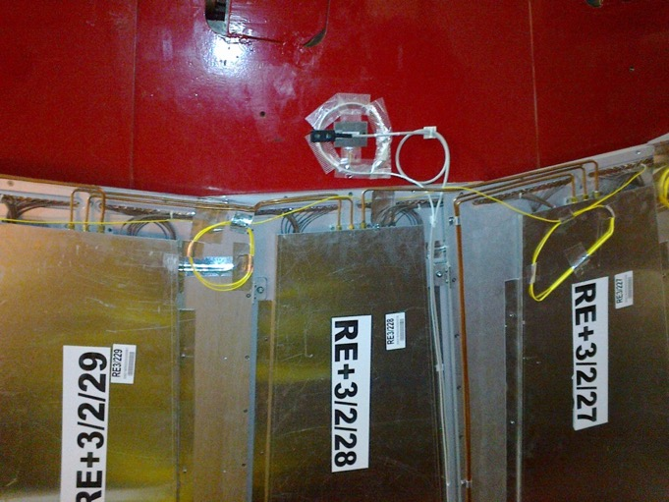
RE3/1 as designed, “short version” was mounted flush with the Yoke. Shielding takes up significant space in “Z”. Z space over shielding to be studied.
Services to extend to RE3/1 ? Gas and cooling.
Space to cover

Slide 17
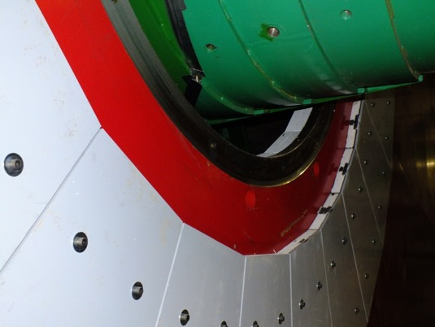
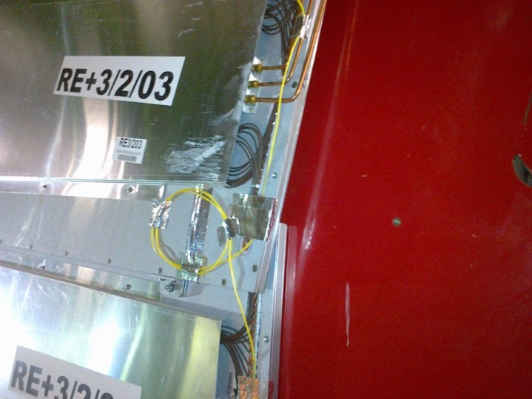
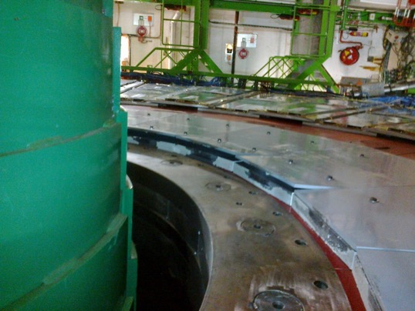
RE3/1 Mounting
Bolt heads (and washers ?) to be made flush with shield (Pb) to gain >10mm
Chambers will be exposed to this type of error !
M12 Mounting holes drilled for “short” RE3/1

Slide 18
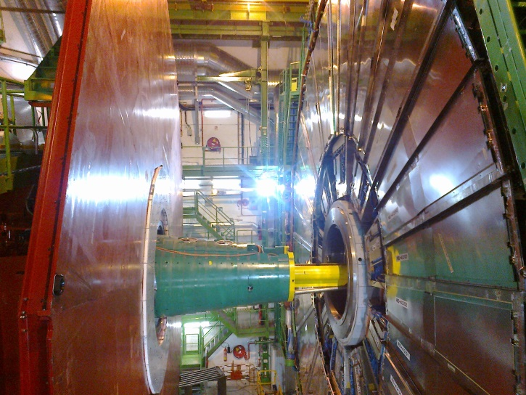
RE4/1 Mounting
Chambers to be mounted between the shielding, CSCs and RE4 SMs

Slide 19
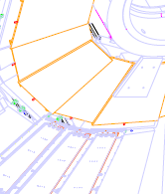
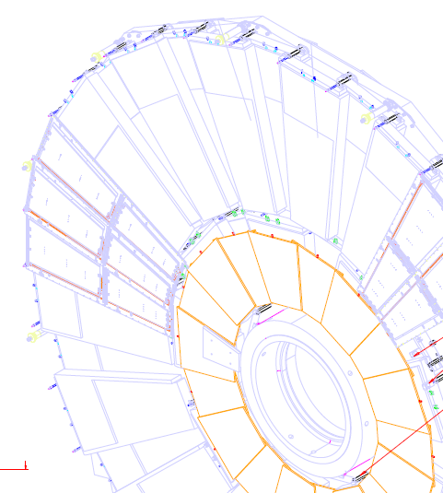
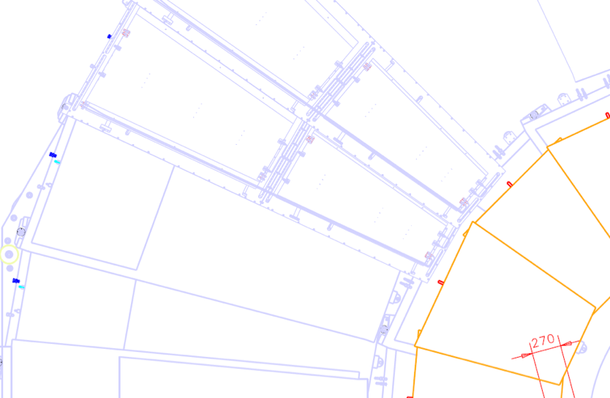
Envelope of RE4/1
RE4/1 extended
RE4 SM

Slide 20
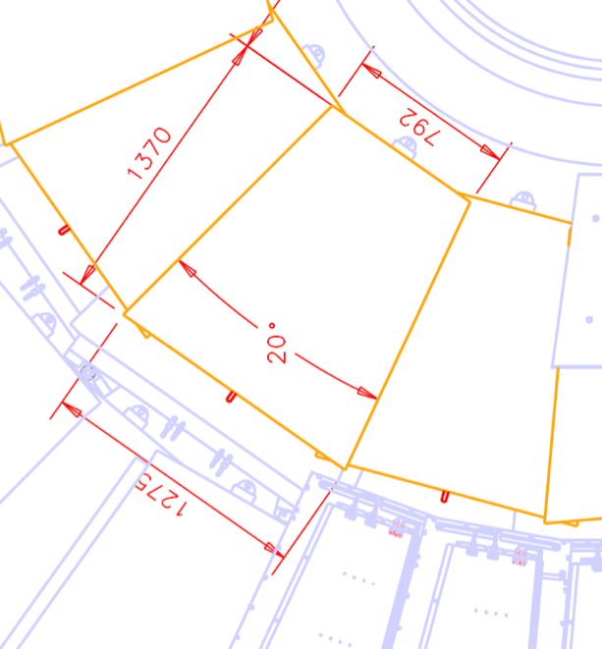
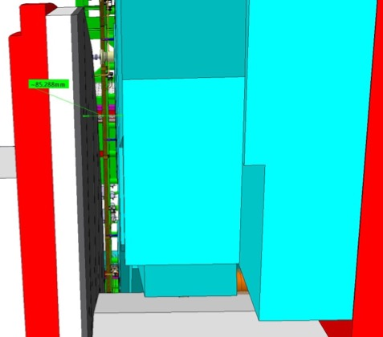
Envelope of RE4/1
These dimensions will be verified with Integration office .
Resultant RE4/1 envelope
85mm Gap.
A model should be made and tested in situ.

Slide 21
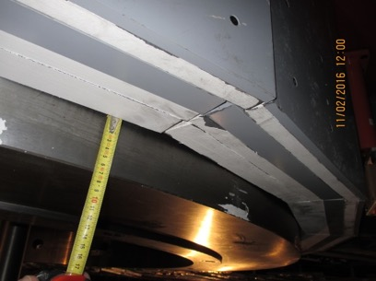
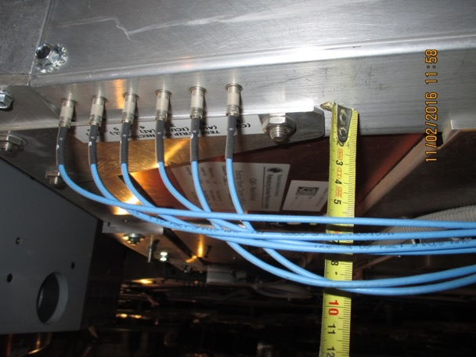
RE4/1 Mounting
Services on top of CSCs to be understood wrt the envelope that Integration office have
Details of as built to be understood.

Slide 22
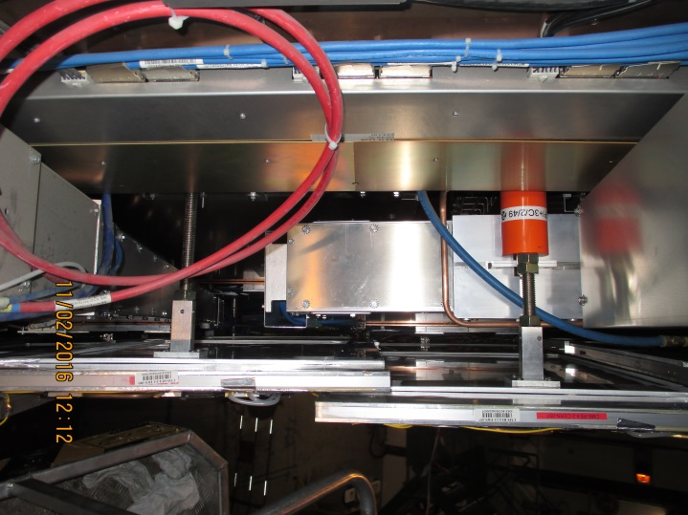
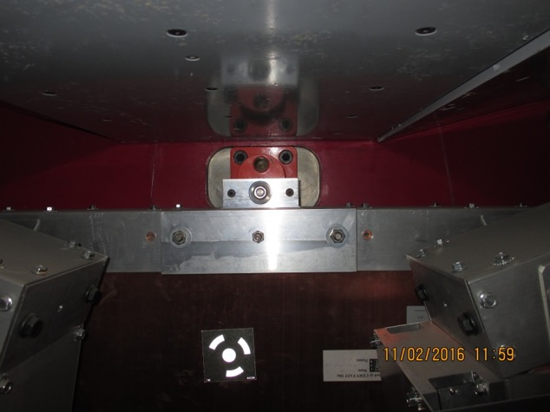
RE4/1 mounting
Inner radius CSC mounting with Spare M24
Outer radius Mounting (M24) supporting the RE4 SMs. An astute solution is required here.

Slide 23
Very preliminary installation schedule
For each disk of RE3/1 or RE4/1
18 chambers installed in 3 days. Crane needed full time.
Cable (HV/LV,Signal) : 3 days
Cooling (including commissioning at 18 bar with gas): 4 days
Gas : 3 days
Final chamber commissioning: 1 week
Total installation/commissioning time ~ 3 weeks (including w.e.)
Services have to be installed in advance during previous LS or YETS
Job on different disks can be parallelised if manpower available.
Services can be installed during LS2
Chambers can be installed 1-2 disks / YETS before LS3

Slide 24
Conclusion
First view of service needed for the RE3/1 and RE4/1 Upgrade
Much work on all fronts to be completed in a short time.
Services can be installed during LS2 and Chambers during YETS before LS3.

Slide 25
Additional Slides

Slide 26
LV Power System Requirements: Summary

Slide 27
backup

Slide 28
Gas System modification
  Use the same gas mixture: Requires minimal efforts from gas group and ZEC team. The spare 12 gas channels of rack 85 (RE+3/Top) and of rack 67 (RE-3/Top) can be used to supply RE(3,4)/1. Also this possibility is implemented in the GCS software.
  Use the same but not humidified (dry) gas mixture: Requires medium efforts from the gas group and ZEC team. Modifications of the existing gas system are needed in SGX and USC gas room. The supply to the new chambers can be included in the close loop of the existing system. The manifolds (rack 81, RE+3/Bot and rack 63, RE-3/Bot) can be used to supply the dry gas to the chambers while the chambers from RE±3 will be connected to the free manifold of rack 85 and rack 67. Again no change in the GCS software.
  Use different gas mixture: Requires an enormous amount of efforts from gas group and ZEC team. Installation of new mixer in SGX and new gas distributor in the USC gas room. Installation of new pipes from USC to the gas racks are needed. The gas racks (racks 85, 67) have to be extracted and modified. There is no possibility for close loop unless a new gas system is build. Also there should be performed some changes to the GCS software.

Slide 29
RPC Upgrade RE(3,4)/1 gas system
The gas supply from SGX to USC gas room is covered by the existing spare gas lines even if different gas mixture is used.
The free manifold (12 gas channels) of the gas racks X2(A,S)51 (racks 85 and 67 from GCS) can provide the gas supply for RE±(3,4)/1 → installation of new gas racks in UXC is not required.
The flow cells of the free manifolds and their readout are already implemented in the GCS software.
In case a different gas mixture have to be used the two manifolds of racks 85 and 67 sharing a common gas line have to be separated → requires installation of new gas pipes from UXC to the gas racks, modifications of the racks and a new mixer in SGX.
Taking into account the volume of the chambers, the refresh rate for HL-LHC (1 volume change/hour) and using 6 gas channels per RE±(3,4)/1) fixes the upper limit for the flow of a single gas channel to ~9 l/h.
The gas distribution from the gas racks to RE±(3,4)/1 chamber patch panel requires installation of copper pipes ((1 return + 1 supply)/gas channel), patch panels and flow reducers.

