Slide 1
RPC Power System Review
Anton Dimitrov
30.Nov.2018, CERN

Slide 2
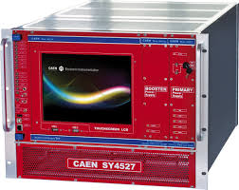
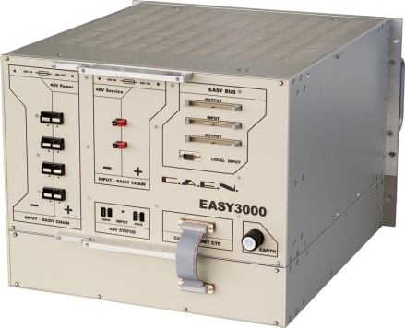
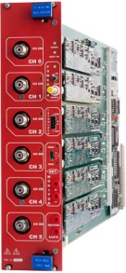
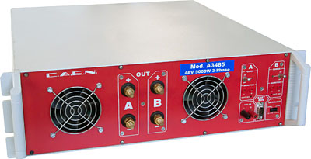
HV Power System Upgrade for RE3/1 & RE4/1 (I)
USC
UXC
SY4527
The HV power system will be based on CAEN EASY system
(practically, extension of the existing HV system):
SY4527 – 1 (existing)
A3485S - 2 modules (existing)
4 EASY3000 crates
A3512N – 12 HV Boards
TDR Baseline: Variant I
EASY3000
4 HV multiconductor cables per endcap. Each with 20 HV channels
All must go via the YE1’s main cable chains (MCC)
A3485S
A3512N
Long term maintenance will be secured by CERN-CAEN contract.
To be integrated in the RPC DCS.
1

Slide 3
S1H12
S1H07
HEX
HEX
HV Distribution Box
ENDCAP RACKS
S1H11 – S1H08
HV Distribution Box
HV Distribution Box
SY4527
HV Distribution Box
HV Distribution Box
HV Distribution Box
HEX
SY4527
HV Distribution Box
HV Distribution Box
48V DC cable connected after Crate3 in rack S1H09
Crate4
RE+3/1
RE+4/1
1 new rack (already defined S1H12, to be equipped)
2 EASY crates
8 umbilical cables all arriving to one rack
6 A3512N HV boards in each Crate (12 boards in total)
8 HV Distributor Boxes in total (all in one rack)
HEX
A3485S
Crate4
RE-3/1
RE-4/1
A3485S
48V DC cable connected after Crate3 in rack S1H11
A3485S
A3485S
2

Slide 4
HV Power System Upgrade for RE3/1 & RE4/1 (II)
USC
UXC
SY4527
The HV power system will be based on CAEN NON-EASY system:
SY4527 – 2 (new)
New HV boards – prototype ready in 2019
Preferred Variant: Variant II
4 HV multiconductor cables per endcap. Each with 20 HV channels
All must go via the YE1’s main cable chains (MCC)
New boards
Long term maintenance will be secured by CERN-CAEN contract.
To be integrated in the RPC DCS.
3

Slide 5
S1H12
S1H07
HEX
HEX
HV Distribution Box
ENDCAP RACKS
S1H11 – S1H08
HV Distribution Box
SY4527
SY4527
HV Distribution Box
SY4527
HV Distribution Box
- No EASY system ➔ no EASY crates
- 2 SY4527 mainframes more
- 8 umbilical cables all arriving to one rack
- New type of HV boards!
- 8 HV Distributor Boxes in total (all in one rack), but bigger in size
since all inputs and outputs should be at the back side of the rack
- No rack cross reference in DSS Action Matrix
HEX
HV Distribution Box
HEX
HV Distribution Box
A3485S
SY4527
A3485S
A3485S
HV Distribution Box
A3485S
HV Distribution Box
4

Slide 6
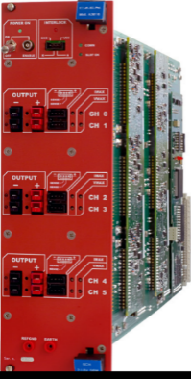
RPC LV Power System for RE3/1 & RE4/1
USC
UXC
YE+3: X2J52, X3J51, X3A51, X4A51
YE-3: X2V52, X3V51,X3S51, X4S51
CAEN EASY3000S
with CAEN A3016
in X2Near && X4Far racks
Existing RE3&RE4 detector
SY4527 with A1676A
24 A3016 LV boards in total to power the FE of all RE3/1 and RE4/1 chambers.
9U in each YE3 X4Far tower rack for
  1 CAEN EASY3000S crate
  1 CAEN A3486S MAO- AC/DC 48V PS
15U in each X2Near YE3 tower rack for
  2 CAEN EASY3000S crates
  1 CAEN A3486S MAO- AC/DC 48V PS
A3486S
Relay
YE1 LV PP
50p Communication bus
going directly to YE3
48V Service power
5

Slide 7
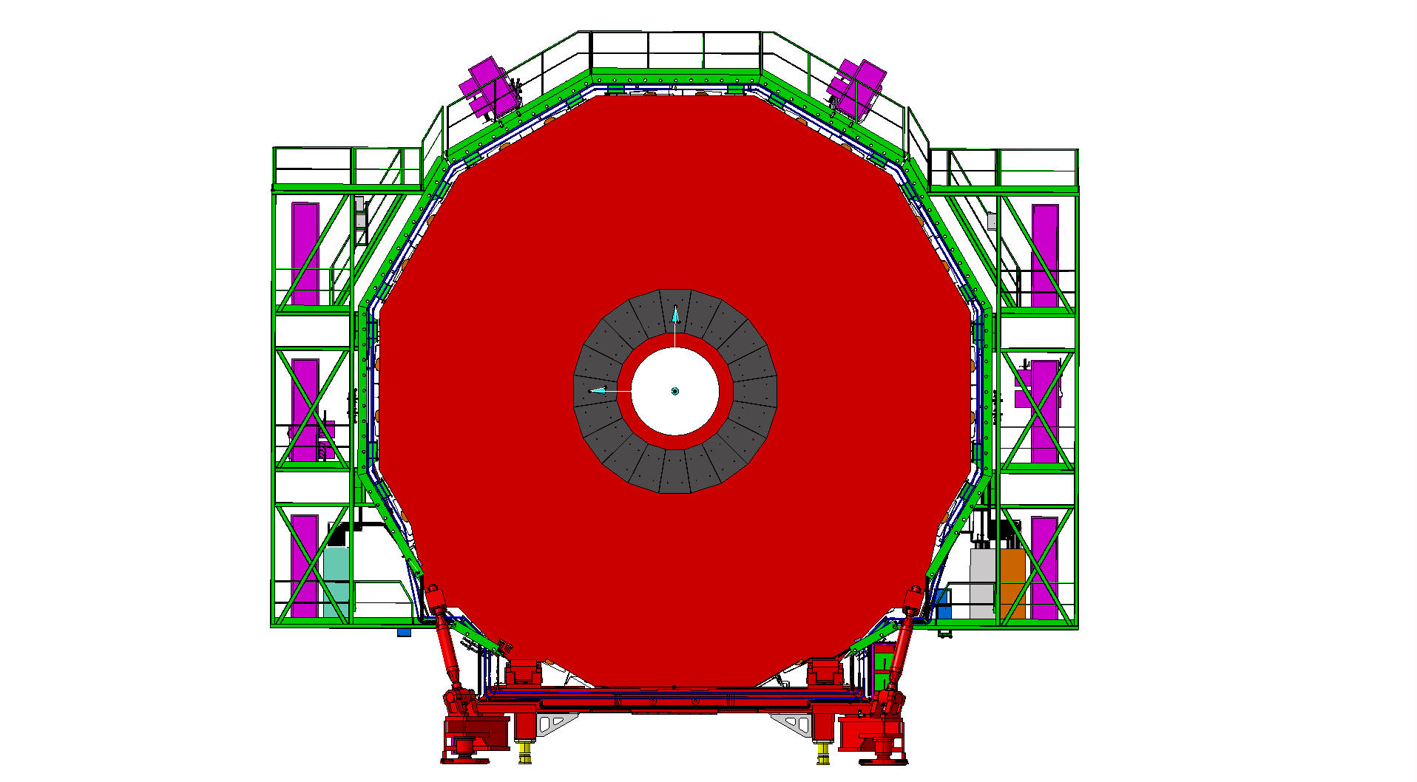
RPC LV Services
Far Side
Near Side
mini Cable Chains for OF
mini Cable Chains for OF
X4
LV Easy crates
LV Easy crates
X2
X2Near – X4Far
diagonal
6

Slide 8
Far Side
YE+3
Near Side
X3A51
X4A51
X3J51
X2J52
Power Distribution
Power Distribution
Power Distribution
Power Distribution
Turbine
Turbine
Turbine
Turbine
HEX
HEX
HEX
HEX
EMU VME
RE3 LBB
EMU VME
EMU Maraton
HEX
RE4 LBB
EMU Maraton
EMU
EMU
RE4 LBB
RE4 LBB
RE3-4/1 FE EASY3000S
Crate2
RE3-4 LBB EASY3000S
Crate1
RE3-4 LBB EASY3000S
Crate2
RE3-4/1 FE EASY3000S
Crate0
RE A3486S AC/DC-1
CH0 CH1
RE3-4 FEB EASY3000S
Crate0
Alignment DAQ
RE3-4 FEB EASY3000S
Crate1
RE A3486S AC/DC-0
CH0 CH1
RE4 LBB
RE A3486S AC/DC-0
CH0 CH1
RE A3486S AC/DC-1
CH0 CH1
Cable Distribution
EMU Maraton
RE4 LBB
Cable Distribution
RE3 LBB
HEX
RE3 LBB
EMU Maraton
HEX
HEX
Cable Distribution
HEX
HEX
Air Deflector
Air Deflector
Air Deflector
Air Deflector
Power Dist.
Power Dist.
Power Dist.
Power Dist.

