Slide 1
Service Installation
Ian
April 2018

Slide 2
It should include information on
- HV cables and routing from USC to chambers. Cables passages in main (MCC)
and mini cables chains (mCC).
- procedure of installation: from where to where (chamber end to periphery
and then to PP), behind ME4/2 or above ME4/2. If behind, how the
installation will be done. Misha and Armando were worried how the cables
will be terminated to avoid noise induction before they are connected to a
chamber. Since we are going to install RE4/1 cables before ME4/1
re-installation, Misha was worried that no cable ends should protrude in the
ME4/1 envelope and make the re-installation difficult.
- LV cables and routing from chambers to towers. I will have a talk before
where I will explain the 2 variants in tower ends (X3 OR (X2 AND X4)).
- optical fibres routing and installation
- any documentation from Integration Office will be an enormous advantage at
that time to show that there is progress on that. Please, ask Stephane for
at least one drawing and if possible a preliminary cable lengths.
- planning: I will provide you one file with the service installation to
show when they will happen in time.
In addition, Gabriella requested to have a talk about RE4 only. Not clear
yet who will present, but I would kindly ask you to prepare 2-3 slides for
that talk to explain what we can do with the RE4 cooling in LS2 assuming we
can open the chambers in the new surface building. Again our discussion last
Wednesday. Still I would like to consider the option of preproducing new
cooling frames and replace them in a fast way without too much bricolage.
Please, make a list of what is needed to reproduce the cooling frames again.

Slide 3
Routing and x-section
Specification of cables and connectors
Contents
Cables and Fibres
Cooling
Gas
The Integration office (IO) will study routing and lengths for these services. In additions all DB and consequent labels will be supplied by the IO.

Slide 4
Cables and pipes
HV cables
LV Cables
Fibre optics
Gas
Cooling

Slide 5
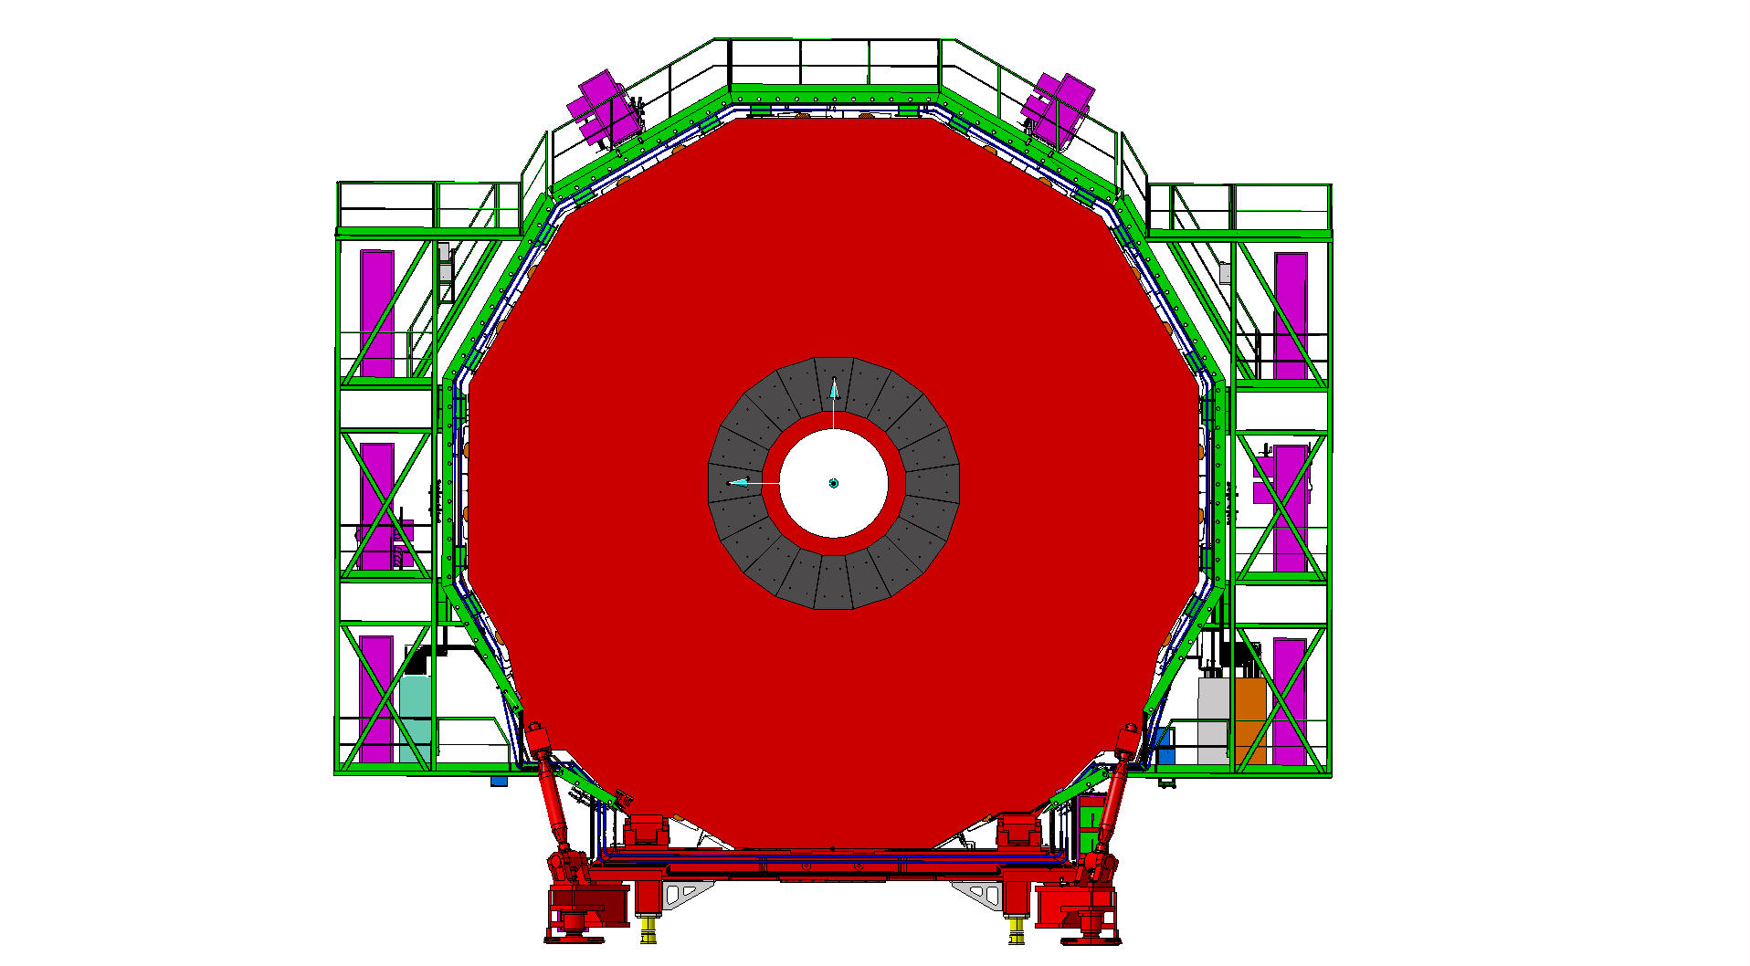
Services on YE3 serving RE3/1 and RE4/1
Mini Cable Chains for HV and OF, near side
Space for OF Patch panels
X3 LV racks
X3 LV racks
RPC Gas Rack with spare channels
Gas Impedances installed on the green peripheral structure

Slide 6
HV
Cables will link the USC supply system to the chambers in UXC
Large 40mm diameter cables will go from one of the racks, system dependant, in the USC thru’ the main-cable chains to the YE1 PP in the UXC.
Individual coaxial cables will go from the YE1 PP to the chambers thru’ the mini-cable chains.
The Main cable chains have been checked over by IO and myself. Access is not easy but will improve when the chains are stretched open and made accessible from the top. The two cables used by GEM will have to be re-installed.
The mini-cable chains have been studied and sections are being verified.
The coaxial cables can be prepared with both Jupiter connectors on, and tested, and then installed from the chamber end and if they can be fed through the Mini-cable chains and stored in front of the YE1 PP then there will be no need to remove the PP end connecters.
The HV dia 40mm cables will not be connecterised.
For reasons of safety the cables should all have termination if they have been tested.

Slide 7

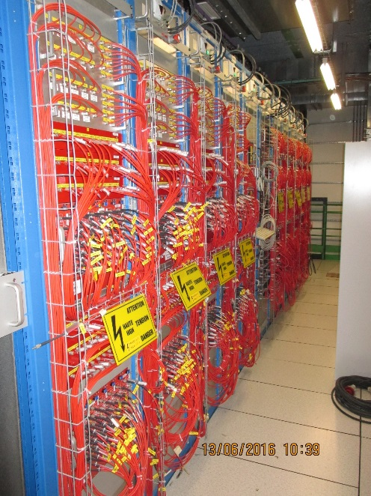
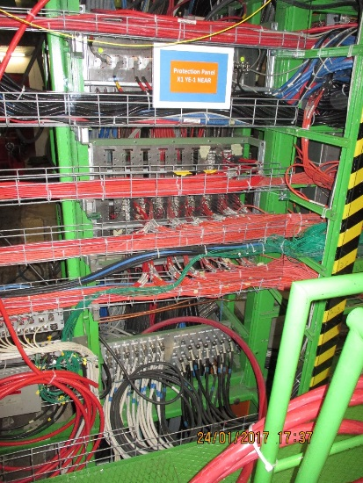


HV system RE3/1 & RE4/1
USC 55
UXC 55
Co-axial HV connectors throughout.
All equipment in the USC is to be installed, including the additional rack.
x4 Easy 3000 Crates
X8 Distribution boards
X72 Chambers
Modified PP for 72 Channels
x12 A3512N HV Boards
x8 HV Umbilical cables

Slide 8
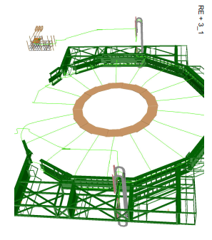
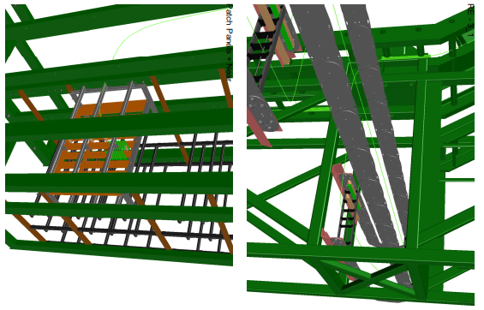
RE3/1 cable routing as defined in detail by the IO

Slide 9
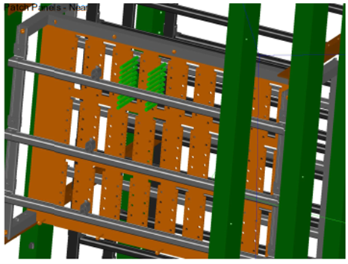
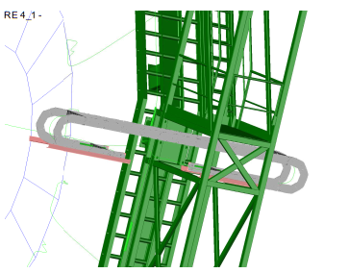
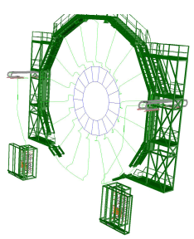
All Drawings by Theo Victor Lachavanne, supervised by S. Bally in the Integration office
Patch Panel modification for conversion from 3Pole to Coaxial Jupiter
RE4/1 cable routing as defined in detail by the IO

Slide 10
LV
From chamber to Racks . Both stations will go to the racks on the same yoke so the plan is simple.
RE3/1 will transit behind the RE3/1 & RE3/3 chambers
RE4/1 will transit behind the off yoke ME4/2 chambers
Routing and lengths will be established with the IO once the choice of system is made.

Slide 11
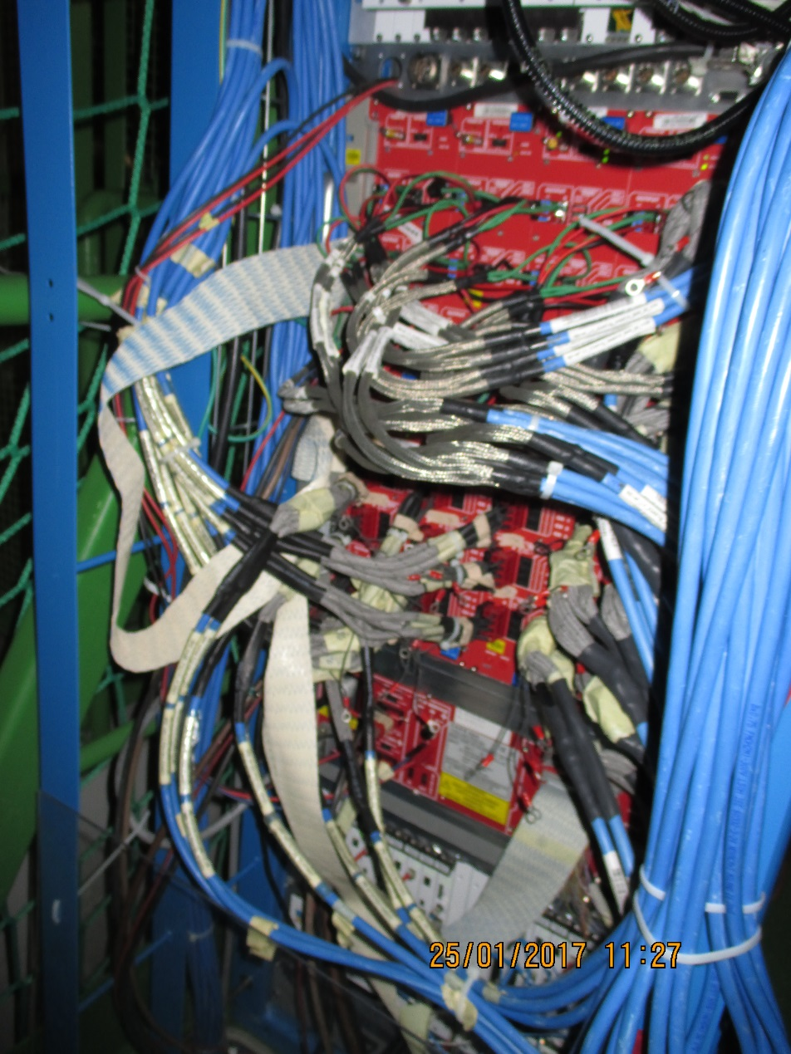
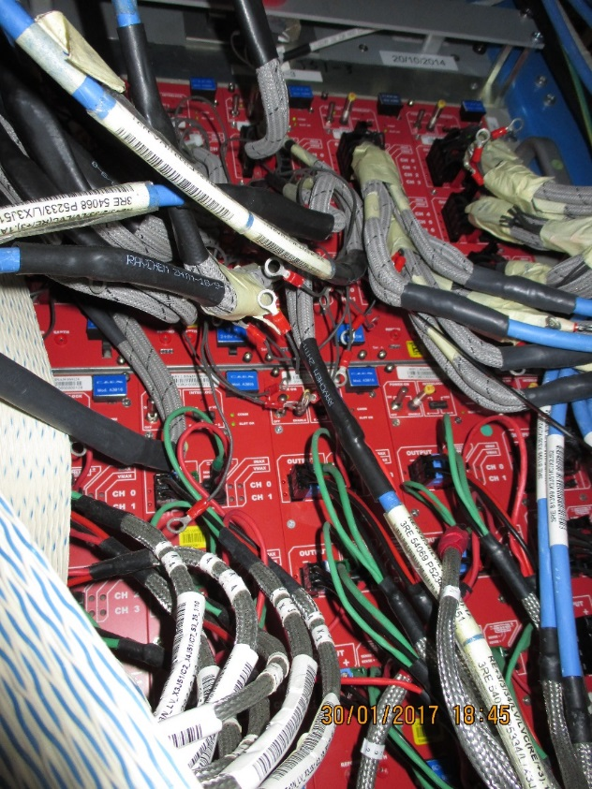
LV Power System
X3A51
LV Power for both RE4/1 and RE3/1 will be taken from the presently installed crates and modules. Re-cabling to liberate 2 modules (CAEN A3009 )will require PP/Fan-out space.

Slide 12
Fibre Optics
Fibres will leave the chambers and go through the mini-cable chains to the YE1 PP where boxes will act as PP for the fibre link to the USC through the Main cable chains and trigger tunnels.
This task will be studied by IO.
Today’s technology from a reputable supplier in the communications domain.

Slide 13
Schematic of UXC to USC Optical Fibre (OF) routing components
USC
YE3
YE1
UXC
USC Racks
Mini Cable Chains
LC OF conversion to dia3mm MPO, x3/station.
YE1 PP
MPO to MPO PP
RE4/1
RE3/1
2 SFP/chamber.
LC OF output
OF passages UXC-USC
All components are to be procured and installed
Main Cable Chains

Slide 14
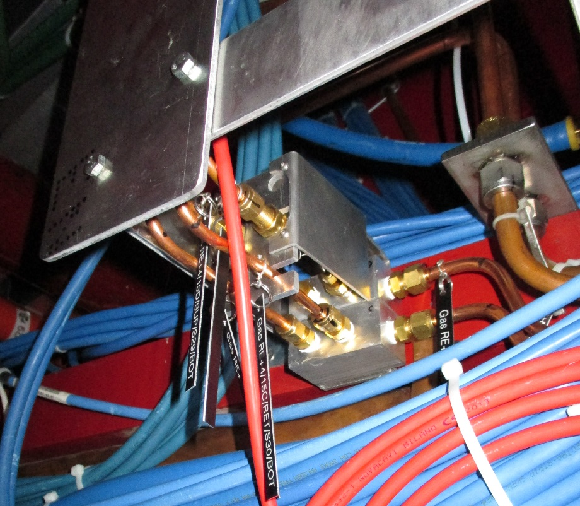
Gas
Additional gas pipes will be made from the USC gas room to the UXC gas racks on the X2 Far. The x-section in the Cable chains is being verified by IO.
It may be possible to recover the already installed piping , originally for RE3/1, to route to both RE3/1 and RE4/1. Additions and cutting may be better than attempting to remove all and start from new ?
Need schematic of design
Need detailed drawings of the peripheral installation
with bulkheads, impedances and piping from
chamber to X2 Rack.

Slide 15
Cooling RE3/1
Links to be made from the present RE3/2 to the new RE3/1 once the chambers have been installed.
These links can be done with copper pipe as installed for the present system or better would be flexible links to easy assembly and improve reliability.

Slide 16
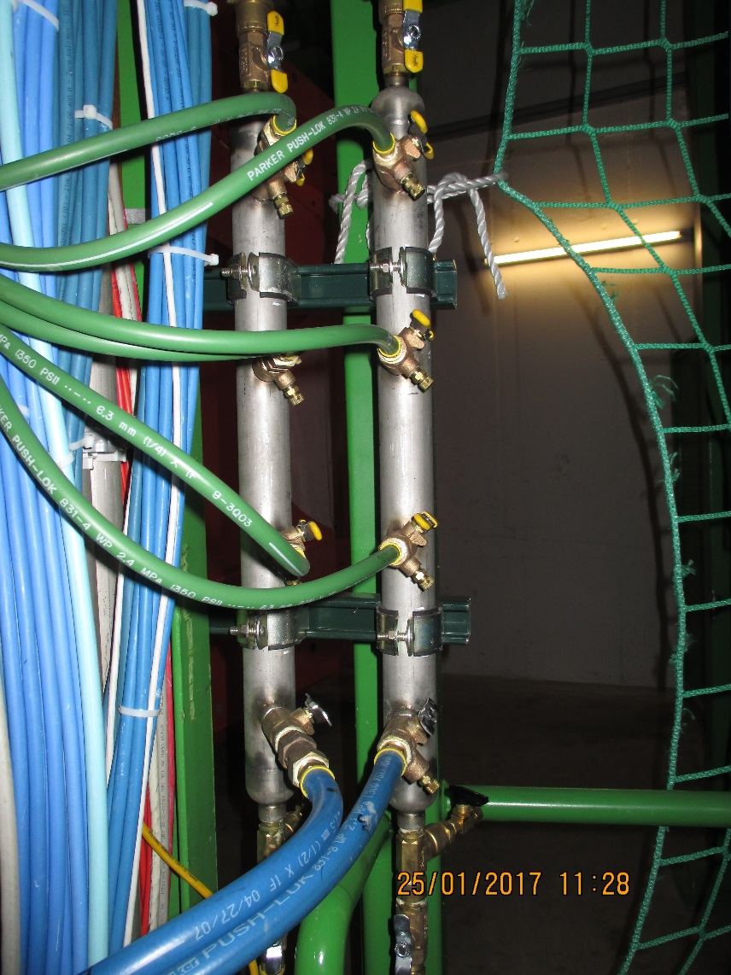
Cooling system
The power loads on the cooling system are not so large so extensions of the present system should give approx. 0.1deg C increase. These values have been communicated to TCO and CMS cooling group.
Cooling Mini Manifold for RE4/1 cooling to which “T”s and flow restrictors will be added to supply the 9 channels. Hosing from the mini manifolds directly all the way to the RE4/1 will simplify the installation.
The RE3/1 system will be a taken off from the RE3/2s, two RE3/2s for one RE3/1 using the flexible hoses.

Slide 17
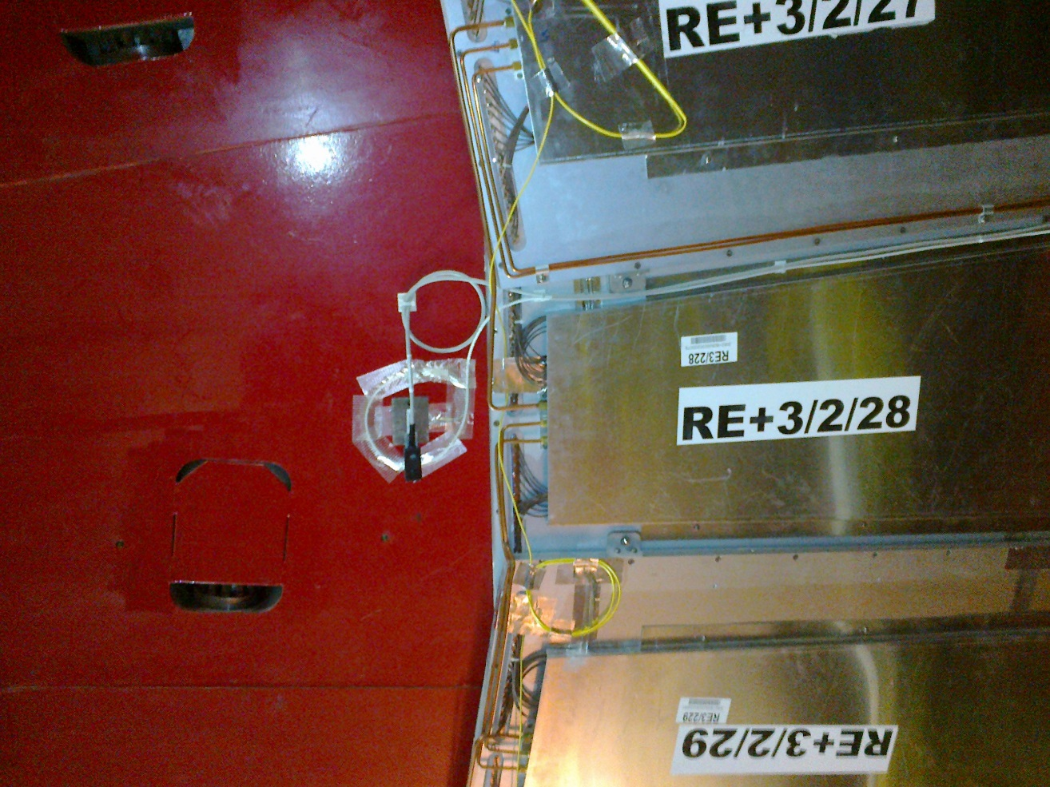
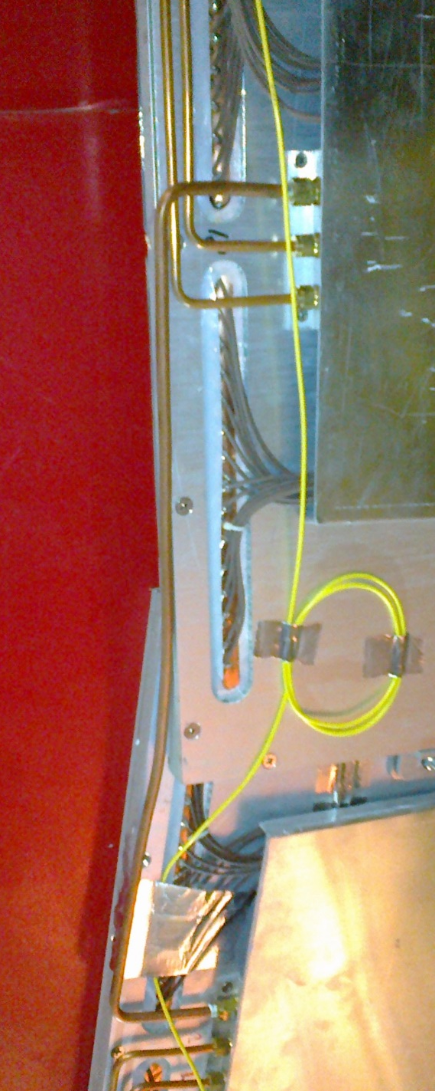
The presently installed link between two chambers.
Once the RE3/1 chambers are installed then these are removed and replaced with shorter pipes to the RE3/1.
This should be verified on a mock-up in 904
The field sensors will go behind the off yoke chambers

Slide 18
Service path on the RE3 station
Behind the off yoke RE3/2 and RE3/3 chambers.
Working from the inner radius pushing HV, LV, Gas and fibres through to the outer radius where they are recovered through the mass of pipes and cables already there.
Services should be attached at the two ends, low R & high R, of the passage behind the RE3s. Mock-up work.

Slide 19
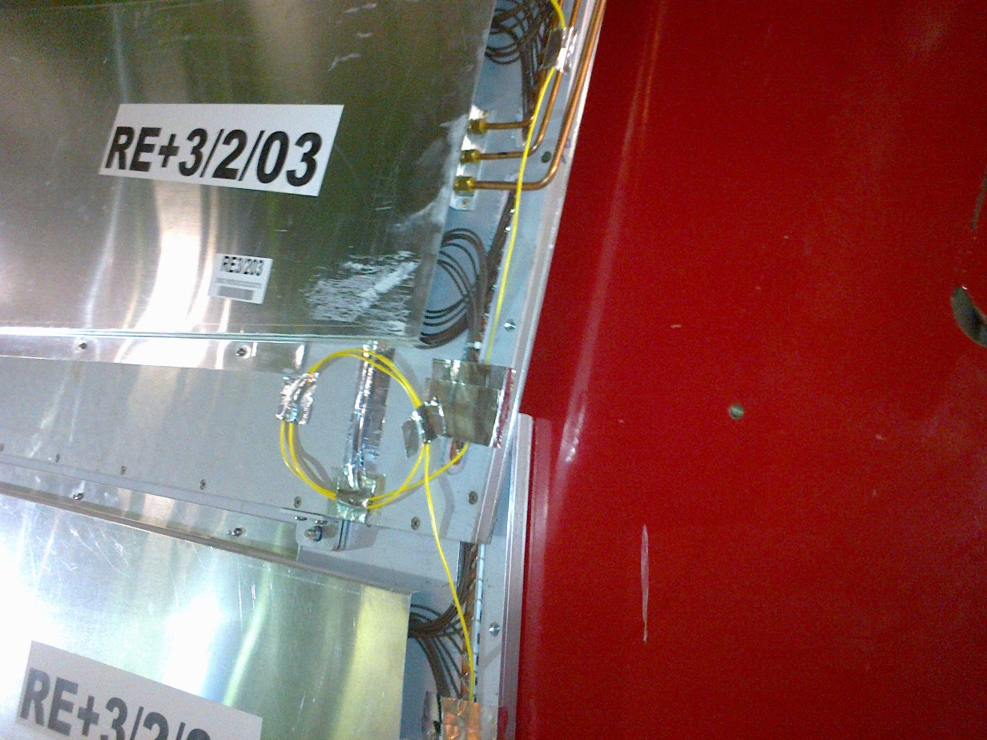
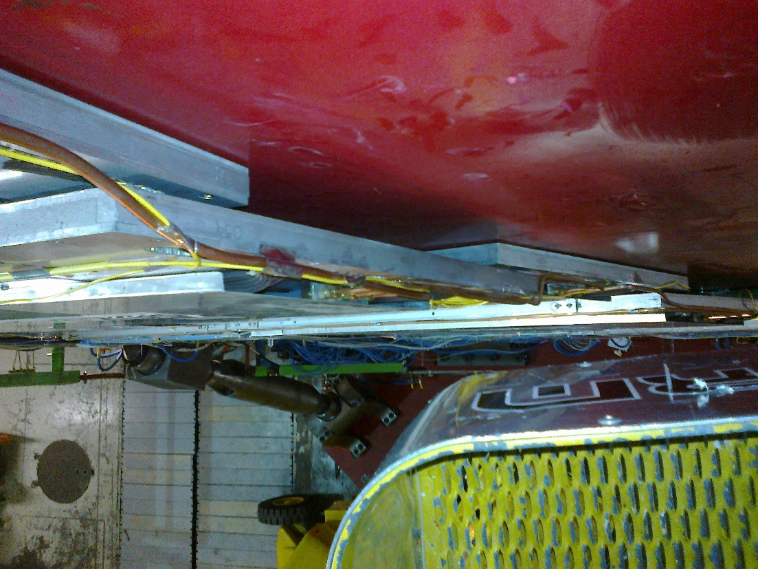
Service path behind the off yoke chambers
Service path.
Chamber mounts already present may well be used in the future installation

Slide 20
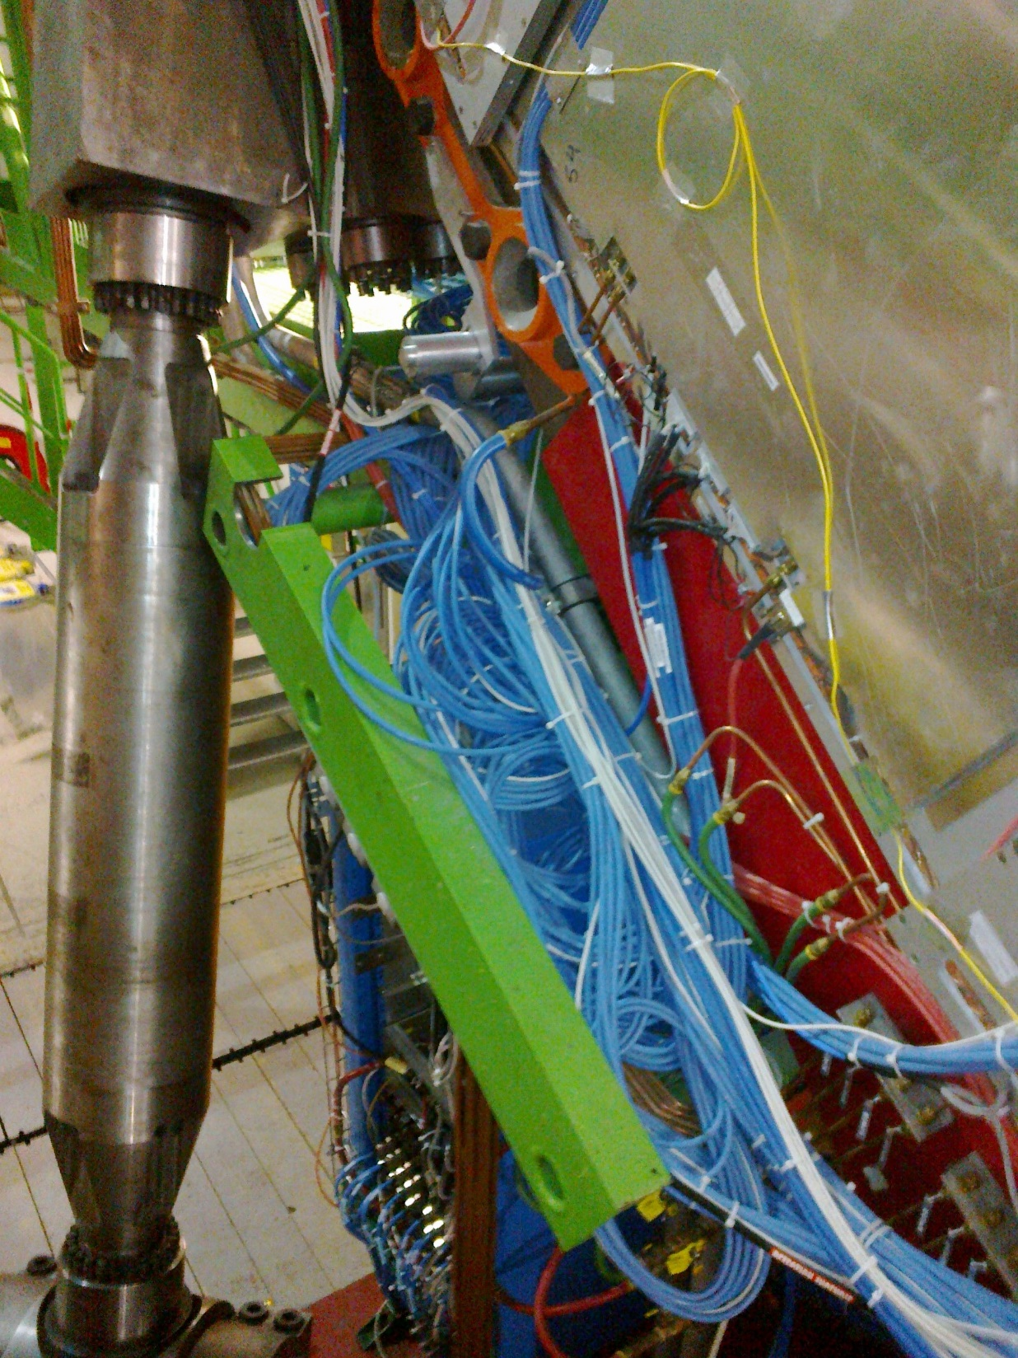
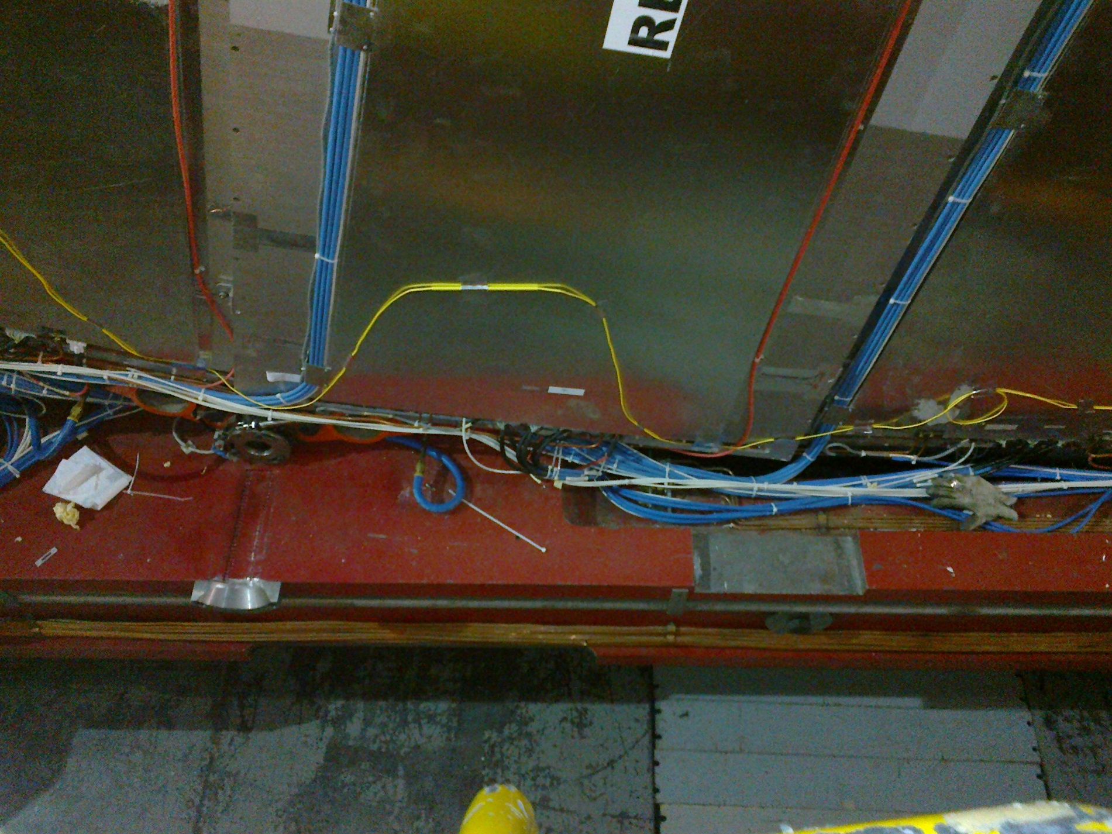
Congested and limited access in service areas around the periphery

Slide 21
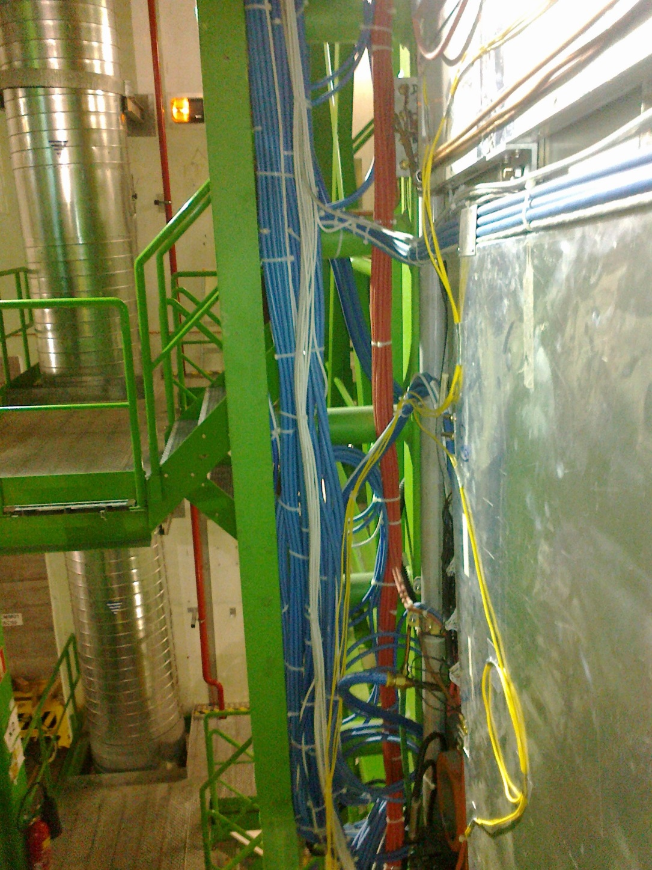
On the top and sides the situation is not so bad
But access forces the installation from an inner radius to an outer

Slide 22
RE4/1 services
The following will go behind the off yoke ME4/2s.
  HV & LV
  FO
  Gas
  Cooling
  This is not the original plan and getting gas pipes through is not easy with no damage to the CSCSs.

Slide 23
Cooling RE4/1
There are numerous solutions to the question.
Repeat what is done for RE3/1
Repeat what is done for RE4 SMs, ie flexibles
See my talk for a few more details of both.

Slide 24
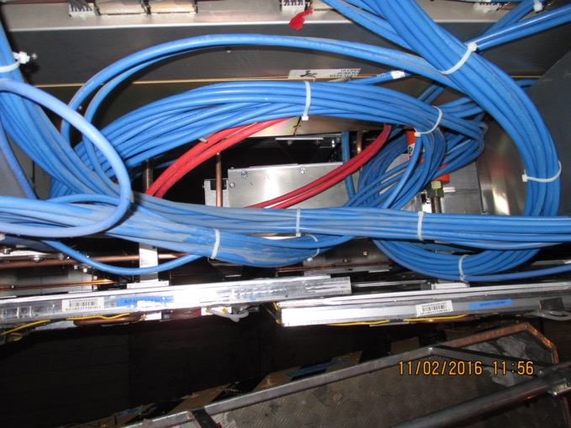
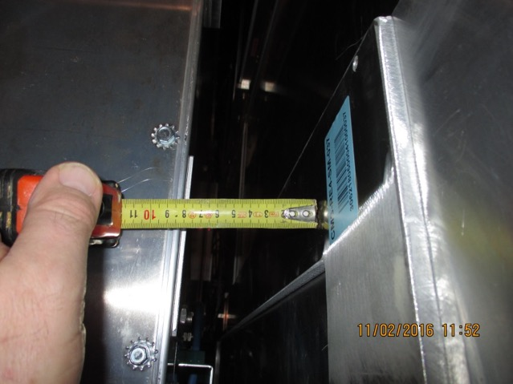
RE4/1 Service Passages
There are large passages under the off yoke CSCs that will be used. Trials with appropriate tooling will have to be performed. Again starting from lower radius and only becoming apparent on the peripheral areas.
This is not the original proposal which was attached to the back of the RE4 SMs
We will have to discuss with our CSC colleagues.

Slide 25
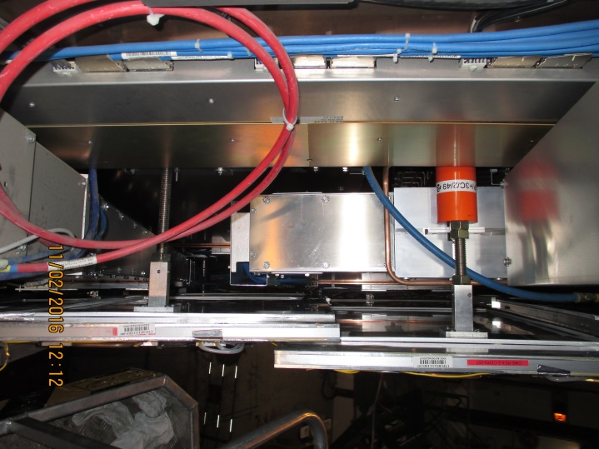
View looking from beam pipe out to the periphery
RE4 SM off Yoke
ME4/2 off Yoke
RE4SM on Yoke
ME4/1 off Yoke
ME4/2 off Yoke
YE4
YE3
ME4/1 off Yoke
ME4/1 on Yoke
Service passage with cable tray.

Slide 26
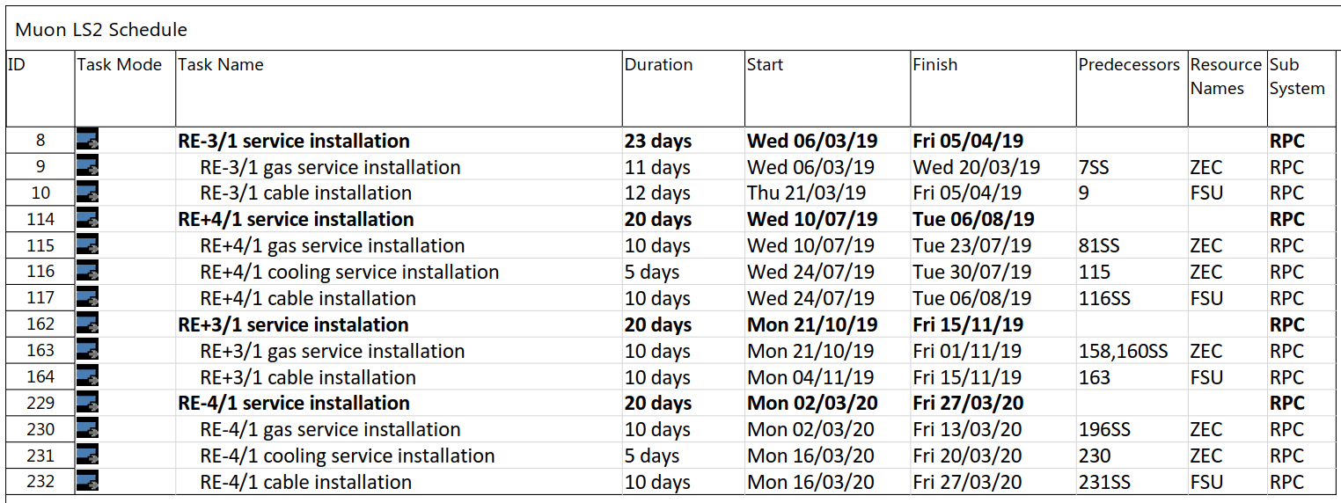
LS2 Schedule

Slide 27
A series of actions,
Choices of systems
Design
Component definition and order
Tooling and assembly methods
Validation of ready to install system, LV, HV, OF, gas impedances & cooling
Installation
Commissioning

Slide 28
Conclusions
We have a stock of HV dia. 40mm cables, may be sufficient. Require choice of system for DB and labels.
We need large quantity of coaxial HV cable, IO will provide values this week.
LV , need to decide on system, and OF will be studied by IO in the following month.
We need detailed design of cooling, choice to be made for RE4/1. Is more urgent than RE3/1.
We need detailed design of gas piping, impedances, bulkheads, schematic as input. We only deal with rack to chamber.
Mock-ups of the service access to the chambers will dictate the design of the chambers.
We need continued and significant help from the IO, Stephan, Daniela, Theo and the Georgian team.

Slide 29
