Slide 1
Services for RE3/1 & RE4/1
HV, LV & Cooling
Ian on behalf of the RPC group
20 November 2018

Slide 2
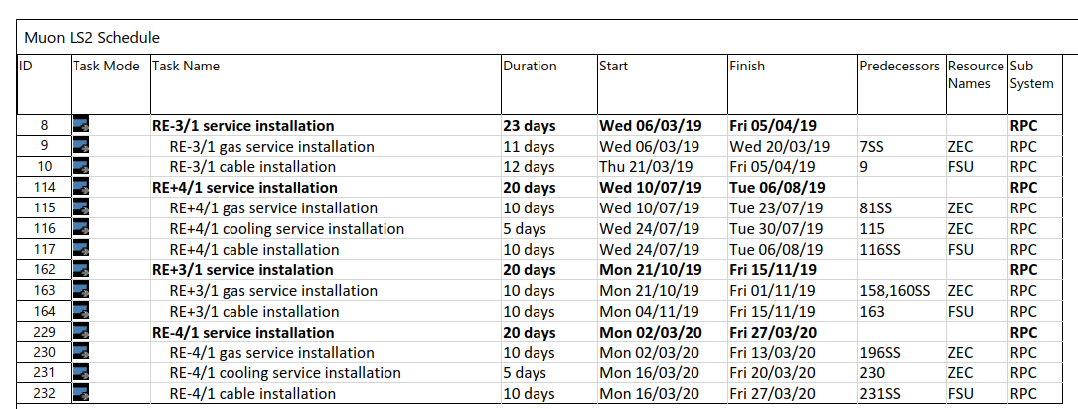
RE3/1 & RE4/1 Service Installation during LS2
Main cable chain installation starts in last week of Jan 2019 and is available for 4 weeks
HV, gas and LV communication.
Alternative April 2020 for the –Z Main Cable chain

Slide 3
HV cables and connectors, Umbilical cables USC to UXC. Coaxial cables from YE1PP to YE3 via mini-cable chains
LV cables & connectors on YE3
Fibre optics & Patch Panels from YE3 to YE1PP through to USC
Gas System piping, Impedances and Bulkheads on YE3
Cooling, flexibles on RE4 face of YE3, RE3/1 cooling comes with chambers
RE 3/1 & RE 4/1

Slide 4
HV
Cables (8 umbilical) for the link from USC to UXC
Cables for UXC between the YE1PP and the RE3/1 & RE4/1 chambers

Slide 5
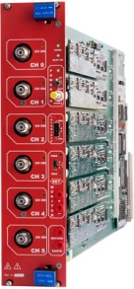
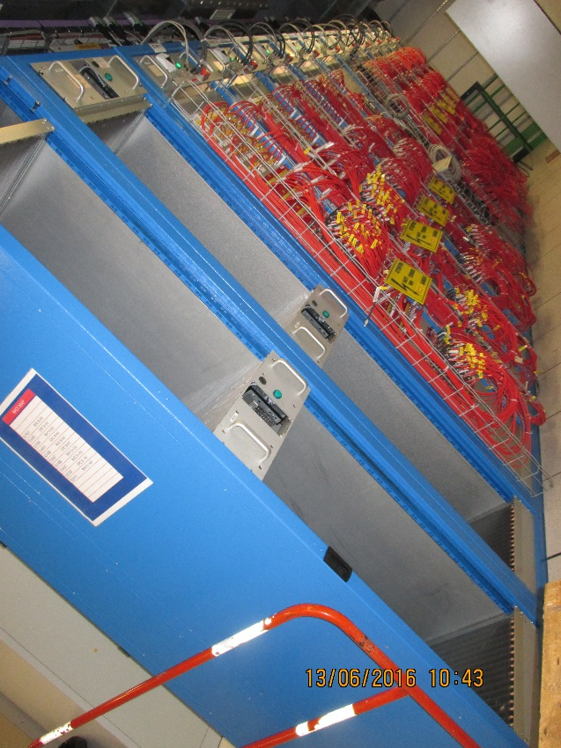
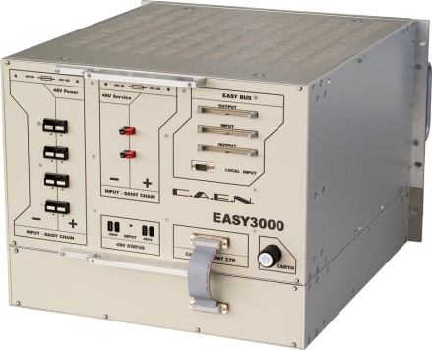
HV System in the USC
S1H12
HEX
A new rack, S1H12, is installed for the RE3/1 and RE4/1 components.
The connectors will be the same as they are.
HV Distribution Box
HV Distribution Box
HV Distribution Box
HV Distribution Box
A3512N
HV Distribution Box
HV Distribution Box
HEX
HV Distribution Box
S1H12
HV Distribution Box
Crate4
RE+3/1
RE+4/1
Crate4
RE-3/1
RE-4/1
EASY3000

Slide 6
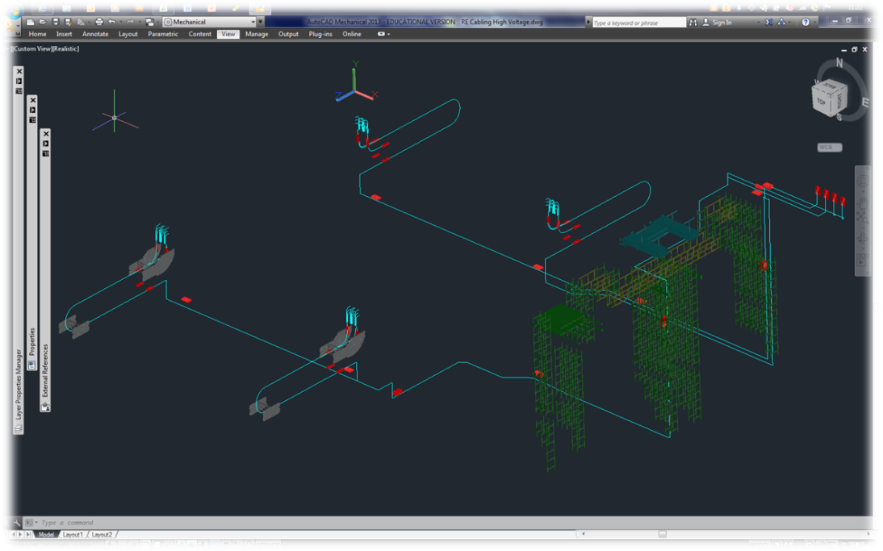
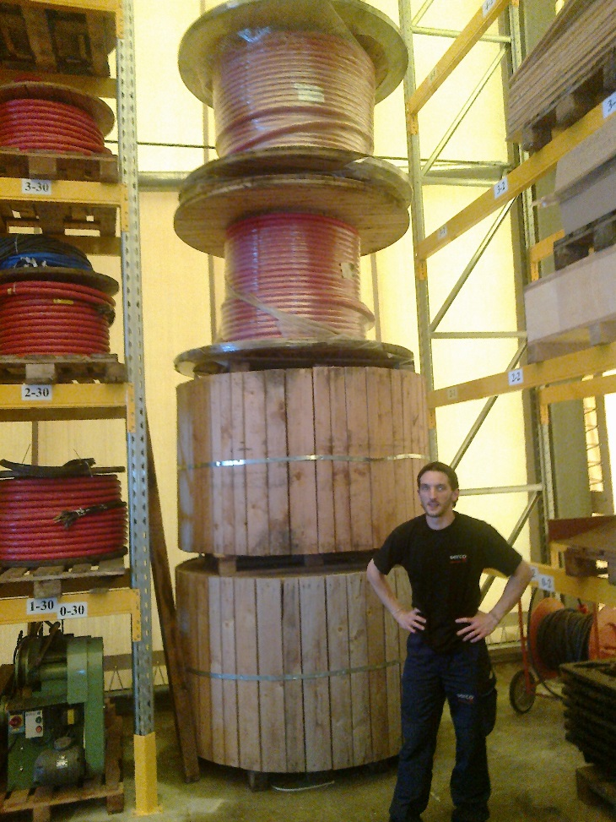
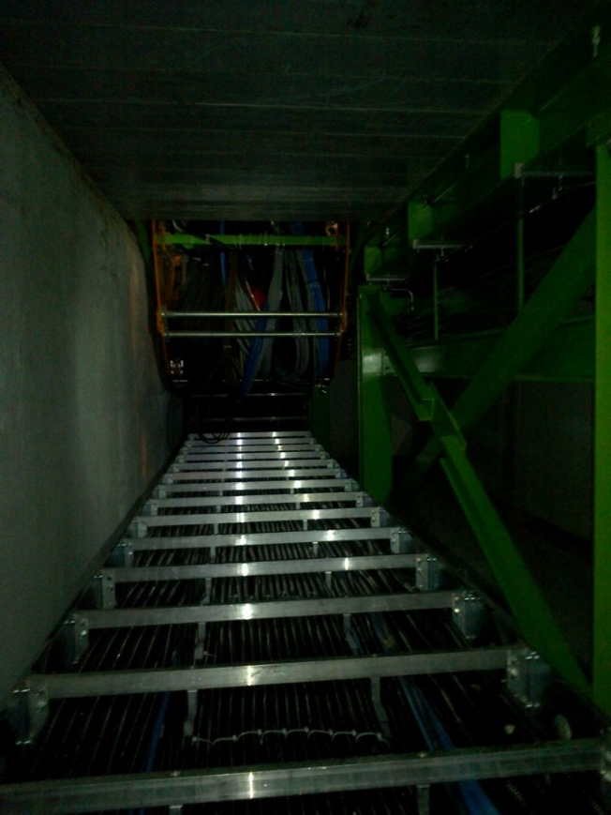
HV system routing from USC to UXC
8 Cables are required two in each cable chain.
Lengths between 73 – 109m
Total required 722m
We have a stock of approx. 1270m. That will be used.
Cable flexibility and integrity verified.
Routing from the USC HV racks to the YE1 PPs
The Main Cable chains in X0 under CMS
Cables to be shipped to P5 to agreed with Maf for installation in Jan 2018. No connectors, only cut to length
Cable sections and lengths, including spares, have been evaluated with CMS Integ Office, S. Bally and Boki

Slide 7
HV System in UXC
We have selected a coaxial connector, tested over many years, namely the C.P.E. “Jupiter” coaxial connector.
The order for the cables and connectors is ready, with the change of dielectric from Teflon to PEEK. The cables will be QA in the company under our supervision and retested in 904. Delay for ready to install cables is 2 months.
Commissioning will be enhanced with resistances in boxes, simulating the chamber load, placed in the position of the chambers .
Two cable per chamber. 72 coaxial cables per end cap through the Mini cable chains, between 36-45m long. Total cable length required 5.2km, purchase 6.2km

Slide 8
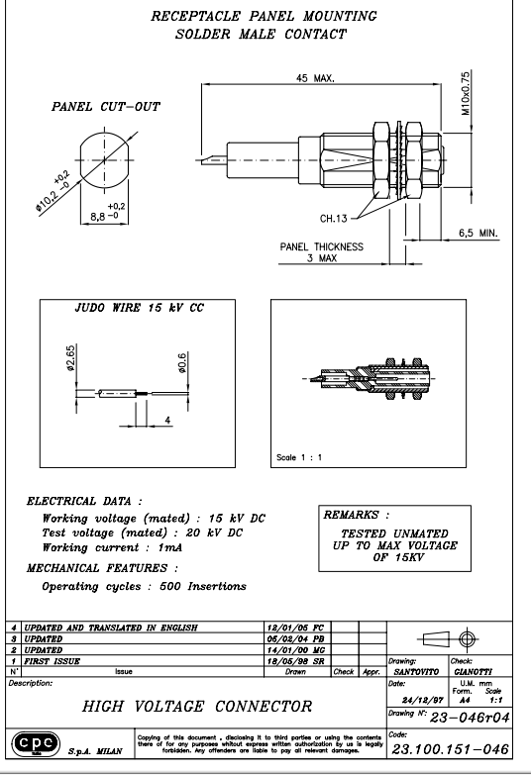
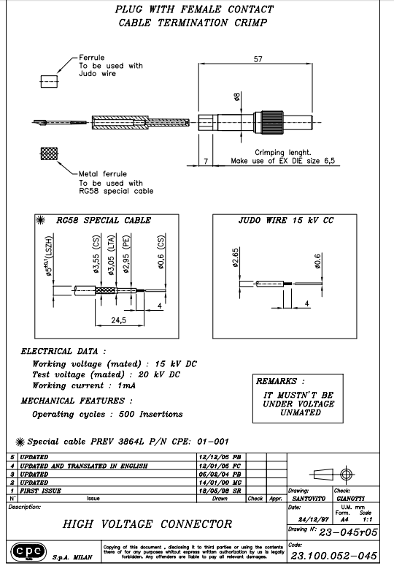
Connector details from Long term supplier

Slide 9
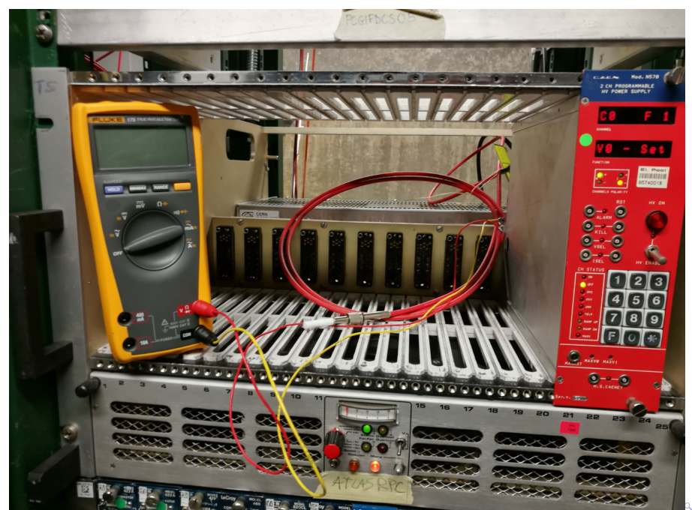
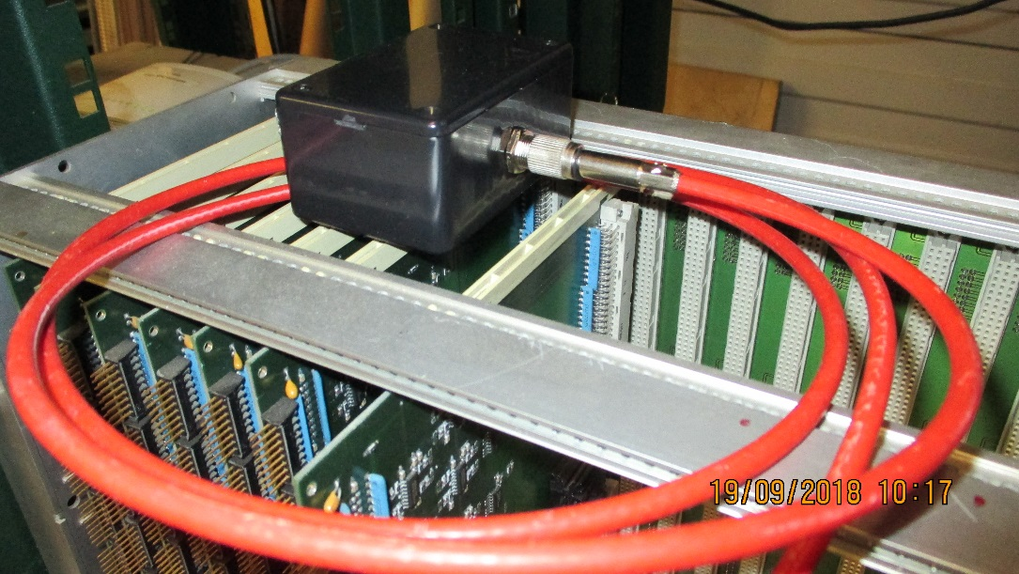
New PEEK insulated HV connector radiation resistance test.
Tested before and after irradiation.

Slide 10
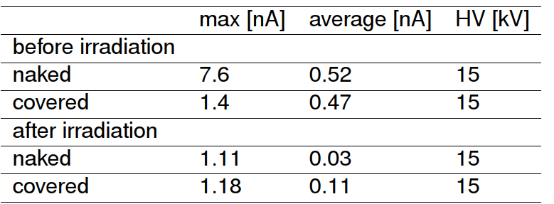
Here are the dose reached during the irradiation of the HV connector :
Dose (Gy) | HEH Fluence (cm⁻²) | 1MeV n eq. (cm⁻²) | Total POT*
103 | 2.83·10¹¹ | 2.71·10¹² | 1.4·10¹⁶
Current is negligible before and after 15kV test
The reference document related to the irradiation test: https://edms.cern.ch/document/2048697/1
Max dose in R3,4/1 : 45 Gy for 3000 fb-1
Dose at the chamber PP is 10Gy
Thanks to Salvatore Danzeca and Chiara Cangialosi of the Charm facility Group who took care of the irradiation test

Slide 11
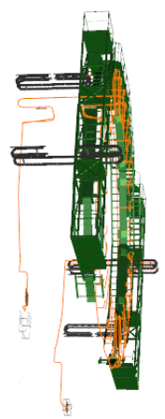
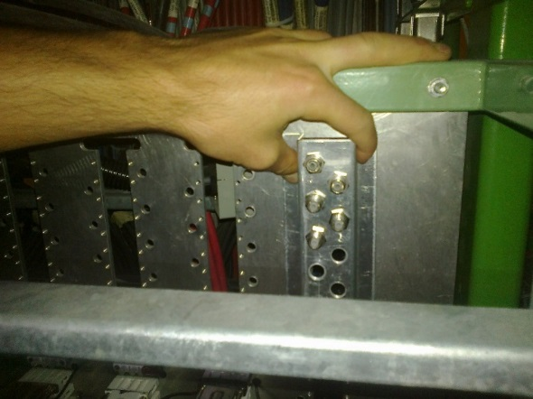
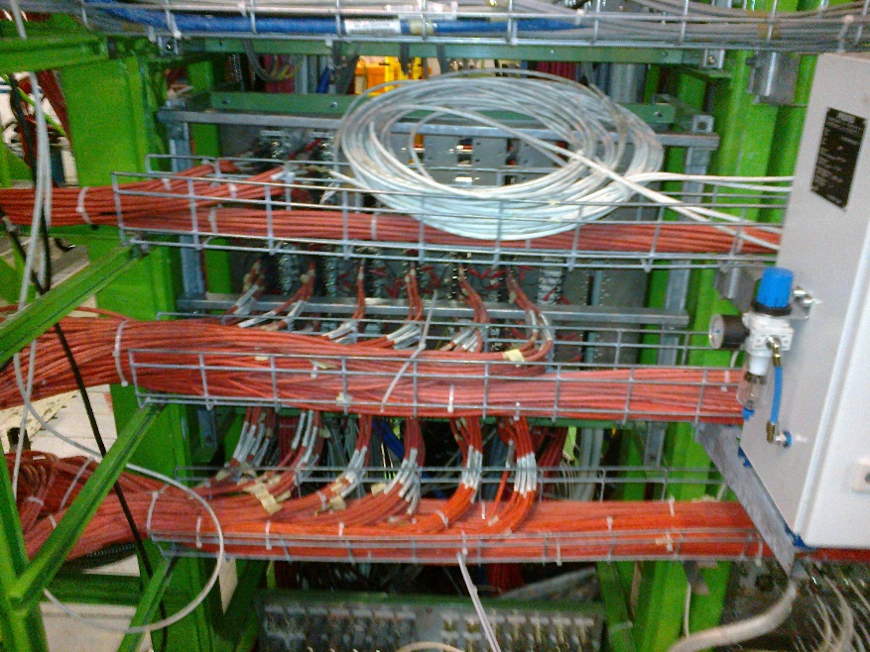
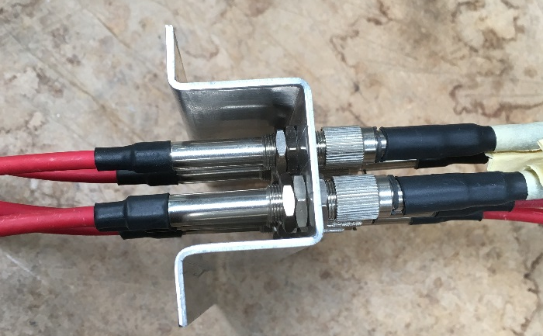
Modification of the YE1 PP to accept the alternative Jupiter connecter
YE1 Patch Panel (PP)
Cable installation, 2 weeks for each station starting in March 2019 and finishing in March 2020
Cable routing done by Integration office. Requires finalising

Slide 12
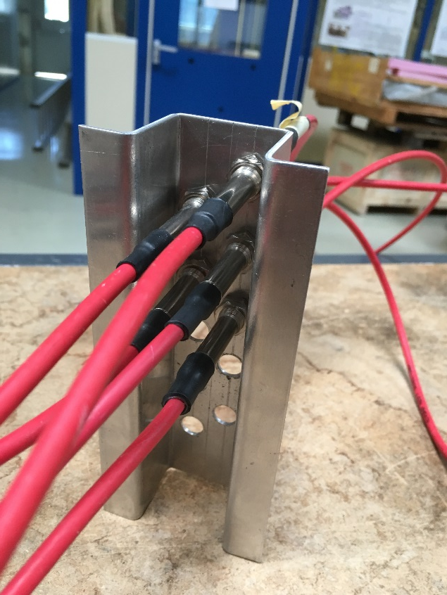
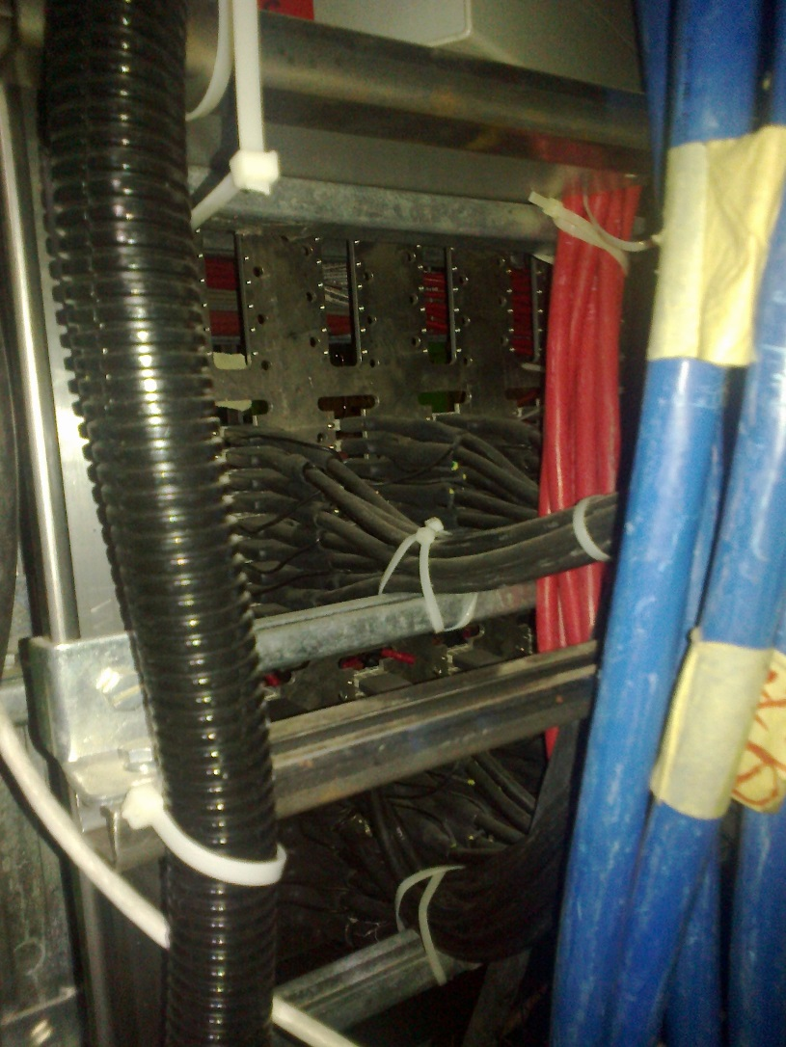

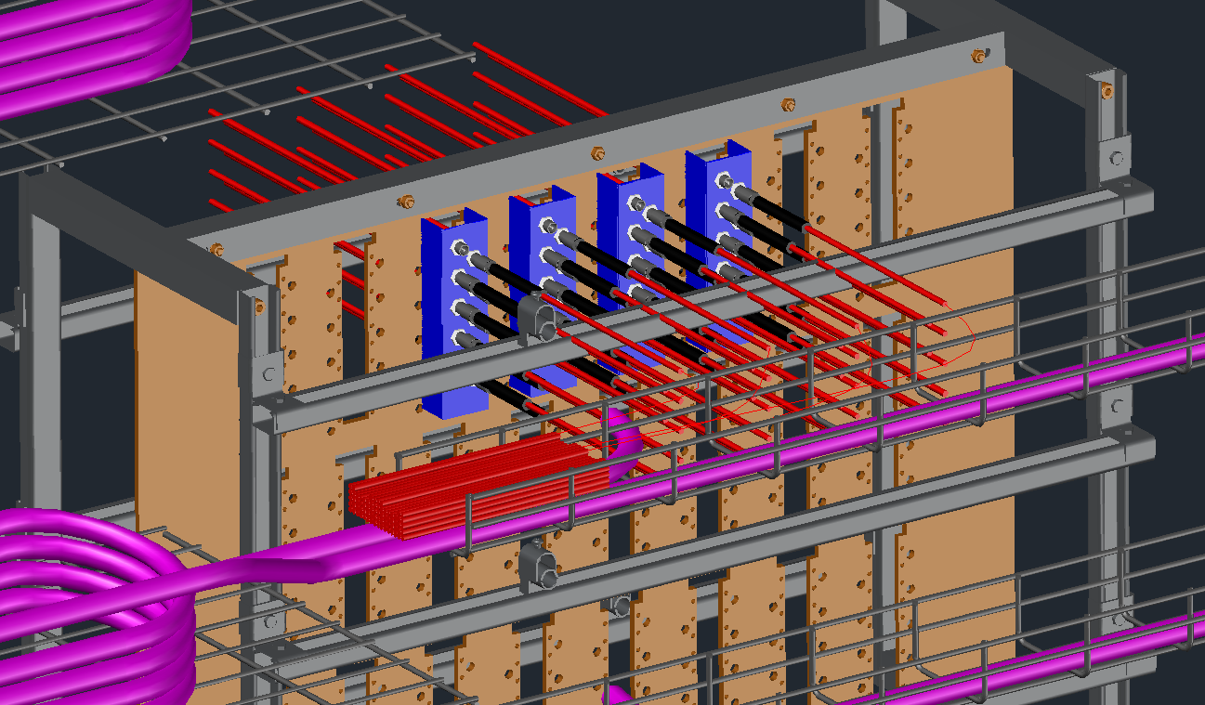
Connector change on the YE1PP cable to chambers at both ends requires an in situ modification of the YE1 HV PP
The panel has to be manufactured with insulators for the connector

Slide 13
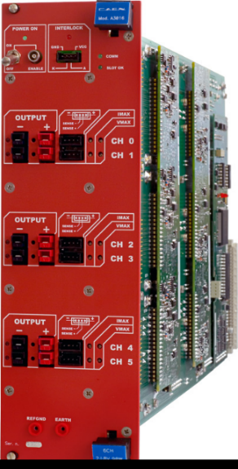
LV
Cables from the chambers RE3/1 & RE4/1 to the racks on YE3
CAEN A3009B
Connectors type to be M6 screwed lugs.
Cable lengths are to be established for new PS (X2 & X4) positions.
36 cables per station, 144 cables for the project.
Require 1 month to produce
Installation periods
RE-3/1 21 March 19 12 days
RE+4/1 24 July 19 10 days
RE+3/1 4 Nov 19 10 days
RE-4/1 16 March 10 days

Slide 14
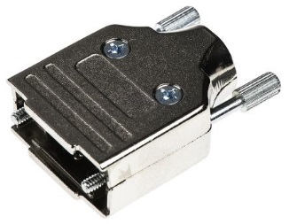
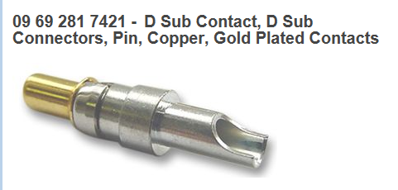
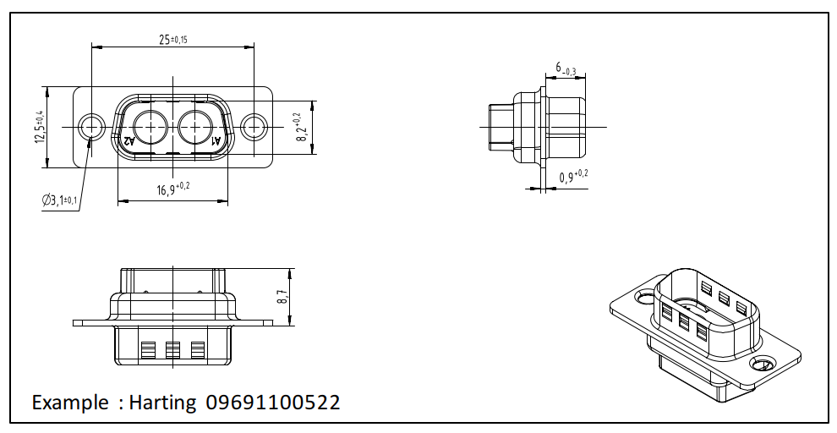
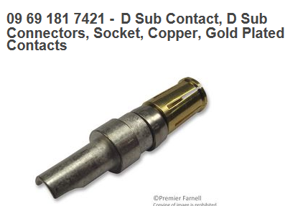
Connector type on Chamber patch panel is D-Sub
2 weeks delivery

Slide 15
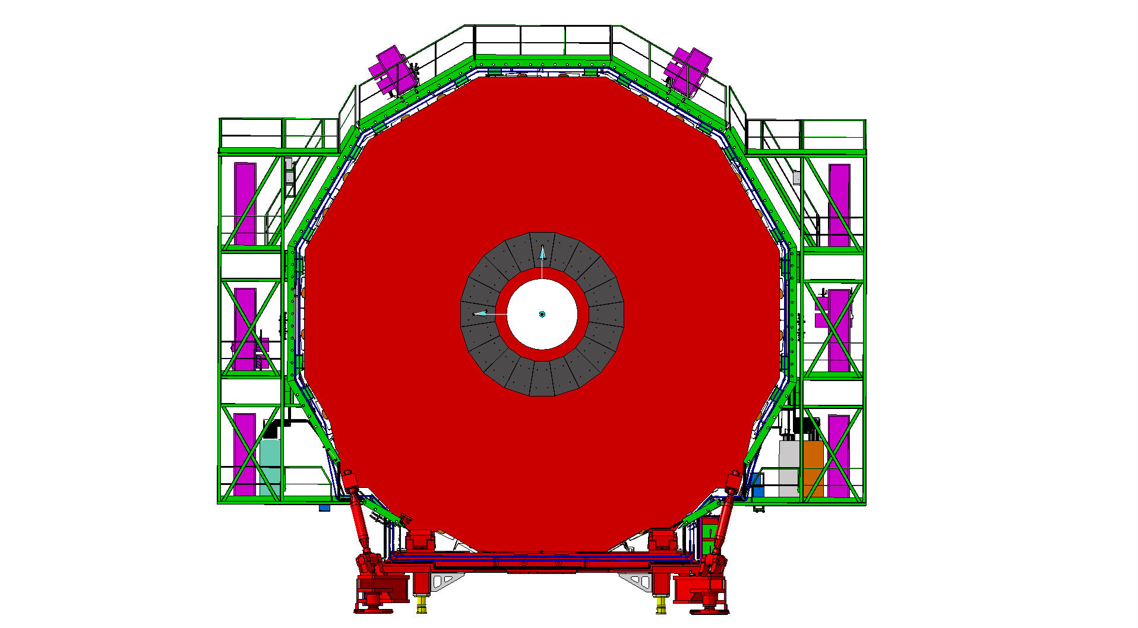
RPC LV Services
Far Side
Near Side
mini Cable Chains for OF
LV Easy crates
X4
LV Easy crates
X2
X2Near – X4Far
diagonal
2

Slide 16
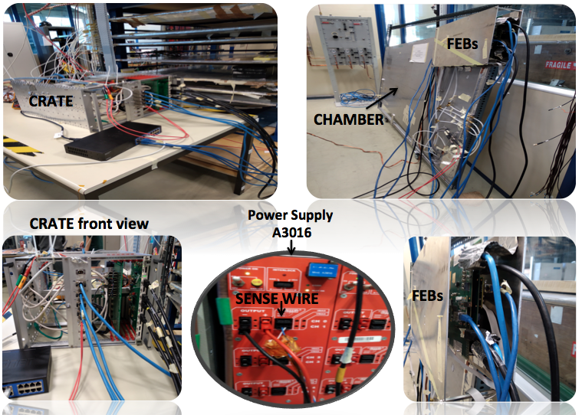
Tests done in H2 and 904 on full LV system
Cable length tested up to 30m to cover all cases. Copper section is 2x2.5mm2 with sense of 2x0.22mm2
1V drop in operating mode
1.2V drop with Firmware up-load

Slide 17
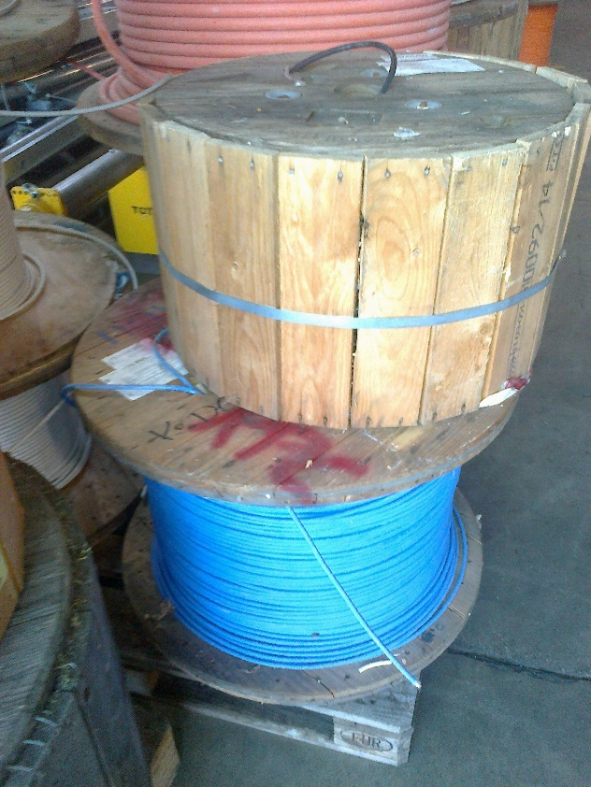
LV Cables UXC, Rack to chamber on YE3
LV tests done, different cable sections and stiffnesses.
Measured time response, using sense wires tested on resistive loads. It has been repeated on the
FEBs during firmware upload.
RE4 used approx. 490m/ station. RE3/1 & RE4/1 both endcaps require ~2km
Stock of 3.5km of the cable (in P5) previously used for LB
Connectors at chamber end are more or less defined , “D-Sub’ with sense pins
2 cables per chamber.
Assembly can be done in Geneva EPI or Cavitech , Boudry, Neuchatel
As with the HV the load will be simulated by a resistance in place to aid in rapid
commissioning during EYETS.
Communication cable from USC to UXC to be installed in main cable chains in Jan 2019
Cable installation, 2 weeks for each station starting in March 2019 and finishing in March 2020

Slide 18
Cooling
Power 20W per chamber
Cooling circuit for RE3/1
        Installed with chamber in EYETS
Cooling circuit for RE4/1
  RE+4/1 installed 24 July 5 days
  RE-4/1 installed 16 March 5 days

Slide 19
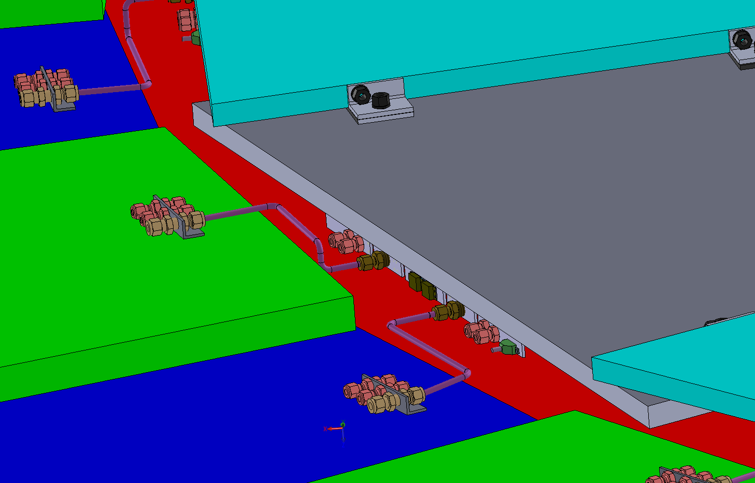
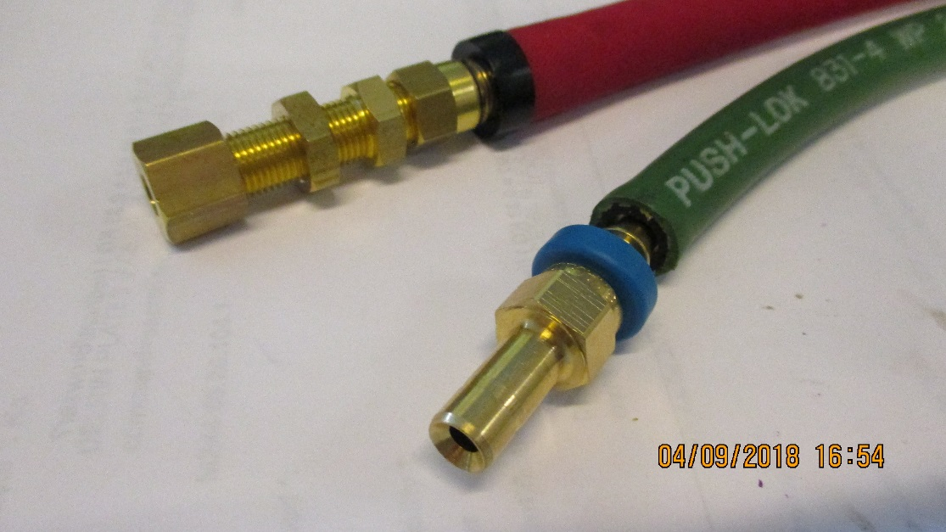
RE3/1 cooling link to RE3/2
x2 RE3/2 circuits feed x1 RE3/1 chamber
The rigid copper piping will be replaced by flexible hose links to reduce the strain on the unions.

Slide 20

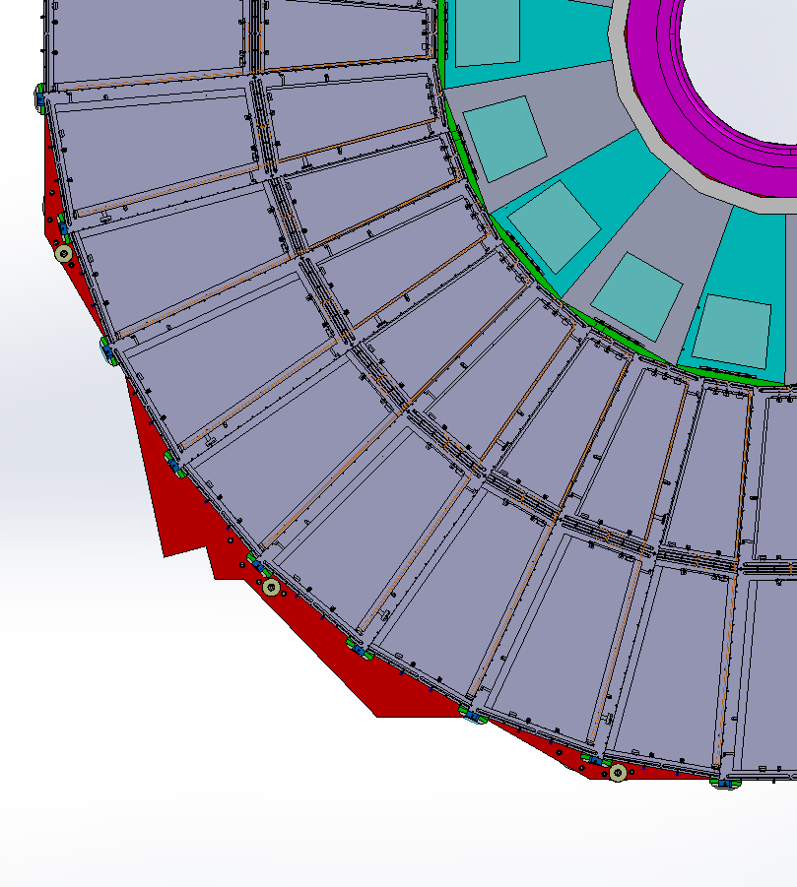
RE4/1 Cooling manifolds
RE4/1
Return
Manifold
Diagram of 1 channel per 2 chambers. Flexible hose from the “T” mounted on the mini manifold.
The two RE4/1s will also be linked by flexibles.
Supply

Slide 21
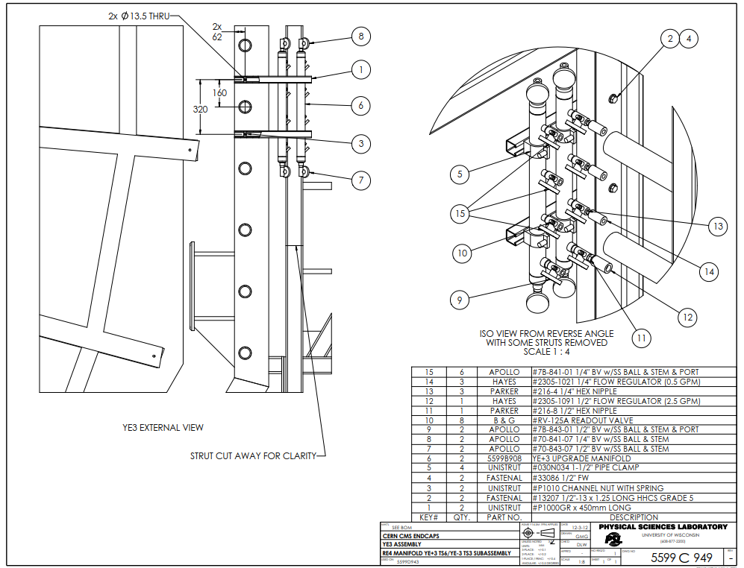
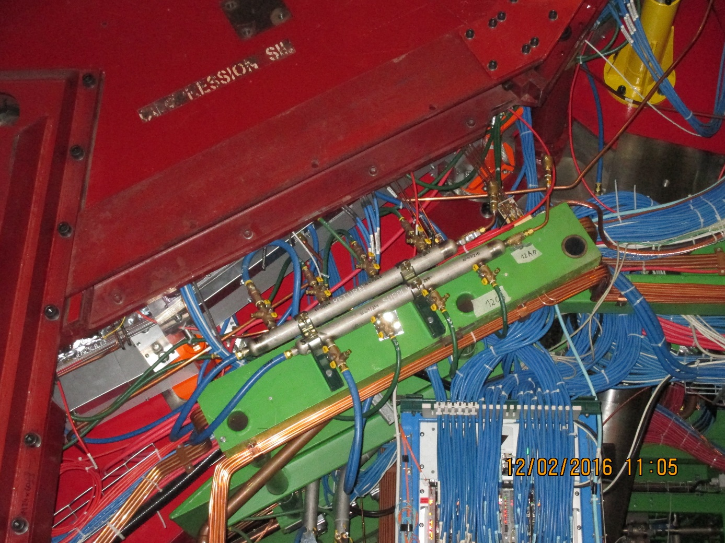
RE4/1 cooling
Mini manifold . To be modified to accept the necessary “T”s for the RE4/1 cooling.
The same flow regulators will be kept with individual cut off valves to each chamber.
The Mini Manifolds will be modified using identical components to avoid mismatch such as NPT and BSP threads.

Slide 22
Concluding table
LV cables 144 available , requires connectorising
lengths to be calculated
HV coaxial 144 order with CPE ready with new quote
HV Umbilical 8 ready for P5
Cooling RE3/1 72 flexible links European order
Cooling RE4/1 36 flexible links USA order
All elements to be labelled with Daniela and logged in the DB
Documents for installation crews to be prepared.
Detailed union order to CSC colleagues, Dick, in USA for cooling.
Orders should leave CERN asap

