Slide 1


Service Installation for RE3/1 and RE4/1: status and plan
Andrés Leonardo Cabrera Mora
Ian Crotty
On behalf of the RPC group

Slide 2
Services installed for RE3/1 and RE4/1
High Voltage installation USC and UXC
Chamber Low Voltage installation in UXC
Power system cabling for YE3.
Cooling System RE4/1 on YE3
Gas system
Schedule
Manpower

Slide 3
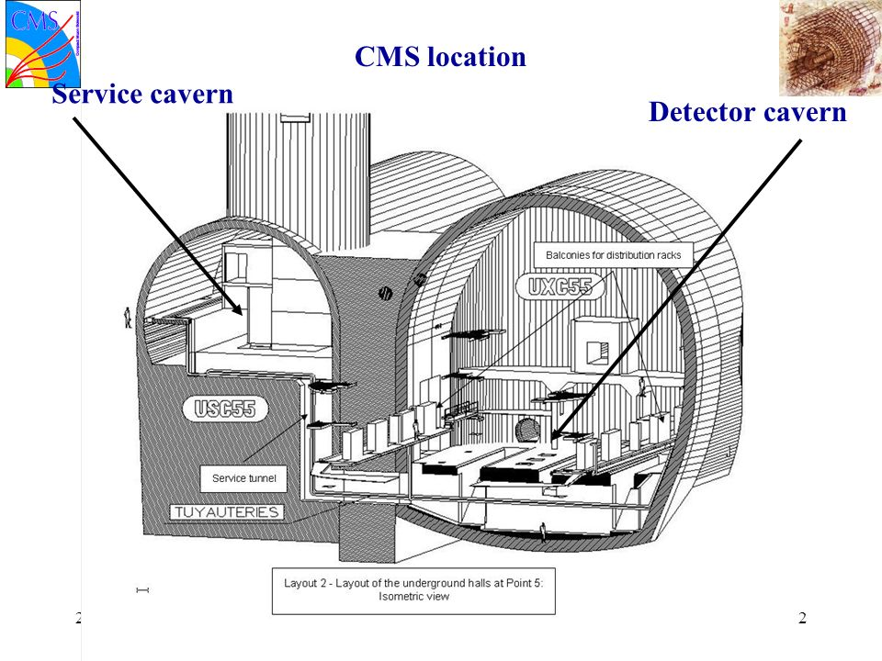
UXC55
USC55
100m below surface

Slide 4
RE3/1 & RE4/1 High voltage cables on the YE3 linking to YE1

Slide 5
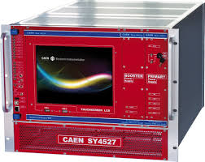
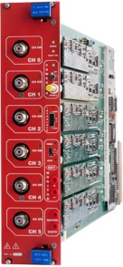
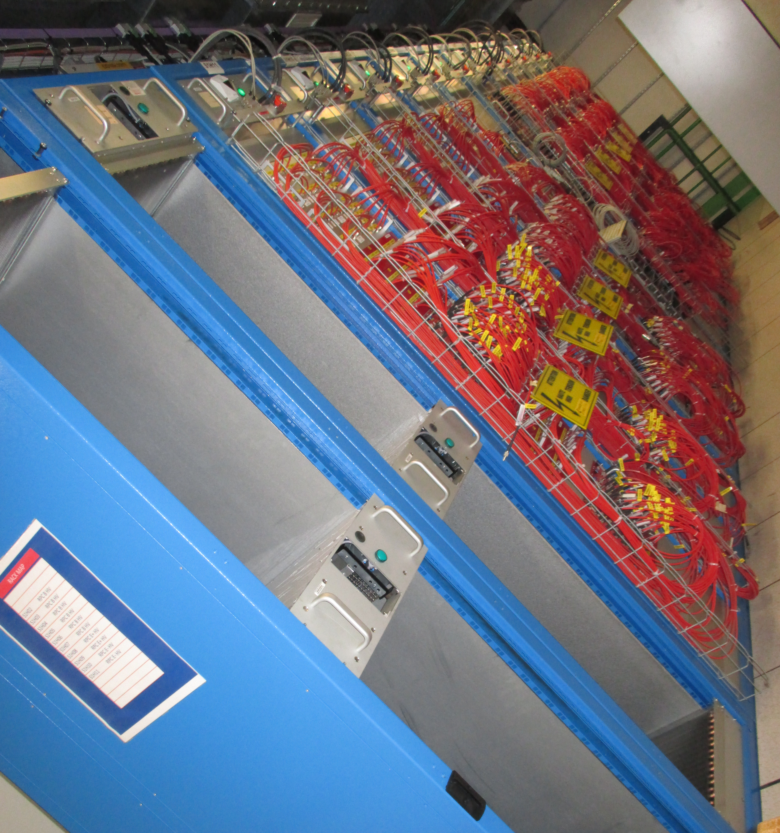
HV Power System Upgrade for RE3/1 & RE4/1 (I)
SY4527
USC
UXC
The HV power system will be based on CAEN NON-EASY system:
SY4527 – 2 (new)
12 New HV boards – prototype ready in 2019
Preferred Variant: Variant I
4 HV multiconductor cables per endcap. Each with 20 HV channels
All go via the YE1’s main cable chains (MCC)
New boards similar to the A3512N.
Connectors at the rear
S1H12
Anton’s slide
INSTALLED
JAN.2019
Long term maintenance will be secured by CERN-CAEN contract.
To be integrated in the RPC DCS.

Slide 6
S1H12
S1H07
HEX
ENDCAP RACKS
S1H11 – S1H08
HEX
HV Distribution Box
HV Distribution Box
SY4527
SY4527
HV Distribution Box
SY4527
HV Distribution Box
- No EASY system ➔ no EASY crates
- 2 SY4527 mainframes more
- 8 umbilical cables all arriving to one rack (S1H12)
- New type of HV boards!
- 8 HV Distributor Boxes in total (all in one rack), but bigger in size
since all inputs and outputs should be at the back side of the rack
- No rack cross reference in DSS Action Matrix
HEX
HV Distribution Box
HEX
HV Distribution Box
A3485S
SY4527
A3485S
A3485S
HV Distribution Box
A3485S
HV Distribution Box
Anton’s slide

Slide 7
High Voltage QA and Installation
QA carried out by;
Fatma, Manuel, Margarida, Darwish
https://indico.cern.ch/event/835724/
Cables certified up to 15 kV during one hour.
144 Cables tested -> 143 Ok / 1 Rejected and fixed.
Installed:
For RE+4/1: 36 cables from chamber to YE+1 patch panel
For RE-3/1: 36 cables from chamber to YE-1 patch panel
For RE+3/1: 36 cables from chamber to YE-1 patch panel
To be completed:
For RE-4/1: 36 cables [Ready to be installed week 39]
Cable connectorisation in UXC/USC.
Patch panel modification in UXC.

Slide 8
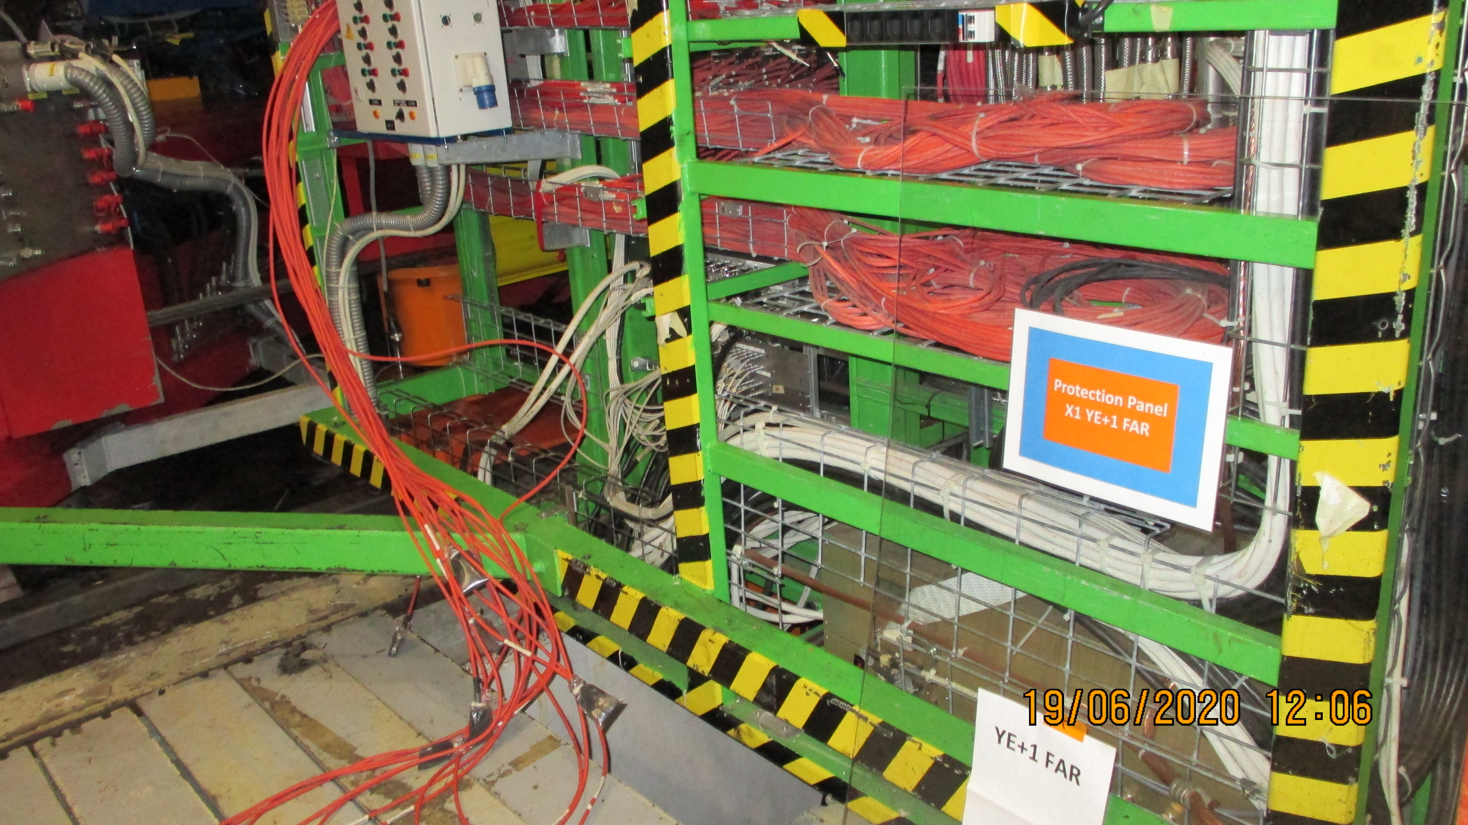
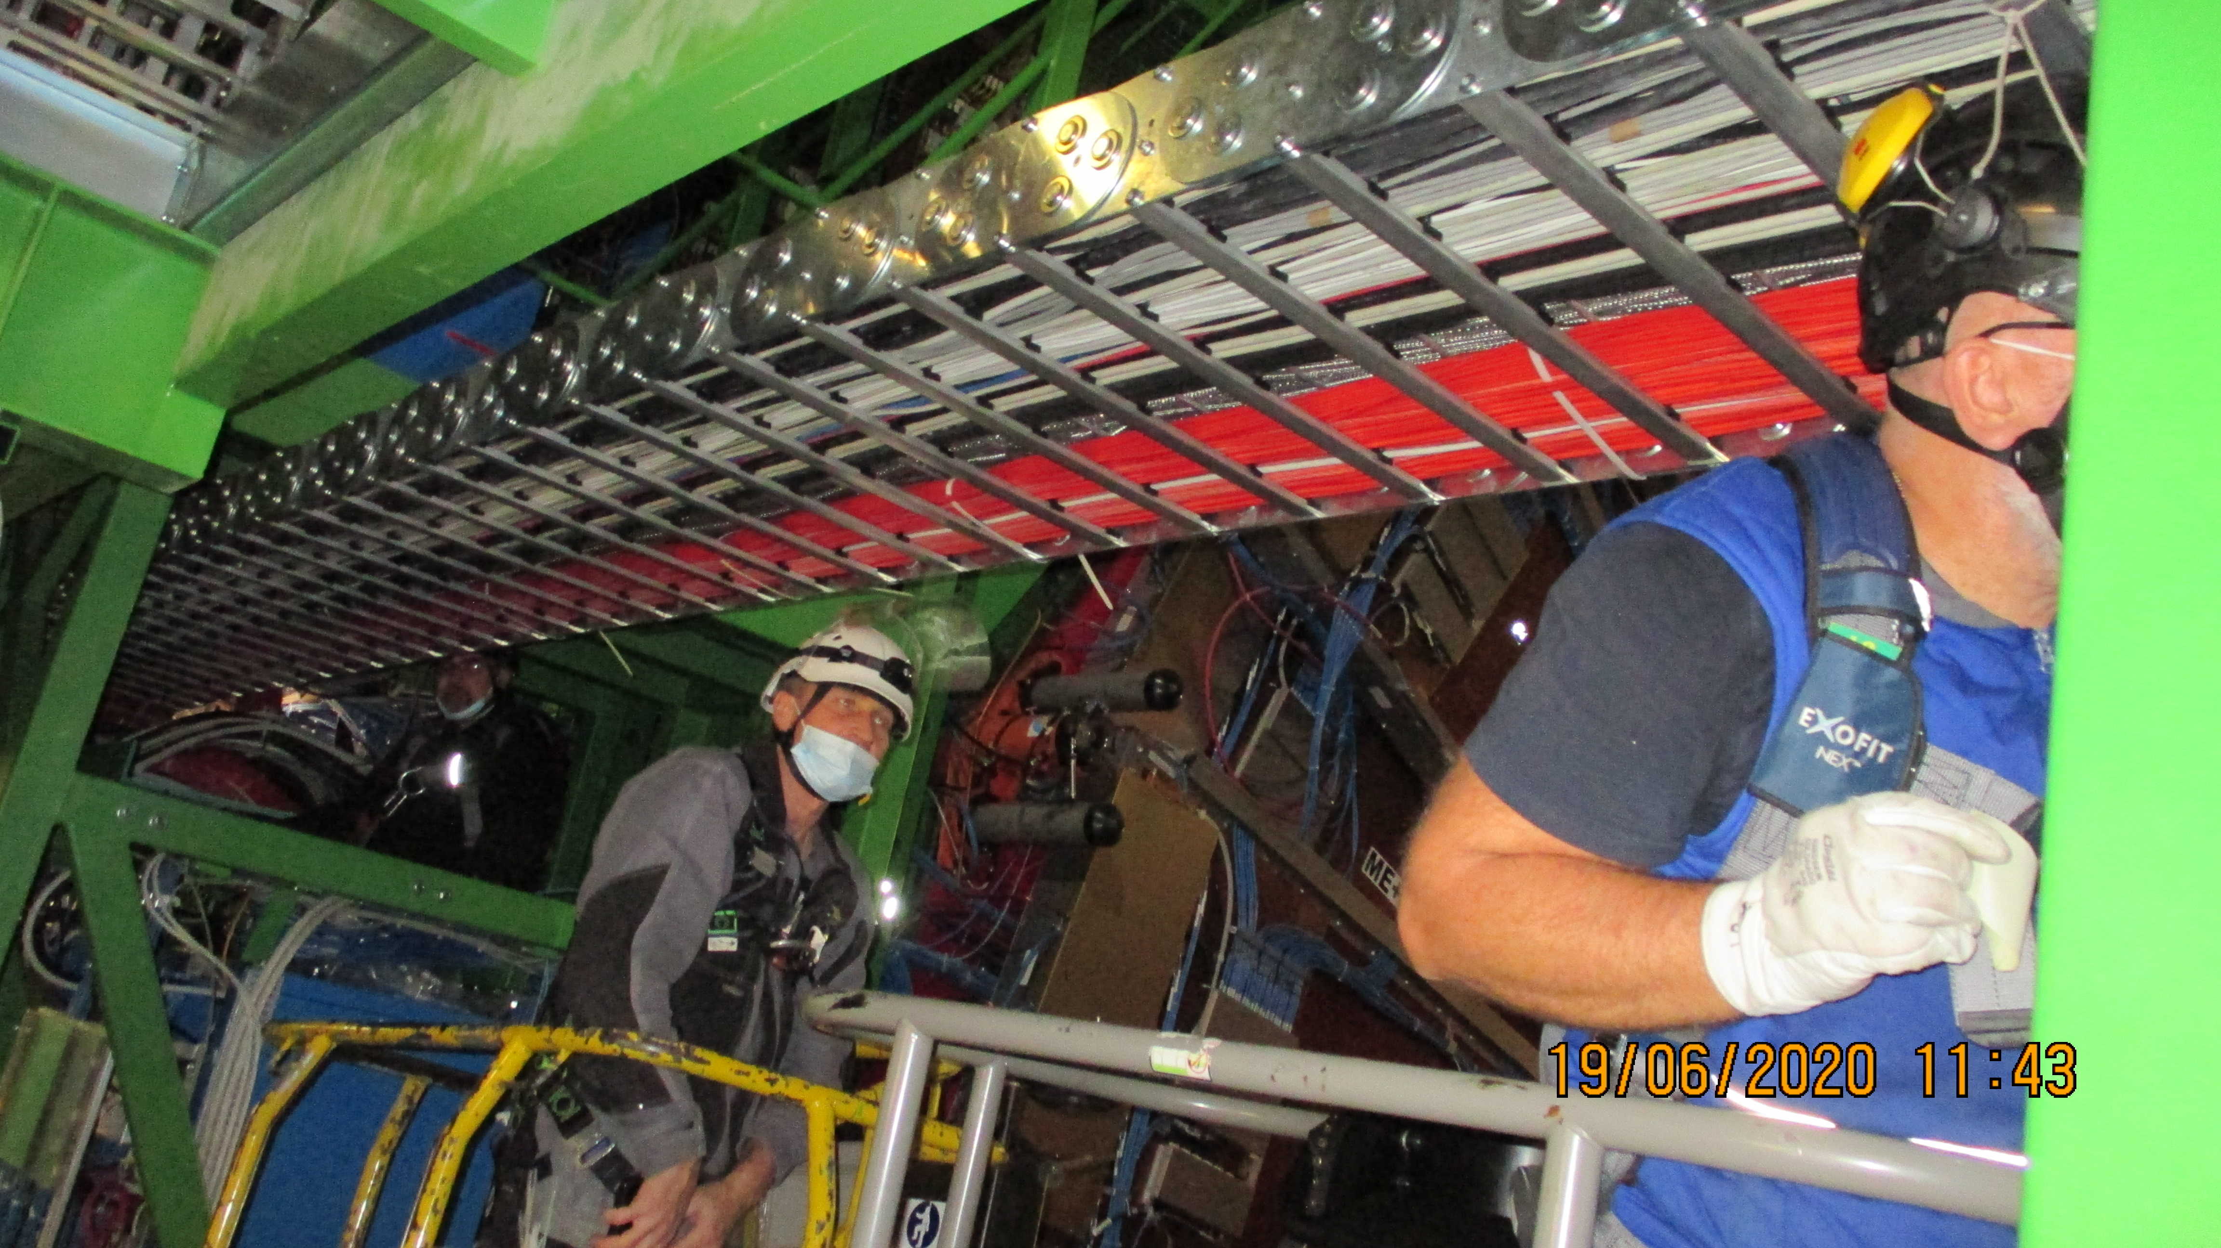
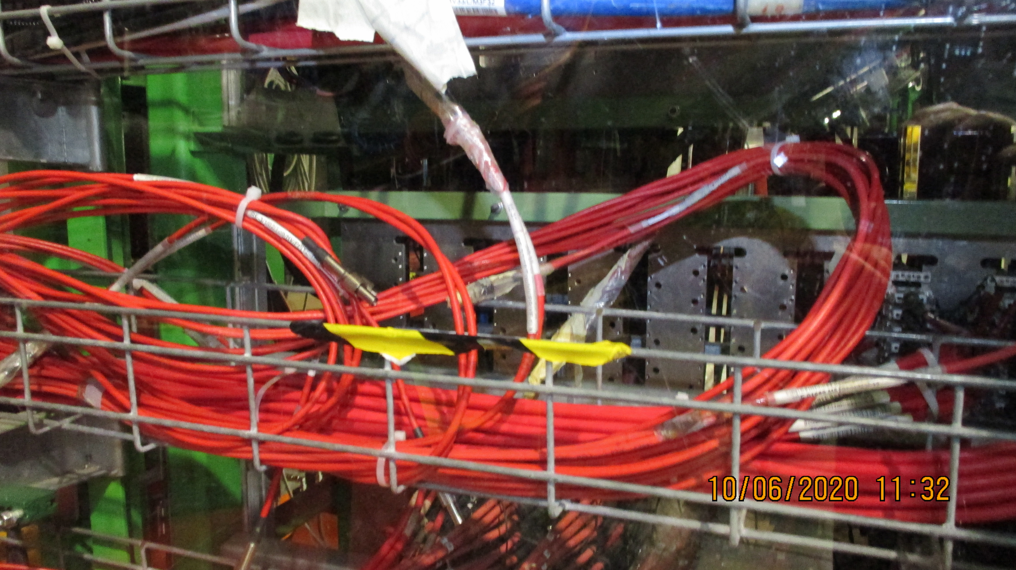
RE1/1 HV cables removed to allow for the RE3/1 & RE4/1 HV cables to come down from the Mini cable chain to the YE1 PP
Russian crew cabling in the mini cable chains
Jupiters arrived at the YE1 PP

Slide 9
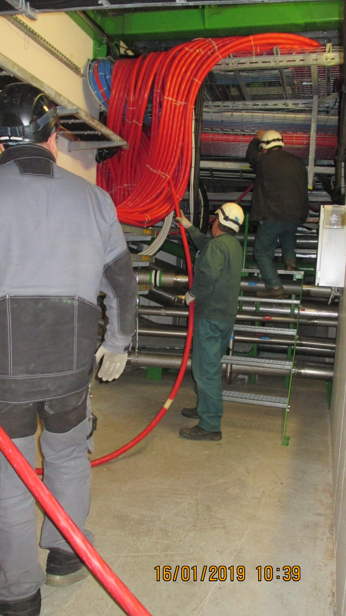
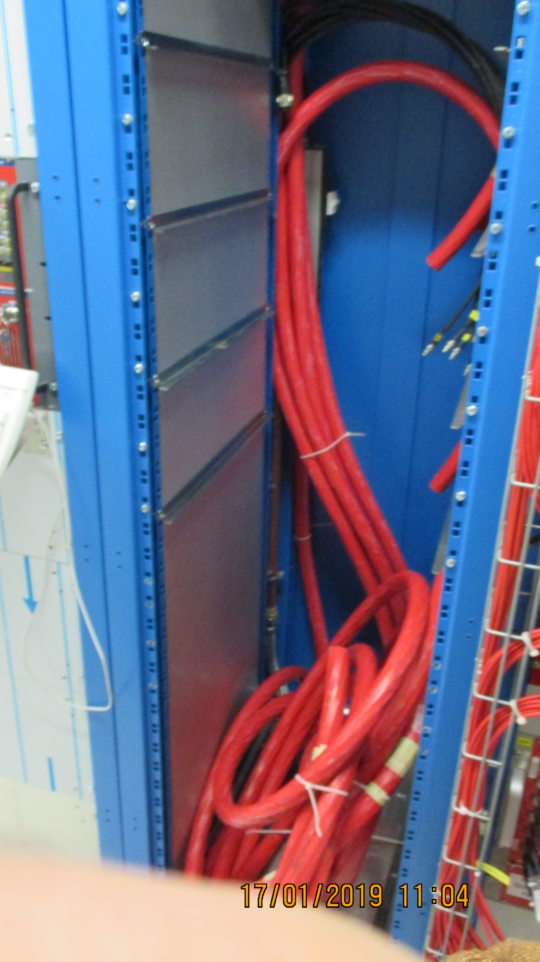
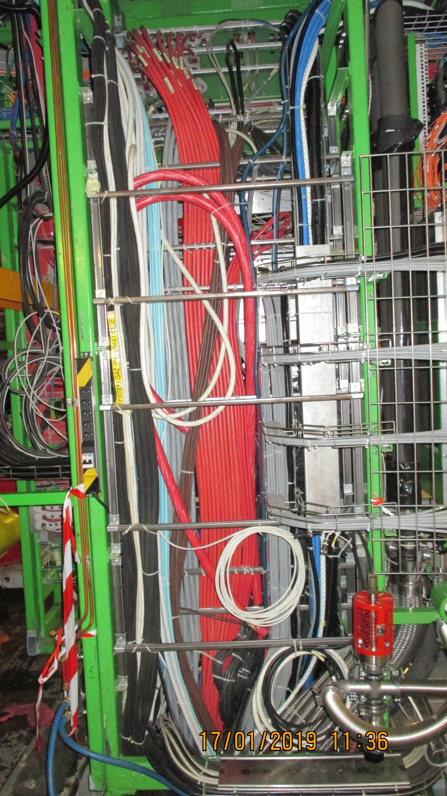
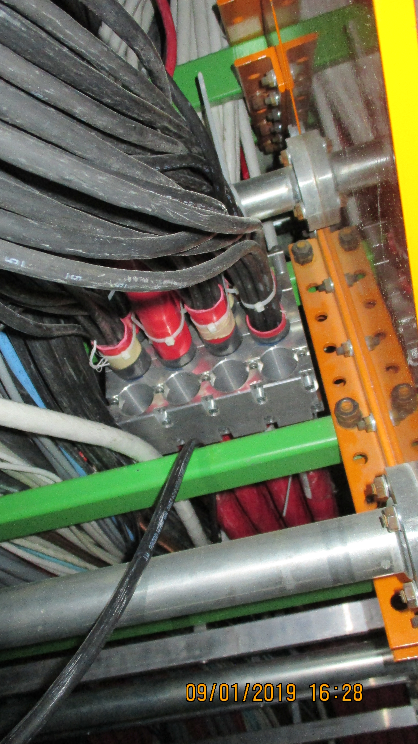
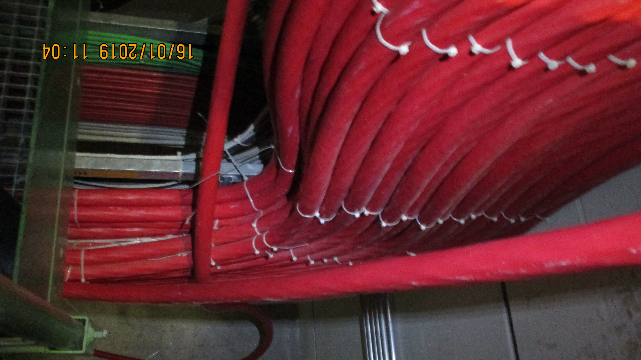
Umbilical HV cables (x8) from the YE1 PP to the USC S1H racks
USC S1H12
UXC YE1 PP
Under CMS X0
Main cable Chain
Coming up from X0 through the UL55 shafts

Slide 10
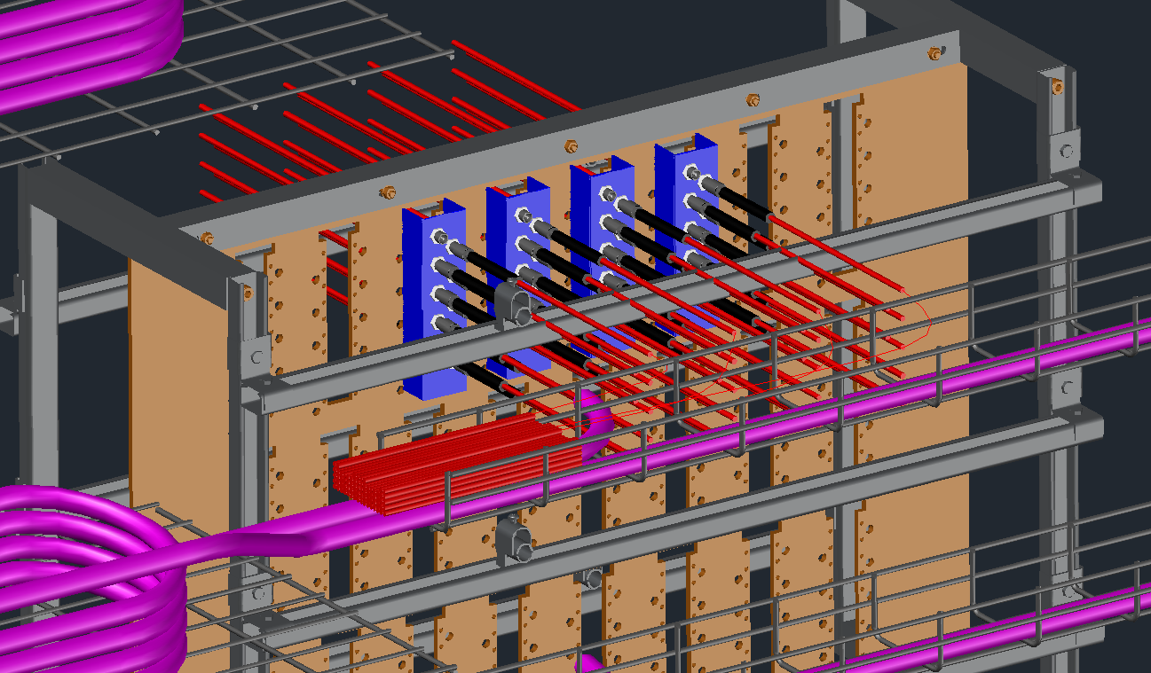
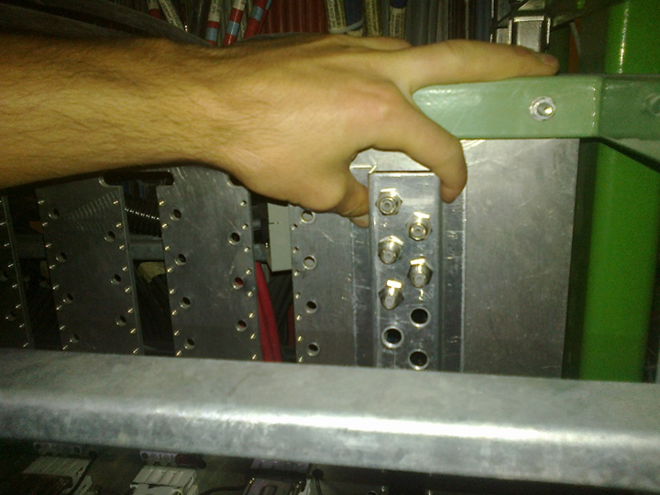
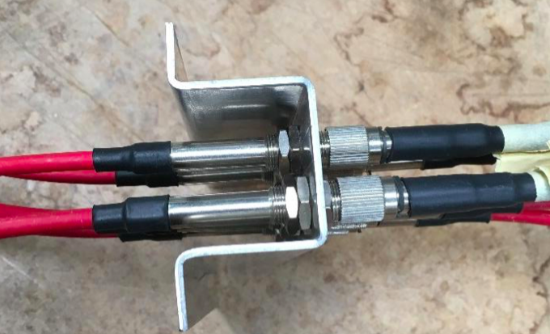
UXC
YE1 PP using modified PP to convert
from 3 polar to Jupiter. Design study
done by Theo, Geneva Eng. school.
Jupiter order and modification plates
planned to be done.
http://project-cms-rpc-endcap.web.cern.ch/rpc/UpscopeHighEta/RPCDevelopements/RE31and41/Services/HV/YE1PP/ModificationJupiter/ModTheo/PatchPanelConnecterSystem19June2018.pptx

Slide 11
RE3/1 & RE4/1 Low voltage system Phase II
YE3 components and links to USC

Slide 12
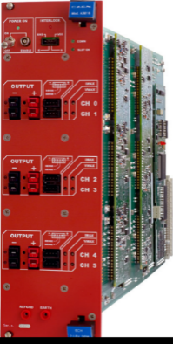
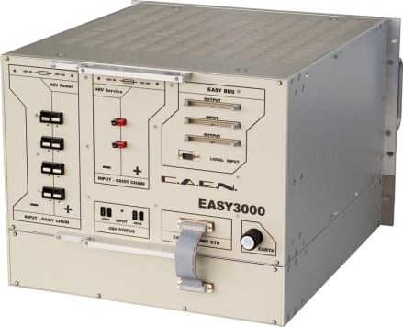
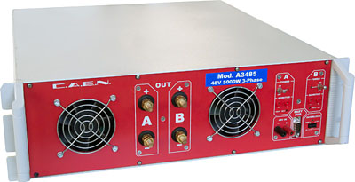
RPC LV Power System for RE3/1 & RE4/1
USC
UXC
YE+3: X2J52, X3J51, X3A51, X4A51
YE-3: X2V52, X3V51,X3S51, X4S51
CAEN EASY3000S
with CAEN A3009B
in X2Near & X4Far racks
Existing RE3&RE4 detector
SY4527 with A1676A
20 A3009B LV boards in total to power the FE of all RE3/1 and RE4/1 chambers.
9U in each X4Far YE3 tower rack for
  1 CAEN EASY3000S crate
  1 CAEN A3486S MAO- AC/DC 48VDC PS
9U in each X2Near YE3 tower rack for
  1 CAEN EASY3000S crate
  1 CAEN A3486S MAO- AC/DC 48VDC PS
A3486S
going through YE1-YE3 mini cable chains to existing RE racks on X3
Relay
YE1 LV PP
50pin Communication bus
48V Service power

Slide 13
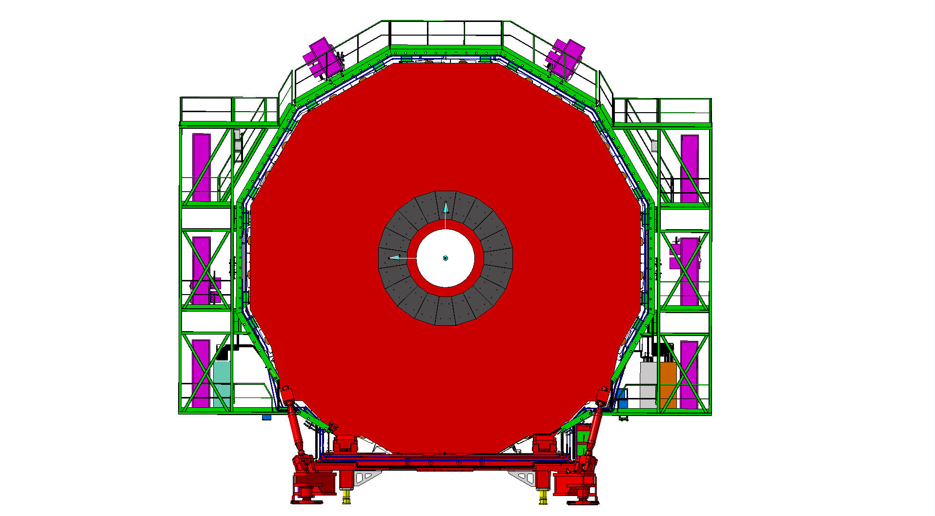
RPC LV cabling & rack occupation
Upgrade requires crates in X2 near and X4 far. Already installed.
Far Side
Near Side
RE3,4/1 Easy Crate X4
mini Cable Chains NEAR for
- LV power 230V 3-phase
(SCEM 04.08.80.072.6)
- DCS Communication 25TWP
(SCEM 04.21.51.550.4)
- 48VDC Service power
(SCEM 04.08.61.450.0)
X4
mini Cable Chains FAR for
- LV power 230V 3-phase
(SCEM 04.08.80.072.6)
- DCS Communication 25TWP
(SCEM 04.21.51.550.4)
- 48VDC Service power
(SCEM 04.08.61.450.0)
Existing RE3/RE4 LV Easy3000S crates
RE3,4/1 Easy Crate X2

Slide 14
Status Report of RPC Power Service Installation
Design the RPC Phase-II Upgrade Power System, DONE, Jun.2017
Install LV Power Distribution Cables between YE1PP and YE3X4 through mCC. Multiconductor cable with 7 conductors, 6 sq.mm. each for LV power (230V). INSTALLED, Sep.2020
Install 48V DC Power & Service cables between YE1PP (Far)/X4N19/55 (Near) and YE1X4. INSTALLED, Sep.2020
Install 50-pin DCS communication jumper cable between YE1PP and YE1X4. To be procured
Install 4 EASY3000S crates in racks X2J52, X4A51, X2V52, X4S51. INSTALLED, Jun.2019
Install 4 A1676A Branch Controllers with properly loaded maps. To be procured
Install 4 A3486S AC/DC 48 VDC power supplies (MAO). To be procured
Implement RPC Phase-II Power System Upgrade on DCS. EYETS23/24, upon chamber installation
https://twiki.cern.ch/twiki/bin/view/CMS/Services_RPCPhase2Upgrade

Slide 15
LV chamber power supply cabling
3 cables per chamber, 5A per cable ( 2.5mm2) with sense wire
Cables installed with all connectors.

Slide 16
3.8 V (5 A)
Given the revised version of the FEB, Lyon engineers proposed an independent source of voltage.
It implies an additional LV cable for each RPC
GND
FEB 1
3.8 V (5 A)
GND
2 V (5 A)
2 V (5 A)
GND
GND
2 V (5 A)
2 V (5 A)
FEB 2
GND
GND
216 Cables tested and prepared for installation (Length, continuity test, connector protection installed, labeled)
Installed:
RE+4/1: 54 cables chamber to balcony racks.
RE+3/1: 54 cables chamber to balcony racks.
RE-3/1: 54 cables from chamber to balcony racks.
GND
5V (1.5 A)
To be completed during September 2020:
For RE-4/1: 54 cables [ In P5 week 39, ready to be installed ],

Slide 17
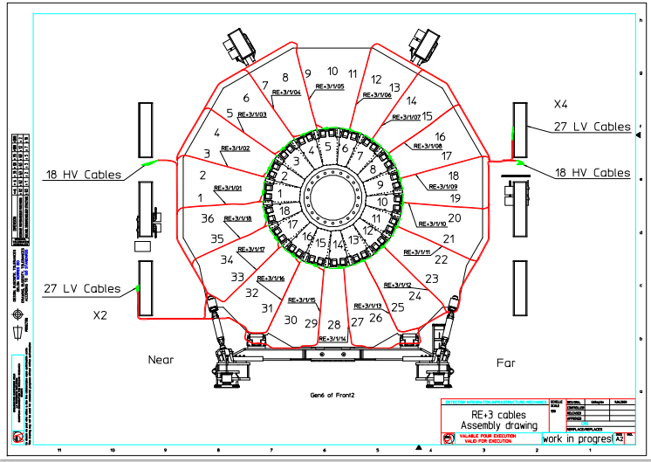
An example of essential work, cable routing and lengths for Russian team, by our colleague Ivan.

Slide 18
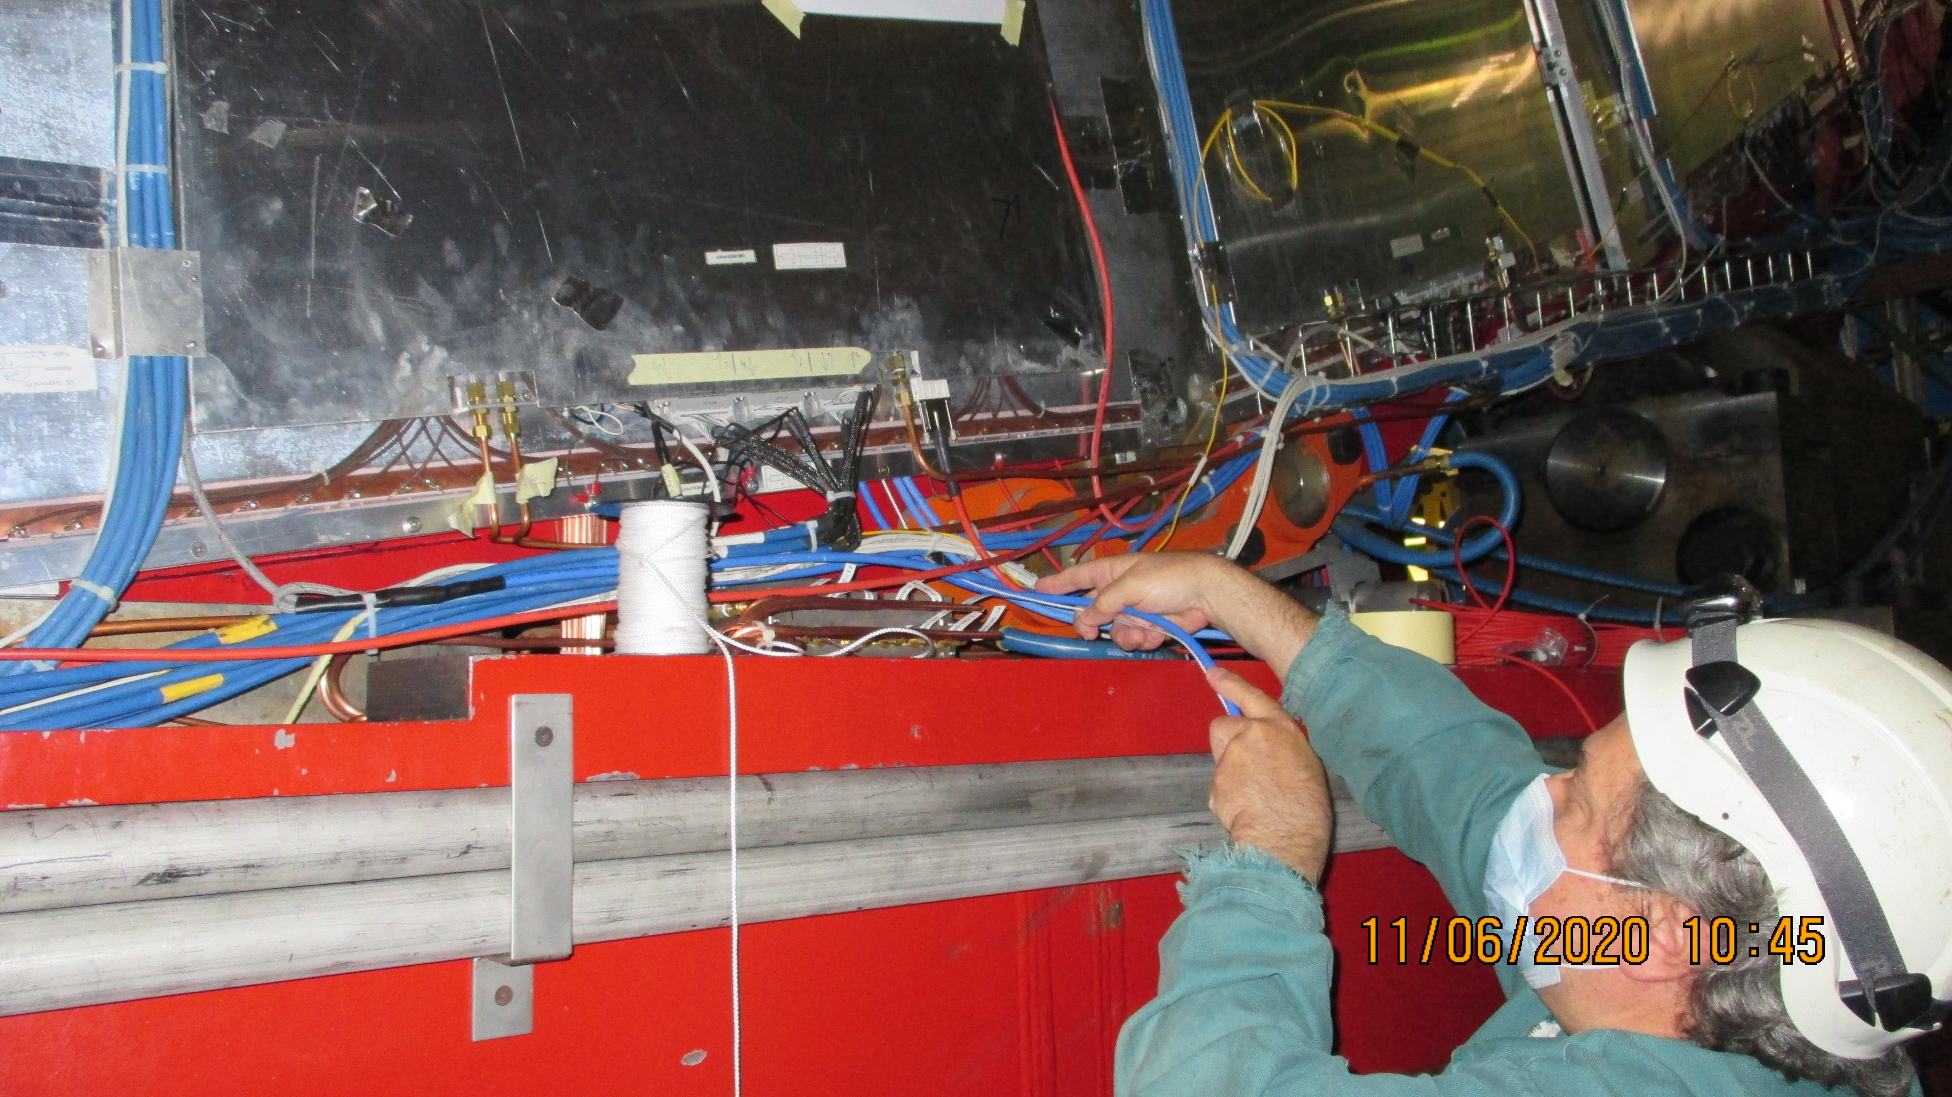
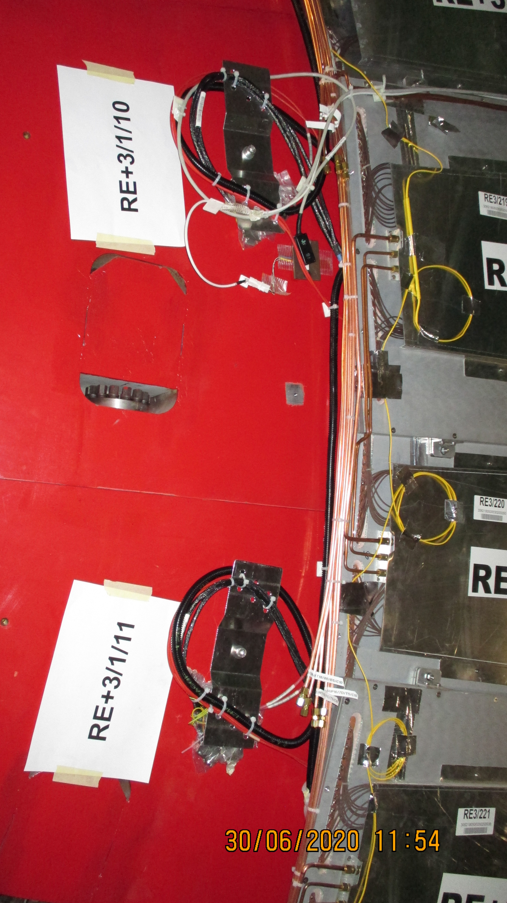
LV Installation, from drawing to reality
Gas piping and cabling on the inner radius , IP side of YE+3 for RE+3/1, ready for chamber connection
LV cabling on the periphery, on the cart of YE+3

Slide 19
Optical Fibres
Fibres from Chamber to YE3 PP
Fibres from YE3 PP to USC
Details here;
http://project-cms-rpc-endcap.web.cern.ch/project-cms-rpc-endcap/rpc/UpscopeHighEta/RPCDevelopements/RE31and41/Services/OpticalFibres/QA/Method/OpticalFiberTest.pptx

Slide 20
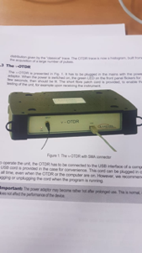
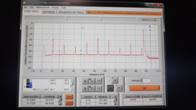
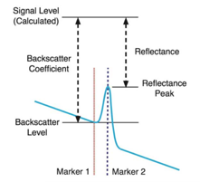
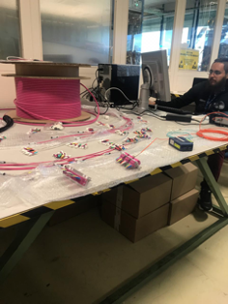
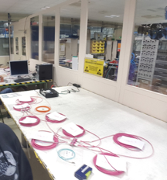
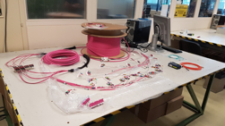
Length measurement and qualitative test for power loss
Connection mapping
Labeling

Slide 21
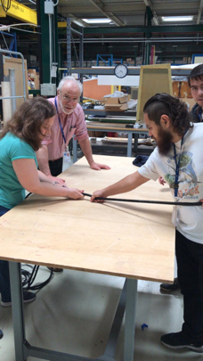
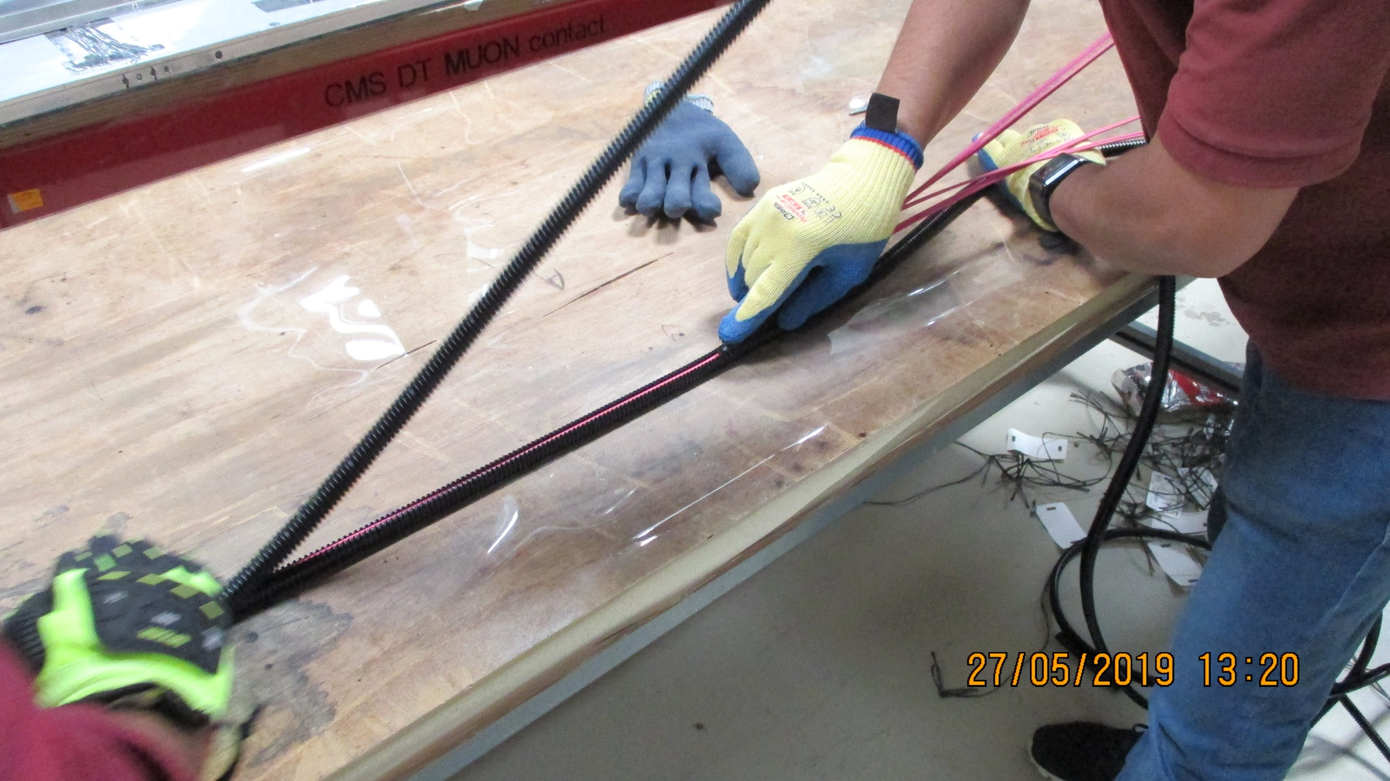
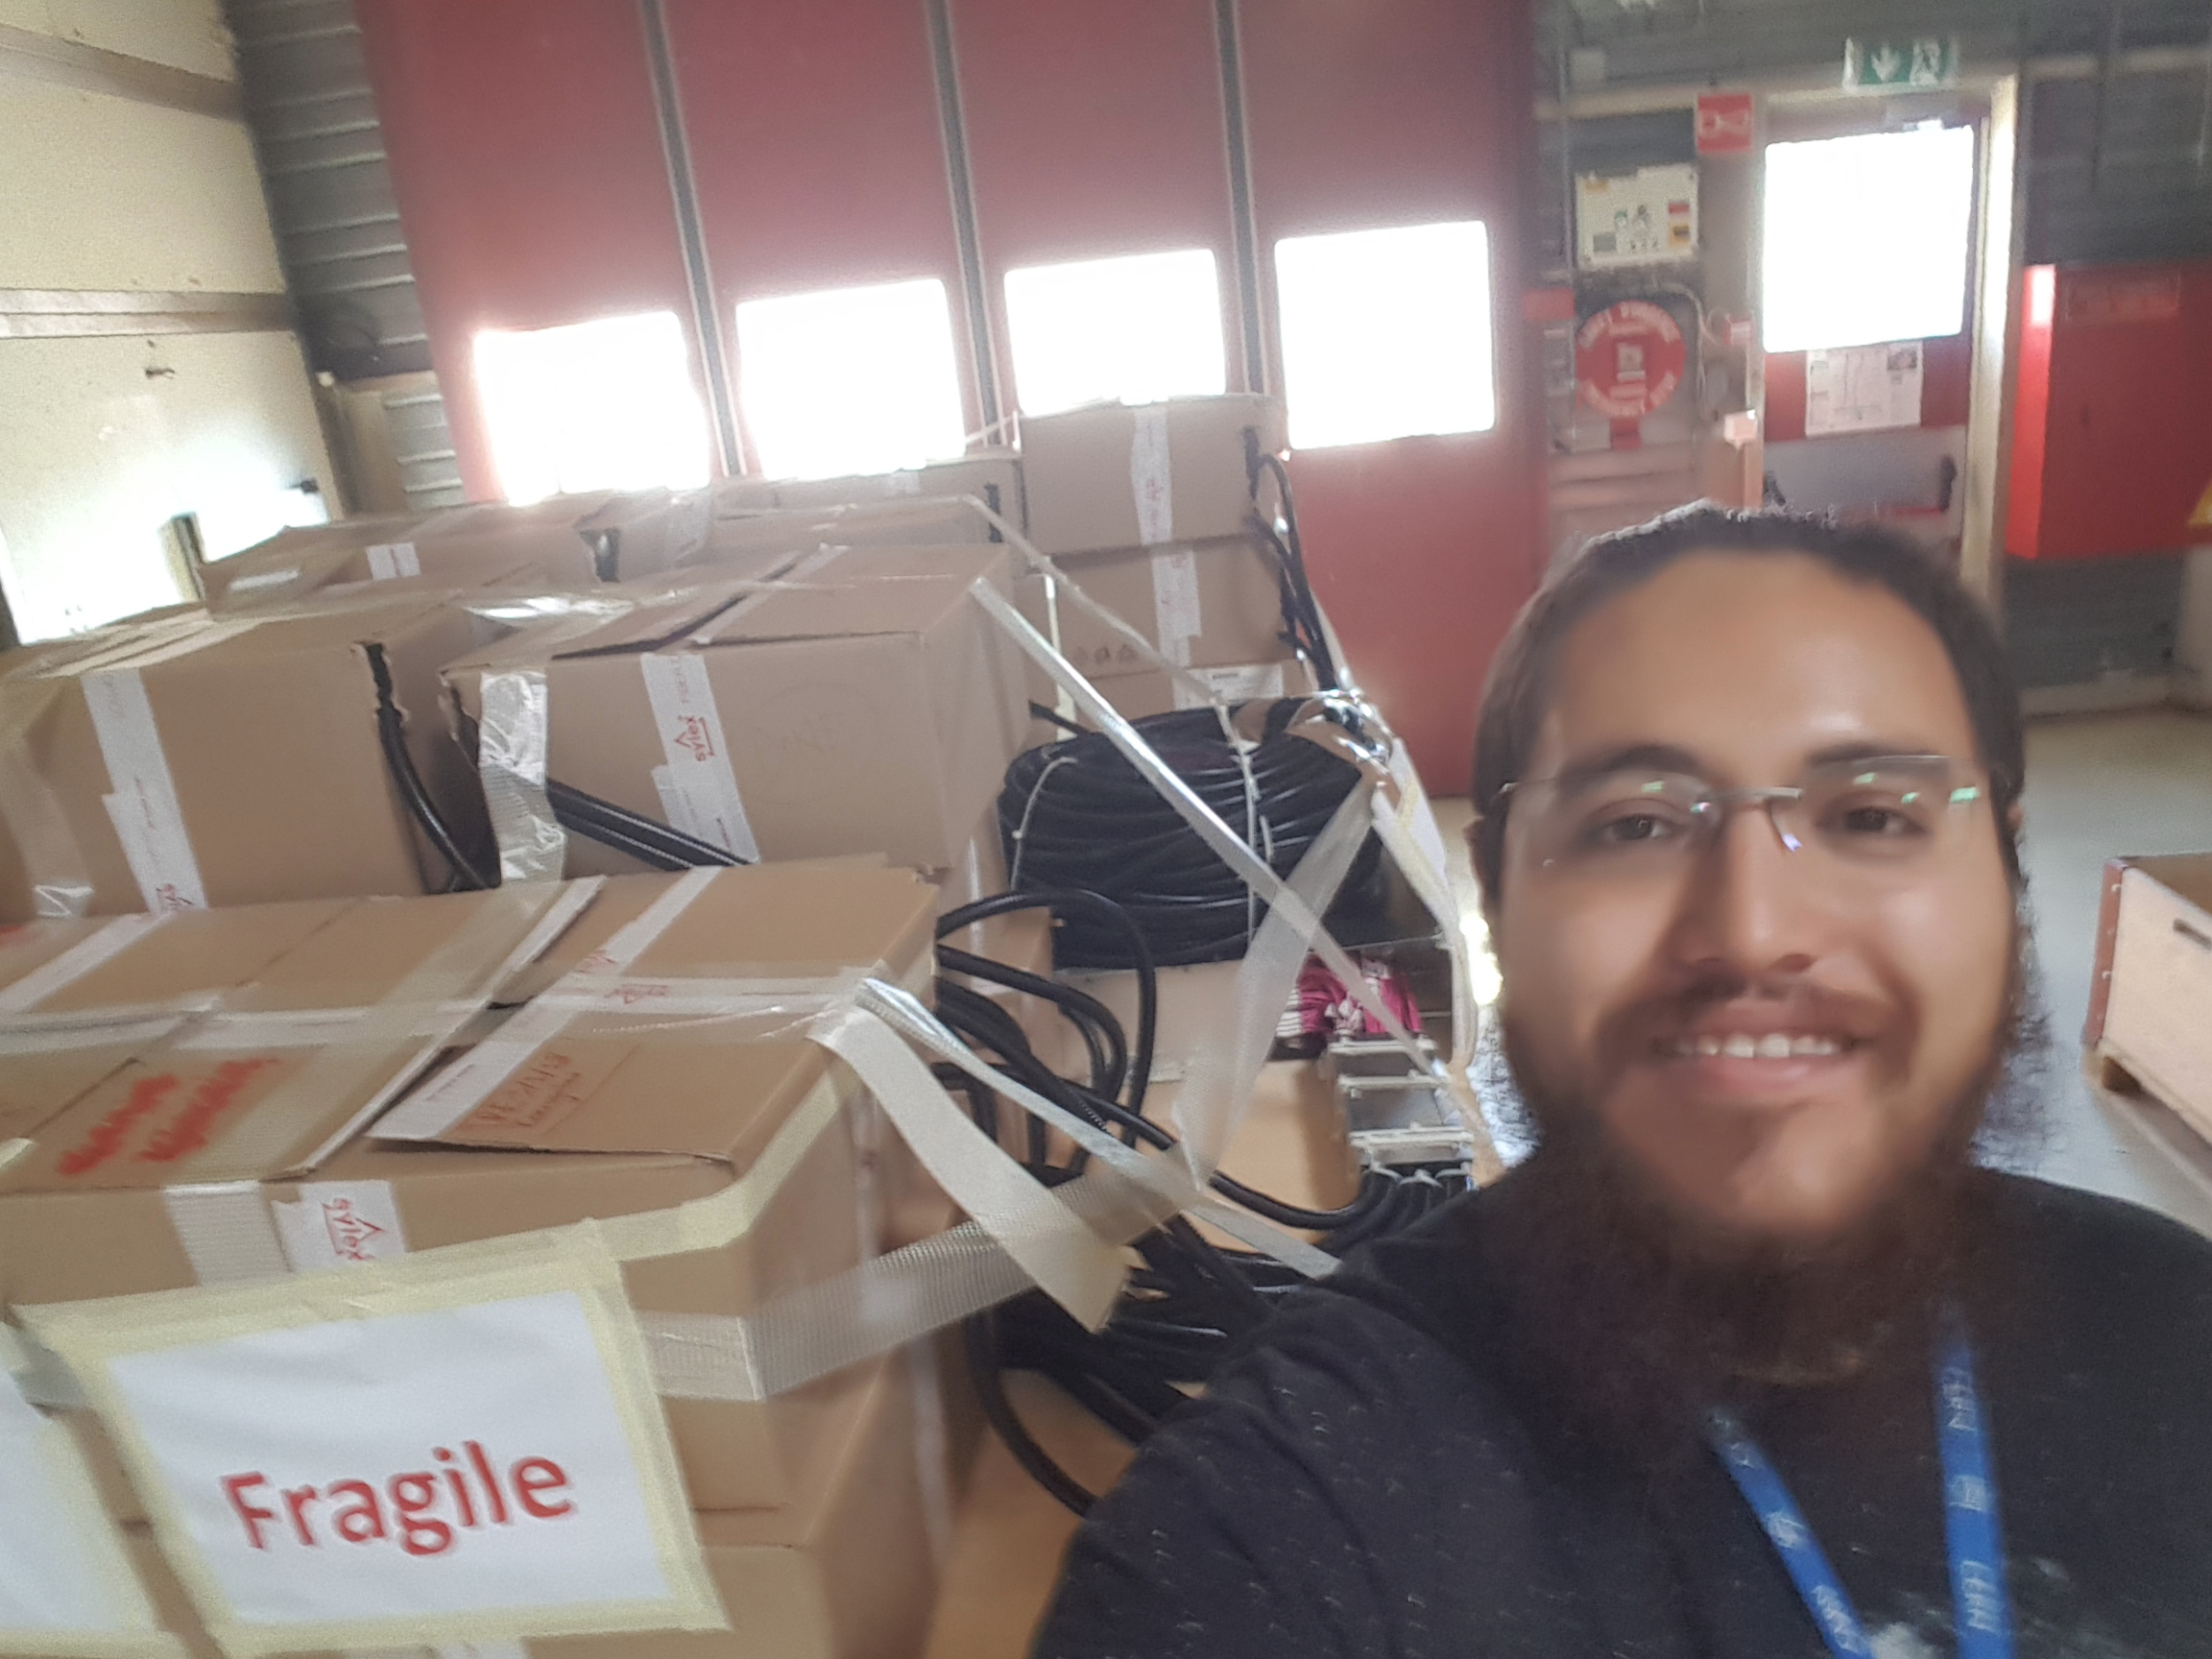
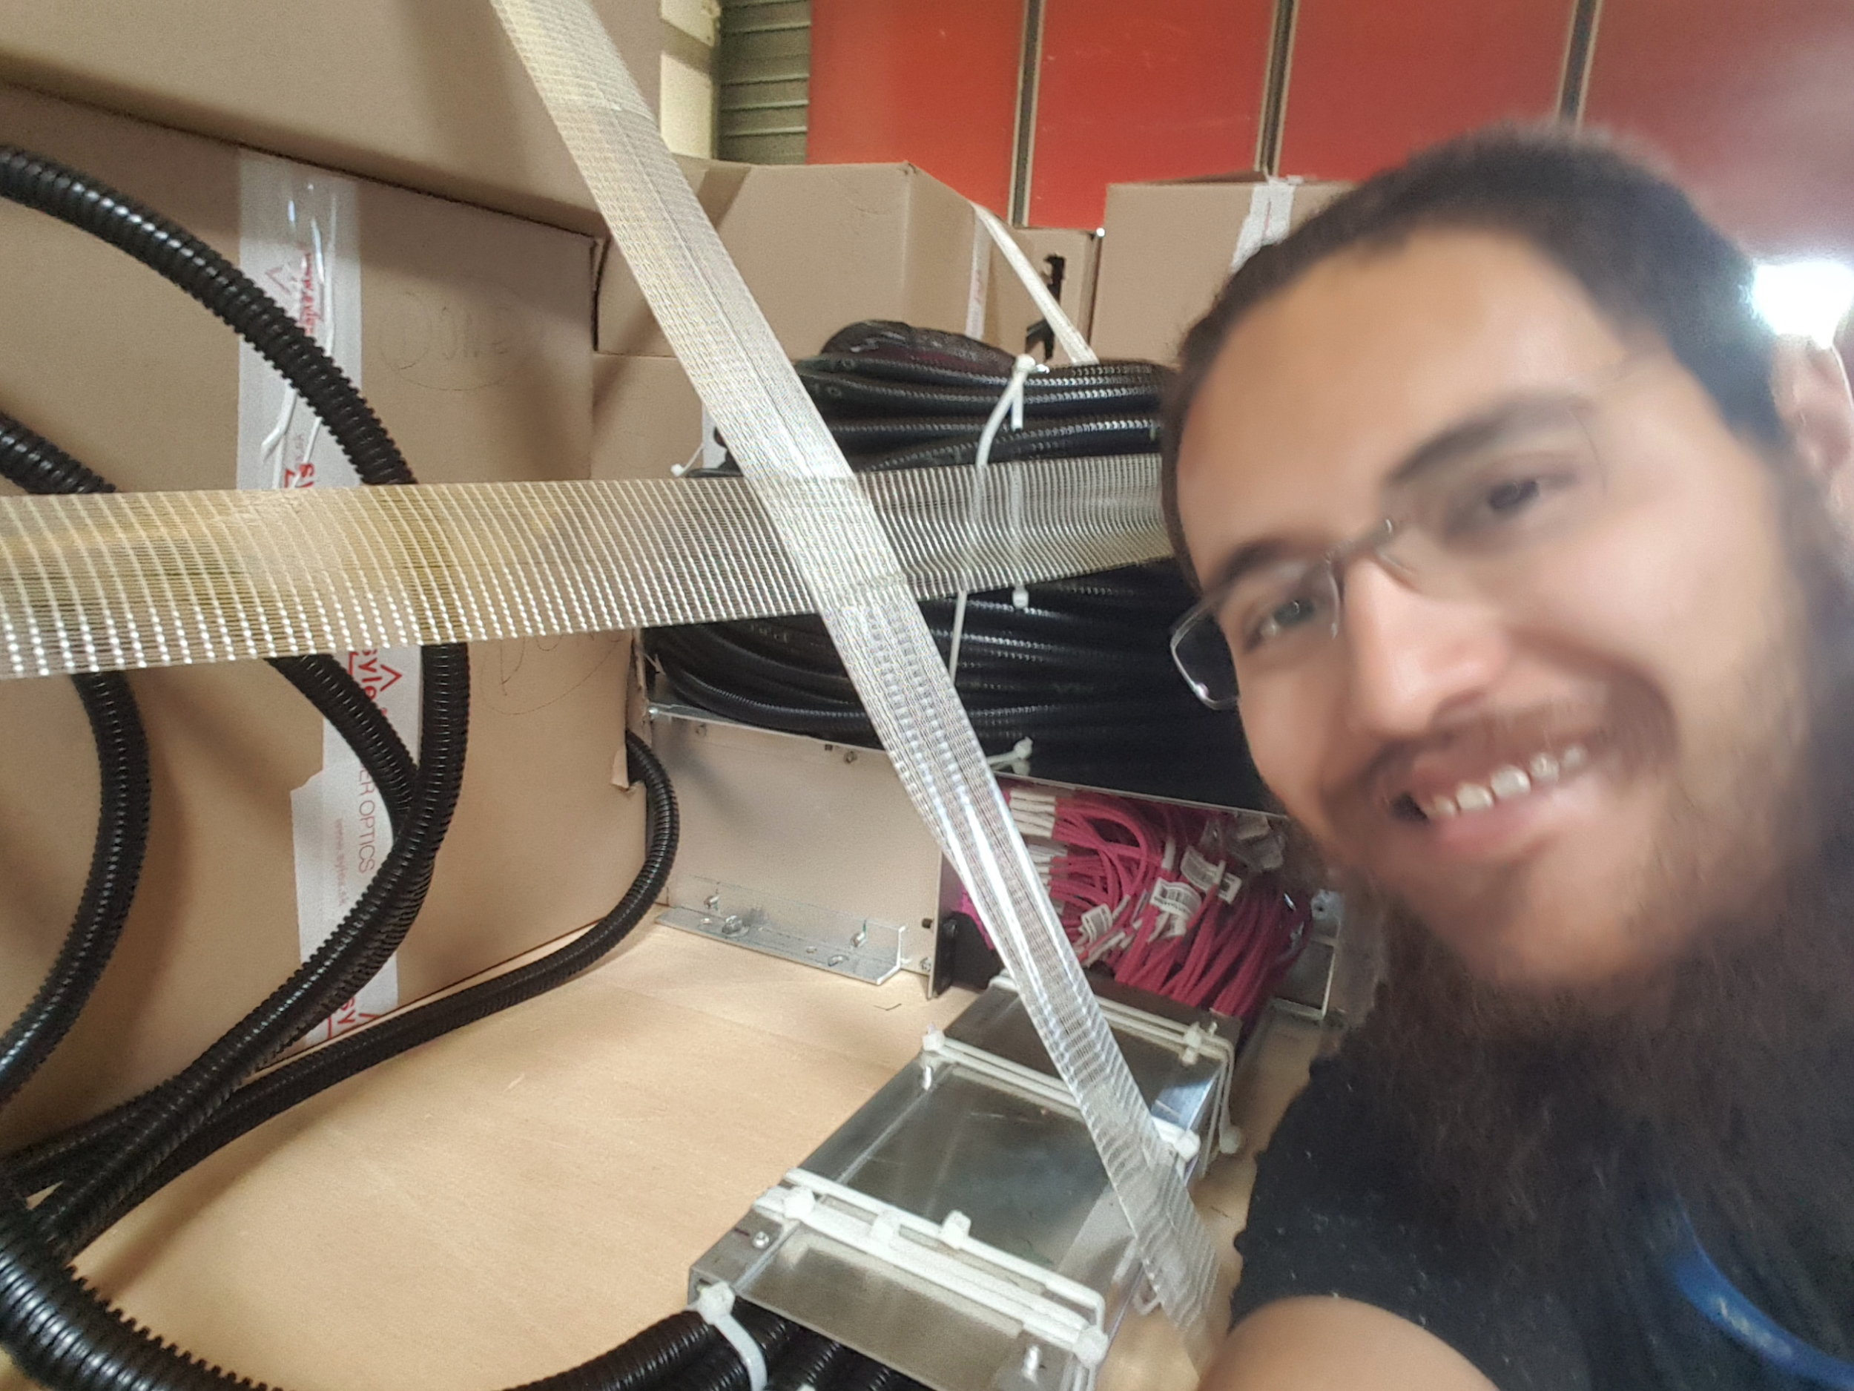
Fiber protection: corrugated conduit installation on fibers

Slide 22
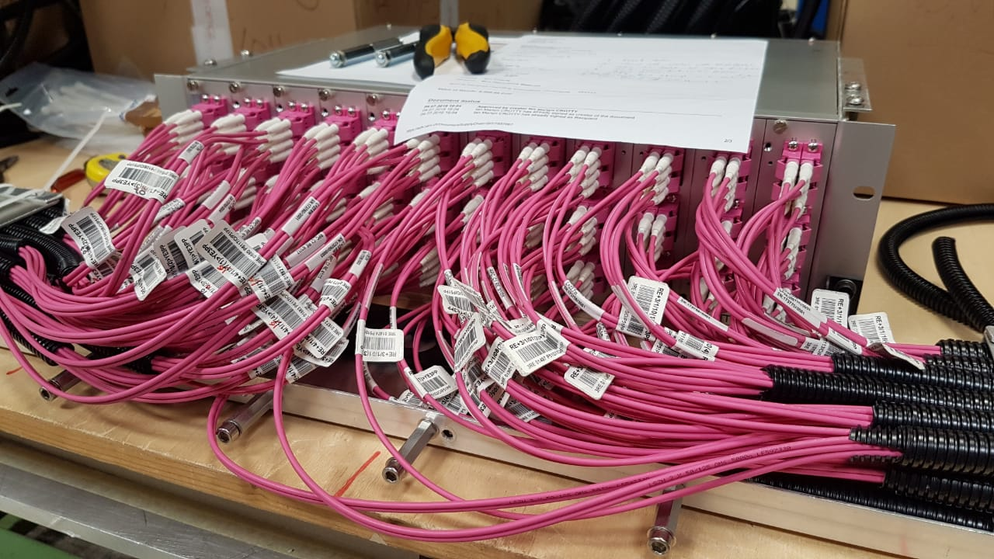
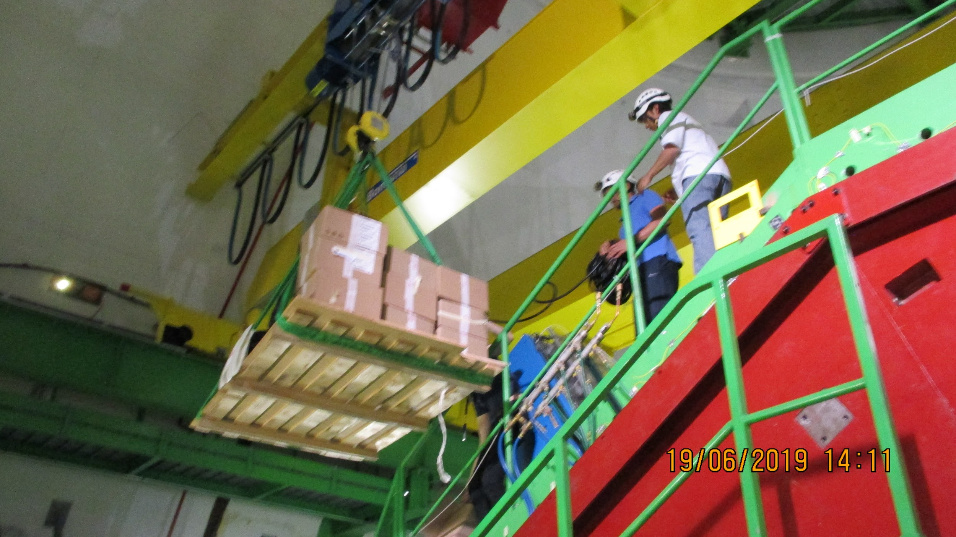
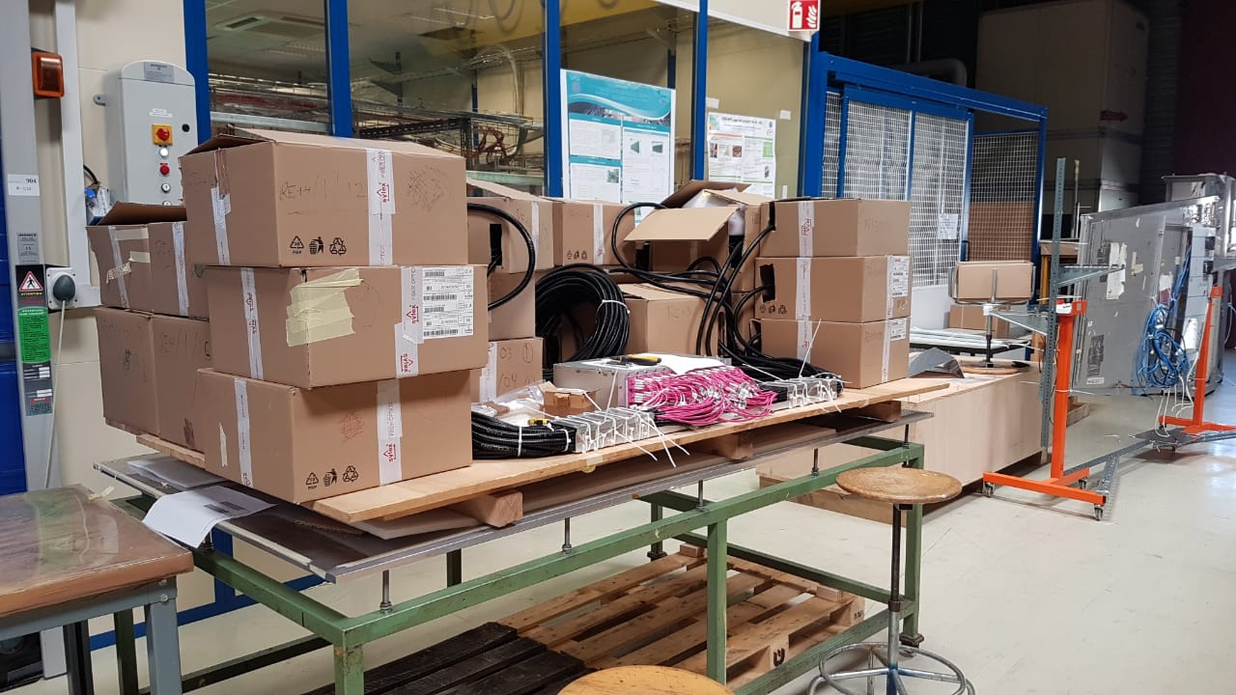
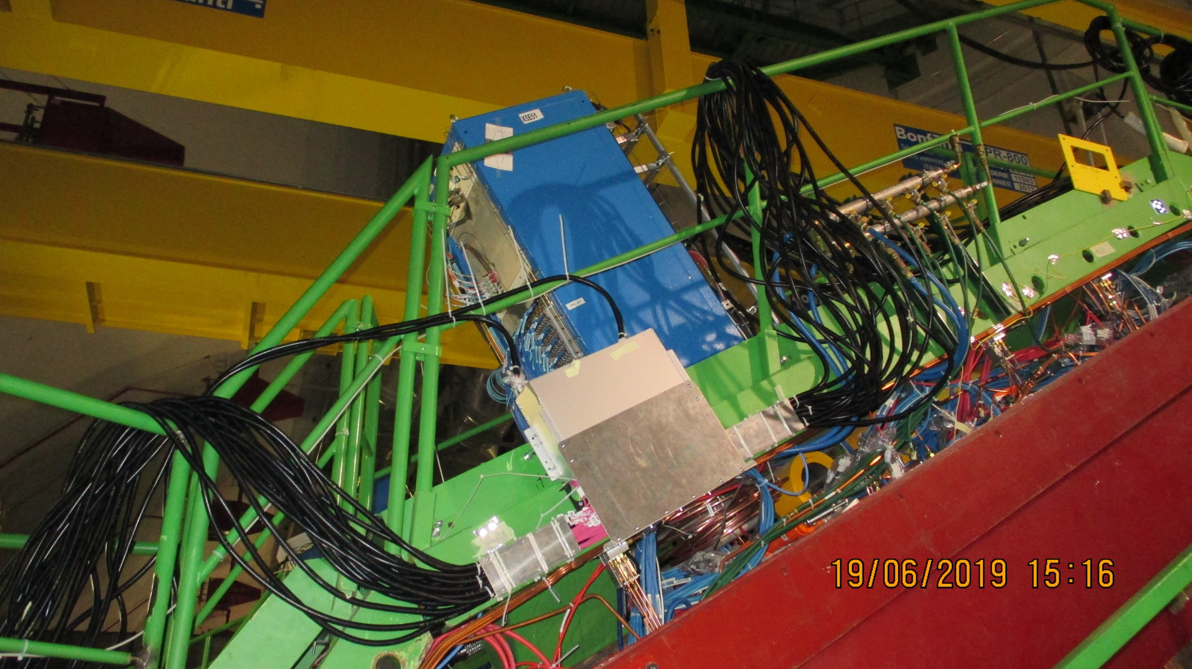
YE3 Patch panel preparation in 904 and installation on the YE3 in one go.
RE-4/1 FO
RE-3/1 FO

Slide 23
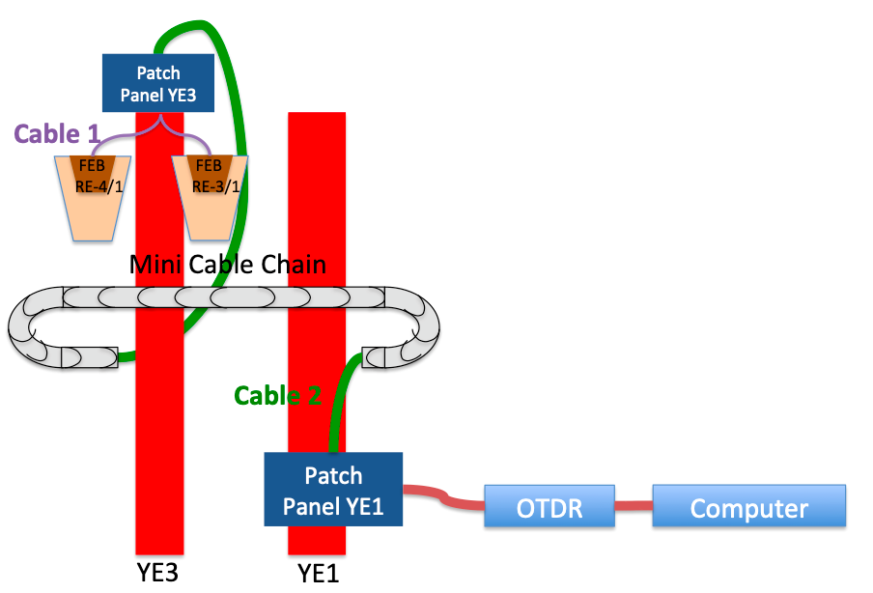
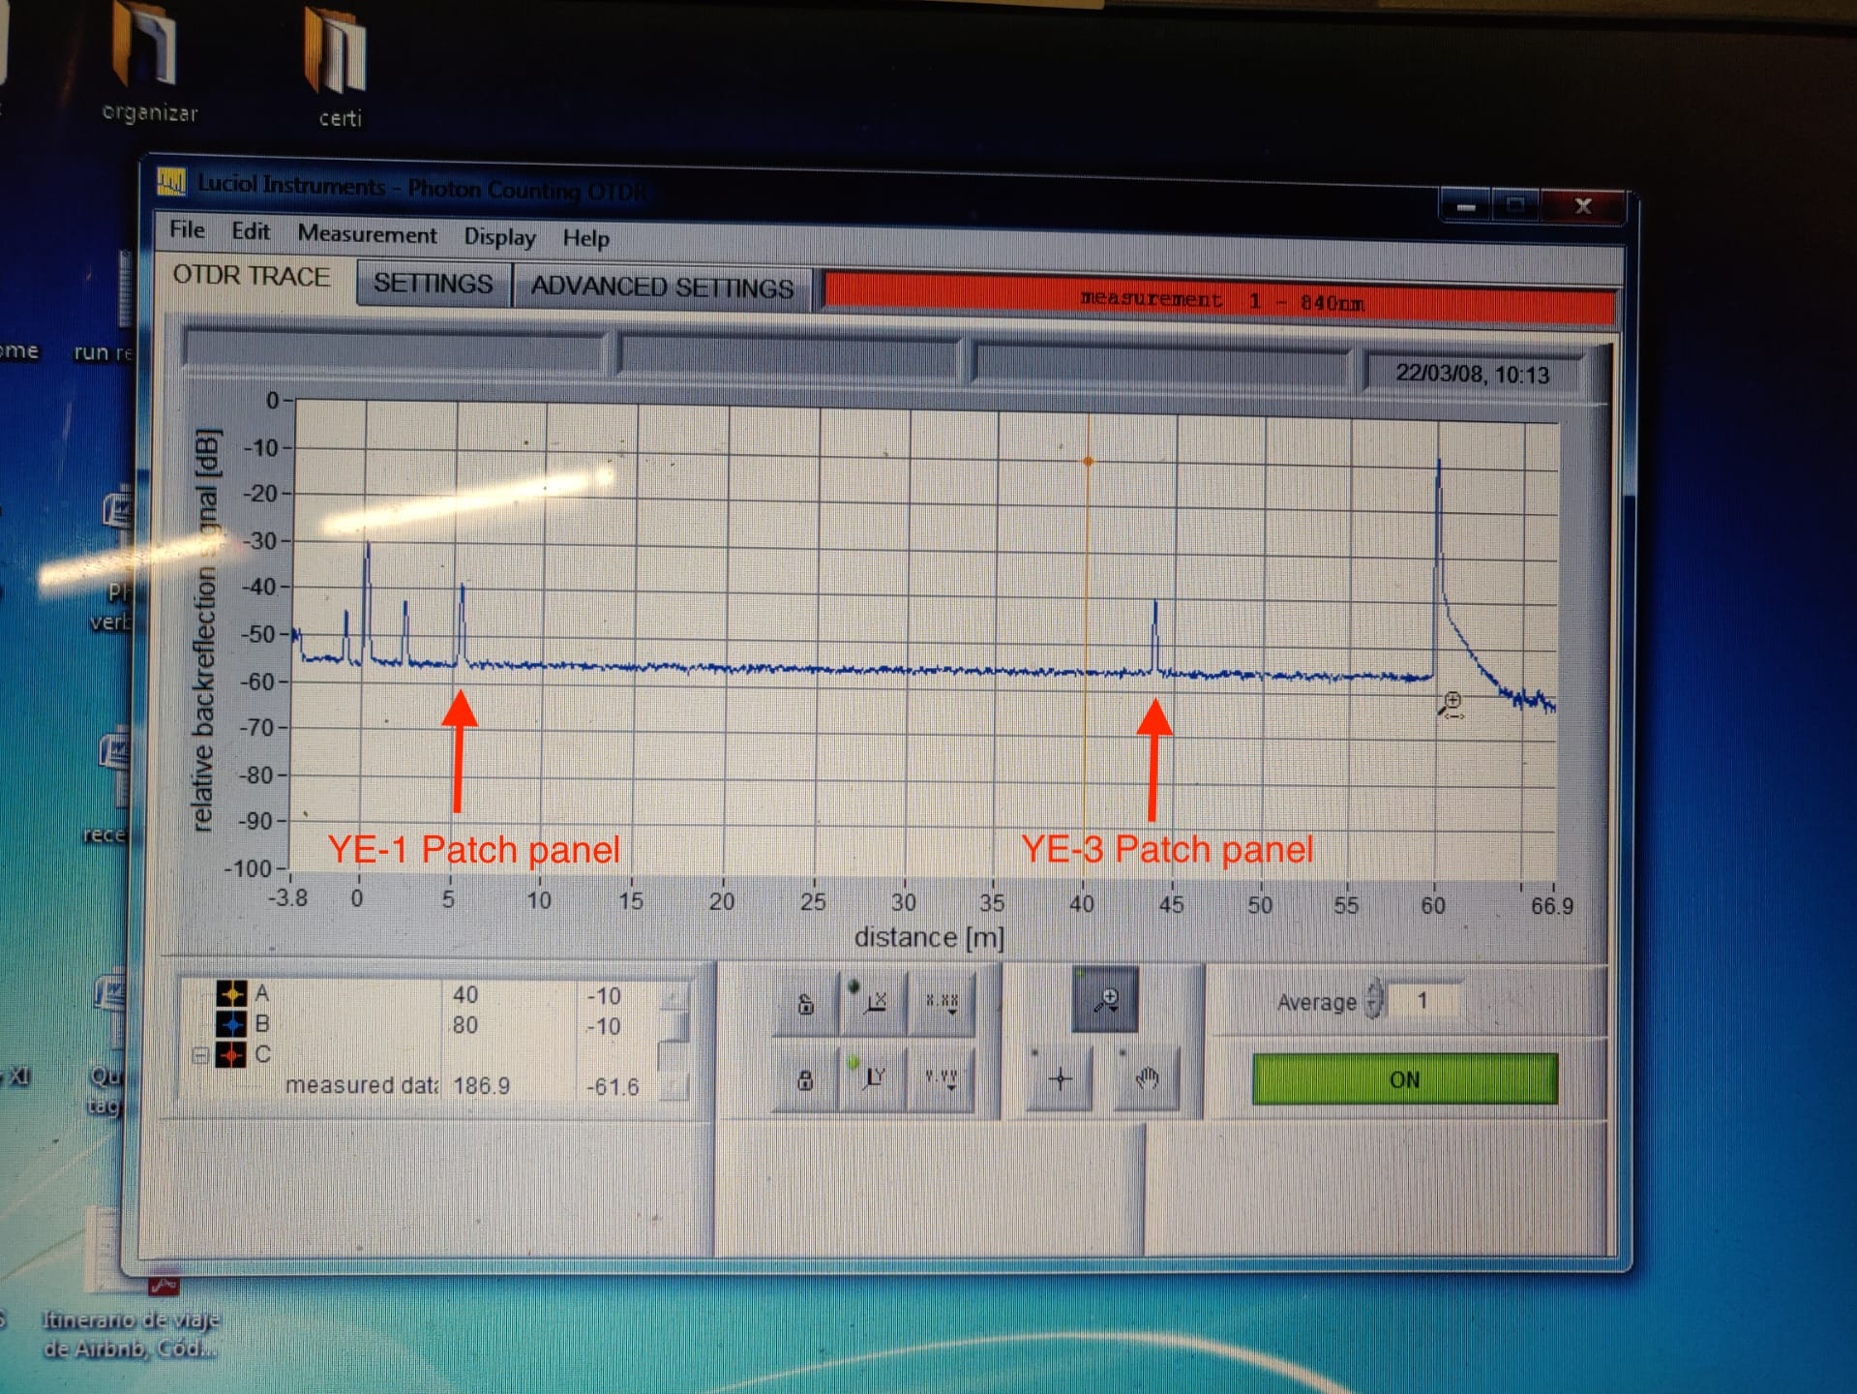
576 fibers tested with OTDR
Installed:
YE+3, YE+1, YE-1 and YE-3 patch panels.
For RE+3/1: 144 fibers from YE+3 patch panel to YE+1 patch panel.
For RE+4/1: 144 fibers from chamber side to YE+1 patch panel.
For RE-3/1: 144 fibers from chamber side to YE-1 patch panel.
For RE-4/1: 144 fibers from YE-3 patch panel to YE-1 patch panel.
For all disks: From YE±1 patch panel to USC rack.
To be completed:
For RE-4/1: 144 fibers from YE-3 patch panel to the chamber.

Slide 24
Cooling of chambers
RE4/1 x2 chambers in one circuit
RE3/1 chambers in series with RE3/2s

Slide 25
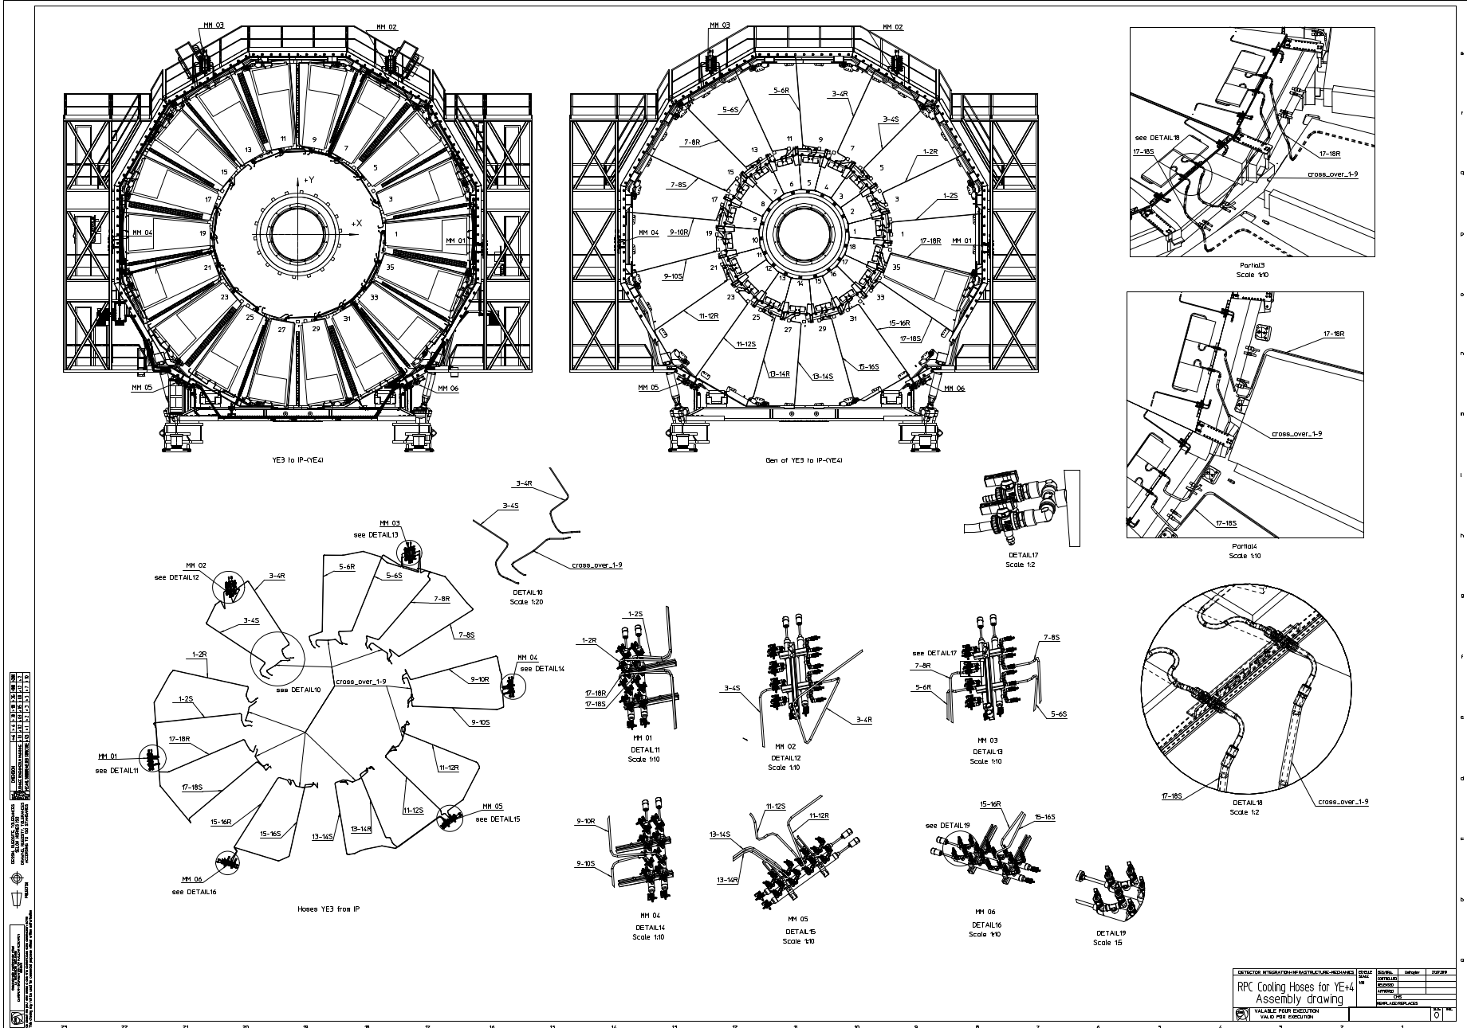
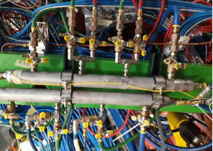
RE4/1 cooling
x6 Mini Manifolds
Link between x2 RE4/1s
“T”s added to the present RE4 SM manifold spigots.
http://project-cms-rpc-endcap.web.cern.ch/project-cms-rpc-endcap/rpc/UpscopeHighEta/RPCDevelopements/RE31and41/Services/Cooling/PipingYoke/Modification/IvanInput/RPCCoolingHosesYEplus427072019.pdf

Slide 26
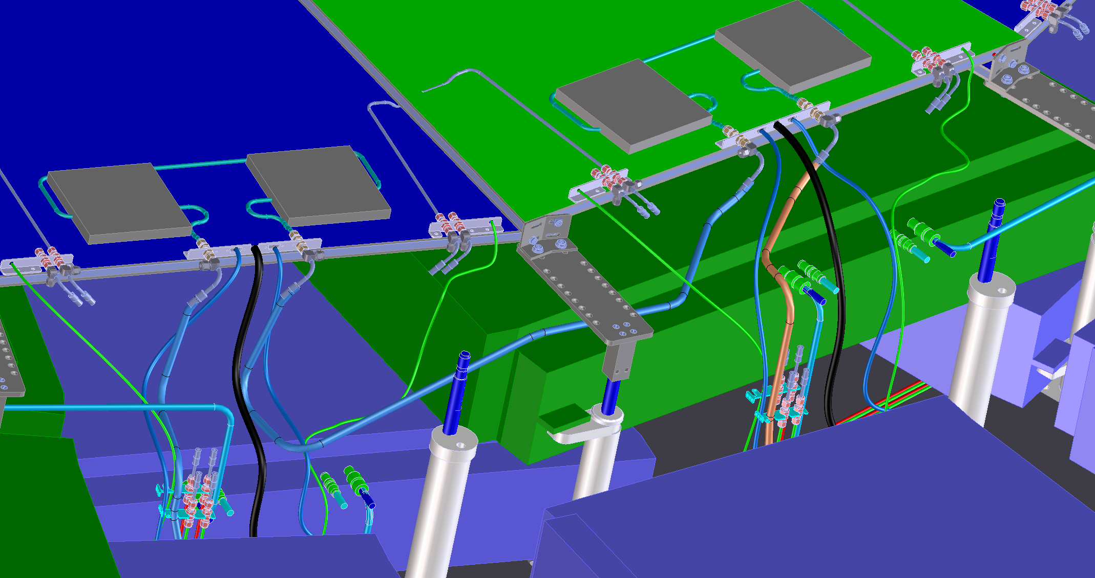
RE4/1 detailed look at Cooling and cables
RE4/1 chambers
Inter link hose joining the two adjacent RE4/1s
ME4/2s
Return hose going under the off yoke ME2/2
Supply hose from under the off yoke ME2/2
Drawing by Ivan

Slide 27
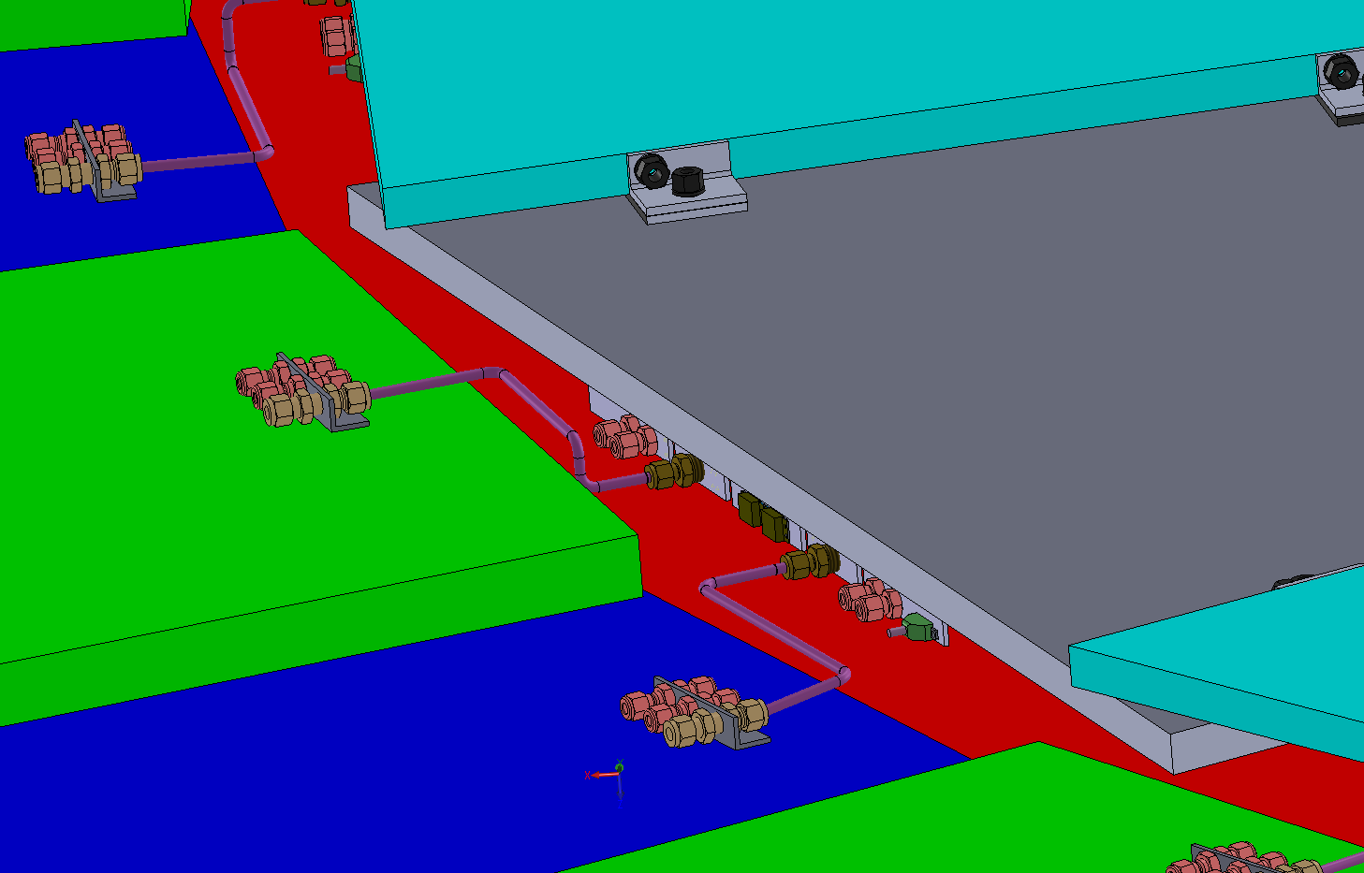
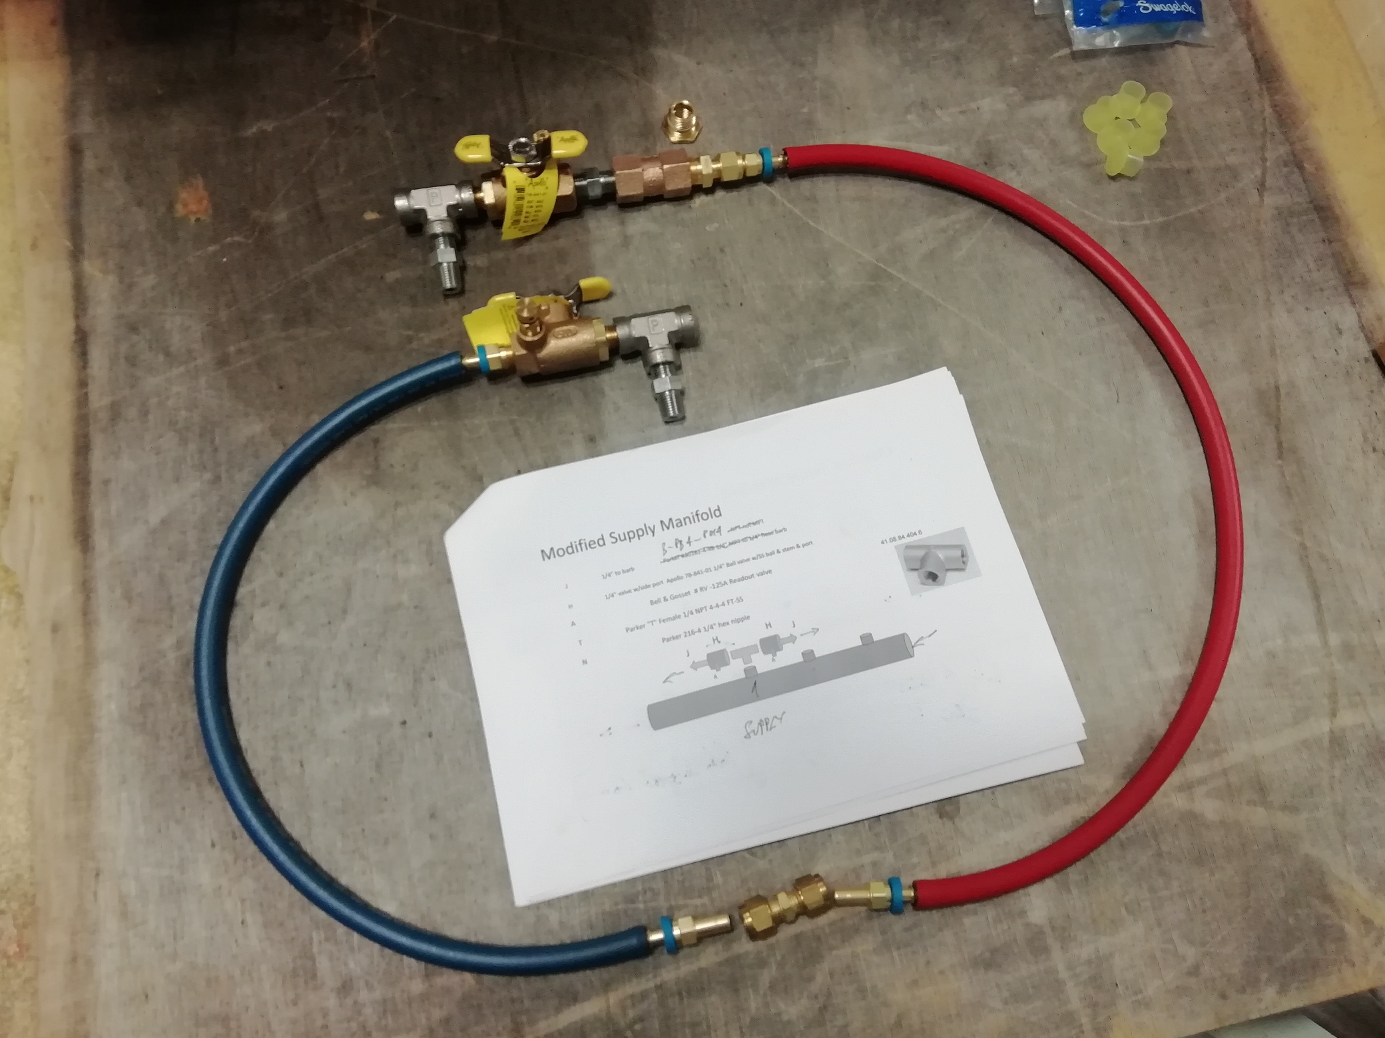
RE3/1 cooling
Installation can only be done after the installation of RE3/1 as the flexibles will link to two adjacent RE3/2s
Components for both stations are identical to those in the rest of the RE cooling
Return Red
Rigid piping replaced with flexibles, less stress on the old RE3/2 fittings
Supply Blue
Pressure test done at x1.5 (gas) the operating pressure, which is ~9Bar.

Slide 28
Gas System Services
Piping from UGX to UXC, through main and mini cable chains.
Piping around and on the face of the yokes
Impedances

Slide 29
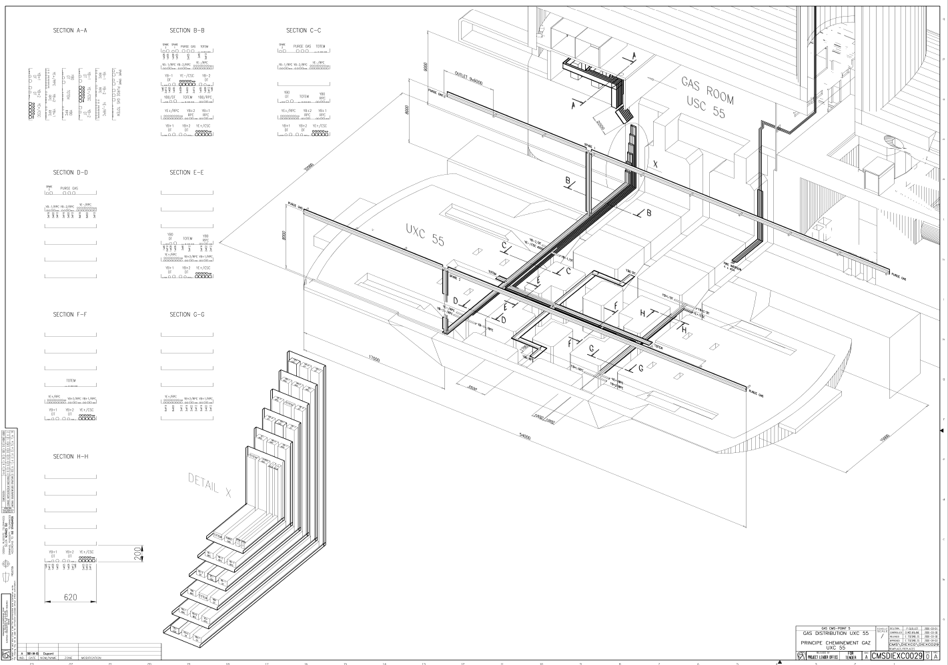
From pre-distribution to distribution UXC racks
From UC gas room to UXC gas racks: new pipes have been installed (2 pipes per disk (negative/positive) for supply/return lines).
Installed Jan 2019 by ZEC team.
Installed:
  Supply: ~240 m inox pipes of Ø 16;
  Return: ~240 m inox pipes of Ø 22;
  Flexible pipes for the chains (MCC+mCC): ~ 72 m flexible pipe of Ø 21;

Slide 30
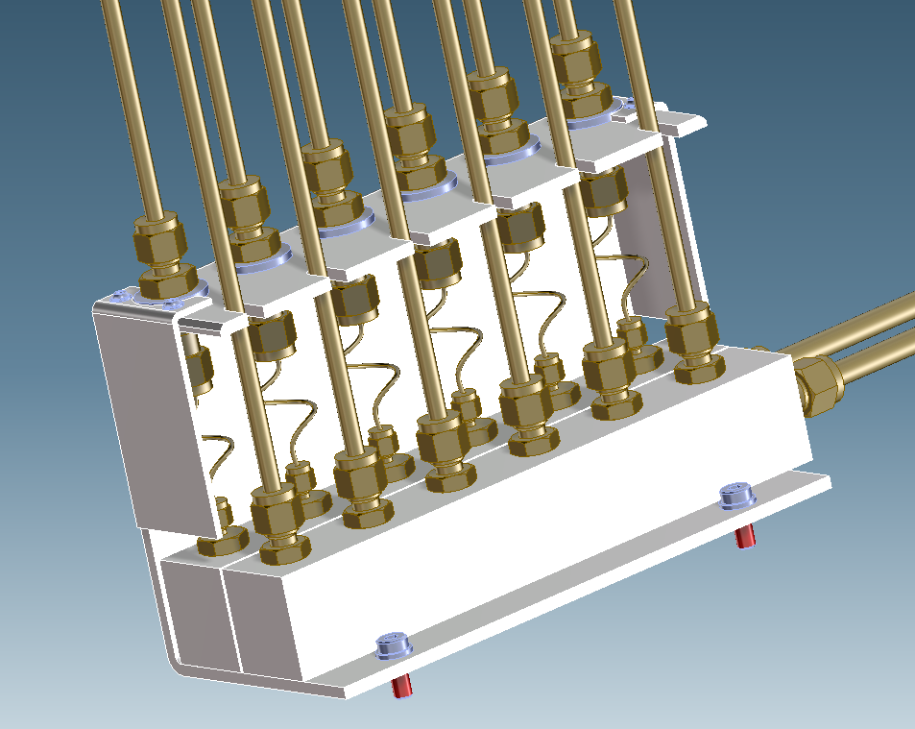
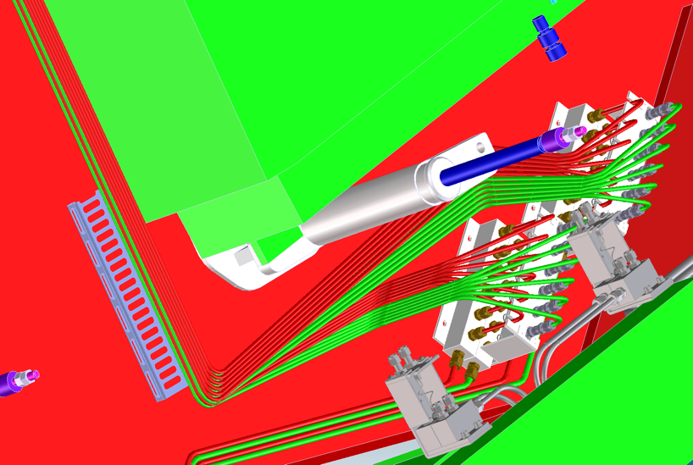
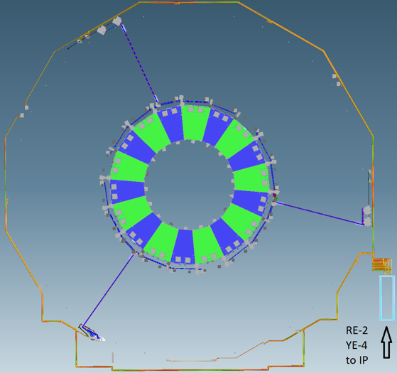
Installation by ZEC of pipes from the UGX to the UXC55, almost 0.5km, in addition to those shown here
Gas distribution based on original piping to 3 points on the periphery requiring impedances. The chambers require individual channels.

Slide 31
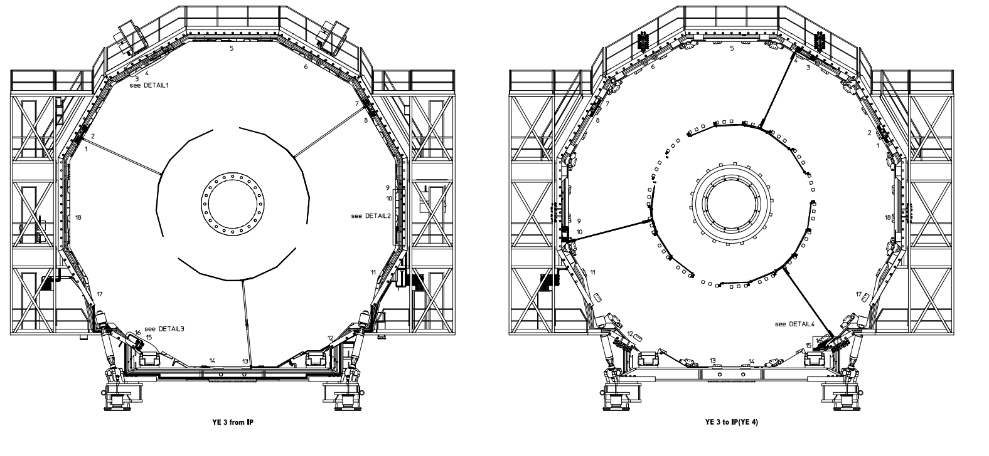
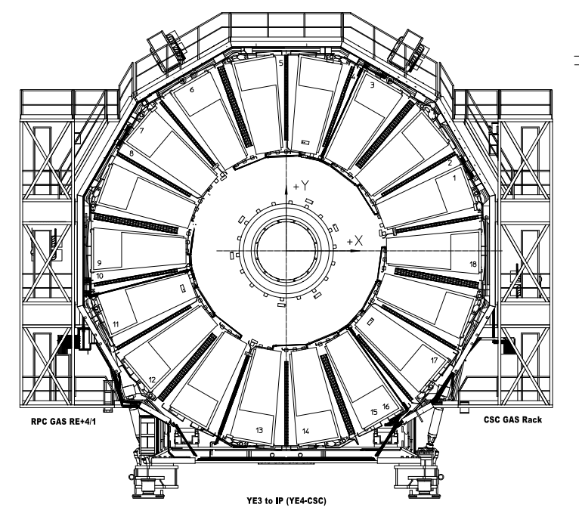
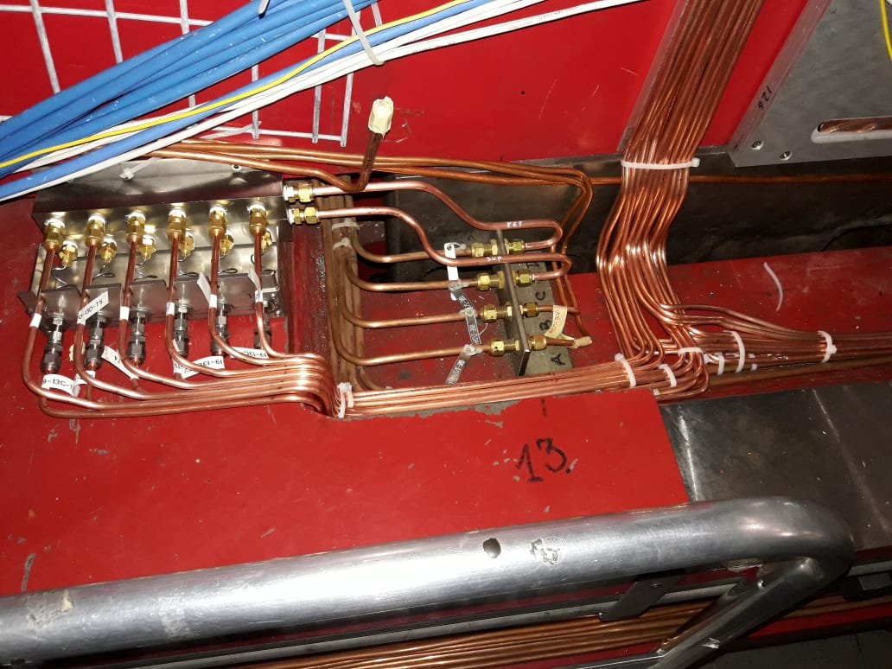
Drawings of RE+4/1 gas service.
The RE-3/1 & RE-4/1 gas service installation is 100% done (pipes and impedance boxes).
Pressure test performed.
For RE+4/1 & RE+3/1 gas service installation is 100% done (pipes and impedance boxes).
Pressure test performed.
RE+4/1 is complete
RE+3/1 is complete
RE-3/1 is complete
RE-4/1 is complete
Gas impedance boxes

Slide 32

Schedule, what was done

Slide 33

Schedule, what is left to do

Slide 34
Manpower
The RPC community wish to thank the teams, shown below, for their persistant work, specifically during this very difficult period due to the Sars-Cov-II virus.
Gas and cooling -> ZEC
Optical Fibers -> Russian team
High Voltage -> Russian team
Low Voltage and Rack Power P2 -> Russian team

Slide 35
Conclusions
Majority of services for chamber operation are installed.
A large work to install crates and their final modules, both in UXC and USC, has still to be done.
The commissioning, consisting of the map verification (labels) and performance validation, can now start before the final and complete electronic module installation.
A significant amount of work was done in P5 by numerous colleagues/teams and all this despite the Sars-Cov-II virus. The world can go on.

Slide 36
Thanks for your attention !

Slide 37
Backup Slides
https://twiki.cern.ch/twiki/bin/viewauth/CMS/Services_RPCPhase2Upgrade#Inox_pipes_Details
This presentation;
http://project-cms-rpc-endcap.web.cern.ch/rpc/UpscopeHighEta/RPCDevelopements/RE31and41/Services/Presentations/MuonReview22sept2020/RPCservices22Sept2020.pptx

Slide 39
HV Power System Upgrade for RE3/1 & RE4/1 (II)
USC
UXC
SY4527
EASY3000
The HV power system will be based on CAEN EASY system
(practically, extension of the existing HV system):
SY4527 – 1 (existing)
A3485S - 2 modules (existing)
2 EASY3000 crates
A3512N – 12 HV Boards
TDR Baseline: Variant II
4 HV multiconductor cables per endcap. Each with 20 HV channels
All must go via the YE1’s main cable chains (MCC)
A3485S
A3512N
INSTALLED
JAN.2019
Long term maintenance will be secured by CERN-CAEN contract.
To be integrated in the RPC DCS.
3

Slide 40
S1H12
S1H07
HEX
HEX
HV Distribution Box
ENDCAP RACKS
S1H11 – S1H08
HV Distribution Box
HV Distribution Box
SY4527
HV Distribution Box
HV Distribution Box
HV Distribution Box
HEX
SY4527
HV Distribution Box
HV Distribution Box
48V DC cable connected after Crate3 in rack S1H09
Crate4
RE+3/1
RE+4/1
HEX
1 new rack (S1H12)
2 EASY crates
8 umbilical cables all arriving to one rack
12 A3512N HV boards (6 boards in each crate)
8 HV Distributor Boxes in total (all in one rack)
A3485S
Crate4
RE-3/1
RE-4/1
A3485S
48V DC cable connected after Crate3 in rack S1H11
A3485S
A3485S
4

Slide 41

High Voltage
All cables tested.
January 30th, 2020
41

Slide 42

Low Voltage
January 30th, 2020
42

Slide 43

Low Voltage
January 30th, 2020
43

Slide 44
Readiness and Schedule (to be updated)
RE-3/1 cable installation 9 days Thu 13/06/19 Tue 25/06/19 (Done)
RE+4/1 cable installation 14 days Fri 02/08/19 Wed 21/08/19 (Done)
RE+3/1 cable installation 11 days Wed 13/05/20 Wed 27/05/20 (Ready, cooling incomplete)
RE-4/1 cable installation 10 days Wed 15/04/20 Tue 28/04/20 (Ready, cooling incomplete)
Optical fibre from UXC to USC:
Positive side: 04-11.May.2020 (6 days)
Negative side: after the end of the muon critical path
January 30th, 2020
44

Slide 45
RE Power Cabling: YE-3 Run2 & Run3 Configurations
Slide by S. Lusin
Existing RE power cable
feeds both sides of YE3
Two new power distribution boxes will be added per endcap
Will need to install new on-detector power cable on far side
… by “going over the top” of YE3 steel
& route through mini cable-chain
http://project-cms-rpc-endcap.web.cern.ch/rpc/Services/LV%20LS2%20Upgrade/re_ls2_power_upgrade.pptx

Slide 46
Labeling Status today
Type | Location | Printed | Installed | # Individual Labels | # Copies | Total | Comments
HV | RE+3/1 | Yes | Done by Fatma | 18 | 2 | 36
HV | RE-3/1 | Yes | Yes | 18 | 2 | 36
HV | RE+4/1 | Yes | Done by Fatma | 18 | 2 | 36 | 16 July finished
HV | RE-4/1 | Yes | Done by Fatma, Gamal, Ekhlas | 18 | 2 | 36 | 18 July finished
LV | RE+3/1 | Yes | Yes | 18 | 2 | 36
LV | RE-3/1 | Yes | Yes | 18 | 2 | 36
LV | RE+4/1 | Yes | Done by Fatma, Gamal, Ekhlas, Manuel | 18 | 2 | 36 | Correction done on UXC by Daniel and Andres, missing chamber side
LV | RE-4/1 | yes | Done by Fatma, Gamal, Ekhlas, Manuel | 18 | 2 | 36 | Correction done on 904 by Manuel and Andres
Fiber | RE+3/1 Cable 1 | Yes | Yes | 18 | 2 | 36
Fiber | RE-3/1 Cable 1 | Yes | Yes | 18 | 2 | 36
Fiber | RE+4/1 Cable 1 | Yes | Yes | 18 | 2 | 36 | Correction done on 904 by Daniel and Andres
Fiber | RE-4/1 Cable 1 | Yes | Yes | 18 | 2 | 36 | Correction done on UXC by Daniel and Andres
January 30th, 2020
46

Slide 47

Experimental setup for ΔP tests of the impedances
Gas: freon
Rotameter and flowmeter
Pressure sensor
The goal: define the tube specification for RE4.1, RE3.1 impedance boxes.
Two types of capillary:
  OD 1.59mm, ID 0.99 mm (used for RE4)
  OD 1.59 mm, ID 0.87 mm

Slide 48



Readiness and Schedule
We are here now. Covid-19 Delay.
4 month delay

Slide 49
Muon LS2 Schedule
ID | Task Name | Duration | Start | Finish | Predecessors | Resource Names | % Complete | Sub System
8 | Install RE-3/1 & RE-4/1 HV umbilical cables in MCC | 7 days | Wed 09/01/19 | Fri 18/01/19 | 2FS+1 day | RTech | 100% | RPC
112 | YE-3 Activities | 13 days | Thu 06/06/19 | Tue 25/06/19 |  |  | 100%
115 | RE-3/1 cable installation | 9 days | Thu 13/06/19 | Tue 25/06/19 | 111FS+0.5 | dRTech | 100% | RPC
214 | YE+4 Activities | 67 days | Fri 05/07/19 | Fri 11/10/19 |  |  | 100%
215 | RE+4/1 service installation | 67 days | Fri 05/07/19 | Fri 11/10/19 |  |  | 100% | RPC
218 | RPC YE+3 OF Patch Panel Installation | 1 day | Fri 09/08/19 | Fri 09/08/19 | 179,217 |  | 100% | RPC
219 | RE+4/1 HV FAR cable installation CH2mCC | 3 days | Thu 08/08/19 | Mon 12/08/19 | 217FS+1 da | RTech | 100% | RPC
220 | RE+4/1 HV NEAR cable installation CH2mCC | 3 days | Fri 09/08/19 | Tue 13/08/19 | 219FS-2 da | yRTech | 100% | RPC
221 | RE+4/1 LV cable installation | 3 days | Tue 13/08/19 | Thu 15/08/19 | 220FS-1 da | yRTech | 100% | RPC
222 | RE+4/1 HV&OF installation in mCC Near | 1 day | Fri 16/08/19 | Fri 16/08/19 | 221 | RTech | 100% | RPC
223 | RE+4/1 OF installation CH2PP | 5 days | Mon 19/08/19 | Fri 23/08/19 | 222 | RTech | 100% | RPC
225 | RE+4/1 HV installation in mCC Far | 1 day | Mon 26/08/19 | Mon 26/08/19 | 223 | RTech | 100% | RPC
227 | RE+4/1 LV cable correction | 1 day | Mon 02/09/19 | Mon 02/09/19 | 226 | RTech | 100% | RPC
236 | Recabling & commissioning X4A51 & X4S51 racks | 4 days | Tue 08/10/19 | Fri 11/10/19 | 234 |  | 100% | RPC
426 | YE+3 Activities | 19.5 days | Tue 09/06/20 | Mon 06/07/20 |  |  | 100%
427 | RE+3/1 cable installation | 16 days | Tue 09/06/20 | Tue 30/06/20 | 425 | RTech B5 | 100% | RPC
428 | RE+3/1 ground cable installation | 1 day | Thu 02/07/20 | Thu 02/07/20 | 427FS+1 da | Anton | 100% | RPC
451 | RPC Optical Fibre Installation Positive End | 5 days | Mon 24/08/20 | Fri 28/08/20 | 453SS-5 da | yRTech A5 | 100% | RPC
455 | ME-x/1 refurbishment | 121 days | Thu 28/05/20 | Wed 18/11/20 |  |  | 73% | CSC
479 | RE-3/1 3rd LV cable installation | 2 days | Fri 03/07/20 | Mon 06/07/20 | 476 | RTech A4 | 100% | RPC
485 | RE-3/1 ground cable installation | 1 day | Thu 09/07/20 | Thu 09/07/20 | 483SS | Anton | 100% | RPC

Slide 50
543 | YE-4 Activities | 58 days | Mon 20/07/20 | Mon 12/10/20 |  |  | 31%
550 | RE-4/1 cable installation | 12 days | Fri 25/09/20 | Mon 12/10/20 |  |  | 0%
551 | RE-4/1 HV FAR cable installation CH2mCC | 4 days | Fri 25/09/20 | Wed 30/09/20 | 549FS-1 da | yRTech A4 | 0% | RPC
552 | RE-4/1 HV NEAR cable installation CH2mCC | 3 days | Mon 28/09/20 | Wed 30/09/20 | 549 | RTech B4 | 0% | RPC
553 | RE-4/1 LV cable installation | 4 days | Thu 01/10/20 | Tue 06/10/20 | 552 | RTech B4 | 0% | RPC
Page 1
Muon LS2 Schedule
ID | Task Name | Duration | Start | Finish | Predecessors | Resource Names | % Complete | Sub System
554 | RE-4/1 OF installation CH2PP | 6 days | Thu 01/10/20 | Thu 08/10/20 | 551 | RTech A4 | 0% | RPC
555 | RE-4/1 HV&OF installation in mCC Near | 2 days | Wed 07/10/20 | Thu 08/10/20 | 552,553 | RTech B4 | 0% | RPC
556 | Drill and tap holes for RE-4/1 grounding | 1 day | Fri 09/10/20 | Fri 09/10/20 | 555 | RTech B2 | 0% | RPC
557 | RE-4/1 ground cable installation | 1 day | Mon 12/10/20 | Mon 12/10/20 | 556 | RTech B2 | 0% | RPC

Slide 51
Material for slide showing Caverns
https://edms.cern.ch/ui/file/167912/AA/cmsdiexl0011-vAA.pdf
https://edms.cern.ch/ui/file/167920/AB/cmsdiexl0003-vAB.pdf

Slide 52





Slide 53



