Slide 1


Service Installation for RE3/1 and RE4/1: status and plan
Andrés Leonardo Cabrera Mora
Ian Crotty
On behalf of the RPC group
January 30th, 2020
1

Slide 2
Services installed for RE3/1 and RE4/1
High Voltage installation USC and UXC
Chamber Low Voltage installation in UXC
Power system cabling for YE3.
Cooling System RE4/1 on YE3
Gas system
Schedule
Manpower

Slide 3
High voltage cables on the YE3 linking to YE1 for RE3/1 and RE4/1

Slide 4
High Voltage
Thanks to: Fatma, Manuel, Margarida, Darwish
https://indico.cern.ch/event/835724/
Cables certified up to 15 kV during one hour.
144 Cables tested -> 143 Ok / 1 Rejected and fixed.
Installed:
For RE+4/1: 36 cables from chamber to YE+1 patch panel
For RE-3/1: 36 cables from chamber to YE-1 patch panel
For RE+3/1: 36 cables from chamber to YE-1 patch panel
To be completed:
For RE-4/1: 36 cables [Ready to be installed week 39]
Cable connectorisation in UXC/USC.
Patch panel modification in UXC.

Slide 5
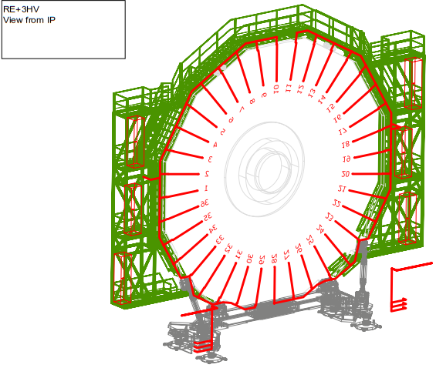
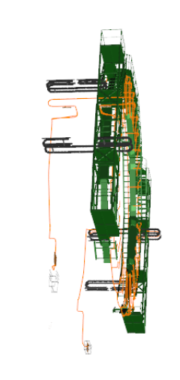
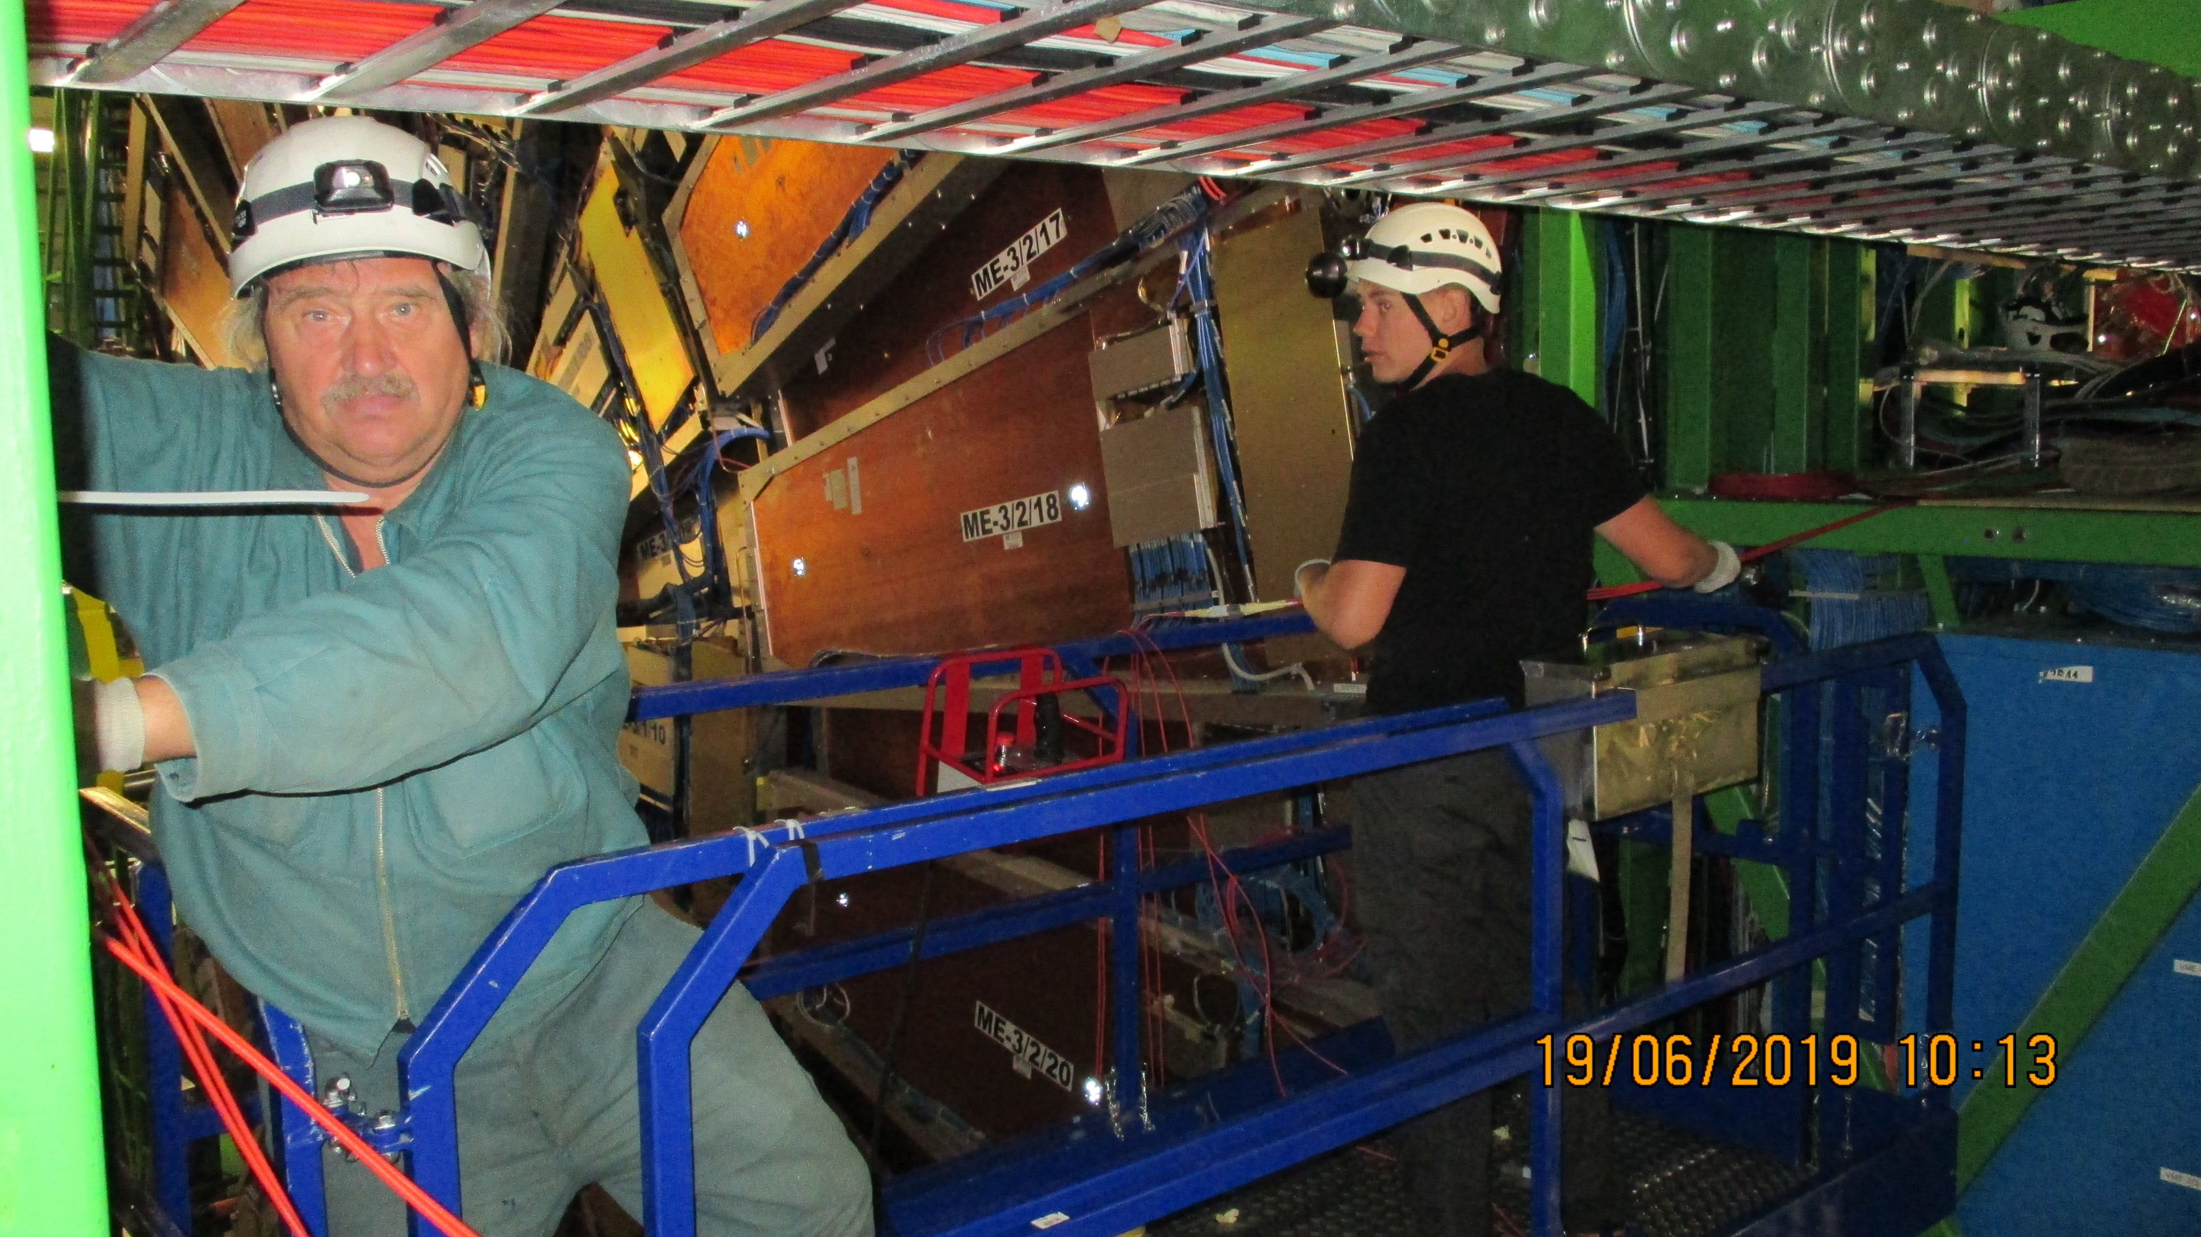
YE3
YE3
YE1 PP
Russian team cabling of the Mini Cable chains linking YE3 to YE1
Mini Cable chains linking YE3 to YE1

Slide 6
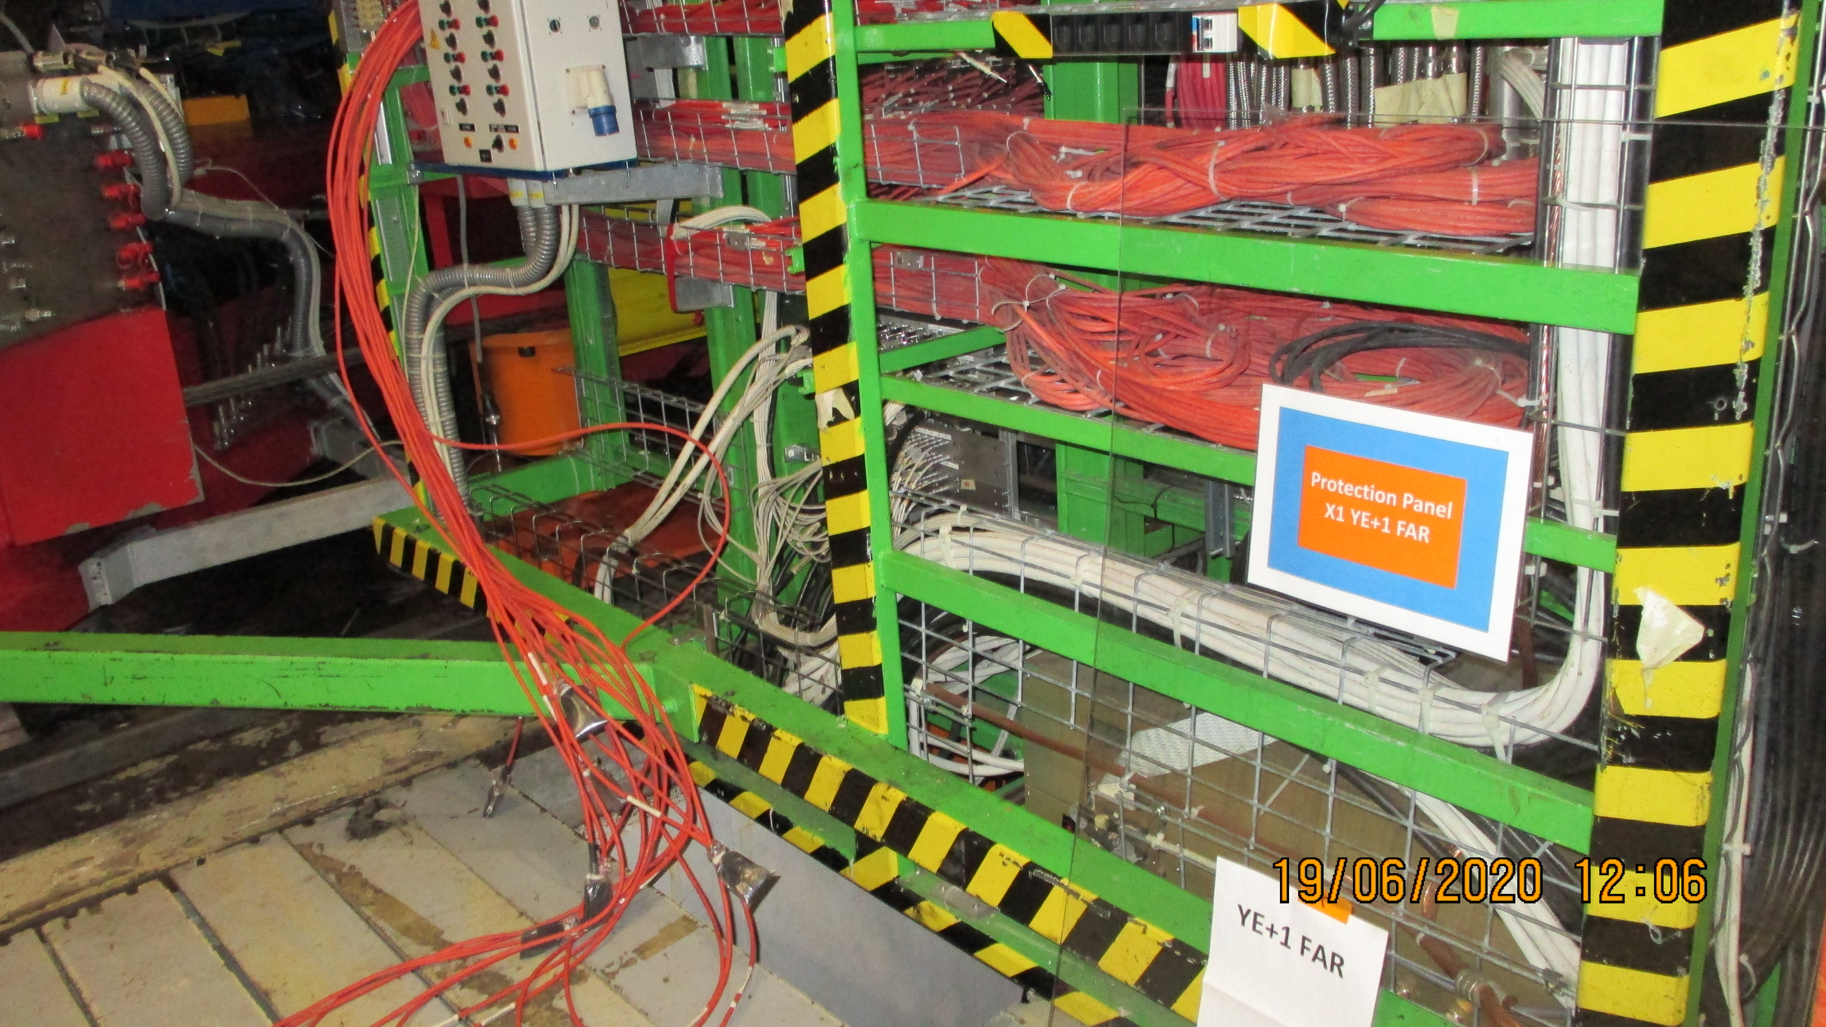
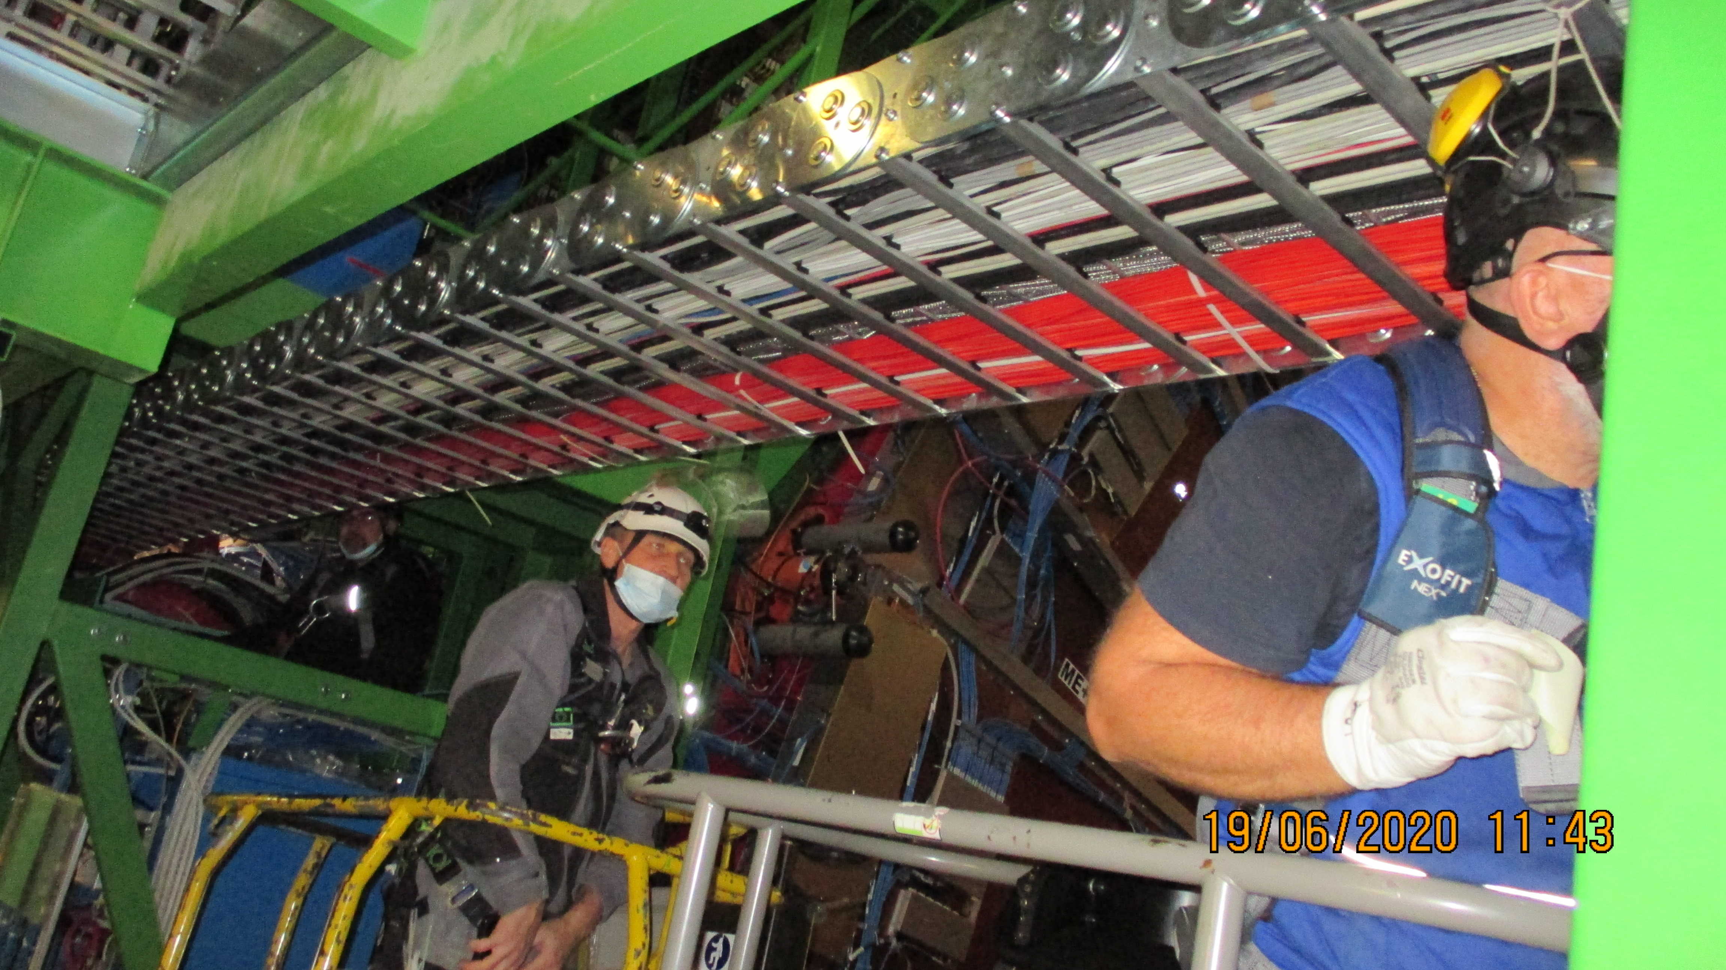
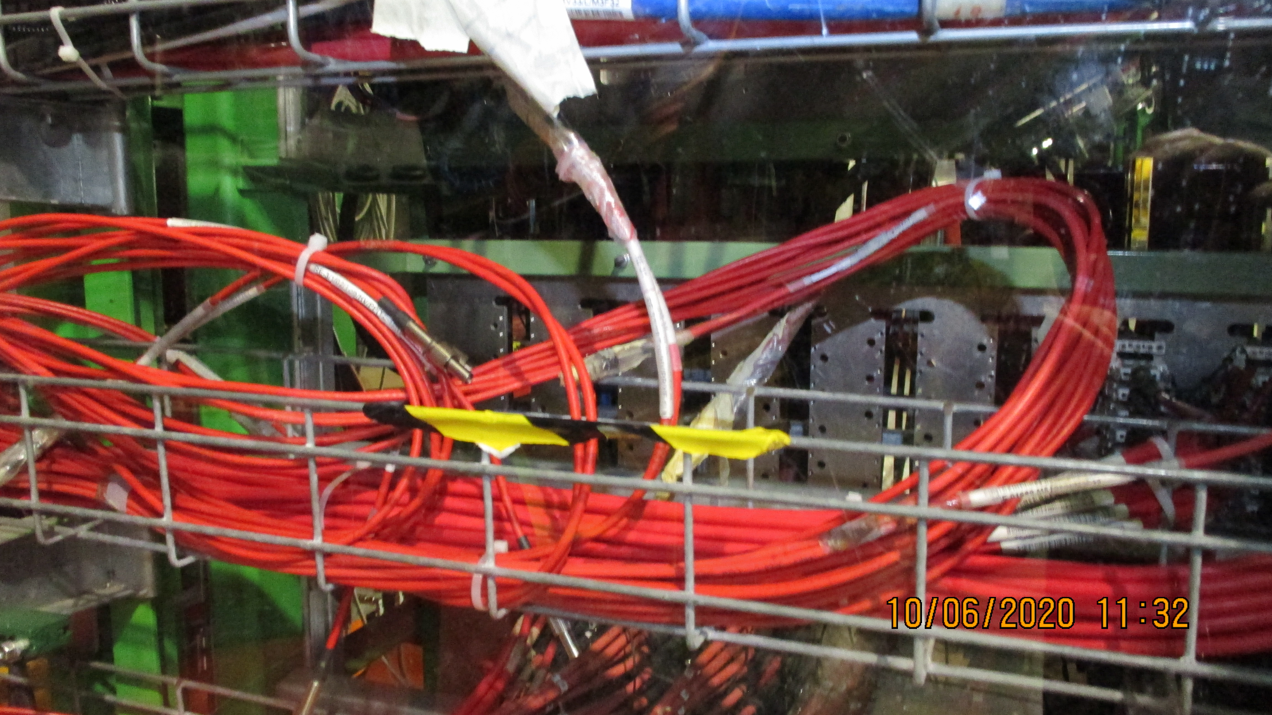
RE1/1 HV cables removed to allow for the RE3/1 & RE4/1 HV cables to come down from the Mini cable chain to the YE1 PP
Cabling in the mini cable chains
Jupiters arrived at the YE1 PP

Slide 7
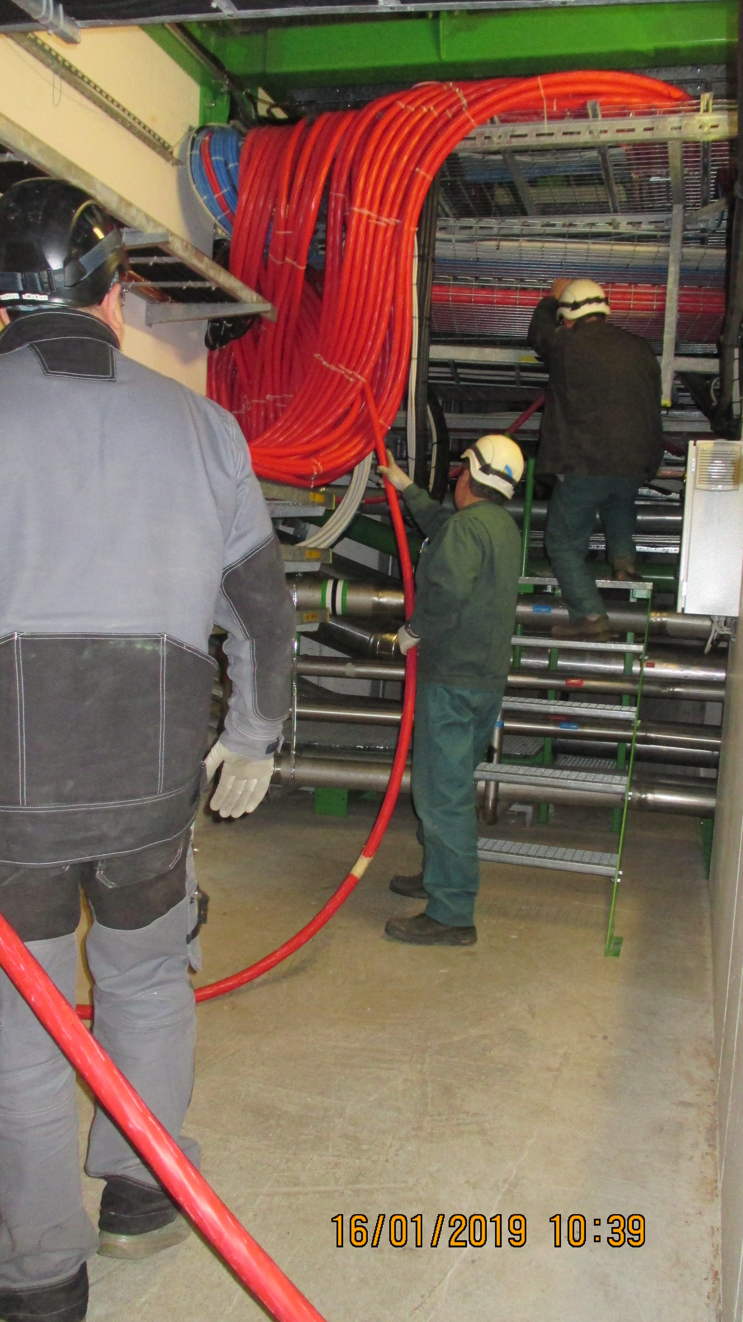
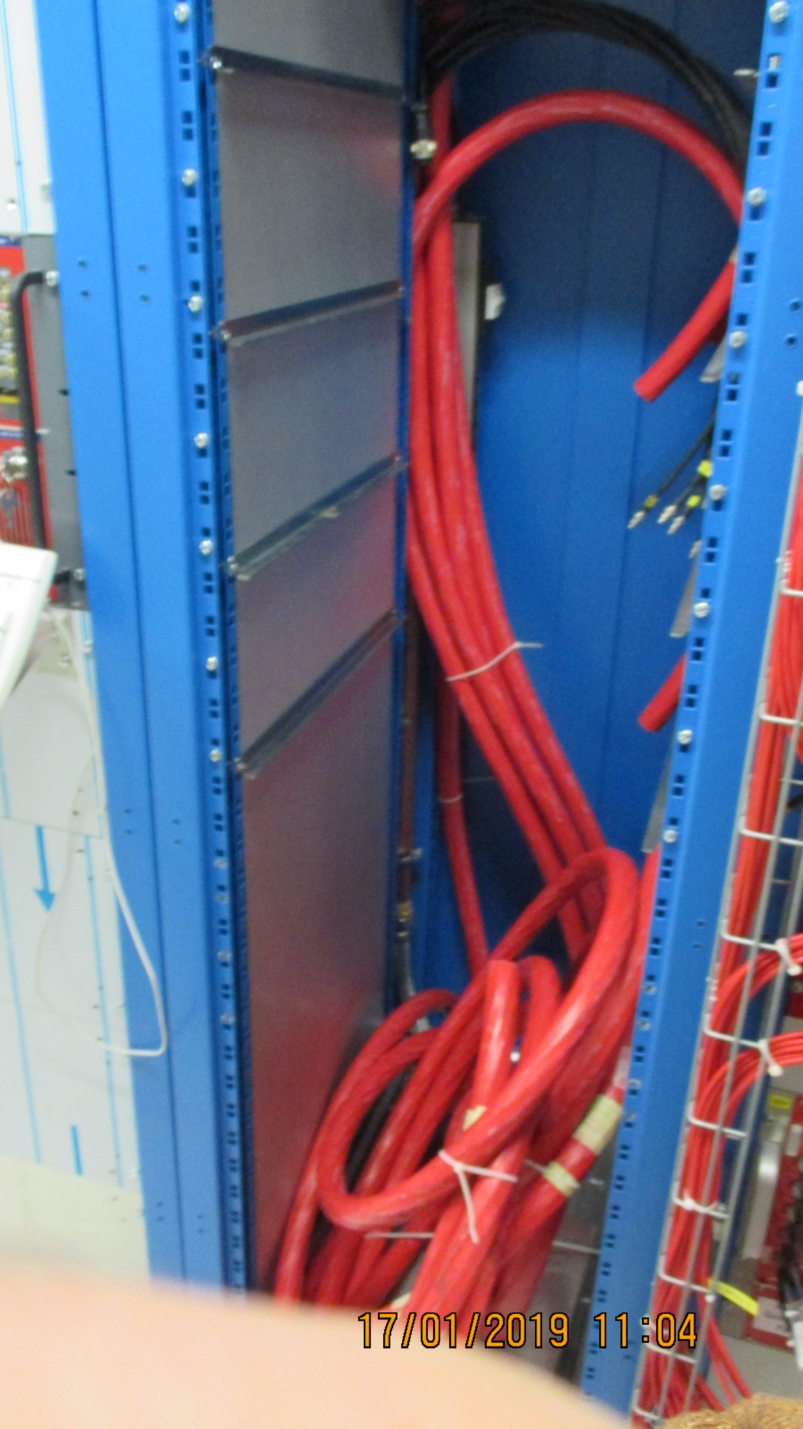
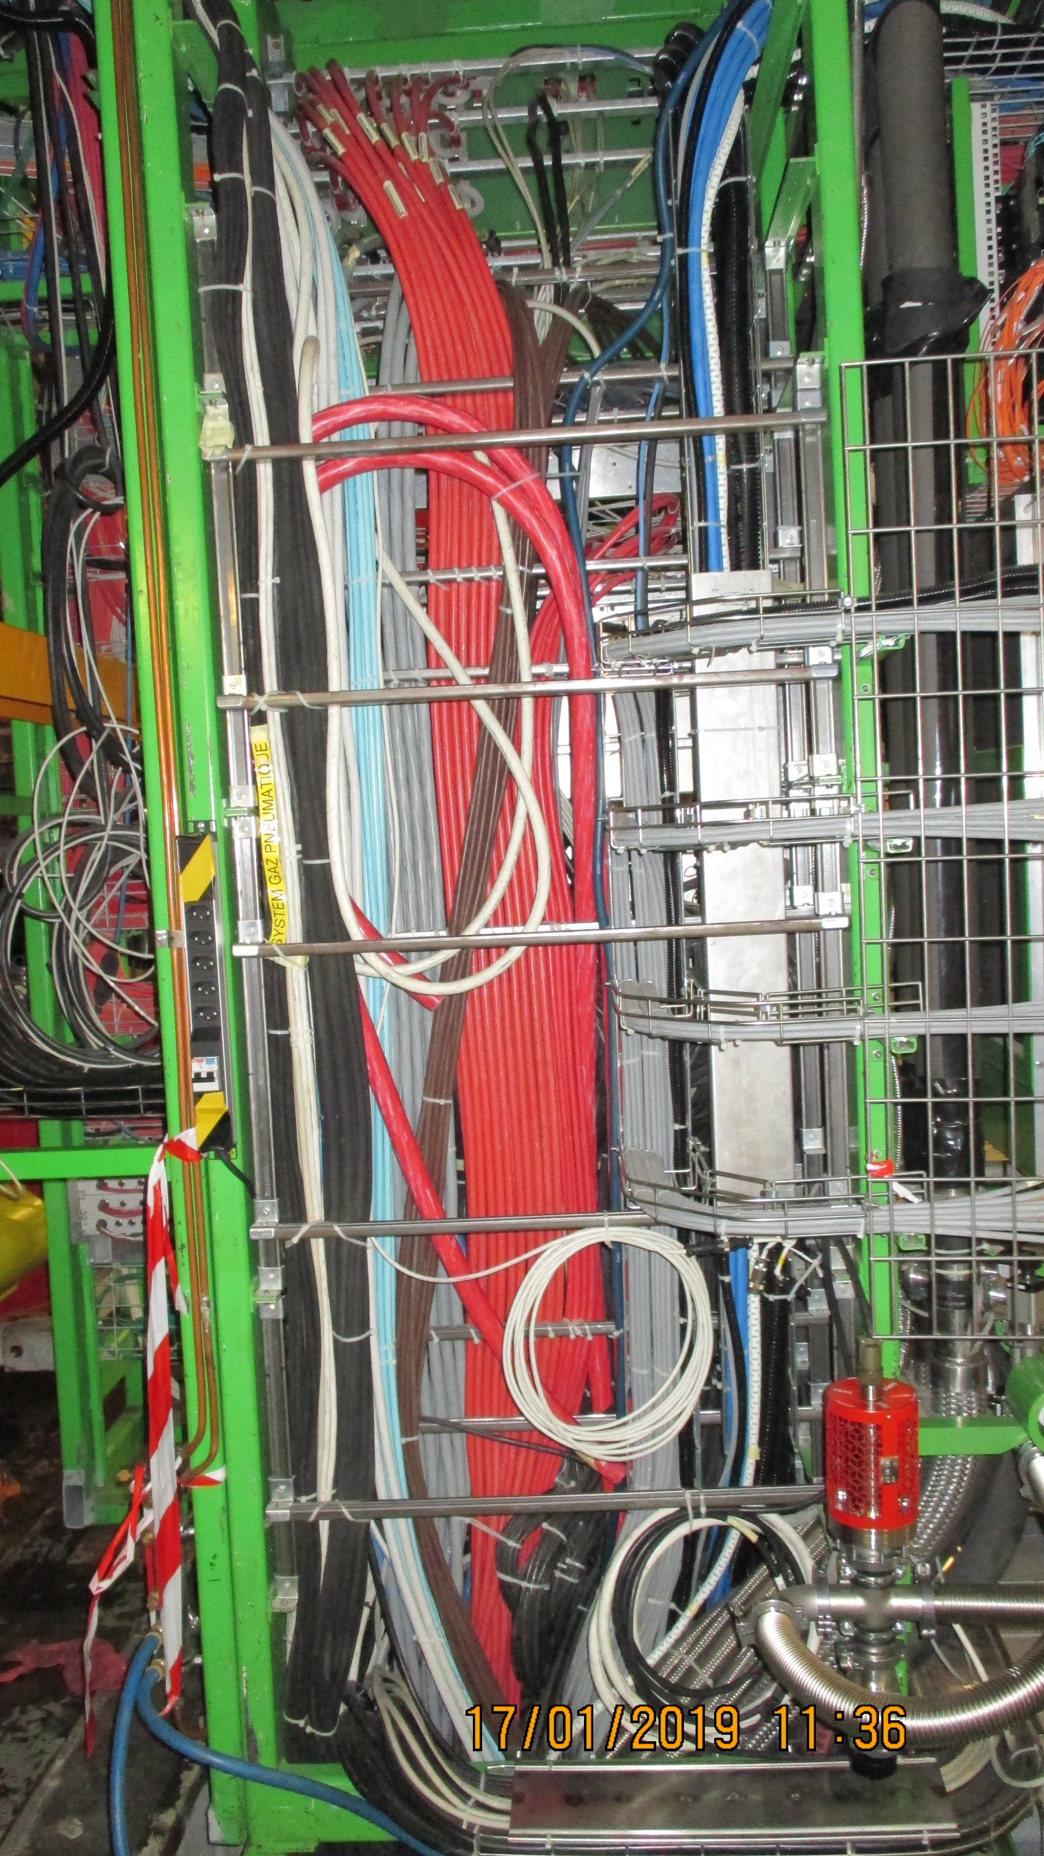
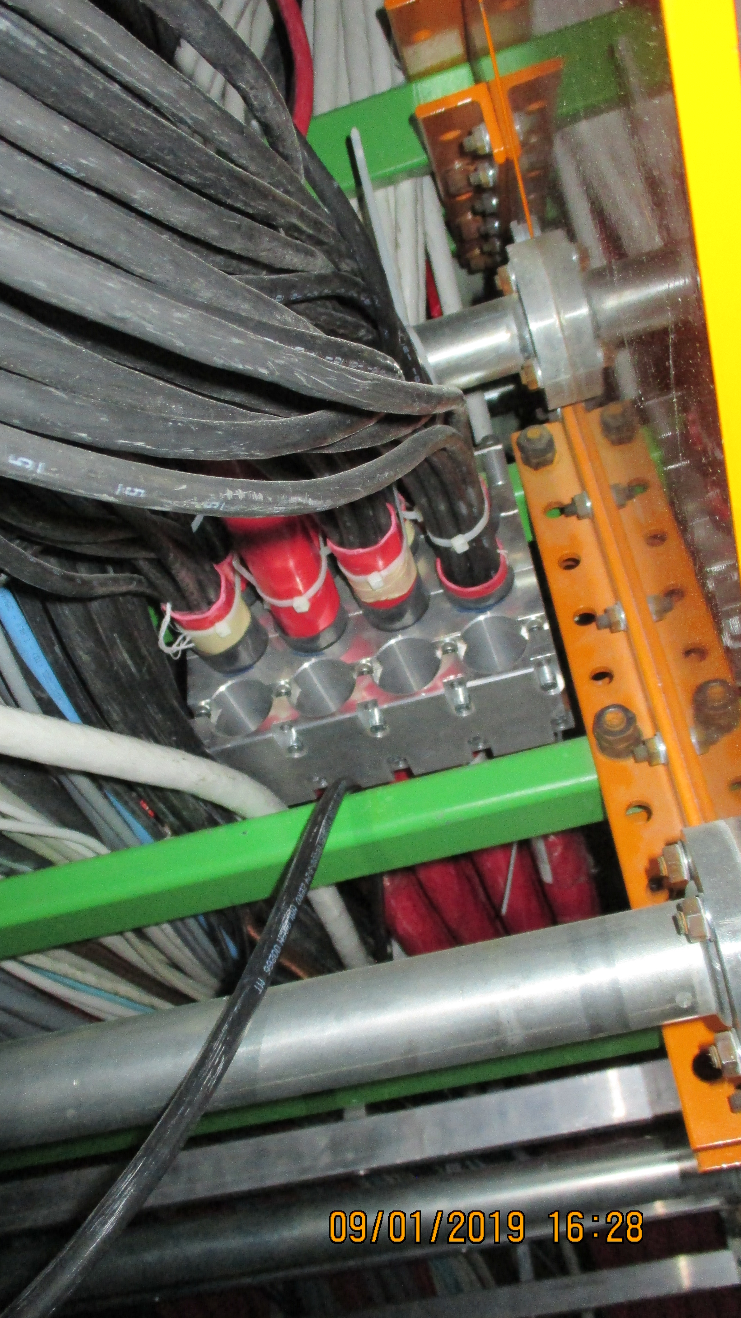
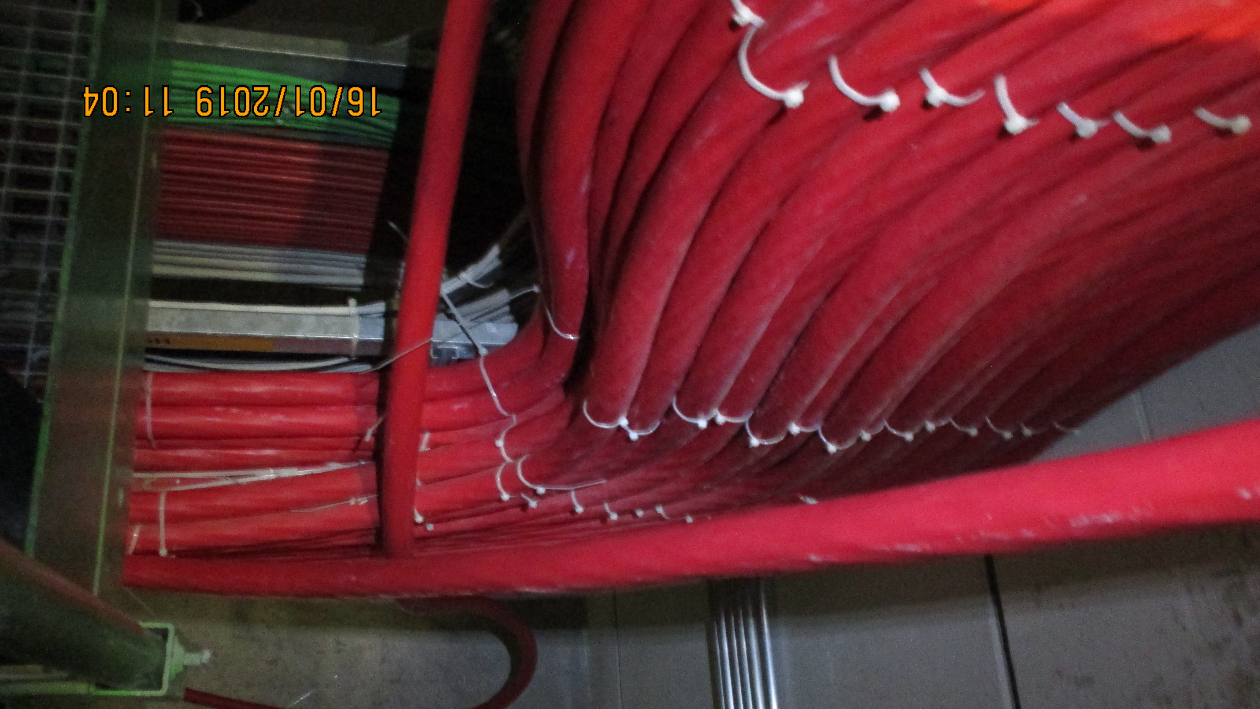
From the YE1 PP to The USC S1H racks
USC S1H12
UXC YE1 PP
Under CMS X0
Main cable Chain
Coming up from X0 through the UL55 shafts

Slide 8
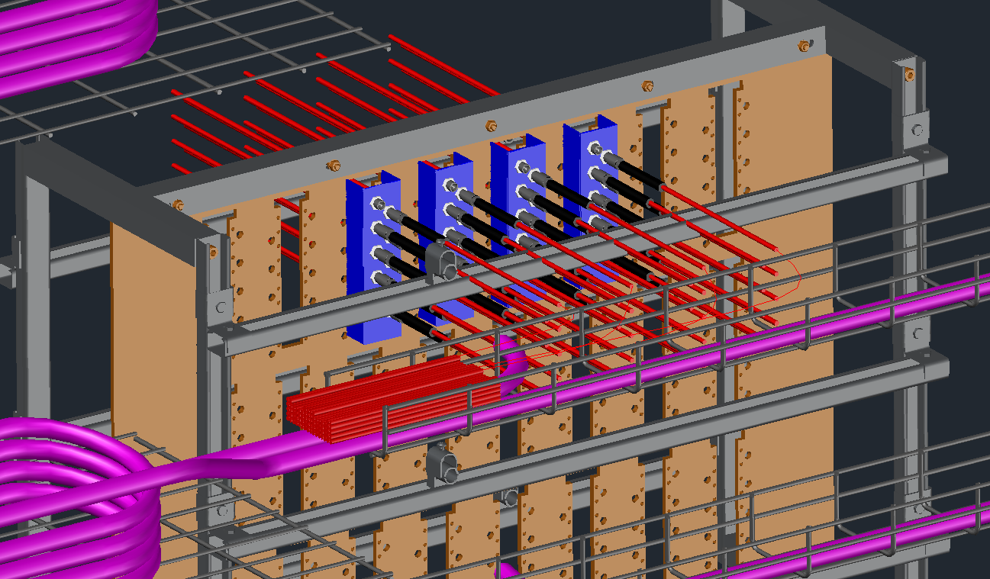
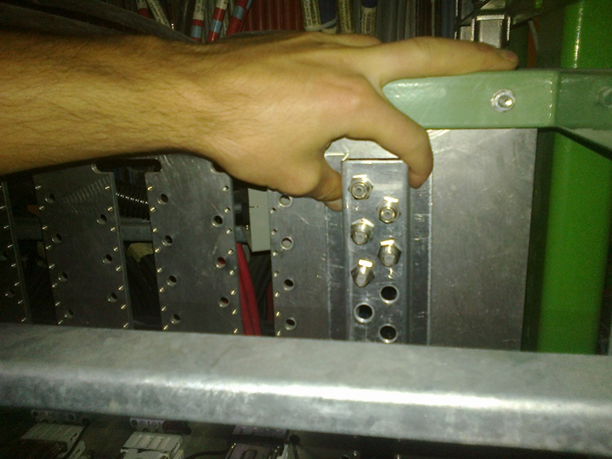
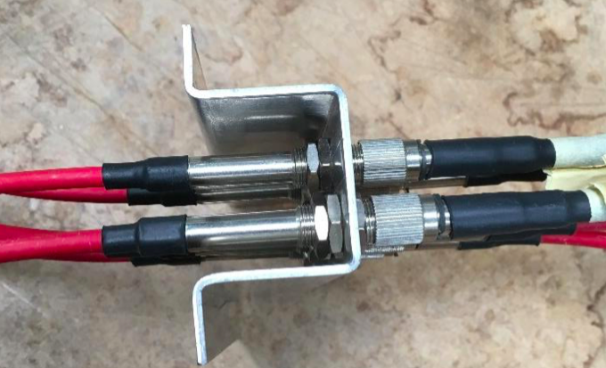
UXC
YE1 PP using modified PP to convert
from 3 polar to Jupiter. Design study
done by Theo, Geneve Eng. school.
Jupiter order to be done
Work to be completed
http://project-cms-rpc-endcap.web.cern.ch/rpc/UpscopeHighEta/RPCDevelopements/RE31and41/Services/HV/YE1PP/ModificationJupiter/ModTheo/PatchPanelConnecterSystem19June2018.pptx

Slide 9
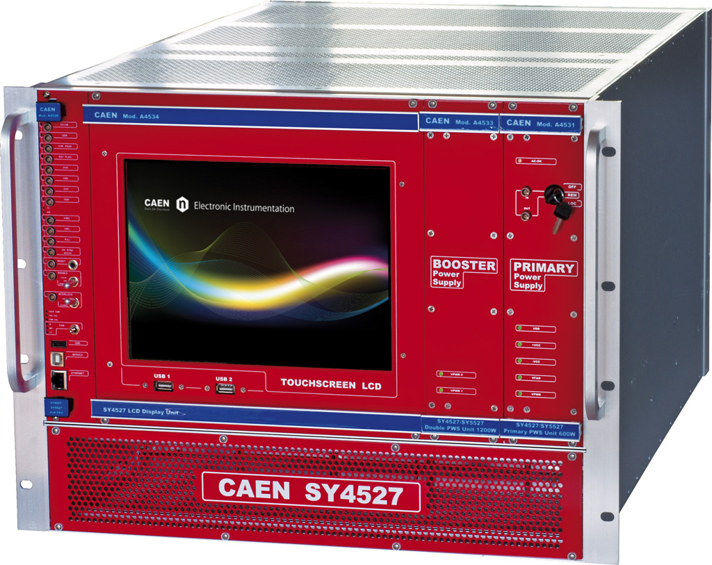
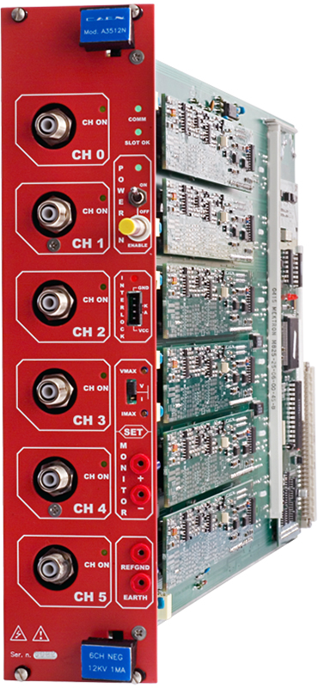
USC
Connecterising of the cables coming from UXC, order to be done
Installation of modules SZ 4527 and A3512N with associated local cabling in the S1H12 rack.

Slide 10
Low Voltage
3.8 V (5 A)
Given the revised version of the FEB, Lyon engineers proposed an independent source of voltage.
It implies an additional LV cable for each RPC
GND
FEB 1
3.8 V (5 A)
GND
2 V (5 A)
2 V (5 A)
GND
GND
2 V (5 A)
2 V (5 A)
FEB 2
GND
GND
216 Cables tested and prepared for installation (Length, continuity test, connector protection installed, labeled)
Installed:
RE+4/1: 54 cables chamber to balcony racks.
RE+3/1: 54 cables chamber to balcony racks.
RE-3/1: 54 cables from chamber to balcony racks.
GND
5V (1.5 A)
To be completed during September 20:
For RE-4/1: 54 cables [Ready to be installed],

Slide 11
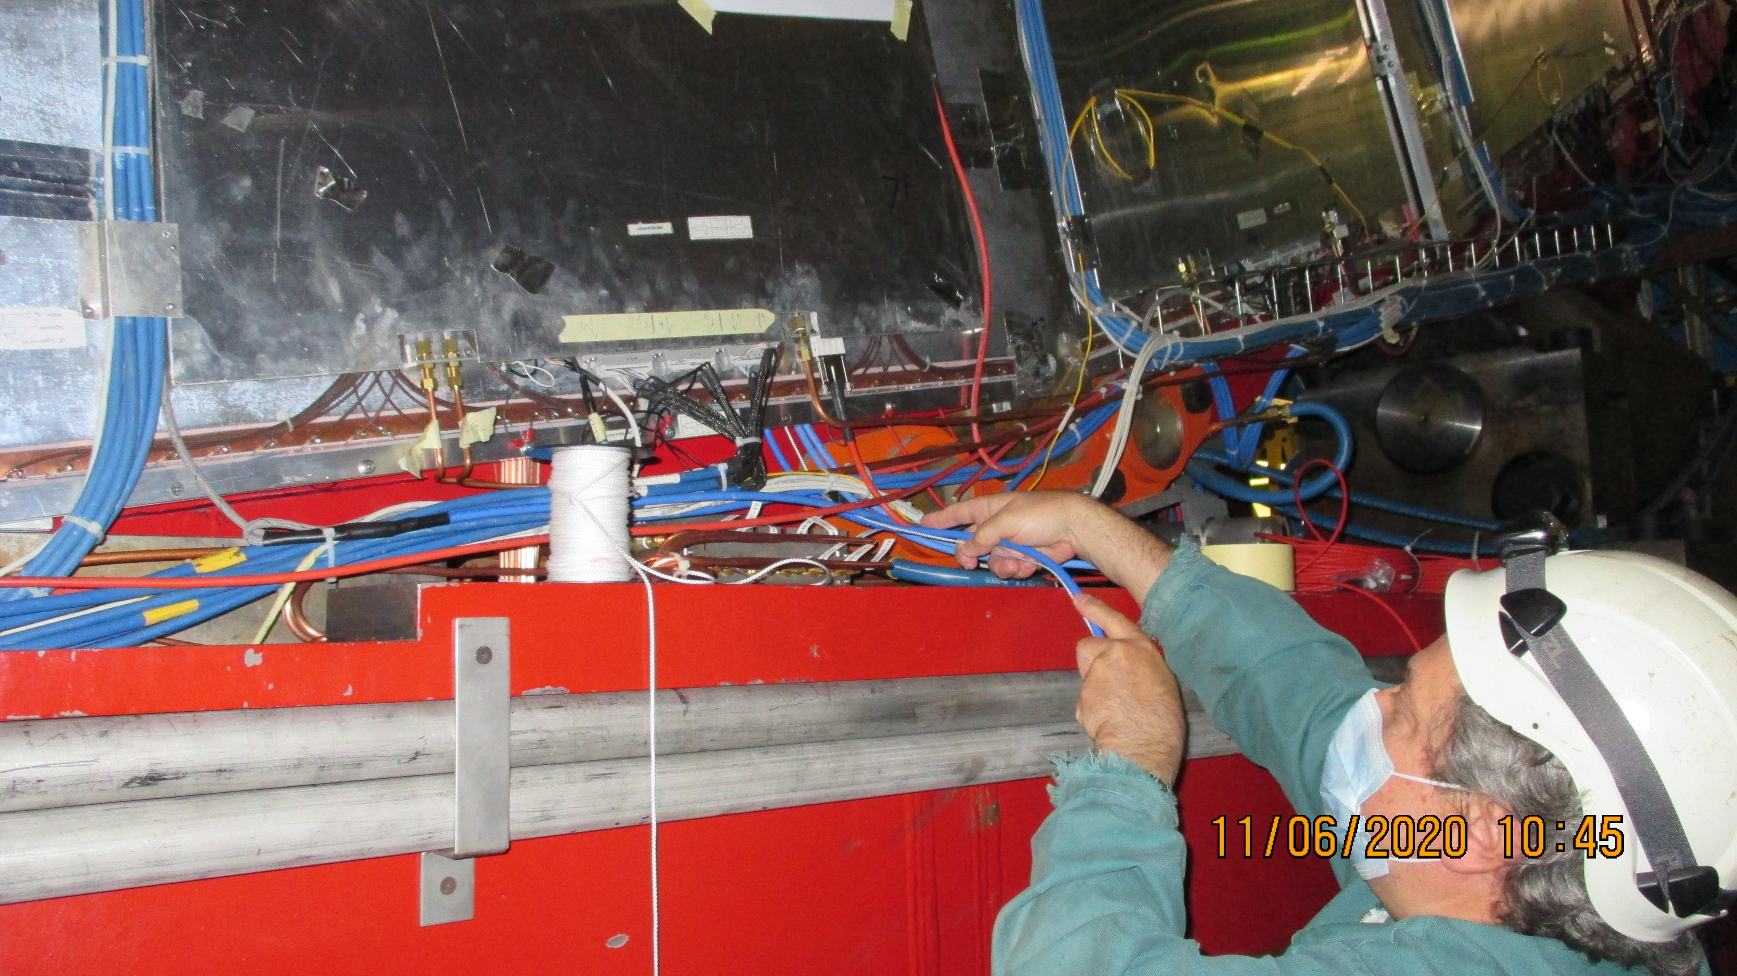
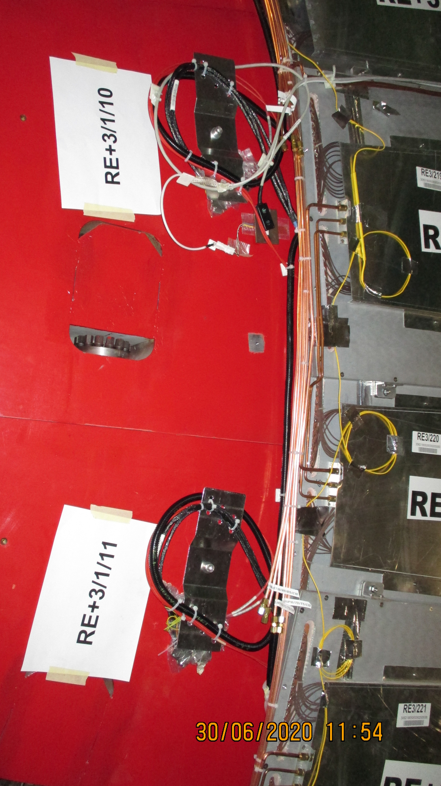
Gas piping and cabling on the inner radius , IP side of YE+3 for RE+3/1
LV cabling on the periphery , on the cart of YE+3

Slide 12
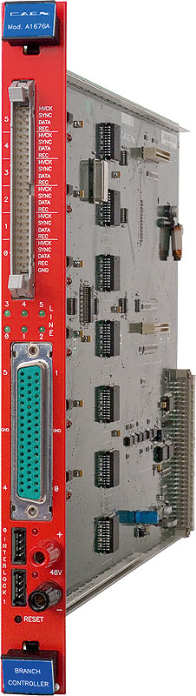
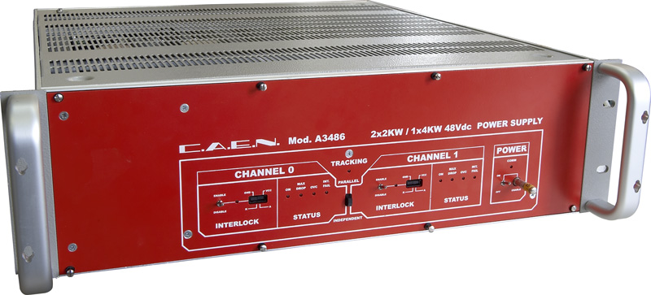
Phase II power system
LV cabling for the ACDC (MAU A3486S) installation on YE3
Cabling at YE 3 near and far from X1 to X4
LV 48V Service power cables installed, not connectorised
230V 3phase to Mau thru’ distribution boxes cables installed, not connectorised
DCS (50c flat cable) cabling will be starting during Sept 2020
New modules , Branch controller module A1676A, require 4
MAU A3486S, require 4

Slide 13
Optical Fibers
More details at:
http://project-cms-rpc-endcap.web.cern.ch/project-cms-rpc-endcap/rpc/UpscopeHighEta/RPCDevelopements/RE31and41/Services/OpticalFibres/QA/Method/OpticalFiberTest.pptx

Slide 14
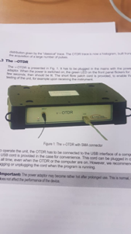
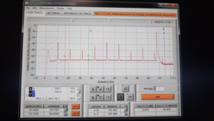
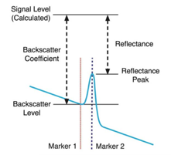
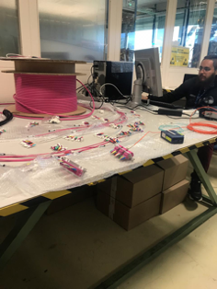
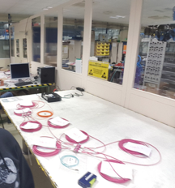
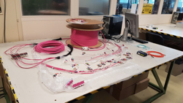
Fiber quality assurance test
Length measurement and qualitative test for power loss
Connection mapping
Labeling

Slide 15
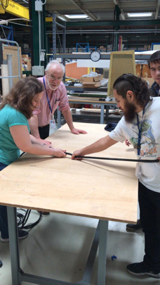
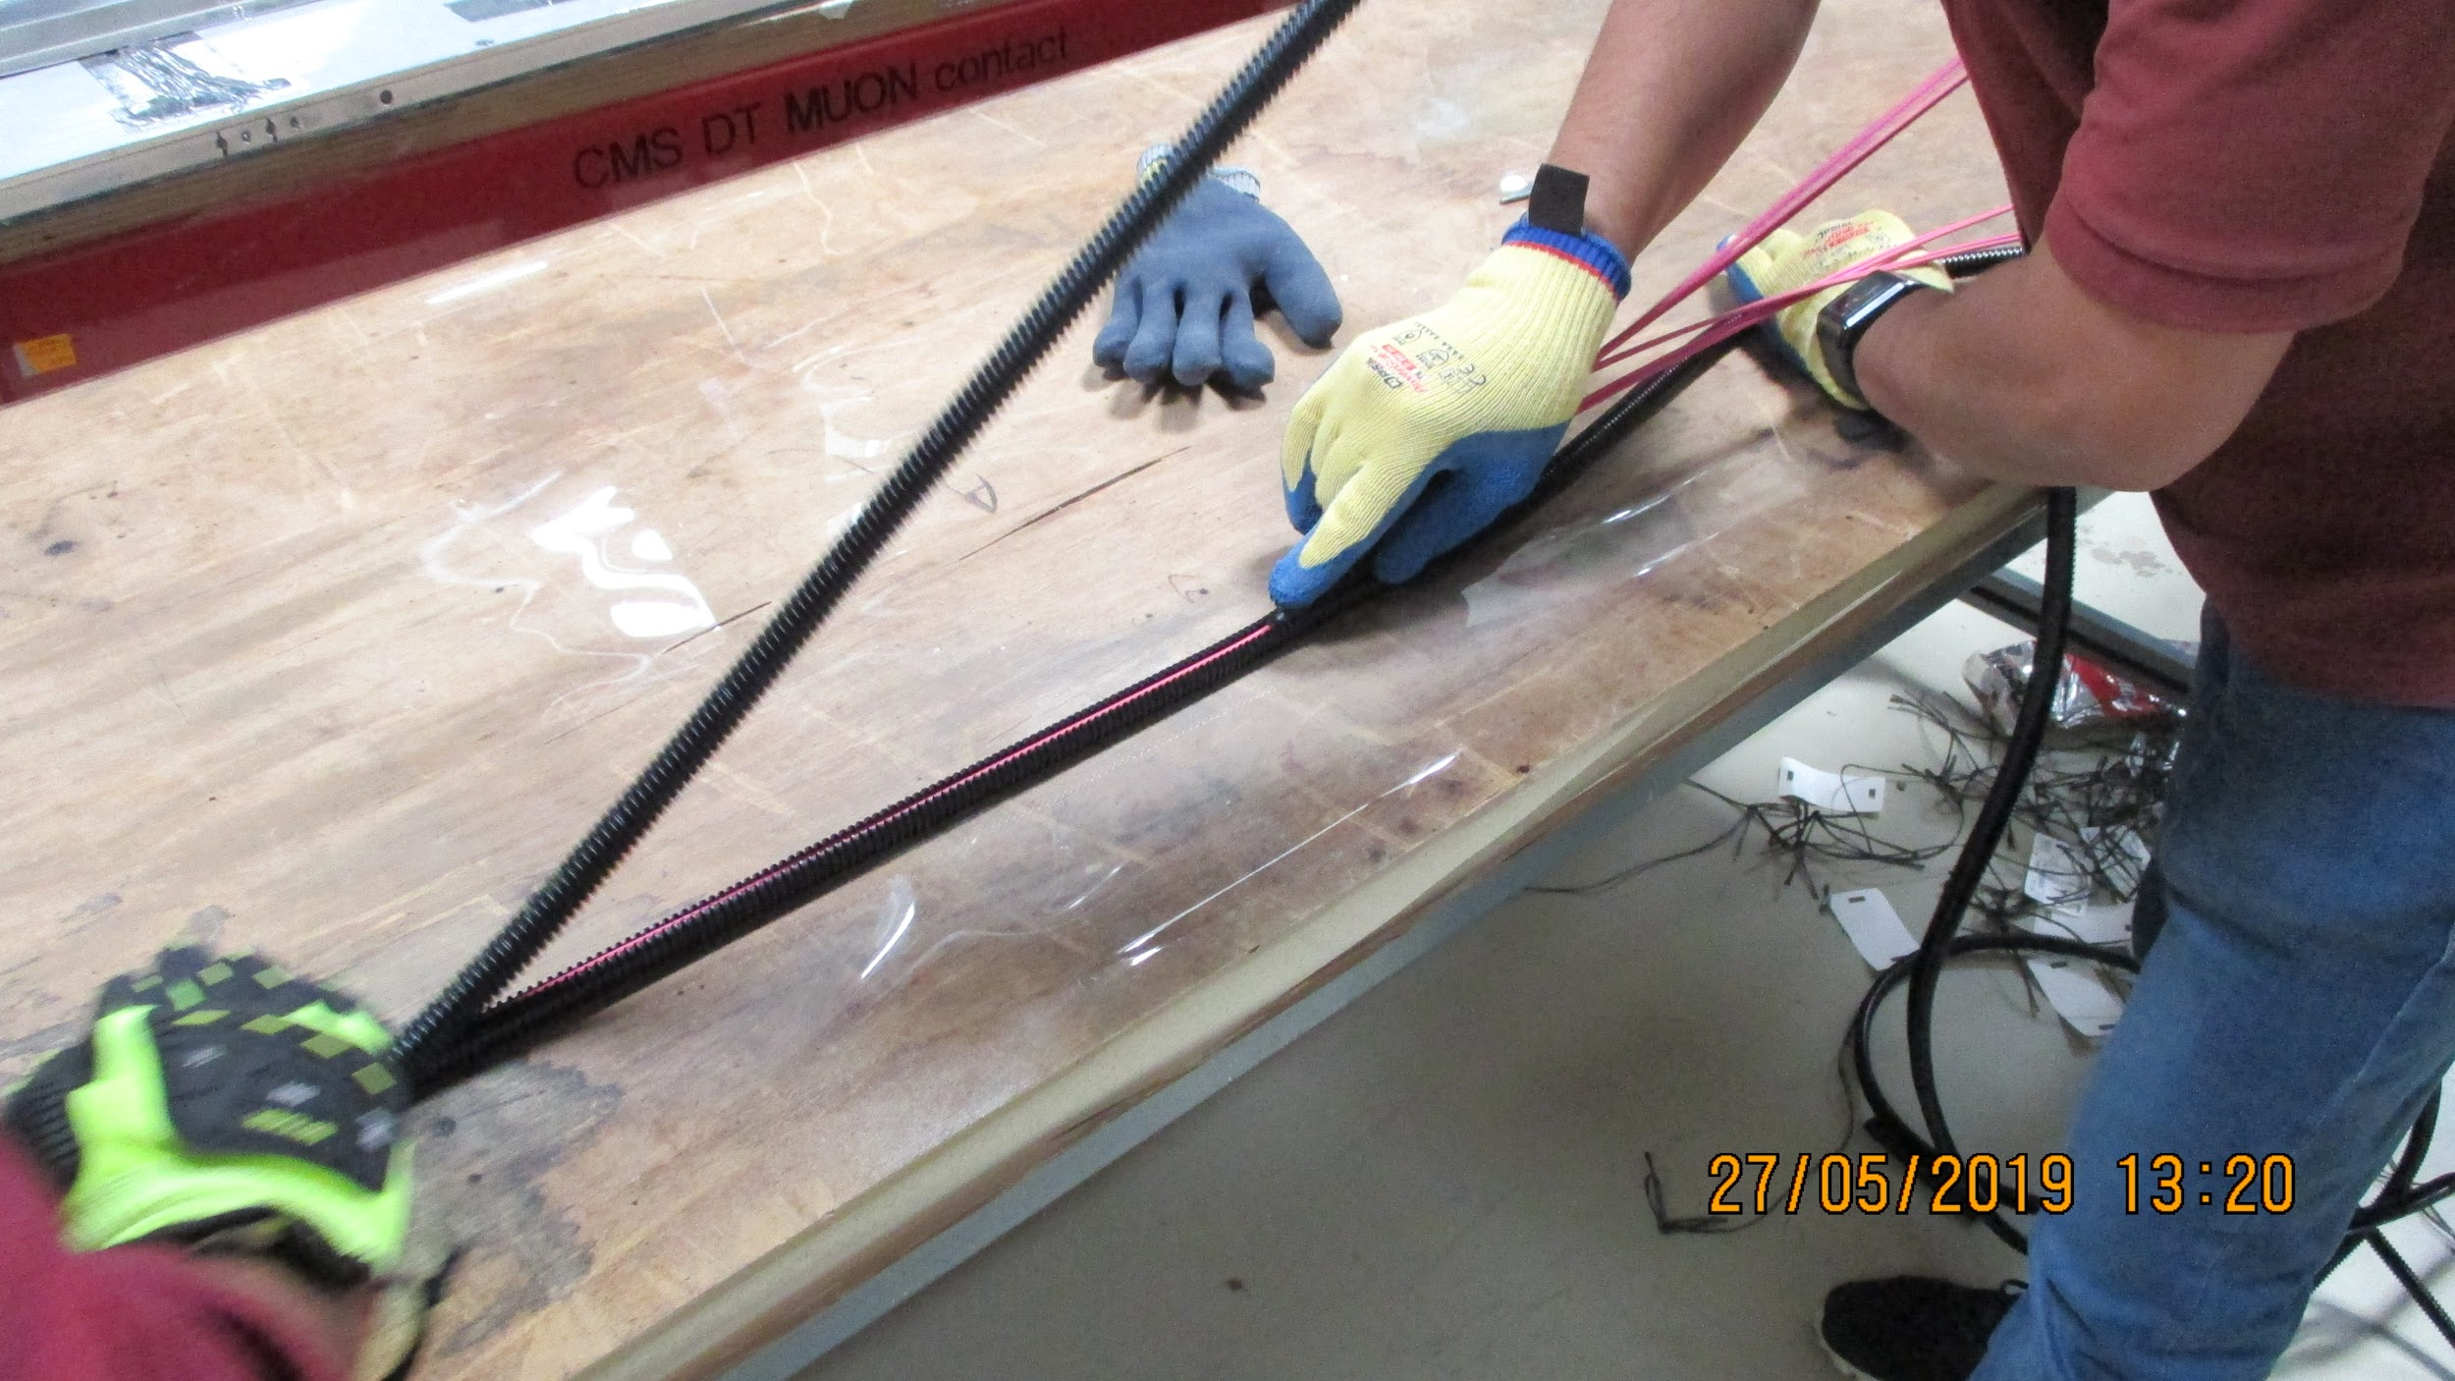
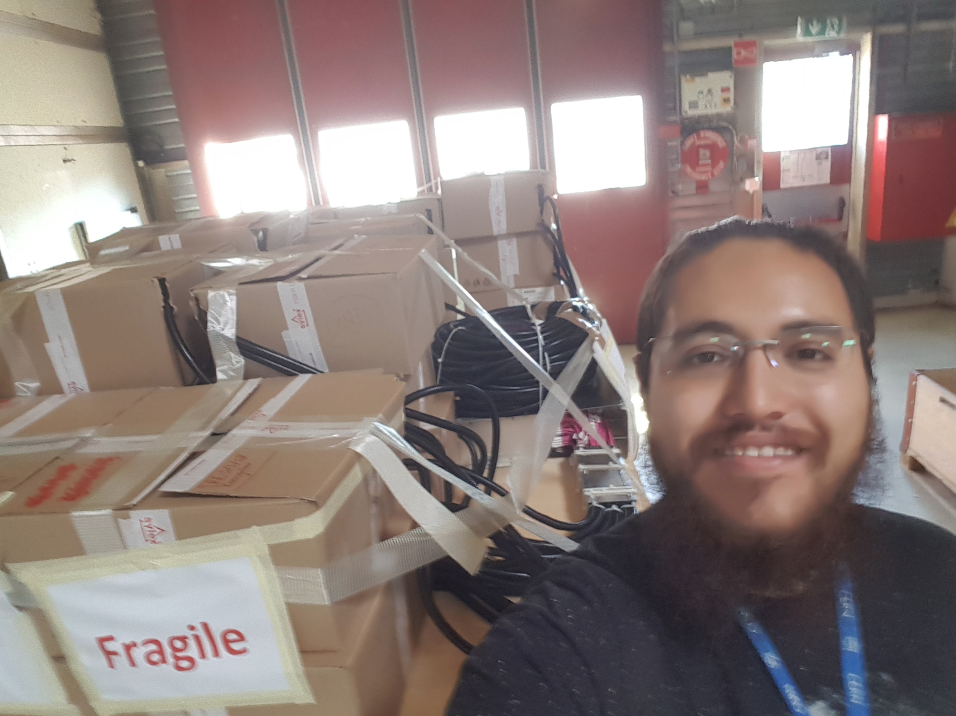
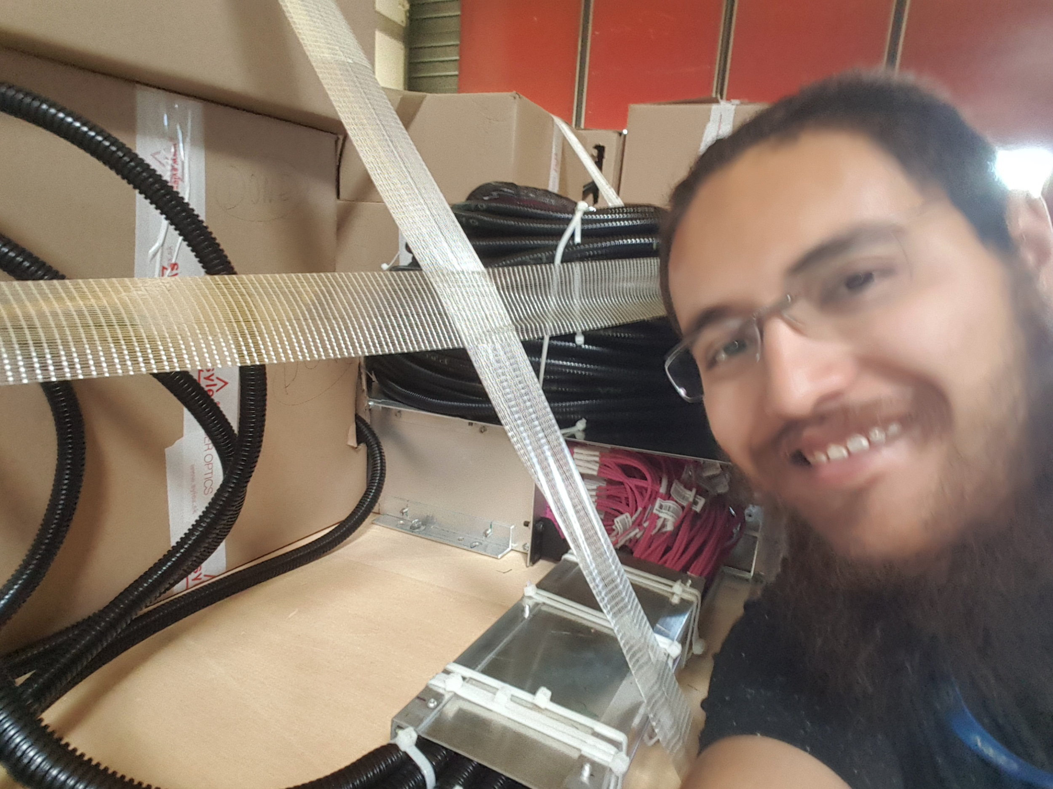
Optical Fibers
Fiber protection: corrugated conduit installation on fibers

Slide 16
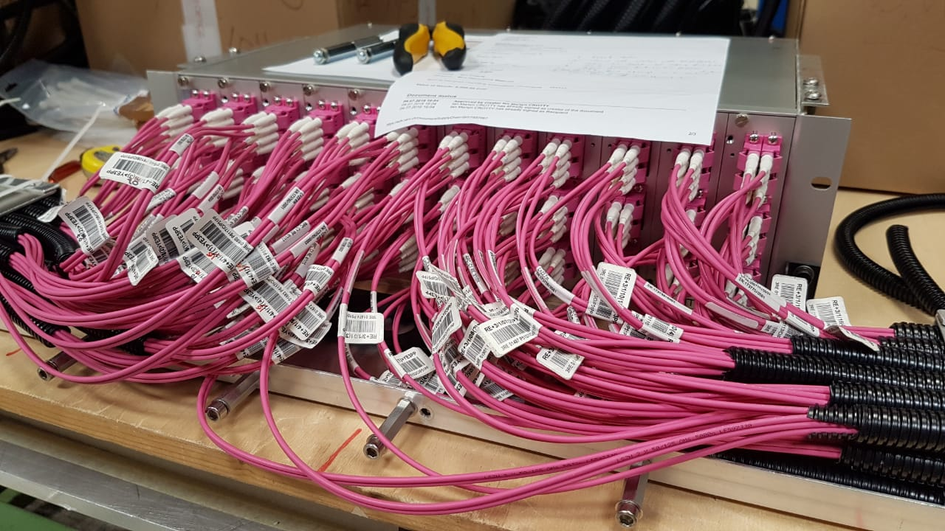
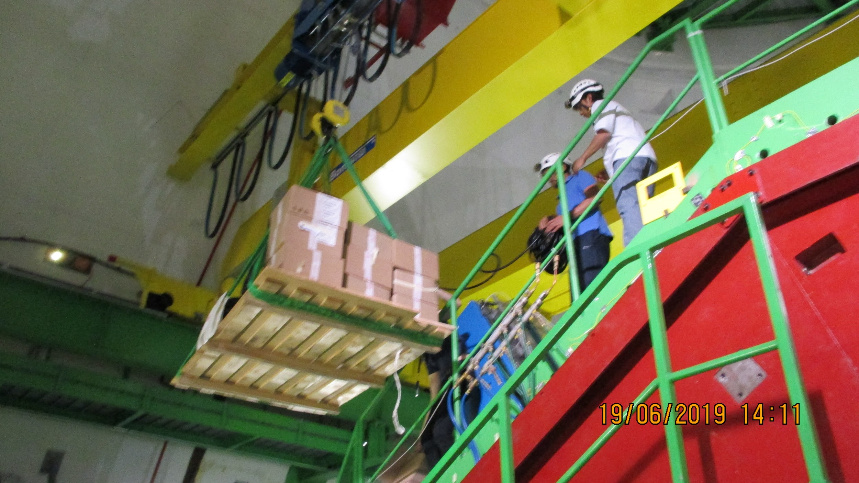
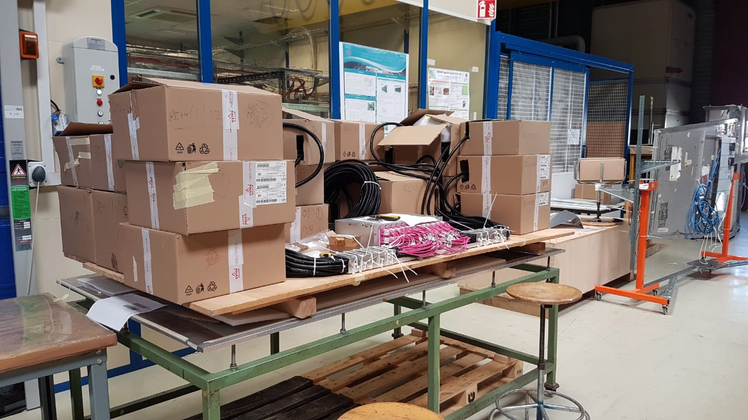
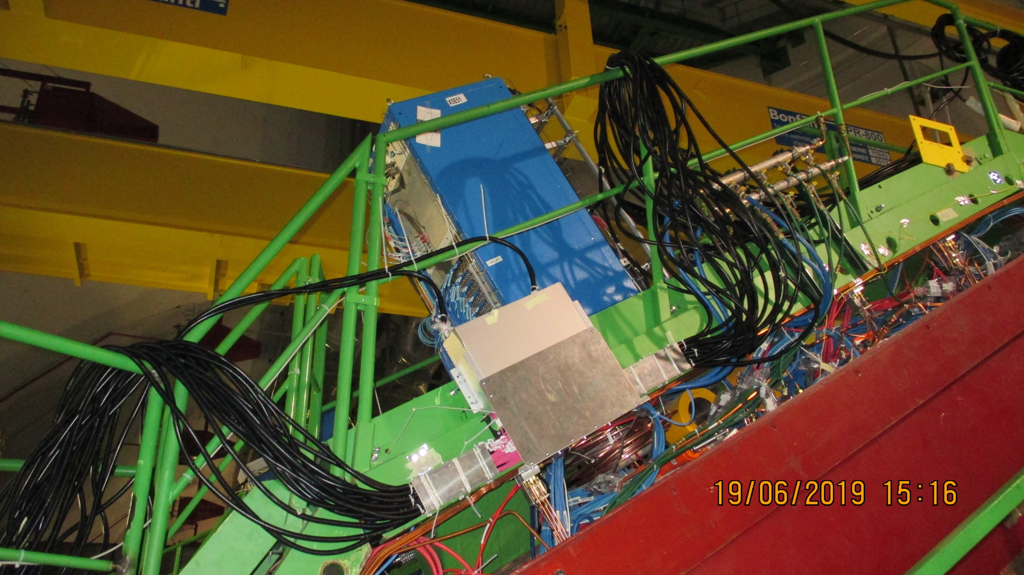
Optical Fibers
YE3 Patch panel preparation in 904 and installed on the YE3 in one go.
RE-4/1 FO
RE-3/1 FO

Slide 17
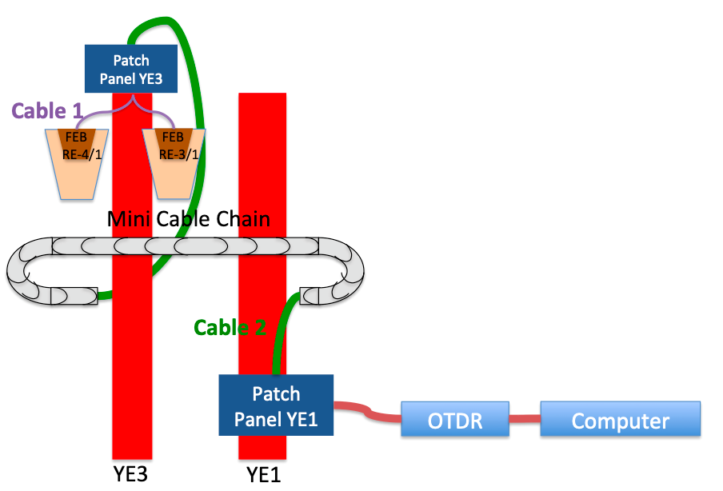
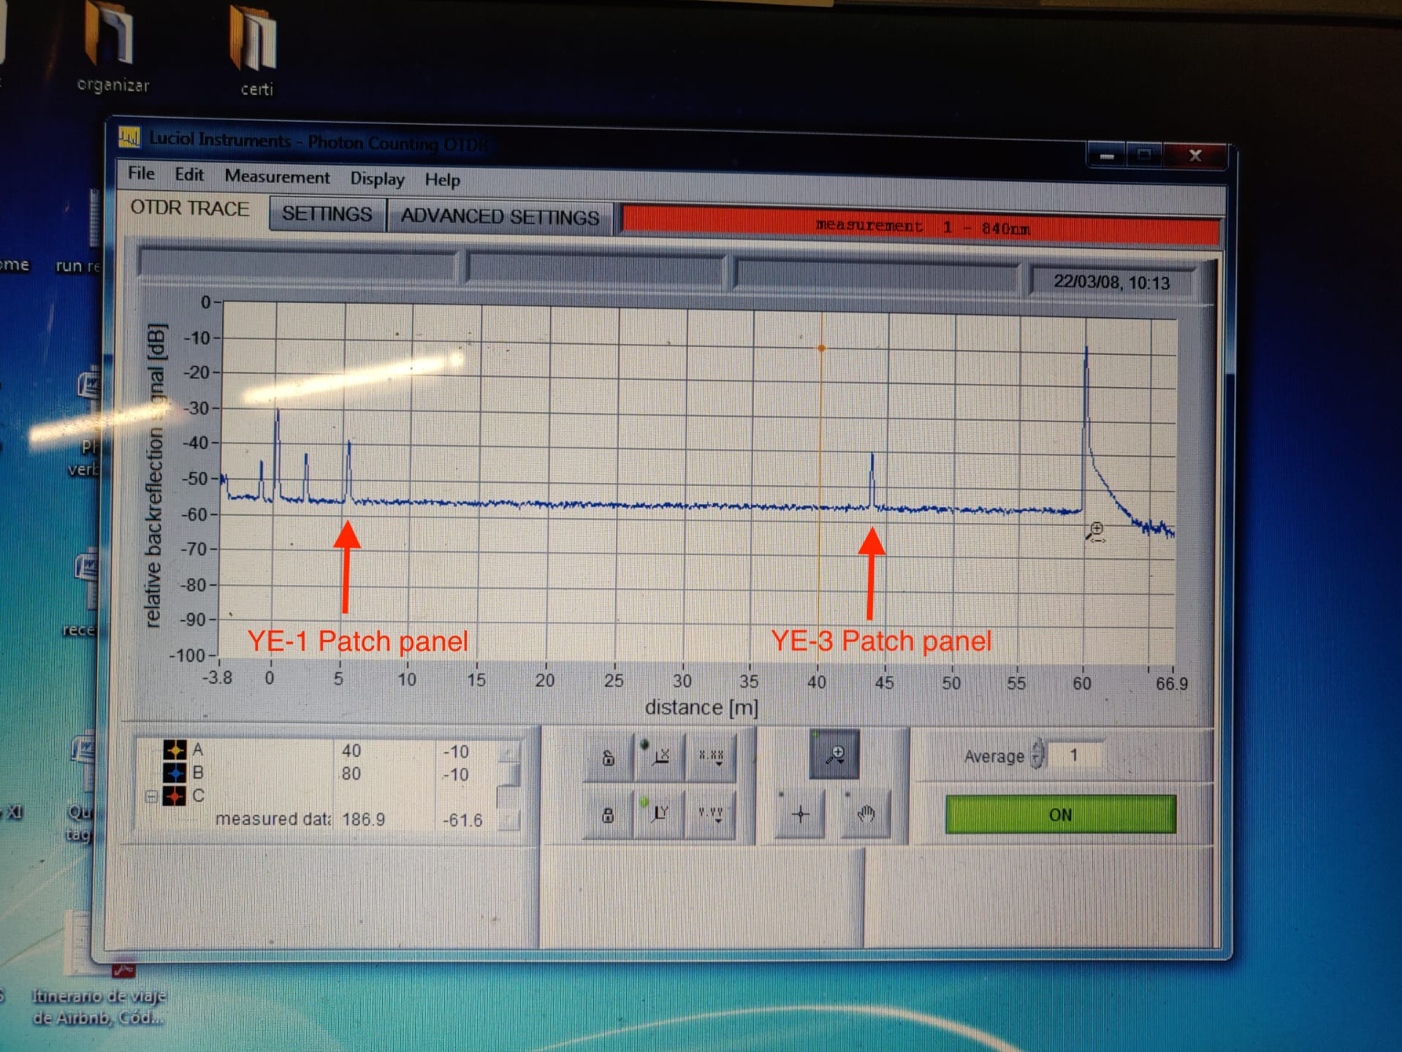
Optical Fibers
576 fibers tested with OTDR
Installed:
YE+3, YE+1, YE-1 and YE-3 patch panels.
For RE+3/1: 144 fibers from YE+3 patch panel to YE+1 patch panel.
For RE+4/1: 144 fibers from chamber side to YE+1 patch panel.
For RE-3/1: 144 fibers from chamber side to YE-1 patch panel.
For RE-4/1: 144 fibers from YE-3 patch panel to YE-1 patch panel.
For all disks: From YE±1 patch panel to USC rack.
To be completed:
For RE-4/1: 144 fibers from YE-3 patch panel to the chamber.

Slide 18
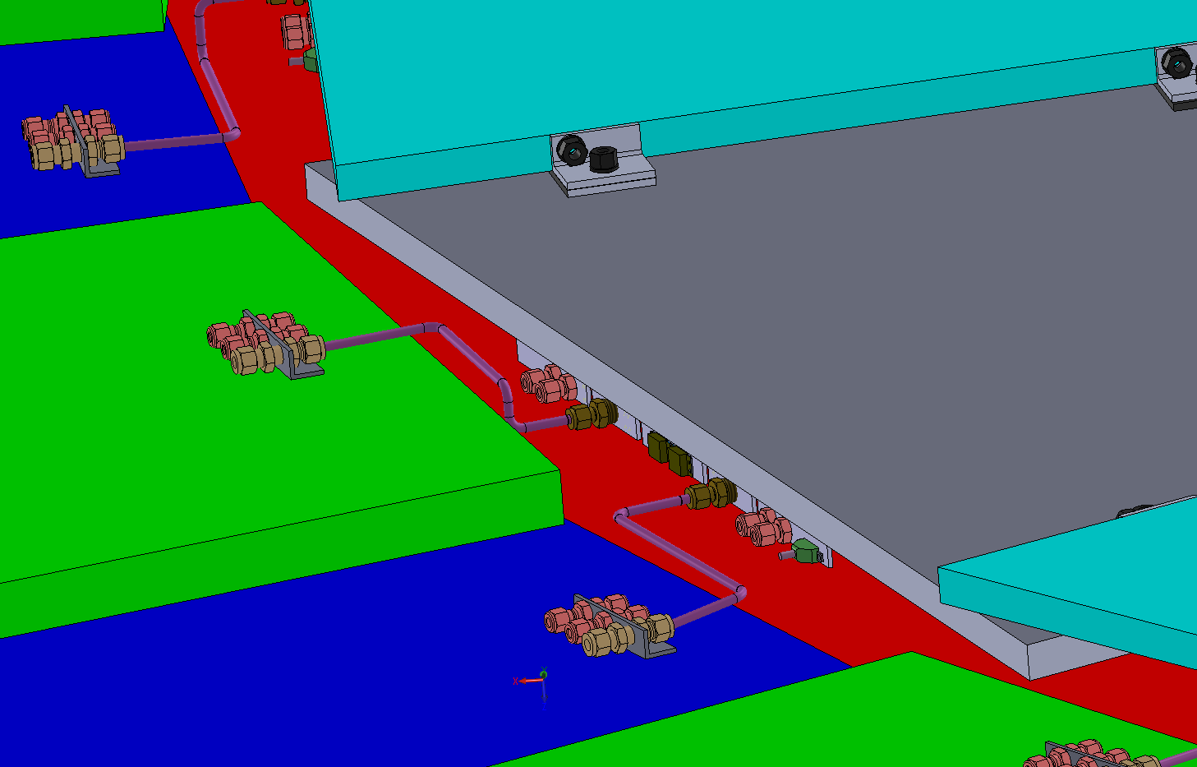
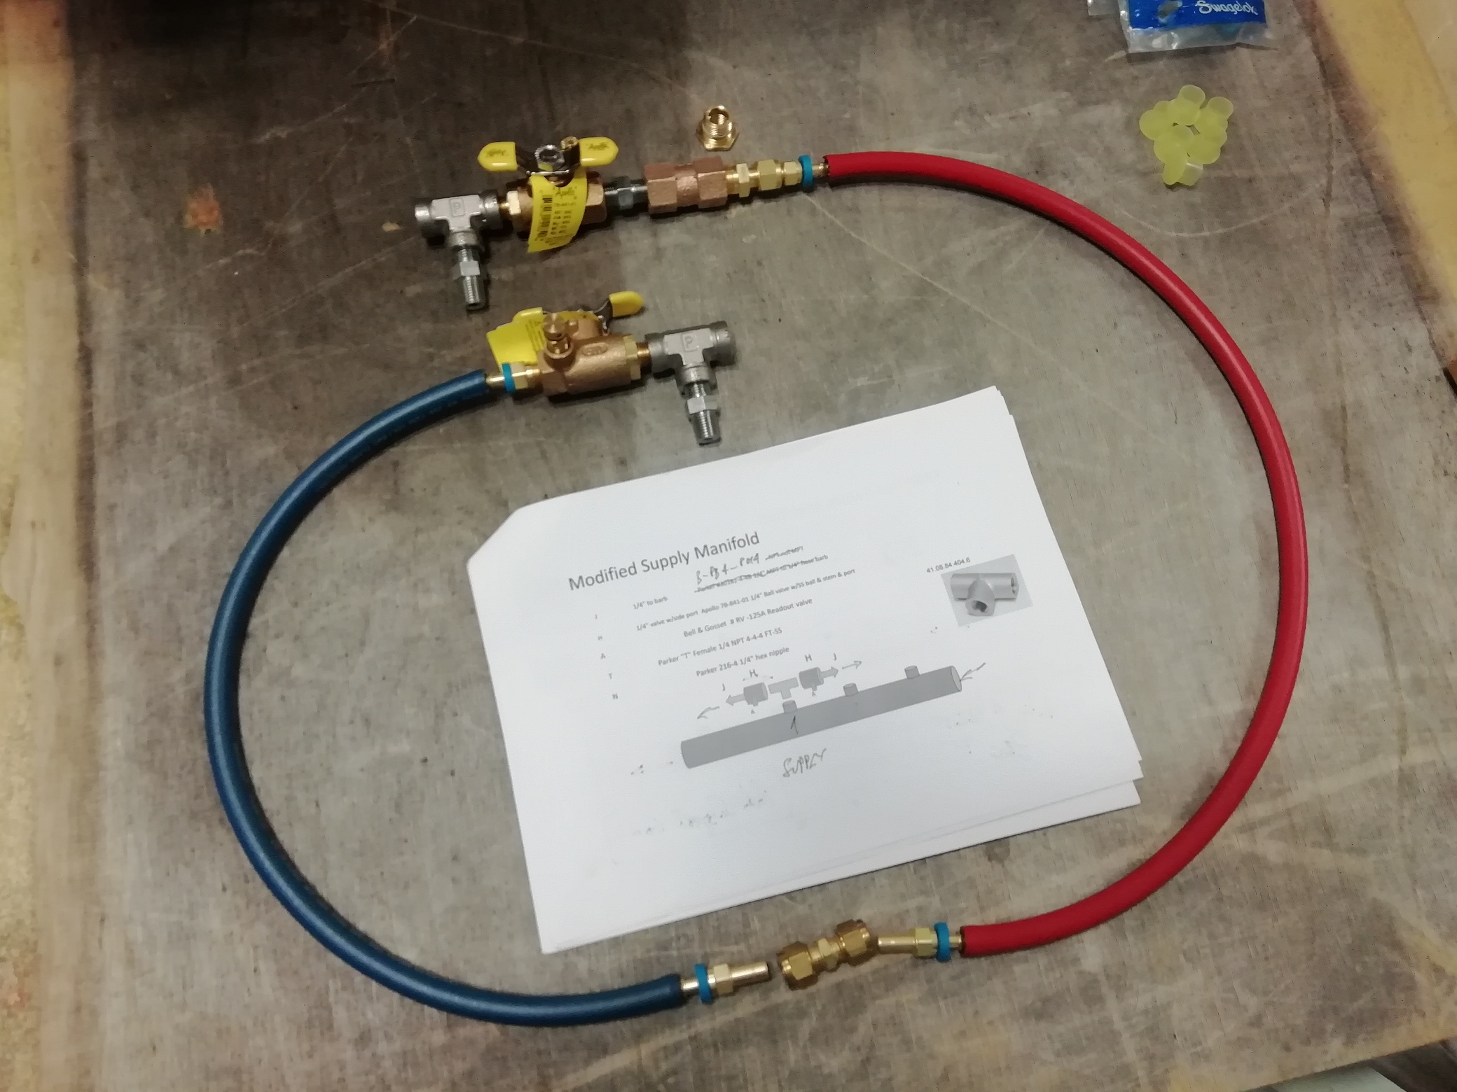
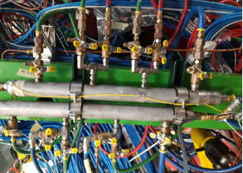
Cooling
RE3/1 cooling link to RE3/2
The rigid copper piping will be replaced by flexible hose links to reduce the strain on the unions.
Installation to be done after RE3/1 installation.
x2 RE3/2 circuits feed x1 RE3/1 chamber
Return Red
Supply Blue
RE+4/1 Cooling
For RE+4/1:
Added 9 “t” connection to the mini-manifold (ZEC). [Pressure test performed]

Slide 19
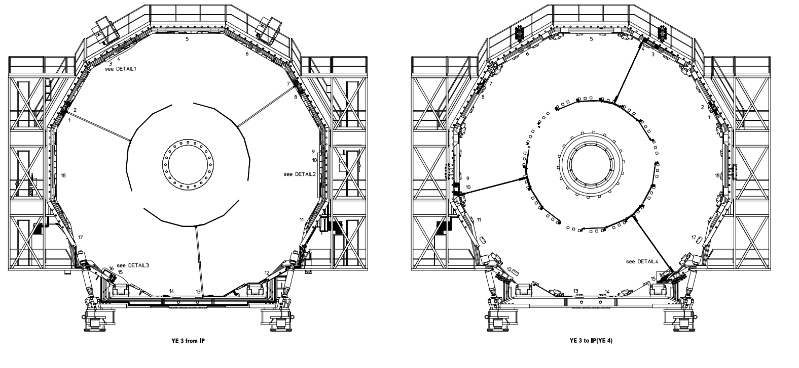
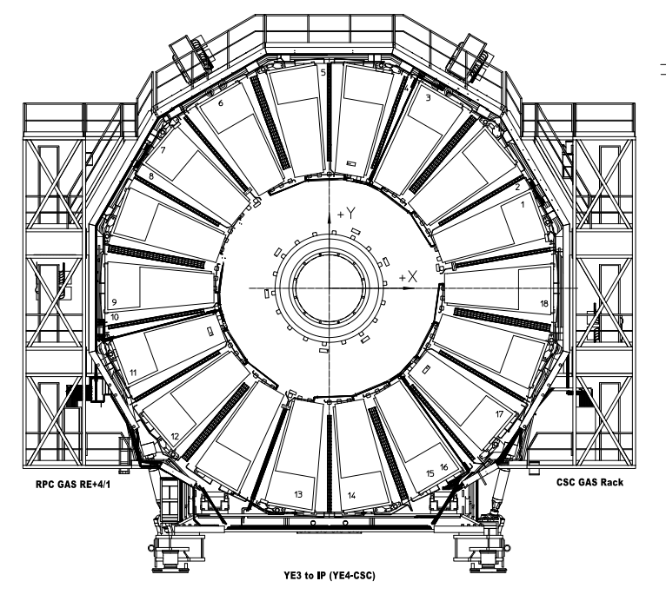
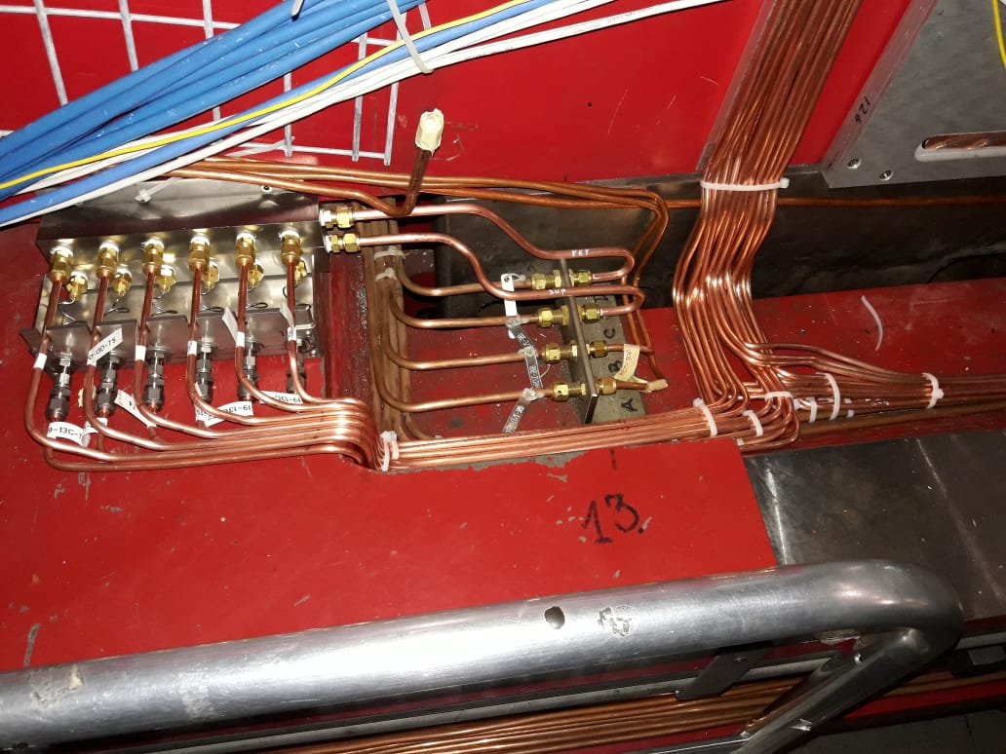
Gas System
Latest drawings of RE+4/1 gas service.
The RE-3/1 gas service installation is 100% done in March (pipes and impedance boxes).
Pressure test performed.
For RE+4/1 gas service installation is 100% done (pipes and impedance boxes).
Pressure test performed.
To be completed:
RE+3/1 gas service installation
RE-4/1 gas service installation
Gas impedance boxes

Slide 20
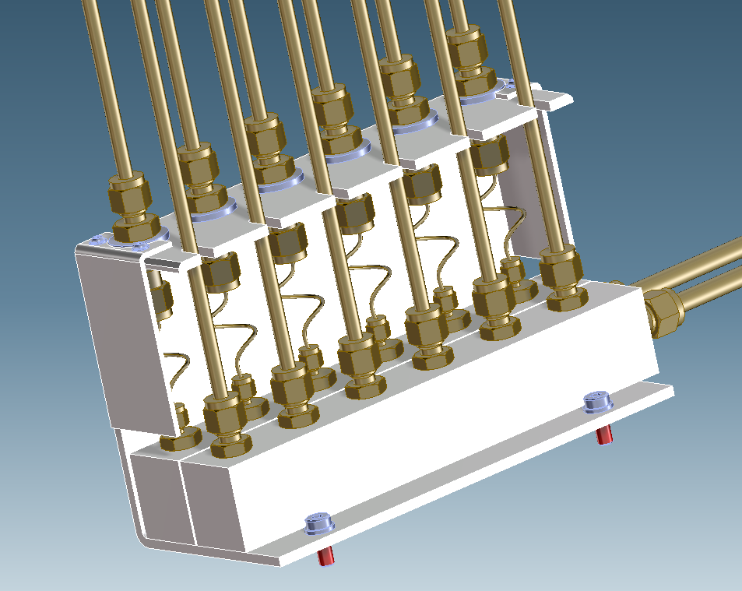
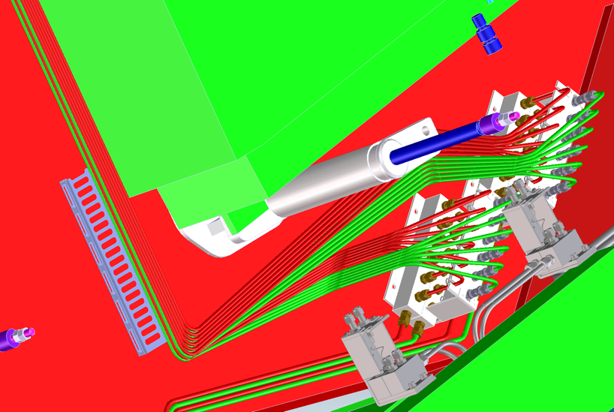
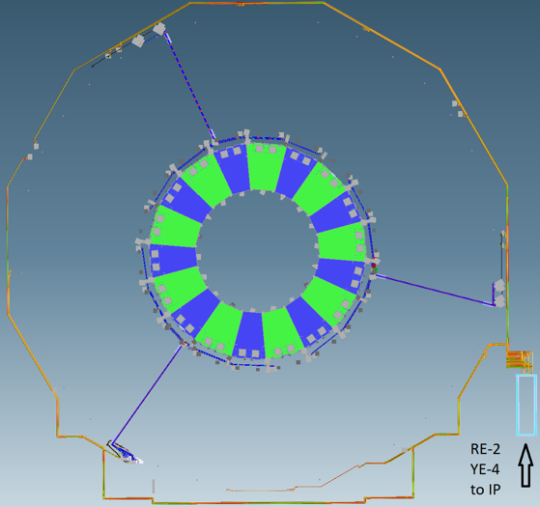
Installation by ZEC of pipes from the UGX5 to the UXC55, almost 1km, in addition to those shown here
Gas distribution based on original piping to 3 points on the periphery requiring impedances as the chambers require individual channels.

Slide 21
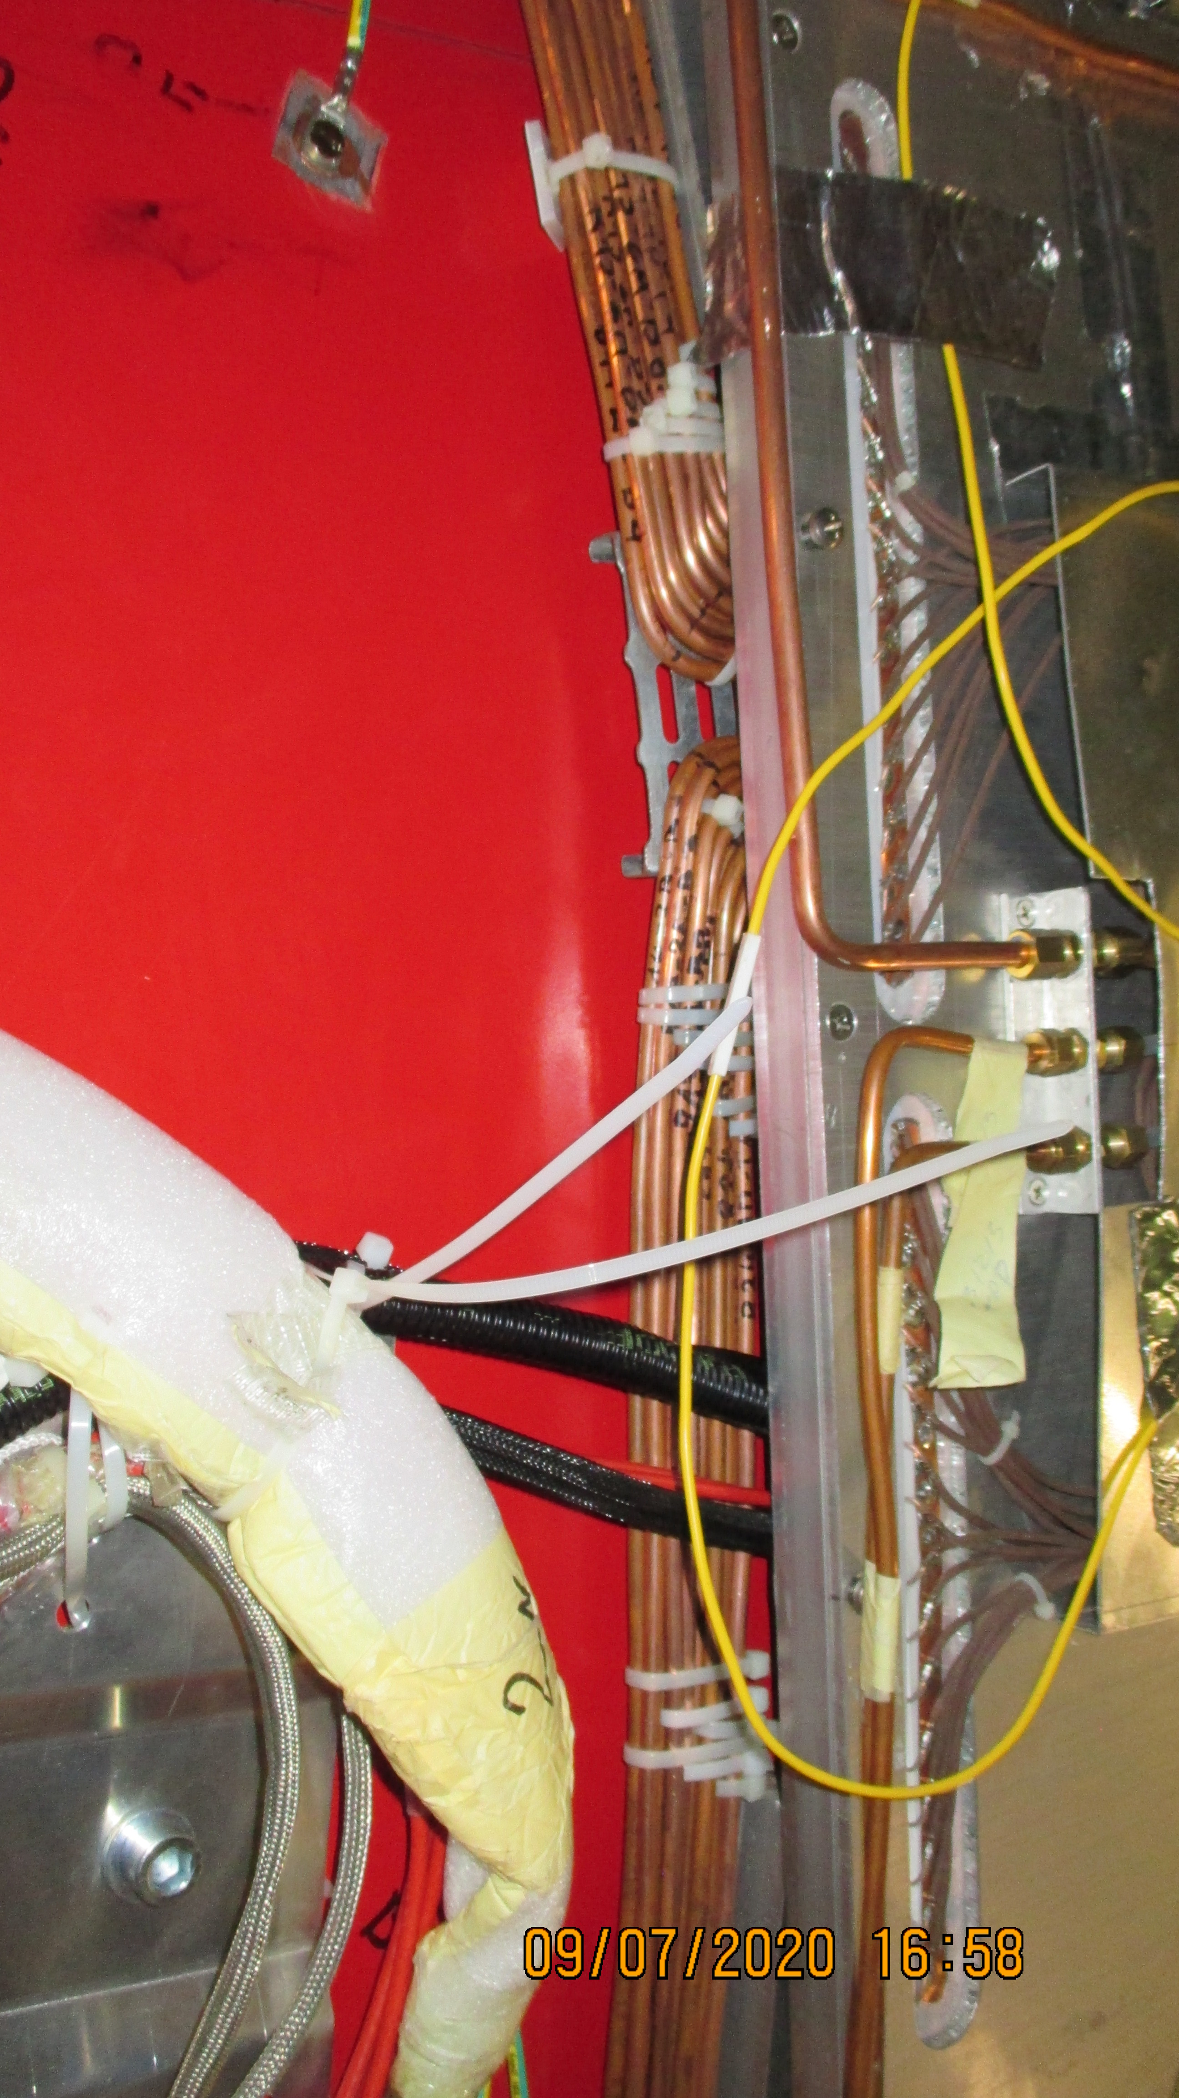

Slide 22
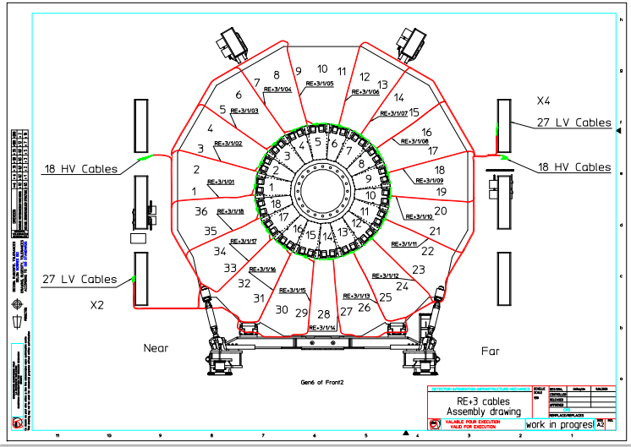
An example of the essential work by our colleague Ivan

Slide 23
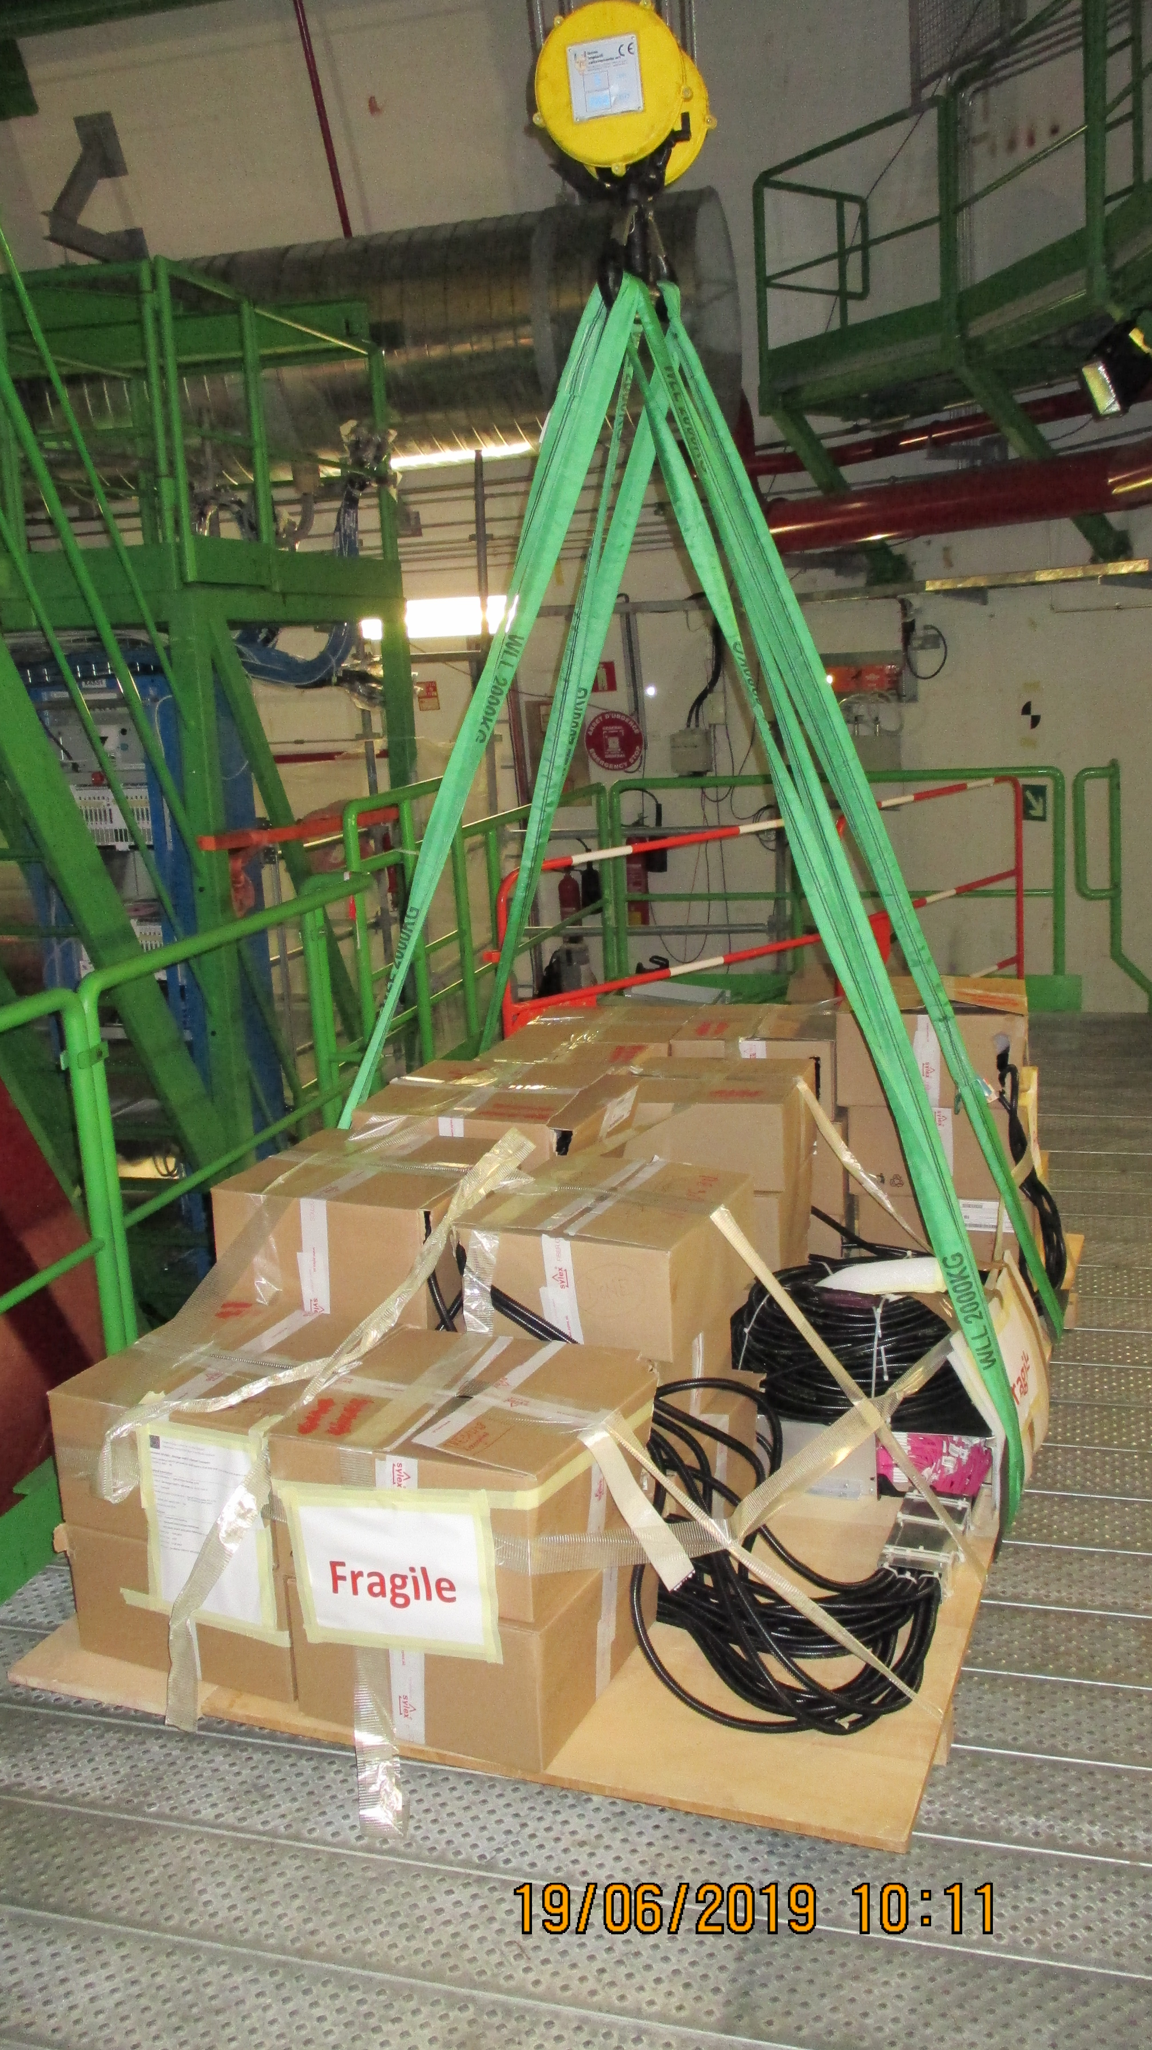
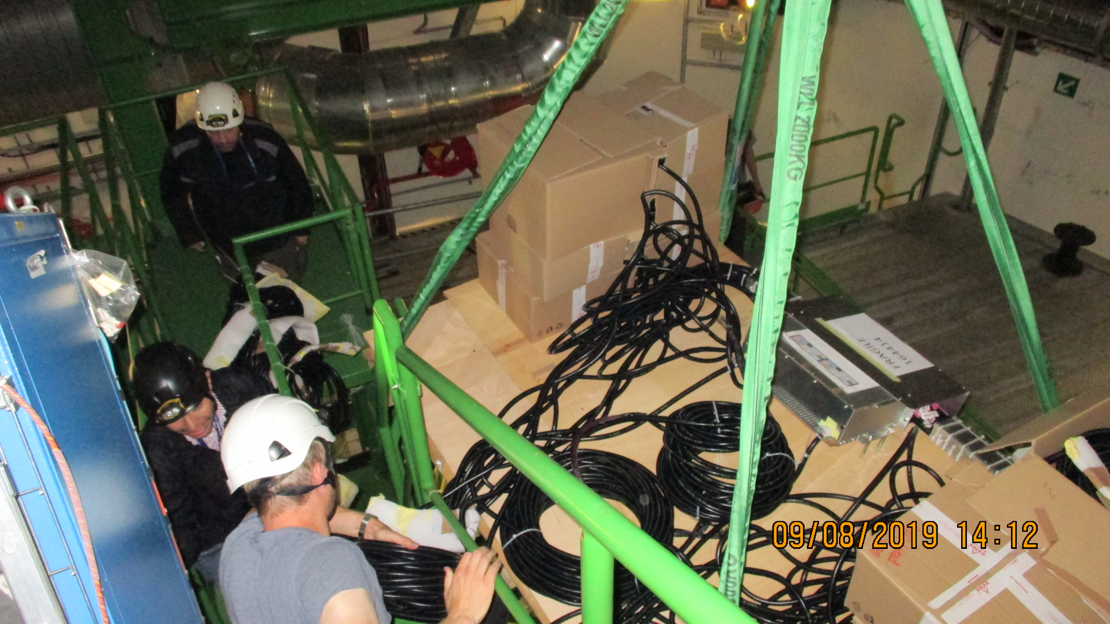

Slide 24
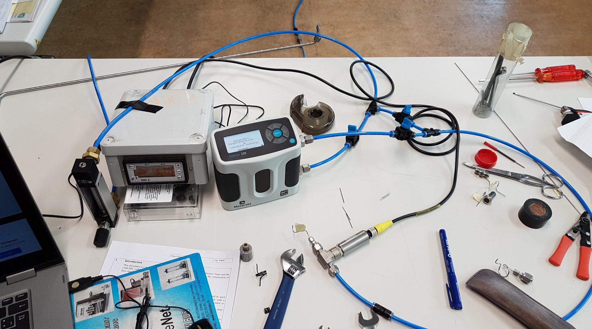
Experimental setup for ΔP tests
Gas: freon
Rotameter and flowmeter
Pressure sensor
The goal: define the tube specification for RE4.1, RE3.1 impedance boxes.
Two types of capillary:
  OD 1.59mm, ID 0.99 mm (used for RE4)
  OD 1.59 mm, ID 0.87 mm

Slide 25
Gas System
Missing material (order ongoing)
1) Flexible hoses: 40 short + 40 long, we have 1 quote from ZEC, expecting a second one from CEIHP this week.
2) Swagelok unions for flaoating patch panel end of flexible hoses.
3) Legris unions + 6mm caps on the CH side of the flexible hoses.
4) Drill and tap holes for RE-3/1 and RE-4/1 ground cables
5) 2 RE-4/1 impedance boxes finalized and tested and installed
Delivered
https://edh.cern.ch/Document/SupplyChain/DAI/7826363
40 short flexible pipes, 40 long flexible pipes-> Delivered (12.07.2019)
https://edh.cern.ch/Document/SupplyChain/DAI/7818647
Ferrules for CMS RPC Impedance Boxes, Swagelok material needed for the CMS RPC RE4/1 -> Delivered (19/06/2019)
https://edh.cern.ch/Document/SupplyChain/MAG/7819757
Double ferrule unión, Ferr. Union tube caps -> Delivered
January 30th, 2020
25

Slide 26
Missing material (order ongoing)
1) Flexible hoses: 40 short + 40 long, we have 1 quote from ZEC, expecting a second one from CEIHP this week.
2) Swagelok unions for flaoating patch panel end of flexible hoses.
3) Legris unions + 6mm caps on the CH side of the flexible hoses.
4) Drill and tap holes for RE-3/1 and RE-4/1 ground cables
5) 2 RE-4/1 impedance boxes finalized and tested and installed
Delivered
https://edh.cern.ch/Document/SupplyChain/DAI/7826363
40 short flexible pipes, 40 long flexible pipes-> Delivered (12.07.2019)
https://edh.cern.ch/Document/SupplyChain/DAI/7818647
Ferrules for CMS RPC Impedance Boxes, Swagelok material needed for the CMS RPC RE4/1 -> Delivered (19/06/2019)
https://edh.cern.ch/Document/SupplyChain/MAG/7819757
Double ferrule unión, Ferr. Union tube caps -> Delivered

Slide 27
Status of the Gas system
RE+4/1 is complete
RE+3/1 is complete
RE-3/1 is complete
RE-4/1 will be complete week 39

Slide 28



Readiness and Schedule

Slide 29
Readiness and Schedule
RE-3/1 cable installation 9 days Thu 13/06/19 Tue 25/06/19 (Done)
RE+4/1 cable installation 14 days Fri 02/08/19 Wed 21/08/19 (Done)
RE+3/1 cable installation 10 days Fri 24/04/20 Mon 11/05/20 (Done)
RE-4/1 cable installation 9 days Fri 29/05/20 Thu 11/06/20 (Ready)
Optical fibre from UXC to USC:
Positive side: 14-20.May.2020 (5 days)
Negative side: after the end of the muon critical path

Slide 30
Manpower for installation
Gas and cooling -> ZEC
Optical Fibers -> Russian team
High Voltage -> Russian team
Low Voltage -> Russian team

Slide 31
Thanks!

Slide 32
Backup Slides
https://twiki.cern.ch/twiki/bin/viewauth/CMS/Services_RPCPhase2Upgrade#Inox_pipes_Details
This presentation;
January 30th, 2020
32

Slide 33

High Voltage
All cables tested.
January 30th, 2020
33

Slide 34

Low Voltage
January 30th, 2020
34

Slide 35

Low Voltage
January 30th, 2020
35

Slide 36
Readiness and Schedule (to be updated)
RE-3/1 cable installation 9 days Thu 13/06/19 Tue 25/06/19 (Done)
RE+4/1 cable installation 14 days Fri 02/08/19 Wed 21/08/19 (Done)
RE+3/1 cable installation 11 days Wed 13/05/20 Wed 27/05/20 (Ready, cooling incomplete)
RE-4/1 cable installation 10 days Wed 15/04/20 Tue 28/04/20 (Ready, cooling incomplete)
Optical fibre from UXC to USC:
Positive side: 04-11.May.2020 (6 days)
Negative side: after the end of the muon critical path
January 30th, 2020
36

Slide 37
Labeling Status today
Type | Location | Printed | Installed | # Individual Labels | # Copies | Total | Comments
HV | RE+3/1 | Yes | Done by Fatma | 18 | 2 | 36
HV | RE-3/1 | Yes | Yes | 18 | 2 | 36
HV | RE+4/1 | Yes | Done by Fatma | 18 | 2 | 36 | 16 July finished
HV | RE-4/1 | Yes | Done by Fatma, Gamal, Ekhlas | 18 | 2 | 36 | 18 July finished
LV | RE+3/1 | Yes | Yes | 18 | 2 | 36
LV | RE-3/1 | Yes | Yes | 18 | 2 | 36
LV | RE+4/1 | Yes | Done by Fatma, Gamal, Ekhlas, Manuel | 18 | 2 | 36 | Correction done on UXC by Daniel and Andres, missing chamber side
LV | RE-4/1 | yes | Done by Fatma, Gamal, Ekhlas, Manuel | 18 | 2 | 36 | Correction done on 904 by Manuel and Andres
Fiber | RE+3/1 Cable 1 | Yes | Yes | 18 | 2 | 36
Fiber | RE-3/1 Cable 1 | Yes | Yes | 18 | 2 | 36
Fiber | RE+4/1 Cable 1 | Yes | Yes | 18 | 2 | 36 | Correction done on 904 by Daniel and Andres
Fiber | RE-4/1 Cable 1 | Yes | Yes | 18 | 2 | 36 | Correction done on UXC by Daniel and Andres
January 30th, 2020
37

