Slide 1
Services RE3 & 4/1
Ian on behalf of the RPC Group
5 Sept 2018

Slide 2
HV cables and connectors, Umbilical cables USC to UXC. Coaxial cables from YE1PP to YE3 via mini-cable chains
LV cables & connectors on YE3
Fibre optics & Patch Panels from YE3 to YE1PP through to USC
Gas System piping, Impedances and Bulkheads on YE3
Cooling, flexibles on RE4 face of YE3, RE3/1 cooling comes with chambers
RE 3/1 & RE 4/1

Slide 3
HV System in UXC
We have selected a coaxial connector, tested over many years, namely the C.P.E. “Jupiter” coaxial connector.
The order for the cables and connectors is ready, only awaiting the choice of dielectric. The cables will be QA in the company under our supervision and retested in 904.
Commissioning will be enhanced with resistances in boxes, simulating the chamber load, placed in place of the chambers .

Slide 4
HV System in the USC
A new rack, S1H12, is installed for the RE3/1 and RE4/1 components.
The TDR version, an extension of the present system is planned.
However an alternative preferred version is planned for testing in 2019
Layout from Anton with calculation of components.
Which ever solution is finally taken does not influence the cabling from UXC.

Slide 5
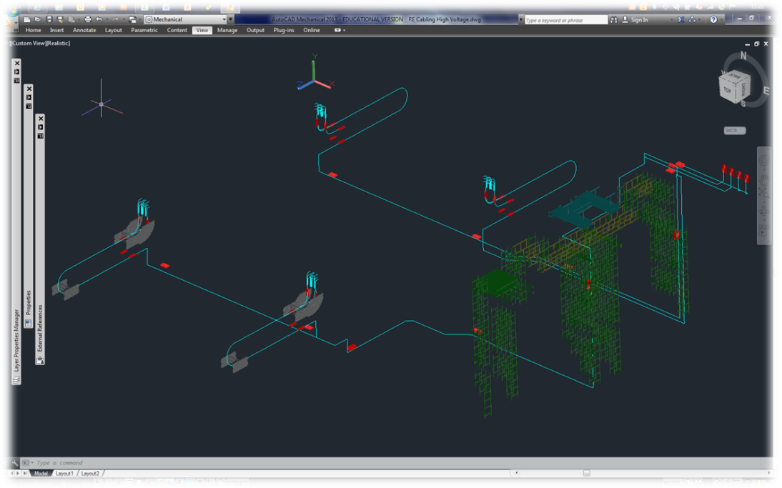
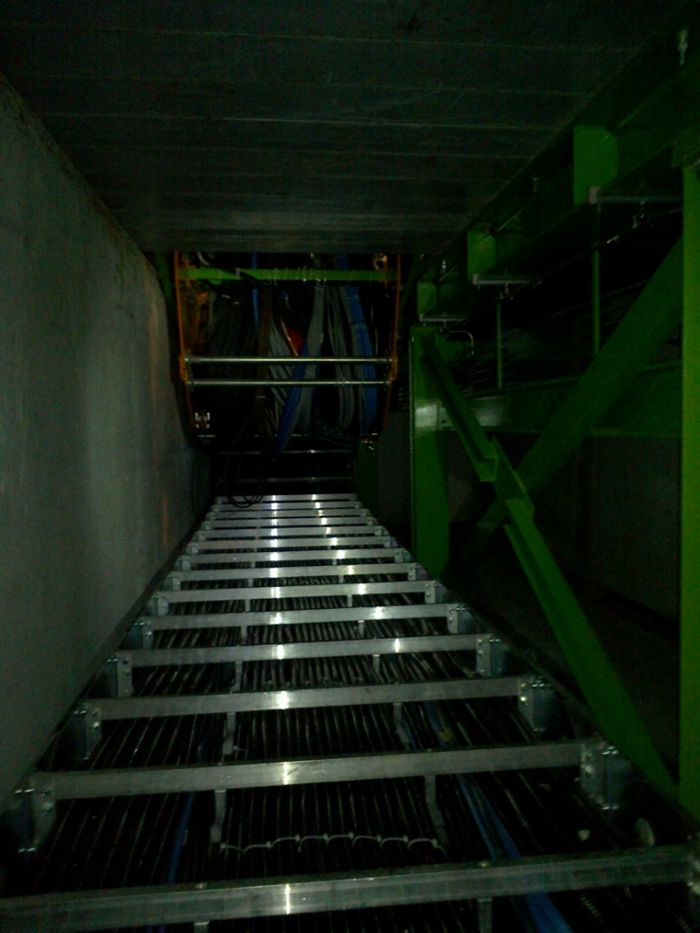
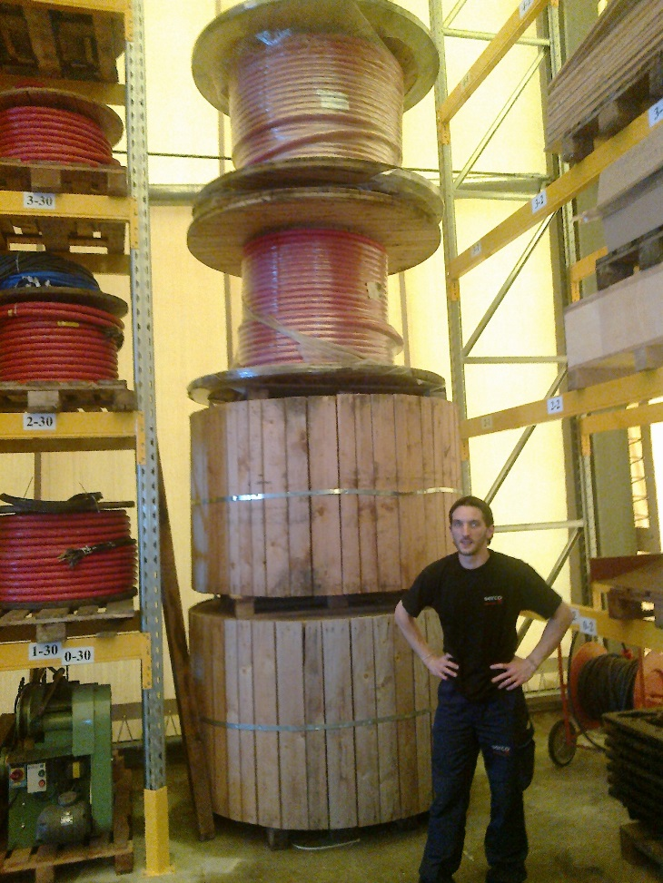
HV system routing from USC to UXC
The Main Cable chains in X0 under CMS
Routing from the USC HV racks to the YE1 PPs
Cable sections and lengths, including spares, to be evaluated with CMS Integ Office, S. Bally and Boki

Slide 6
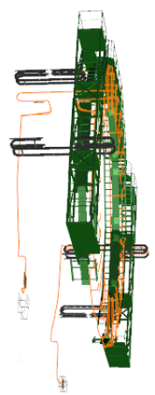
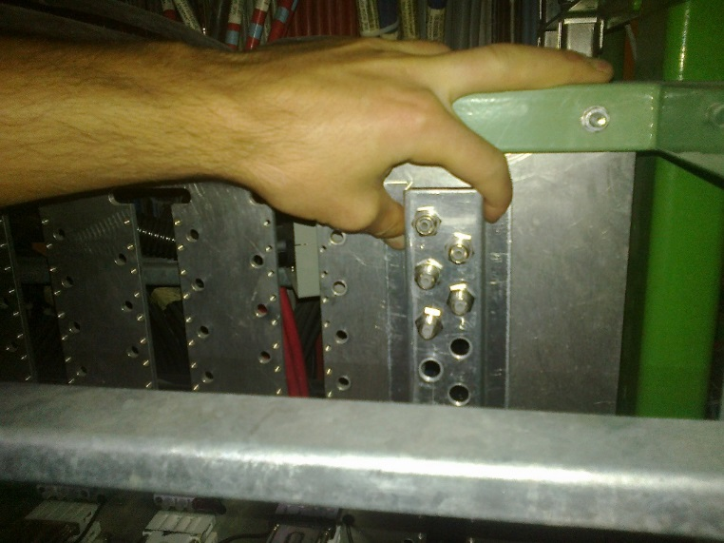
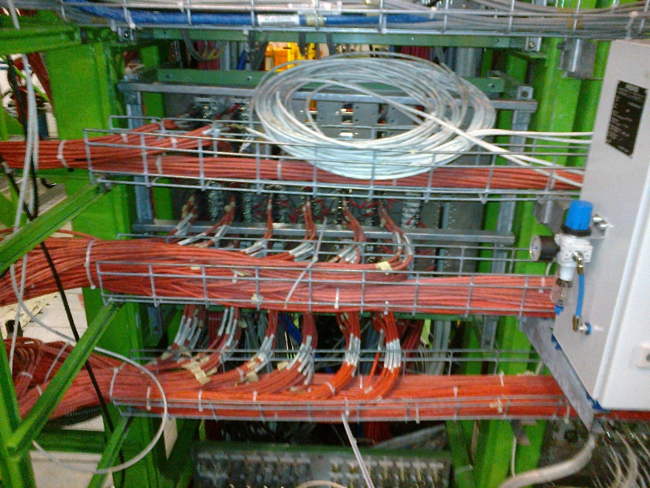
Modification of the YE1 PP to accept the alternative Jupiter connecter
YE1 Patch Panel (PP)
Cable routing done by Integration office. Requires finalising
Cable installation, 2 weeks for each station starting in March 2019 and finishing in March 2020

Slide 7
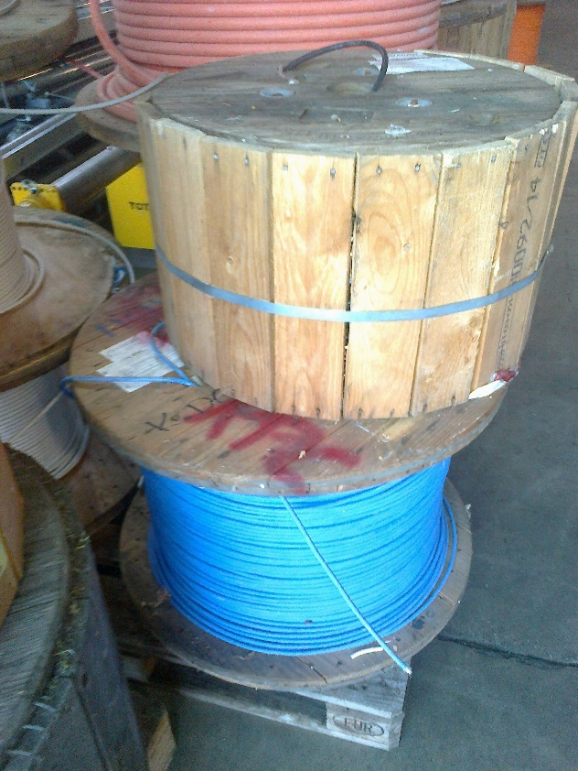
LV Cables UXC, Rack to chamber on YE3
LV tests done, different cable sections and stiffnesses.
Measured time response, using sense wires tested on restive loads, to be repeated on the FEBs during firmware upload ?
Supply of 3.5km of the cable (in P5) previously used for LB
Connectors at chamber end are more or less defined , “D-Sub’ with sense pins
2 cables per chamber but what of the connection in the CAEN module ? Choice of two.
Assembly can be done in Geneva EPI or Cavitech , Boudry, Neuchatel
As with the HV the load should be simulated by a resistance in place to
aid in rapid commissioning.
Communication cable from USC to UXC to be installed in main cable chains Jan 2019
Cable installation, 2 weeks for each station starting in March 2019 and finishing in March 2020

Slide 8
Fibre optics.
From the choice between Blown fibres and Trunk cables, we have taken the latter, with approval from TC .
As the main protagonists, Zhenan and Behzad are here at CERN we will come out with a full spec by end of next week
The order should leave CERN before the end of September.
Fibres to be installed in week 5 of 2019

Slide 9
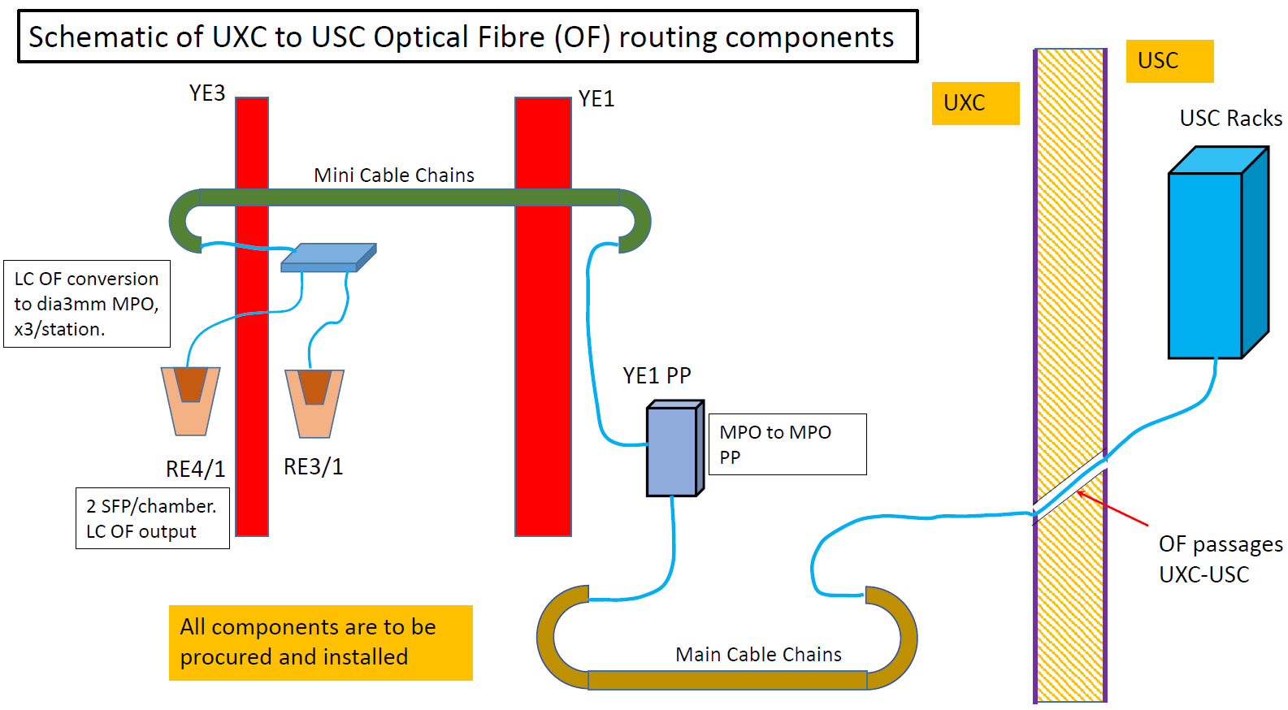
Schematic
6
2
1
3
4
5

Slide 10
RE4(3)/1 chambers gas distribution schematic
Sagana brass union
reduction from 8mm to 6mm
Impedance box 6 channel
RE4(3)/3 chamber
8 mm copper pipe
RE4(3)/2 chamber
Parallel flow
Supply
Return
6 mm copper pipe
Gas Rack
Bottom layer
Top layer
Legris brass unions (6mm)
RE4(3)/1 chamber

Slide 11
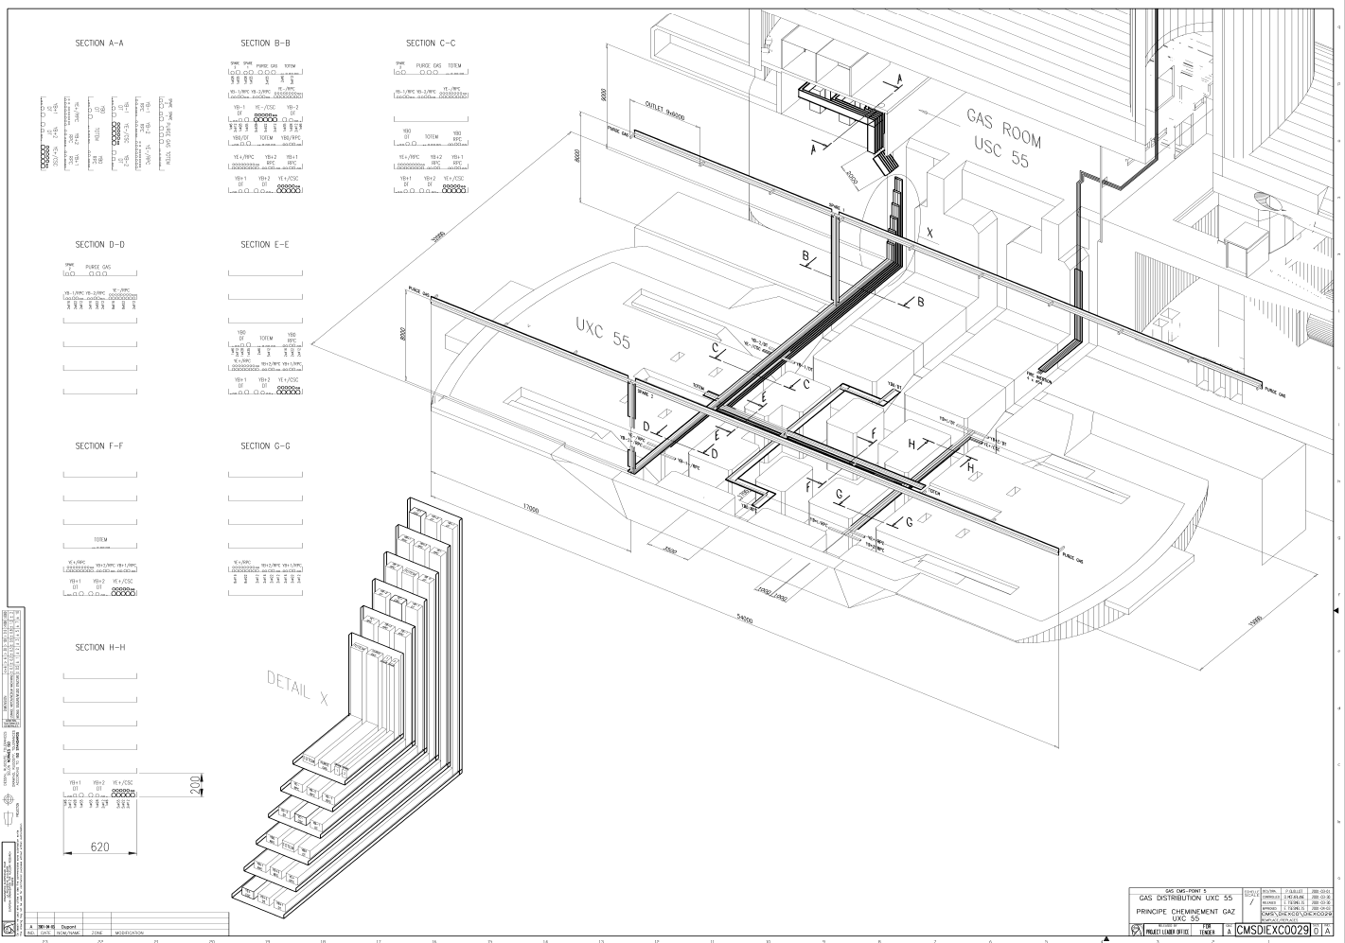
Piping from USC to UXC distribution racks
From USC gas room to UXC gas racks: new pipes will be installed (2 pipes per disk (negative/positive) for supply/return lines).
To be installed by ZEC in Jan 2019.

Slide 12
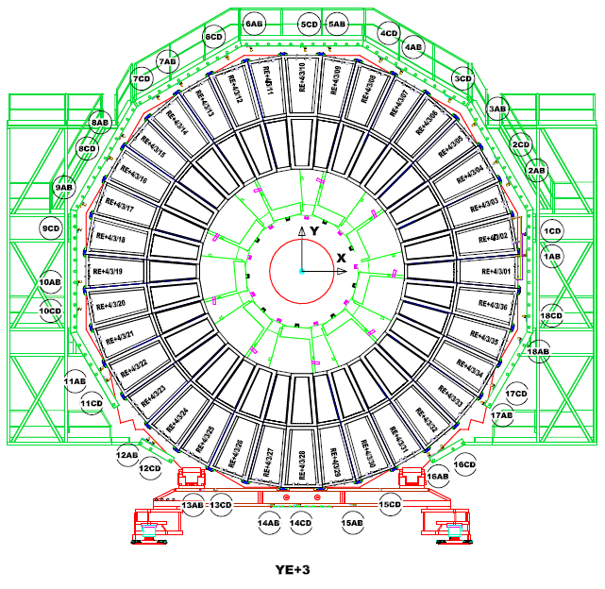
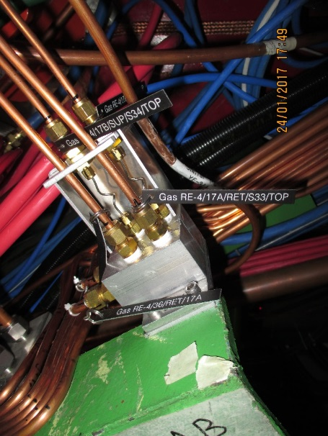
Gas piping, bulkheads and Impedances
YE3 gas rack to be modified to make the 12 channels independent from the present channels
Impedance boxes positioned at three points around the periphery for both RE4/1 and RE3/1
Material proqurement in 1st week of October.
Installation occurs over 2 weeks for each station starting in March 2019 and finishing March 2020
Impedance box for parallel operation, 2 channel shown

Slide 13
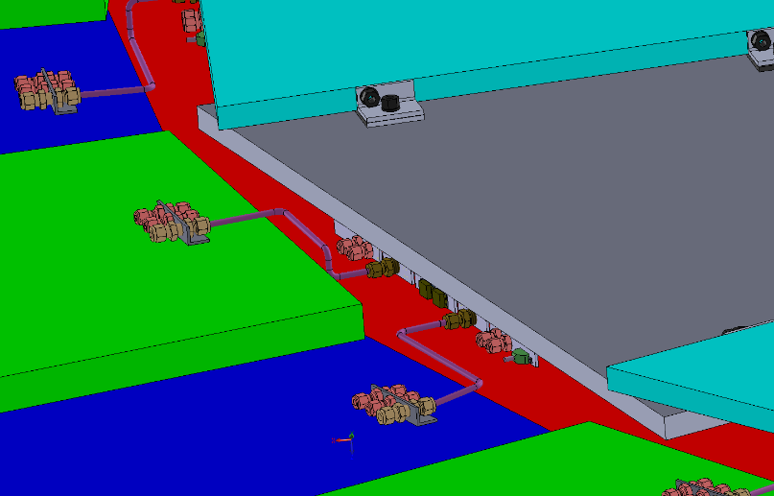
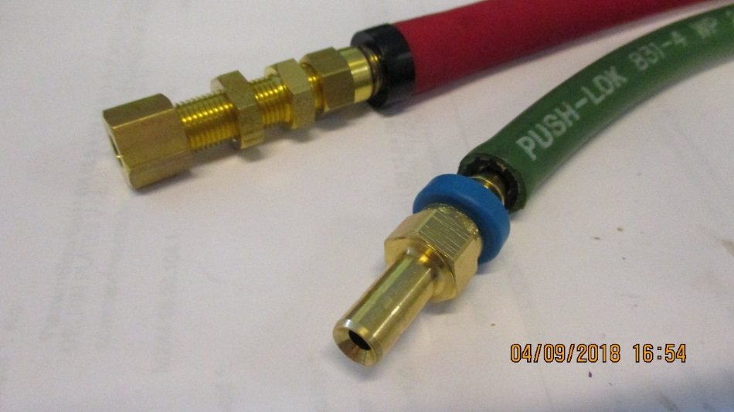
Cooling
Cooling load per station is 540W
RE3/1
Verify the assembly of the flexibles with simplified safer version, namely direct from RE3/2 PP to RE3/1 PP with three elements only, as opposed to 3 times as many unions with a “L” Cu pipe producing a lever arm on the chamber PP.
RE4/1
Modify the present Mini-manifolds to take additional “take offs” direct to the chambers with flexibles all the way to the RE4/1 PP.

Slide 14
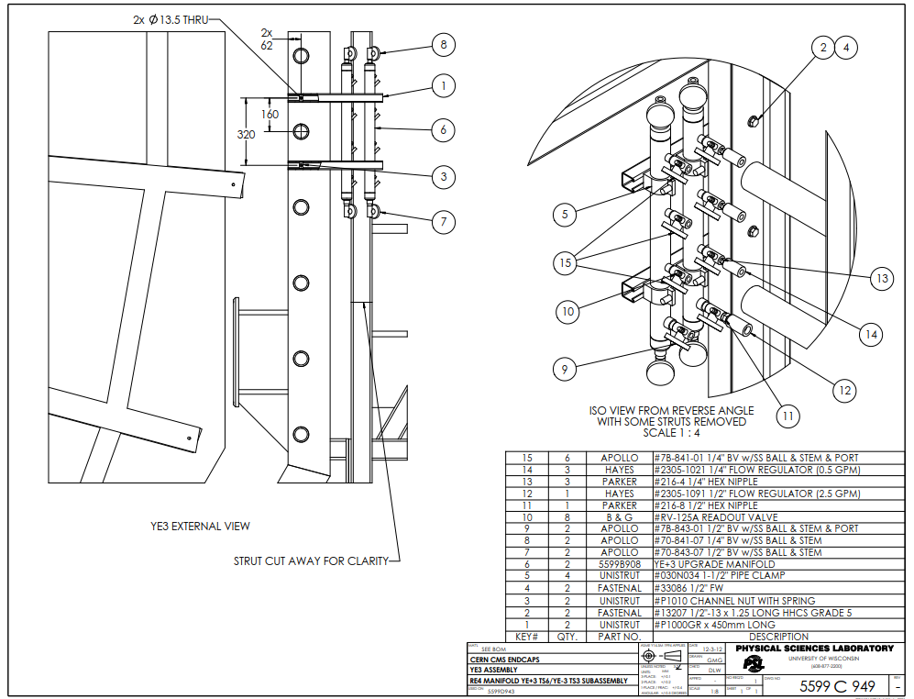
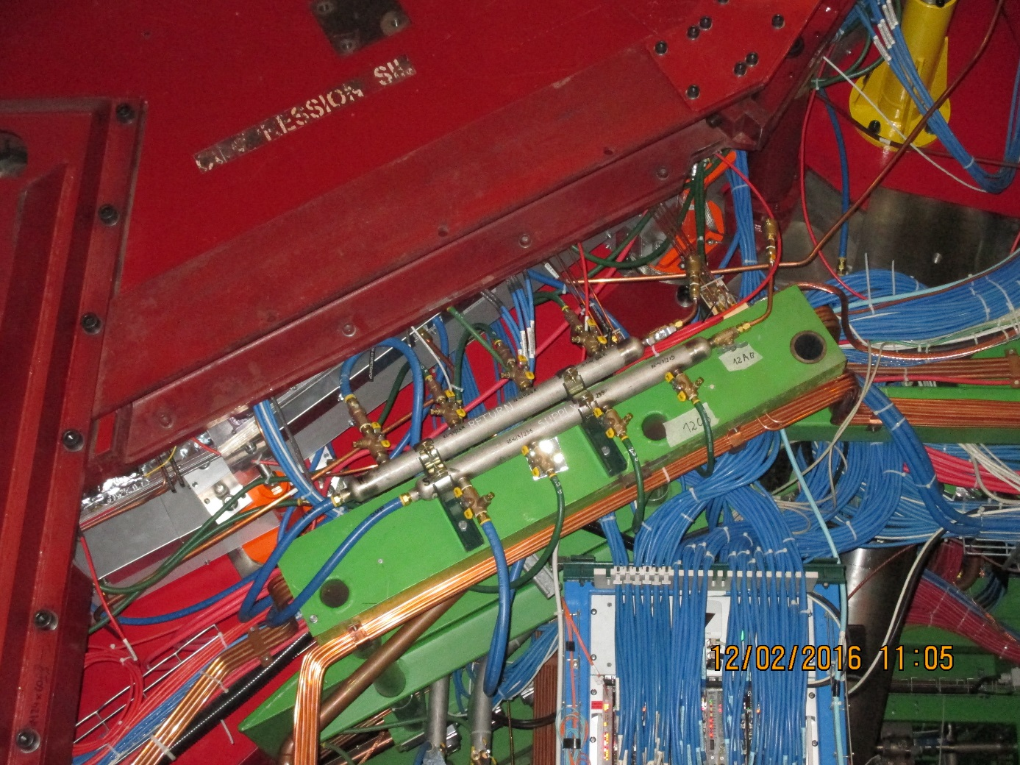
RE4/1 cooling
Mini manifold . To be modified to accept the necessary “T”s for the RE4/1 cooling.
The same flow regulators will be kept with individual cut off valves to each chamber, if costs permit.
Details of which unions to be arranged with cooling group

Slide 15
Actions required
HV. Outstanding points with CPE, assembly QC methods and timeline
LV
  Do test with New FEB while loading firmware and max cable length ~30m
  S. Bally for exact cable lengths
  Contact Houari for cable length in P5 store.
Fibres, check where we are with spec and supplier in next 10 days as Bezhad and Zhenan are here.
  Check procurement details with Austin.
Gas requires details drawing for installation.
See with cooling suppliers for the inch size on “T” mini manifolds and the metric on the chamber.

Slide 16
Additional Material

Slide 17
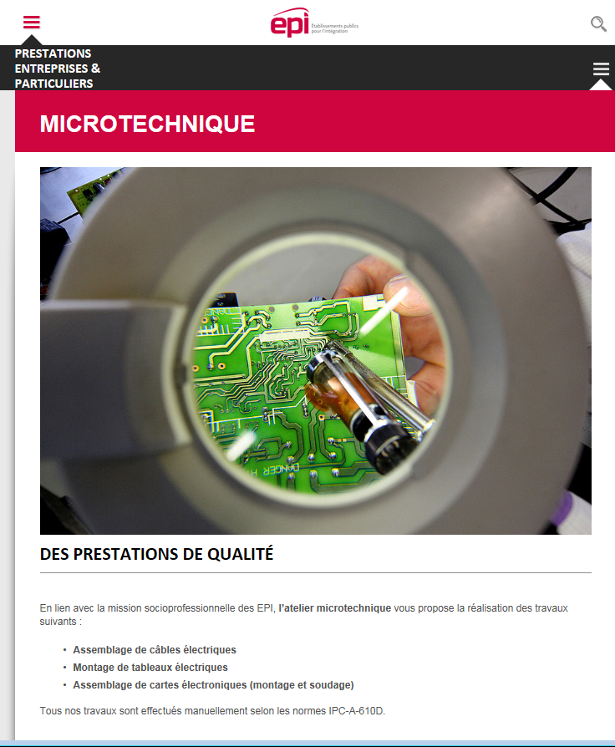
https://www.epi.ge.ch/prestations-entreprises-particuliers/ateliers/microtechnique/

Slide 18
RPC Power System Review
Anton Dimitrov, Ian Crotty
RPC Upgrade Mini Workshop, 05.Sep.2018, CERN

Slide 19
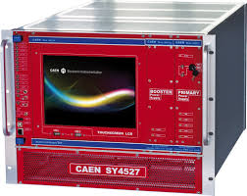
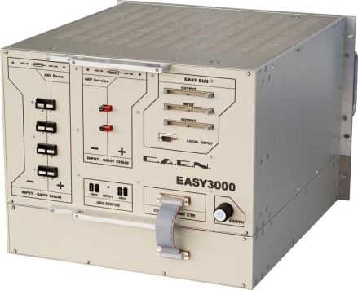
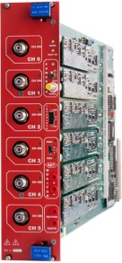
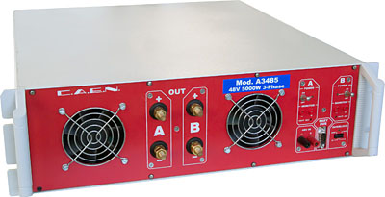
HV Power System Upgrade for RE3/1 & RE4/1 (I)
USC
UXC
SY4527
The HV power system will be based on CAEN EASY system
(practically, extension of the existing HV system):
SY4527 – 1 (existing)
A3485S - 2 modules (existing)
4 EASY3000 crates
A3512N – 12 HV Boards
TDR Baseline: Variant I
EASY3000
4 HV multiconductor cables per endcap. Each with 20 HV channels
All must go via the YE1’s main cable chains (MCC)
A3485S
A3512N
Long term maintenance will be secured by CERN-CAEN contract.
To be integrated in the RPC DCS.
1

Slide 20
S1H12
S1H07
HEX
HEX
HV Distribution Box
ENDCAP RACKS
S1H11 – S1H08
HV Distribution Box
HV Distribution Box
SY4527
HV Distribution Box
HV Distribution Box
HV Distribution Box
HEX
SY4527
HV Distribution Box
HV Distribution Box
48V DC cable connected after Crate3 in rack S1H09
Crate4
RE+3/1
RE+4/1
1 new rack (already defined S1H12, to be equipped)
2 EASY crates
8 umbilical cables all arriving to one rack
6 A3512N HV boards in each Crate (12 boards in total)
8 HV Distributor Boxes in total (all in one rack)
HEX
A3485S
Crate4
RE-3/1
RE-4/1
A3485S
48V DC cable connected after Crate3 in rack S1H11
A3485S
A3485S
2

Slide 21
HV Power System Upgrade for RE3/1 & RE4/1 (II)
USC
UXC
SY4527
The HV power system will be based on CAEN NON-EASY system:
SY4527 – 2 (new)
New HV boards – prototype ready in 2019
Preferred Variant: Variant II
EASY3000
4 HV multiconductor cables per endcap. Each with 20 HV channels
All must go via the YE1’s main cable chains (MCC)
A3485S
A3512N
Long term maintenance will be secured by CERN-CAEN contract.
To be integrated in the RPC DCS.
3

Slide 22
S1H12
S1H07
HEX
HEX
HV Distribution Box
ENDCAP RACKS
S1H11 – S1H08
HV Distribution Box
SY4527
SY4527
HV Distribution Box
SY4527
HV Distribution Box
- No EASY system ➔ no EASY crates
- 2 SY4527 mainframes more
- 8 umbilical cables all arriving to one rack
- New type of HV boards!
- 8 HV Distributor Boxes in total (all in one rack), but bigger in size
since all inputs and outputs should be at the back side of the rack
- No rack cross reference in DSS Action Matrix
HEX
HV Distribution Box
HEX
HV Distribution Box
A3485S
SY4527
A3485S
A3485S
HV Distribution Box
A3485S
HV Distribution Box
4

Slide 23
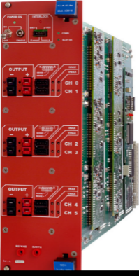
RPC LV Power System for RE3/1 & RE4/1
USC
UXC
YE+3: X2J52, X3J51, X3A51, X4A51
YE-3: X2V52, X3V51,X3S51, X4S51
CAEN EASY3000S
with CAEN A3016
in X2Near && X4Far racks
Existing RE3&RE4 detector
SY4527 with A1676A
24 A3016 LV boards in total to power the FE of all RE3/1 and RE4/1 chambers.
9U in each YE3 X4Far tower rack for
  1 CAEN EASY3000S crate
  1 CAEN A3486S MAO- AC/DC 48V PS
15U in each X2Near YE3 tower rack for
  2 CAEN EASY3000S crates
  1 CAEN A3486S MAO- AC/DC 48V PS
A3486S
Relay
YE1 LV PP
50p Communication bus
going directly to YE3
48V Service power
1

Slide 24
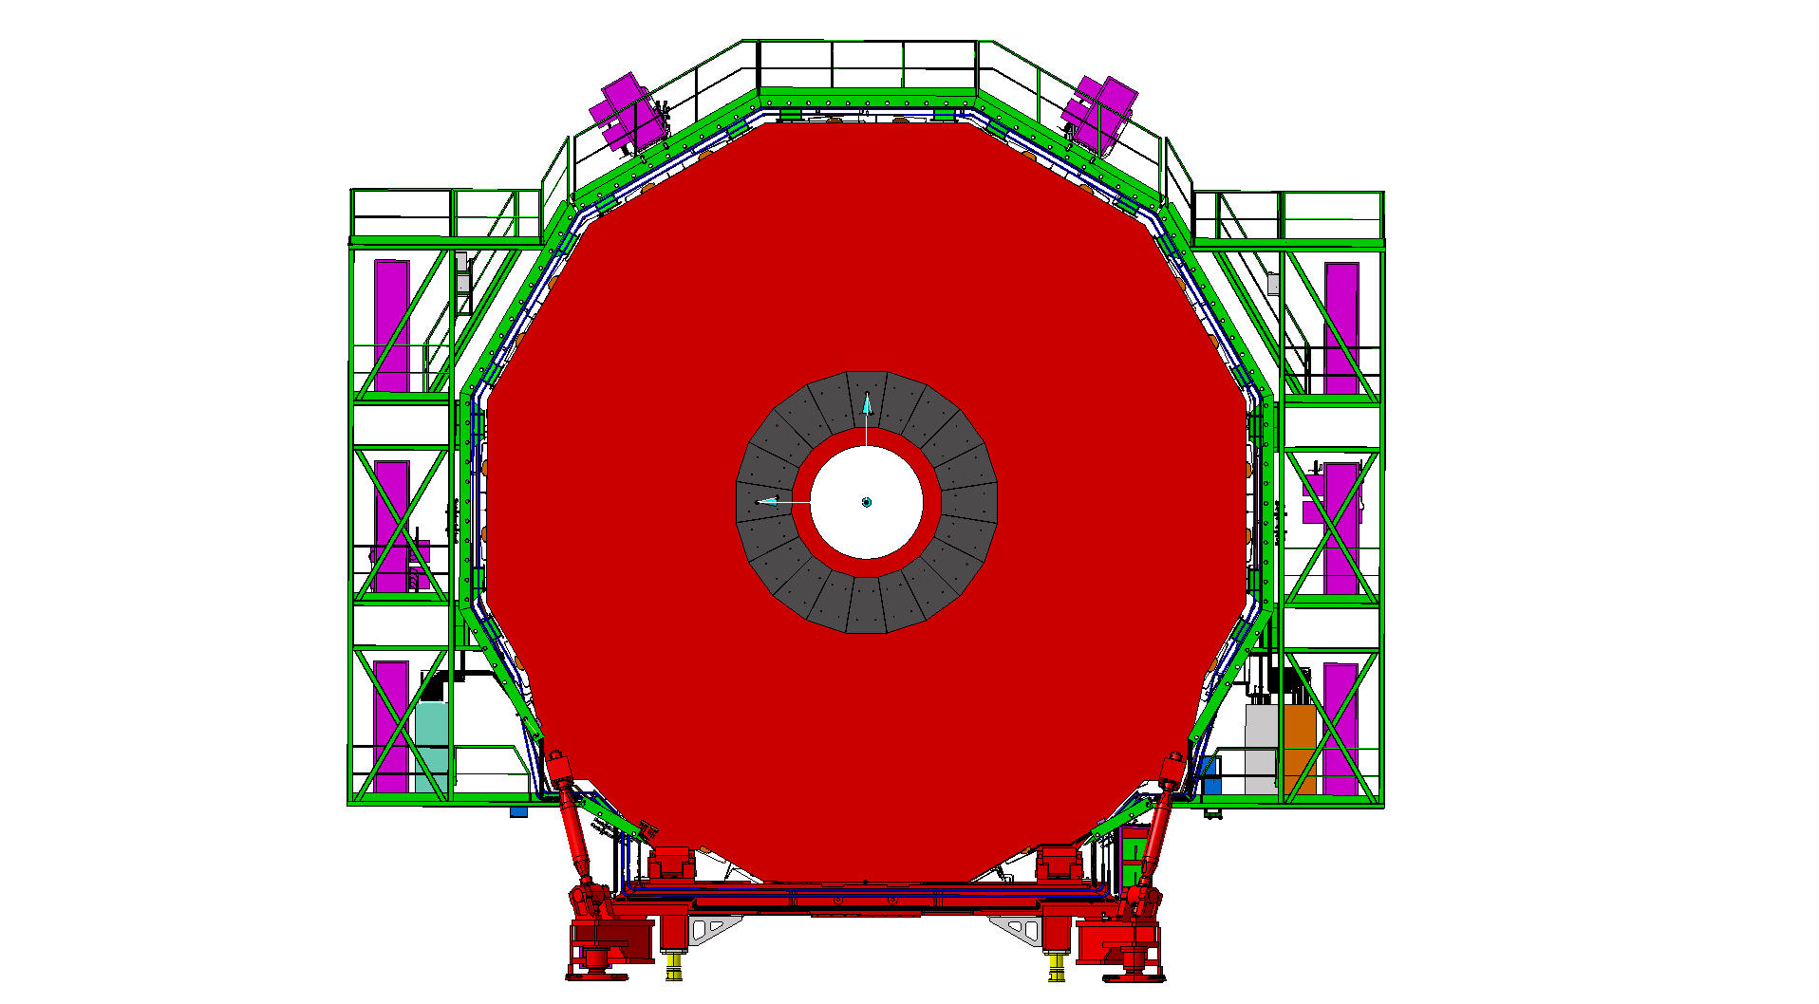
RPC LV Services
Far Side
Near Side
mini Cable Chains for OF
mini Cable Chains for OF
X4
LV Easy crates
LV Easy crates
X2
X2Near – X4Far
diagonal
2

Slide 25
Far Side
YE+3
Near Side
X3A51
X4A51
X3J51
X2J52
Power Distribution
Power Distribution
Power Distribution
Power Distribution
Turbine
Turbine
Turbine
Turbine
HEX
HEX
HEX
HEX
EMU VME
RE3 LBB
EMU VME
EMU Maraton
HEX
RE4 LBB
EMU Maraton
EMU
EMU
RE4 LBB
RE4 LBB
RE3-4/1 FE EASY3000S
Crate2
RE4/1 FE EASY3000S
Crate1
RE3-4 LBB EASY3000S
Crate1
RE3-4 LBB EASY3000S
Crate3
RE3/1 FE EASY3000S
Crate0
RE A3486S AC/DC-1
CH0 CH1
RE3-4 FEB EASY3000S
Crate0
Alignment DAQ
RE3-4 FEB EASY3000S
Crate2
RE A3486S AC/DC-0
CH0 CH1
RE4 LBB
RE A3486S AC/DC-0
CH0 CH1
RE A3486S AC/DC-1
CH0 CH1
Cable Distribution
EMU Maraton
RE4 LBB
Cable Distribution
RE3 LBB
HEX
RE3 LBB
EMU Maraton
HEX
HEX
Cable Distribution
HEX
HEX
Air Deflector
Air Deflector
Air Deflector
Air Deflector
Power Dist.
Power Dist.
Power Dist.
Power Dist.

Slide 26
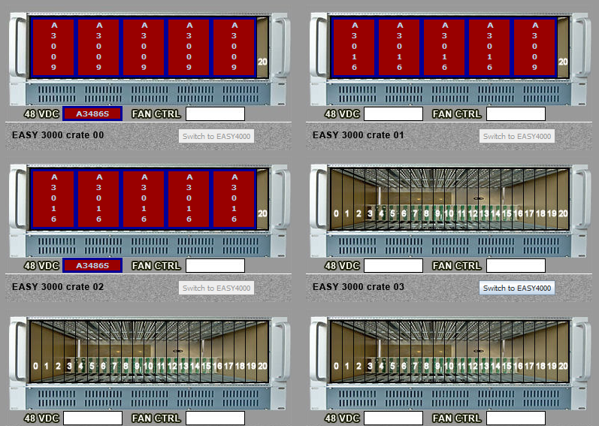
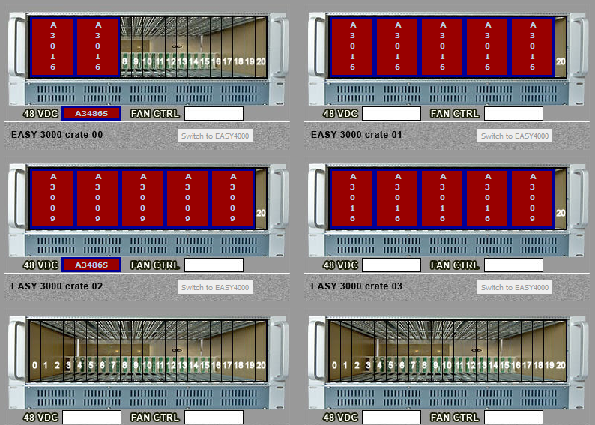
DCS daisy chain
Far Side
YE+3
Near Side
X3A51
X2J52
X4A51
X3J51
YE3Near and YE3far equipment (including existing RE3&RE4 detector on X3) on separate branch controllers,
therefore 4 new A1676 branches will be needed in total.

