Slide 1
Services RE3 & 4/1
Ian
5 Sept 2018

Slide 2
Services to be installed in UXC during LS 2 , 2019 & 2020
HV cables and connectors, Umbilical cables USC to UXC. Coaxial cables from YE1PP to YE3 via mini-cable chains
LV cables & connectors on YE3
Fibre optics & Patch Panels from YE3 to YE1PP through to USC
Gas System piping, Impedances and Bulkheads on YE3
Cooling, flexibles on RE4 face of YE3, RE3/1 cooling comes with chambers

Slide 3
HV System in UXC
Design change in the UXC area as the community has decided that the “3 pole “ is not a reliable solution.
This means that the connectors on the chambers and YE1 PP will be changed to what we have used in all tests since 2013. Namely the C.P.E. “Jupiter” coaxial connector.
HV order, There is a question on the insulator in the connectors. Is it Teflon and should we convert to PEEK. Technical documentation and EDH order ready No. 7367439
Resistances in boxes, simulating the chamber load, should be placed around the periphery to speed up commissioning.

Slide 4
HV System in the USC
A new rack, S1H12, is installed for the RE3/1 and RE4/1 components.
The TDR version, an extension of the present system is planned.
However an alternative preferred version is planned for testing in 2019
Layout from Anton with calculation of components.
Which ever solution is finally taken does not influence the cabling from UXC.

Slide 5
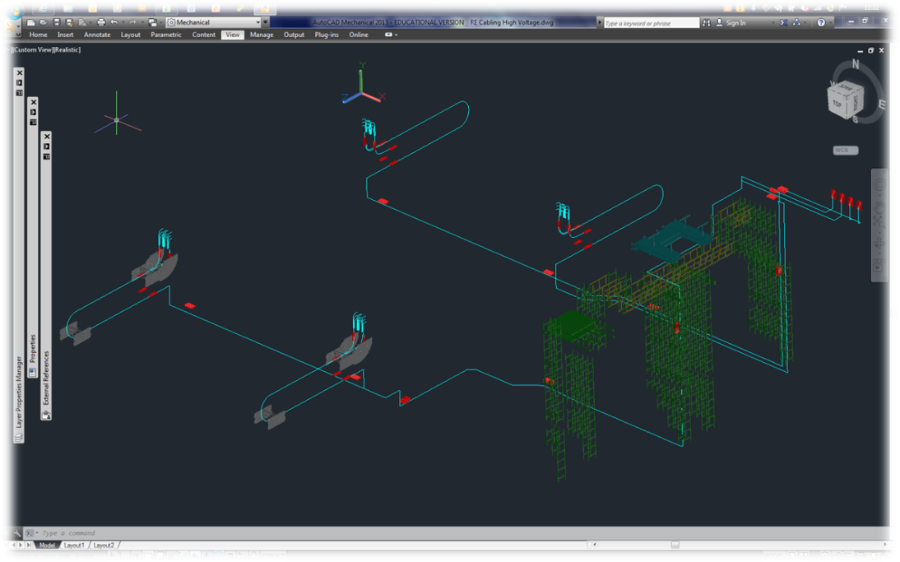
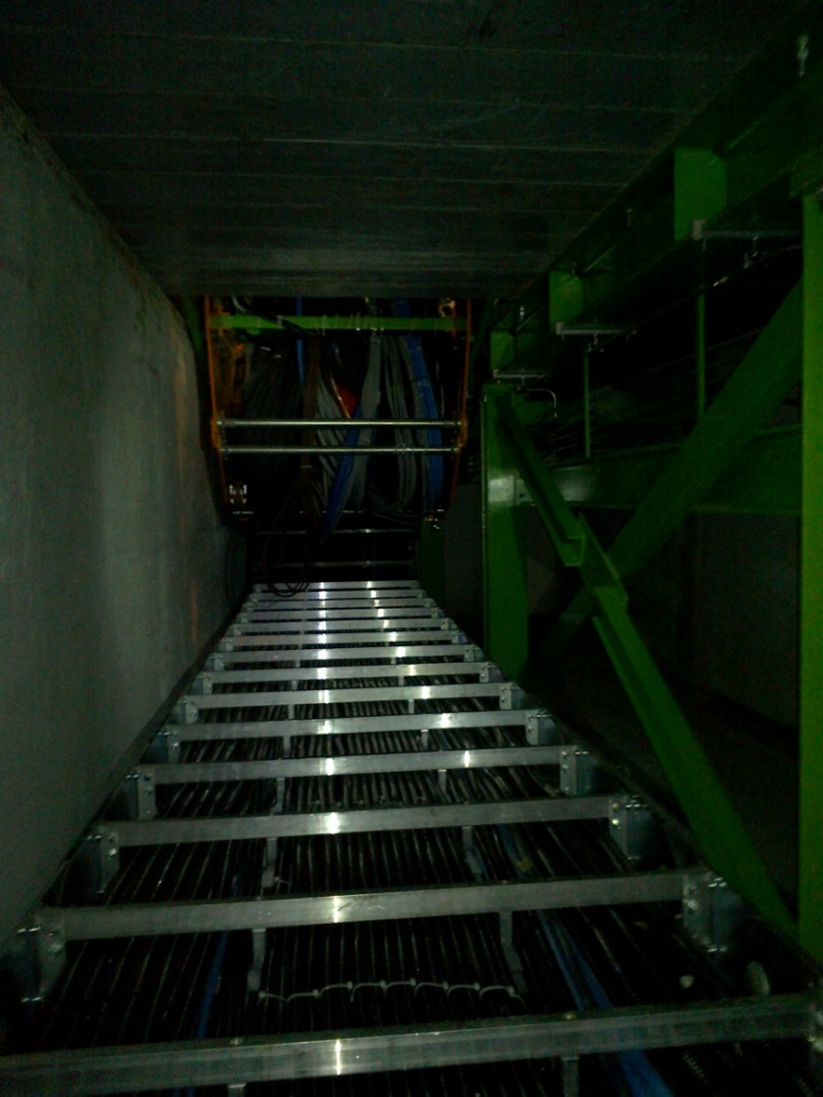
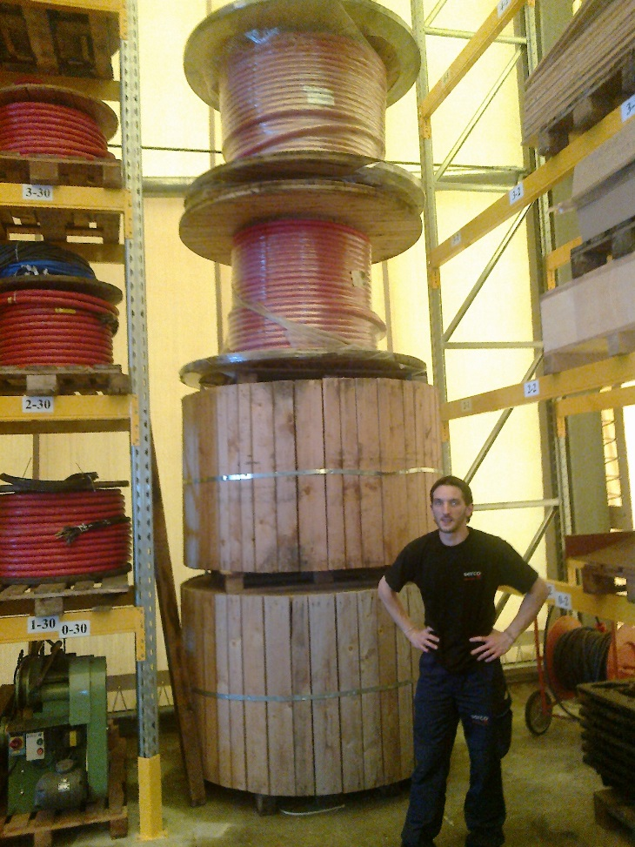
HV system routing from USC to UXC
The Main Cable chains in X0 under CMS
Routing from the USC HV racks to the YE1 PPs
Cable sections and lengths, including spares, to be evaluated with CMS Integ Office, S. Bally and Boki

Slide 6
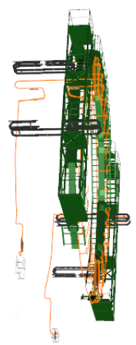
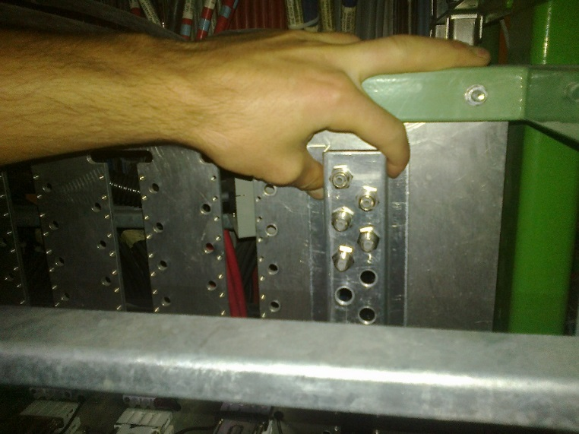
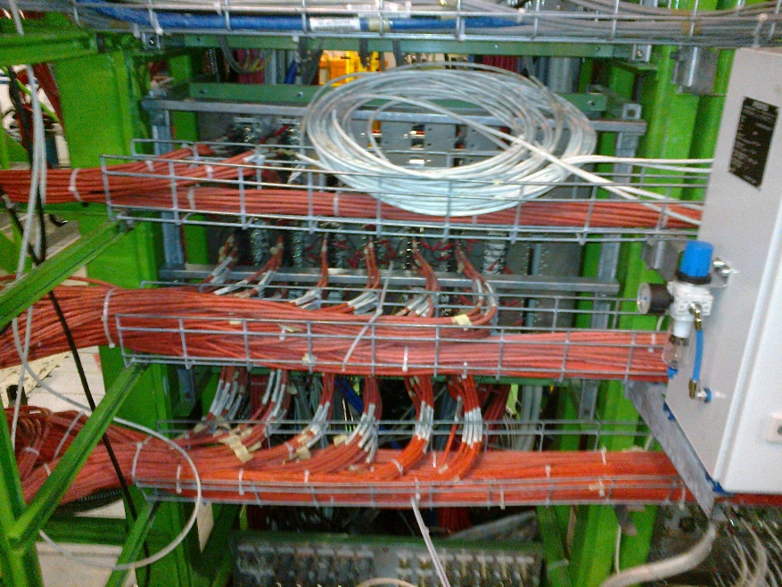
Modification of the YE1 PP to accept the alternative Jupiter connecter
YE1 Patch Panel (PP)
Cable routing done by Integration office. Requires finalising

Slide 7
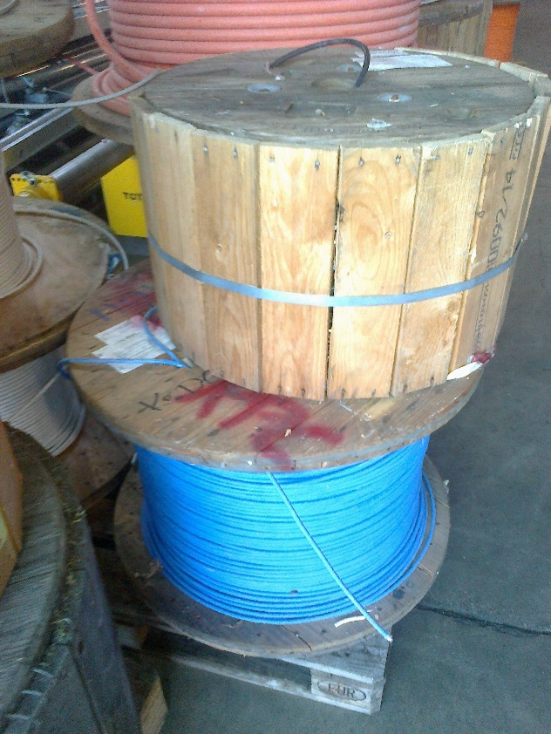
LV Cables UXC, Rack to chamber on YE3
LV tests done, different cable sections and stiffnesses.
Measured time response, is it what CAEN state, good enough ?
Do test with FEBs on chamber.
Supply of 3.5km of the cable (in P5) used for LB
Connectors at chamber end are more or less defined , “D-Sub’ with sense pins
2 cables per chamber but what of the connection in the CAEN module ? Choice of two.
Assembly can be done in Geneva EPI or Cavitech , Boudry, Neuchatel
As with the HV the load should be simulated by a resistance in place to
aid in rapid commissioning.
With the crates and modules in place the cabling is more efficient and quicker.
Coomunication cable fro USC to Uxc to be installed in main cable chains Jan 2019 ?

Slide 8
Offers from CERN Logistics office
Power Sense
2 x 4mm2 plus 2 x 0.5mm2 Novacavi
5.0Euro/m 0.92Euro/m Draka but wrong colour ! GEM use black ?
With colour change require 12 weeks including August from Novacavi and 10-12 fro Draka inc Aug
Offer for combined Sense and Power never received. Renewed request on 4 Sept 2018, waiting.

Slide 9
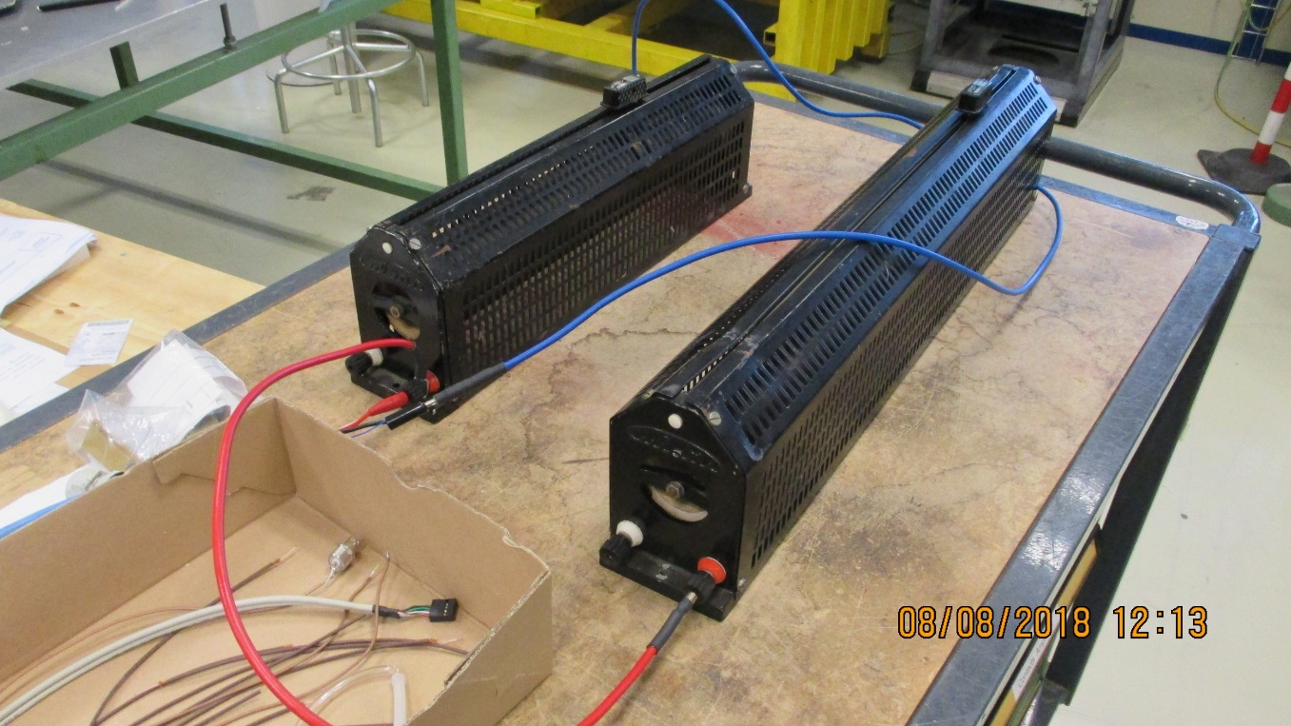
Christoph suggested a test transiting between 3A and 6.5A simulating the Firmware upload state.
Voltage drop at “Operational load” of 15W/FEB is <1.5V at the worst case of 30m. At 6.5A the worst case V drop is ~3V, that is on the limit of CAEN module.
Now that BT is finished the test should be done with the real FEBs. The real difference in current and transient should be studied.
Voltage drop on RPC LB cable
 |  |  |  | ian Crotty
 |  |  |  | 06-Aug-18
 | Set point | Current | Power in Load | PS voltage | Voltage | Voltage Drop | V Drop/m | Worst case drop 30m
 |  |  |  |  | Load
 | [V] | [A] | [W] | [V] | [V] | [V] | [V] | [V]
Sense | 5.00 | 3.11 | 15.52 | 5.70 | 4.99 | -0.71 | -0.04797 | -1.44
Sense | 5.00 | 6.70 | 33.43 | 6.53 | 4.99 | -1.54 | -0.10405 | -3.12
No Sense | 5.00 | 5.33 | 21.21 | 5.21 | 3.98 | -1.23 | -0.08311 | -2.49
No Sense | 5.00 | 2.83 | 12.90 | 5.21 | 4.56 | -0.65 | -0.04392 | -1.32
Sense | 5.00 | 3.10 | 15.47 | 5.70 | 4.99 | -0.71 | -0.04797 | -1.44
Sense | 5.00 | 6.71 | 33.42 | 6.53 | 4.98 | -1.55 | -0.10473 | -3.14
TB cable 2 x 2.5mm2 plus sense 2 x
Cable length = |  | 14.80 | [m]
Max able length = |  | 30.00 | [m]
Done with Iuri and Irakli

Slide 10
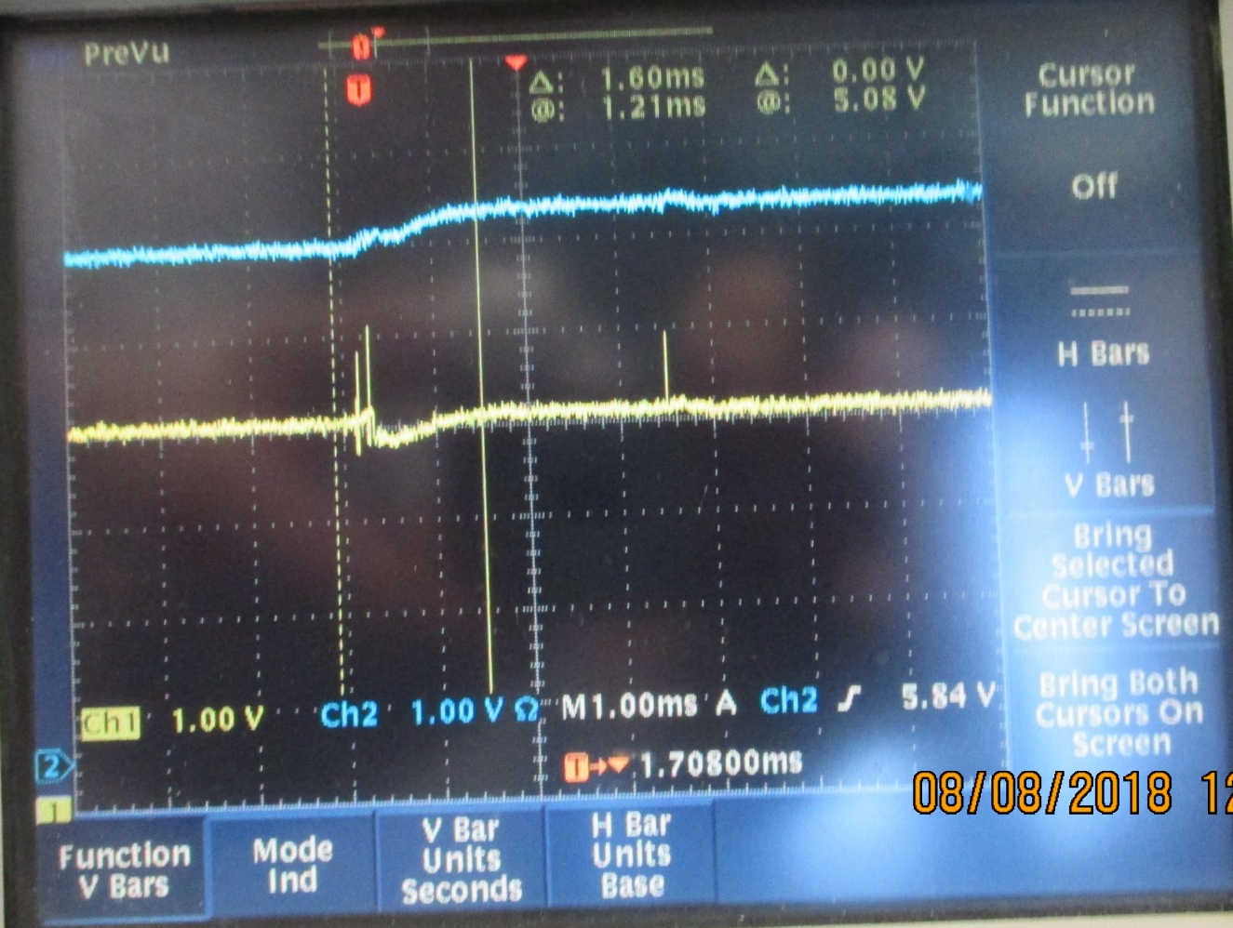
Response time of the CAEN module to the transition from low current (3A) to the high current (6-7A) condition
Response of the PS to the sense input = 1ms
Voltage at CAEN power terminals
Sense Voltage at Load
Thanks Iuri for your help in getting this view
Time of switching from 3 to 6.5A

Slide 11
Fibre optics.
What technology can we install, frame contract with Blown fibres of “Trunk cables “ a la Polish trigger team.
Specification, see Behzad talks.
This week we will understand exactly what is the specification and within a few weeks the provider, order by end of October 2018.
Wolfram has stated yesterday that we can install what we want but it must be in the plan.
Fibres to installed in week 5 of 2019 !!
The order should leave CERN before the end of September.

Slide 12
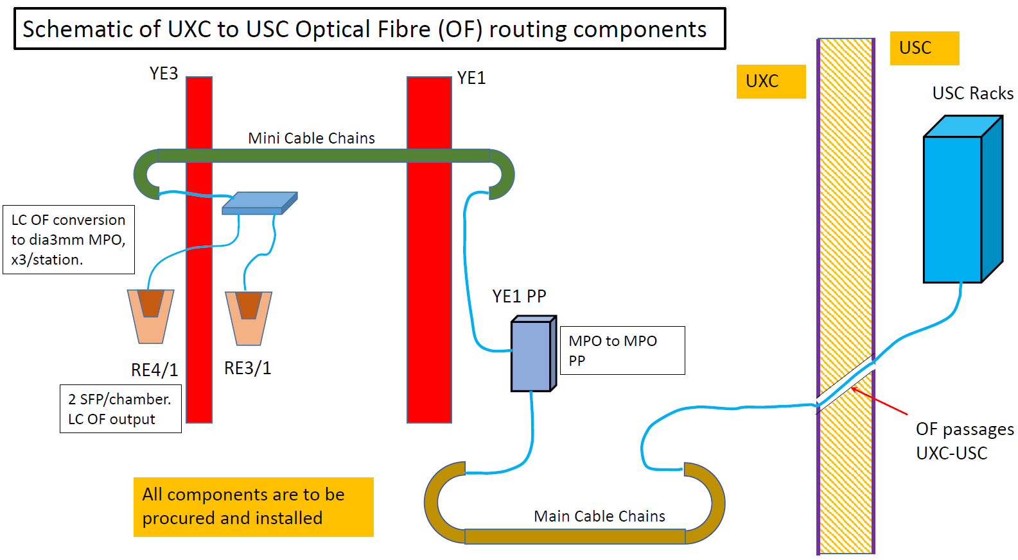
Schematic
6
2
1
3
4
5

Slide 13



Specification of Every Cisco 10 gig
SFP transceiver
Cisco SFP+ | Wavelength (nm) | Interface | Cable Type | Core Size (Microns) | Cable Distance
Cisco SFP-10G-T-S | / | RJ-45 | Cat6a/cat7 | / | 100m*
Cisco SFP-10G-SR-S | 850 | Dual LC/PC | MMF | 62.5(OM1) | 26m
Cisco SFP-10G-SR | 850 | Dual LC/PC |  | 62.5(OM1) | 33m
Cisco SFP-10G-SR-X | 850 | Dual LC/PC |  | 50(OM2) | 66m
 |  |  |  | 50(OM2) | 82m
 |  |  |  | 50(OM3) | 300m
 |  |  |  | 50(OM4) | 400m
Cisco SFP-10G-LRM | 1310 | Dual LC/PC | SMF | G.652(OS2) | 300m
 |  |  | MMF | 62.5(OM1) | 100m
 |  |  |  | 50(OM2) | 220m
 |  |  |  | 50(OM3) | 220m
Cisco SFP-10G-LR | 1310 | Dual LC/PC | SMF | G.652(OS2) | 10km
*30 meters via 10Gbps, 50 meters via 5Gbps and 2.5Gbps, 100 meters via 1000Mbps

Slide 14
RE4(3)/1 chambers gas distribution schematic
Sagana brass union
reduction from 8mm to 6mm
Impedance box 6 channel
RE4(3)/3 chamber
8 mm copper pipe
RE4(3)/2 chamber
Parallel flow
Supply
Return
6 mm copper pipe
Gas Rack
Bottom layer
Top layer
Legris brass unions (6mm)
RE4(3)/1 chamber

Slide 15
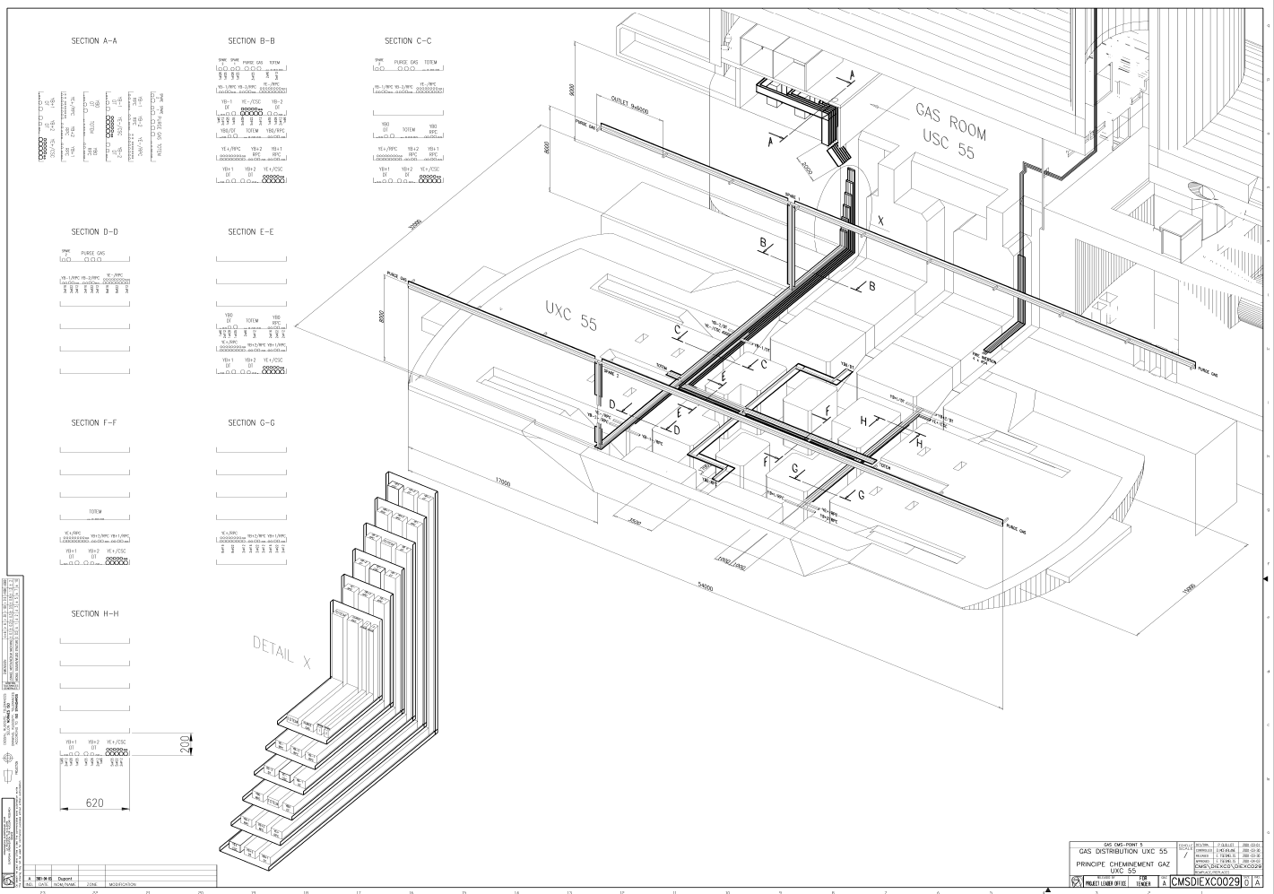
From pre-distribution to distribution UXC racks
From USC gas room to UXC gas racks: new pipes will be installed (2 pipes per disk (negative/positive) for supply/return lines).
To be installed Jan 2019.
We need:
  Supply: 2 inox pipes of Ø 16 (90m for RE+ and 77m for RE- ~170m).
  Return: 2 inox pipes of Ø 22 (90m for RE+ and 77m for RE- ~170m).
  4 Flexible pipes for the chains (20 – 30 m of 2 x Ø 16 and 2 x Ø 22).

Slide 16
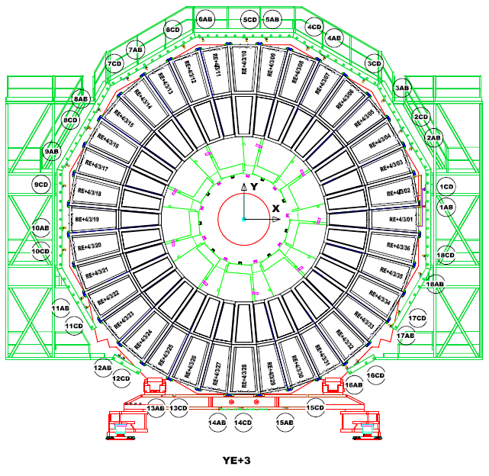
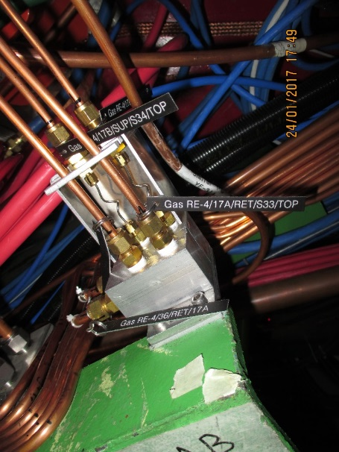
YE3 gas rack to be modified to make the 12 channels independent from the present channels
Impedance boxes positioned at three points around the periphery for both RE4/1 and RE3/1
Impedance box for parallel operation, 2 channel shown

Slide 17
Gas
Piping (8x6mm) from YE3 rack to bulkheads on the peripheral “green structure’ area.
Require spread sheet of take off points on the top of the rack to the bulkheads, and so chambers.
Require detailed tech drawings of this piping.
Integrate the 6 impedance boxes around the periphery, naming tags (metal), fabricated and tested then installed and commissioned.
Lay piping (6x4mm ?) ,with labels , from the periphery to the chamber position and place short cut to commission system.
Calculate impedances based on ‘higher” flow rates, as shown in GIF tests, and so define the final piping to the chambers from the periphery

Slide 18
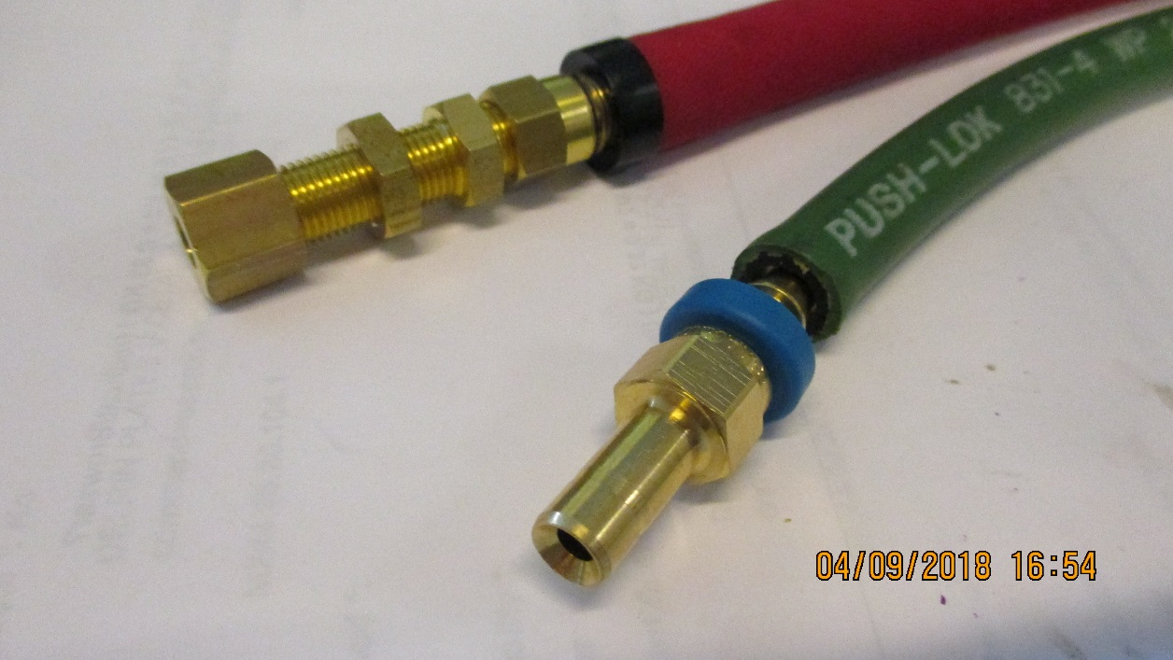
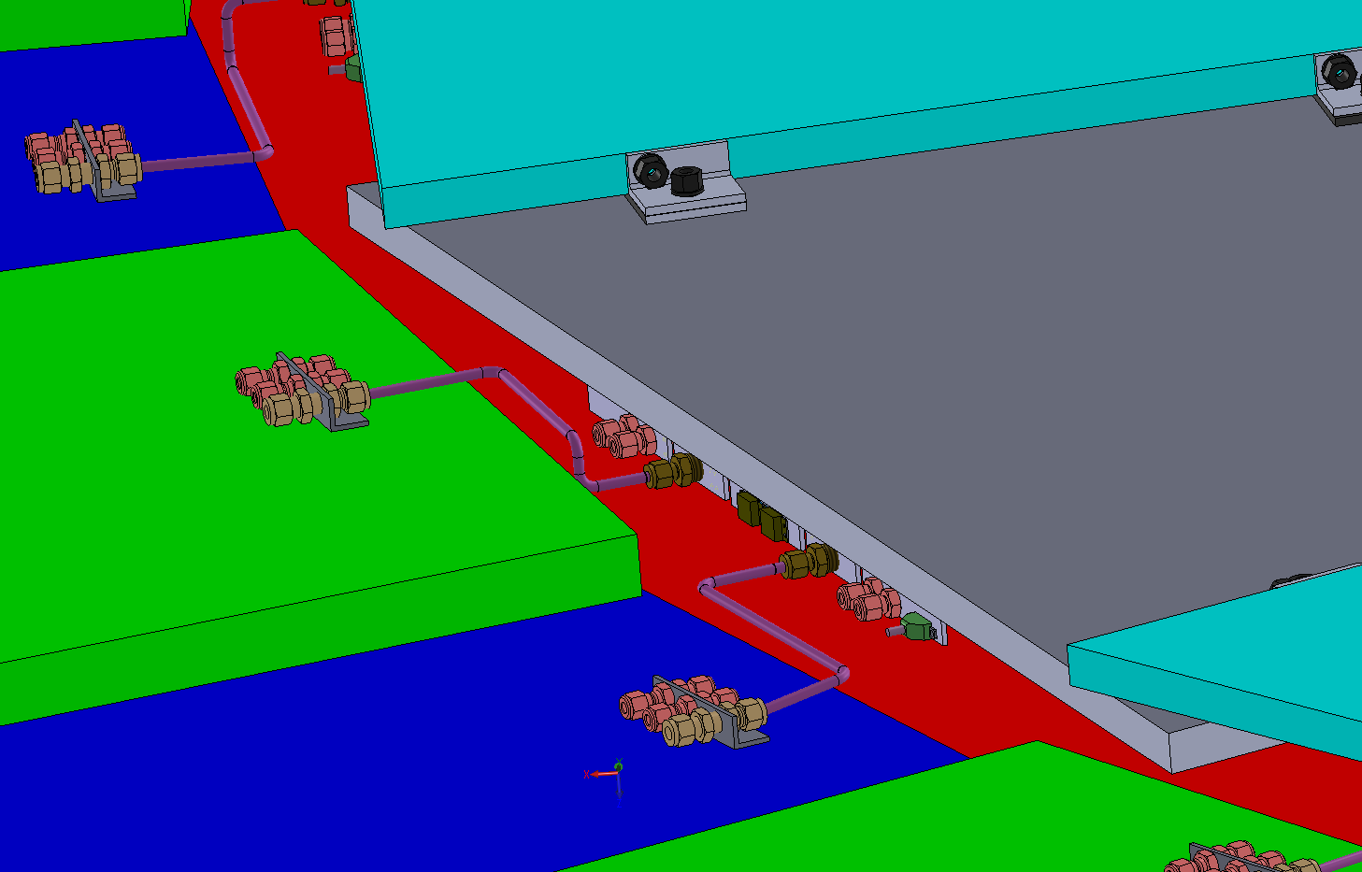
Cooling
RE3/1
Verify the assembly of the flexibles with simplified safer version, namely direct from RE3/2 PP to RE3/1 PP with three elements only, as opposed to 3 times as many unions with a “L” Cu pipe producing a lever arm on the chamber PP.
RE4/1
Modify the present Mini-manifolds to take additional “take offs” direct to the chambers with flexibles all the way to the RE4/1 PP.

Slide 19
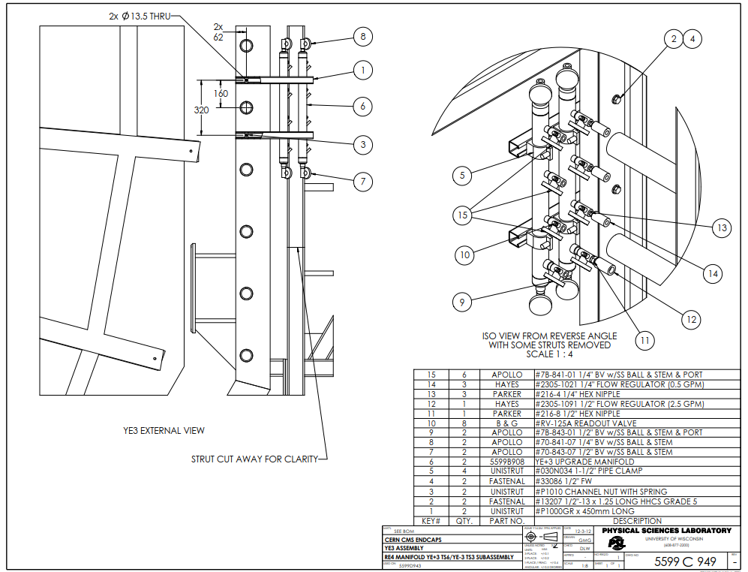
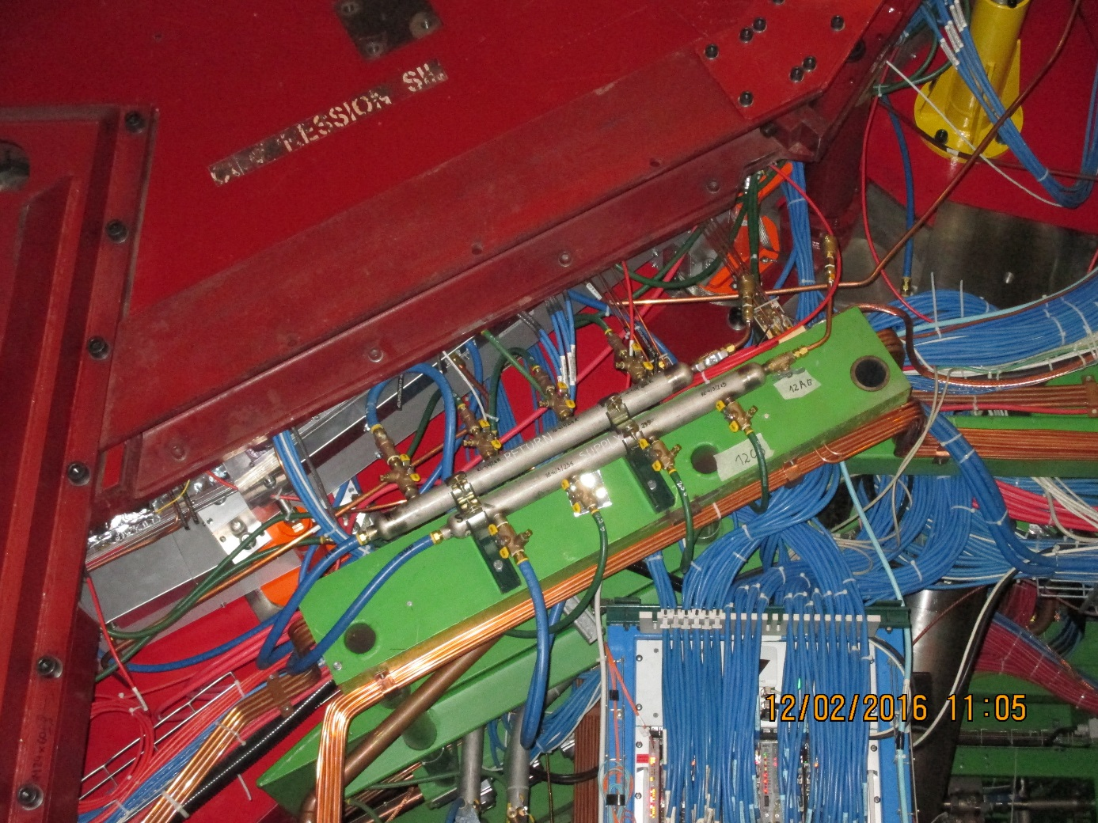
Mini manifold . To be modified to accept the necessary “T”s for the RE4/1 cooling.
The same flow regulators will be kept with individual cut off valves to each chamber, if costs permit.

Slide 20
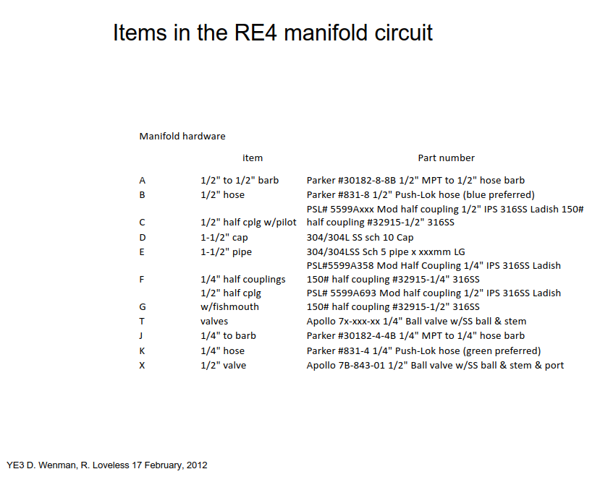
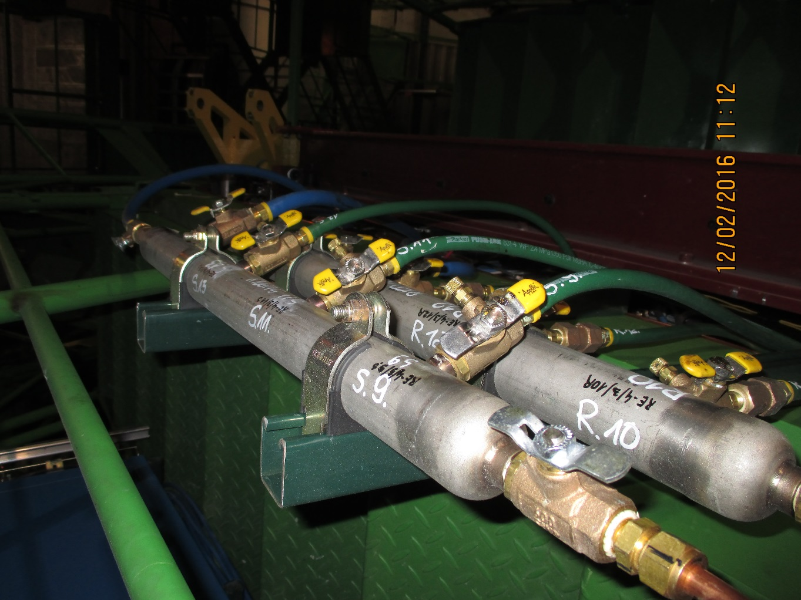
This list will be ordered, simplified , from the USA or from XX in P5 in inch size.

Slide 21
Man power

Slide 22
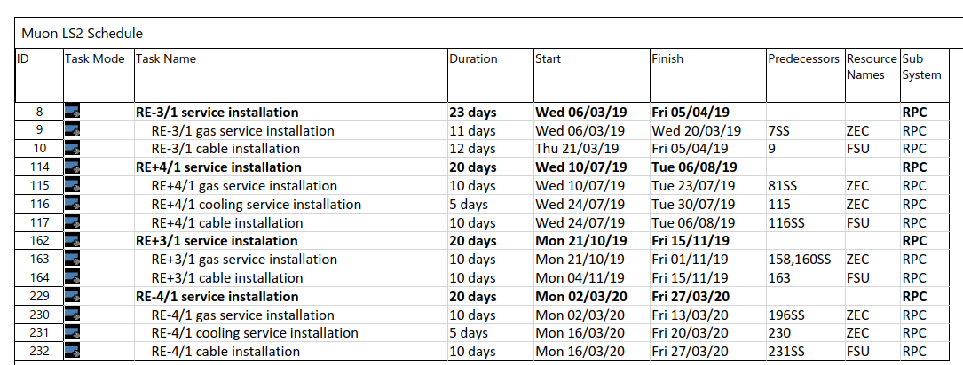
RE3/1 & RE4/1 Service Installation during LS2

Slide 23
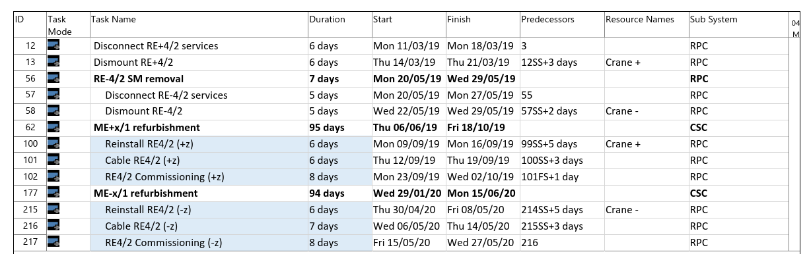
RE4 interventions during LS2

Slide 24
Contacts and action
HV. Outstanding points with CPE, assembly QC methods and timeline
LV
  Do test with New FEB while loading firmware and max cable length ~30m
  S. Bally for exact cable lengths
  Contact Houari for cable length in P5 store.
Fibres, check where we are with spec and supplier in next two weeks as Bezhad and Zhenan are here.
  Check procurement details with Austin.
Gas see with PK and Anton/Alexander/ZEC
See with cooling suppliers, French and XX at P5 for the inch size on “T” mini manifolds and the metric on the chamber.

Slide 25
Additional Material

Slide 26

https://www.epi.ge.ch/prestations-entreprises-particuliers/ateliers/microtechnique/

Slide 27
RE4(3)/1 chambers gas distribution schematic
Sagana brass union
reduction from 8mm to 6mm
Parallel flow
Capillary
RE4(3)/3 chamber
8 mm copper pipe
RE4(3)/2 chamber
Supply
Return
6 mm copper pipe
Gas Rack
Bottom layer
Top layer
Legris brass unions (6mm)
RE4(3)/1 chamber

Slide 28
RPC Power System Review
Anton Dimitrov, Ian Crotty
RPC Upgrade Mini Workshop, 05.Sep.2018, CERN

Slide 29
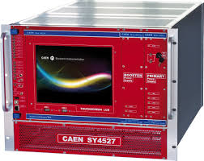
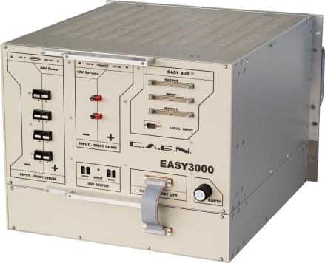
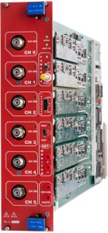
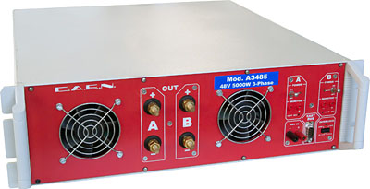
HV Power System Upgrade for RE3/1 & RE4/1 (I)
USC
UXC
SY4527
The HV power system will be based on CAEN EASY system
(practically, extension of the existing HV system):
SY4527 – 1 (existing)
A3485S - 2 modules (existing)
4 EASY3000 crates
A3512N – 12 HV Boards
TDR Baseline: Variant I
EASY3000
4 HV multiconductor cables per endcap. Each with 20 HV channels
All must go via the YE1’s main cable chains (MCC)
A3485S
A3512N
Long term maintenance will be secured by CERN-CAEN contract.
To be integrated in the RPC DCS.
1

Slide 30
S1H12
S1H07
HEX
HEX
HV Distribution Box
ENDCAP RACKS
S1H11 – S1H08
HV Distribution Box
HV Distribution Box
SY4527
HV Distribution Box
HV Distribution Box
HV Distribution Box
HEX
SY4527
HV Distribution Box
HV Distribution Box
48V DC cable connected after Crate3 in rack S1H09
Crate4
RE+3/1
RE+4/1
1 new rack (already defined S1H12, to be equipped)
2 EASY crates
8 umbilical cables all arriving to one rack
6 A3512N HV boards in each Crate (12 boards in total)
8 HV Distributor Boxes in total (all in one rack)
HEX
A3485S
Crate4
RE-3/1
RE-4/1
A3485S
48V DC cable connected after Crate3 in rack S1H11
A3485S
A3485S
2

Slide 31
HV Power System Upgrade for RE3/1 & RE4/1 (II)
USC
UXC
SY4527
The HV power system will be based on CAEN NON-EASY system:
SY4527 – 2 (new)
New HV boards – prototype ready in 2019
Preferred Variant: Variant II
EASY3000
4 HV multiconductor cables per endcap. Each with 20 HV channels
All must go via the YE1’s main cable chains (MCC)
A3485S
A3512N
Long term maintenance will be secured by CERN-CAEN contract.
To be integrated in the RPC DCS.
3

Slide 32
S1H12
S1H07
HEX
HEX
HV Distribution Box
ENDCAP RACKS
S1H11 – S1H08
HV Distribution Box
SY4527
SY4527
HV Distribution Box
SY4527
HV Distribution Box
- No EASY system ➔ no EASY crates
- 2 SY4527 mainframes more
- 8 umbilical cables all arriving to one rack
- New type of HV boards!
- 8 HV Distributor Boxes in total (all in one rack), but bigger in size
since all inputs and outputs should be at the back side of the rack
- No rack cross reference in DSS Action Matrix
HEX
HV Distribution Box
HEX
HV Distribution Box
A3485S
SY4527
A3485S
A3485S
HV Distribution Box
A3485S
HV Distribution Box
4

Slide 33
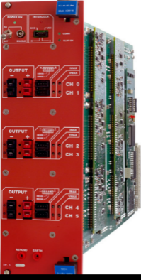
RPC LV Power System for RE3/1 & RE4/1
USC
UXC
YE+3: X2J52, X3J51, X3A51, X4A51
YE-3: X2V52, X3V51,X3S51, X4S51
CAEN EASY3000S
with CAEN A3016
in X2Near && X4Far racks
Existing RE3&RE4 detector
SY4527 with A1676A
24 A3016 LV boards in total to power the FE of all RE3/1 and RE4/1 chambers.
9U in each YE3 X4Far tower rack for
  1 CAEN EASY3000S crate
  1 CAEN A3486S MAO- AC/DC 48V PS
15U in each X2Near YE3 tower rack for
  2 CAEN EASY3000S crates
  1 CAEN A3486S MAO- AC/DC 48V PS
A3486S
Relay
YE1 LV PP
50p Communication bus
going directly to YE3
48V Service power
1

Slide 34
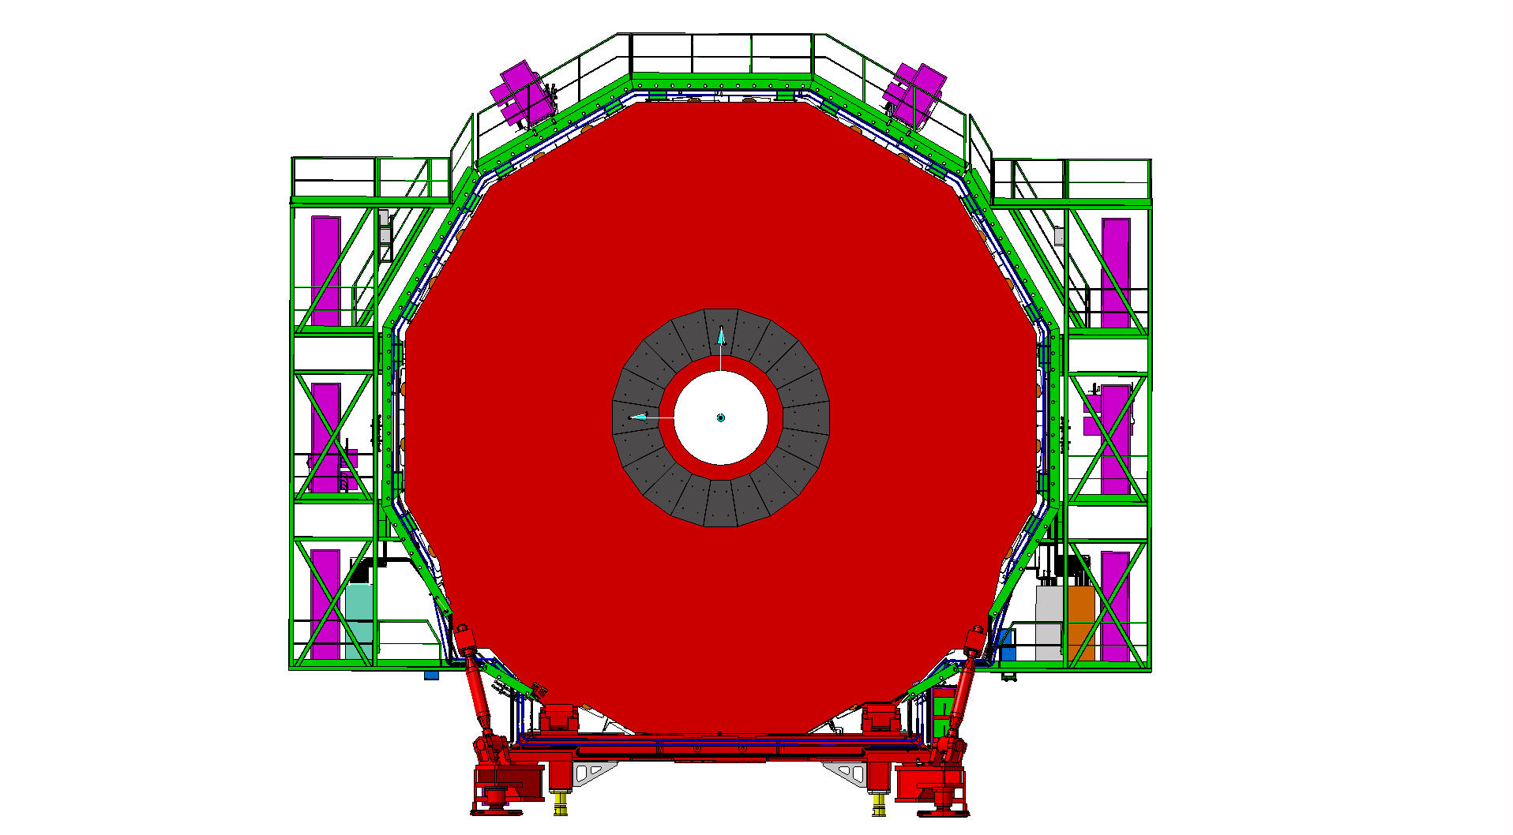
RPC LV Services
Far Side
Near Side
mini Cable Chains for OF
mini Cable Chains for OF
X4
LV Easy crates
LV Easy crates
X2
X2Near – X4Far
diagonal
2

Slide 35
Far Side
YE+3
Near Side
X3A51
X4A51
X3J51
X2J52
Power Distribution
Power Distribution
Power Distribution
Power Distribution
Turbine
Turbine
Turbine
Turbine
HEX
HEX
HEX
HEX
EMU VME
RE3 LBB
EMU VME
EMU Maraton
HEX
RE4 LBB
EMU Maraton
EMU
EMU
RE4 LBB
RE4 LBB
RE3-4/1 FE EASY3000S
Crate2
RE4/1 FE EASY3000S
Crate1
RE3-4 LBB EASY3000S
Crate1
RE3-4 LBB EASY3000S
Crate3
RE3/1 FE EASY3000S
Crate0
RE A3486S AC/DC-1
CH0 CH1
RE3-4 FEB EASY3000S
Crate0
Alignment DAQ
RE3-4 FEB EASY3000S
Crate2
RE A3486S AC/DC-0
CH0 CH1
RE4 LBB
RE A3486S AC/DC-0
CH0 CH1
RE A3486S AC/DC-1
CH0 CH1
Cable Distribution
EMU Maraton
RE4 LBB
Cable Distribution
RE3 LBB
HEX
RE3 LBB
EMU Maraton
HEX
HEX
Cable Distribution
HEX
HEX
Air Deflector
Air Deflector
Air Deflector
Air Deflector
Power Dist.
Power Dist.
Power Dist.
Power Dist.

Slide 36
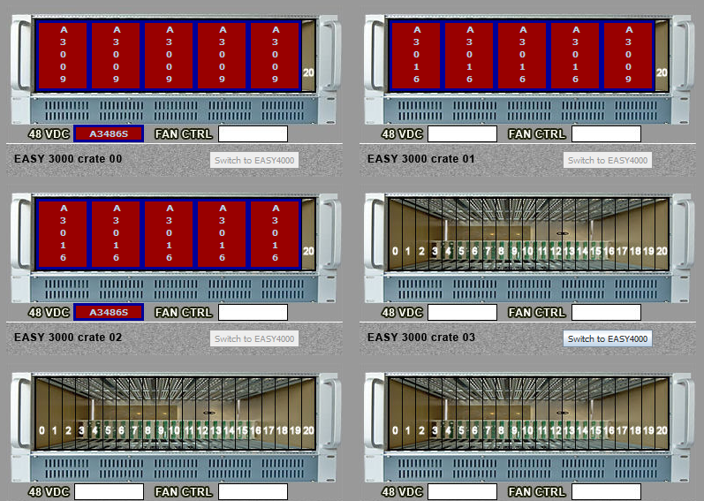
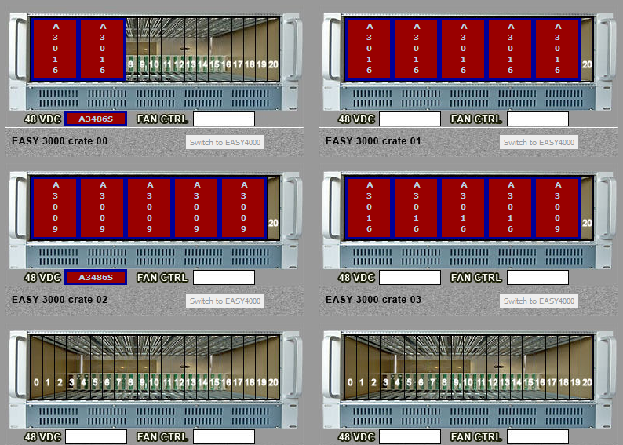
DCS daisy chain
Far Side
YE+3
Near Side
X3A51
X2J52
X4A51
X3J51
YE3Near and YE3far equipment (including existing RE3&RE4 detector on X3) on separate branch controllers,
therefore 4 new A1676 branches will be needed in total.

