Slide 1
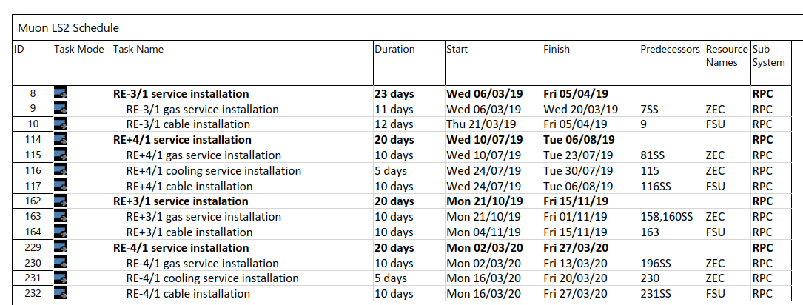
RE3/1 & RE4/1 Service Installation during LS2

Slide 2
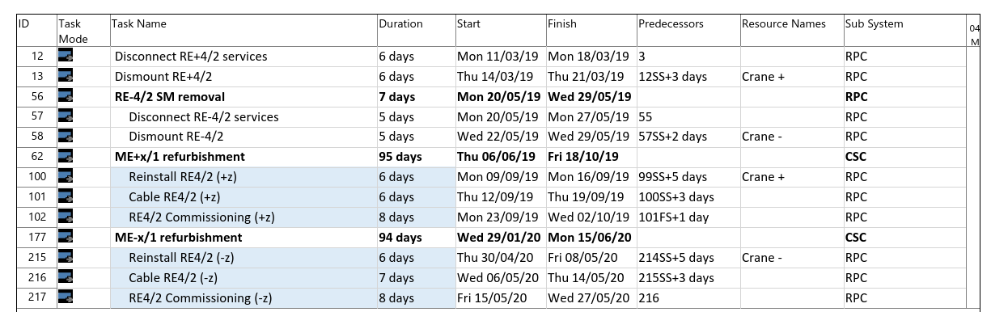
RE4 interventions during LS2

