Slide 1
Services RE3 & 4/1
Ian
5 Sept 2018

Slide 2
HV cables and connectors
LV cables & connectors
Fibre optics
Gas
Cooling

Slide 3
HV System in UXC
Design change in the UXC area as the community has decided that the “3 pole “ is not a good solution.
This means that the connectors on the chambers and YE1 PP will be changed to what we have used in all tests since 201?. Namely the C.P.E. “Jupiter” coaxial connector.
HV order , waiting for the technical documentation that should make the passage through CERN easier.
HV System in the USC
Layout from Anton with calculation of components.

Slide 4
LV Cables UXC, Rack to chamber
LV tests done, different cable sections and stiffnesses.
Measured time response, is it what CAEN state, good enough ?
Do test with FEBs on chamber.
Supply of 3.?km of the cable (in P5) used for LB
Connectors at chamber end are more or less defined , “D-Sub’ with sense pins
2 cables per chamber but what of the connection in the CAEN module ?

Slide 5
Offers from CERN Logistics office
Power Sense
2 x 4mm2 plus 2 x 0.5mm2 Novacavi
5.0Euro/m 0.92Euro/m Draka but wrong colour ! GEM use black ?
With colour change require 12 weeks including August from Novacavi and 10-12 fro Draka inc Aug
Offer for combined Sense and Power never received. Renewed request yesterday.

Slide 6
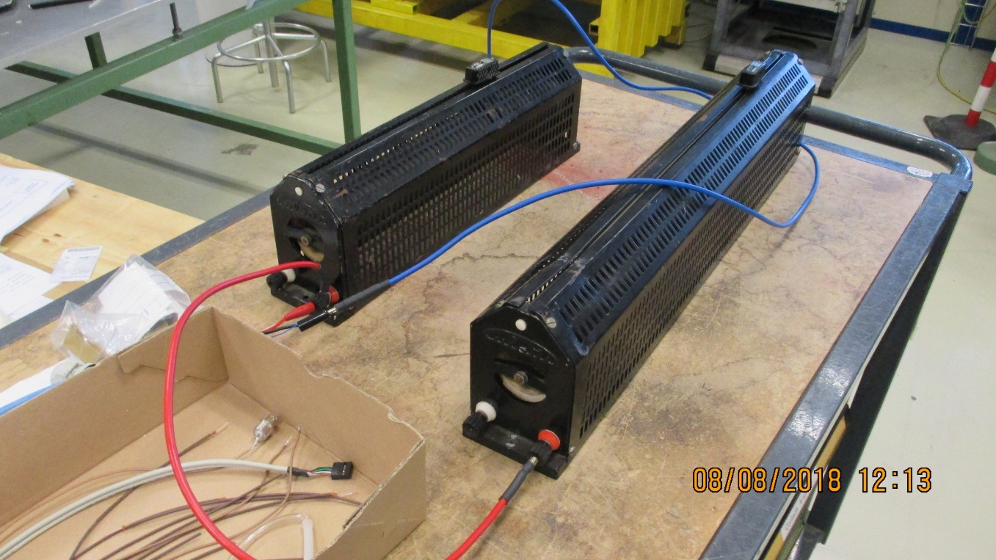
Christoph suggested a test with 3A and 6-7A that should be switched between the two simulating the ‘stand-by” and “Operational” mode.
Voltage drop at “Operational load” of 15W/FEB is <1.5V at the worst case of 30m. Even at 6.5A the worst case V drop is ~3V, that is on the limit of CAEN module.
Now that BT is finished the test should be done with the real FEBs. The real difference in current and transient should be studied.
Voltage drop on RPC LB cable
 |  |  |  | ian Crotty
 |  |  |  | 06-Aug-18
 | Set point | Current | Power in Load | PS voltage | Voltage | Voltage Drop | V Drop/m | Worst case drop 30m
 |  |  |  |  | Load
 | [V] | [A] | [W] | [V] | [V] | [V] | [V] | [V]
Sense | 5.00 | 3.11 | 15.52 | 5.70 | 4.99 | -0.71 | -0.04797 | -1.44
Sense | 5.00 | 6.70 | 33.43 | 6.53 | 4.99 | -1.54 | -0.10405 | -3.12
No Sense | 5.00 | 5.33 | 21.21 | 5.21 | 3.98 | -1.23 | -0.08311 | -2.49
No Sense | 5.00 | 2.83 | 12.90 | 5.21 | 4.56 | -0.65 | -0.04392 | -1.32
Sense | 5.00 | 3.10 | 15.47 | 5.70 | 4.99 | -0.71 | -0.04797 | -1.44
Sense | 5.00 | 6.71 | 33.42 | 6.53 | 4.98 | -1.55 | -0.10473 | -3.14
TB cable 2 x 2.5mm2 plus sense 2 x
Cable length = |  | 14.80 | [m]
Max able length = |  | 30.00 | [m]
Done with Iuri and Irakli

Slide 7
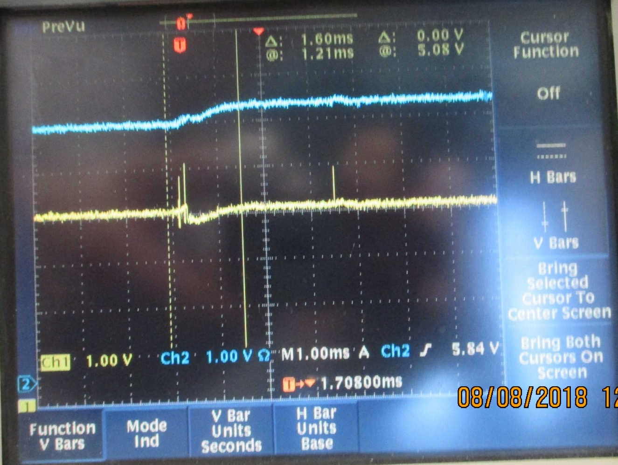
Response time of the CAEN module to the transition from low current (3A) to the high current (6-7A) condition
Response of the PS to the sense input = 1ms
Voltage at CAEN power terminals
Sense Voltage at Load
Thanks Iuri for your help in getting this view
Time of switching from 3 to 6.5A

Slide 8
Fibre optics.
What technology can we install, frame contract with Blown fibres of “Trunk cables “ a la Polish trigger team.
Specification, see Behzad talks
Wolfram has stated yesterday that we can install what we want but it must be in the plan.

Slide 9
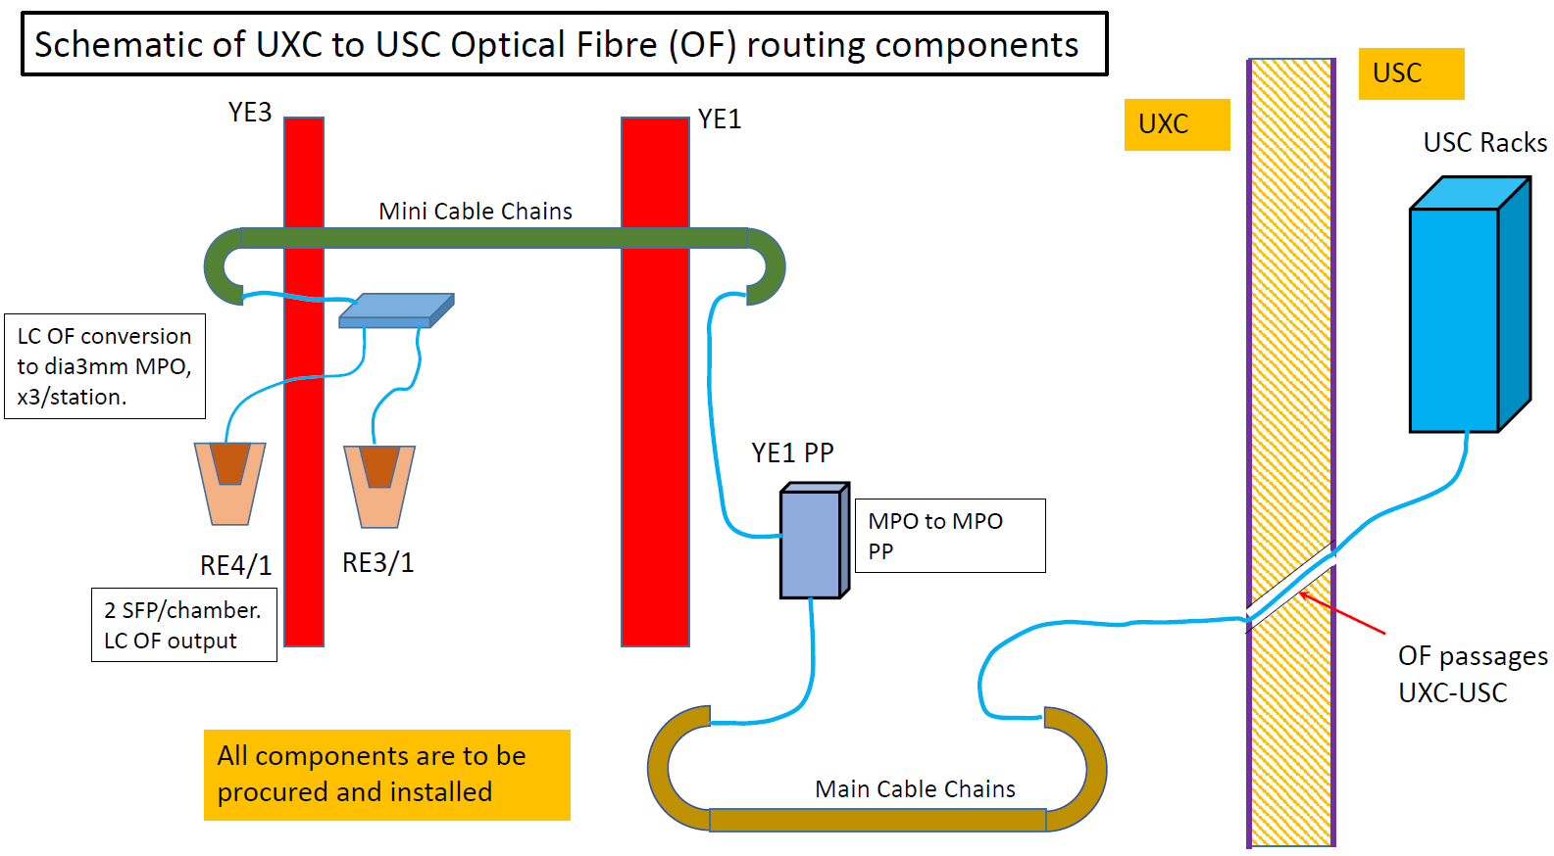
Questions
2
6
1- How many chambers install here ?
1
3
4
2- How many chambers install here ?
5
3- What is a typical distance between chambers RE3/1 and RE4/1 to the Patch Panel (point 2 in figure) ?
4- What is a Minimum and Maximum Permissible Diameter of Mini/Main Cable Chain?
5- What is a typical distance between Patch Panel on YE1 (Point 4) to the USC Rack (Point 6) ?
6- Why we have two Patch Panels (Point2 & Point 4 ) in this Layout?

Slide 10



Specification of Every Cisco 10 gig
SFP transceiver
Cisco SFP+ | Wavelength (nm) | Interface | Cable Type | Core Size (Microns) | Cable Distance
Cisco SFP-10G-T-S | / | RJ-45 | Cat6a/cat7 | / | 100m*
Cisco SFP-10G-SR-S | 850 | Dual LC/PC | MMF | 62.5(OM1) | 26m
Cisco SFP-10G-SR | 850 | Dual LC/PC |  | 62.5(OM1) | 33m
Cisco SFP-10G-SR-X | 850 | Dual LC/PC |  | 50(OM2) | 66m
 |  |  |  | 50(OM2) | 82m
 |  |  |  | 50(OM3) | 300m
 |  |  |  | 50(OM4) | 400m
Cisco SFP-10G-LRM | 1310 | Dual LC/PC | SMF | G.652(OS2) | 300m
 |  |  | MMF | 62.5(OM1) | 100m
 |  |  |  | 50(OM2) | 220m
 |  |  |  | 50(OM3) | 220m
Cisco SFP-10G-LR | 1310 | Dual LC/PC | SMF | G.652(OS2) | 10km
*30 meters via 10Gbps, 50 meters via 5Gbps and 2.5Gbps, 100 meters via 1000Mbps

Slide 11
Gas
Piping (8x6mm) from YE3 rack to bulkheads on the peripheral “green structure’ area.
Require spread sheet of take off points on the top of the rack to the bulkheads, and so chambers.
Require detailed tech drawings of this piping.
Integrate the 6 impedance boxes around the periphery, naming tags (metal), fabricated and tested then installed and commissioned.
Lay piping (6x4mm ?) ,with labels , from the periphery to the chamber position and place short cut to commission system.
Calculate impedances based on ‘higher” flow rates, as shown in GIF tests, and so define the final piping to the chambers from the periphery

Slide 12
RE4(3)/1 chambers gas distribution schematic
Sagana brass union
reduction from 8mm to 6mm
Parallel flow
Capillary
RE4(3)/3 chamber
8 mm copper pipe
RE4(3)/2 chamber
Supply
Return
6 mm copper pipe
Gas Rack
Bottom layer
Top layer
Legris brass unions (6mm)
RE4(3)/1 chamber

Slide 13
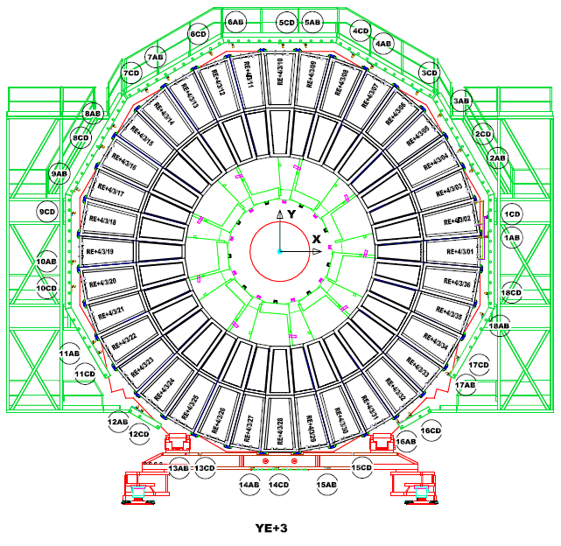
Patch panel location RE4/1
12 channels, 12 S & 12R
For 36 chambers split in Top and Bottom.
6 chambers for 2 channels
The patch panels (PP) of RE4/1 can be organized by using three patch panels (120°)
Each patch panel will contain supply and return of TOP/BOT gaps (4 gas channels supplying 6 chambers)
The patch panels for the return lines may be placed at the bottom disk periphery to avoid gas pockets.
LEGEND:
PP supply
PP return
RE+4 Rack
PP return if we decide to move to bottom periphery
The bottom of the yoke area is very dense with cables and piping

Slide 14
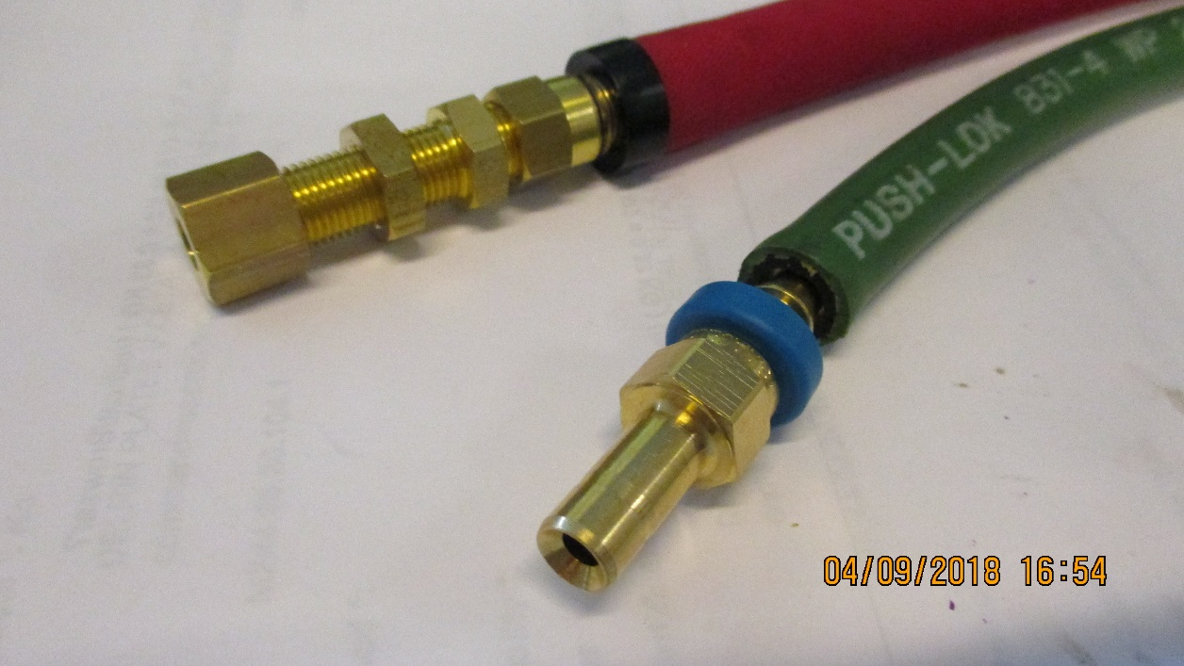
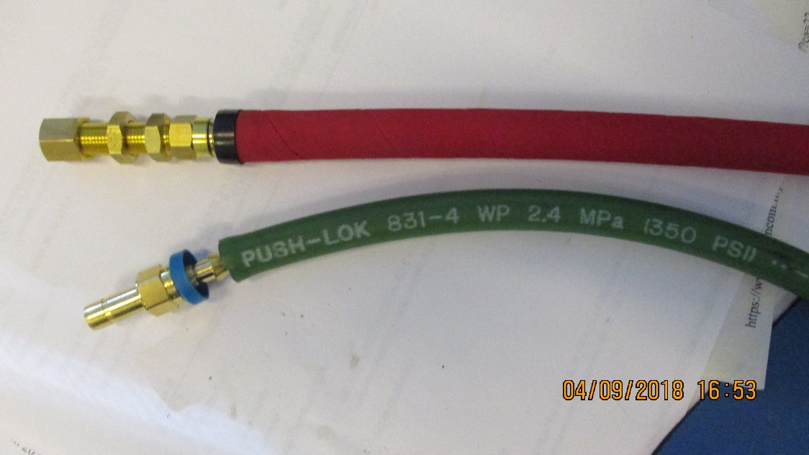
Cooling
RE3/1
Verify the assembly of the flexibles with simplified safer version, namely direct from RE3/2 PP to RE3/1 PP with three elements only, as opposed to 3 times as many unions with a “L” Cu pipe producing a lever arm on the chamber PP.
RE4/1
Modify the present Mini-manifolds to take additional “take offs” direct to the chambers with flexibles all the way to the RE4/1 PP.

Slide 15
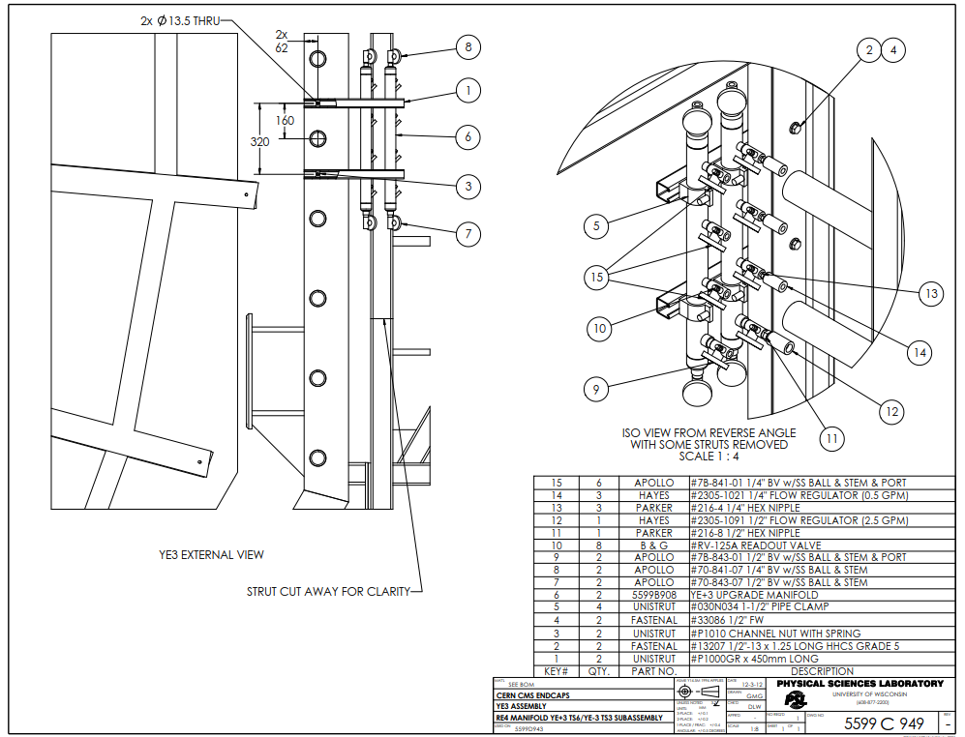
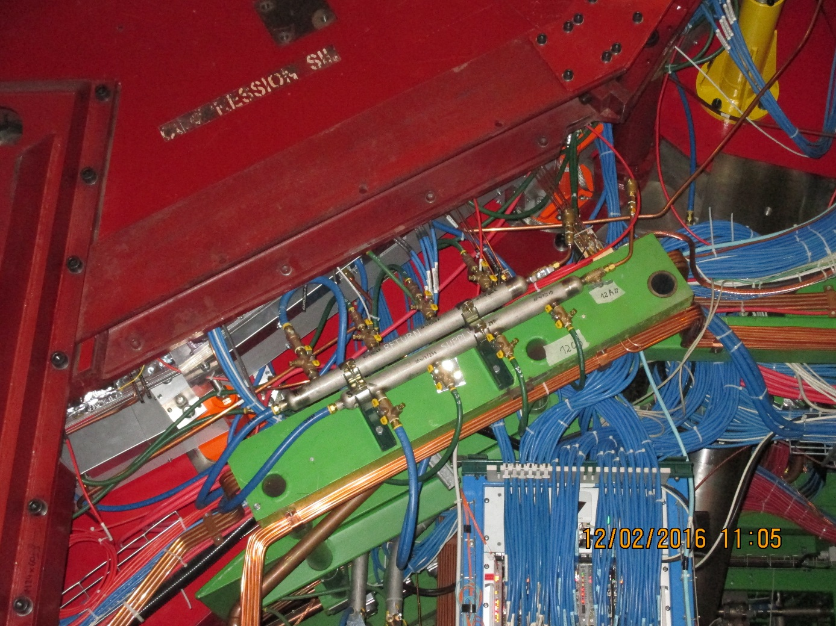
Mini manifold . To be modified to accept the necessary “T”s for the RE4/1 cooling.
The same flow regulators will be kept with individual cut off valves to each chamber, if costs permit.

Slide 16
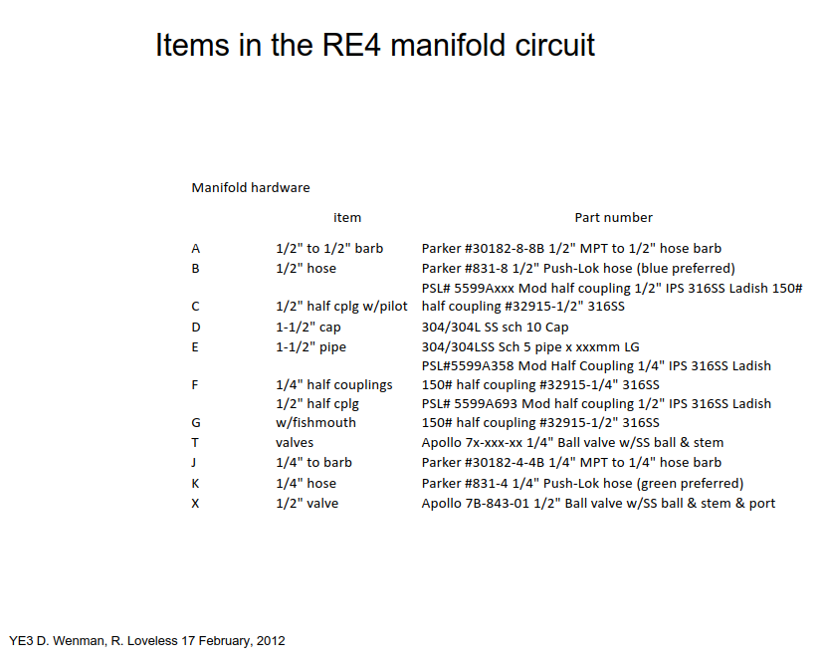
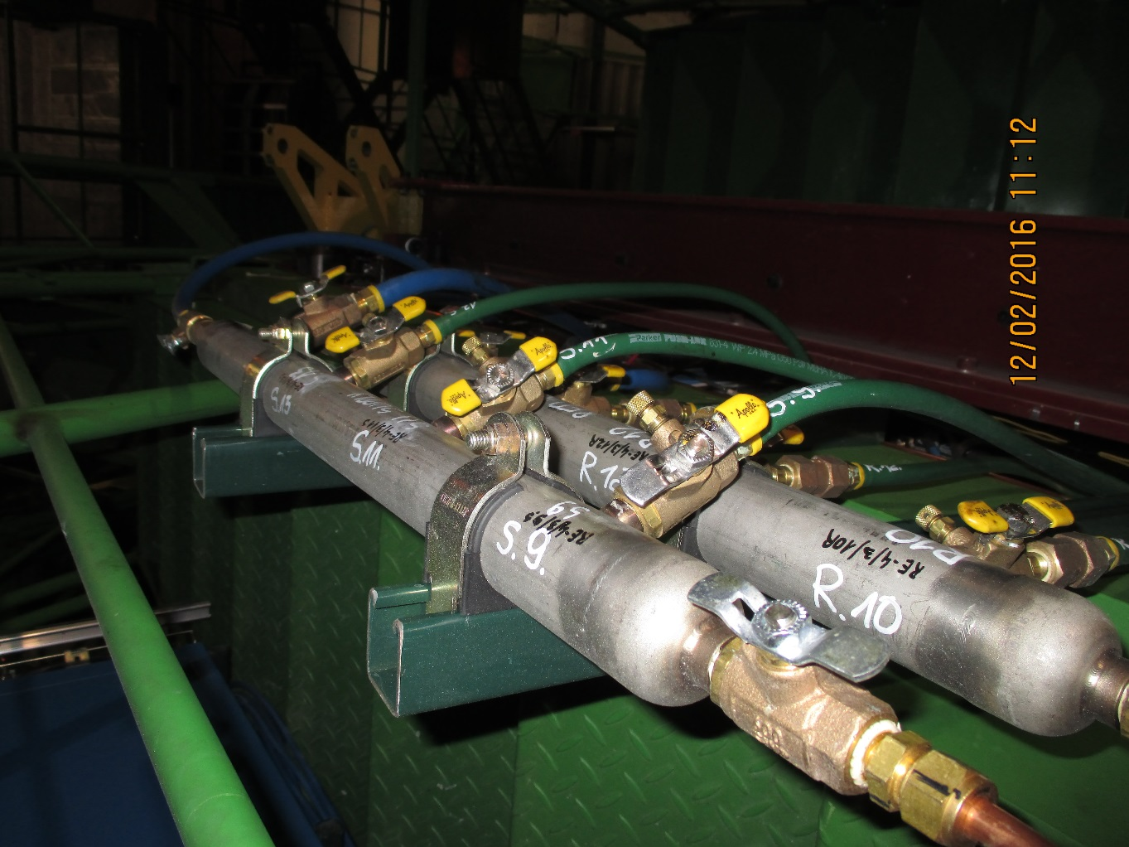
This list will be ordered, simplified , from the USA or from XX in P5 in inch size.

Slide 17
Contacts and action
HV. Check with CPE for requested tech doc. and assembly QC methods and timeline
LV
  Check with Georgia for LB currents and power
  Is the LB cable suitable ?
  S. Bally for cable lengths
  Contact Houari for cable length in store
Fibres, check where we are with spec and supplier in next two weeks as Bezhad and Zhenan are here.
  Talk with AB/WZ for installation technique, do check details with Austin.
Gas see with PK and Anton/Alexander/ZEC
See with cooling suppliers, French and XX at P5 for the inch size on “T” mini manifolds and the metric on the chamber.

