Slide 1
DB and Labels
April 2019

Slide 2
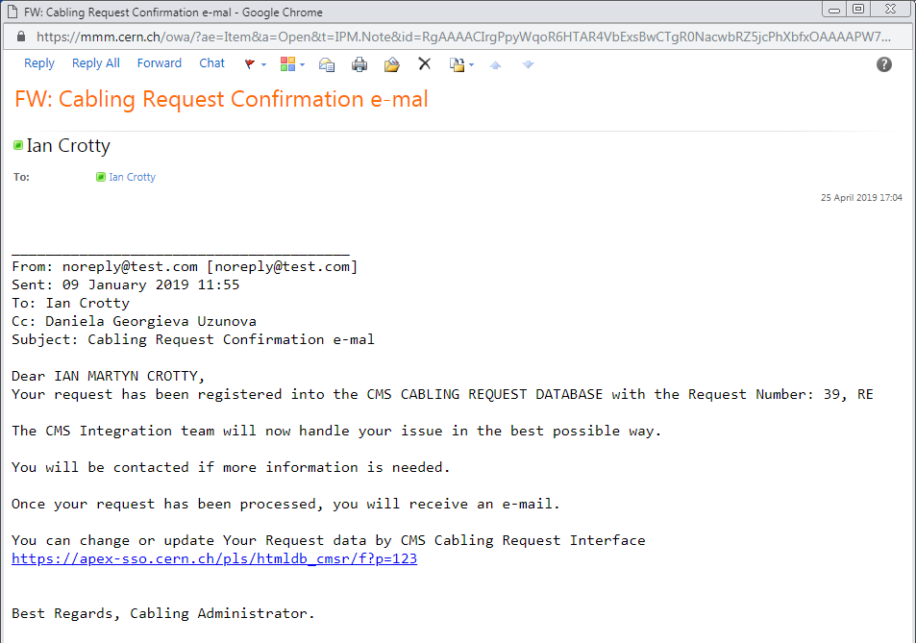
https://apex-sso.cern.ch/pls/htmldb_cmsr/f?p=123

Slide 3
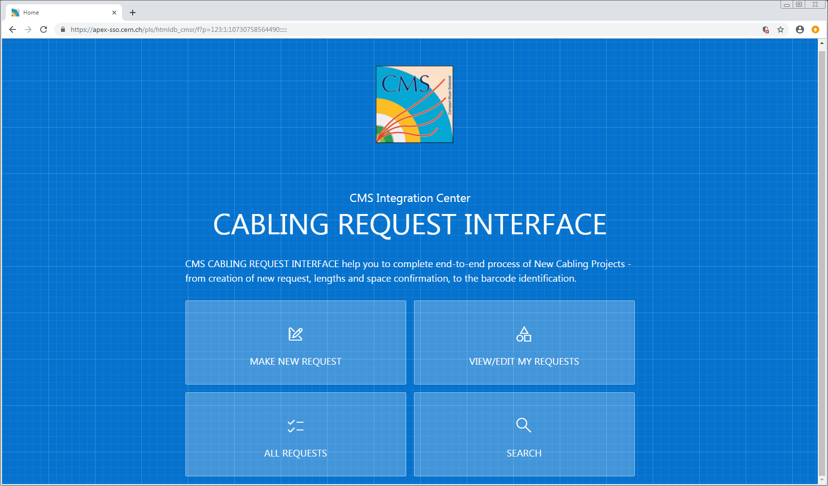

Slide 4
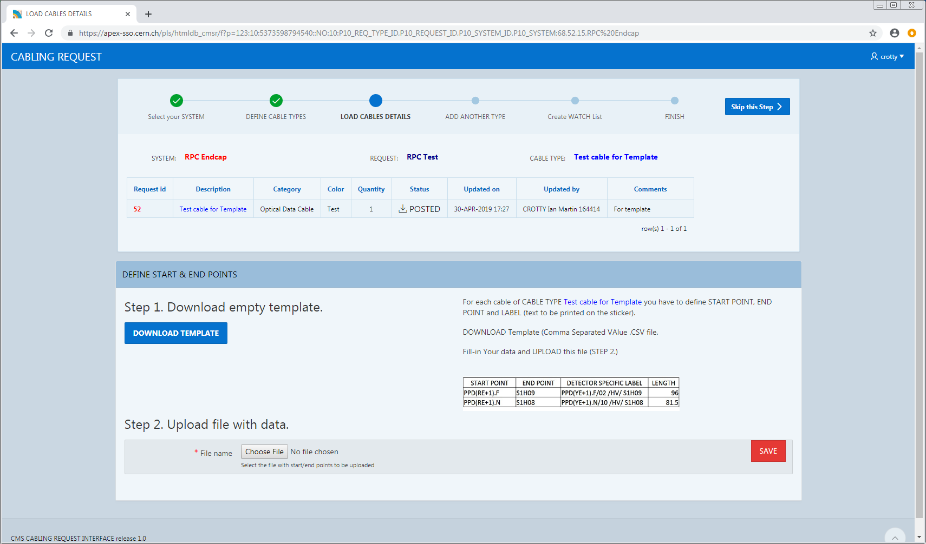

Slide 5
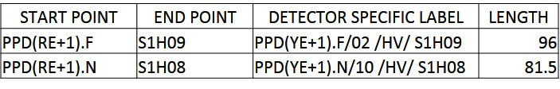
START POINT | END POINT | DETECTOR SPECIFIC LABEL | LENGTH
START POINT | END POINT | DETECTOR SPECIFIC LABEL | LENGTH
START POINT | END POINT | DETECTOR SPECIFIC LABEL | LENGTH

