Slide 1
Cable Service needs
Ian
6 April 2019

Slide 2
Optical fibres
QA going ahead very slowly
Install fibres in corrugated piping Fibres on YE3 June 2019
The order was done last week. Fibres from YE3 to YE1 mCC ??
Fibres from YE1 UXC to USC 2020
Mount and modify YE3 PP
Mount YE1 PP or make new if not compatible
Start mounting in USC to deal with spare length
Prepare documents for P5 installation crew

Slide 3
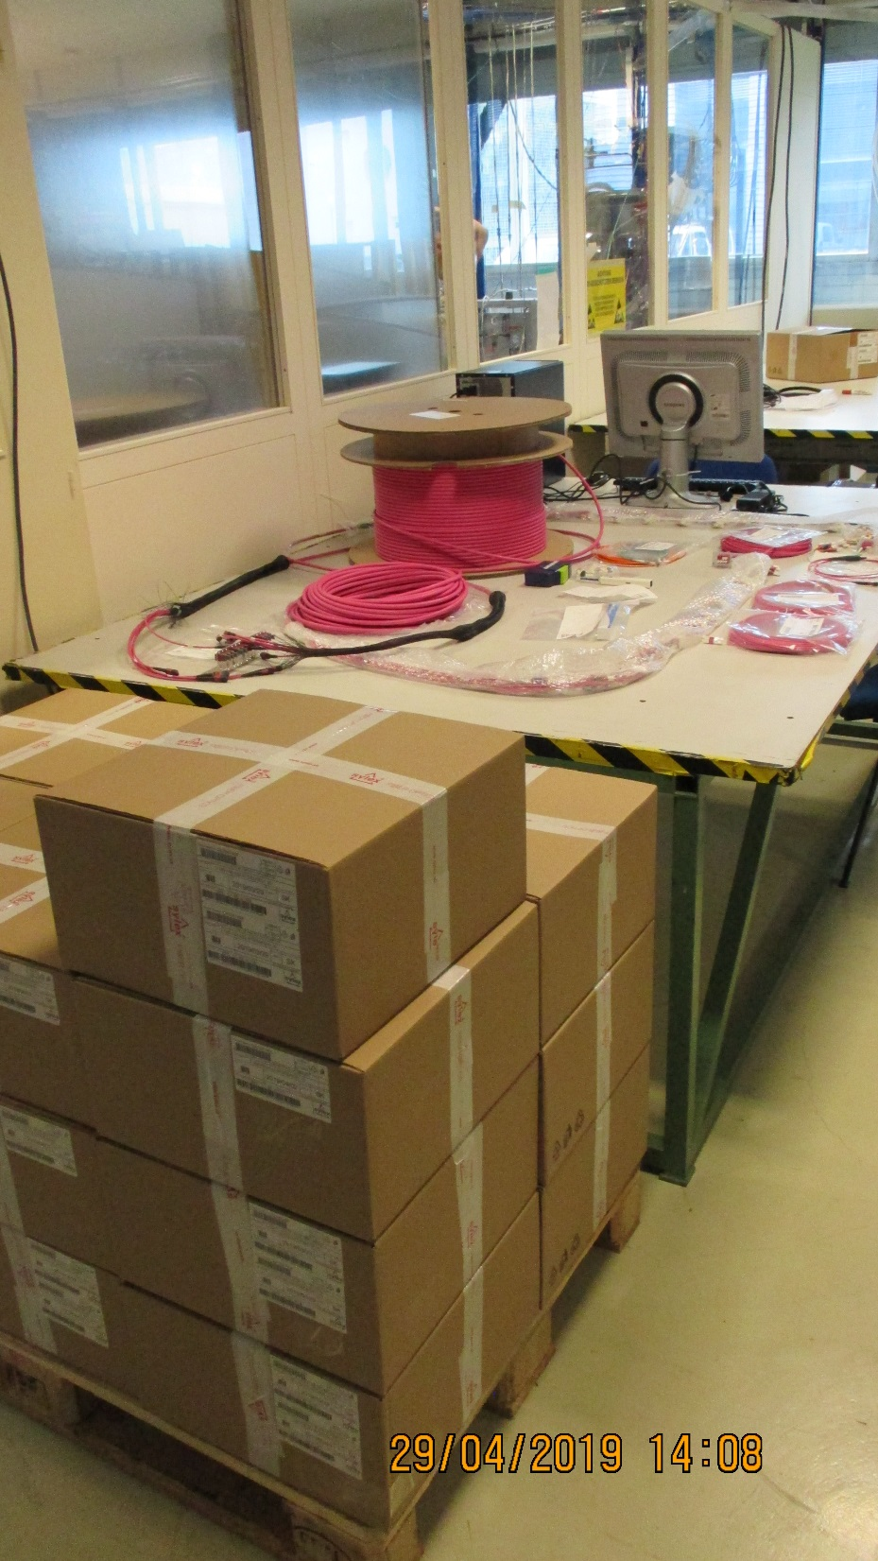
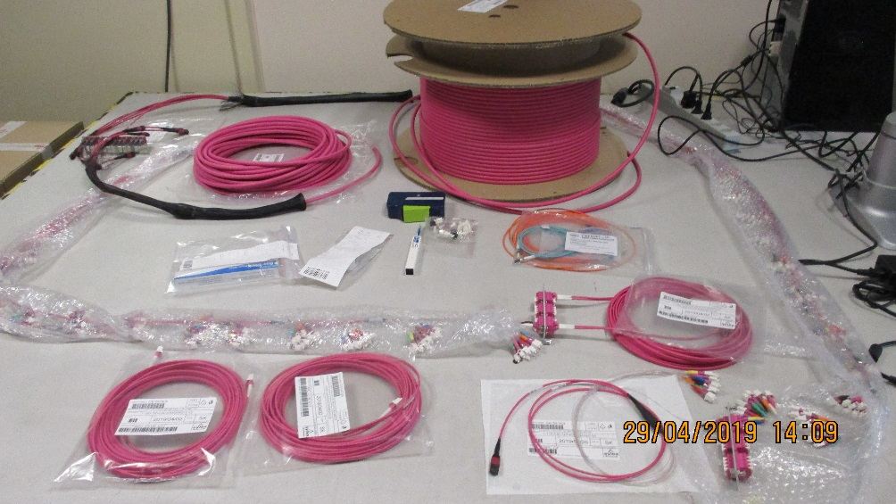
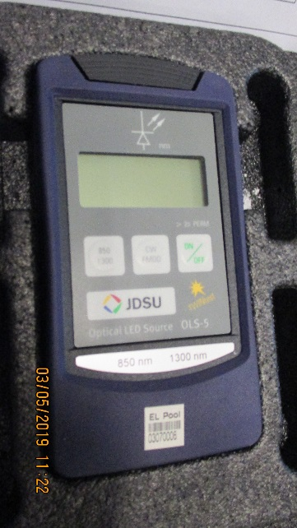
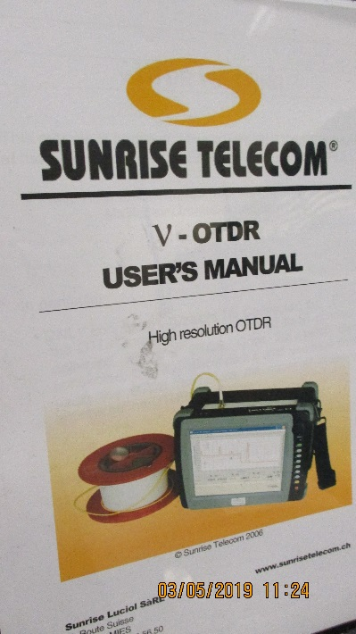
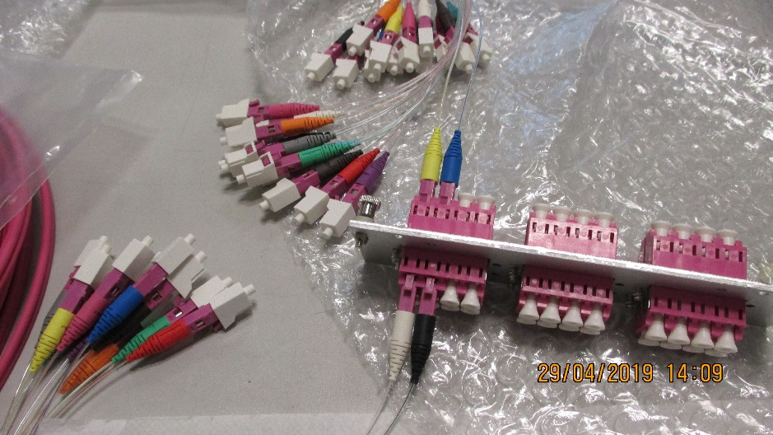
QA
Stock established after delivery
Labels are developed with Daniela. DB done.
Two instruments to do testing,
OTDR for system and power loss meter for individual OFs
Should establish power loss and check with Sylex numbers.
Then insert in the corrugated piping and see that no damage was done
Install in P5 and check again.

Slide 4
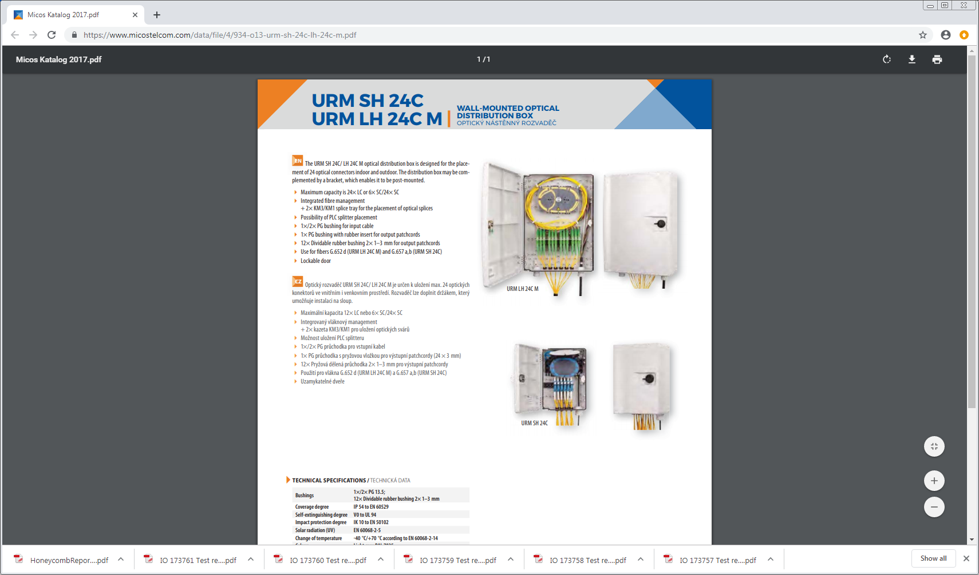
YE1 PP
exact position to be identified withIO
Require labels and Equipement DB
https://www.micostelcom.com/data/file/4/934-o13-urm-sh-24c-lh-24c-m.pdf

Slide 5
YE3 PP
DB and labels to do.
Modification for;
Mounting holes/brackets
Strain relief on the output (bottom)
Blank off the Rear panel leaving 2 entries only (top) dust ingress.
YE1 PP
Plastic boxes, are they compatible with IS41 ?
Prepare are for installation on the YE1. IO approval. !
Prepare documents for P5 installation crew
Cables trays to lay

Slide 6
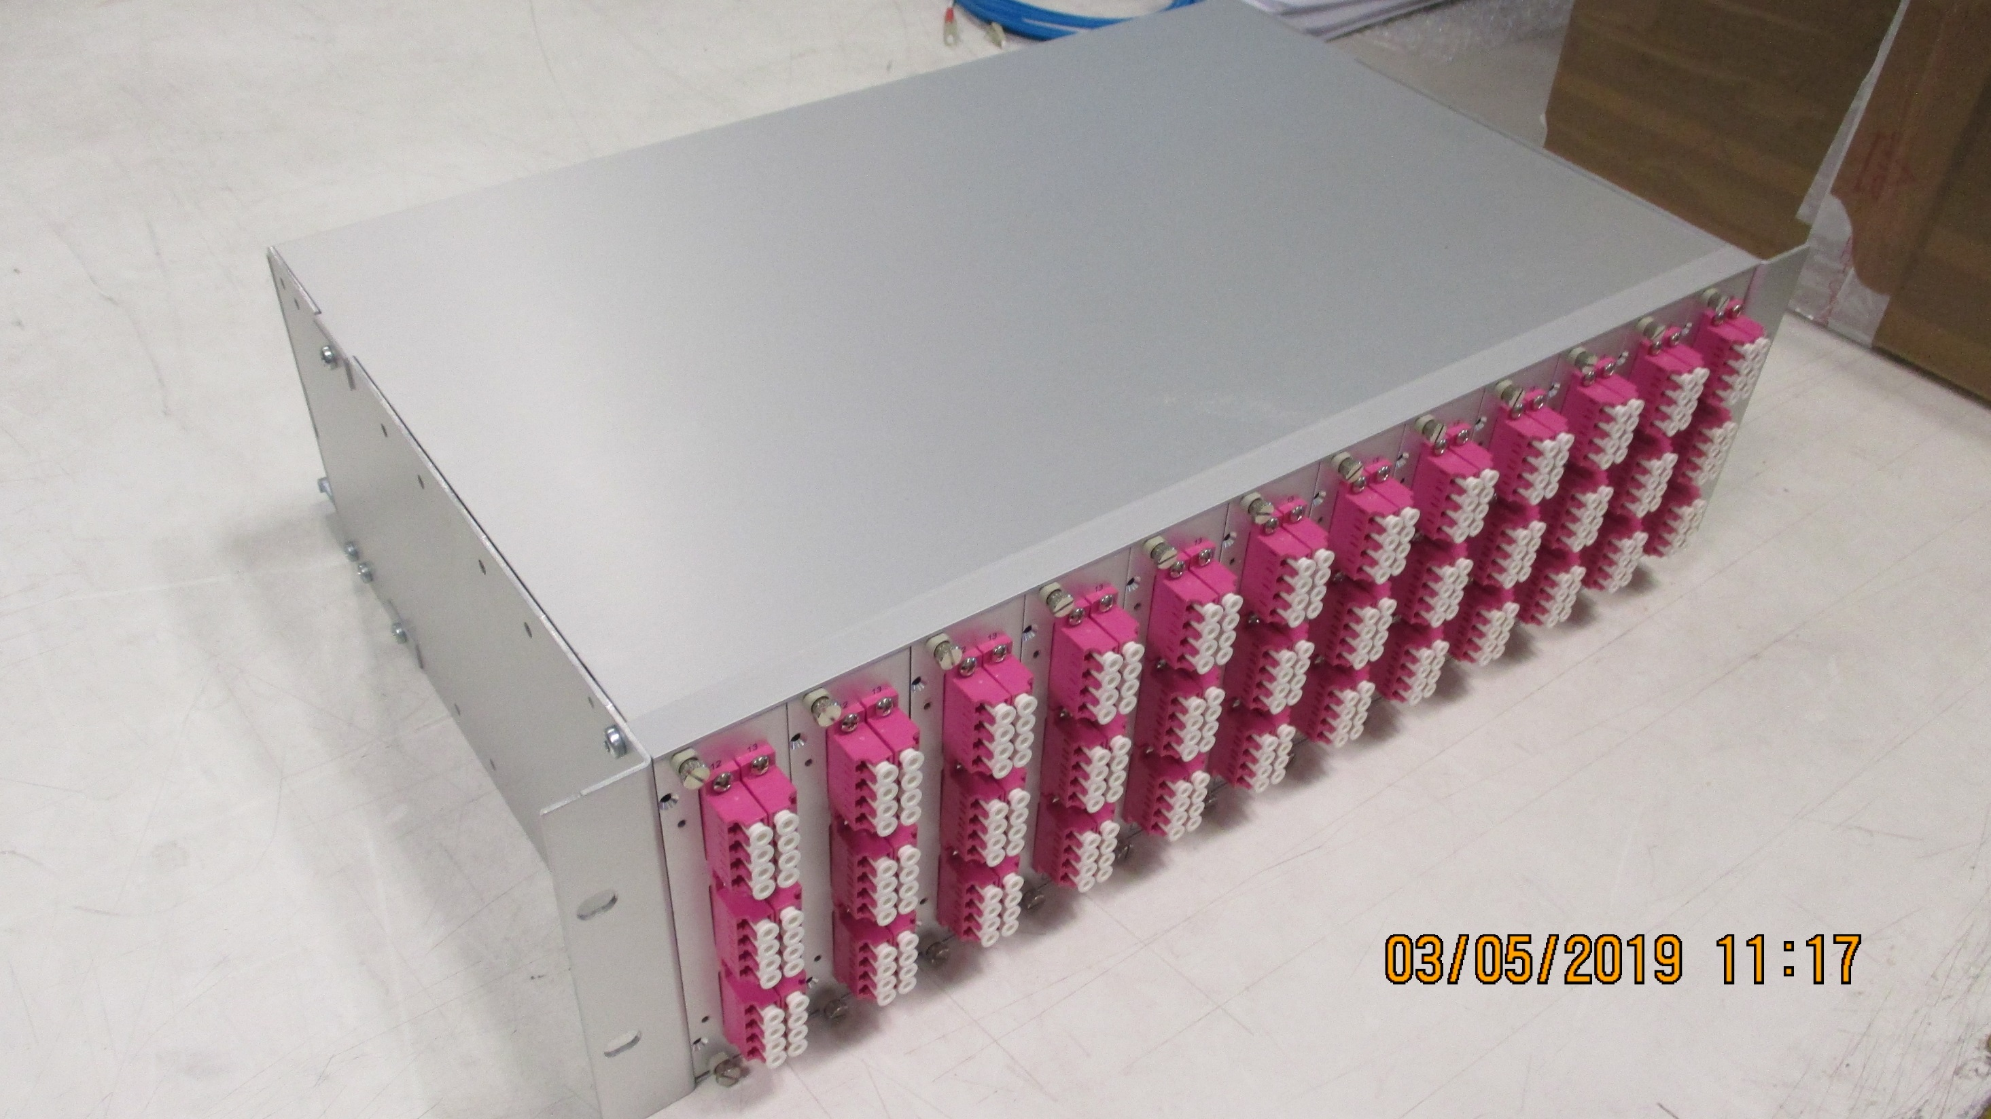
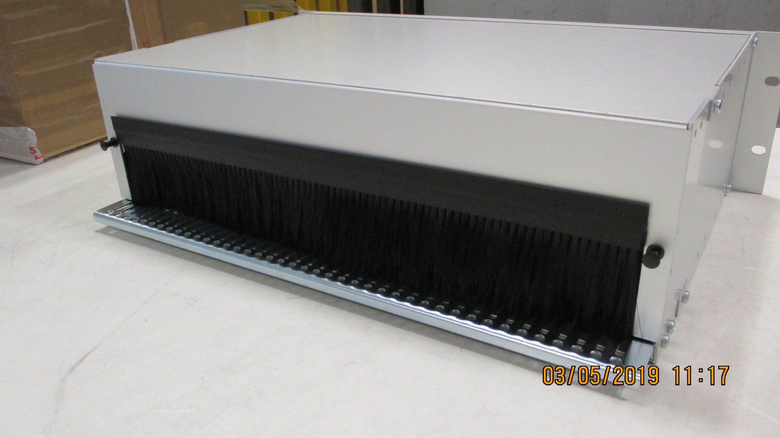
YE3 PP for OF.
Require modification to support cables at the front
Require modification at rear to limit dust etc ingress as this will be the face on top. Only 2 cables enter here.
Front face and top
Fibre management 288 inside is not obvious, top panel does not remove
Rear Face

Slide 7
LV cables
Order left CERN 29 April 2019.
Strain relief on PS side ? How to support the cables
Order PS from Pool and install so final cabling and slack management can be studied off the rack area
DB and labels to do.
Prepare documents for P5 installation crew

Slide 8
HV cables
WE should have verified the 4 cables as the fabrication of the rest has started today.
Test cables according to approved procedure to avoid giving 3kV shock hazard to our Russian colleagues as on RE4 installation.
S. Lusin consulted, require 10MOhm resistance and switch to short that must remain in place until the final moment before final connection. The capacitive charge is easily removed but the Volume charge, polarised dielectric, must also be removed over a long time.
DB and labels to do
Pack in order, Near Far and Send to P5 .
Prepare documents for P5 installation crew

Slide 9
Chamber end
Require simulation of the PP for each chamber position as was done for the RE4 SM
This is part of the preparation is allied to the service passage under the chambers, a method to establish, similar to the Gas installation.

Slide 10
Cooling
Install in July RE4/1
Order for MiniManifold componets done in USA. First part delivered to Wisconsin colleague. All will be shipped together.
Swagelok components are to be ordered with flexibles
Do we order for the chamber ?
Trial on flexible installation behind the ME4/2s
Documentation for installation

Slide 11
Conclusion
Plenty of work in preparation to be done before material is ready to ship to P5
OF in Mini Cable chains ?
Trials of services behind Chambers

