Slide 1


Service Installation for RE3/1 and RE4/1: status and plan
Andrés Leonardo Cabrera Mora
Ian Crotty
On behalf of the RPC group
January 30th, 2020
1

Slide 2
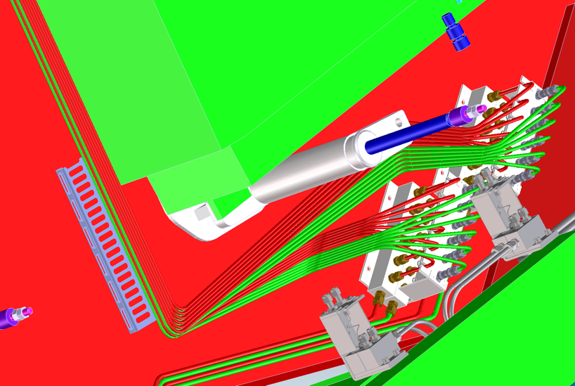
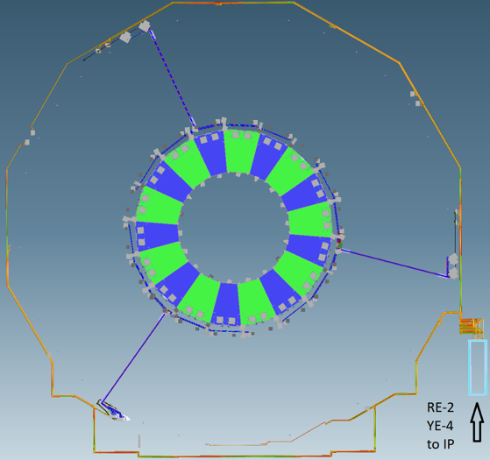
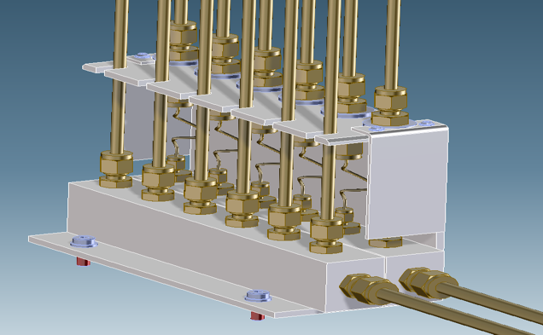
Outline
High Voltage
Low Voltage
Fiber Optics
Cooling System
Gas System
January 30th, 2020
2

Slide 3
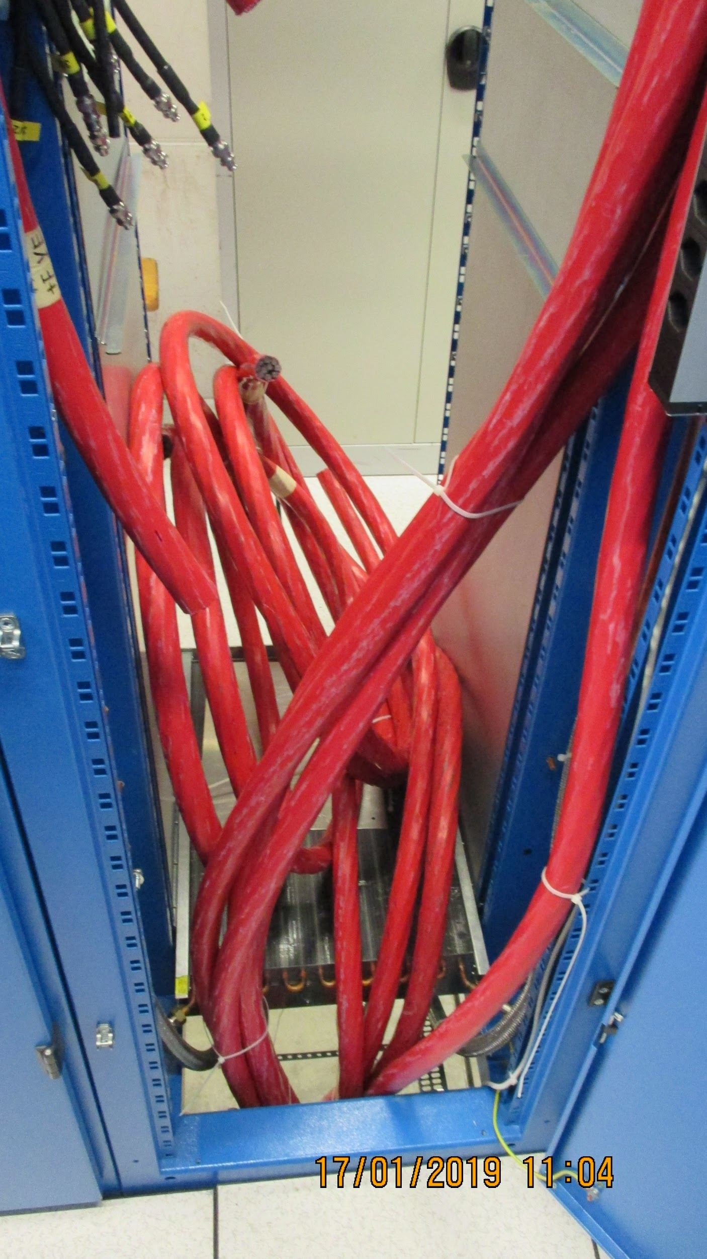
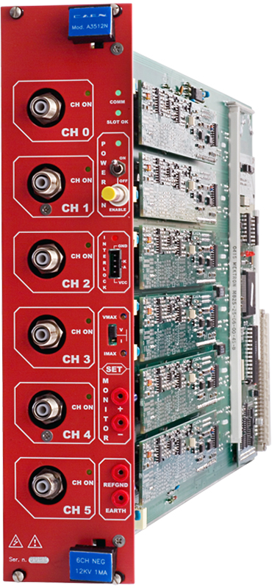
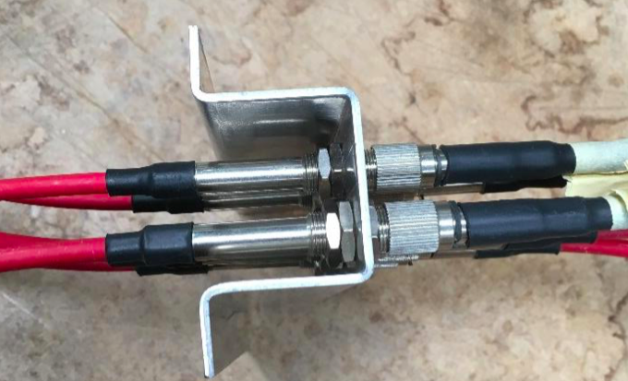
High Voltage
Thanks to: Fatma, Manuel, Margarida, Darwish
https://indico.cern.ch/event/835724/
Missing connectors and patch panel
Cables certified up to 15 kV during one hour.
144 Cables tested -> 143 Ok / 1 Rejected and fixed.
Installed:
For RE+4/1: 36 cables from chamber side to YE+1 patch panel
For RE-3/1: 36 cables from chamber side to YE-1 patch panel
To be completed:
For RE+3/1: 36 cables [Ready to be installed]
For RE-4/1: 36 cables [Ready to be installed]
Cable connectorization in UXC/USC.
Patch panel modification in UXC.
A3512N
Jupiter coaxial connector
January 30th, 2020
3

Slide 4
Low Voltage
3.8 V (5 A)
Given the revised version of the FEB, Lyon engineers proposed an independent source of voltage.
It implies an additional LV cable for each RPC
GND
FEB 1
3.8 V (5 A)
GND
2 V (5 A)
2 V (5 A)
GND
GND
2 V (5 A)
2 V (5 A)
FEB 2
GND
GND
144 Cables tested and prepared for installation (Length, continuity test, connector protection installed, labeled)
Installed:
For RE+4/1: 54 cables from chamber side to balcony racks.
For RE-3/1: 36 cables from chamber side to balcony racks.
GND
5V (1.5 A)
To be completed:
For RE+3/1: 36 cables [Ready to be installed], 18 cables [ordered]
For RE-3/1: 18 cables [ordered]
For RE-4/1: 18 cables [Ready to be installed], 36 cables [ordered]
January 30th, 2020
4

Slide 5
Low Voltage
Missing material
https://edh.cern.ch/Document/SupplyChain/DAI/8088990
LV Cables for RE3/1 and RE4/1 (Novacavi)
Order sent on 12.12.2019.
Delivery: 8-10 working weeks from order (February)
https://edh.cern.ch/Document/SupplyChain/DAI/8061905
Cable connectorization (Cavitech)
Waiting for the cable.
Delivery: 3-4 weeks depending on material reception. (March)
January 30th, 2020
5

Slide 6
Optical Fibers
More details at:
http://project-cms-rpc-endcap.web.cern.ch/project-cms-rpc-endcap/rpc/UpscopeHighEta/RPCDevelopements/RE31and41/Services/OpticalFibres/QA/Method/OpticalFiberTest.pptx
January 30th, 2020
6

Slide 7
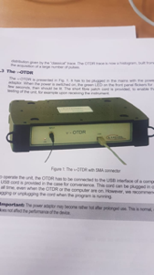
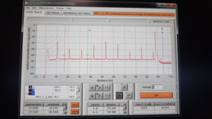
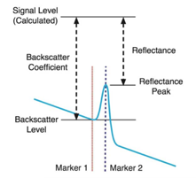
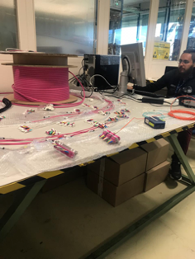
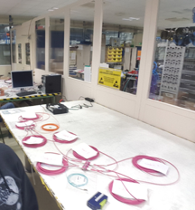
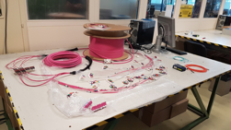
Fiber quality assurance test
Length measurement and qualitative test for power loss
Connection mapping
Labeling
January 30th, 2020
7

Slide 8
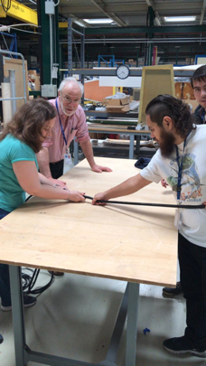
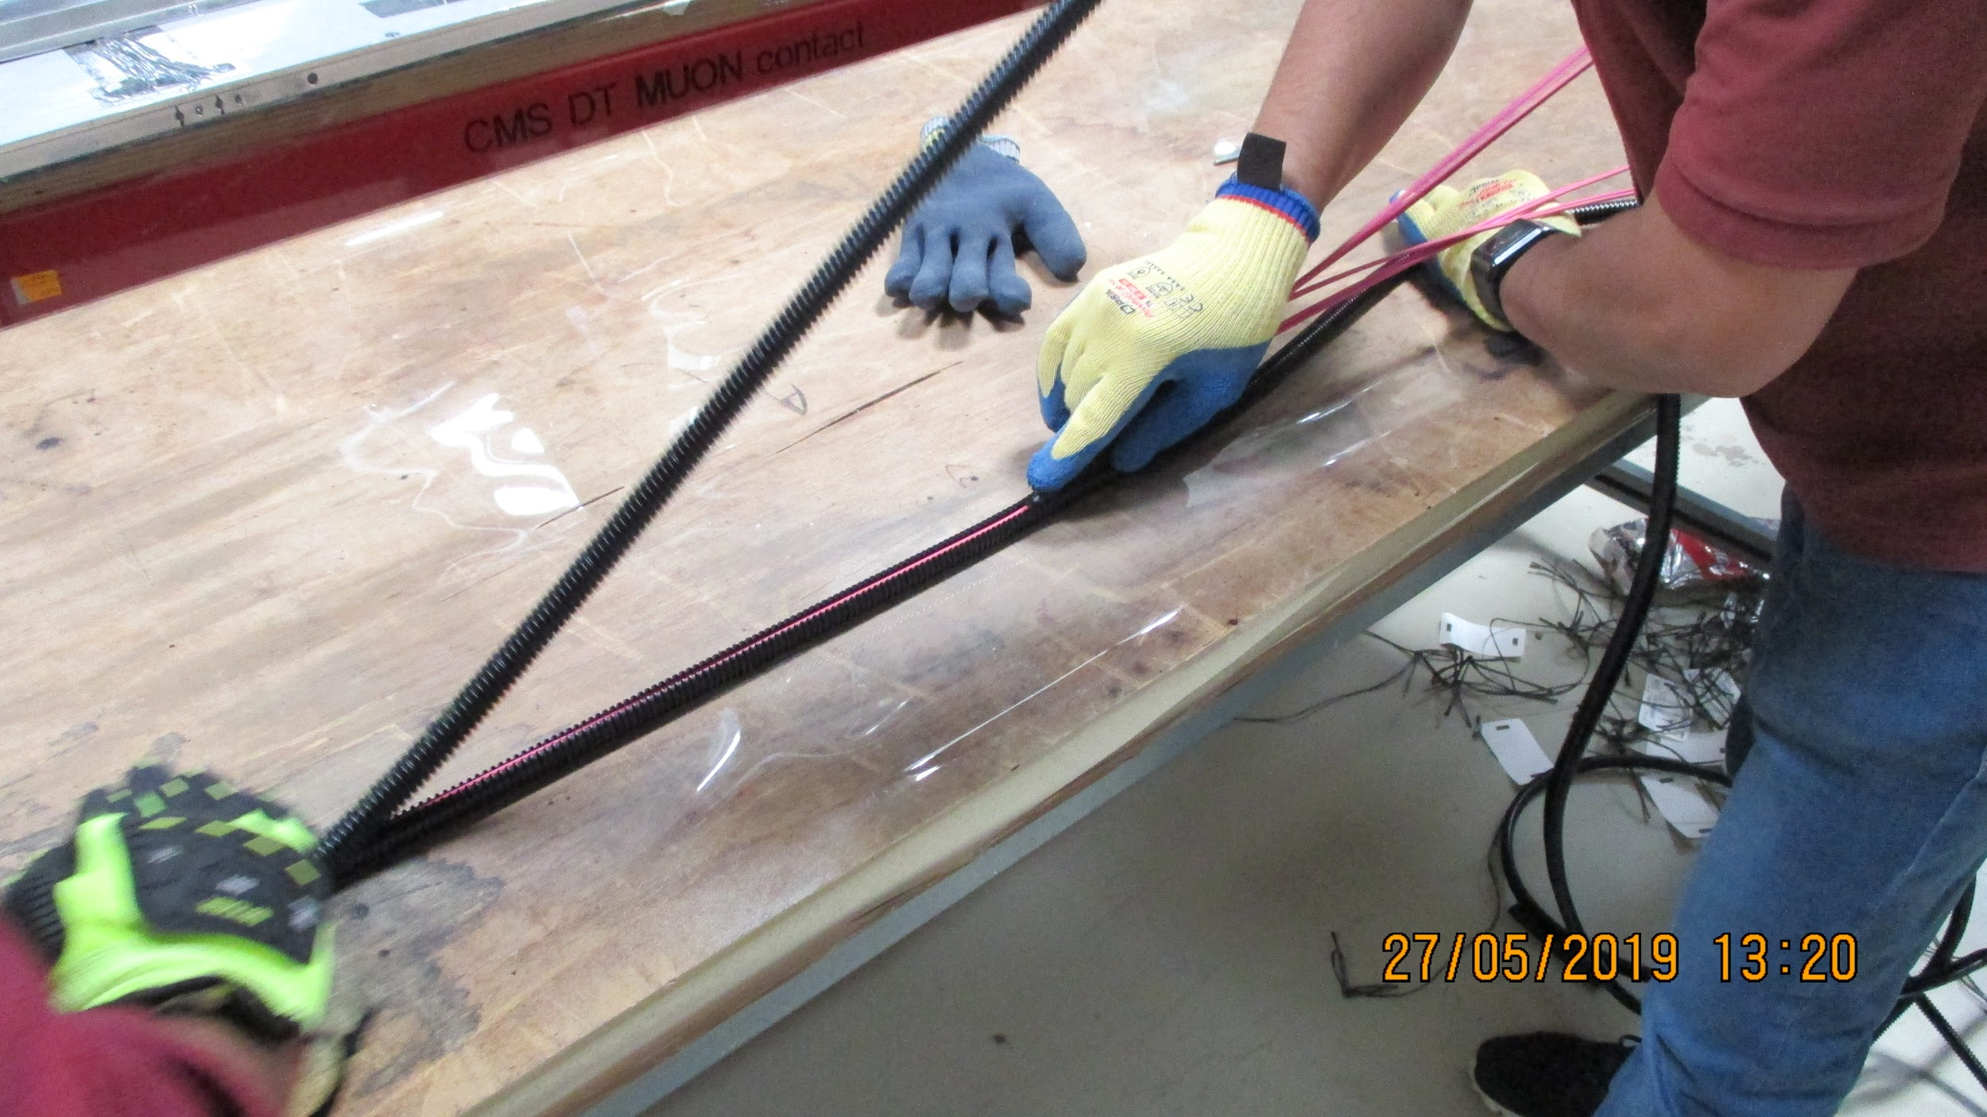
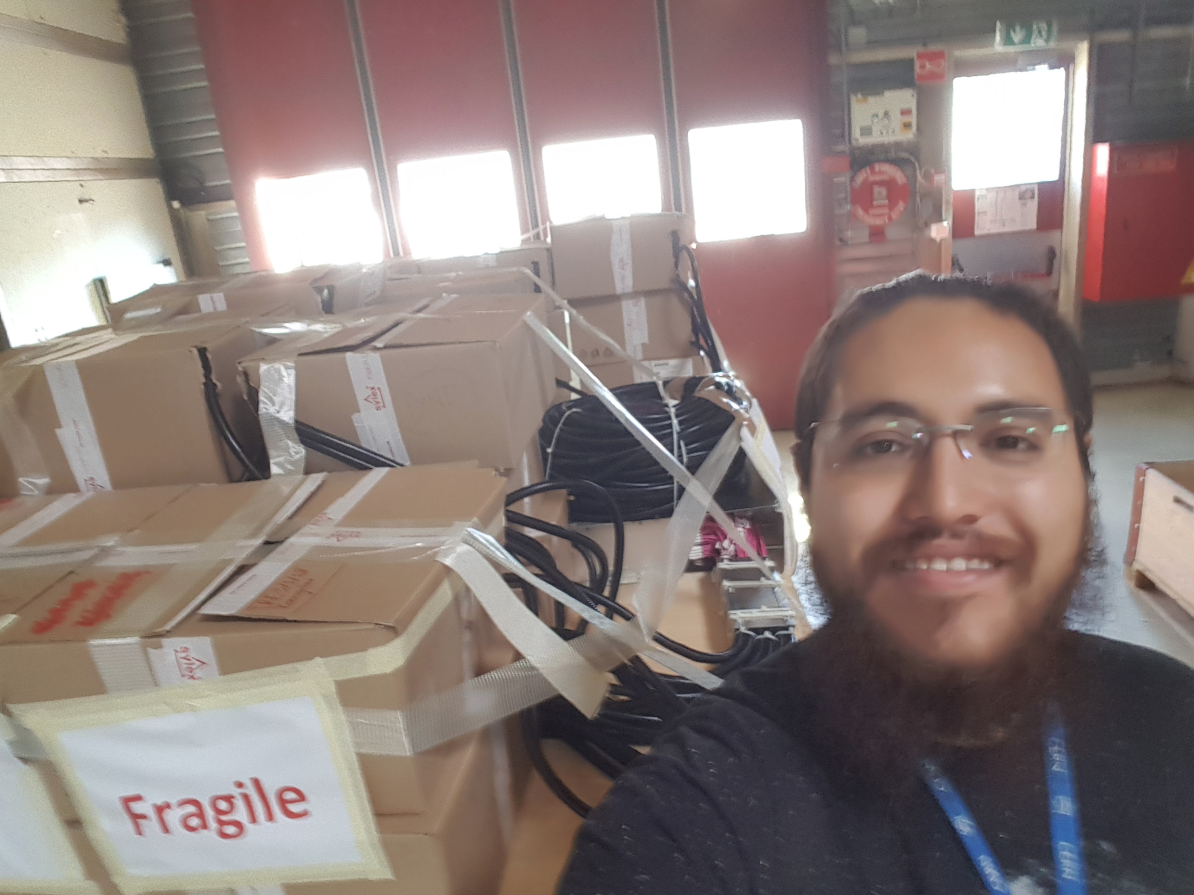
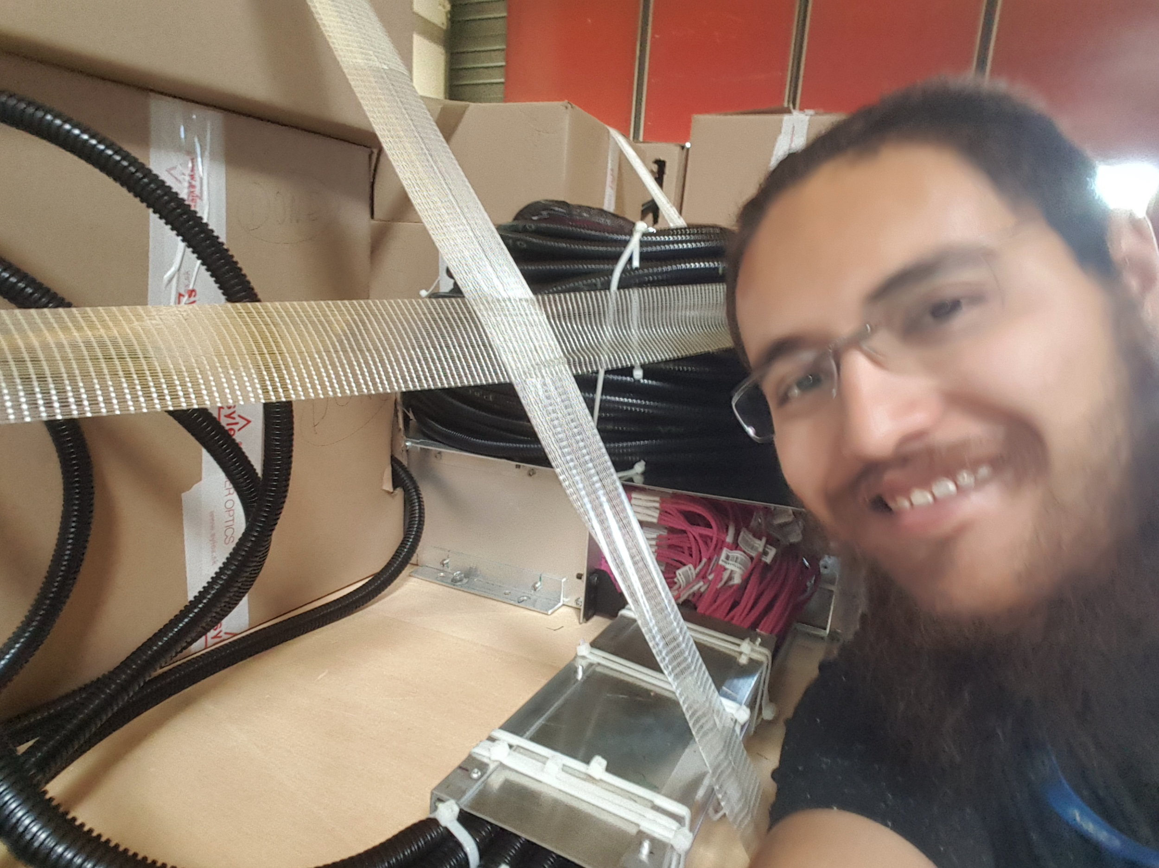
Optical Fibers
Fiber protection: corrugated conduit installation on fibers
January 30th, 2020
8

Slide 9
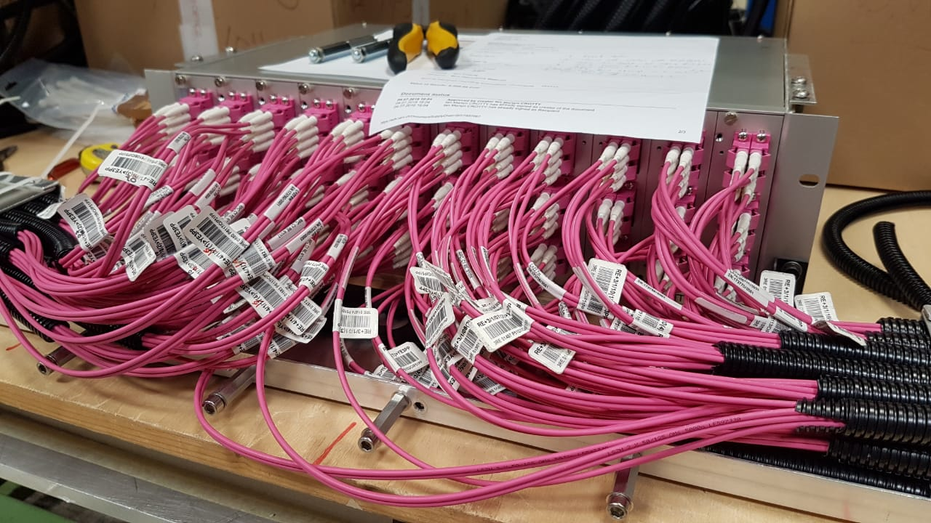
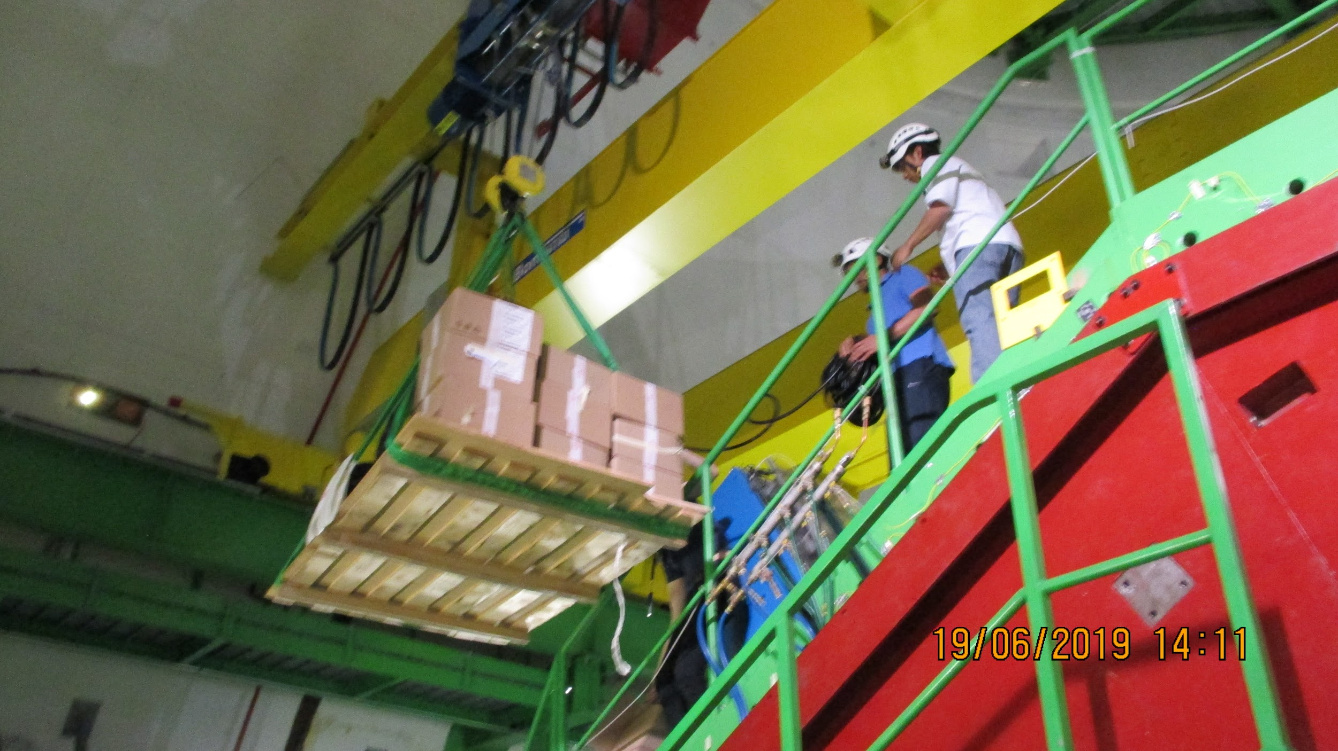
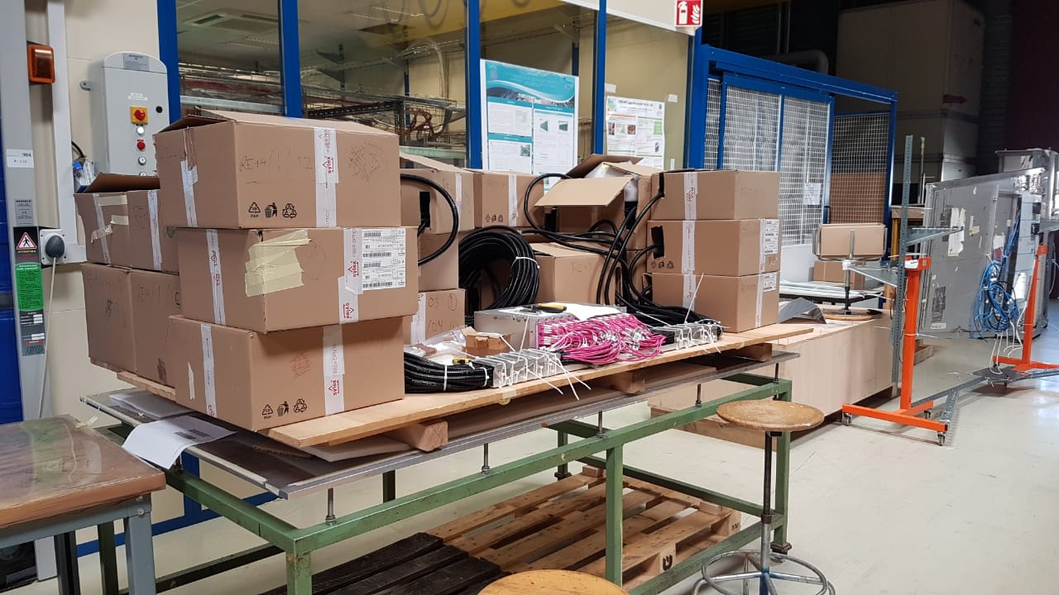
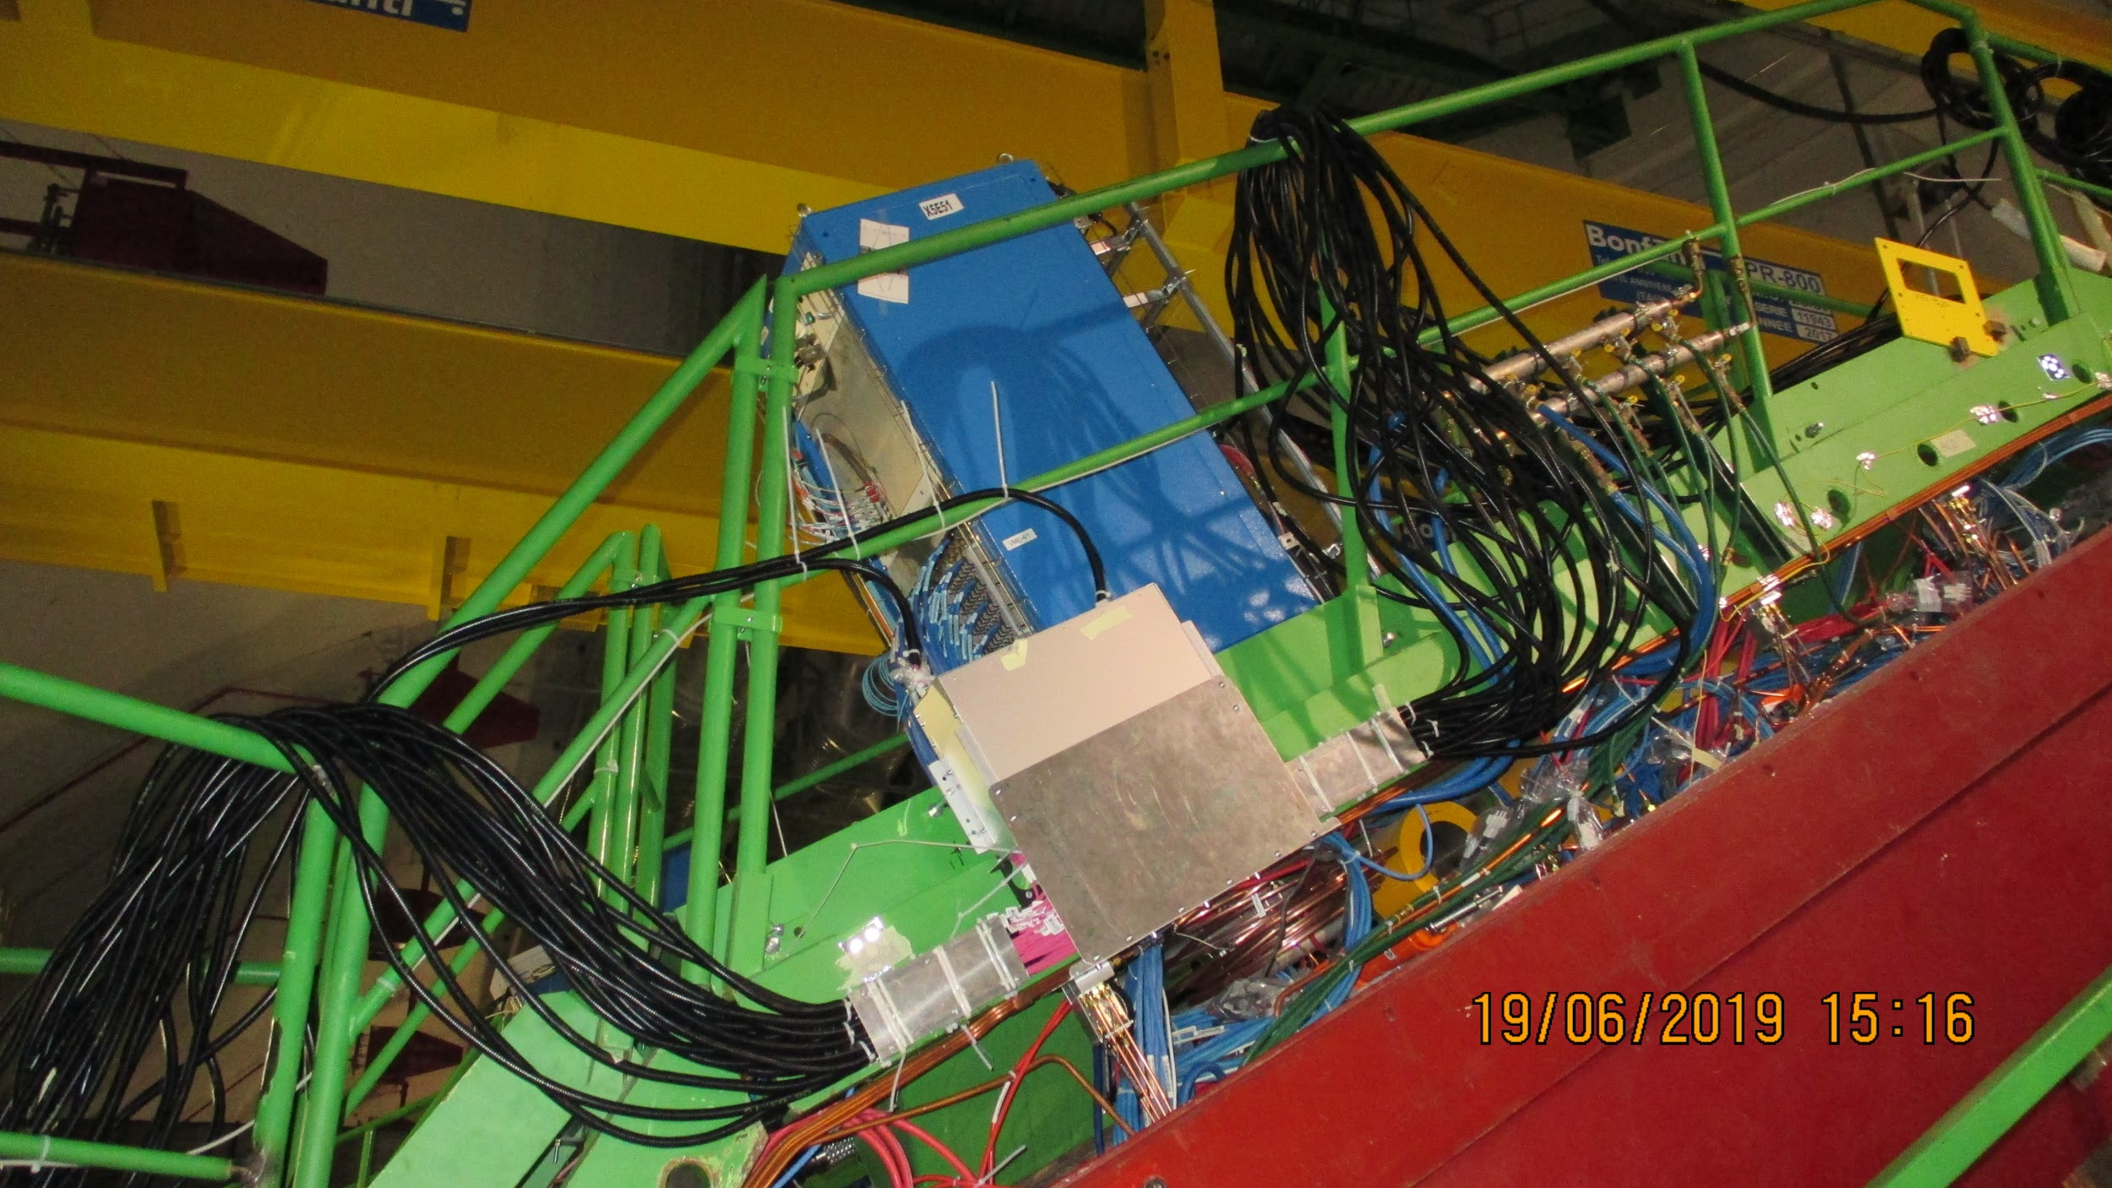
Optical Fibers
Patch panel preparation to P5: assembly and installation of YE3PP
RE-4/1 FO
RE-3/1 FO
January 30th, 2020
9

Slide 10
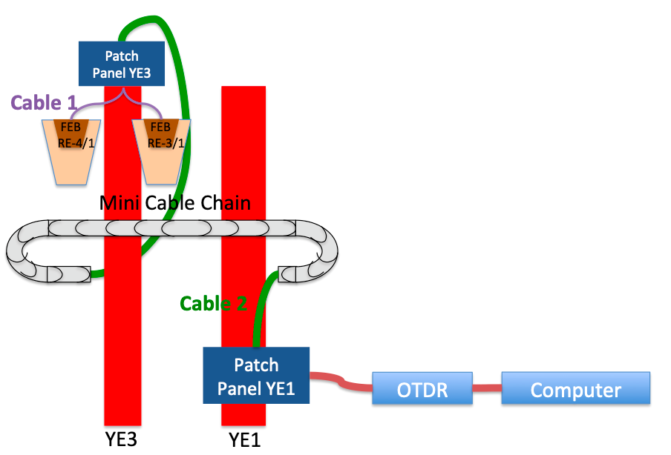
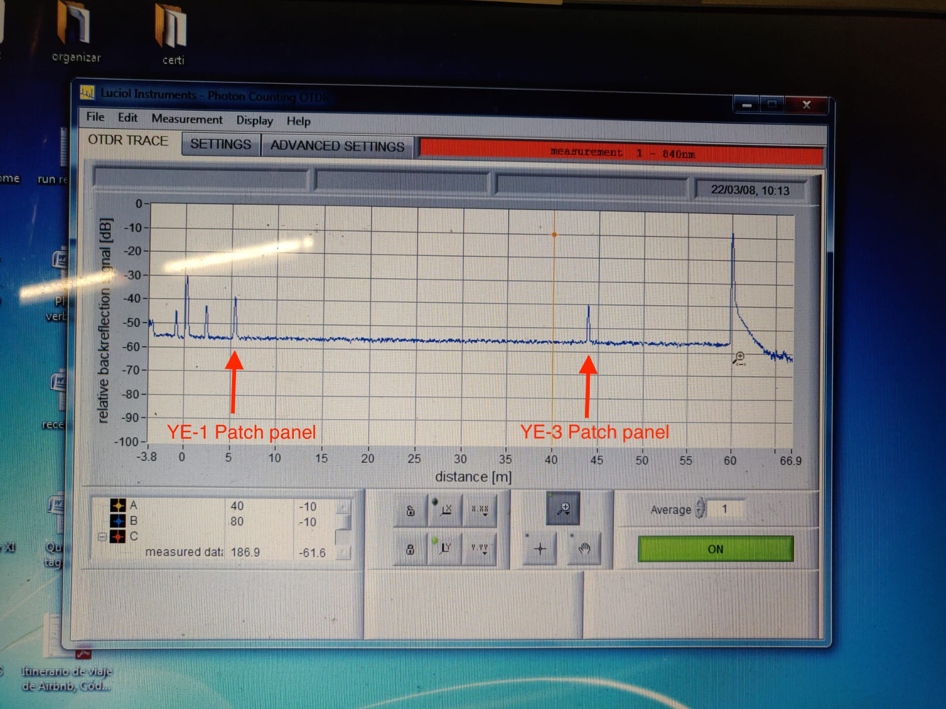
Optical Fibers
576 fibers tested with OTDR
Installed:
YE+3, YE+1, YE-1 and YE-3 patch panels.
For RE+3/1: 144 fibers from YE+3 patch panel till YE+1 patch panel.
For RE+4/1: 144 fibers from chamber side until YE+1 patch panel.
For RE-3/1: 144 fibers from chamber side until YE-1 patch panel.
For RE-4/1: 144 fibers from YE-3 patch panel till YE-1 patch panel.
To be completed:
For RE+3/1: 144 fibers from YE+3 patch panel until chamber side.
For RE-4/1: 144 fibers from YE-3 patch panel until chamber side.
For all disks: From YE±1 patch panel to USC rack.
January 30th, 2020
10

Slide 11
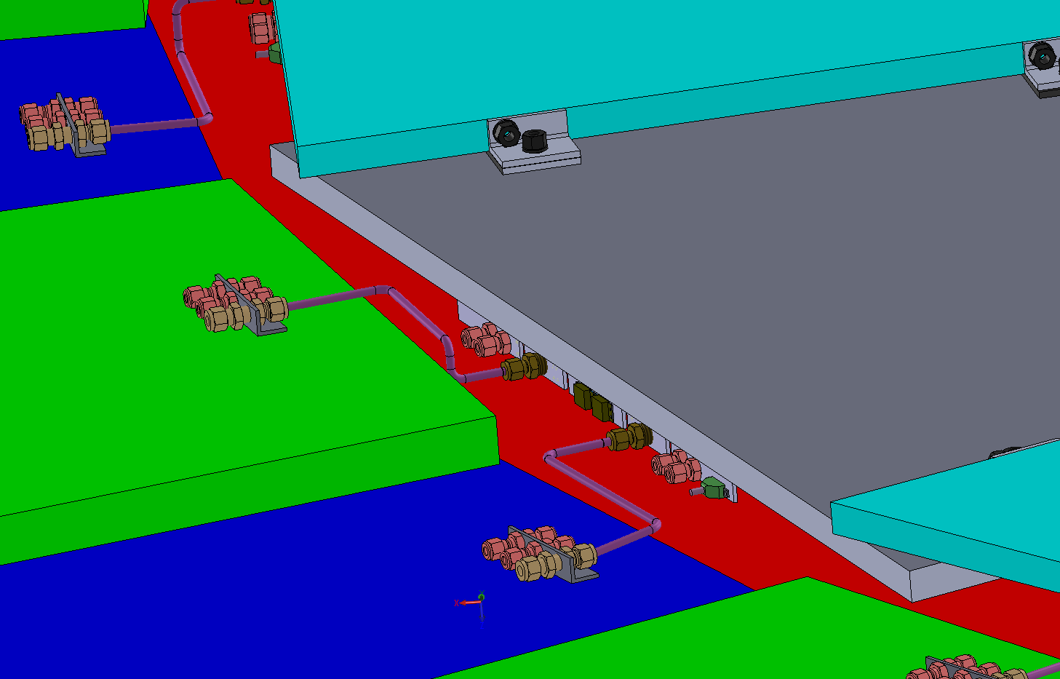
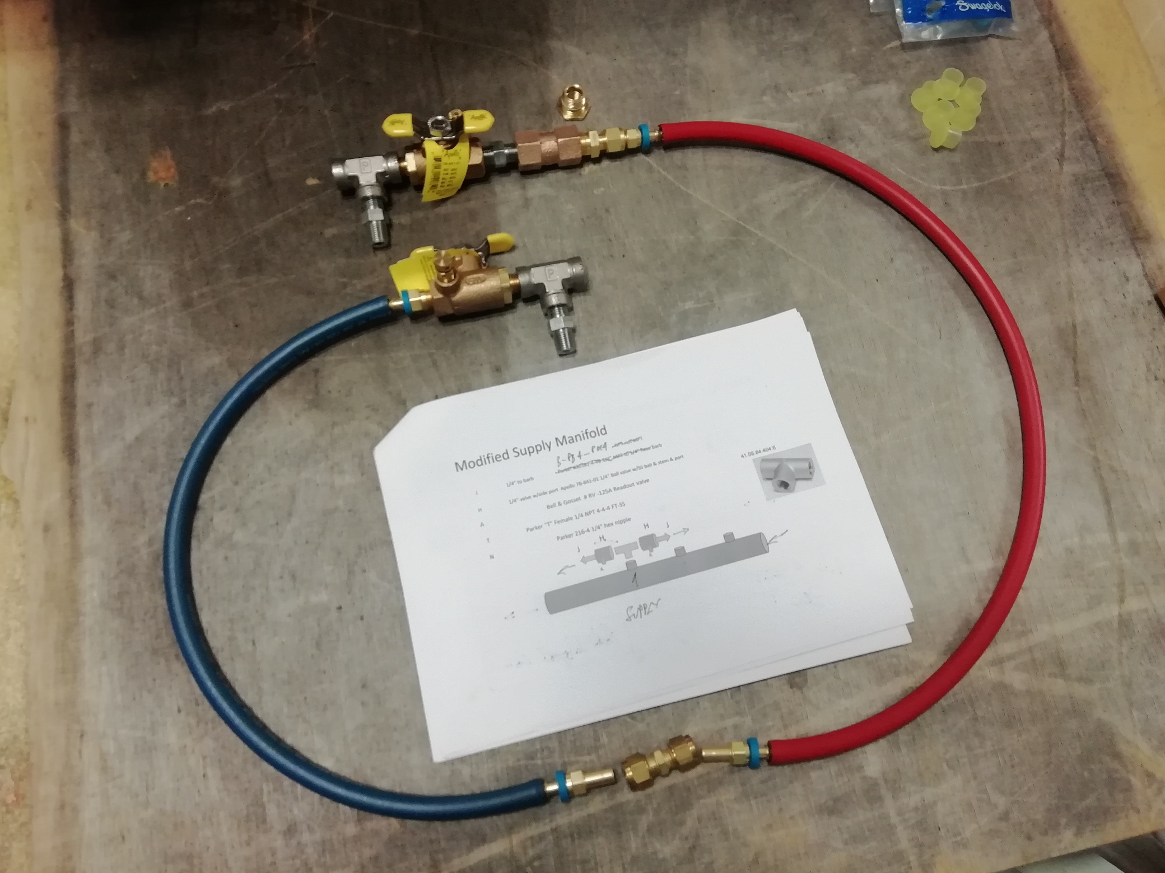
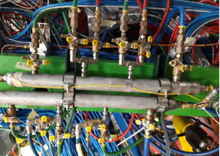
Cooling
RE3/1 cooling link to RE3/2
The rigid copper piping will be replaced by flexible hose links to reduce the strain on the unions.
Installation to be done after RE3/1 installation.
x2 RE3/2 circuits feed x1 RE3/1 chamber
Return Red
Supply Blue
RE+4/1 Cooling
For RE+4/1:
Added 9 “t” connection to the mini-manifold (ZEC). [Pressure test performed]
January 30th, 2020
11

Slide 12
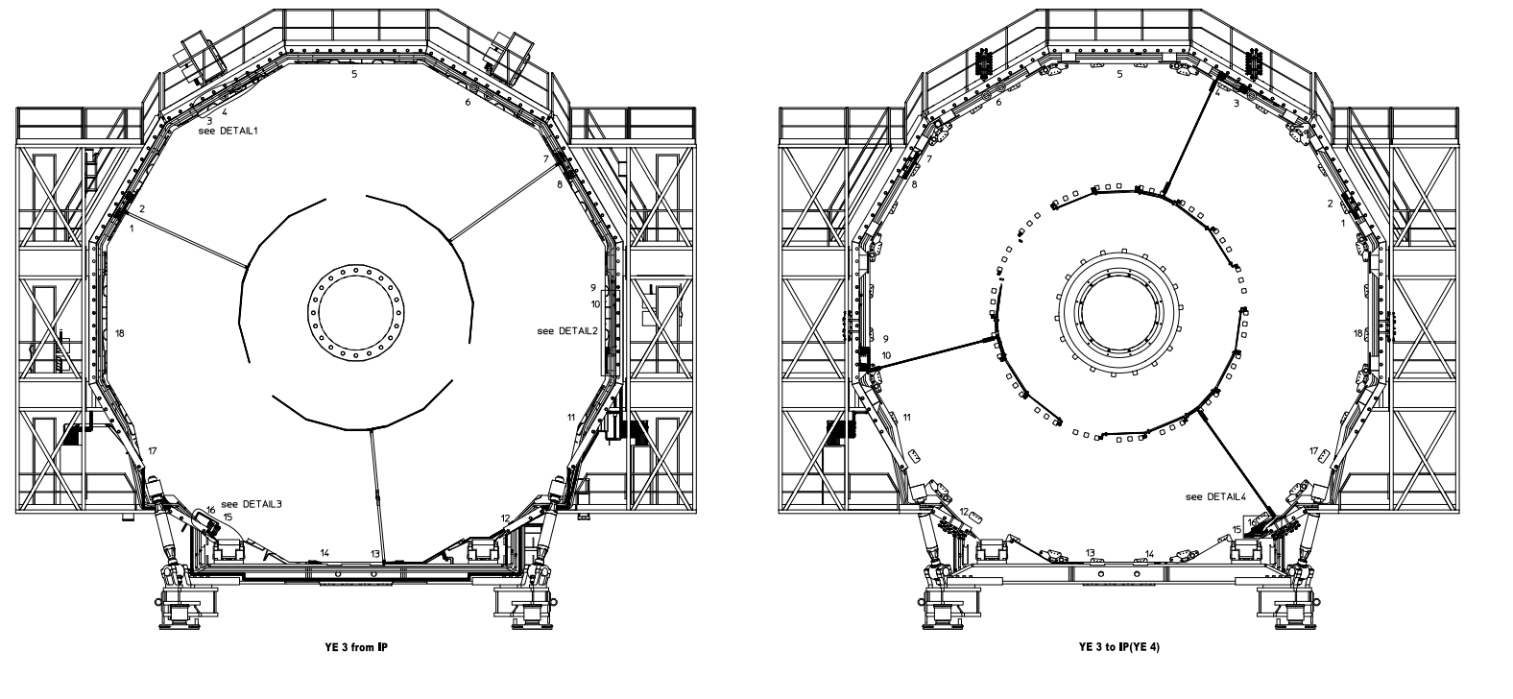
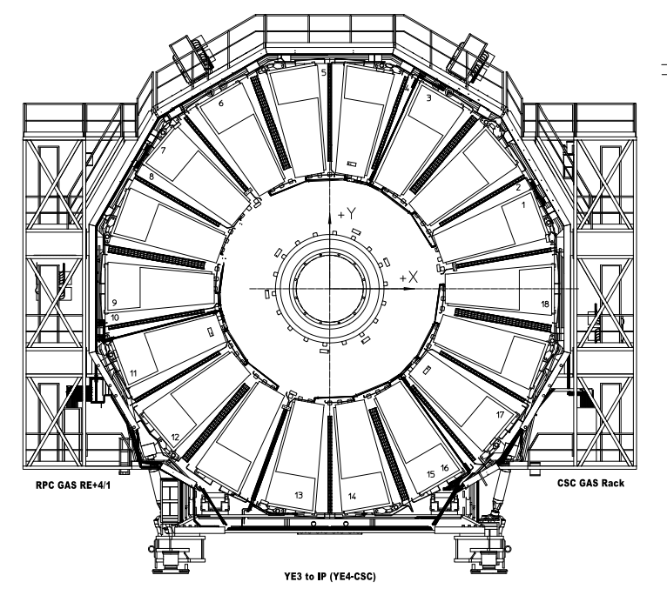
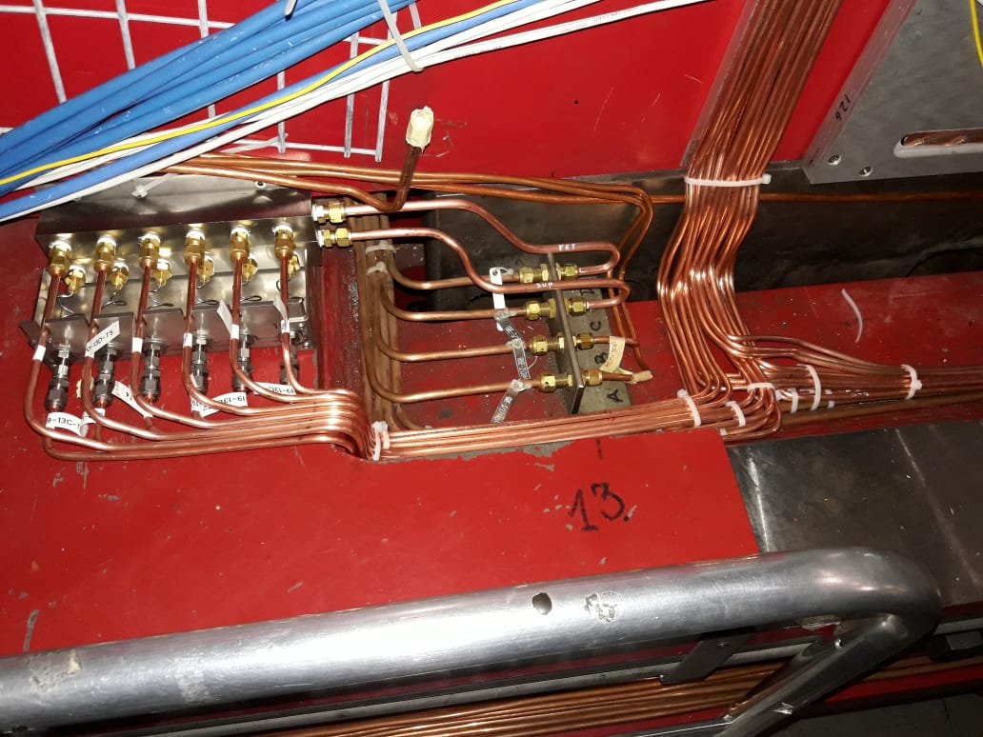
Gas System
Latest drawings of RE+4/1 gas service.
The RE-3/1 gas service installation is 100% done in March (pipes and impedance boxes).
Pressure test performed.
For RE+4/1 gas service installation is 100% done (pipes and impedance boxes).
Pressure test performed.
To be completed:
RE+3/1 gas service installation
RE-4/1 gas service installation
Gas impedance boxes
January 30th, 2020
12

Slide 13
Gas System
Missing material (order ongoing)
1) Flexible hoses: 40 short + 40 long, we have 1 quote from ZEC, expecting a second one from CEIHP this week.
2) Swagelok unions for flaoating patch panel end of flexible hoses.
3) Legris unions + 6mm caps on the CH side of the flexible hoses.
4) Drill and tap holes for RE-3/1 and RE-4/1 ground cables
5) 2 RE-4/1 impedance boxes are to be finalized and tested
Delivered
https://edh.cern.ch/Document/SupplyChain/DAI/7826363
40 short flexible pipes, 40 long flexible pipes-> Delivered (12.07.2019)
https://edh.cern.ch/Document/SupplyChain/DAI/7818647
Ferrules for CMS RPC Impedance Boxes, Swagelok material needed for the CMS RPC RE4/1 -> Delivered (19/06/2019)
https://edh.cern.ch/Document/SupplyChain/MAG/7819757
Double ferrule unión, Ferr. Union tube caps -> Delivered
January 30th, 2020
13

Slide 14
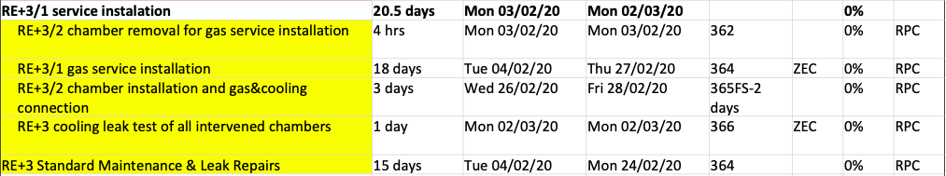
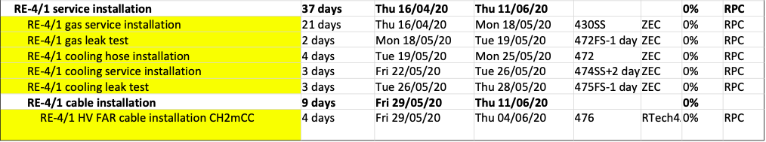
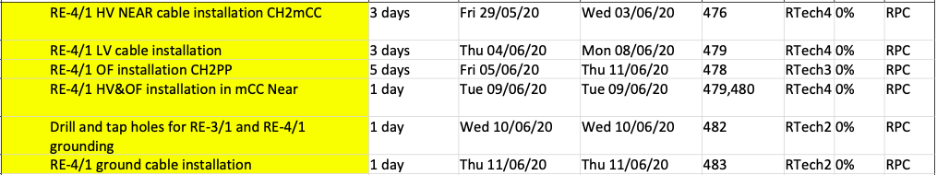
Readiness and Schedule
January 30th, 2020
14

Slide 15
Readiness and Schedule
RE-3/1 cable installation 9 days Thu 13/06/19 Tue 25/06/19 (Done)
RE+4/1 cable installation 14 days Fri 02/08/19 Wed 21/08/19 (Done)
RE+3/1 cable installation 10 days Fri 24/04/20 Mon 11/05/20 (Ready)
RE-4/1 cable installation 9 days Fri 29/05/20 Thu 11/06/20 (Ready)
Optical fibre from UXC to USC:
Positive side: 14-20.May.2020 (5 days)
Negative side: after the end of the muon critical path
January 30th, 2020
15

Slide 16
Manpower for installation
Gas and cooling -> ZEC
Optical Fibers -> Russian team
High Voltage -> Russian team
Low Voltage -> Russian team
January 30th, 2020
16

Slide 17
Thanks!
January 30th, 2020
17

Slide 18
Backup Slides
January 30th, 2020
18

Slide 19
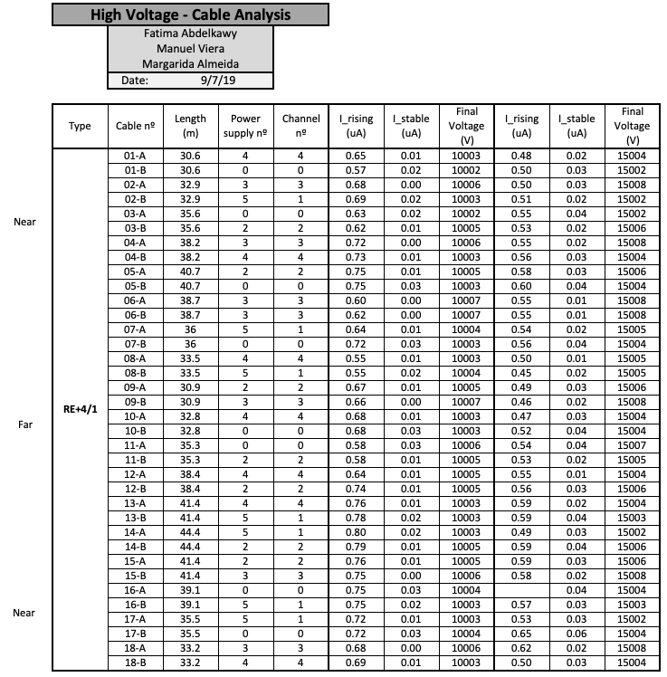
High Voltage
All cables tested.
January 30th, 2020
19

Slide 20
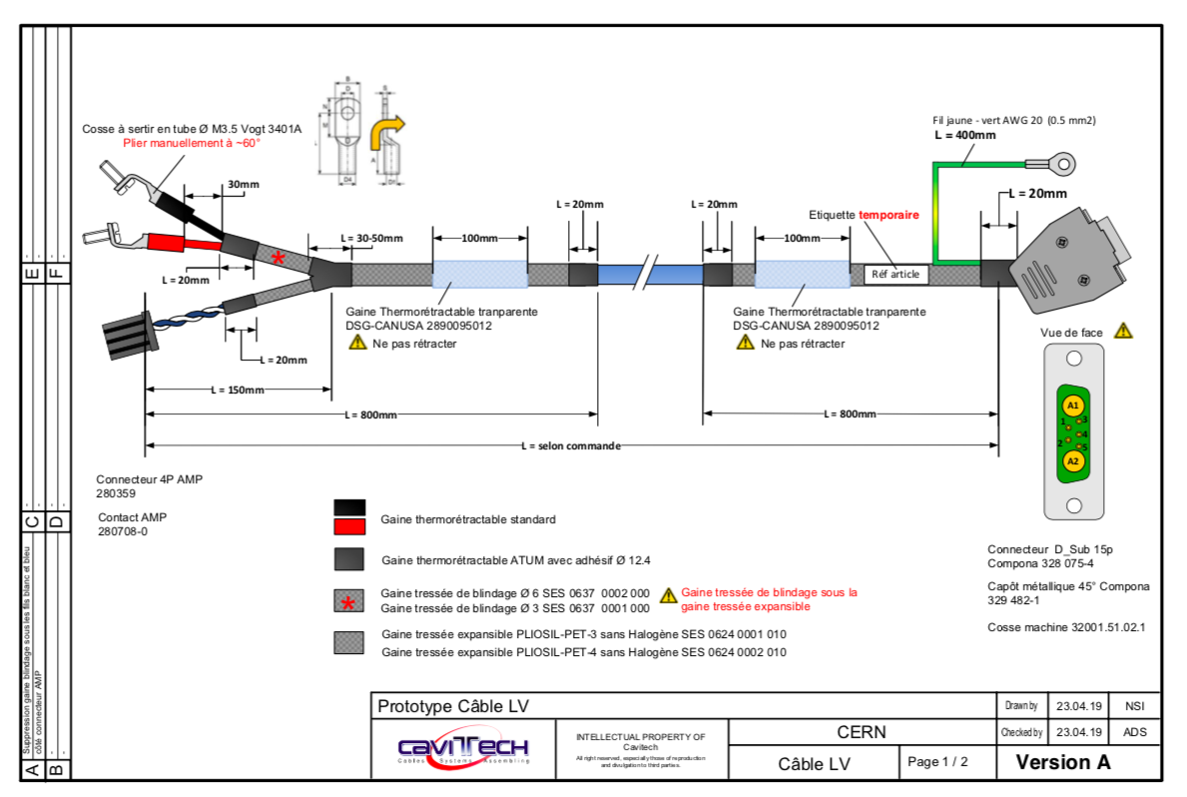
Low Voltage
January 30th, 2020
20

Slide 21
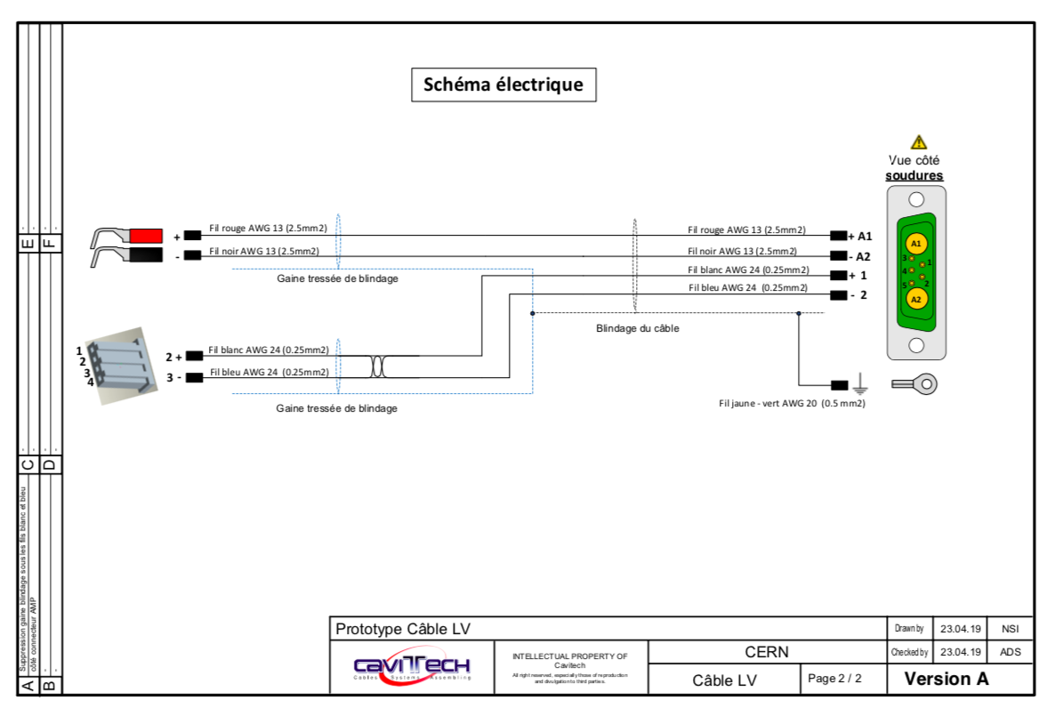
Low Voltage
January 30th, 2020
21

Slide 22
Readiness and Schedule (to be updated)
RE-3/1 cable installation 9 days Thu 13/06/19 Tue 25/06/19 (Done)
RE+4/1 cable installation 14 days Fri 02/08/19 Wed 21/08/19 (Done)
RE+3/1 cable installation 11 days Wed 13/05/20 Wed 27/05/20 (Ready, cooling incomplete)
RE-4/1 cable installation 10 days Wed 15/04/20 Tue 28/04/20 (Ready, cooling incomplete)
Optical fibre from UXC to USC:
Positive side: 04-11.May.2020 (6 days)
Negative side: after the end of the muon critical path
January 30th, 2020
22

Slide 23
Labeling Status today
Type | Location | Printed | Installed | # Individual Labels | # Copies | Total | Comments
HV | RE+3/1 | Yes | Done by Fatma | 18 | 2 | 36
HV | RE-3/1 | Yes | Yes | 18 | 2 | 36
HV | RE+4/1 | Yes | Done by Fatma | 18 | 2 | 36 | 16 July finished
HV | RE-4/1 | Yes | Done by Fatma, Gamal, Ekhlas | 18 | 2 | 36 | 18 July finished
LV | RE+3/1 | Yes | Yes | 18 | 2 | 36
LV | RE-3/1 | Yes | Yes | 18 | 2 | 36
LV | RE+4/1 | Yes | Done by Fatma, Gamal, Ekhlas, Manuel | 18 | 2 | 36 | Correction done on UXC by Daniel and Andres, missing chamber side
LV | RE-4/1 | yes | Done by Fatma, Gamal, Ekhlas, Manuel | 18 | 2 | 36 | Correction done on 904 by Manuel and Andres
Fiber | RE+3/1 Cable 1 | Yes | Yes | 18 | 2 | 36
Fiber | RE-3/1 Cable 1 | Yes | Yes | 18 | 2 | 36
Fiber | RE+4/1 Cable 1 | Yes | Yes | 18 | 2 | 36 | Correction done on 904 by Daniel and Andres
Fiber | RE-4/1 Cable 1 | Yes | Yes | 18 | 2 | 36 | Correction done on UXC by Daniel and Andres
January 30th, 2020
23

