Slide 1
CSC Fibres for their upgrade
19 Sept 2018
Shown to me by Karoly Banicz from CSCs

Slide 2
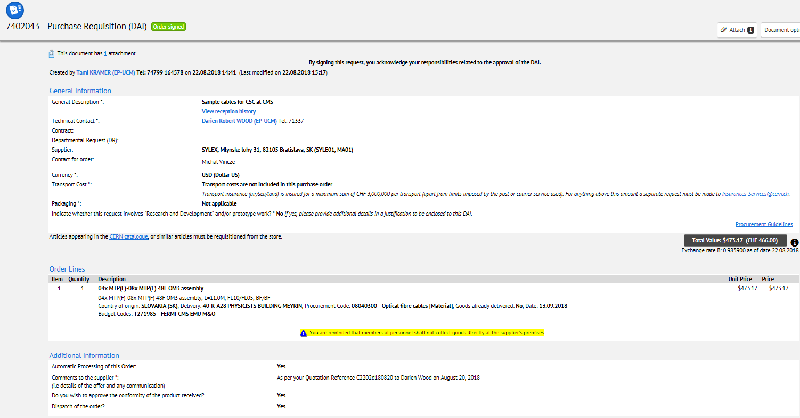

Slide 3
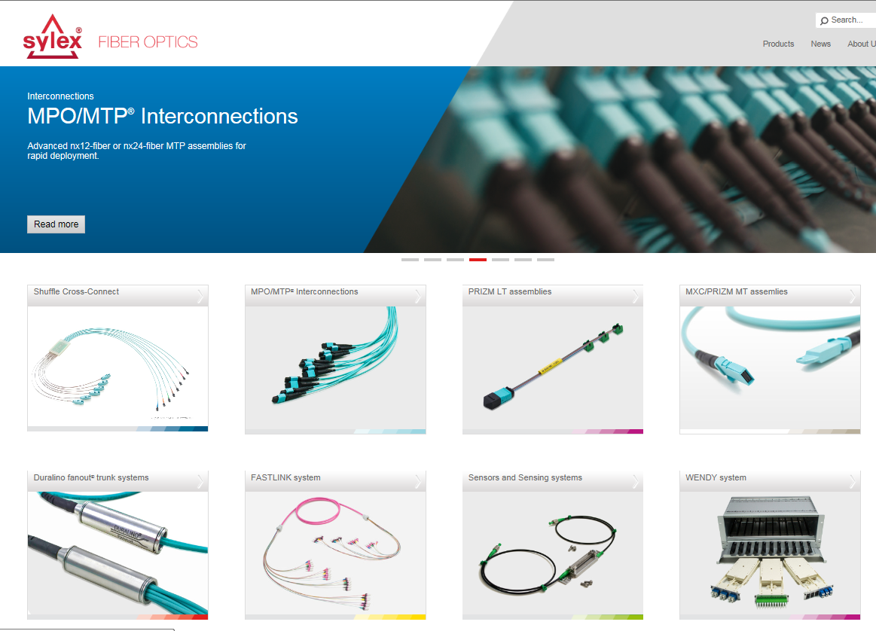
SYLEX, Mlynske luhy 31, 82105 Bratislava, SK (SYLE01, MA01)
https://www.sylex.sk/

