Slide 1
Cost estimate for iRPC at fs.com

Slide 2
Number of cables | Cable Lenght | Fibers per cable | Conector End 1 | Conector End 2 | Project | Price per Unit (CHF) | Total Price (CHF)
4 | 30 meters OM3 | 96 | 8 x MPO/MTP 12 fibers Female | 8 x MPO/MTP 12 fibers Female | iRPC UXC-UXC | 776.76 | 3107.04
4 | 80 meters OM3 | 96 | 8 x MPO/MTP 12 fibers Male | 8 x MPO/MTP 12 fibers Female | iRPC UXC-USC | 1606.31 | 6425.24
 |  |  |  |  |  | Total Cost: | 9532.28
4 | 30 meters OM4 | 96 | 8 x MPO/MTP 12 fibers Female | 8 x MPO/MTP 12 fibers Female | iRPC UXC-UXC | 1151.70 | 4606.8
4 | 80 meters OM4 | 96 | 8 x MPO/MTP 12 fibers Male | 8 x MPO/MTP 12 fibers Female | iRPC UXC-USC | 2605.36 | 10421.44
 |  |  |  |  |  | Total Cost: | 15028.24
Jacket: Low Smoke Zero Halogen (LSZH)
Note: Compliance with CERN IS23 is not evaluated in this estimate
https://edms.cern.ch/document/335745/LAST_RELEASED/

Slide 3
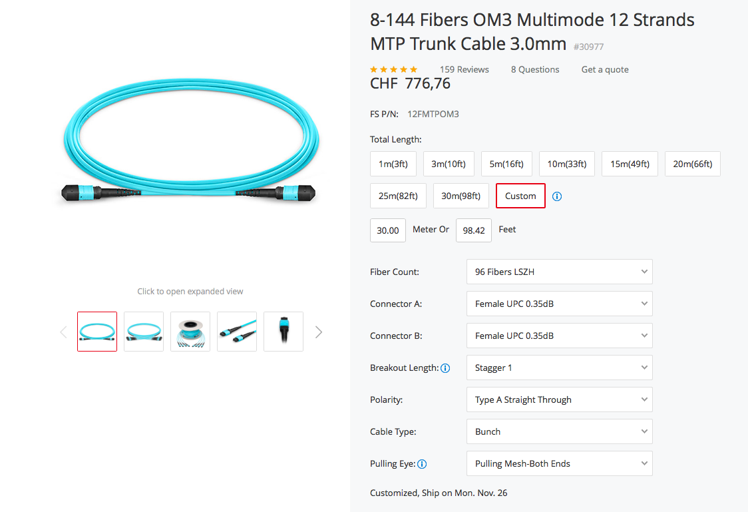
OM3 30 Meters
Source: https://www.fs.com/de/en/products/30977.html

Slide 4
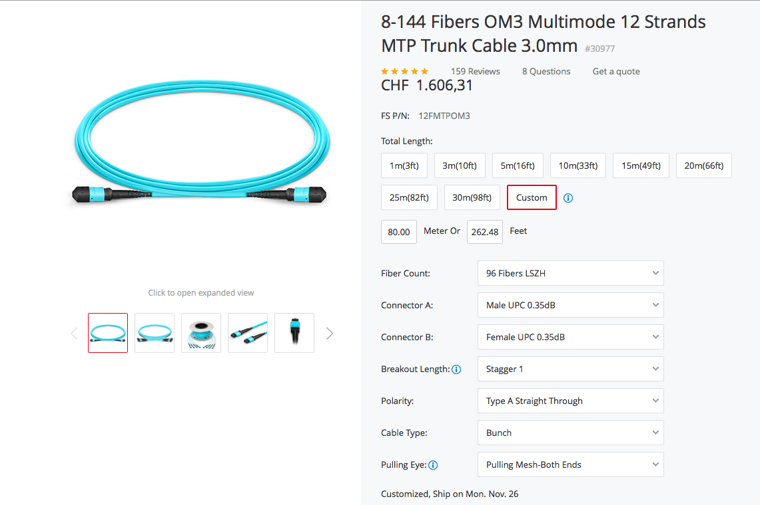
OM3 80 Meters
Source: https://www.fs.com/de/en/products/30977.html

Slide 5
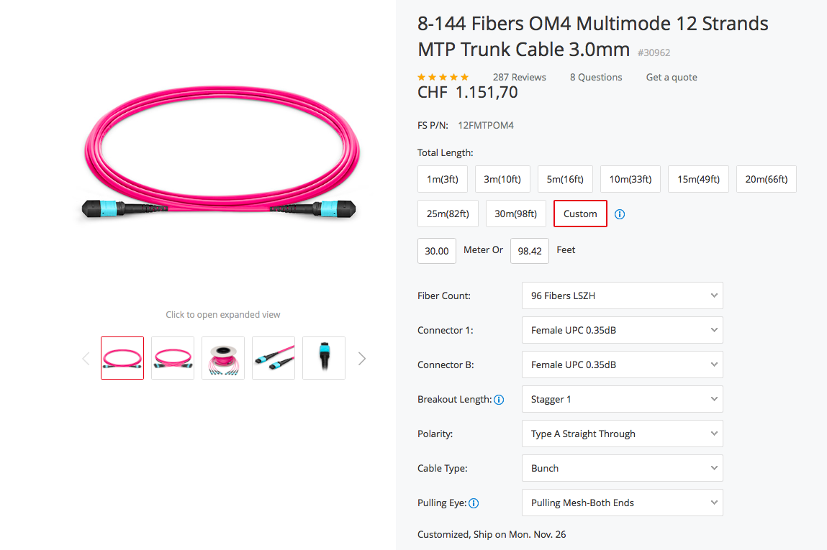
OM4 30 Meters
Source: https://www.fs.com/de/en/products/30962.html

Slide 6
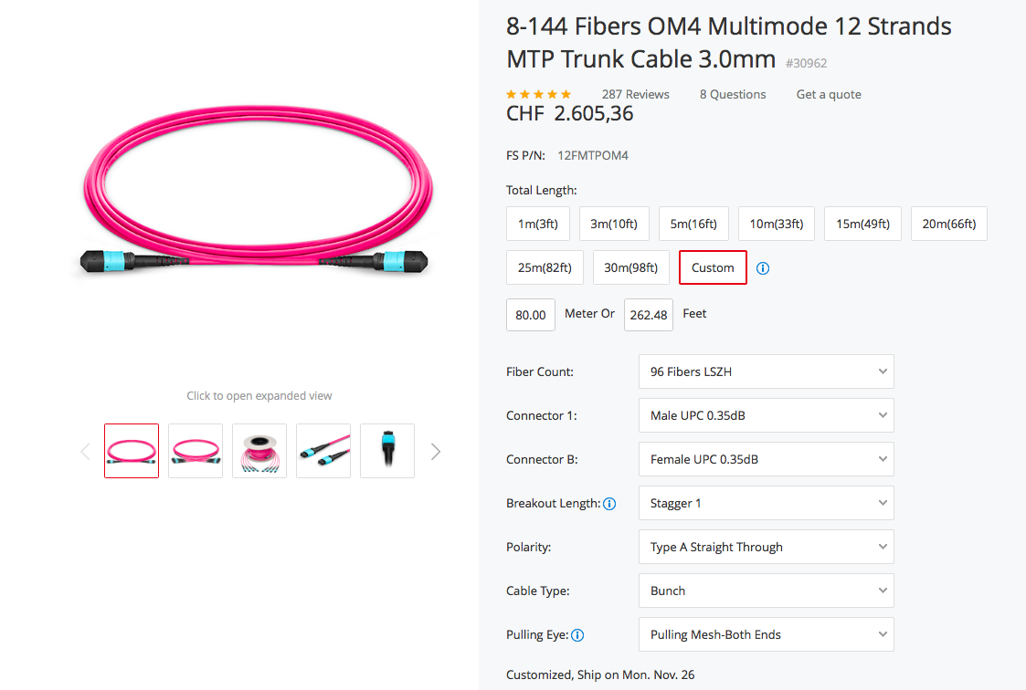
OM4 80 Meters
Source: https://www.fs.com/de/en/products/30962.html

