Slide 1
Optical Fiber Testing
Daniel Alejandro Perez Navarro
18 June 2019

Slide 2
Contents
The Optical Time-Domain Reflectometer (OTDR)
The length measurements: general procedure
Procedure for measurement of RE+3/1/x and RE-4/1/x fibers
Procedure for measurement of Cables 2 and 3
Connecting fibers to the patch panel
Testing after the connection
Shipping the patch panel to P5
Summary of OTDR tests performed so far
Next steps

Slide 3
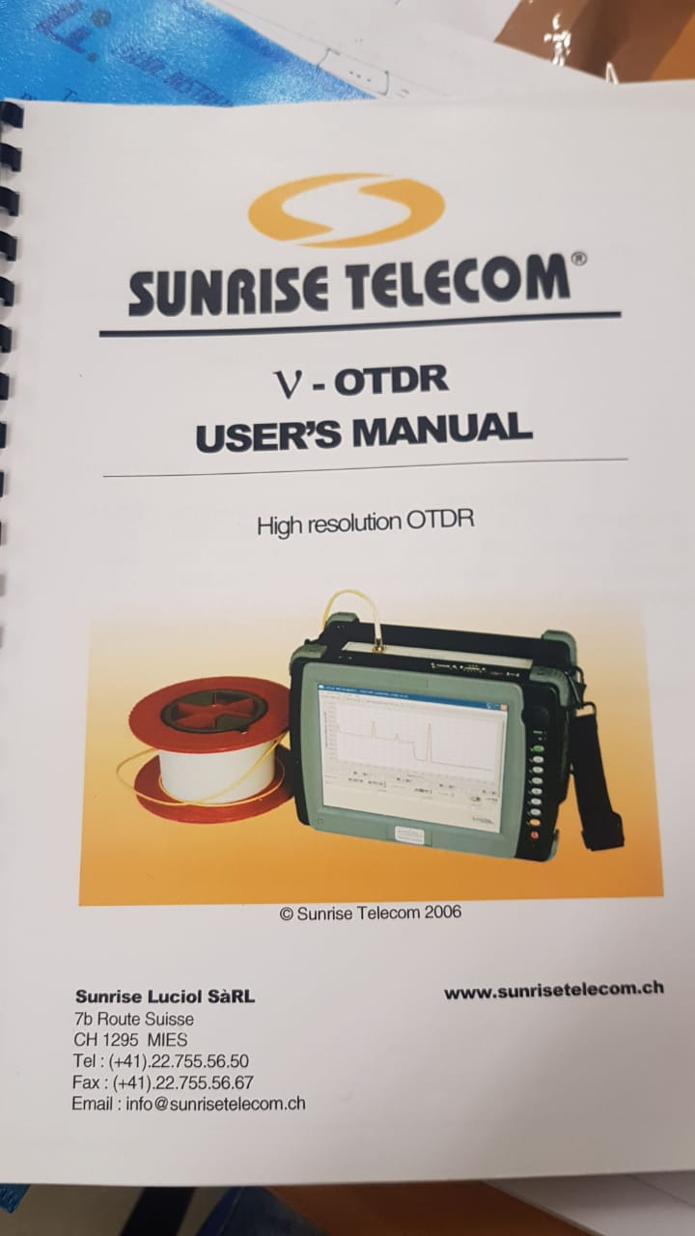
The Optical Time-Domain Reflectometer (OTDR)
The manual describes guidelines on how to connect and clean fibers in order to ensure the OTDR is safe
The OTDR is designed for short-range (10-100’s meters in order of magnitude)
Its photon-counting technology allows measurements of distributed attenuation and homogeneity of the fiber
The later can help identify damages that may occur during the laying out of the fiber
Operation is simple: plug straight tip connector (STP) into the fiber array, connect OTDR usb cable into a PC and power-up the OTDR

Slide 4
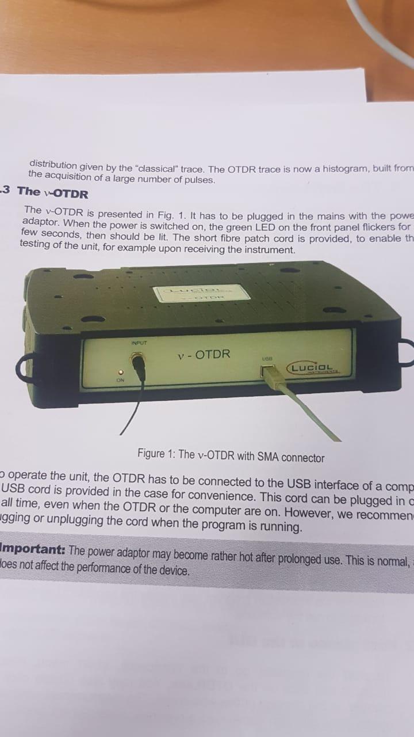
The OTDR: Principle of photon-counting
The OTDR sends short light pulses towards the Fiber Under Test (FUT) and back reflected light is analysed. High resolution (approx 10 cm) demands short pulses (approx 1 ns) and low energy levels. Photon-counting is a solution to both conditions. The OTDR fills a histogram for back-reflection by counting photons
Andres was told by an expert that a standard STP is used for 400 OTDR test. We have used our “poor man” version of a STP for around 2300 tests.

Slide 5
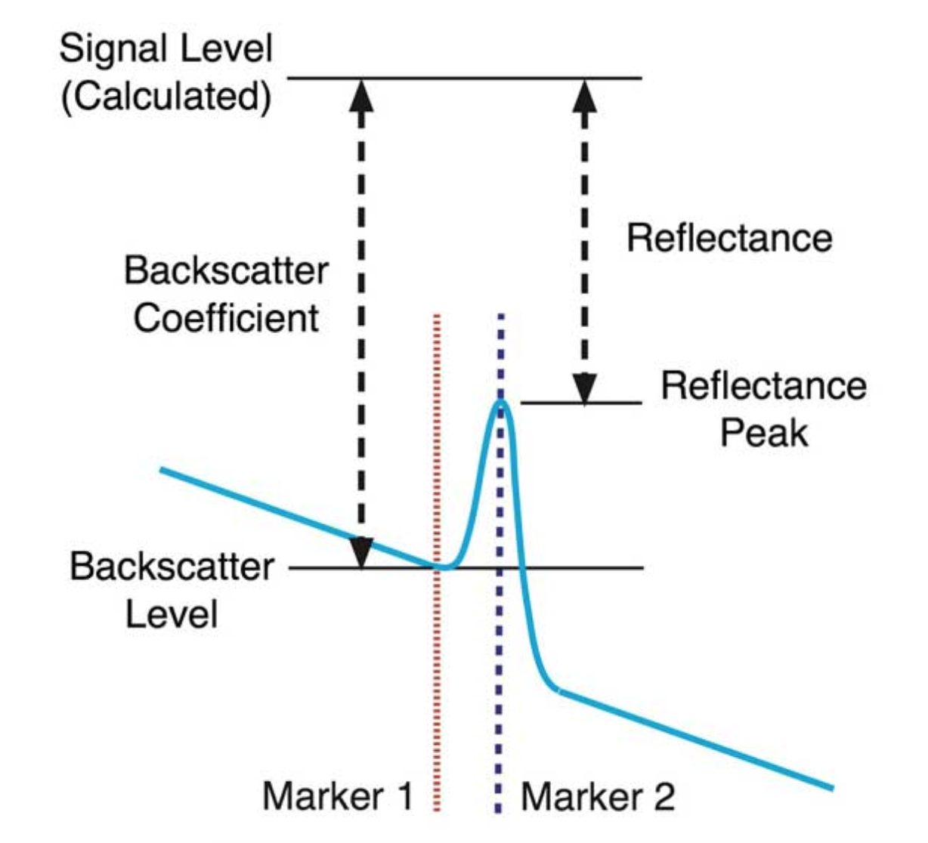
The OTDR: back-reflection measurement
Calculating reflectance in an OTDR is a complicated process involving the baseline of the OTDR, backscatter level and power in the reflected peak as shown in the diagram below. Since reflectance is defined as a fraction of the power in the test signal, the OTDR must calculate the test power from the backscatter level of the fiber, based on the typical backscatter coefficient of the fiber being tested.
But this is done automatically by the OTDR software
http://www.thefoa.org/tech/ref/testing/test/reflectance.html

Slide 6
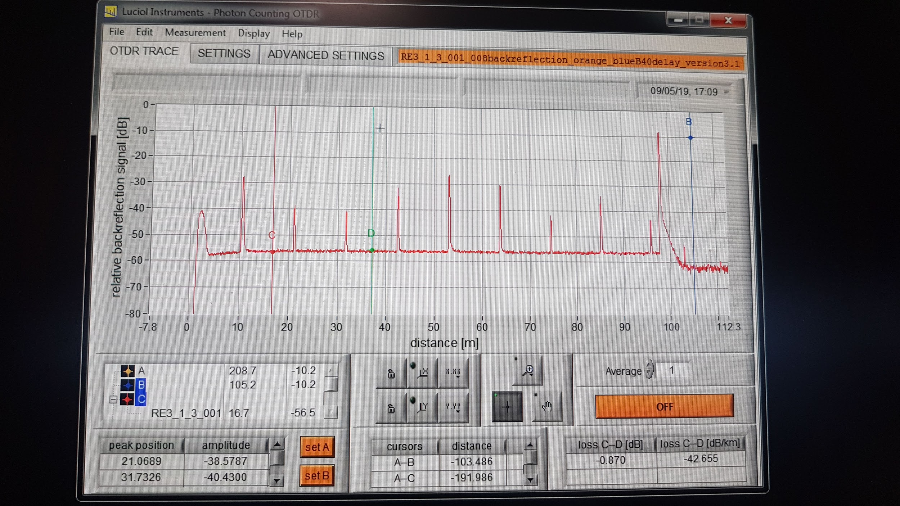
The length measurements: general procedure
The amount of light reflected at a joint between two fibers is determined by electromagnetic processes.
Connectors produce reflectance peaks, higher peaks indicate higher reflectance.
The position of each visible peak is computed by the OTDR software.
We identify the connectors surrounding a fiber of interest and read their difference. This difference is the length of the cable.
Technical details of the measurement on the manual that can be consulted online:
http://www.ttswebsite.com/manuals/otdr_distance.pdf

Slide 7
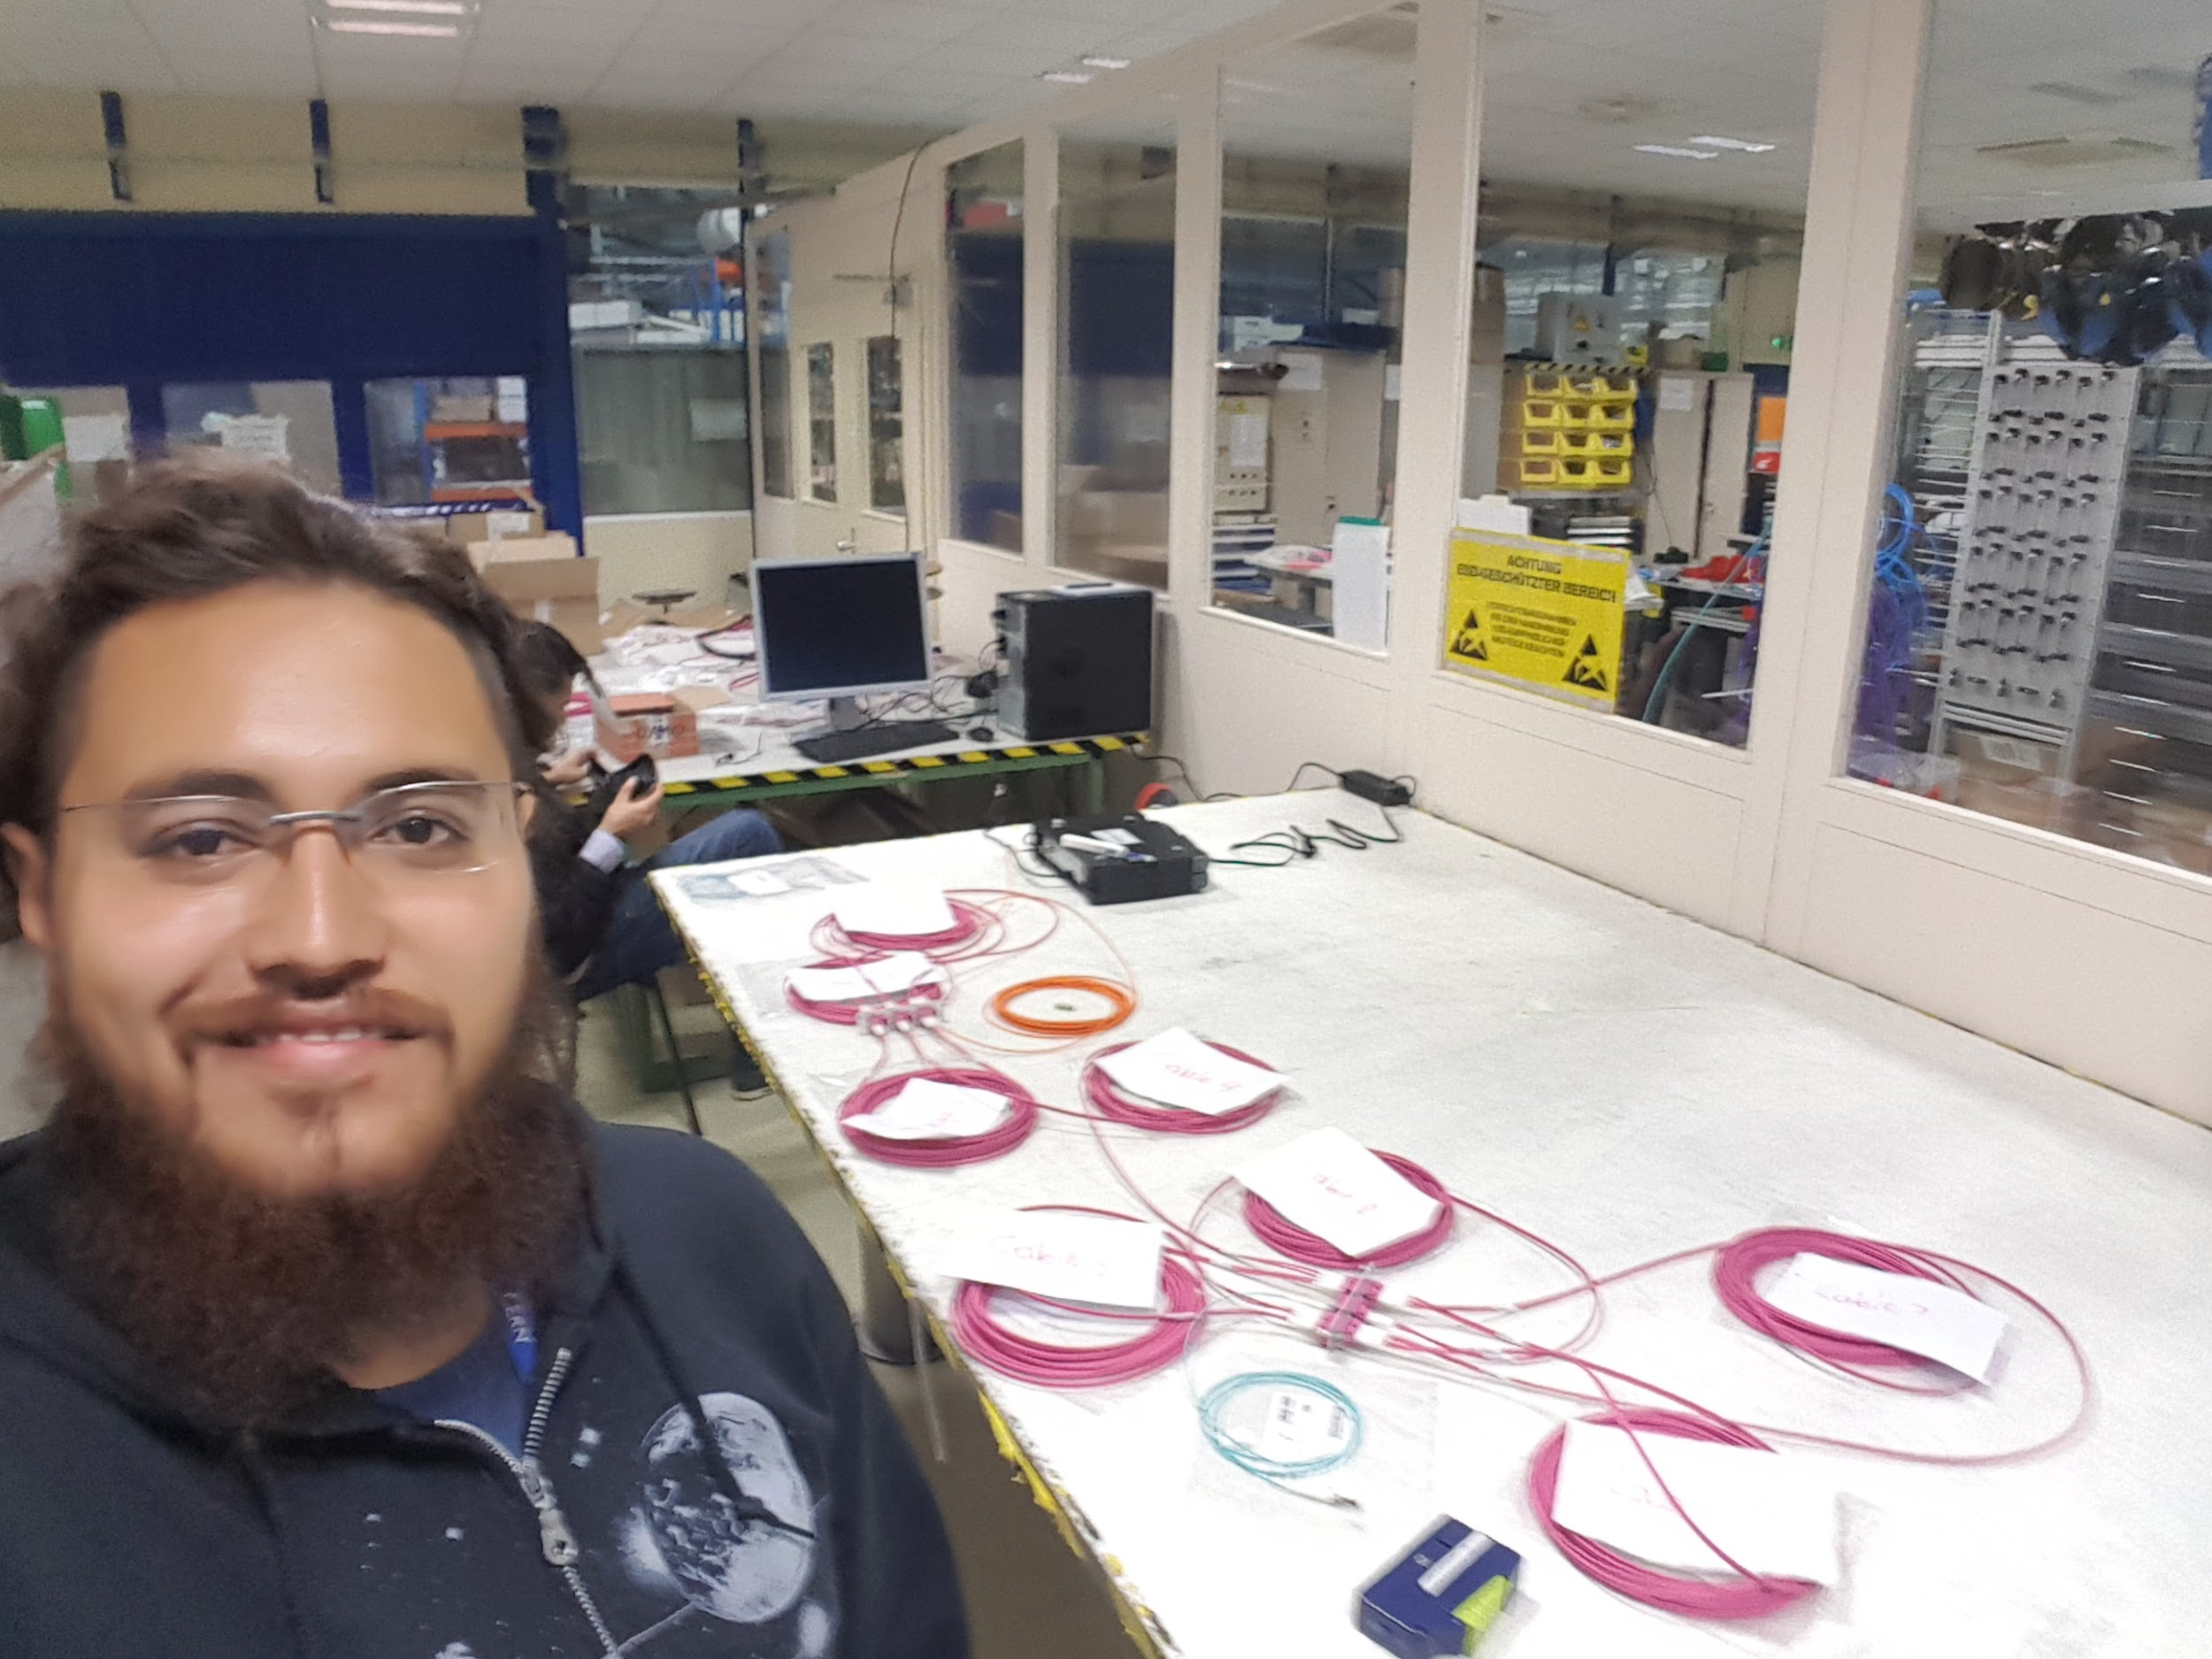
Procedure for measurement of RE+3 and RE-4
Cables were given in boxes containing 8 in total. We connected them in series into the OTDR as shown by the happy person on the picture.
An orange cable is used as straight tip connector (STP) to join the OTDR to the series. A blue cable is used to end the series
Every connection was cleaned appropriately before testing

Slide 8
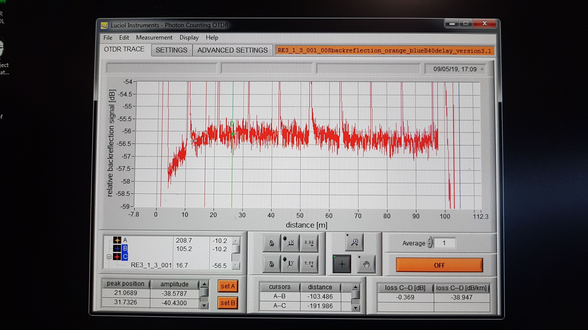
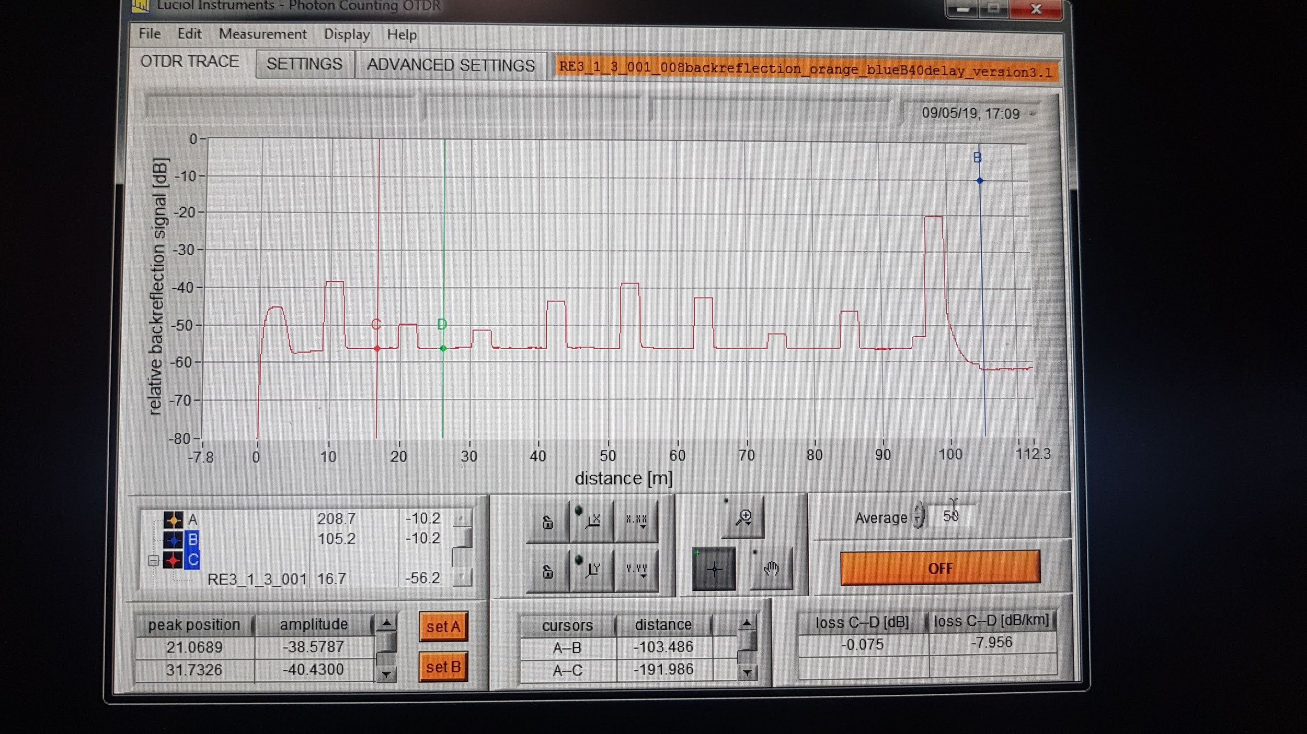
Procedure for measurement of RE+3 and RE-4
Results of the measurement: the software’s default settings showed fluctuations (left screenshot) that did not allow an understanding of the results. Different sampling averages were tested (middle and right figures). The average with the best position resolution was selected empirically (middle fig.) for the rest of the measurements.
The 10 cables (8 for testing, input and output) can be seen in the resulting screen.

Slide 9
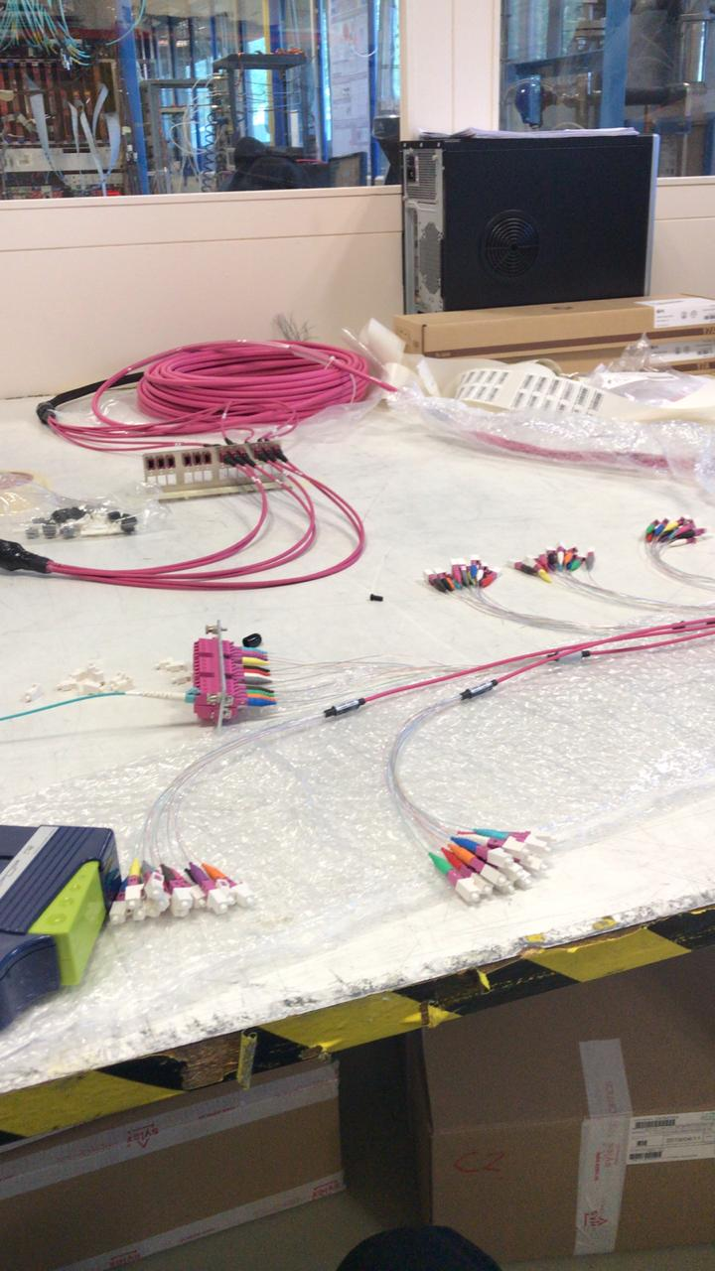
Procedure for measurement of Cable 2 and 3
Cables 2 and 3 are asymmetric:
on one end they have 12x12 optical connectors sorted by color (can be seen at the bottom of the picture)
on the other end they have a 6 cables each with 24 small (nm radius) outputs (can be seen in the middle of the picture)

Slide 10
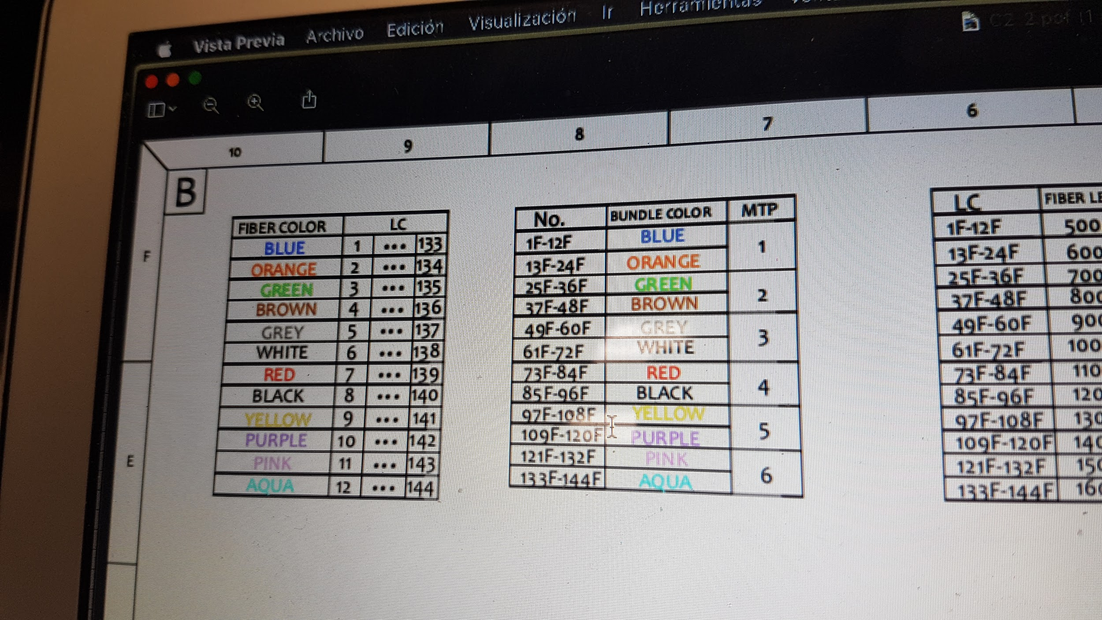
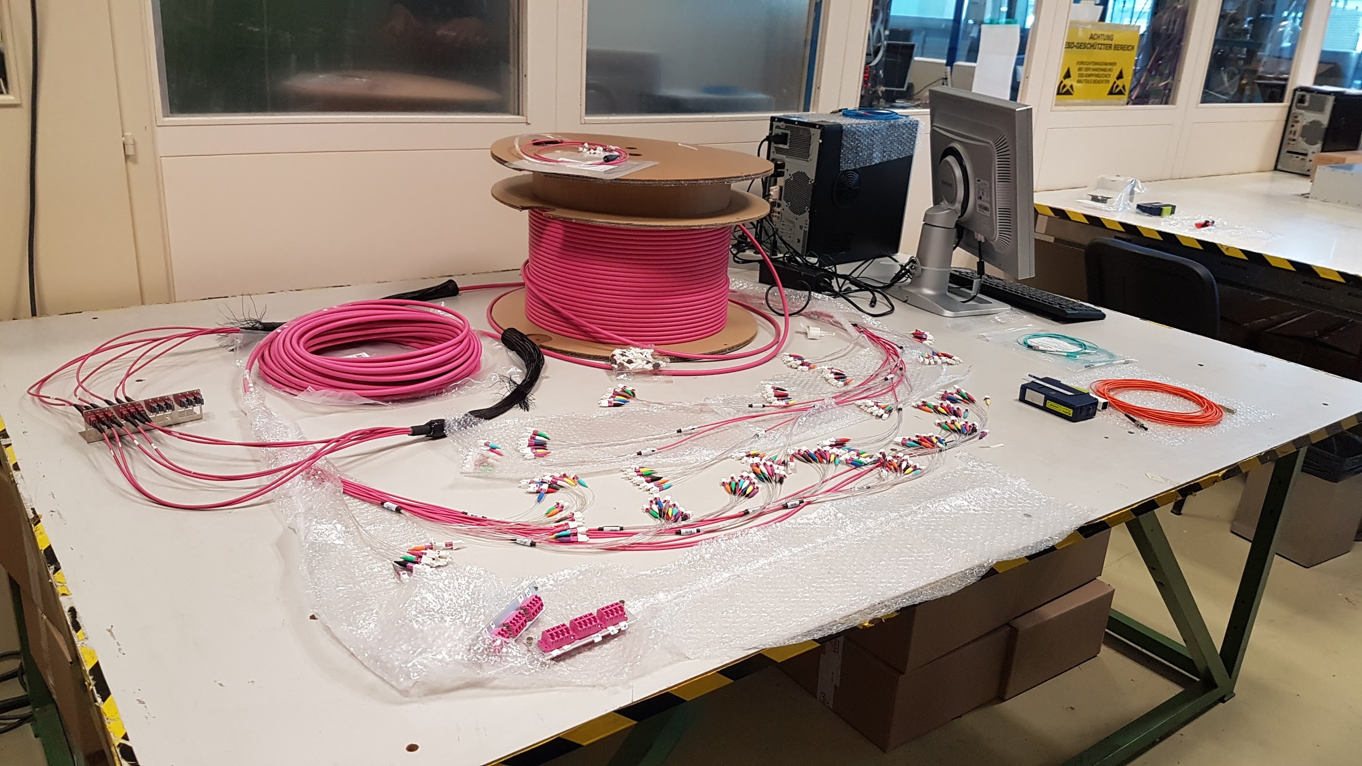
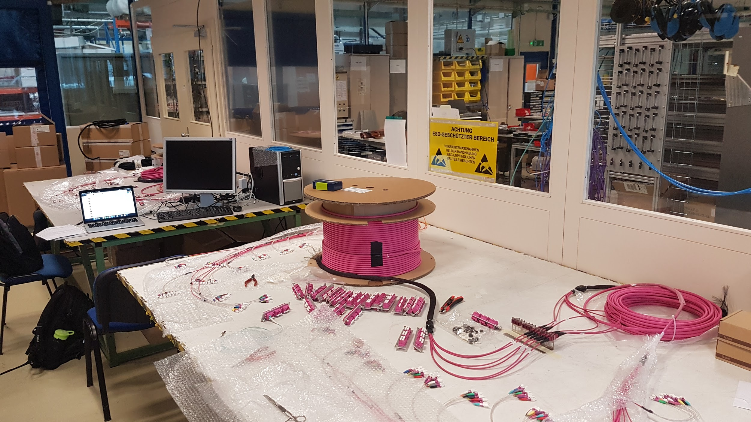
Procedure for measurement of Cable 2 and 3
The map of the colors to the number of the cable connector is shown in the figure
Each connection was cleaned as the OTDR manual demands
The first test was performed with a series with one of each cable
The 2nd test was performed with 2 cables of each in series

Slide 11
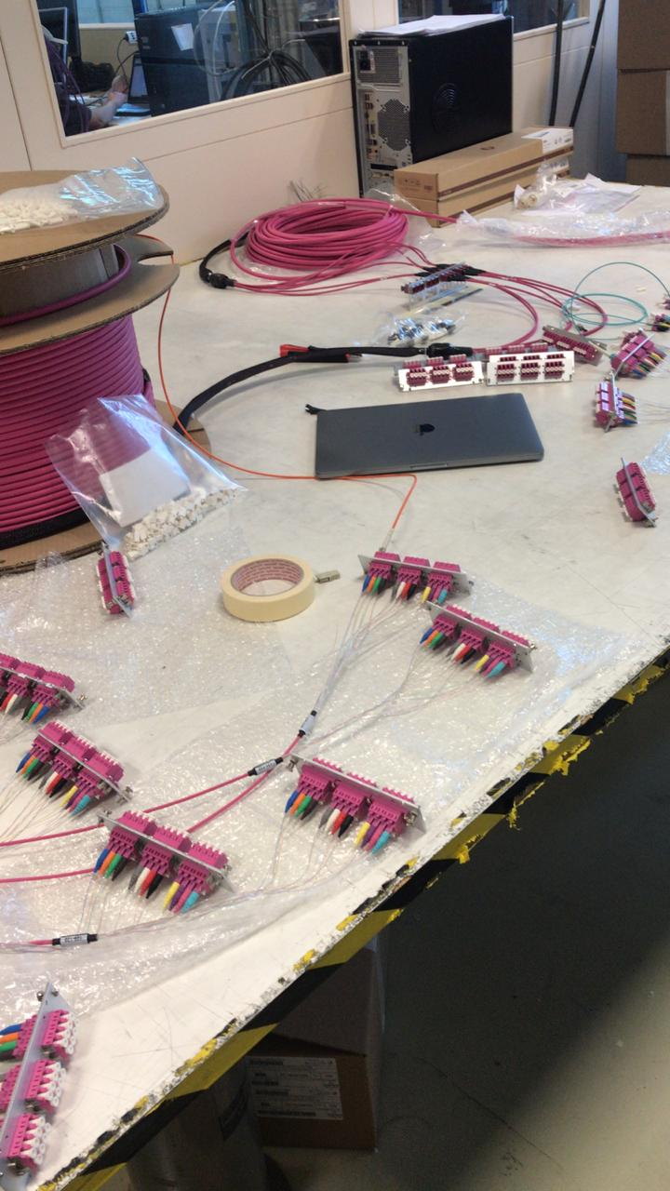
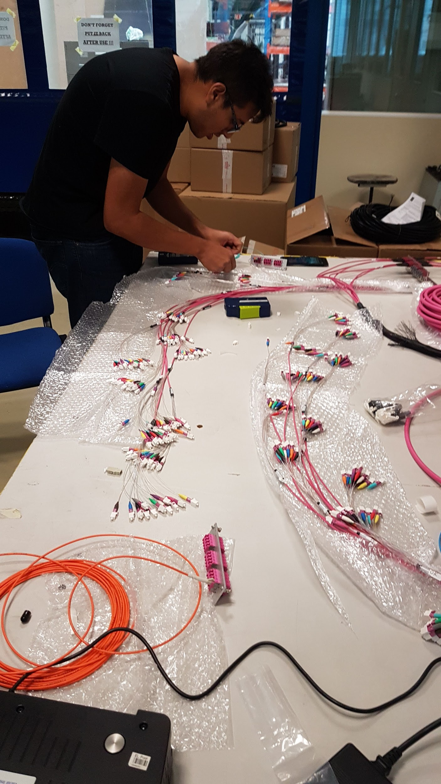
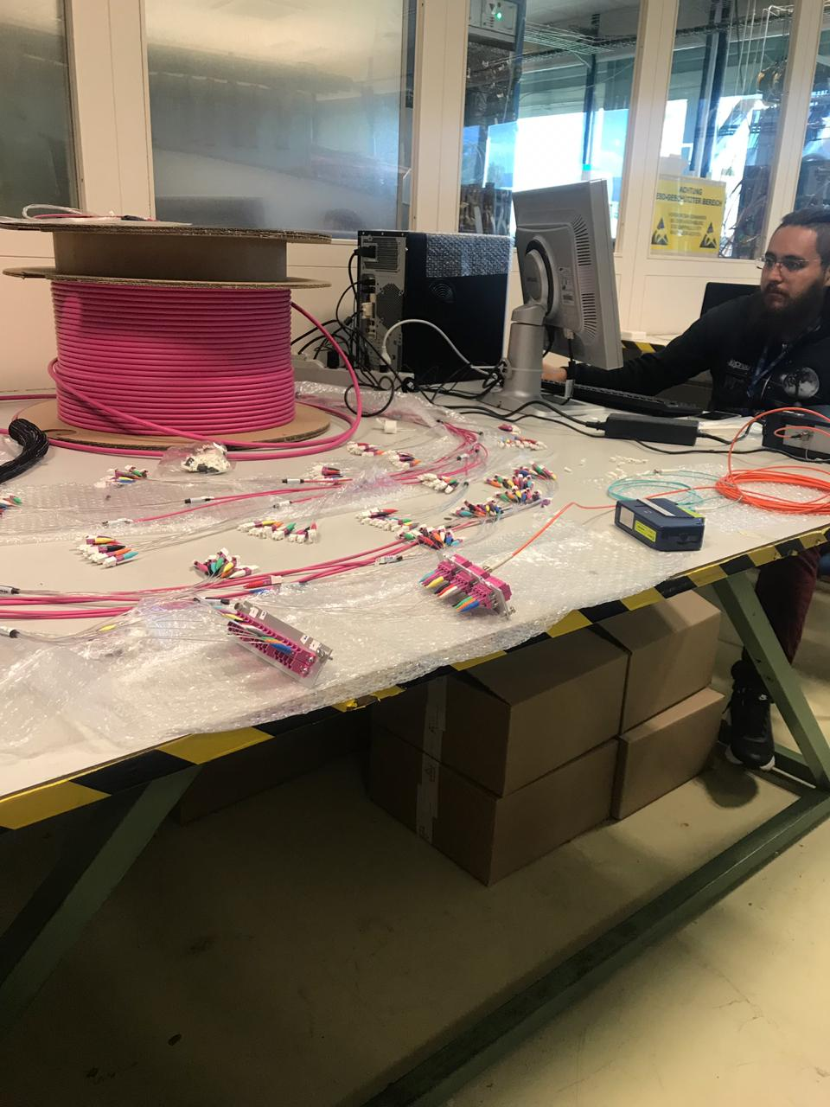
Procedure for measurement of Cable 2 and 3

Slide 12
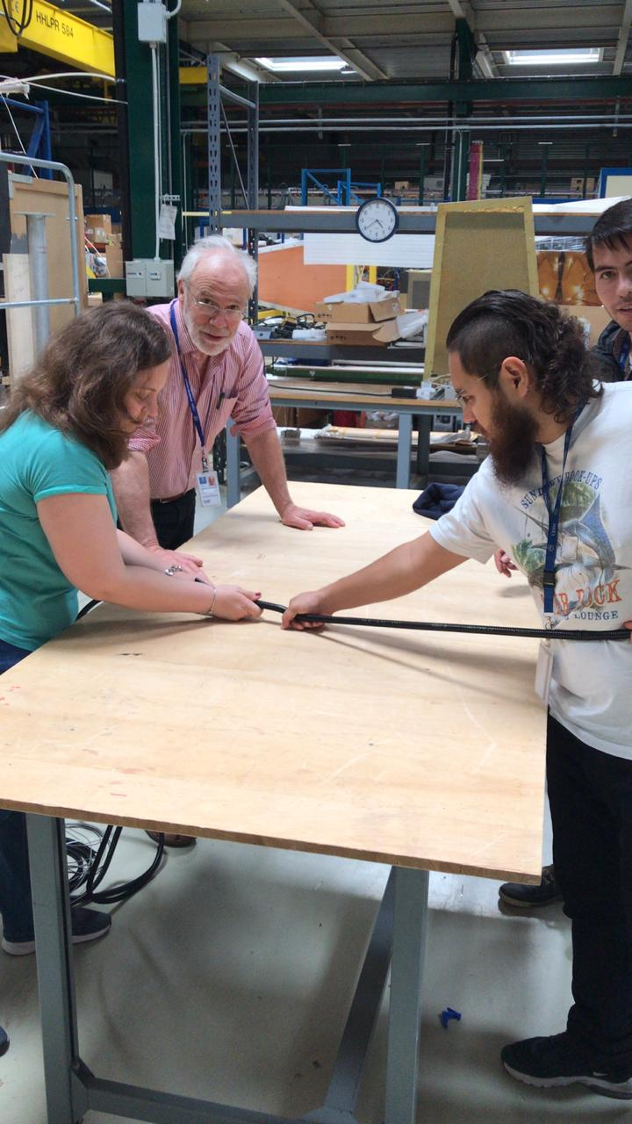
Corrugated Pipe
After the tests, optical fiber for the patch-panel was protected with corrugated pipes
After the cables were protected they were tested again, in order to check that the procedure did not damage the fibers

Slide 13
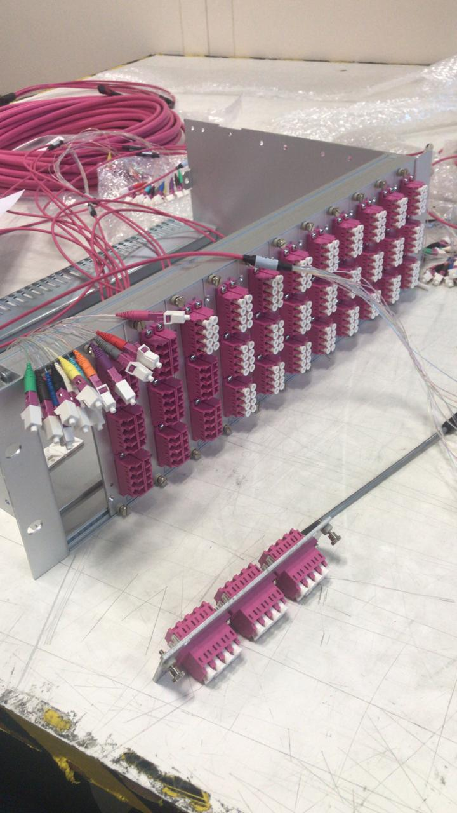
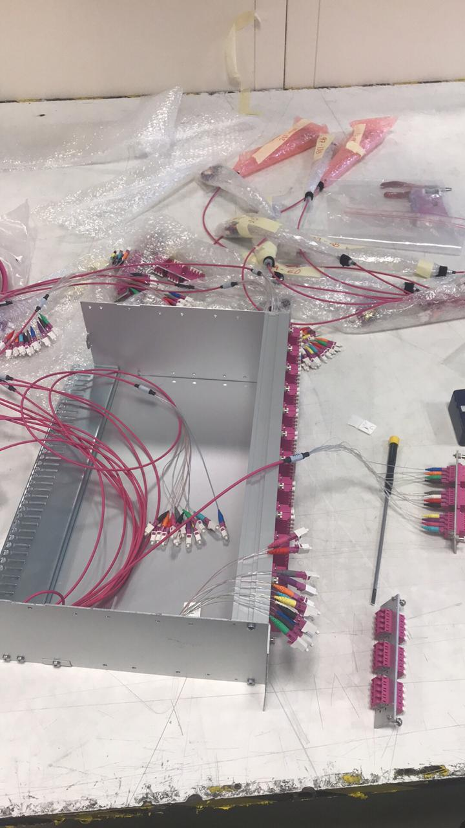
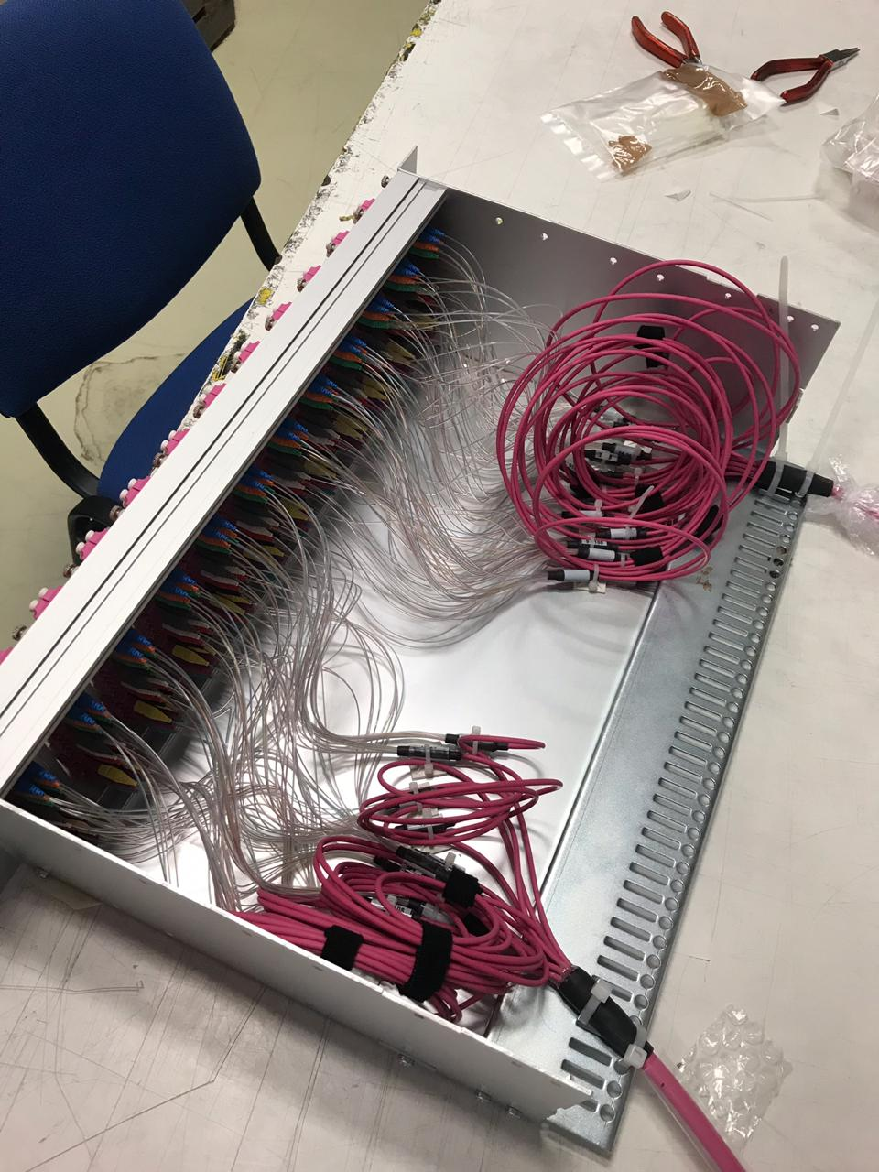
Connecting the fibers to the patch-panel
The protected fibers will be installed in P5 soon (this was written on June 18)
They will be installed in a box we call patch-panel
The connection was performed by my colleague Gabriel Artemio Ayala Sanchez

Slide 14
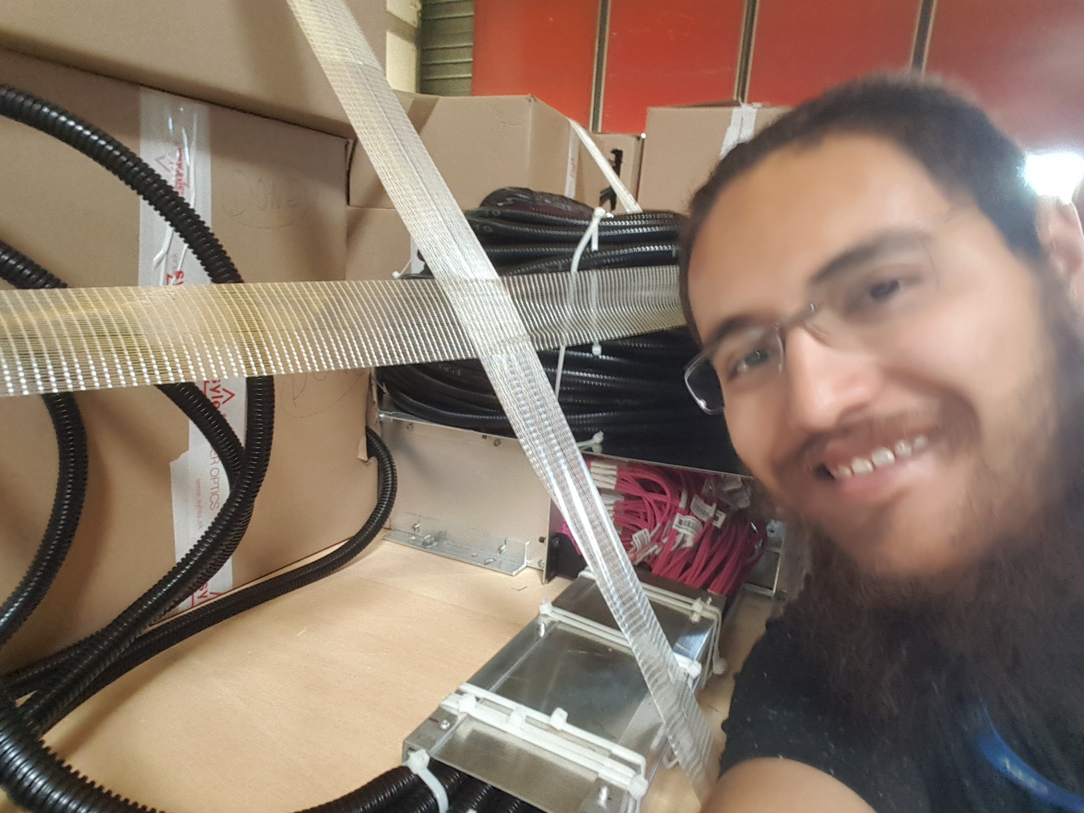
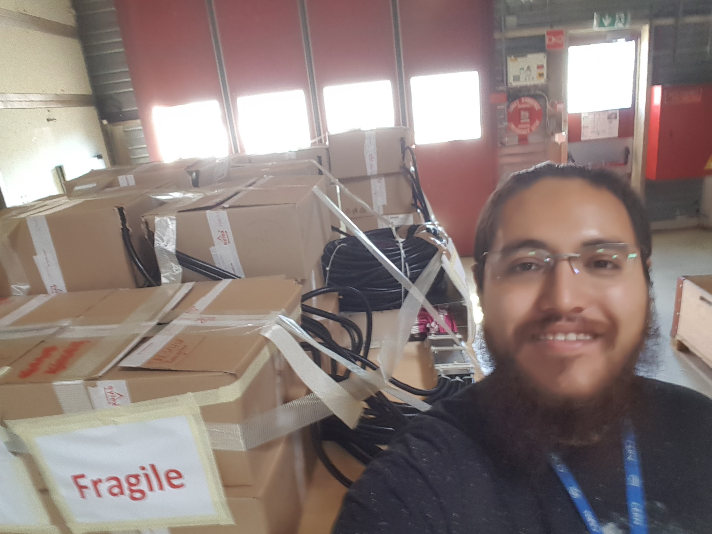
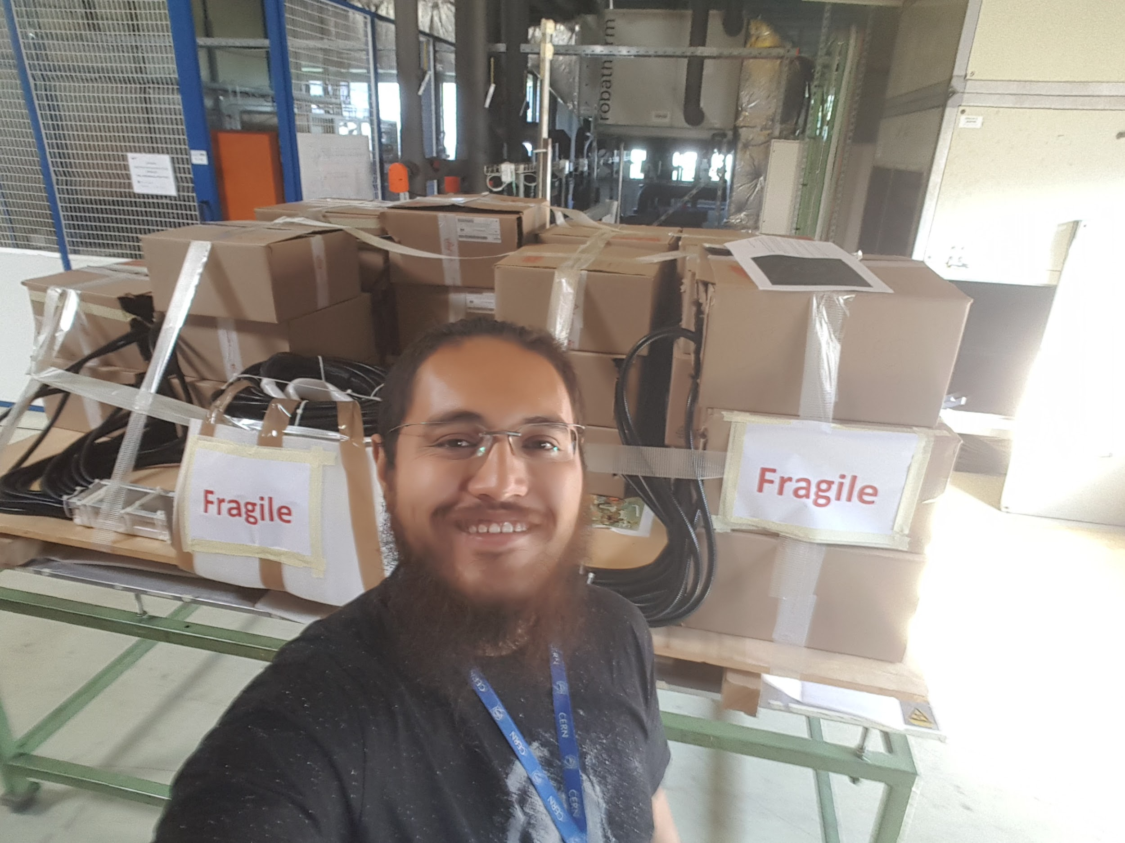
Shipping patch panel to P5
After the connection procedure fibers were arranged in a wood table in order to facilitate its transport to P5
After the arrangement was done, the fibers were tested once more with the OTDR.
Finally, on June 14 at 10 am the patch-panel setup was retrieved from 904 and sent to P5

Slide 15
Summary of OTDR tests performed so far
7 May - 288 RE3
14 May - C2, C3
16 May - 288
20 May - (next)
21 May - RE4
22 May - 288
23 May - 288 C2/3
24 May - 96 RE3
27 May - 168 RE3
--Corrugated test--
28 May - 24 RE4
31 May - 12 C4
1 June - 12 C4
3 June - 96 C4
4 June - 24 C4
5 June - 108 C4
--Test on Panel--
6 June - 24 RE4
11 June - 96 RE3/4 C2/2
12 June - 184 RE3/4 C2/2
13 June - 128 RE3/4 C2/2
14 June - 160 RE3/4 C2/2
Total tests = 2308

Slide 16
Next steps
The summary and the datafiles produced by the OTDR for all the tests is available at CERN box as a compressed document:
https://cernbox.cern.ch/index.php/s/Gh3mq3M5ZQycp65
The patch-panel for the other endcap must be set up and send to P5 urgently

